Slide 1
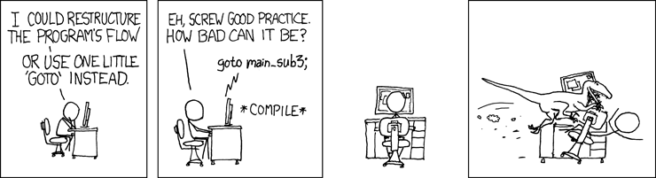
The Stack & Procedures
CSE 351 Summer 2020
Instructor: Teaching Assistants:
Porter Jones Amy Xu
Callum Walker
Sam Wolfson
Tim Mandzyuk
http://xkcd.com/571/

Slide 2
Administrivia
Questions doc: https://tinyurl.com/CSE351-7-15
Unit Summary 1 due Friday (7/17) – 11:59pm
  Can still use late days until 7/20
Mid-quarter Survey due Friday (7/17) – 11:59pm
  Submit via Canvas!
hw8, hw9, hw10 now due Monday (7/20) – 10:30am
  hw11 also due Monday (7/20)
  See course schedule for original/suggested deadlines
Lab 2 due Wednesday (7/22)
  GDB Tutorial on Gradescope walks through first phase

Slide 3
Administrivia
No midterm or final! But the midterm and final cheat sheets could be useful throughout the course
  Can find them at the exams page of the course website
  https://courses.cs.washington.edu/courses/cse351/20su/exams/
These do not mimic a good unit summary
  Too much like a cheat sheet (lots of listed facts w/out much organization and summary)
  See unit summary spec for more details and good/bad examples of unit summaries

Slide 4

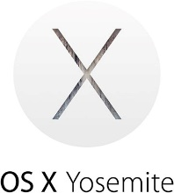

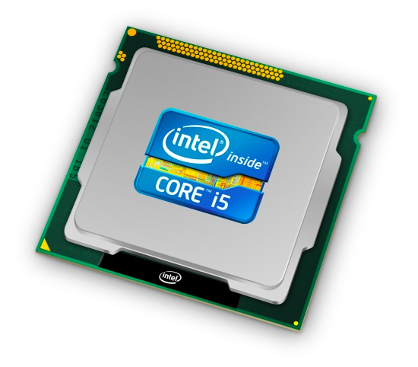
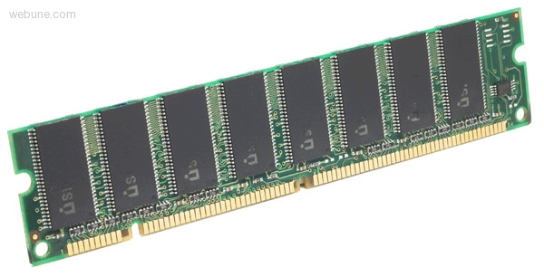
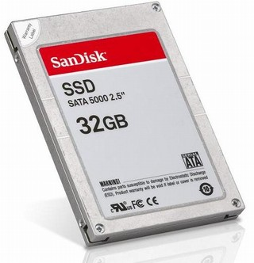
Roadmap
C:
Java:
Memory & data
Integers & floats
x86 assembly
Procedures & stacks
Executables
Arrays & structs
Memory & caches
Processes
Virtual memory
Memory allocation
Java vs. C
car *c = malloc(sizeof(car));
c->miles = 100;
c->gals = 17;
float mpg = get_mpg(c);
free(c);
Car c = new Car();
c.setMiles(100);
c.setGals(17);
float mpg =
c.getMPG();
Assembly language:
get_mpg:
pushq %rbp
movq %rsp, %rbp
...
popq %rbp
ret
OS:
Machine code:
0111010000011000
100011010000010000000010
1000100111000010
110000011111101000011111
Computer system:

Slide 5
Mechanisms required for procedures
Passing control
  To beginning of procedure code
  Back to return point
Passing data
  Procedure arguments
  Return value
Memory management
  Allocate during procedure execution
  Deallocate upon return
All implemented with machine instructions!
  An x86-64 procedure uses only those mechanisms required for that procedure
P(…) {
•
•
y = Q(x);
print(y)
•
}
int Q(int i)
{
int t = 3*i;
int v[10];
•
•
return v[t];
}

Slide 6
Procedures
Stack Structure
Calling Conventions
  Passing control
  Passing data
  Managing local data
Register Saving Conventions
Illustration of Recursion

Slide 7
Simplified Memory Layout
Address Space:
What Goes Here:
High
Addresses
0xF…F
Stack
local variables and
procedure context
Dynamic Data
(Heap)
variables allocated with
new or malloc
Memory
Addresses
Static Data
static variables
(including global variables)
Literals
large literals/constants
(e.g. “example”)
Instructions
program code
Low
Addresses
0x0…0

Slide 8
Memory Management
Address Space:
Who’s Responsible:
High
Addresses
0xF…F
Stack
Managed “automatically”
(by compiler/assembly)
Dynamic Data
(Heap)
Managed “dynamically”
(by programmer)
Memory
Addresses
Static Data
Managed “statically”
(initialized when process starts)
Literals
Managed “statically”
(initialized when process starts)
Instructions
Managed “statically”
(initialized when process starts)
Low
Addresses
0x0…0

Slide 9
Memory Permissions
Address Space:
Permissions:
  Segmentation faults?
High
Addresses
0xF…F
Stack
writable; not executable
Dynamic Data
(Heap)
writable; not executable
Memory
Addresses
Static Data
writable; not executable
Literals
read-only; not executable
Instructions
read-only; executable
Low
Addresses
0x0…0
Notes:
Initialized when prog starts
Heap managed by programmer
Stack usually automatic, but we’ll have to look at how it works in assembly
HW/OS enforces permissions on regions of memory
Will talk about it more later in the course

Slide 10
x86-64 Stack
High
Addresses
Stack “Bottom”
Region of memory managed
with stack “discipline”
  Grows toward lower addresses
  Customarily shown “upside-down”
Register %rsp contains
lowest stack address
  %rsp = address of top element, the most-recently-pushed item that is not-yet-popped
Increasing
Addresses
Stack Grows
Down
Stack Pointer: %rsp
Stack “Top”
Low
Addresses
0x00…00
Notes:
Memory is still just an array
But we treat the upper part like a stack that grows downwards
rsp points at the lowest stack address, the top of the stack
This will be the first thing to be popped off
Remember: stacks only have 2 operations: push and pop

Slide 11
x86-64 Stack: Push
High
Addresses
Stack “Bottom”
pushq src
  Fetch operand at src
    Src can be reg, memory, immediate
  Decrement %rsp by 8
  Store value at address given by %rsp
Example:
  pushq %rcx
  Adjust %rsp and store contents of
  %rcx on the stack
Increasing
Addresses
Stack Grows
Down
Stack Pointer: %rsp
-8
Low
Addresses
0x00…00
Stack “Top”

Slide 12
x86-64 Stack: Pop
High
Addresses
Stack “Bottom”
popq dst
  Load value at address given by %rsp
  Store value at dst
  Increment %rsp by 8
Example:
  popq %rcx
  Stores contents of top of stack
  into %rcx and adjust %rsp
Increasing
Addresses
+8
Stack Grows
Down
Stack Pointer: %rsp
Stack “Top”
Low
Addresses
0x00…00
Those bits are still there; we’re just not using them.

Slide 13
Procedures
Stack Structure
Calling Conventions
  Passing control
  Passing data
  Managing local data
Register Saving Conventions
Illustration of Recursion

Slide 14
Procedure Call Overview
Caller
procedures
…
<set up args>
call
<clean up args>
<find return val>
…
Callee
<create local vars>
…
<set up return val>
<destroy local vars>
ret
Callee must know where to find args
Callee must know where to find return address
Caller must know where to find return value
Caller and Callee run on same CPU, so use the same registers
  How do we deal with register reuse?
Unneeded steps can be skipped (e.g. no arguments)

Slide 15
Procedure Call Overview
Caller
…
<save regs>
<set up args>
call
<clean up args>
<restore regs>
<find return val>
…
Callee
<save regs>
<create local vars>
…
<set up return val>
<destroy local vars>
<restore regs>
ret
The convention of where to leave/find things is called the calling convention (or procedure call linkage)
  Details vary between systems
  We will see the convention for x86-64/Linux in detail
  What could happen if our program didn’t follow these conventions?
Notes:
If everyone doesn’t use the same conventions, then we can’t call each others’ libraries

Slide 16
Code Example (Preview)
void multstore
(long x, long y, long *dest) {
long t = mult2(x, y);
*dest = t;
}
Compiler Explorer:
https://godbolt.org/z/nQ6KbZ
0000000000400540 <multstore>:
400540: push %rbx # Save %rbx
400541: movq %rdx,%rbx # Save dest
400544: call 400550 <mult2> # mult2(x,y)
400549: movq %rax,(%rbx) # Save at dest
40054c: pop %rbx # Restore %rbx
40054d: ret # Return
long mult2
(long a, long b)
{
long s = a * b;
return s;
}
0000000000400550 <mult2>:
400550: movq %rdi,%rax # a
400553: imulq %rsi,%rax # a * b
400557: ret # Return
Notes:
Here we have a function, multstore, which calls another function, mult2
Look at call, specifies where to jump to (400550)
We’ll get to each of the details for this

Slide 17
Procedure Control Flow
Use stack to support procedure call and return
Procedure call: call label
  Push return address on stack (why? which address?)
  Jump to label

Slide 18
Procedure Control Flow
Use stack to support procedure call and return
Procedure call: call label
  Push return address on stack (why? which address?)
  Jump to label
Return address:
  Address of instruction immediately after call instruction
  Example from disassembly:
  400544: callq 400550 <mult2>
  400549: movq %rax,(%rbx)
  Return address = 0x400549
Procedure return: ret
  Pop return address from stack
  Jump to address
  400544: call 400550 <mult2>
  400549: movq %rax,(%rbx)
next instruction
happens to be a move,
but could be anything

Slide 19
Procedure Call Example (step 1)
0000000000400540 <multstore>:
•
•
400544: call 400550 <mult2>
400549: movq %rax,(%rbx)
•
•
•
•
•
0x130
0x128
0x120
0000000000400550 <mult2>:
400550: movq %rdi,%rax
•
•
400557: ret
%rsp
0x120
%rip
0x400544
Notes:
Push return address on stack
update %rsp -> 0x118
400549
Jump to new function
Update %rip

Slide 20
Procedure Call Example (step 2)
0000000000400540 <multstore>:
•
•
400544: call 400550 <mult2>
400549: movq %rax,(%rbx)
•
•
•
•
•
0x130
0x128
0x120
0x118
0x400549
0000000000400550 <mult2>:
400550: movq %rdi,%rax
•
•
400557: ret
%rsp
0x118
%rip
0x400550
Notes:
Now return address points at where we’ll jump back to
%rip is where we are executing now

Slide 21
Procedure Return Example (step 1)
0000000000400540 <multstore>:
•
•
400544: call 400550 <mult2>
400549: movq %rax,(%rbx)
•
•
•
•
•
0x130
0x128
0x120
0x118
0x400549
0000000000400550 <mult2>:
400550: movq %rdi,%rax
•
•
400557: ret
%rsp
0x118
%rip
0x400557
Notes:
Now, after we’ve executed this function, we’re at the ret
Pop return address
read return address
increment %rsp
Jump back to return address
update %rip with return address
execute again starting there

Slide 22
Procedure Return Example (step 2)
0000000000400540 <multstore>:
•
•
400544: call 400550 <mult2>
400549: movq %rax,(%rbx)
•
•
•
•
•
0x130
0x128
0x120
0000000000400550 <mult2>:
400550: movq %rdi,%rax
•
•
400557: ret
%rsp
0x120
%rip
0x400549

Slide 23
Procedures
Stack Structure
Calling Conventions
  Passing control
  Passing data
  Managing local data
Register Saving Conventions
Illustration of Recursion

Slide 24
Procedure Data Flow
Registers (NOT in Memory) Stack (Memory)
First 6 arguments
Return value
High
Addresses
%rdi
Diane’s
Silk
Dress
Costs
$8 9
• • •
%rsi
%rdx
Arg n
• • •
%rcx
%r8
Arg 8
%r9
Arg 7
Low
Addresses
0x00…00
Only allocate stack space when needed
%rax

Slide 25
x86-64 Return Values
By convention, values returned by procedures are placed in %rax
  Choice of %rax is arbitrary
Caller must make sure to save the contents of %rax before calling a callee that returns a value
  Part of register-saving convention
Callee places return value into %rax
  Any type that can fit in 8 bytes – integer, float, pointer, etc.
  For return values greater than 8 bytes, best to return a pointer to them
Upon return, caller finds the return value in %rax
Notes:
Caller-saved vs callee-saved registers?
Will talk about this more later
Larger than 8 bytes:
There’s some other part of the calling convention that dictates what to do
Spoiler alert: usually it’s on the stack

Slide 26
Data Flow Examples
void multstore
(long x, long y, long *dest) {
long t = mult2(x, y);
*dest = t;
}
0000000000400540 <multstore>:
# x in %rdi, y in %rsi, dest in %rdx
• • •
400541: movq %rdx,%rbx # Save dest
400544: call 400550 <mult2> # mult2(x,y)
# t in %rax
400549: movq %rax,(%rbx) # Save at dest
• • •
long mult2
(long a, long b)
{
long s = a * b;
return s;
}
0000000000400550 <mult2>:
# a in %rdi, b in %rsi
400550: movq %rdi,%rax # a
400553: imulq %rsi,%rax # a * b
# s in %rax
400557: ret # Return
Notes:
How do we get data into and out of procedures?
x -> a, y -> b, so no need to change those registers!
Don’t need to save because we don’t use x or y after mult2 returns
but, we do need to save %rdx, need it after mult2

Slide 27
Procedures
Stack Structure
Calling Conventions
  Passing control
  Passing data
  Managing local data
Register Saving Conventions
Illustration of Recursion

Slide 28
Stack-Based Languages
Languages that support recursion
  e.g. C, Java, most modern languages
  Code must be re-entrant
    Multiple simultaneous instantiations of single procedure
  Need some place to store state of each instantiation
    Arguments, local variables, return address
Stack allocated in frames
  State for a single procedure instantiation
Stack discipline
  State for a given procedure needed for a limited time
    Starting from when it is called to when it returns
  Callee always returns before caller does
Notes:
Re-entrant means we need to be able to call the same function more than once
Could be from within the function! or from another called function
Execute a new copy
Each time we call it, need somewhere to keep the local variables, and arguments
The Stack gives us a place to put state while a function is executing
only need state for the currently executing copy
callee returns, and we can pop off its temporary data

Slide 29
Call Chain Example
Example
Call Chain
whoa(…)
{
  •
  •
  who();
  •
  •
}
whoa
who(…)
{
  •
  amI();
  •
  amI();
  •
}
who
amI(…)
{
  •
if(…){
  amI()
}
  •
}
amI
amI
amI
amI
  Procedure amI is recursive
  (calls itself)

Slide 30
1) Call to whoa
Stack
whoa
whoa
whoa(…)
{
•
•
who();
•
•
}
who
%rbp
amI
amI
%rsp
amI
amI

Slide 31
2) Call to who
Stack
whoa
whoa
who
whoa(…)
{
•
•
who();
•
•
}
who(…)
{
•
amI();
•
amI();
•
}
who
amI
amI
%rbp
amI
%rsp
amI

Slide 32
3) Call to amI (1)
Stack
whoa
whoa
who
amI₁
whoa(…)
{
•
•
who();
•
•
}
who(…)
{
•
amI();
•
amI();
•
}
amI(…)
{
  •
if(){
  amI()
}
  •
}
who
amI
amI
amI
%rbp
amI
%rsp

Slide 33
4) Recursive call to amI (2)
Stack
whoa
whoa
who
amI₁
amI₂
whoa(…)
{
•
•
who();
•
•
}
who(…)
{
•
amI();
•
amI();
•
}
amI(…)
{
  •
if(){
  amI()
}
  •
}
who
amI(…)
{
  •
if(){
  amI()
}
  •
}
amI
amI
amI
amI
%rbp
%rsp

Slide 34
5) (another) Recursive call to amI (3)
Stack
whoa
whoa
who
amI₁
amI₂
amI₃
whoa(…)
{
•
•
who();
•
•
}
who(…)
{
•
amI();
•
amI();
•
}
amI(…)
{
  •
if(){
  amI()
}
  •
}
who
amI(…)
{
  •
if(){
  amI()
}
  •
}
amI(…)
{
  •
if(){
  amI()
}
  •
}
amI
amI
amI
amI
%rbp
%rsp
Notes:
Let’s say this time, the if condition is false, so we don’t recurse again

Slide 35
6) Return from (another) recursive call to amI
Stack
whoa
whoa
who
amI₁
amI₂
amI₃
whoa(…)
{
•
•
who();
•
•
}
who(…)
{
•
amI();
•
amI();
•
}
amI(…)
{
  •
if(){
  amI()
}
  •
}
who
amI(…)
{
  •
if(){
  amI()
}
  •
}
amI
amI
amI
amI
%rbp
%rsp
Notes:
Start popping our way back up the stack frames

Slide 36
7) Return from recursive call to amI
Stack
whoa
whoa
who
amI₁
amI₂
amI₃
whoa(…)
{
•
•
who();
•
•
}
who(…)
{
•
amI();
•
amI();
•
}
amI(…)
{
  •
if(){
  amI()
}
  •
}
who
amI
amI
amI
%rbp
amI
%rsp

Slide 37
8) Return from call to amI
Stack
whoa
whoa
who
amI₁
amI₂
amI₃
whoa(…)
{
•
•
who();
•
•
}
who(…)
{
•
amI();
•
amI();
•
}
who
amI
amI
%rbp
amI
%rsp
amI
Notes:
At this point, we’re back up to who, which calls amI twice

Slide 38
9) (second) Call to amI (4)
Stack
whoa
whoa
who
amI₄
amI₂
amI₃
whoa(…)
{
•
•
who();
•
•
}
who(…)
{
•
amI();
•
amI();
•
}
amI(…)
{
  •
if(){
  amI()
}
  •
}
who
amI
amI
amI
%rbp
amI
%rsp
Notes:
Looks similar to Step 3, but it’s NOT!
Let’s assume if condition is false.

Slide 39
10) Return from (second) call to amI
Stack
whoa
whoa
who
amI₄
amI₂
amI₃
whoa(…)
{
•
•
who();
•
•
}
who(…)
{
•
amI();
•
amI();
•
}
who
amI
amI
%rbp
amI
%rsp
amI

Slide 40
11) Return from call to who
Stack
whoa
whoa
who
amI₄
amI₂
amI₃
whoa(…)
{
•
•
who();
•
•
}
who
%rbp
amI
amI
%rsp
amI
amI

Slide 41
Polling Question [Proc I – a]
Vote only on 3rd question at http://pollev.com/pbjones
Answer the following questions about when main() is run (assume x and y stored on the Stack):
  Higher/larger address: x or y?
  How many total stack frames
  are created?
  What is the maximum depth
  (# of frames) of the Stack?
int main() {
int i, x = 0;
for(i = 0; i < 3; i++)
x = randSum(x);
printf("x = %d\n",x);
return 0;
}
int randSum(int n) {
int y = rand() % 20;
return n + y;
}
A. 1 B. 2 C. 3 D. 4

Slide 42
x86-64/Linux Stack Frame
Caller’s Stack Frame
  Extra arguments (if > 6 args) for this call
Current/Callee Stack Frame
  Return address
    Pushed by call instruction
  Old frame pointer (optional)
  Saved register context
  (when reusing registers)
  Local variables
  (If can’t be kept in registers)
  “Argument build” area
  (If callee needs to call another function -parameters for function about to call, if needed)
Caller
Frame
Arguments
7+
Frame pointer
%rbp
Return Addr
Old %rbp
(Optional)
Saved
Registers
+
Local
Variables
Argument
Build
(Optional)
Stack pointer
%rsp
Notes:
Note: CSAPP considers the Return Address to be part of the Caller’s stack frame. (e.g. page 240)
WE will instead follow what is described in the Intel docs:
http://refspecs.linux-foundation.org/elf/x86_64-abi-0.95.pdf#page=16
http://www.sco.com/developers/devspecs/abi386-4.pdf#page=36
http://refspecs.linuxfoundation.org/lsb.shtml

