Slide 1
Floating Point II CSE 351 Summer 2020
Instructor: Teaching Assistants:
Porter Jones Amy Xu
Callum Walker
Sam Wolfson
Tim Mandzyuk
http://xkcd.com/571/

Slide 2
Administrivia
Questions doc: https://tinyurl.com/CSE351-7-6
hw6 & hw7 due Friday (7/10) – 10:30am
Lab 1a due tonight at 11:59 pm!!!
Submit pointer.c and lab1Areflect.txt
Lab 1b due Friday (7/10)
Submit aisle_manager.c, store_client.c and lab1Breflect.txt

Slide 3
Fixed Point Representation
Implied binary point. Two example schemes:
#1: the binary point is between bits 2 and 3 b₇ b₆ b₅ b₄ b₃ [.] b₂ b₁ b₀
#2: the binary point is between bits 4 and 5 b₇ b₆ b₅ [.] b₄ b₃ b₂ b₁ b₀
Wherever we put the binary point, with fixed point representations there is a trade off between the amount of range and precision we have
Fixed point = fixed range and fixed precision
range: difference between largest and smallest numbers possible
precision: smallest possible difference between any two numbers
Hard to pick how much you need of each!

Slide 4
Floating Point Representation
Analogous to scientific notation
In Decimal:
Not 12000000, but 1.2 x 10⁷ In C: 1.2e7
Not 0.0000012, but 1.2 x 10⁻⁶ In C: 1.2e-6
In Binary:
Not 11000.000, but 1.1 x 2⁴
Not 0.000101, but 1.01 x 2⁻⁴
We have to divvy up the bits we have (e.g., 32) among:
the sign (1 bit)
the mantissa (significand)
the exponent

Slide 5
Scientific Notation (Decimal)
Normalized form: exactly one digit (non-zero) to left of decimal point
Alternatives to representing 1/1,000,000,000
Normalized: 1.0×10⁻⁹
Not normalized: 0.1×10⁻⁸,10.0×10⁻¹⁰
mantissa
exponent
6.02₁₀ × 10²³
decimal point
radix (base)

Slide 6
Scientific Notation (Binary)
Computer arithmetic that supports this called floating point due to the “floating” of the binary point
Declare such variable in C as float (or double)
mantissa
exponent
1.01₂ × 2⁻¹
binary point
radix (base)

Slide 7
Scientific Notation Translation
Convert from scientific notation to binary point
Perform the multiplication by shifting the decimal until the exponent disappears
Example: 1.011₂$×$2⁴ = 10110₂ = 22₁₀
Example: 1.011₂$×$2⁻² = 0.01011₂ = 0.34375₁₀
Convert from binary point to normalized scientific notation
Distribute out exponents until binary point is to the right of a single digit
Example: 1101.001₂ = 1.101001₂×2³
Practice: Convert 11.375₁₀ to normalized binary scientific notation
Notes:
Fraction like 1/3 needs an infinite number of digits to be represented, even in base 10!

Slide 8
Floating Point Topics
Fractional binary numbers
IEEE floating-point standard
Floating-point operations and rounding
Floating-point in C
There are many more details that we won’t cover
It’s a 58-page standard…
Notes:
Start by talking about representing fractional numbers in binary in general
Then about the IEEE Standard for floating point representation, operations,
Will not cover:
All the details of the 58-page spec
Or expect you to perform operations
Want to show you how floating point values are represented
To give you a sense of the kinds of things that can go wrong with them

Slide 9
IEEE Floating Point
IEEE 754
Established in 1985 as uniform standard for floating point arithmetic
Main idea: make numerically sensitive programs portable
Specifies two things: representation and result of floating operations
Now supported by all major CPUs
Driven by numerical concerns
Scientists/numerical analysts want them to be as real as possible
Engineers want them to be easy to implement and fast
In the end:
Scientists mostly won out
Nice standards for rounding, overflow, underflow, but...
Hard to make fast in hardware
Float operations can be an order of magnitude slower than integer ops
Notes:
Back in the 80s, it was like the wild west out there
Institute of Electrical and Electronics Engineers
Committee had to balance concerns
Scientists wanted them to be as real as possible
Engineers wanted it to be as easy to implement in HW as possible
Floating point can be order of magnitude slower than integer
When we get super desperate, turn to fixed point
But computers are pretty fast, right?

Slide 10
Floating Point Encoding
Use normalized, base 2 scientific notation:
Value: ±1 × Mantissa × 2^{Exponent}
Bit Fields: (-1)^{S} × 1.M × 2^{(E–bias)}
Representation Scheme:
Sign bit (0 is positive, 1 is negative)
Mantissa (a.k.a. significand) is the fractional part of the number in normalized form and encoded in bit vector M
Exponent weights the value by a (possibly negative) power of 2 and encoded in the bit vector E
31 30
23 22
0
S
E
M
1 bit
8 bits
23 bits

Slide 11
The Exponent Field
Use biased notation
Read exponent as unsigned, but with bias of 2^{w-1}-1 = 127
Representable exponents roughly ½ positive and ½ negative
Exponent 0 (Exp = 0) is represented as E = 0b 0111 1111
Why biased?
Makes floating point arithmetic easier
Makes somewhat compatible with two’s complement
Practice: To encode in biased notation, add the bias then encode in unsigned:
Exp = 1 $→$ $→$ E = 0b
Exp = 127 $→$ $→$ E = 0b
Exp = -63 $→$ $→$ E = 0b
Notes:
E = 1 $→$ 128 $→$ 0b 1000 0000
E = 127 $→$ 254 $→$ 0b 1111 1110
E = -63 $→$ 64 $→$ 0b 0100 0000

Slide 12
The Mantissa (Fraction) Field
Note the implicit 1 in front of the M bit vector
Example: 0b 0011 1111 1100 0000 0000 0000 0000 0000 is read as 1.1₂ = 1.5₁₀, not 0.1₂ = 0.5₁₀
Gives us an extra bit of precision
Mantissa “limits”
Low values near M = 0b0…0 are close to 2^{Exp}
High values near M = 0b1…1 are close to 2^{Exp+1}
31 30
23 22
0
S
E
M
1 bit
8 bits
23 bits
(-1)^{S} x (1 . M) x 2^{(E–bias)}

Slide 13
Polling Question [FP I – a]
What is the correct value encoded by the following floating point number?
0b 0 10000000 11000000000000000000000
Vote at http://pollev.com/pbjones
+ 0.75
+ 1.5
+ 2.75
+ 3.5
We’re lost…

Slide 14
Normalized Floating Point Conversions
FP → Decimal
Append the bits of M to implicit leading 1 to form the mantissa.
Multiply the mantissa by 2^{E – bias}.
Multiply the sign (-1)^{S}.
Multiply out the exponent by shifting the binary point.
Convert from binary to decimal.
Decimal → FP
Convert decimal to binary.
Convert binary to normalized scientific notation.
Encode sign as S (0/1).
Add the bias to exponent and encode E as unsigned.
The first bits after the leading 1 that fit are encoded into M.

Slide 15
Precision and Accuracy
Precision is a count of the number of bits in a computer word used to represent a value
Capacity for accuracy
Accuracy is a measure of the difference between the actual value of a number and its computer representation
High precision permits high accuracy but doesn’t guarantee it. It is possible to have high precision but low accuracy.
Example: float pi = 3.14;
pi will be represented using all 24 bits of the mantissa (highly precise), but is only an approximation (not accurate)

Slide 16
Need Greater Precision?
Double Precision (vs. Single Precision) in 64 bits
C variable declared as double
Exponent bias is now 2¹⁰–1 = 1023
Advantages: greater precision (larger mantissa), greater range (larger exponent)
Disadvantages: more bits used, slower to manipulate
63 62
52 51
32
S
E (11)
M (20 of 52)
31
0
M (32 of 52)

Slide 17
Representing Very Small Numbers
But wait… what happened to zero?
Using standard encoding 0x00000000 =
Special case: E and M all zeros = 0
Two zeros! But at least 0x00000000 = 0 like integers
New numbers closest to 0:
a = 1.0…0₂×2⁻¹²⁶ = 2⁻¹²⁶
b = 1.0…01₂×2⁻¹²⁶ = 2⁻¹²⁶ + 2⁻¹⁴⁹
Normalization and implicit 1 are to blame
Special case: E = 0, M ≠ 0 are denormalized numbers
Gaps!
b
-∞
+∞
0
a

Slide 18
Denorm Numbers
This is extra (non-testable) material
Denormalized numbers
No leading 1
Uses implicit exponent of –126 even though E = 0x00
Denormalized numbers close the gap between zero and the smallest normalized number
Smallest norm: ± 1.0…0_{two}×2⁻¹²⁶ = ± 2⁻¹²⁶
Smallest denorm: ± 0.0…01_{two}×2⁻¹²⁶ = ± 2⁻¹⁴⁹
There is still a gap between zero and the smallest denormalized number
So much closer to 0

Slide 19
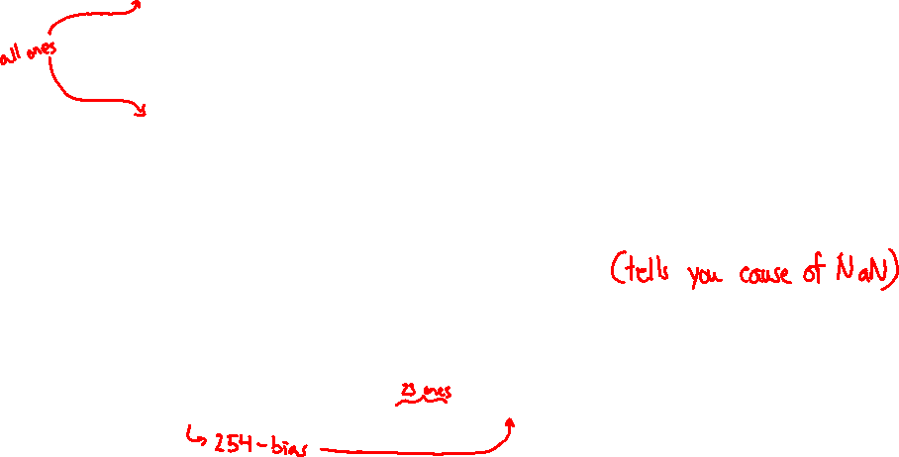
Other Special Cases
E = 0xFF, M = 0: ± ∞
e.g. division by 0
Still work in comparisons!
E = 0xFF, M ≠ 0: Not a Number (NaN)
e.g. square root of negative number, 0/0, ∞–∞
NaN propagates through computations
Value of M can be useful in debugging
New largest value (besides ∞)?
E = 0xFF has now been taken!
E = 0xFE has largest: 1.1…1₂×2¹²⁷ = 2¹²⁸ – 2¹⁰⁴

Slide 20
Floating Point Encoding Summary
E | M | Meaning
0x00 | 0 | ± 0
0x00 | non-zero | ± denorm num
0x01 – 0xFE | anything | ± norm num
0xFF | 0 | ± ∞
0xFF | non-zero | NaN

Slide 21
Floating Point Interpretation Flow Chart
all 0’s
$${\left(−1\right)}^{S}×∞$$
all 1’s
What is the value of M?
anything
else
$$NaN$$
FP Bits
What is the value of E?
$${\left(−1\right)}^{S}×0.M×2^{1−bias}$$
all 0’s
$${\left(−1\right)}^{S}×1.M×2^{E−bias}$$
anything else
= special case

Slide 22
Floating point topics
Fractional binary numbers
IEEE floating-point standard
Floating-point operations and rounding
Floating-point in C
There are many more details that we won’t cover
It’s a 58-page standard…
Notes:
Start by talking about representing fractional numbers in binary in general
Then about the IEEE Standard for floating point representation, operations,
Will not cover:
All the details of the 58-page spec
Or expect you to perform operations
Want to show you how floating point values are represented
To give you a sense of the kinds of things that can go wrong with them

Slide 23
Tiny Floating Point Representation
We will use the following 8-bit floating point representation to illustrate some key points:
Assume that it has the same properties as IEEE floating point:
bias =
encoding of $−0$ =
encoding of $+∞$ =
encoding of the largest (+) normalized # =
encoding of the smallest (+) normalized # =
S
E
M
1
4
3

Slide 24
Distribution of Values
What ranges are NOT representable?
Between largest norm and infinity
Between zero and smallest denorm
Between norm numbers?
Given a FP number, what’s the bit pattern of the next largest representable number?
What is this “step” when Exp = 0?
What is this “step” when Exp = 100?
Distribution of values is denser toward zero
Overflow (Exp too large)
Underflow (Exp too small)
Rounding

Slide 25
Floating Point Rounding
This is extra (non-testable) material
The IEEE 754 standard actually specifies different rounding modes:
Round to nearest, ties to nearest even digit
Round toward $+∞$ (round up)
Round toward $−∞$ (round down)
Round toward 0 (truncation)
In our tiny example:
Man = 1.001 01 rounded to M = 0b001
Man = 1.001 11 rounded to M = 0b010
Man = 1.001 10 rounded to M = 0b010
S
E
M
1
4
3

Slide 26
Floating Point Operations: Basic Idea
x +_{f} y = Round(x + y)
x *_{f} y = Round(x * y)
Basic idea for floating point operations:
First, compute the exact result
Then round the result to make it fit into the specified precision (width of M)
Possibly over/underflow if exponent outside of range
Value = (-1)^{S}×Mantissa×2^{Exponent}
S
E
M
Notes:
We won’t be asking you to do these yourself, but seeing a bit about how it works will help you understand the ways in which it can go wrong, which we may ask you about

Slide 27
Mathematical Properties of FP Operations
Overflow yields $±∞$ and underflow yields $0$
Floats with value $±∞$ and NaN can be used in operations
Result usually still $±∞$ or NaN, but not always intuitive
Floating point operations do not work like real math, due to rounding
Not associative: (3.14+1e100)–1e100 != 3.14+(1e100–1e100)
0 3.14
Not distributive: 100*(0.1+0.2) != 100*0.1+100*0.2
30.000000000000003553 30
Not cumulative
Repeatedly adding a very small number to a large one may do nothing
Notes:
NaNs or infinity can taint results, spread through a numerical computations
Floating point operations are not like real mathematical operations
The same algebraic properties, associative, commutative, distributive, no longer work right

Slide 28
Aside: Limits of Interest
This is extra (non-testable) material
The following thresholds will help give you a sense of when certain outcomes come into play, but don’t worry about the specifics:
FOver = $2^{bias+1}$ = $2^{8}$
This is just larger than the largest representable normalized number
FDenorm = $2^{1−bias}$ = $2^{−6}$
This is the smallest representable normalized number
FUnder = $2^{1−bias−m}$ = $2^{−9}$
$m$ is the width of the mantissa field
This is the smallest representable denormalized number

Slide 29
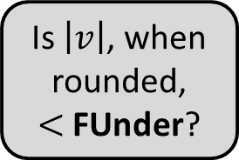
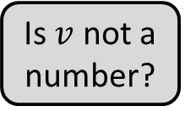
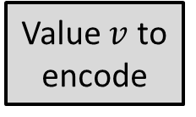
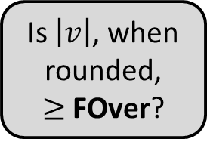
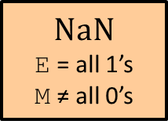
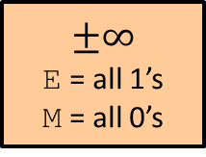
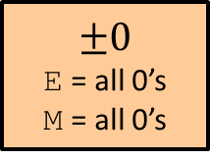
Floating Point Encoding Flow Chart
Is $\left|v\right|$, when rounded, $≥$ FOver?
No
Value $v$ to encode
Is $v$ not a number?
No
Yes
Yes
$NaN$
E = all 1’s M ≠ all 0’s
$$±∞$$
E = all 1’s M = all 0’s
$$±0$$
E = all 0’s M = all 0’s
Is $\left|v\right|$, when rounded, $<$ FUnder?
Is $\left|v\right|$, when rounded, $<$ FDenorm?
Yes
Yes
No
No
Denormed
E = all 0’s
0.M = Man
Normed
E = Exp + bias 1.M = Man
= special case

Slide 30
Example Question [FP II - a]
Using our 8-bit representation, what value gets stored when we try to encode 384 = 2⁸ + 2⁷?
No voting
+ 256
+ 384
+ $∞$
NaN
We’re lost…
S
E
M
1
4
3

Slide 31
Polling Question [FP II - b]
Using our 8-bit representation, what value gets stored when we try to encode 2.625 = 2¹ + 2⁻¹ + 2⁻³?
Vote at http://pollev.com/pbjones
+ 2.5
+ 2.625
+ 2.75
+ 3.25
We’re lost…
S
E
M
1
4
3

Slide 32
BONUS SLIDES
An example that applies the IEEE Floating Point concepts to a smaller (8-bit) representation scheme. These slides expand on material covered today, so while you don’t need to read these, the information is “fair game.”

Slide 33
Tiny Floating Point Example
S
E
M
1
4
3
8-bit Floating Point Representation
The sign bit is in the most significant bit (MSB)
The next four bits are the exponent, with a bias of 2⁴⁻¹–1 = 7
The last three bits are the mantissa
Same general form as IEEE Format
Normalized binary scientific point notation
Similar special cases for 0, denormalized numbers, NaN, ∞

Slide 34
Dynamic Range (Positive Only)
S E M Exp Value
0 0000 000 -6 0
0 0000 001 -6 1/8*1/64 = 1/512
0 0000 010 -6 2/8*1/64 = 2/512
…
0 0000 110 -6 6/8*1/64 = 6/512
0 0000 111 -6 7/8*1/64 = 7/512
0 0001 000 -6 8/8*1/64 = 8/512
0 0001 001 -6 9/8*1/64 = 9/512
…
0 0110 110 -1 14/8*1/2 = 14/16
0 0110 111 -1 15/8*1/2 = 15/16
0 0111 000 0 8/8*1 = 1
0 0111 001 0 9/8*1 = 9/8
0 0111 010 0 10/8*1 = 10/8
…
0 1110 110 7 14/8*128 = 224
0 1110 111 7 15/8*128 = 240
0 1111 000 n/a inf
closest to zero
Denormalized
numbers
largest denorm
smallest norm
closest to 1 below
Normalized
numbers
closest to 1 above
largest norm

Slide 35
Special Properties of Encoding
Floating point zero (0⁺) exactly the same bits as integer zero
All bits = 0
Can (Almost) Use Unsigned Integer Comparison
Must first compare sign bits
Must consider 0⁻ = 0⁺ = 0
NaNs problematic
Will be greater than any other values
What should comparison yield?
Otherwise OK
Denorm vs. normalized
Normalized vs. infinity

