Slide 1
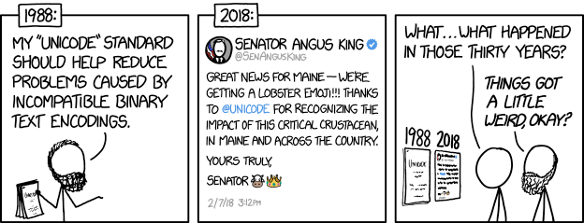
Integers II, Floating Point I CSE 351 Summer 2020
Instructor: Teaching Assistants:
Porter Jones Amy Xu
Callum Walker
Sam Wolfson
Tim Mandzyuk
http://xkcd.com/1953/

Slide 2
Administrivia
Questions doc: https://tinyurl.com/CSE351-7-1
hw4 and hw5 due Monday 7/6 – 10:30am
hw6 and hw7 due Friday 7/10 – 10:30am
Will post Monday’s slides later today so you can get started
Lab 1a due Monday (7/6) (try to finish by Friday!)
Submit pointer.c and lab1Areflect.txt to Gradescope
Lab 1b released tomorrow, due 7/10
Bit manipulation problems using custom data type
Today’s bonus slides have helpful examples, omorrow’s section will have helpful examples too

Slide 3
Gradescope Lab Turnin
Make sure you pass the File and Compilation Check!
Doesn’t indicate if you passed all tests, just indicates that all the correct files were found and there were no compilation or runtime errors.
Use the testing programs we provide to check your solution for correctness (on attu or the VM)

Slide 4
Quick Aside: C Macros
Lab1b will have you use some C macros for bit masks
Syntax is of the form:
#define NAME expression
Can now use “NAME” instead of “expression” in code
Useful to help with readability/factoring in code
Especially useful for defining constants such as bit masks!
Are NOT exactly the same as a constant in Java
Does naïve copy and replace before compilation.
Everywhere the characters “NAME” appear in the code, the characters “expression” will now appear instead.
See Lecture 4 (Integers I) slides for example usages

Slide 5
Integers
Binary representation of integers
Unsigned and signed
Shifting and arithmetic operations – useful for Lab 1a
In C: Signed, Unsigned and Casting
Consequences of finite width representations
Overflow, sign extension
Notes:
5

Slide 6
Two’s Complement Arithmetic
The same addition procedure works for both unsigned and two’s complement integers
Simplifies hardware: only one algorithm for addition
Algorithm: simple addition, discard the highest carry bit
Called modular addition: result is sum modulo $2^{w}$
4-bit Examples:
HW. | TC.
0100 +0011 | 4 +3
= 0111 | = 7
HW. | TC. |  | HW. | TC.
1100 +0011 | -4 +3 |  | 0100 +1101 | 4 -3
= 1111 | =-1 |  | =10001 | = 1
Notes:
Ask class to help with math
Drop the carry!

Slide 7
Why Does Two’s Complement Work?
For all representable positive integers $x$, we want:
What are the 8-bit negative encodings for the following?
bit representation of –$x$ $+$ bit representation of –$x$
$0$
(ignoring the carry-out bit)
00000001 + ????????
00000000
00000010 + ????????
00000000
11000011 + ????????
00000000

Slide 8
Why Does Two’s Complement Work?
For all representable positive integers $x$, we want:
What are the 8-bit negative encodings for the following?
bit representation of –$x$ $+$ bit representation of –$x$
$0$
(ignoring the carry-out bit)
00000001 + 11111111
100000000
00000010 + 11111110
100000000
11000011 + 00111101
100000000
These are the bitwise complement plus 1!
-x == ~x + 1

Slide 9
Signed/Unsigned Conversion Visualized
Two’s Complement $→$ Unsigned
Ordering Inversion
Negative $→$ Big Positive
UMax
UMax – 1
TMax + 1
Unsigned
Range
TMax
TMax
2’s Complement Range
0
0/UMin
–1
–2
TMin
Notes:
Tmax = Two’s complement max value
Umax = Unsigned max value

Slide 10
Values To Remember
Unsigned Values
UMin = 0b00…0 = $0$
UMax = 0b11…1 = $2^{w}−1$
Example: Values for $w=64$
Two’s Complement Values
TMin = 0b10…0 = $−2^{w−1}$
TMax = 0b01…1 = $2^{w−1}−1$
$−1$ = 0b11…1
 | Decimal | Hex
UMax | 18,446,744,073,709,551,615 | FF FF FF FF FF FF FF FF
TMax | 9,223,372,036,854,775,807 | 7F FF FF FF FF FF FF FF
TMin | -9,223,372,036,854,775,808 | 80 00 00 00 00 00 00 00
-1 | -1 | FF FF FF FF FF FF FF FF
0 | 0 | 00 00 00 00 00 00 00 00

Slide 11
Integers
Binary representation of integers
Unsigned and signed
Shifting and arithmetic operations – useful for Lab 1a
In C: Signed, Unsigned and Casting
Consequences of finite width representations
Overflow, sign extension
Notes:
11

Slide 12
In C: Signed vs. Unsigned
Casting
Bits are unchanged, just interpreted differently!
int tx, ty;
unsigned int ux, uy;
Explicit casting
tx = (int) ux;
uy = (unsigned int) ty;
Implicit casting can occur during assignments or function calls
tx = ux;
uy = ty;
Notes:
These are user-chosen names, there is nothing special about starting your variable name with ‘t’ or ‘u’.
Natural language analogy: written “chat” means “to talk” in English or “cat” in French.

Slide 13
Casting Surprises
!!!
Integer literals (constants)
By default, integer constants are considered signed integers
Hex constants already have an explicit binary representation
Use “U” (or “u”) suffix to explicitly force unsigned
Examples: 0U, 4294967259u
Expression Evaluation
When you mixed unsigned and signed in a single expression, then signed values are implicitly cast to unsigned
Including comparison operators <, >, ==, <=, >=

Slide 14
Casting Surprises
!!!
32-bit examples:
TMin = -2,147,483,648, TMax = 2,147,483,647
Left Constant | Order | Right Constant | Interpretation
0 0000 0000 0000 0000 0000 0000 0000 0000 |  | 0U 0000 0000 0000 0000 0000 0000 0000 0000
-1 1111 1111 1111 1111 1111 1111 1111 1111 |  | 0 0000 0000 0000 0000 0000 0000 0000 0000
-1 1111 1111 1111 1111 1111 1111 1111 1111 |  | 0U 0000 0000 0000 0000 0000 0000 0000 0000
2147483647 0111 1111 1111 1111 1111 1111 1111 1111 |  | -2147483648 1000 0000 0000 0000 0000 0000 0000 0000
2147483647U 0111 1111 1111 1111 1111 1111 1111 1111 |  | -2147483648 1000 0000 0000 0000 0000 0000 0000 0000
-1 1111 1111 1111 1111 1111 1111 1111 1111 |  | -2 1111 1111 1111 1111 1111 1111 1111 1110
(unsigned) -1 1111 1111 1111 1111 1111 1111 1111 1111 |  | -2 1111 1111 1111 1111 1111 1111 1111 1110
2147483647 0111 1111 1111 1111 1111 1111 1111 1111 |  | 2147483648U 1000 0000 0000 0000 0000 0000 0000 0000
2147483647 0111 1111 1111 1111 1111 1111 1111 1111 |  | (int) 2147483648U 1000 0000 0000 0000 0000 0000 0000 0000
Notes:
These all evaluate to TRUE (the Order indicates the correct ordering).

Slide 15
Integers
Binary representation of integers
Unsigned and signed
Shifting and arithmetic operations – useful for Lab 1a
In C: Signed, Unsigned and Casting
Consequences of finite width representations
Overflow, sign extension
Notes:
15

Slide 16
Arithmetic Overflow
Bits | Unsigned | Signed
0000 | 0 | 0
0001 | 1 | 1
0010 | 2 | 2
0011 | 3 | 3
0100 | 4 | 4
0101 | 5 | 5
0110 | 6 | 6
0111 | 7 | 7
1000 | 8 | -8
1001 | 9 | -7
1010 | 10 | -6
1011 | 11 | -5
1100 | 12 | -4
1101 | 13 | -3
1110 | 14 | -2
1111 | 15 | -1
When a calculation produces a result that can’t be represented in the current encoding scheme
Integer range limited by fixed width
Can occur in both the positive and negative directions
C and Java ignore overflow exceptions
You end up with a bad value in your program and no warning/indication… oops!

Slide 17
Overflow: Unsigned
Addition: drop carry bit ($−2^{N}$)
Subtraction: borrow ($+2^{N}$)
15
+ 2
17
1
1111
+ 0010
10001
15
0
14
1111
0000
1
13
1110
0001
2
1101
0010
12
1100
0011
3
Unsigned
11
1011
0100
4
1
- 2
-1
15
10001
- 0010
1111
1010
0101
10
1001
0110
5
9
1000
0111
6
8
7
$±2^{N}$ because of
modular arithmetic

Slide 18
Overflow: Two’s Complement
Addition: ($+$) + ($+$) = ($−$) result?
Subtraction: ($−$) + ($−$) = ($+$)?
6
+ 3
9
-7
0110
+ 0011
1001
– 1
0
– 2
1111
0000
+ 1
– 3
1110
0001
+ 2
1101
0010
– 4
1100
Two’s Complement
0011
+ 3
– 5
1011
0100
+ 4
-7
- 3
-10
6
1001
- 0011
0110
1010
0101
– 6
1001
0110
+ 5
– 7
1000
0111
+ 6
– 8
+ 7
For signed: overflow if operands have same sign and result’s sign is different

Slide 19
Sign Extension
What happens if you convert a signed integral data type to a larger one?
e.g. char $→$ short $→$ int $→$ long
4-bit $→$ 8-bit Example:
Positive Case
Add 0’s?
Negative Case?
4-bit: | 0010 | = | +2
8-bit: | ????0010 | = | ?
✓
00000010
+2

Slide 20
Polling Question [Int II - a]
Which of the following 8-bit numbers has the same signed value as the 4-bit number 0b1100?
Underlined digit = MSB
Vote at http://pollev.com/pbjones
0b 0000 1100
0b 1000 1100
0b 1111 1100
0b 1100 1100
We’re lost…

Slide 21
Sign Extension
Task: Given a $w$-bit signed integer $X$, convert it to $w$+$k$-bit signed integer $X′$ with the same value
Rule: Add $k$ copies of sign bit
Let $x_{i}$ be the $i$-th digit of $X$ in binary
$X^{′}=x_{w−1},…,x_{w−1},x_{w−1},x_{w−2},…,x_{1},x_{0}$
$k$ copies of MSB
original $X$
$$w$$
$X$
• • •
• • •
$$Xʹ$$
• • •
• • •
$$k$$
$$w$$
Notes:
General algorithm for any number of bits

Slide 22
Sign Extension Example
Convert from smaller to larger integral data types
C automatically performs sign extension
Java too
short int x = 12345;
int ix = (int) x;
short int y = -12345;
int iy = (int) y;
Var | Decimal | Hex | Binary
x | 12345 | 30 39 | 00110000 00111001
ix | 12345 | 00 00 30 39 | 00000000 00000000 00110000 00111001
y | -12345 | CF C7 | 11001111 11000111
iy | -12345 | FF FF CF C7 | 11111111 11111111 11001111 11000111

Slide 23
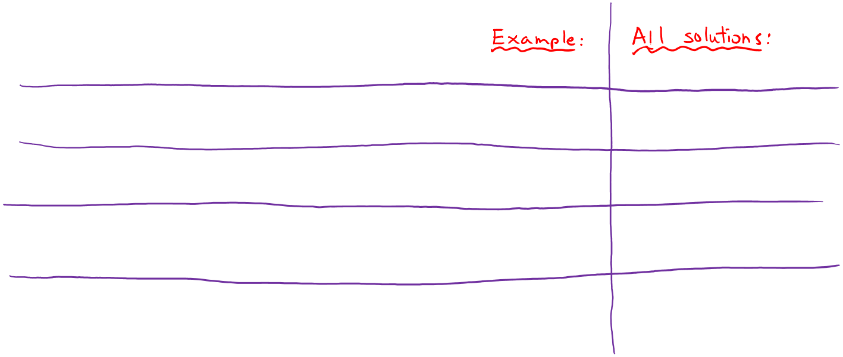
Practice Question
Assume we are using 8-bit arithmetic:
x == (unsigned char) x
x >= 128U
x != (x>>2)<<2
x == -x
Hint: there are two solutions
(x < 128U) && (x > 0x3F)
For the following expressions, find a value of signed char x, if there exists one, that makes the expression TRUE. Compare with your neighbor(s)!

Slide 24
Aside: Unsigned Multiplication in C
u
• • •
Operands: $w$ bits
*
v
• • •
True Product: $2w$ bits
u · v
• • •
• • •
Discard $w$ bits: $w$ bits
UMult_{w}(u , v)
• • •
Standard Multiplication Function
Ignores high order $w$ bits
Implements Modular Arithmetic
UMult_{w}(u , v) = u · v mod 2^{w}

Slide 25
Aside: Multiplication with shift and add
Operation u<<k gives u*2^{k}
Both signed and unsigned
Examples:
u<<3 == u * 8
u<<5 - u<<3 == u * 24
Most machines shift and add faster than multiply
Compiler generates this code automatically
u
• • •
Operands: $w$ bits
k
*
2^{k}
0
•••
0
1
0
•••
0
0
True Product: $w+k$ bits
u · 2^{k}
• • •
0
•••
0
0
Discard $k$ bits: $w$ bits
UMult_{w}(u , 2^{k})
•••
0
•••
0
0
TMult_{w}(u , 2^{k})

Slide 26
Number Representation Revisited
What can we represent so far?
Signed and Unsigned Integers
Characters (ASCII)
Addresses
How do we encode the following:
Real numbers (e.g. 3.14159)
Very large numbers (e.g. 6.02×10²³)
Very small numbers (e.g. 6.626×10⁻³⁴)
Special numbers (e.g. ∞, NaN)
Floating
Point

Slide 27
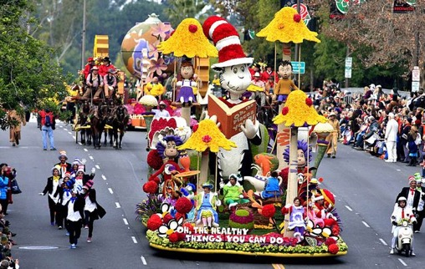
Floating Point Topics
Fractional binary numbers
IEEE floating-point standard
Floating-point operations and rounding
Floating-point in C
There are many more details that we won’t cover
It’s a 58-page standard…
Notes:
Start by talking about representing fractional numbers in binary in general
Then about the IEEE Standard for floating point representation, operations,
Will not cover:
All the details of the 58-page spec
Or expect you to perform operations
Want to show you how floating point values are represented
To give you a sense of the kinds of things that can go wrong with them

Slide 28
Representation of Fractions
“Binary Point,” like decimal point, signifies boundary between integer and fractional parts:
Example 6-bit representation:
Example: 10.1010₂ = 1×2¹ + 1×2⁻¹ + 1×2⁻³ = 2.625₁₀
xx.yyyy
2¹
2⁻⁴
2⁰
2⁻¹
2⁻²
2⁻³

Slide 29
Representation of Fractions
“Binary Point,” like decimal point, signifies boundary between integer and fractional parts:
Example 6-bit representation:
In this 6-bit representation:
What is the encoding and value of the smallest (most negative) number?
What is the encoding and value of the largest (most positive) number?
What is the smallest number greater than 2 that we can represent?
xx.yyyy
2¹
2⁻⁴
2⁰
2⁻¹
2⁻²
2⁻³

Slide 30
Fractional Binary Numbers
2^{i}
2^{i–1}
4
• • •
2
1
b_{i}
b_{i–1}
• • •
b₂
b₁
b₀
.
b_{–1}
b_{–2}
b_{–3}
b_{–j}
• • •
1/2
1/4
• • •
1/8
2^{–j}
Representation
Bits to right of “binary point” represent fractional powers of 2
Represents rational number:

Slide 31
Fractional Binary Numbers
Value Representation
5 and 3/4
2 and 7/8
47/64
Observations
Shift left = multiply by power of 2
Shift right = divide by power of 2
Numbers of the form 0.111111…₂ are just below 1.0
1/2 + 1/4 + 1/8 + … + 1/2^{i} + … ➙ 1.0
Use notation 1.0 – ε
101.11₂
10.111₂
0.101111₂
Notes:
 = lowercase epsilon

Slide 32
Limits of Representation
Limitations:
Even given an arbitrary number of bits, can only exactly represent numbers of the form x * 2^{y} (y can be negative)
Other rational numbers have repeating bit representations
Value: Binary Representation:
1/3 = 0.333333…₁₀ = 0.01010101[01]…₂
1/5 = 0.001100110011[0011 ]…₂
1/10 = 0.0001100110011[0011 ]…₂

Slide 33
Fixed Point Representation
Implied binary point. Two example schemes:
#1: the binary point is between bits 2 and 3 b₇ b₆ b₅ b₄ b₃ [.] b₂ b₁ b₀
#2: the binary point is between bits 4 and 5 b₇ b₆ b₅ [.] b₄ b₃ b₂ b₁ b₀
Wherever we put the binary point, with fixed point representations there is a trade off between the amount of range and precision we have
Fixed point = fixed range and fixed precision
range: difference between largest and smallest numbers possible
precision: smallest possible difference between any two numbers
Hard to pick how much you need of each!

Slide 34
Floating Point Representation
Analogous to scientific notation
In Decimal:
Not 12000000, but 1.2 x 10⁷ In C: 1.2e7
Not 0.0000012, but 1.2 x 10⁻⁶ In C: 1.2e-6
In Binary:
Not 11000.000, but 1.1 x 2⁴
Not 0.000101, but 1.01 x 2⁻⁴
We have to divvy up the bits we have (e.g., 32) among:
the sign (1 bit)
the mantissa (significand)
the exponent

Slide 35
Scientific Notation (Decimal)
Normalized form: exactly one digit (non-zero) to left of decimal point
Alternatives to representing 1/1,000,000,000
Normalized: 1.0×10⁻⁹
Not normalized: 0.1×10⁻⁸,10.0×10⁻¹⁰
mantissa
exponent
6.02₁₀ × 10²³
decimal point
radix (base)

Slide 36
Scientific Notation (Binary)
Computer arithmetic that supports this called floating point due to the “floating” of the binary point
Declare such variable in C as float (or double)
mantissa
exponent
1.01₂ × 2⁻¹
binary point
radix (base)

Slide 37
Scientific Notation Translation
Convert from scientific notation to binary point
Perform the multiplication by shifting the decimal until the exponent disappears
Example: 1.011₂$×$2⁴ = 10110₂ = 22₁₀
Example: 1.011₂$×$2⁻² = 0.01011₂ = 0.34375₁₀
Convert from binary point to normalized scientific notation
Distribute out exponents until binary point is to the right of a single digit
Example: 1101.001₂ = 1.101001₂×2³
Practice: Convert 11.375₁₀ to normalized binary scientific notation
Notes:
Fraction like 1/3 needs an infinite number of digits to be represented, even in base 10!

Slide 38
Summary
Sign and unsigned variables in C
Bit pattern remains the same, just interpreted differently
Strange things can happen with our arithmetic when we convert/cast between sign and unsigned numbers
Type of variables affects behavior of operators (shifting, comparison)
We can only represent so many numbers in $w$ bits
When we exceed the limits, arithmetic overflow occurs
Sign extension tries to preserve value when expanding
Floating point approximates real numbers
We will discuss more details on Monday!

Slide 39
BONUS SLIDES
Some examples of using shift operators in combination with bitmasks, which you may find helpful for Lab 1.
Extract the 2nd most significant byte of an int
Extract the sign bit of a signed int
Conditionals as Boolean expressions

Slide 40
Using Shifts and Masks
Extract the 2nd most significant byte of an int:
First shift, then mask: (x>>16) & 0xFF
Or first mask, then shift: (x & 0xFF0000)>>16
x | 00000001 | 00000010 | 00000011 | 00000100
x>>16 | 00000000 | 00000000 | 00000001 | 00000010
0xFF | 00000000 | 00000000 | 00000000 | 11111111
(x>>16) & 0xFF | 00000000 | 00000000 | 00000000 | 00000010
x | 00000001 | 00000010 | 00000011 | 00000100
0xFF0000 | 00000000 | 11111111 | 00000000 | 00000000
x & 0xFF0000 | 00000000 | 00000010 | 00000000 | 00000000
(x&0xFF0000)>>16 | 00000000 | 00000000 | 00000000 | 00000010

Slide 41
Using Shifts and Masks
Extract the sign bit of a signed int:
First shift, then mask: (x>>31) & 0x1
Assuming arithmetic shift here, but this works in either case
Need mask to clear 1s possibly shifted in
0
x | 00000001 | 00000010 | 00000011 | 00000100
x>>31 | 00000000 | 00000000 | 00000000 | 00000000
0x1 | 00000000 | 00000000 | 00000000 | 00000001
(x>>31) & 0x1 | 00000000 | 00000000 | 00000000 | 00000000
0
1
x | 10000001 | 00000010 | 00000011 | 00000100
x>>31 | 11111111 | 11111111 | 11111111 | 11111111
0x1 | 00000000 | 00000000 | 00000000 | 00000001
(x>>31) & 0x1 | 00000000 | 00000000 | 00000000 | 00000001
1

Slide 42
Using Shifts and Masks
Conditionals as Boolean expressions
For int x, what does (x<<31)>>31 do?
Can use in place of conditional:
In C: if(x) {a=y;} else {a=z;} equivalent to a=x?y:z;
a=(((x<<31)>>31)&y) | (((!x<<31)>>31)&z);
x=!!123 | 00000000 | 00000000 | 00000000 | 00000001
x<<31 | 10000000 | 00000000 | 00000000 | 00000000
(x<<31)>>31 | 11111111 | 11111111 | 11111111 | 11111111
!x | 00000000 | 00000000 | 00000000 | 00000000
!x<<31 | 00000000 | 00000000 | 00000000 | 00000000
(!x<<31)>>31 | 00000000 | 00000000 | 00000000 | 00000000
Notes:
Use !! to force to 0/1

