Slide 1
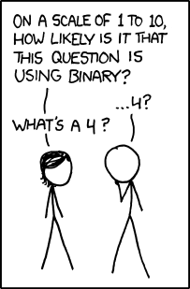
Memory, Data, & Addressing I CSE 351 Spring 2020
Instructor:
Ruth Anderson
Teaching Assistants:
Alex Olshanskyy
Rehaan Bhimani
Callum Walker
Chin Yeoh
Diya Joy
Eric Fan
Edan Sneh
Jonathan Chen
Jeffery Tian
Millicent Li
Melissa Birchfield
Porter Jones
Joseph Schafer
Connie Wang
Eddy (Tianyi) Zhou
http://xkcd.com/953/

Slide 2
Administrivia
Assignments – Nothing Due this week!
Pre-Course Survey, hw0, hw1, hw2 due Mon (4/06) – 11:59pm
Lab 0 due Tuesday (4/07) – 11:59pm
This lab is exploratory and looks like a hw; the other labs will look a lot different (involve writing code etc.)
Don’t worry if everything in Lab 0 doesn’t make perfect sense right now! We will cover all of these topics in more detail later in the course.
Lab 0 is about getting you used to modifying C code and running it to see what the outcome is – a powerful tool for understanding the concepts in this course!
hw3 due Wednesday (4/08) – 11am

Slide 3
Q & A Since Monday (1 of 2)
CSE391 – Unix Tools
Anyone taking this course, including non-CSE majors
Tuesday 1:30-2:20pm
https://courses.cs.washington.edu/courses/cse391/20sp/
391 Instructors trying to increase enrollment cap, if not I can post some old 391 videos
Textbook
Normally I have a copy of our text on reserve at the Engineering library, this quarter I have requested that an electronic version be on reserve but have not heard back about that.
There is a 180 day digital rental available for $34.99 from the UW Bookstore.

Slide 4
Q & A Since Monday (2 of 2)
PollEverywhere participation
You may attend either lecture section – your pollEverywhere responses will be counted for credit in either lecture.
This week PollEverywhere use is just to get folks used to the technology, not for Participation credit
Starting next week we will have a mechanism in place for students who cannot attend lecture synchronously to be able to answer pollEverywhere questions. This will likely be outside of pollEverywhere (maybe canvas), and will likely be due before the next lecture meeting. (We cannot simply leave pollEverywhere open between classes in the case that we have multiple questions per class (likely) – I can only have one question open at a time. I am trying to leave a question open after lecture this week just to let folks try out the technology.)

Slide 5
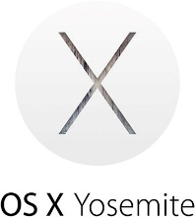
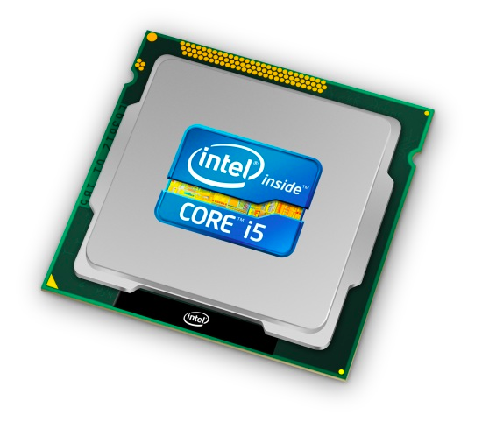
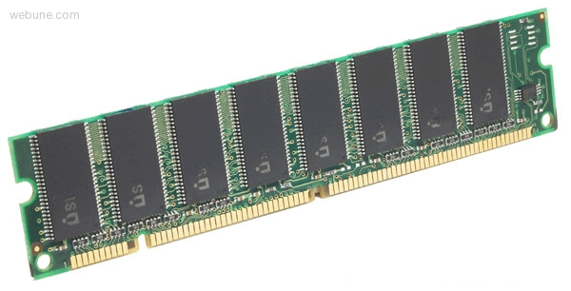
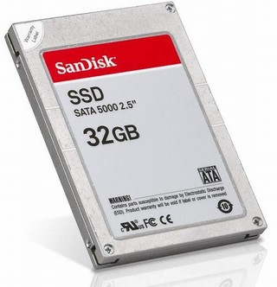
Roadmap
C:
Java:
Memory & data
Integers & floats
x86 assembly
Procedures & stacks
Executables
Arrays & structs
Memory & caches
Processes
Virtual memory
Memory allocation
Java vs. C
car *c = malloc(sizeof(car));
c->miles = 100;
c->gals = 17;
float mpg = get_mpg(c);
free(c);
Car c = new Car();
c.setMiles(100);
c.setGals(17);
float mpg = c.getMPG();
Assembly language:
get_mpg:
pushq %rbp
movq %rsp, %rbp
...
popq %rbp
ret
OS:
Machine code:
0111010000011000
100011010000010000000010
1000100111000010
110000011111101000011111
Computer system:
Notes:
Today we’ll be talking about the basic execution model, and focusing on how data gets stored in memory and addressed

Slide 6
Memory, Data, and Addressing
Hardware - High Level Overview
Representing information as bits and bytes
Memory is a byte-addressable array
Machine “word” size = address size = register size
Organizing and addressing data in memory
Endianness – ordering bytes in memory
Manipulating data in memory using C
Boolean algebra and bit-level manipulations

Slide 7
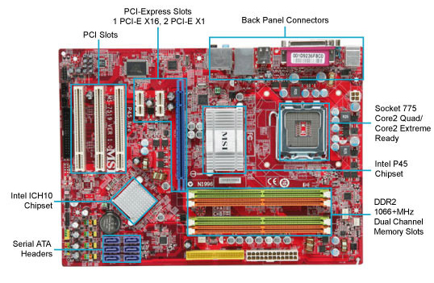
Hardware: Physical View
USB…
Bus connections
CPU
(empty slot)
I/O
controller
Memory
Storage connections
Notes:
CPU
Looks funny because of heat sink

Slide 8
Hardware: Logical View
Memory
CPU
Bus
Disks
USB
Etc.
Net
Notes:
CPU: all computations done here
Memory: big array of bytes
Big pipe between CPU and memory, in order to keep CPU fed
Bus: connect everything else to each other
Bus just means you broadcast on it (to everyone)
Same root as the other kind of “bus”
Disks bigger storage, slower, farther away, persistent
Network, etc.

Slide 9
Hardware: 351 View (version 0)
Memory
?
CPU
The CPU executes instructions
Memory stores data
Binary encoding!
Instructions are just data
How are data and instructions represented?
Notes:
The CPU and Memory are what this course focuses on.

Slide 10
Aside: Why Base 2?
Electronic implementation
Easy to store with bi-stable elements
Reliably transmitted on noisy and inaccurate wires
Other bases possible, but not yet viable:
DNA data storage (base 4: A, C, G, T) is a hot topic
Quantum computing
0
1
0
3.3V
2.8V
0.5V
0.0V
Notes:
adenine (A), cytosine (C), guanine (G), or thymine (T)

Slide 11
Binary Encoding Additional Details
Because storage is finite in reality, everything is stored as “fixed” length
Data is moved and manipulated in fixed-length chunks
Multiple fixed lengths (e.g. 1 byte, 4 bytes, 8 bytes)
Leading zeros now must be included up to “fill out” the fixed length
Example: the “eight-bit” representation of the number 4 is 0b00000100
Least Significant Bit (LSB)
Most Significant Bit (MSB)

Slide 12
Hardware: 351 View (version 0)
Memory
instructions
?
data
CPU
To execute an instruction, the CPU must:
Fetch the instruction
(if applicable) Fetch data needed by the instruction
Perform the specified computation
(if applicable) Write the result back to memory
Notes:
The CPU and Memory are what this course focuses on.

Slide 13
Hardware: 351 View (version 1)
Memory
instructions
i-cache
take 469
data
CPU
registers
More CPU details:
Instructions are held temporarily in the instruction cache
Other data are held temporarily in registers
Instruction fetching is hardware-controlled
Data movement is programmer-controlled (assembly)
Notes:
Take EE/CSE469 to learn about the internal workings and design of the CPU, but we will reveal a few more details here.

Slide 14
Hardware: 351 View (version 1)
Memory
instructions
i-cache
take 469
data
CPU
registers
We will start by learning about Memory
How does a program find its data in memory?

Slide 15
An Address Refers to a Byte of Memory
0x0…00
0xF…FE
0x0…01
0xF…FF
 |  |  |  |  |  | • • •
Conceptually, memory is a single, large array of bytes, each with a unique address (index)
Each address is just a number represented in fixed-length binary
Programs refer to bytes in memory by their addresses
Domain of possible addresses = address space
We can store addresses as data to “remember” where other data is in memory
But not all values fit in a single byte… (e.g. 351)
Many operations actually use multi-byte values
Notes:
House analogy: each byte is a house, which has a unique address/number. Address space is the block, size of address space is how many houses are on this block.
Each byte can be read and written
Address space determined by how many bits in the address
So what if things don’t fit in a single byte?
How many things does 1 byte allow us to address?

Slide 16
Polling Question
If we choose to use 4-bit addresses, how big is our address space?
i.e. How much space can we “refer to” using our addresses?
Vote at http://PollEv.com/rea
16 bits
16 bytes
4 bits
4 bytes
We’re lost…

Slide 17
Machine “Words”
Instructions encoded into machine code (0’s and 1’s)
Historically (still true in some assembly languages), all instructions were exactly the size of a word
We have chosen to tie word size to address size/width
word size = address size = register size
word size = $w$ bits $→$ $2w$ addresses
Current x86 systems use 64-bit (8-byte) words
Potential address space: $264$ addresses 2⁶⁴ bytes ≈ 1.8 x 10¹⁹ bytes = 18 billion billion bytes = 18 EB (exabytes)
Actual physical address space: 48 bits
Notes:
Instead, we typically talk about addresses in terms of “words”
Use same word size anywhere that you typically store addresses
You could count the world population with 33 fingers (using population number of 7.454 billion)

Slide 18
Word-Oriented View of Memory
64-bit
Words
32-bit
Words
Addr.
(hex)
Addresses still specify locations of bytes in memory, but we can choose to view memory as a series of word-sized chunks of data instead
Addresses of successive words differ by word size
Which byte’s address should we use for each word?
Bytes
0x00
Addr
=
??
0x01
0x02
Addr
=
??
0x03
0x04
Addr
=
??
0x05
0x06
0x07
0x08
Addr
=
??
0x09
0x0A
Addr
=
??
0x0B
0x0C
Addr
=
??
0x0D
0x0E
0x0F
Notes:
What do we use to address bigger chunks of bytes?

Slide 19
Address of a Word = Address of First Byte in the Word
64-bit
Words
32-bit
Words
Addr.
(hex)
Addresses still specify locations of bytes in memory, but we can choose to view memory as a series of word-sized chunks of data instead
Addresses of successive words differ by word size
Which byte’s address should we use for each word?
The address of any chunk of memory is given by the address of the first byte
To specify a chunk of memory, need both its address and its size
Bytes
0x00
Addr
=
??
0x01
0x02
0000
Addr
=
??
0x03
0x04
0000
Addr
=
??
0x05
0x06
0004
0x07
0x08
Addr
=
??
0x09
0x0A
Addr
=
??
0008
0x0B
0008
0x0C
Addr
=
??
0x0D
0x0E
0012
0x0F
Notes:
Use the first byte of the word
Still count by bytes
Aside: isn’t this wasteful?
Yes, but remember how much we can address with 64 bits? Probably don’t need to worry too much.

Slide 20
Alignment
64-bit
Words
32-bit
Words
Addr.
(hex)
The address of a chunk of memory is considered aligned if its address is a multiple of its size
View memory as a series of consecutive chunks of this particular size and see if your chunk doesn’t cross a boundary
Bytes
0x00
Addr
=
??
0x01
0x02
0000
Addr
=
??
0x03
0x04
0000
Addr
=
??
0x05
0x06
0004
0x07
0x08
Addr
=
??
0x09
0x0A
Addr
=
??
0008
0x0B
0008
0x0C
Addr
=
??
0x0D
0x0E
0012
0x0F
Notes:
Use the first byte of the word
Still count by bytes
Aside: isn’t this wasteful?
Yes, but remember how much we can address with 64 bits? Probably don’t need to worry too much.

Slide 21
A Picture of Memory (64-bit view)
A “64-bit (8-byte) word-aligned” view of memory:
In this type of picture, each row is composed of 8 bytes
Each cell is a byte
An aligned, 64-bit chunk of data will fit on one row
one word
Address
0x00
0x01
0x02
0x03
0x04
0x05
0x06
0x07
0x00
0x08
0x10
0x18
0x20
0x28
0x30
0x38
0x40
0x48
Notes:
In this course, we’ll be doing everything in 64-bits
What’s the second row’s address going to be?
0x08
Third?
0x10

Slide 22
A Picture of Memory (64-bit view)
A “64-bit (8-byte) word-aligned” view of memory:
In this type of picture, each row is composed of 8 bytes
Each cell is a byte
An aligned, 64-bit chunk of data will fit on one row
one word
Address
0x00
0x01
0x02
0x03
0x04
0x05
0x06
0x07
0x00
0x08
0x10
0x08
0x09
0x0A
0x0B
0x0C
0x0D
0x0E
0x0F
0x18
0x20
0x28
0x30
0x38
0x40
0x48

Slide 23
Addresses and Pointers
64-bit example
(pointers are 64-bits wide)
big-endian
An address refers to a location in memory
A pointer is a data object that holds an address
Address can point to any data
Value 504 stored at address 0x08
504₁₀ = 1F8₁₆ = 0x 00 ... 00 01 F8
Pointer stored at 0x38 points to address 0x08
Address
0x00
0x08
00
00
00
00
00
00
01
F8
0x10
0x18
0x20
0x28
0x30
0x38
00
00
00
00
00
00
00
08
0x40
0x48
Notes:
Note that everything is just padded with extra 0s

Slide 24
Addresses and Pointers
64-bit example
(pointers are 64-bits wide)
big-endian
An address refers to a location in memory
A pointer is a data object that holds an address
Address can point to any data
Pointer stored at 0x48 points to address 0x38
Pointer to a pointer!
Is the data stored at 0x08 a pointer?
Could be, depending on how you use it
Address
0x00
0x08
00
00
00
00
00
00
01
F8
0x10
0x18
0x20
0x28
0x30
0x38
00
00
00
00
00
00
00
08
0x40
0x48
00
00
00
00
00
00
00
38
Notes:
Note that everything is just padded with extra 0s

Slide 25
Data Representations
Sizes of data types (in bytes)
Java Data Type | C Data Type | 32-bit (old) | x86-64
boolean | bool | 1 | 1
byte | char | 1 | 1
char |  | 2 | 2
short | short int | 2 | 2
int | int | 4 | 4
float | float | 4 | 4
 | long int | 4 | 8
double | double | 8 | 8
long | long long | 8 | 8
 | long double | 8 | 16
(reference) | pointer * | 4 | 8
(reference) | pointer * | 4 | 8
address size = word size
To use “bool” in C, you must #include <stdbool.h>
Notes:
This mapping is mostly an arbitrary historical artifact except for address sizes.

Slide 26
Memory Alignment Revisited
A primitive object of $K$ bytes must have an address that is a multiple of $K$ to be considered aligned
For good memory system performance, Intel (x86) recommends data be aligned
However the x86-64 hardware will work correctly otherwise
Design choice: x86-64 instructions are variable bytes long
$K$ | Type
1 | char
2 | short
4 | int, float
8 | long, double, pointers

Slide 27
Byte Ordering
How should bytes within a word be ordered in memory?
Want to keep consecutive bytes in consecutive addresses
Example: store the 4-byte (32-bit) int: 0x a1 b2 c3 d4
By convention, ordering of bytes called endianness
The two options are big-endian and little-endian
In which address does the least significant byte go?
Based on Gulliver’s Travels: tribes cut eggs on different sides (big, little)

Slide 28
Byte Ordering
Big-endian (SPARC, z/Architecture)
Least significant byte has highest address
Little-endian (x86, x86-64)
Least significant byte has lowest address
Bi-endian (ARM, PowerPC)
Endianness can be specified as big or little
Example: 4-byte data 0xa1b2c3d4 at address 0x100
0x100
0x101
0x102
0x103
Big-Endian
01
23
45
67
0x100
0x101
0x102
0x103
Little-Endian
67
45
23
01
Notes:
Big Endian
Most significant is first
Little Endian
Looks backwards
Let’s look at some more examples…

Slide 29
Byte Ordering
Big-endian (SPARC, z/Architecture)
Least significant byte has highest address
Little-endian (x86, x86-64)
Least significant byte has lowest address
Bi-endian (ARM, PowerPC)
Endianness can be specified as big or little
Example: 4-byte data 0xa1b2c3d4 at address 0x100
0x100
0x101
0x102
0x103
Big-Endian
01
a1
23
b2
45
c3
67
d4
0x100
0x101
0x102
0x103
Little-Endian
67
d4
45
c3
23
b2
01
a1
Notes:
Big Endian
Most significant is first
Little Endian
Looks backwards
Let’s look at some more examples…

Slide 30
Byte Ordering Examples
Decimal: 12345
Binary: 0011 0000 0011 1001
Hex: 3 0 3 9
IA32, x86-64 (little-endian)
SPARC (big-endian)
int x = 12345;
// or x = 0x3039;
0x00
39
00
0x00
0x01
30
00
0x01
0x02
00
30
0x02
0x03
00
39
0x03
long int y = 12345;
// or y = 0x3039;
(A long int is the size of a word)
32-bit
IA32
64-bit
x86-64
32-bit
SPARC
64-bit
SPARC
0x00
39
39
0x00
0x00
00
00
0x00
0x01
30
30
0x01
0x01
00
00
0x01
0x02
00
00
0x02
0x02
30
00
0x02
0x03
00
00
0x03
0x03
39
00
0x03
00
0x04
00
0x04
00
0x05
00
0x05
00
0x06
30
0x06
00
0x07
39
0x07

Slide 31
Polling Question
We store the value 0x 01 02 03 04 as a word at address 0x100 in a big-endian, 64-bit machine
What is the byte of data stored at address 0x104?
Vote at http://pollev.com/rea
0x04
0x40
0x01
0x10
We’re lost…

Slide 32
Endianness
Endianness only applies to memory storage
Often programmer can ignore endianness because it is handled for you
Bytes wired into correct place when reading or storing from memory (hardware)
Compiler and assembler generate correct behavior (software)
Endianness still shows up:
Logical issues: accessing different amount of data than how you stored it (e.g. store int, access byte as a char)
Need to know exact values to debug memory errors
Manual translation to and from machine code (in 351)

Slide 33
Summary
Memory is a long, byte-addressed array
Word size bounds the size of the address space and memory
Different data types use different number of bytes
Address of chunk of memory given by address of lowest byte in chunk
Object of $K$ bytes is aligned if it has an address that is a multiple of $K$
Pointers are data objects that hold addresses
Endianness determines memory storage order for multi-byte data

