Slide 1
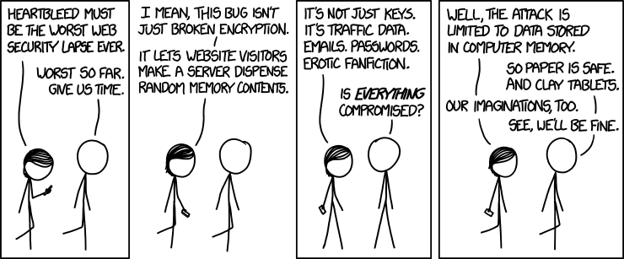
Executables & Buffer Overflows CSE 351 Winter 2019
Instructors:
Max Willsey
Luis Ceze
Teaching Assistants:
Britt Henderson
Lukas Joswiak
Josie Lee
Wei Lin
Daniel Snitkovsky
Luis Vega
Kory Watson
Ivy Yu
http://xkcd.com/1353/

Slide 2
Administrivia
Mid-quarter survey due tomorrow (2/14)
Homework 3 due Friday (2/15)
Lab 3 releasing today, due next Friday (2/22)
Midterm tomorrow (2/14)
Will be posted in the morning
Due 11:59PM same day
See Piazza for rules
✅ course material
❌ collaboration
Notes:
We are trusting you!

Slide 3
Assembly Programmer’s View
CPU
Memory
Addresses
%rip
%rax
%r8
Stack
%rbx
%r9
Data
%rcx
%r10
CF
ZF
%rdx
%r11
%rsi
%r12
Instructions
%rdi
%r13
Dynamic Data (Heap)
SF
OF
%rsp
%r14
%rbp
%r15
Programmer-visible state
PC: the Program Counter (%rip in x86-64)
Address of next instruction
Named registers
Together in “register file”
Heavily used program data
Condition codes
Store status information about most recent arithmetic operation
Used for conditional branching
Static Data
Literals
Instructions
Memory
Byte-addressable array
Code and user data
Includes the Stack (for supporting procedures)
Notes:
Let’s look at a computer
Static and dynamic allocation
Haven’t really talk about how ”stuff” gets into memory

Slide 4
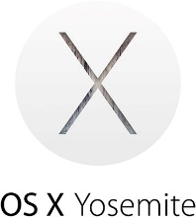
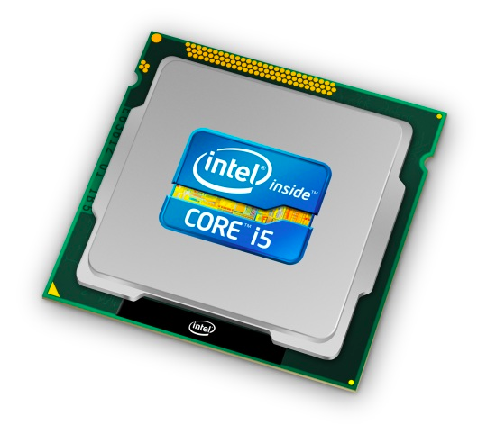
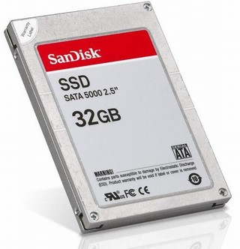
Roadmap
C:
Java:
Memory & data
Integers & floats
x86 assembly
Procedures & stacks
Executables
Arrays & structs
Memory & caches
Processes
Virtual memory
Memory allocation
Java vs. C
car *c = malloc(sizeof(car));
c->miles = 100;
c->gals = 17;
float mpg = get_mpg(c);
free(c);
Car c = new Car();
c.setMiles(100);
c.setGals(17);
float mpg = c.getMPG();
Assembly language:
get_mpg:
pushq %rbp
movq %rsp, %rbp
...
popq %rbp
ret
OS:
Machine code:
0111010000011000
100011010000010000000010
1000100111000010
110000011111101000011111
Computer system:

Slide 5
Building an Executable from a C File
Code in files p1.c p2.c
Compile with command: gcc -Og p1.c p2.c -o p
Put resulting machine code in file p
Run with command: ./p
text
C program (p1.c p2.c)
Compiler (gcc –Og -S)
text
Asm program (p1.s p2.s)
Assembler (gcc -c or as)
binary
Object program (p1.o p2.o)
Static libraries (.a)
Linker (gcc or ld)
binary
Executable program (p)
Loader (the OS)
Notes:
CALL mnemonic
Want to compile separately, combine with linking

Slide 6
Compiler
Input: Higher-level language code (e.g. C, Java)
foo.c
Output: Assembly language code (e.g. x86, ARM, MIPS)
foo.s
First there’s a preprocessor step to handle #directives
Macro substitution, plus other specialty directives
If curious/interested: http://tigcc.ticalc.org/doc/cpp.html
Super complex, whole courses devoted to these!
Compiler optimizations
“Level” of optimization specified by capital ‘O’ flag (e.g. -Og, -O3)
Options: https://gcc.gnu.org/onlinedocs/gcc/Optimize-Options.html

Slide 7
Compiling Into Assembly
C Code (sum.c)
x86-64 assembly (gcc –Og –S sum.c)
Warning: You may get different results with other versions of gcc and different compiler settings
void sumstore(long x, long y, long *dest) {
long t = x + y;
*dest = t;
}
sumstore(long, long, long*):
addq %rdi, %rsi
movq %rsi, (%rdx)
ret
Notes:
https://godbolt.org/g/5hQk8a
-S flag

Slide 8
Assembler
Input: Assembly language code (e.g. x86, ARM, MIPS)
foo.s
Output: Object files (e.g. ELF, COFF)
foo.o
Contains object code and information tables
Reads and uses assembly directives
e.g. .text, .data, .quad
x86: https://docs.oracle.com/cd/E26502_01/html/E28388/eoiyg.html
Produces “machine language”
Does its best, but object file is not a completed binary
Example: gcc -c foo.s
Notes:
ELF = executable and linkable format
COFF = common object file format

Slide 9
Producing Machine Language
Simple cases: arithmetic and logical operations, shifts, etc.
All necessary information is contained in the instruction itself
What about the following?
Conditional jump
Accessing static data (e.g. global var or jump table)
call
Addresses and labels are problematic because the final executable hasn’t been constructed yet!
So how do we deal with these in the meantime?
Notes:
What is the assembler actually doing?

Slide 10
Object File Information Tables
Symbol Table holds list of “items” that may be used by other files
Non-local labels – function names for call
Static Data – variables & literals that might be accessed across files
Relocation Table holds list of “items” that this file needs the address of later (currently undetermined)
Any label or piece of static data referenced in an instruction in this file
Both internal and external
Each file has its own symbol and relocation tables
Notes:
What I have
What I need

Slide 11
Object File Format
object file header: size and position of the other pieces of the object file
text segment: the machine code
data segment: data in the source file (binary)
relocation table: identifies lines of code that need to be “handled”
symbol table: list of this file’s labels and data that can be referenced
debugging information
More info: ELF format
http://www.skyfree.org/linux/references/ELF_Format.pdf

Slide 12
Linker
Input: Object files (e.g. ELF, COFF)
foo.o
Output: executable binary program
a.out
Combines several object files into a single executable (linking)
Enables separate compilation/assembling of files
Changes to one file do not require recompiling of whole program
But you might have to relink

Slide 13
Linking
Take text segment from each .o file and put them together
Take data segment from each .o file, put them together, and concatenate this onto end of text segments
Resolve References
Go through Relocation Table; handle each entry using Symbol Tables
object file 1
info 1
a.out
data 1
Relocated data 1
text 1
Linker
Relocated data 2
object file 2
Relocated text 1
info 2
Relocated text 2
data 2
text 2

Slide 14
Disassembling Object Code
Disassembled:
Disassembler (objdump -d sum)
Useful tool for examining object code (man 1 objdump)
Analyzes bit pattern of series of instructions
Produces approximate rendition of assembly code
Can run on either a.out (complete executable) or .o file
0000000000400536 <sumstore>:
400536: 48 01 fe add %rdi,%rsi
400539: 48 89 32 mov %rsi,(%rdx)
40053c: c3 retq

Slide 15
Disassembling Object Code
Executable has addresses
gcc -g pcount.c –o pcount
objdump –d pcount
00000000004004f6 <pcount_r>:
4004f6: b8 00 00 00 00 mov $0x0,%eax
4004fb: 48 85 ff test %rdi,%rdi
4004fe: 74 13 je 400513 <pcount_r+0x1d>
400500: 53 push %rbx
400501: 48 89 fb mov %rdi,%rbx
400504: 48 d1 ef shr %rdi
400507: e8 ea ff ff ff callq 4004f6 <pcount_r>
40050c: 83 e3 01 and $0x1,%ebx
40050f: 48 01 d8 add %rbx,%rax
400512: 5b pop %rbx
400513: f3 c3 rep ret
assembler
Notes:
Assembling replaced labels with numbers, can’t get them back

Slide 16
A Picture of Memory (64-bit view)
00000000004004f6 <pcount_r>:
4004f6: b8 00 00 00 00 mov $0x0,%eax
4004fb: 48 85 ff test %rdi,%rdi
4004fe: 74 13 je 400513 <pcount_r+0x1d>
400500: 53 push %rbx
400501: 48 89 fb mov %rdi,%rbx
400504: 48 d1 ef shr %rdi
400507: e8 ea ff ff ff callq 4004f6 <pcount_r>
40050c: 83 e3 01 and $0x1,%ebx
40050f: 48 01 d8 add %rbx,%rax
400512: 5b pop %rbx
400513: f3 c3 rep ret
0|8 | 1|9 | 2|a | 3|b | 4|c | 5|d | 6|e | 7|f
 |  |  |  |  |  |  |  | 0x00
 |  |  |  |  |  |  |  | 0x08
 |  |  |  |  |  |  |  | 0x10
... |  |  |  |  |  |  |  | ...
 |  |  |  |  |  | b8 | 00 | 0x4004f0
00 | 00 | 00 | 48 | 85 | ff | 74 | 13 | 0x4004f8
53 | 48 | 89 | fb | 48 | d1 | ef | e8 | 0x400500
ea | ff | ff | ff | 83 | e3 | 01 | 48 | 0x400508
01 | d8 | 5b | f3 | c3 |  |  |  | 0x400510
Notes:
Note that it’s not word-aligned!
But look how compact it is

Slide 17
Loader
Input: executable binary program, command-line arguments
./a.out arg1 arg2
Output: <program is run>
Loader duties primarily handled by OS/kernel
More about this when we learn about processes
Memory sections (Instructions, Static Data, Stack) are set up
Registers are initialized
Notes:
Program is done! Now we just want to run it
Put things from file into memory

Slide 18
Buffer Overflows
Address space layout (more details!)
Input buffers on the stack
Overflowing buffers and injecting code
Defenses against buffer overflows

Slide 19
Review: General Memory Layout
not drawn to scale
2^{N}-1
Stack
Stack
Local variables (procedure context)
Heap
Dynamically allocated as needed
malloc(), calloc(), new, …
Statically allocated Data
Read/write: global variables (Static Data)
Read-only: string literals (Literals)
Code/Instructions
Executable machine instructions
Read-only
Heap
Static Data
Literals
Instructions
0

Slide 20
x86-64 Linux Memory Layout
not drawn to scale
0x00007FFFFFFFFFFF
Stack
Stack
Runtime stack has 8 MiB limit
Heap
Dynamically allocated as needed
malloc(), calloc(), new, …
Statically allocated data (Data)
Read-only: string literals
Read/write: global arrays and variables
Code / Shared Libraries
Executable machine instructions
Read-only
Heap
Shared
Libraries
Heap
Data
Hex Address
0x400000
Instructions
0x000000
Notes:
OS-only at top
Heap is complicated
Stack is limited!
Address space only 48 bits (this is changing)

Slide 21
Memory Allocation Example
not drawn to scale
char big_array[1L<<24]; /* 16 MB */
char huge_array[1L<<31]; /* 2 GB */
int global = 0;
int useless() { return 0; }
int main()
{
void *p1, *p2, *p3, *p4;
int local = 0;
p1 = malloc(1L << 28); /* 256 MB */
p2 = malloc(1L << 8); /* 256 B */
p3 = malloc(1L << 32); /* 4 GB */
p4 = malloc(1L << 8); /* 256 B */
/* Some print statements ... */
}
Stack
Heap
Shared
Libraries
Heap
Data
Instructions
Where does everything go?
Notes:
big_array, huge_array, global: data
int local;
p1 on stack, points to heap

Slide 22
Memory Allocation Example
not drawn to scale
char big_array[1L<<24]; /* 16 MB */
char huge_array[1L<<31]; /* 2 GB */
int global = 0;
int useless() { return 0; }
int main()
{
void *p1, *p2, *p3, *p4;
int local = 0;
p1 = malloc(1L << 28); /* 256 MB */
p2 = malloc(1L << 8); /* 256 B */
p3 = malloc(1L << 32); /* 4 GB */
p4 = malloc(1L << 8); /* 256 B */
/* Some print statements ... */
}
Stack
Heap
Shared
Libraries
Heap
Data
Instructions
Where does everything go?
Notes:
big_array, huge_array, global: data
int local,

Slide 23
Reminder: x86-64/Linux Stack Frame
Higher Addresses
Caller’s Stack Frame
Arguments (if > 6 args) for this call
Current/ Callee Stack Frame
Return address
Pushed by call instruction
Old frame pointer (optional)
Saved register context (when reusing registers)
Local variables (if can’t be kept in registers)
“Argument build” area (If callee needs to call another function -parameters for function about to call, if needed)
Caller
Frame
Arguments
7+
Frame pointer %rbp
Return Addr
Old %rbp
(Optional)
Saved
Registers
+
Local
Variables
Argument
Build
(Optional)
Stack pointer
%rsp
Lower Addresses

Slide 24
Buffer Overflow in a Nutshell
Characteristics of the traditional Linux memory layout provide opportunities for malicious programs
Stack grows “backwards” in memory
Data and instructions both stored in the same memory
C does not check array bounds
Some Unix/Linux/C functions don’t check argument sizes
Allows overflowing (writing past the end) of buffers (arrays)
Notes:
http://en.wikipedia.org/wiki/Morris_worm

Slide 25
Buffer Overflow in a Nutshell
Buffer overflows on the stack can overwrite “interesting” data
Attackers just choose the right inputs
Simplest form (sometimes called “stack smashing”)
Unchecked length on string input into bounded array causes overwriting of stack data
Try to change the return address of the current procedure
Why is this a big deal?
It is (was?) the #1 technical cause of security vulnerabilities
#1 overall cause is social engineering / user ignorance

Slide 26
String Library Code
Implementation of Unix function gets()
What could go wrong in this code?
/* Get string from stdin */
char* gets(char* dest) { int c = getchar();
char* p = dest;
while (c != EOF && c != '\n') {
*p++ = c;
c = getchar();
}
*p = '\0';
return dest;
}
pointer to start
of an array
same as:
*p = c;
p++;

Slide 27
String Library Code
Implementation of Unix function gets()
No way to specify limit on number of characters to read
Similar problems with other Unix functions:
strcpy: Copies string of arbitrary length to a dst
scanf, fscanf, sscanf, when given %s specifier
/* Get string from stdin */
char* gets(char* dest) { int c = getchar();
char* p = dest;
while (c != EOF && c != '\n') {
*p++ = c;
c = getchar();
}
*p = '\0';
return dest;
}
Notes:
The man page for gets(3) now says “BUGS: Never use gets().”

Slide 28
Vulnerable Buffer Code
/* Echo Line */ void echo() { char buf[8]; /* Way too small! */ gets(buf); puts(buf); }
void call_echo() {
echo();
}
unix> ./buf-nsp
Enter string: 123456789012345
123456789012345
unix> ./buf-nsp
Enter string: 1234567890123456
Illegal instruction
unix> ./buf-nsp
Enter string: 12345678901234567
Segmentation Fault
Notes:
If we overrun the buffer, it’s fine for a while...
But then we add one more character, and it seg-faults!
Why? (let’s see...)

Slide 29
Buffer Overflow Disassembly (buf-nsp)
echo:
0000000000400597 <echo>:
400597: 48 83 ec 18 sub $0x18,%rsp
... ... other stuff ...
4005aa: 48 8d 7c 24 08 lea 0x8(%rsp),%rdi
4005af: e8 d6 fe ff ff callq 400480 <gets@plt>
4005b4: 48 89 7c 24 08 lea 0x8(%rsp),%rdi
4005b9: e8 b2 fe ff ff callq 4004a0 <puts@plt>
4005be: 48 83 c4 18 add $0x18,%rsp
4005c2: c3 retq
call_echo:
00000000004005c3 <call_echo>:
4005c3: 48 83 ec 08 sub $0x8,%rsp
4005c7: b8 00 00 00 00 mov $0x0,%eax
4005cc: e8 c6 ff ff ff callq 400597 <echo>
4005d1: 48 83 c4 08 add $0x8,%rsp
4005d5: c3 retq
return address
Notes:
@plt means grab from “procedure linkage table” (specific to dynamic linking and loading)

Slide 30
Buffer Overflow Stack
Before call to gets
Stack frame for call_echo
Return address (8 bytes)
8 bytes unused
[7] | [6] | [5] | [4]
[3] | [2] | [1] | [0]
8 bytes unused
/* Echo Line */ void echo() { char buf[8]; /* Way too small! */ gets(buf); puts(buf); }
echo:
subq $24, %rsp
...
leaq 8(%rsp), %rdi
call gets
...
buf
⟵%rsp
Note: addresses increasing right-to-left, bottom-to-top
Notes:
(sorry) addresses go right-to-left, bottom-to-top

Slide 31
Buffer Overflow Example
Before call to gets
Stack frame for call_echo
00 | 00 | 00 | 00
00 | 40 | 05 | d1
8 bytes unused
[7] | [6] | [5] | [4]
[3] | [2] | [1] | [0]
8 bytes unused
void echo() { char buf[8];
gets(buf); . . . }
echo:
subq $24, %rsp
...
leaq 8(%rsp), %rdi
call gets
...
call_echo:
. . .
4005cc: callq 400597 <echo>
4005d1: add $0x8,%rsp
. . .
buf
⟵%rsp
Notes:
Little-endian

Slide 32
Buffer Overflow Example #1
After call to gets
Stack frame for call_echo
00 | 00 | 00 | 00
00 | 40 | 05 | d1
00 | 35 | 34 | 33
32 | 31 | 30 | 39
38 | 37 | 36 | 35
34 | 33 | 32 | 31
8 bytes unused
void echo() { char buf[8];
gets(buf); . . . }
echo:
subq $24, %rsp
...
leaq 8(%rsp), %rdi
call gets
...
call_echo:
. . .
4005cc: callq 400597 <echo>
4005d1: add $0x8,%rsp
. . .
buf
⟵%rsp
unix> ./buf-nsp
Enter string: 123456789012345
123456789012345
Note: Digit “$N$” is
just 0x3$N$ in ASCII!
Overflowed buffer, but did not corrupt state
Notes:
31 is ascii char 1
Null-terminated string

Slide 33
Buffer Overflow Example #2
After call to gets
Stack frame for call_echo
00 | 00 | 00 | 00
00 | 40 | 05 | 00
36 | 35 | 34 | 33
32 | 31 | 30 | 39
38 | 37 | 36 | 35
34 | 33 | 32 | 31
8 bytes unused
void echo() { char buf[8];
gets(buf); . . . }
echo:
subq $24, %rsp
...
leaq 8(%rsp), %rdi
call gets
...
call_echo:
. . .
4005cc: callq 400597 <echo>
4005d1: add $0x8,%rsp
. . .
buf
⟵%rsp
unix> ./buf-nsp
Enter string: 1234567890123456
Illegal instruction
Overflowed buffer and corrupted return pointer

Slide 34
Buffer Overflow Example #2 Explained
After return from echo
Stack frame for call_echo
00 | 00 | 00 | 00
00 | 40 | 05 | 00
36 | 35 | 34 | 33
32 | 31 | 30 | 39
38 | 37 | 36 | 35
34 | 33 | 32 | 31
8 bytes unused
00000000004004f0 <deregister_tm_clones>:
4004f0: push %rbp
4004f1: mov $0x601040,%eax
4004f6: cmp $0x601040,%rax
4004fc: mov %rsp,%rbp
4004ff: je 400518
400501: mov $0x0,%eax
400506: test %rax,%rax
400509: je 400518
40050b: pop %rbp
40050c: mov $0x601040,%edi
400511: jmpq *%rax
400513: nopl 0x0(%rax,%rax,1)
400518: pop %rbp
400519: retq
⟵%rsp
buf
“Returns” to a byte that is not the beginning of an instruction,
so program signals SIGILL, Illegal instruction
Notes:
Jump to midway in an instruction in some random std library code

Slide 35
Malicious Use of Buffer Overflow: Code Injection Attacks
Stack after call to gets()
High Addresses
void foo(){
bar();
}
foo stack frame
return address A
A B
A (return addr)
pad
int bar() {
char buf[64];
gets(buf);
...
return ...;
}
data written
by gets()
bar stack frame
exploit code
buf starts here
B
Low Addresses
Input string contains byte representation of executable code
Overwrite return address A with address of buffer B
When bar() executes ret, will jump to exploit code

Slide 36
Peer Instruction Question
smash_me is vulnerable to stack smashing!
What is the maximum number of characters that gets can safely read without corrupting the return address to a stack address (in x86-64 Linux)?
Previous stack frame
00 | 00 | 00 | 00
00 | 40 | 05 | d1
. . .
 |  |  | [0]
smash_me:
subq $0x40, %rsp
...
leaq 16(%rsp), %rdi
call gets
...
Notes:
64 – 16 = 48 (+ up to eight more)

Slide 37
Exploits Based on Buffer Overflows
Buffer overflow bugs can allow remote machines to execute arbitrary code on victim machines
Distressingly common in real programs
Programmers keep making the same mistakes ☹
Recent measures make these attacks much more difficult
Examples across the decades
Original “Internet worm” (1988)
Still happens!!
Heartbleed (2014, affected 17% of servers)
Cloudbleed (2017)
Fun: Nintendo hacks
Using glitches to rewrite code: https://www.youtube.com/watch?v=TqK-2jUQBUY
FlappyBird in Mario: https://www.youtube.com/watch?v=hB6eY73sLV0
Notes:
Get bytes from network, overflow!

Slide 38
Example: the original Internet worm (1988)
Exploited a few vulnerabilities to spread
Early versions of the finger server (fingerd) used gets() to read the argument sent by the client:
finger droh@cs.cmu.edu
Worm attacked fingerd server with phony argument:
finger “exploit-code padding new-return-addr”
Exploit code: executed a root shell on the victim machine with a direct TCP connection to the attacker
Scanned for other machines to attack
Invaded ~6000 computers in hours (10% of the Internet)
see June 1989 article in Comm. of the ACM
The young author of the worm was prosecuted…
Notes:
TCP: transmission control protocol

Slide 39
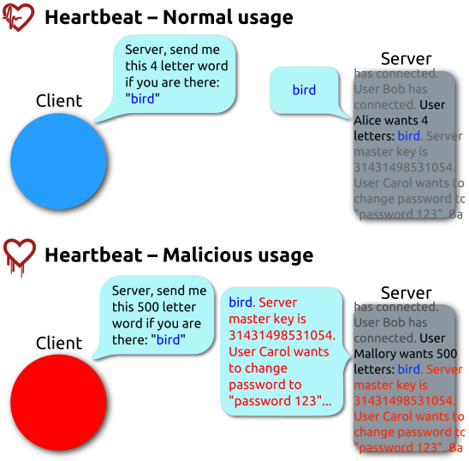
Heartbleed (2014)
Buffer over-read in OpenSSL
Open source security library
Bug in a small range of versions
“Heartbeat” packet
Specifies length of message
Server echoes it back
Library just “trusted” this length
Allowed attackers to read contents of memory anywhere they wanted
Est. 17% of Internet affected
“Catastrophic”
Github, Yahoo, Stack Overflow, Amazon AWS, ...
By FenixFeather - Own work, CC BY-SA 3.0, https://commons.wikimedia.org/w/index.php?curid=32276981

Slide 40
Dealing with buffer overflow attacks
Avoid overflow vulnerabilities
Employ system-level protections
Have compiler use “stack canaries”

Slide 41
1) Avoid Overflow Vulnerabilities in Code
/* Echo Line */ void echo() { char buf[8]; /* Way too small! */ fgets(buf, 8, stdin); puts(buf); }
Use library routines that limit string lengths
fgets instead of gets (2nd argument to fgets sets limit)
strncpy instead of strcpy
Don’t use scanf with %s conversion specification
Use fgets to read the string
Or use %ns where n is a suitable integer

Slide 42
2) System-Level Protections
High Addresses
Randomized stack offsets
At start of program, allocate random amount of space on stack
Shifts stack addresses for entire program
Addresses will vary from one run to another
Makes it difficult for hacker to predict beginning of inserted code
Example: Code from Slide 6 executed 5 times; address of variable local =
0x7ffd19d3f8ac
0x7ffe8a462c2c
0x7ffe927c905c
0x7ffefd5c27dc
0x7fffa0175afc
Stack repositioned each time program executes
Random
allocation
main’s stack frame
Other functions’ stack frames
B?
pad
exploit
code
B?
Low Addresses

Slide 43
2) System-Level Protections
Non-executable code segments
In traditional x86, can mark region of memory as either “read-only” or “writeable”
Can execute anything readable
x86-64 added explicit “execute” permission
Stack marked as non-executable
Do NOT execute code in Stack, Static Data, or Heap regions
Hardware support needed
Stack after call
to gets()
foo
stack
frame
B
pad
data written
by gets()
bar
stack
frame
exploit
code
B
Any attempt to execute this code will fail

Slide 44
3) Stack Canaries
Basic Idea: place special value (“canary”) on stack just beyond buffer
Secret value known only to compiler
“After” buffer but before return address
Check for corruption before exiting function
GCC implementation (now default)
-fstack-protector
Code back on Slide 14 (buf-nsp) compiled with –fno-stack-protector flag
unix>./buf
Enter string: 12345678
12345678
unix> ./buf
Enter string: 123456789
*** stack smashing detected ***

Slide 45
Protected Buffer Disassembly (buf)
This is extra (non-testable) material
echo:
400607: sub $0x18,%rsp
40060b: mov %fs:0x28,%rax
400614: mov %rax,0x8(%rsp)
400619: xor %eax,%eax
... ... call printf ...
400625: mov %rsp,%rdi
400628: callq 400510 <gets@plt>
40062d: mov %rsp,%rdi
400630: callq 4004d0 <puts@plt>
400635: mov 0x8(%rsp),%rax
40063a: xor %fs:0x28,%rax
400643: jne 40064a <echo+0x43>
400645: add $0x18,%rsp
400649: retq
40064a: callq 4004f0 <__stack_chk_fail@plt>

Slide 46
Setting Up Canary
This is extra (non-testable) material
Before call to gets
Stack frame for call_echo
Return address (8 bytes)
Canary (8 bytes)
[7] | [6] | [5] | [4]
[3] | [2] | [1] | [0]
/* Echo Line */ void echo() { char buf[8]; /* Way too small! */ gets(buf); puts(buf); }
Segment register (don’t worry about it)
echo:
. . .
movq %fs:40, %rax # Get canary
movq %rax, 8(%rsp) # Place on stack
xorl %eax, %eax # Erase canary
. . .
buf
⟵%rsp

Slide 47
Checking Canary
This is extra (non-testable) material
After call to gets
Stack frame for call_echo
Return address (8 bytes)
Canary (8 bytes)
00 | 37 | 36 | 35
34 | 33 | 32 | 31
/* Echo Line */ void echo() { char buf[8]; /* Way too small! */ gets(buf); puts(buf); }
echo:
. . .
movq 8(%rsp), %rax # retrieve from Stack
xorq %fs:40, %rax # compare to canary
jne .L4 # if not same, FAIL
. . .
.L4: call __stack_chk_fail
buf
⟵%rsp
Input: 1234567

Slide 48
Summary
Avoid overflow vulnerabilities
Use library routines that limit string lengths
Employ system-level protections
Randomized Stack offsets
Code on the Stack is not executable
Have compiler use “stack canaries”

Slide 49
Where Is It?
Variable/Label | Section of Memory
big_array
global
huge_array
local
main
p1
*p1
useless

