Slide 1
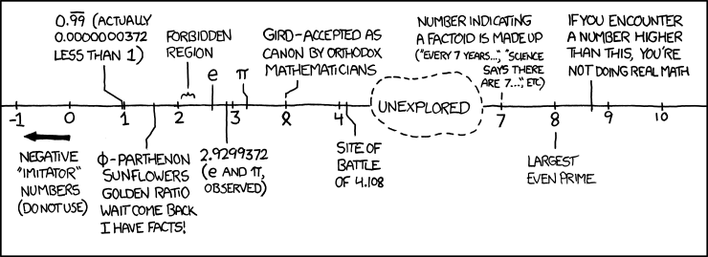
Floating Point II, x86-64 Intro CSE 351 Winter 2019
Instructors:
Max Willsey
Luis Ceze
Teaching Assistants:
Britt Henderson
Lukas Joswiak
Josie Lee
Wei Lin
Daniel Snitkovsky
Luis Vega
Kory Watson
Ivy Yu
http://xkcd.com/899/

Slide 2
Administrivia
Lab 1b due Friday (1/25)
Submit bits.c and lab1Breflect.txt
Homework 2 due next Friday (2/1)
On Integers, Floating Point, and x86-64
Section tomorrow on Integers and Floating Point

Slide 3
Denorm Numbers
This is extra (non-testable) material
Denormalized numbers (E = 0x00)
No leading 1
Uses implicit exponent of –126
Denormalized numbers close the gap between zero and the smallest normalized number
Smallest norm: ± 1.0…0_{two}×2⁻¹²⁶ = ± 2⁻¹²⁶
Smallest denorm: ± 0.0…01_{two}×2⁻¹²⁶ = ± 2⁻¹⁴⁹
There is still a gap between zero and the smallest denormalized number
So much closer to 0

Slide 4
Other Special Cases
E = 0xFF, M = 0: ± ∞
e.g. division by 0
Still work in comparisons!
E = 0xFF, M ≠ 0: Not a Number (NaN)
e.g. square root of negative number, 0/0, ∞–∞
NaN propagates through computations
Value of M can be useful in debugging
New largest value (besides ∞)?
E = 0xFF has now been taken!
E = 0xFE has largest: 1.1…1₂×2¹²⁷ = 2¹²⁸ – 2¹⁰⁴

Slide 5
Floating Point Encoding Summary
E | M | Meaning
0x00 | 0 | ± 0
0x00 | non-zero | ± denorm num
0x01 – 0xFE | anything | ± norm num
0xFF | 0 | ± ∞
0xFF | non-zero | NaN

Slide 6
Floating point topics
Fractional binary numbers
IEEE floating-point standard
Floating-point operations and rounding
Floating-point in C
There are many more details that we won’t cover
It’s a 58-page standard…
Notes:
Start by talking about representing fractional numbers in binary in general
Then about the IEEE Standard for floating point representation, operations,
Will not cover:
All the details of the 58-page spec
Or expect you to perform operations
Want to show you how floating point values are represented
To give you a sense of the kinds of things that can go wrong with them

Slide 7
Tiny Floating Point Representation
We will use the following 8-bit floating point representation to illustrate some key points:
Assume that it has the same properties as IEEE floating point:
bias =
encoding of $−0$ =
encoding of $+∞$ =
encoding of the largest (+) normalized # =
encoding of the smallest (+) normalized # =
S
E
M
1
4
3

Slide 8
Peer Instruction Question
Using our 8-bit representation, what value gets stored when we try to encode 2.625 = 2¹ + 2⁻¹ + 2⁻³?
+ 2.5
+ 2.625
+ 2.75
+ 3.25
We’re lost…
S
E
M
1
4
3

Slide 9
Peer Instruction Question
Using our 8-bit representation, what value gets stored when we try to encode 384 = 2⁸ + 2⁷?
+ 256
+ 384
+ $∞$
NaN
We’re lost…
S
E
M
1
4
3

Slide 10
Distribution of Values
What ranges are NOT representable?
Between largest norm and infinity
Between zero and smallest denorm
Between norm numbers?
Given a FP number, what’s the bit pattern of the next largest representable number?
What is this “step” when Exp = 0?
What is this “step” when Exp = 100?
Distribution of values is denser toward zero
Overflow (Exp too large)
Underflow (Exp too small)
Rounding

Slide 11
Floating Point Rounding
This is extra (non-testable) material
The IEEE 754 standard actually specifies different rounding modes:
Round to nearest, ties to nearest even digit
Round toward $+∞$ (round up)
Round toward $−∞$ (round down)
Round toward 0 (truncation)
In our tiny example:
Man = 1.001 01 rounded to M = 0b001
Man = 1.001 11 rounded to M = 0b010
Man = 1.001 10 rounded to M = 0b010
S
E
M
1
4
3

Slide 12
Floating Point Operations: Basic Idea
x +_{f} y = Round(x + y)
x *_{f} y = Round(x * y)
Basic idea for floating point operations:
First, compute the exact result
Then round the result to make it fit into the specificed precision (width of M)
Possibly over/underflow if exponent outside of range
Value = (-1)^{S}×Mantissa×2^{Exponent}
S
E
M
Notes:
We won’t be asking you to do these yourself, but seeing a bit about how it works will help you understand the ways in which it can go wrong, which we may ask you about

Slide 13
Mathematical Properties of FP Operations
Overflow yields $±∞$ and underflow yields $0$
Floats with value $±∞$ and NaN can be used in operations
Result usually still $±∞$ or NaN, but not always intuitive
Floating point operations do not work like real math, due to rounding
Not associative: (3.14+1e100)–1e100 != 3.14+(1e100–1e100)
0 3.14
Not distributive: 100*(0.1+0.2) != 100*0.1+100*0.2
30.000000000000003553 30
Not cumulative
Repeatedly adding a very small number to a large one may do nothing
Notes:
NaNs or infinity can taint results, spread through a numerical computations
Floating point operations are not like real mathematical operations
The same algebraic properties, associative, commutative, distributive, no longer work right

Slide 14
Floating point topics
Fractional binary numbers
IEEE floating-point standard
Floating-point operations and rounding
Floating-point in C
There are many more details that we won’t cover
It’s a 58-page standard…
Notes:
Start by talking about representing fractional numbers in binary in general
Then about the IEEE Standard for floating point representation, operations,
Will not cover:
All the details of the 58-page spec
Or expect you to perform operations
Want to show you how floating point values are represented
To give you a sense of the kinds of things that can go wrong with them

Slide 15
Floating Point in C
!!!
Two common levels of precision:
float 1.0f single precision (32-bit)
double 1.0 double precision (64-bit)
#include <math.h> to get INFINITY and NAN constants
Equality (==) comparisons between floating point numbers are tricky, and often return unexpected results, so just avoid them!

Slide 16
Floating Point Conversions in C
!!!
Casting between int, float, and double changes the bit representation
int $→$ float
May be rounded (not enough bits in mantissa: 23)
Overflow impossible
int or float $→$ double
Exact conversion (all 32-bit ints representable)
long $→$ double
Depends on word size (32-bit is exact, 64-bit may be rounded)
double or float $→$ int
Truncates fractional part (rounded toward zero)
“Not defined” when out of range or NaN: generally sets to Tmin (even if the value is a very big positive)

Slide 17
Peer Instruction Question
We execute the following code in C. How many bytes are the same (value and position) between i and f?
0 bytes
1 byte
2 bytes
3 bytes
We’re lost…
int i = 384; // 2^8 + 2^7
float f = (float) i;
Notes:
Purposely choose to skip this one. But do include solution in posted materials.

Slide 18
Floating Point and the Programmer
#include <stdio.h> int main(int argc, char* argv[]) { float f1 = 1.0; float f2 = 0.0; int i; for (i = 0; i < 10; i++) f2 += 1.0/10.0; printf("0x%08x 0x%08x\n", *(int*)&f1, *(int*)&f2); printf("f1 = %10.9f\n", f1); printf("f2 = %10.9f\n\n", f2); f1 = 1E30; f2 = 1E-30; float f3 = f1 + f2; printf("f1 == f3? %s\n", f1 == f3 ? "yes" : "no" );
return 0; }
$ ./a.out
0x3f800000 0x3f800001
f1 = 1.000000000
f2 = 1.000000119
f1 == f3? yes

Slide 19
Floating Point Summary
Floats also suffer from the fixed number of bits available to represent them
Can get overflow/underflow
“Gaps” produced in representable numbers means we can lose precision, unlike ints
Some “simple fractions” have no exact representation (e.g. 0.2)
“Every operation gets a slightly wrong result”
Floating point arithmetic not associative or distributive
Mathematically equivalent ways of writing an expression may compute different results
Never test floating point values for equality!
Careful when converting between ints and floats!

Slide 20
Number Representation Really Matters
1991: Patriot missile targeting error
clock skew due to conversion from integer to floating point
1996: Ariane 5 rocket exploded ($1 billion)
overflow converting 64-bit floating point to 16-bit integer
2000: Y2K problem
limited (decimal) representation: overflow, wrap-around
2038: Unix epoch rollover
Unix epoch = seconds since 12am, January 1, 1970
signed 32-bit integer representation rolls over to TMin in 2038
Other related bugs:
1982: Vancouver Stock Exchange 10% error in less than 2 years
1994: Intel Pentium FDIV (floating point division) HW bug ($475 million)
1997: USS Yorktown “smart” warship stranded: divide by zero
1998: Mars Climate Orbiter crashed: unit mismatch ($193 million)
Notes:
This is the part where I try to scare you…

Slide 21
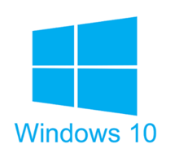
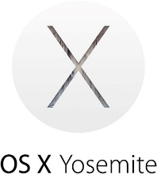
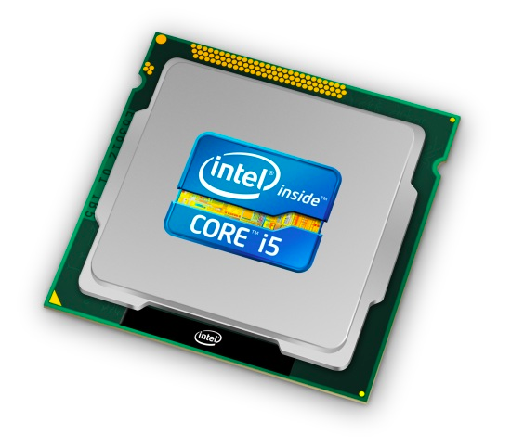
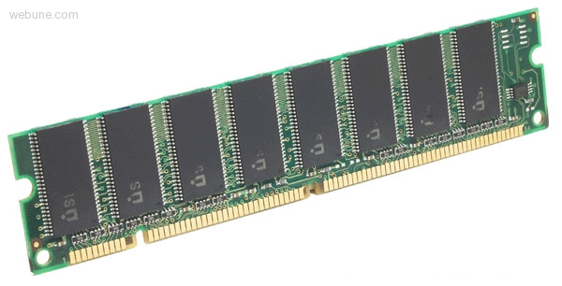
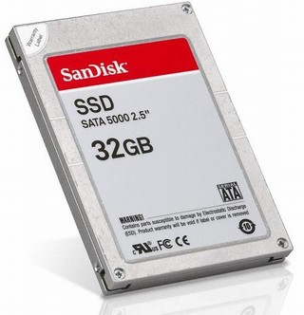
Roadmap
C:
Java:
Memory & data
Integers & floats
x86 assembly
Procedures & stacks
Executables
Arrays & structs
Memory & caches
Processes
Virtual memory
Memory allocation
Java vs. C
car *c = malloc(sizeof(car));
c->miles = 100;
c->gals = 17;
float mpg = get_mpg(c);
free(c);
Car c = new Car();
c.setMiles(100);
c.setGals(17);
float mpg = c.getMPG();
Assembly language:
get_mpg:
pushq %rbp
movq %rsp, %rbp
...
popq %rbp
ret
OS:
Machine code:
0111010000011000
100011010000010000000010
1000100111000010
110000011111101000011111
Computer system:

Slide 22
Architecture Sits at the Hardware Interface
Source code
Compiler
Architecture
Hardware
Different applications
or algorithms
Perform optimizations,
generate instructions
Instruction set
Different implementations
Intel Pentium 4
C Language
Program A
Intel Core 2
GCC
x86-64
Intel Core i7
Program B
AMD Opteron
Clang
AMD Athlon
Your program
ARMv8 (AArch64/A64)
ARM Cortex-A53
Apple A7
Notes:
Different programs written in C, have different algorithms
Compilers figure out what instructions to generate
do different optimizations
Different architectures expose different interfaces
Hardware implementations have different performance

Slide 23
Definitions
Architecture (ISA): The parts of a processor design that one needs to understand to write assembly code
“What is directly visible to software”
Microarchitecture: Implementation of the architecture
CSE/EE 469

Slide 24
Instruction Set Architectures
The ISA defines:
The system’s state (e.g. registers, memory, program counter)
The instructions the CPU can execute
The effect that each of these instructions will have on the system state
CPU
PC
Memory
Registers
Notes:
Textbook: “the format and behavior of a machine-level program is defined by the ISA, defining the processor state, the format of the instructions, and the effect each of these instructions will have on the state.”

Slide 25
Instruction Set Philosophies
Complex Instruction Set Computing (CISC): Add more and more elaborate and specialized instructions as needed
Lots of tools for programmers to use, but hardware must be able to handle all instructions
x86-64 is CISC, but only a small subset of instructions encountered with Linux programs
Reduced Instruction Set Computing (RISC): Keep instruction set small and regular
Easier to build fast hardware
Let software do the complicated operations by composing simpler ones

Slide 26
General ISA Design Decisions
Instructions
What instructions are available? What do they do?
How are they encoded?
Registers
How many registers are there?
How wide are they?
Memory
How do you specify a memory location?
Notes:
Registers: word size

Slide 27
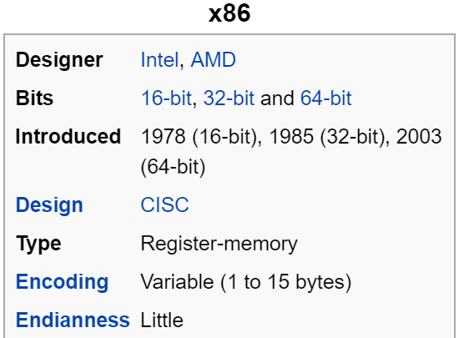
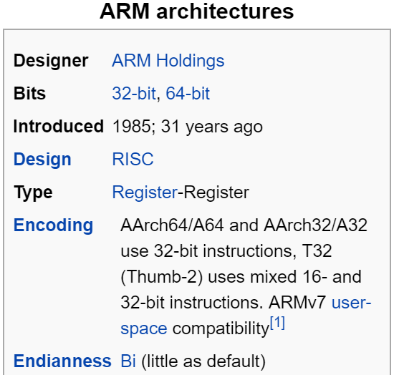
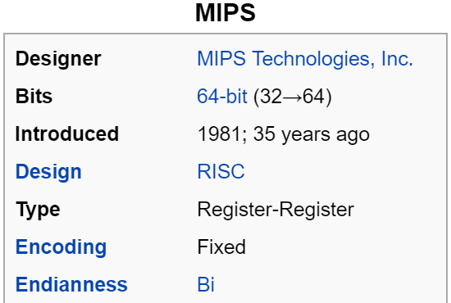
Mainstream ISAs
Macbooks & PCs
(Core i3, i5, i7, M)
x86-64 Instruction Set
Smartphone-like devices
(iPhone, iPad, Raspberry Pi)
ARM Instruction Set
Digital home & networking equipment
(Blu-ray, PlayStation 2)
MIPS Instruction Set
Notes:
x86 backwards-compatible all the way to 8086 architecture (introduced in 1978!), has had many, many new features added since.
x86 dominates the server, desktop, and laptop markets.
ARM stands for Advanced RISC Machine.
MIPS was originally an acronym for Microprocessor without Interlocked Pipeline Stages. Developed by MIPS Technologies (formerly MIPS Computer Systems, Inc).

Slide 28
Summary
Floating point encoding has many limitations
Overflow, underflow, rounding
Rounding is a HUGE issue due to limited mantissa bits and gaps that are scaled by the value of the exponent
Floating point arithmetic is NOT associative or distributive
Converting between integral and floating point data types does change the bits
x86-64 is a complex instruction set computing (CISC) architecture

