Slide 1
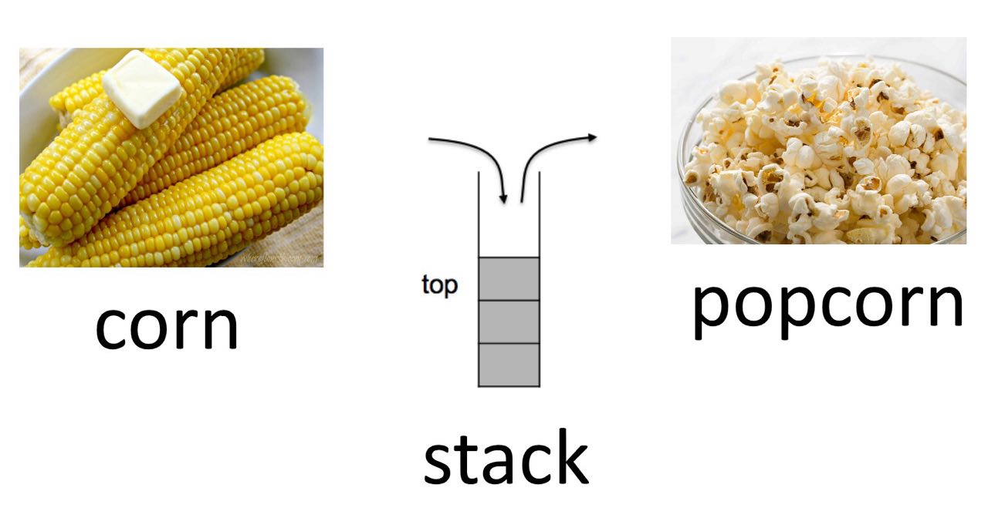
The Stack & Procedures CSE 351 Summer 2019
Instructor:
Sam Wolfson
Teaching Assistants:
Rehaan Bhimani Corbin Modica
Daniel Hsu

Slide 2
Administrivia
Homework 2 due TONIGHT Wednesday (7/17)
Lab 2 (x86-64) due Monday (7/22)
Homework 3, coming soon
On midterm material, but due after the midterm
Section tomorrow on Assembly and GDB
Bring your laptops!
Midterm (Fri 7/26, 10:50-11:50am)
You are allowed one double-sided, handwritten 8.5x11” sheet of notes
Find a study group! Look at past exams!
Review session: Wednesday, 7/24, 4-6pm, location TBD
Notes:
HW3 will be helpful for the midterm, but if your schedule is crazy you have some flexibility

Slide 3
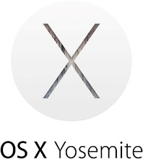
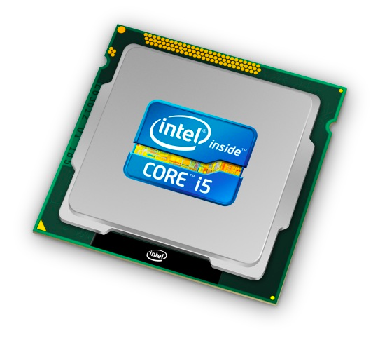
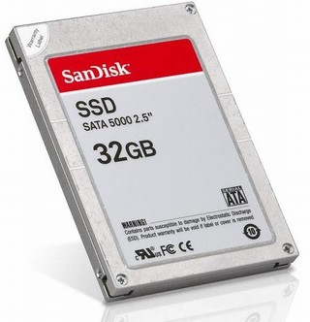
Roadmap
C:
Java:
Memory & data
Integers & floats
x86 assembly
Procedures & stacks
Executables
Arrays & structs
Memory & caches
Processes
Virtual memory
Memory allocation
Java vs. C
car *c = malloc(sizeof(car));
c->miles = 100;
c->gals = 17;
float mpg = get_mpg(c);
free(c);
Car c = new Car();
c.setMiles(100);
c.setGals(17);
float mpg = c.getMPG();
Assembly language:
get_mpg:
pushq %rbp
movq %rsp, %rbp
...
popq %rbp
ret
OS:
Machine code:
0111010000011000
100011010000010000000010
1000100111000010
110000011111101000011111
Computer system:
Notes:
How do we actually control what goes on in procedure calls with only assembly constructs?

Slide 4
Mechanisms required for procedures
Passing control
To beginning of procedure code
Back to return point
Passing data
Procedure arguments
Return value
Memory management
Allocate during procedure execution
De-allocate upon return
All implemented with machine instructions!
An x86-64 procedure uses only those mechanisms required for that procedure
P(…) {
•
•
y = Q(x);
print(y)
•
}
int Q(int i)
{
int t = 3*i;
int v[10];
•
•
return v[t];
}
Notes:
Here, p calls q.
How is this behavior implemented?
Control flow: how to jump to a procedure, then jump back?
Where to go, where to return?
Passing data: into a procedure? Returning results back?
How to keep track of memory used by a procedure?

Slide 5
Procedures
Stack Structure
Calling Conventions
Passing control
Passing data
Managing local data
Register Saving Conventions
Illustration of Recursion
Notes:
How is memory organized? We will focus on the stack right now.

Slide 6
Simplified Memory Layout
High Addresses
2^{N}-1
Stack
local variables; procedure context
Dynamic Data (Heap)
variables allocated with new or malloc
Memory Addresses
Static Data
static variables
(including global variables (C))
Literals
large constants (e.g. “example”)
Instructions
Low Addresses
program code
0
Notes:
Previously: memory is just one giant array of bytes.
Actually apply some type of organization to which regions store what data
Data types or use
LHS: names
RHS: what they hold
Focus on stack for now, heap will come later.
Lower 3 areas: static, size never changes during program.
Stack and heap: will change in size, so we use all the rest of the space for them.
Start them as far away as possible.
Grow towards each other to maximize space.

Slide 7
Memory Permissions
segmentation faults?
Stack
writable; not executable
Managed “automatically” (by compiler)
Dynamic Data (Heap)
writable; not executable
Managed by programmer
Static Data
writable; not executable
Initialized when process starts
Literals
read-only; not executable
Initialized when process starts
Instructions
read-only; executable
Initialized when process starts
Notes:
Static data initialized when prog starts
Heap managed by programmer
Stack usually automatic, but we’ll have to look at how it works in assembly
HW/OS enforces permissions on regions of memory
Will talk about it more later in the course
Example: wouldn’t want code to change during execution
Permissions can be different based on the data type
Segfaults: data that doesn’t exist yet, isn’t allocated, trying to write to RO, etc.
A little counterintuitive: stack grows downwards.

Slide 8
x86-64 Stack
High Addresses
Stack “Bottom”
Region of memory managed with stack “discipline”
Grows toward lower addresses
Customarily shown “upside-down”
Register %rsp contains lowest stack address
%rsp = address of top element, the most-recently-pushed item that is not-yet-popped
Increasing
Addresses
Stack Grows
Down
Stack Pointer: %rsp
Stack “Top”
Low Addresses
0x00…00
Notes:
Memory is still just an array
But we treat the upper part like a stack that grows downwards
Bottom of the stack has the highest address, top has the lowest adress
Special register rsp points at the lowest stack address, the top of the stack (still 8B, just happens to be address)
All conceptual, nothing actually different about it
Address will be the first thing to be popped off
To grow the stack: subtract from rsp
To shrink: add to rsp
Remember: stacks only have 2 operations: push and pop

Slide 9
x86-64 Stack: Push
High Addresses
Stack “Bottom”
pushq src
Fetch operand at src
Src can be reg, memory, immediate
Decrement %rsp by 8
Store value at address given by %rsp
Example:
pushq %rcx
Adjust %rsp and store contents of %rcx on the stack
Increasing
Addresses
Stack Grows
Down
Stack Pointer: %rsp
-8
Low Addresses
0x00…00
%rcx
Stack “Top”
Notes:
Two special instructions to deal with the stack and rsp
Size specifier: can push different sizes of things onto the stack
Push is single instruction, but actually does two things
Order matters! Don’t want to overwrite old data

Slide 10
x86-64 Stack: Pop
High Addresses
Stack “Bottom”
popq dst
Load value at address given by %rsp
Store value at dst
Increment %rsp by 8
Example:
popq %rcx
Stores contents of top of stack into %rcx and adjust %rsp
Increasing
Addresses
+8
Stack Grows
Down
Stack Pointer: %rsp
%rcx
Stack “Top”
Low Addresses
0x00…00
Those bits are still there; we’re just not using them.
Notes:
Same 2-part instruction, but opposite order
Read data off at address stored in %rsp
Then increment
Did not explicitly erase data!

Slide 11
Procedures
Stack Structure
Calling Conventions
Passing control
Passing data
Managing local data
Register Saving Conventions
Illustration of Recursion
Notes:
How procedures can use the stack to call one another?

Slide 12
Procedure Call Overview
Caller
procedures
…
<set up args>
call
<clean up args>
<find return val>
…
Callee
<create local vars>
…
<set up return val>
<destroy local vars>
ret
Callee must know where to find args
Callee must know where to find return address
Caller must know where to find return value
Caller and Callee run on same CPU, so use the same registers
How do we deal with register reuse?
Unneeded steps can be skipped (e.g. no arguments)
Notes:
Procedure doing the calling is the caller
The one called is the callee
A single procedure can be both a caller and a callee in different interactions
Return address: which code to return to in caller?

Slide 13
Procedure Call Overview
Caller
…
<save regs>
<set up args>
call
<clean up args>
<restore regs>
<find return val>
…
Callee
<save regs>
<create local vars>
…
<set up return val>
<destroy local vars>
<restore regs>
ret
The convention of where to leave/find things is called the calling convention (or procedure call linkage)
Details vary between systems
We will see the convention for x86-64/Linux in detail
What could happen if our program didn’t follow these conventions?
Notes:
Arbitrary decisions about where to put things and how to manage data.
If you write your own thing, you can do whatever you want, but…
If everyone doesn’t use the same conventions, then we can’t call each others’ libraries
We’ll discuss x86-64 on Linux.
Different arch/platforms will use different conventions but same idea.

Slide 14
Code Example (Preview)
void multstore
(long x, long y, long *dest) {
long t = mult2(x, y);
*dest = t;
}
Compiler Explorer:
https://godbolt.org/g/cKKDZn
0000000000400540 <multstore>:
400540: push %rbx # Save %rbx
400541: movq %rdx,%rbx # Save dest
400544: call 400550 <mult2> # mult2(x,y)
400549: movq %rax,(%rbx) # Save at dest
40054c: pop %rbx # Restore %rbx
40054d: ret # Return
long mult2
(long a, long b)
{
long s = a * b;
return s;
}
0000000000400550 <mult2>:
400550: movq %rdi,%rax # a
400553: imulq %rsi,%rax # a * b
400557: ret # Return
Notes:
Here we have a function, multstore, which calls another function, mult2
Look at call, specifies where to jump to (400550)
We’ll get to each of the details for this

Slide 15
Procedure Control Flow
Use stack to support procedure call and return
Procedure call: call label
Push return address on stack (why? which address?)
Jump to label
Notes:
How to go from multstore to mult2 and back again?
Specific instructions for procedure flow.
Return address tells callee where to return back to
Jump to label starting callee’s function

Slide 16
Procedure Control Flow
Use stack to support procedure call and return
Procedure call: call label
Push return address on stack (why? which address?)
Jump to label
Return address:
Address of instruction immediately after call instruction
Example from disassembly:
400544: callq 400550 <mult2>
400549: movq %rax,(%rbx)
Return address = 0x400549
Procedure return: ret
Pop return address from stack
Jump to address
400544: call 400550 <mult2>
400549: movq %rax,(%rbx)
next instruction
happens to be a move,
but could be anything
Notes:
What would happen if we stored 400544 as return address?
Infinite recursion!
Next instruction could be anything – just know that we’re done with call.
Ret is special pop
We know that call pushed return address on to stack
So ret pops it back off and jumps to there
Let’s see how this works with an example.

Slide 17
Procedure Call Example (step 1)
Memory
0000000000400540 <multstore>:
•
•
400544: call 400550 <mult2>
400549: movq %rax,(%rbx)
•
•
•
•
•
0x130
0x128
0x120
0000000000400550 <mult2>:
400550: movq %rdi,%rax
•
•
400557: ret
%rsp
0x120
%rip
0x400544
Notes:
Say we’re paused in our execution right before the call to mult2.
So PC points to this address.
Assume that stack ends at address 120.
Push return address on stack
(subtract 8 bytes) update %rsp -> 0x118
Store return address: 400549
Jump to new function
Update %rip (400550)
Now we’re in mult2, don’t care about the details, interested in return.

Slide 18
Procedure Call Example (step 2)
Memory
0000000000400540 <multstore>:
•
•
400544: call 400550 <mult2>
400549: movq %rax,(%rbx)
•
•
•
•
•
0x130
0x128
0x120
0x118
0x400549
0000000000400550 <mult2>:
400550: movq %rdi,%rax
•
•
400557: ret
%rsp
0x118
%rip
0x400550
Notes:
Now return address points at where we’ll jump back to
%rip is where we are executing now

Slide 19
Procedure Return Example (step 1)
Memory
0000000000400540 <multstore>:
•
•
400544: call 400550 <mult2>
400549: movq %rax,(%rbx)
•
•
•
•
•
0x130
0x128
0x120
0x118
0x400549
0000000000400550 <mult2>:
400550: movq %rdi,%rax
•
•
400557: ret
%rsp
0x118
%rip
0x400557
Notes:
Now, after we’ve executed this function, we’re at the ret
Pop return address
read return address 500549, pop into rip
increment %rsp to 120
Jump back to return address
update %rip with return address
execute again starting there
Stack looks identical to before the call (intentional!)
Cleaned itself up.

Slide 20
Procedure Return Example (step 2)
Memory
0000000000400540 <multstore>:
•
•
400544: call 400550 <mult2>
400549: movq %rax,(%rbx)
•
•
•
•
•
0x130
0x128
0x120
0000000000400550 <mult2>:
400550: movq %rdi,%rax
•
•
400557: ret
%rsp
0x120
%rip
0x400549

Slide 21
Procedures
Stack Structure
Calling Conventions
Passing control
Passing data
Managing local data
Register Saving Conventions
Illustration of Recursion
Notes:
Again, arbitrary conventions.

Slide 22
Procedure Data Flow
Registers (NOT in Memory) Stack (Memory)
First 6 arguments
Return value
High Addresses
%rdi
Diane’s
Silk
Dress
Costs
$8 9
• • •
%rsi
Arg n
%rdx
• • •
%rcx
%r8
Arg 8
%r9
Arg 7
Low Addresses
0x00…00
%rax
Only allocate stack space when needed
Notes:
How to we pass arguments from a caller to a callee, and pass return values back?
If your procedure requires > 6 arguments, put them on the stack in reverse order
This is on your reference sheet.

Slide 23
x86-64 Return Values
By convention, values returned by procedures are placed in %rax
Choice of %rax is arbitrary
Caller must make sure to save the contents of %rax before calling a callee that returns a value
Part of register-saving convention
Callee places return value into %rax
Any type that can fit in 8 bytes – integer, float, pointer, etc.
For return values greater than 8 bytes, best to return a pointer to them
Upon return, caller finds the return value in %rax
Notes:
Return value overwrites rax! What if caller needs that value later?
Caller-saved vs callee-saved registers
Will talk about this more later
What if larger than 8 bytes:
There’s some other part of the calling convention that dictates what to do
Spoiler alert: usually it’s on the stack

Slide 24
Data Flow Examples
void multstore
(long x, long y, long *dest) {
long t = mult2(x, y);
*dest = t;
}
0000000000400540 <multstore>:
# x in %rdi, y in %rsi, dest in %rdx
• • •
400541: movq %rdx,%rbx # Save dest
400544: call 400550 <mult2> # mult2(x,y)
# t in %rax
400549: movq %rax,(%rbx) # Save at dest
• • •
long mult2
(long a, long b)
{
long s = a * b;
return s;
}
0000000000400550 <mult2>:
# a in %rdi, b in %rsi
400550: movq %rdi,%rax # a
400553: imulq %rsi,%rax # a * b
# s in %rax
400557: ret # Return
Notes:
Multstore has three arguments: rdi, rsi, rdx
But now multstore calls mult2, whose params are in the same order
So no need to move data around
Don’t need to save data because we won’t use x or y after mult2 returns
but, we do need to save %rdx, need it after mult2
We don’t know how mult2 is implemented, so we’ll need to save rdx somehow.
Normally would need to set up arguments, but since the order is already correct, we’re good.
In mult2, do the mult and store the result in rax

Slide 25
Procedures
Stack Structure
Calling Conventions
Passing control
Passing data
Managing local data
Register Saving Conventions
Illustration of Recursion

Slide 26
Stack-Based Languages
Languages that support recursion
e.g. C, Java, most modern languages
Code must be re-entrant
Multiple simultaneous instantiations of single procedure
Need some place to store state of each instantiation
Arguments, local variables, return address
Stack allocated in frames
State for a single procedure instantiation
Stack discipline
State for a given procedure needed for a limited time
Starting from when it is called to when it returns
Callee always returns before caller does
Notes:
Re-entrant means we need to be able to call the same function more than once
Multiple instances of the same code running simultaneously
Could be from within the function! or from another called function
Execute a new copy
Each time we call it, need somewhere to keep the local variables, and arguments
Split up the stack into “frames” – one frame holds entire procedural context for one instance of a function
”Stack discipline”: need to clean up before returning
Example of call chain.

Slide 27
Call Chain Example
Example
Call Chain
yoo(…)
{
•
•
who();
•
•
}
yoo
who(…)
{
•
amI();
•
amI();
•
}
who
amI(…)
{
•
if(…){
amI()
}
•
}
amI
amI
amI
amI
Procedure amI is recursive (calls itself)
Notes:
Yoo calls who calls amI twice; amI is conditionally recursive.
Suppose first call to amI recurses twice, second call does not recurse.

Slide 28
1) Call to yoo
Stack
yoo
yoo
yoo(…)
{
•
•
who();
•
•
}
who
%rbp
amI
amI
%rsp
amI
amI
Notes:
Suppose main called yoo(), then the function above yoo is main and stack frame corresponds to it.
Historical: rbp is the frame pointer, not always used now but will give you the top of the stack frame.

Slide 29
2) Call to who
Stack
yoo
yoo
who
yoo(…)
{
•
•
who();
•
•
}
who(…)
{
•
amI();
•
amI();
•
}
who
amI
amI
%rbp
amI
%rsp
amI
Notes:
New stack frame allocated for who (can push/pop local variables)

Slide 30
3) Call to amI (1)
Stack
yoo
yoo
who
amI₁
yoo(…)
{
•
•
who();
•
•
}
who(…)
{
•
amI();
•
amI();
•
}
amI(…)
{
•
if(){
amI()
}
•
}
who
amI
amI
amI
%rbp
amI
%rsp

Slide 31
4) Recursive call to amI (2)
Stack
yoo
yoo
who
amI₁
amI₂
yoo(…)
{
•
•
who();
•
•
}
who(…)
{
•
amI();
•
amI();
•
}
amI(…)
{
•
if(){
amI()
}
•
}
who
amI(…)
{
•
if(){
amI()
}
•
}
amI
amI
amI
amI
%rbp
%rsp
Notes:
amI recurses three times – same code but multiple instances on the stack.

Slide 32
5) (another) Recursive call to amI (3)
Stack
yoo
yoo
who
amI₁
amI₂
amI₃
yoo(…)
{
•
•
who();
•
•
}
who(…)
{
•
amI();
•
amI();
•
}
amI(…)
{
•
if(){
amI()
}
•
}
who
amI(…)
{
•
if(){
amI()
}
•
}
amI(…)
{
•
if(){
amI()
}
•
}
amI
amI
amI
amI
%rbp
%rsp
Notes:
Let’s say this time, the if condition is false, so we don’t recurse again

Slide 33
6) Return from (another) recursive call to amI
Stack
yoo
yoo
who
amI₁
amI₂
amI₃
yoo(…)
{
•
•
who();
•
•
}
who(…)
{
•
amI();
•
amI();
•
}
amI(…)
{
•
if(){
amI()
}
•
}
who
amI(…)
{
•
if(){
amI()
}
•
}
amI
amI
amI
amI
%rbp
%rsp
Notes:
Start popping our way back up the stack frames

Slide 34
7) Return from recursive call to amI
Stack
yoo
yoo
who
amI₁
amI₂
amI₃
yoo(…)
{
•
•
who();
•
•
}
who(…)
{
•
amI();
•
amI();
•
}
amI(…)
{
•
if(){
amI()
}
•
}
who
amI
amI
amI
%rbp
amI
%rsp
Notes:
Notice data is still there in memory, just not used for anything.

Slide 35
8) Return from call to amI
Stack
yoo
yoo
who
amI₁
amI₂
amI₃
yoo(…)
{
•
•
who();
•
•
}
who(…)
{
•
amI();
•
amI();
•
}
who
amI
amI
%rbp
amI
%rsp
amI
Notes:
At this point, we’re back up to who, which calls amI twice
The old data from amI is still there, but will be overwritten by a new stack frame
Dangerous to use stack data from functions that have returned

Slide 36
9) (second) Call to amI (4)
Stack
yoo
yoo
who
amI₄
amI₂
amI₃
yoo(…)
{
•
•
who();
•
•
}
who(…)
{
•
amI();
•
amI();
•
}
amI(…)
{
•
if(){
amI()
}
•
}
who
amI
amI
amI
%rbp
amI
%rsp
Notes:
Looks similar to Step 3, but it’s NOT!
Let’s assume if condition is false.

Slide 37
10) Return from (second) call to amI
Stack
yoo
yoo
who
amI₄
amI₂
amI₃
yoo(…)
{
•
•
who();
•
•
}
who(…)
{
•
amI();
•
amI();
•
}
who
amI
amI
%rbp
amI
%rsp
amI

Slide 38
11) Return from call to who
Stack
yoo
yoo
who
amI₄
amI₂
amI₃
yoo(…)
{
•
•
who();
•
•
}
who
%rbp
amI
amI
%rsp
amI
amI
Notes:
How many total stack frame created?
Including main: 7
Total depth?
Including main: 6

Slide 39
x86-64/Linux Stack Frame
Caller’s Stack Frame
Extra arguments (if > 6 args) for this call
Current/Callee Stack Frame
Return address
Pushed by call instruction
Old frame pointer (optional)
Saved register context (when reusing registers)
Local variables (If can’t be kept in registers)
“Argument build” area (If callee needs to call another function -parameters for function about to call, if needed)
Caller
Frame
Arguments
7+
Frame pointer %rbp
Return Addr
Old %rbp
(Optional)
Saved
Registers
+
Local
Variables
Argument
Build
(Optional)
Stack pointer
%rsp
Notes:
Note: CSAPP considers the Return Address to be part of the Caller’s stack frame. (e.g. page 240)
WE will instead follow what is described in the Intel docs:
Separation between caller and callee is between args and return address
Return address is first spot in the callee’s stack frame
After that, can store whatever we want on the stack (local variables, arg build, etc)
http://refspecs.linux-foundation.org/elf/x86_64-abi-0.95.pdf#page=16
http://www.sco.com/developers/devspecs/abi386-4.pdf#page=36
http://refspecs.linuxfoundation.org/lsb.shtml

Slide 40
Peer Instruction Question
Vote only on 3rd question at http://pollev.com/wolfson
Answer the following questions about when main() is run (assume x and y stored on the Stack):
Higher/larger address: x or y?
How many total stack frames are created?
What is the maximum depth (# of frames) of the Stack?
int main() {
int i, x = 0;
for(i = 0; i < 3; i++)
x = randSum(x);
printf(“x = %d\n”, x);
return 0;
}
int randSum(int n) {
int y = rand() % 20;
return n + y;
}
A. 1 B. 2 C. 3 D. 4
Notes:
Main → randSum → rand
randSum called multiple times, but in a loop, so each additional call doesn’t actually increase the depth
Answer: C

