Slide 1
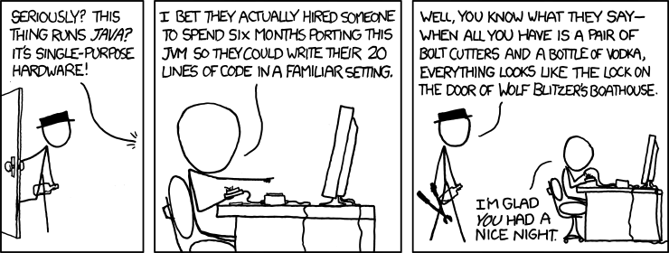
Java and C CSE 351 Spring 2019
Instructor: Teaching Assistants:
Ruth Anderson Gavin Cai Jack Eggleston John Feltrup Britt Henderson Richard Jiang Jack Skalitzky
Sophie Tian Connie Wang Sam Wolfson
Casey Xing Chin Yeoh
https://xkcd.com/801/

Slide 2
Administrivia
Lab 5, due Friday (6/7)
Memory Allocation
Recommended that you watch the Lab 5 helper videos
Sunday 6/9 is last day Lab 5 may be submitted (if one late day is used)
Final Exam: Wed, 6/12, 12:30-2:20 pm in KNE 130
Course evaluations now open, please fill out!

Slide 3
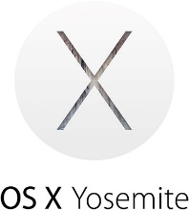
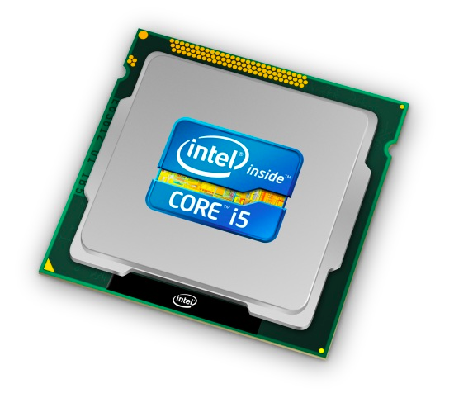
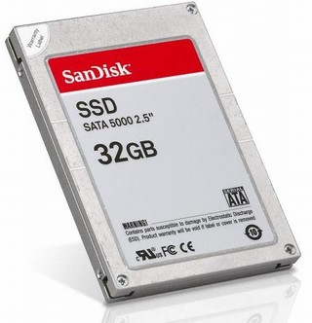
Roadmap
C:
Java:
Memory & data
Integers & floats
x86 assembly
Procedures & stacks
Executables
Arrays & structs
Memory & caches
Processes
Virtual memory
Memory allocation
Java vs. C
car *c = malloc(sizeof(car));
c->miles = 100;
c->gals = 17;
float mpg = get_mpg(c);
free(c);
Car c = new Car();
c.setMiles(100);
c.setGals(17);
float mpg = c.getMPG();
Assembly language:
get_mpg:
pushq %rbp
movq %rsp, %rbp
...
popq %rbp
ret
OS:
Machine code:
0111010000011000
100011010000010000000010
1000100111000010
110000011111101000011111
Computer system:

Slide 4
Java vs. C
Reconnecting to Java (hello CSE143!)
But now you know a lot more about what really happens when we execute programs
We’ve learned about the following items in C; now we’ll see what they look like for Java:
Representation of data
Pointers / references
Casting
Function / method calls including dynamic dispatch

Slide 5
Worlds Colliding
CSE351 has given you a “really different feeling” about what computers do and how programs execute
We have occasionally contrasted to Java, but CSE143 may still feel like “a different world”
It’s not – it’s just a higher-level of abstraction
Connect these levels via how-one-could-implement-Java in 351 terms

Slide 6
Meta-point to this lecture
None of the data representations we are going to talk about are guaranteed by Java
In fact, the language simply provides an abstraction (Java language specification)
Tells us how code should behave for different language constructs, but we can't easily tell how things are really represented
But it is important to understand an implementation of the lower levels – useful in thinking about your program

Slide 7
Data in Java
Integers, floats, doubles, pointers – same as C
“Pointers” are called “references” in Java, but are much more constrained than C’s general pointers
Java’s portability-guarantee fixes the sizes of all types
Example: int is 4 bytes in Java regardless of machine
No unsigned types to avoid conversion pitfalls
Added some useful methods in Java 8 (also use bigger signed types)
null is typically represented as 0 but “you can’t tell”
Much more interesting:
Arrays
Characters and strings
Objects

Slide 8
Data in Java: Arrays
Every element initialized to 0 or null
Length specified in immutable field at start of array (int – 4 bytes)
array.length returns value of this field
Since it has this info, what can it do?
C:
int array[5];
??
??
??
??
??
0
4
20
Java:
int[] array = new int[5];
5
00
00
00
00
00
0
4
20
24

Slide 9
Data in Java: Arrays
Every element initialized to 0 or null
Length specified in immutable field at start of array (int – 4 bytes)
array.length returns value of this field
Every access triggers a bounds-check
Code is added to ensure the index is within bounds
Exception if out-of-bounds
C:
int array[5];
To speed up bounds-checking:
Length field is likely in cache
Compiler may store length field in register for loops
Compiler may prove that some checks are redundant
??
??
??
??
??
0
4
20
Java:
int[] array = new int[5];
5
00
00
00
00
00
0
4
20
24

Slide 10
Data in Java: Characters & Strings
Two-byte Unicode instead of ASCII
Represents most of the world’s alphabets
String not bounded by a ‘\0’ (null character)
Bounded by hidden length field at beginning of string
All String objects read-only (vs. StringBuffer)
Example: the string “CSE351”
C:
(ASCII)
43
53
45
33
35
31
\0
0
1
4
7
Java:
(Unicode)
6
43
00
53
00
45
00
33
00
35
00
31
00
0
4
8
16
Notes:
Unicode in C: http://www.cprogramming.com/tutorial/unicode.html
UTF-16: http://www.oracle.com/us/technologies/java/supplementary-142654.html

Slide 11
Data in Java: Objects
Data structures (objects) are always stored by reference, never stored “inline”
Include complex data types (arrays, other objects, etc.) using references
C:
a[] stored “inline” as part of struct
Java:
a stored by reference in object
struct rec {
int i;
int a[3];
struct rec *p;
};
class Rec {
int i;
int[] a = new int[3];
Rec p; ...
}
i
a
p
i
a
p
0
4
12
20
0
4
16
24
3
0
4
16

Slide 12
Pointer/reference fields and variables
In C, we have “->” and “.” for field selection depending on whether we have a pointer to a struct or a struct
(*r).a is so common it becomes r->a
In Java, all non-primitive variables are references to objects
We always use r.a notation
But really follow reference to r with offset to a, just like r->a in C
So no Java field needs more than 8 bytes
C:
Java:
struct rec *r = malloc(...);
struct rec r2;
r->i = val;
r->a[2] = val;
r->p = &r2;
r = new Rec();
r2 = new Rec();
r.i = val;
r.a[2] = val;
r.p = r2;

Slide 13
Pointers/References
Pointers in C can point to any memory address
References in Java can only point to [the starts of] objects
Can only be dereferenced to access a field or element of that object
C:
Java:
struct rec {
int i;
int a[3];
struct rec *p;
};
struct rec* r = malloc(…);
some_fn(&(r->a[1])); // ptr
class Rec {
int i;
int[] a = new int[3];
Rec p;
}
Rec r = new Rec();
some_fn(r.a, 1); // ref, index
r
r
i
a
p
X
i
a
p
0
4
12
20
0
4
16
24
3
int[3]
0
4
16
Notes:
http://programmers.stackexchange.com/questions/141834/how-is-a-java-reference-different-from-a-c-pointer

Slide 14
Casting in C (example from Lab 5)
Can cast any pointer into any other pointer
Changes dereference and arithmetic behavior
struct BlockInfo {
size_t sizeAndTags;
struct BlockInfo* next;
struct BlockInfo* prev;
};
typedef struct BlockInfo BlockInfo;
...
int x;
BlockInfo *b;
BlockInfo *newBlock;
...
newBlock = (BlockInfo *) ( (char *) b + x );
...
Cast b into char * to do unscaled addition
Cast back into BlockInfo * to use as BlockInfo struct
s
n
p
s
n
p
0
8
16
24
x
Notes:
Dereference behavior includes size of data pulled and interpretation of bits.

Slide 15
Type-safe casting in Java
Can only cast compatible object references
Based on class hierarchy
class Boat extends Vehicle {
int propellers;
}
class Object {
...
}
class Vehicle {
int passengers;
}
class Car extends Vehicle {
int wheels;
}
Vehicle v = new Vehicle(); // super class of Boat and Car
Boat b1 = new Boat(); // |--> sibling
Car c1 = new Car(); // |--> sibling
Vehicle v1 = new Car();
Vehicle v2 = v1;
Car c2 = new Boat();
Car c3 = new Vehicle();
Boat b2 = (Boat) v;
Car c4 = (Car) v2;
Car c5 = (Car) b1;

Slide 16
Type-safe casting in Java
Can only cast compatible object references
Based on class hierarchy
class Boat extends Vehicle {
int propellers;
}
class Object {
...
}
class Vehicle {
int passengers;
}
class Car extends Vehicle {
int wheels;
}
Vehicle v = new Vehicle(); // super class of Boat and Car
Boat b1 = new Boat(); // |--> sibling
Car c1 = new Car(); // |--> sibling
Vehicle v1 = new Car();
Vehicle v2 = v1;
Car c2 = new Boat();
Car c3 = new Vehicle();
Boat b2 = (Boat) v;
Car c4 = (Car) v2;
Car c5 = (Car) b1;
✓ Everything needed for Vehicle also in Car
✓ v1 is declared as type Vehicle
✗ Compiler error: Incompatible type – elements in Car that are not in Boat (siblings)
✗ Compiler error: Wrong direction – elements in Car not in Vehicle (wheels)
✗ Runtime error: Vehicle does not contain all elements in Boat (propellers)
✓ v2 refers to a Car at runtime
✗ Compiler error: Unconvertable types – b1 is declared as type Boat
Notes:
How do we implement/enforce this? (particularly with catching runtime errors)

Slide 17
Java Object Definitions
class Point { double x; double y;
Point() { x = 0; y = 0; }
boolean samePlace(Point p) { return (x == p.x) && (y == p.y);
} }
...
Point p = new Point();
...
fields
constructor
method(s)
creation

Slide 18
Java Objects and Method Dispatch
Point object
p
header
vtable ptr
x
y
vtable for class Point:
code for Point()
code for samePlace()
q
Point object
header
vtable ptr
x
y
Virtual method table (vtable)
Like a jump table for instance (“virtual”) methods plus other class info
One table per class
Object header : GC info, hashing info, lock info, etc.
Why no size?

Slide 19
Java Constructors
When we call new: allocate space for object (data fields and references), initialize to zero/null, and run constructor method
Java:
C pseudo-translation:
Point p = new Point();
Point* p = calloc(1,sizeof(Point));
p->header = ...;
p->vtable = &Point_vtable;
p->vtable[0](p);
Point object
p
header
vtable ptr
x
y
vtable for class Point:
code for Point()
code for samePlace()

Slide 20
Java Methods
Static methods are just like functions
Instance methods:
Can refer to this;
Have an implicit first parameter for this; and
Can be overridden in subclasses
The code to run when calling an instance method is chosen at runtime by lookup in the vtable
Java:
C pseudo-translation:
p.samePlace(q);
p->vtable[1](p, q);
p
Point object
header
vtable ptr
x
y
vtable for class Point:
code for Point()
code for samePlace()

Slide 21
Subclassing
class ThreeDPoint extends Point { double z; boolean samePlace(Point p2) { return false; } void sayHi() { System.out.println("hello"); } }
Where does “z” go? At end of fields of Point
Point fields are always in the same place, so Point code can run on ThreeDPoint objects without modification
Where does pointer to code for two new methods go?
No constructor, so use default Point constructor
To override “samePlace”, use same vtable position
Add new pointer at end of vtable for new method “sayHi”

Slide 22
Subclassing
class ThreeDPoint extends Point { double z; boolean samePlace(Point p2) { return false; } void sayHi() { System.out.println("hello"); } }
z tacked on at end
ThreeDPoint object
header
vtable ptr
x
y
z
sayHi tacked on at end
Code for sayHi
vtable for ThreeDPoint: (not Point)
constructor
samePlace
sayHi
Old code for constructor
New code for samePlace

Slide 23
Dynamic Dispatch
Point object
header
vtable ptr
x
y
Point vtable:
code for Point’s samePlace()
p ???
code for Point()
ThreeDPoint object
header
vtable ptr
x
y
z
code for sayHi()
ThreeDPoint vtable:
code for ThreeDPoint’s samePlace()
Java:
C pseudo-translation:
Point p = ???;
return p.samePlace(q);
// works regardless of what p is
return p->vtable[1](p, q);

Slide 24
Ta-da!
In CSE143, it may have seemed “magic” that an inherited method could call an overridden method
You were tested on this endlessly
The “trick” in the implementation is this part: p->vtable[i](p,q)
In the body of the pointed-to code, any calls to (other) methods of this will use p->vtable
Dispatch determined by p, not the class that defined a method

Slide 25
Practice Question
Assume: 64-bit pointers and that a Java object header is 8 B
What are the sizes of the things being pointed at by ptr_c and ptr_j?
struct c {
int i;
char s[3];
int a[3];
struct c *p;
};
struct c* ptr_c;
class jobj {
int i;
String s = "hi";
int[] a = new int[3];
jobj p;
}
jobj ptr_j = new jobj();

Slide 26
Implementing Programming Languages
Many choices in how to implement programming models
We’ve talked about compilation, can also interpret
Interpreting languages has a long history
Lisp, an early programming language, was interpreted
Interpreters are still in common use:
Python, Javascript, Ruby, Matlab, PHP, Perl, …
Interpreter implementation
Your source code
Your source code
Binary executable
Interpreter binary
Hardware
Hardware

Slide 27
An Interpreter is a Program
Execute (something close to) the source code directly
Simpler/no compiler – less translation
More transparent to debug – less translation
Easier to run on different architectures – runs in a simulated environment that exists only inside the interpreter process
Just port the interpreter (program), not the program-being-interpreted
Slower and harder to optimize
Interpreter implementation
Your source code
Interpreter binary

Slide 28
Interpreter vs. Compiler
An aspect of a language implementation
A language can have multiple implementations
Some might be compilers and other interpreters
“Compiled languages” vs. “Interpreted languages” a misuse of terminology
But very common to hear this
And has some validation in the real world (e.g. JavaScript vs. C)
Also, as about to see, modern language implementations are often a mix of the two. E.g. :
Compiling to a bytecode language, then interpreting
Doing just-in-time compilation of parts to assembly for performance

Slide 29
“The JVM”
Note: The JVM is different than the CSE VM running on VMWare. Yet another use of the word “virtual”!
Java programs are usually run by a Java virtual machine (JVM)
JVMs interpret an intermediate language called Java bytecode
Many JVMs compile bytecode to native machine code
Just-in-time (JIT) compilation
http://en.wikipedia.org/wiki/Just-in-time_compilation
Java is sometimes compiled ahead of time (AOT) like C
Notes:
http://en.wikipedia.org/wiki/Just-in-time_compilation

Slide 30
Compiling and Running Java
Save your Java code in a .java file
To run the Java compiler:
javac Foo.java
The Java compiler converts Java into Java bytecodes
Stored in a .class file
To execute the program stored in the bytecodes, Java bytecodes can be interpreted by a program (an interpreter)
For Java, this interpreter is called the Java Virtual Machine (the JVM)
To run the virtual machine:
java Foo
This Loads the contents of Foo.class and interprets the bytecodes

Slide 31
Virtual Machine Model
High-Level Language Program (e.g. Java, C)
Bytecode compiler (e.g. javac Foo.java)
Ahead-of-time compiler
compile time
Virtual Machine Language (e.g. Java bytecodes)
run time
Virtual machine (interpreter) (e.g. java Foo)
JIT compiler
Native Machine Language (e.g. x86, ARM, MIPS)

Slide 32
Java Bytecode
Holds pointer this
Like assembly code for JVM, but works on all JVMs
Hardware-independent!
Typed (unlike x86 assembly)
Strong JVM protections
Other arguments to method
Other local variables
0
1
2
3
4
n
variable table
operand stack
constant pool

Slide 33
JVM Operand Stack
Holds pointer this
Other arguments to method
Other local variables
JVM:
0
1
2
3
4
n
variable table
‘i’ = integer,
‘a’ = reference,
‘b’ for byte,
‘c’ for char,
‘d’ for double, ...
operand stack
constant
pool
Bytecode:
iload 1 // push 1st argument from table onto stack
iload 2 // push 2nd argument from table onto stack
iadd // pop top 2 elements from stack, add together, and // push result back onto stack
istore 3 // pop result and put it into third slot in table
Compiled
to (IA32) x86:
mov 8(%ebp), %eax
mov 12(%ebp), %edx
add %edx, %eax
mov %eax, -8(%ebp)
No registers or stack locations!
All operations use operand stack

Slide 34
A Simple Java Method
Method java.lang.String getEmployeeName()
0 aload 0 // "this" object is stored at 0 in the var table
1 getfield #5 <Field java.lang.String name>
// getfield instruction has a 3-byte encoding
// Pop an element from top of stack, retrieve its
// specified instance field and push it onto stack
// "name" field is the fifth field of the object
4 areturn // Returns object at top of stack
Byte number:
0
1
4
aload_0
getfield
00
05
areturn
As stored in the .class file:
2A
B4
00
05
B0
http://en.wikipedia.org/wiki/Java_bytecode_instruction_listings
Notes:
a prefix on aload, areturn indicates reference (see previous slide).
getfield is the bytecode instruction to get a field’s value for a particular object; to get a static value for a particular class, the getstatic bytecode instruction is used.

Slide 35
Class File Format
Every class in Java source code is compiled to its own class file
10 sections in the Java class file structure:
Magic number: 0xCAFEBABE (legible hex from James Gosling – Java’s inventor)
Version of class file format: The minor and major versions of the class file
Constant pool: Set of constant values for the class
Access flags: For example whether the class is abstract, static, final, etc.
This class: The name of the current class
Super class: The name of the super class
Interfaces: Any interfaces in the class
Fields: Any fields in the class
Methods: Any methods in the class
Attributes: Any attributes of the class (for example, name of source file, etc.)
A .jar file collects together all of the class files needed for the program, plus any additional resources (e.g. images)
Notes:
http://en.wikipedia.org/wiki/Java_class_file#Sections

Slide 36
Disassembled Java Bytecode
Compiled from Employee.java
class Employee extends java.lang.Object {
public Employee(java.lang.String,int);
public java.lang.String getEmployeeName();
public int getEmployeeNumber();
}
Method Employee(java.lang.String,int)
0 aload_0
1 invokespecial #3 <Method java.lang.Object()>
4 aload_0
5 aload_1
6 putfield #5 <Field java.lang.String name>
9 aload_0
10 iload_2
11 putfield #4 <Field int idNumber>
14 aload_0
15 aload_1
16 iload_2
17 invokespecial #6 <Method void storeData(java.lang.String, int)>
20 return
Method java.lang.String getEmployeeName()
0 aload_0
1 getfield #5 <Field java.lang.String name>
4 areturn
Method int getEmployeeNumber()
0 aload_0
1 getfield #4 <Field int idNumber>
4 ireturn
Method void storeData(java.lang.String, int)
…
> javac Employee.java
> javap -c Employee
http://en.wikipedia.org/wiki/Java_bytecode_instruction_listings
Notes:
The first opcode instruction at location 0, aload_0, pushes the this reference onto the operand stack. (Remember, the first entry of the local variable table for instance methods and constructors is this reference.)
The next opcode instruction at location 1, invokespecial, calls the constructor of this class's superclass. Because all classes that do not explicitly extend any other class implicitly inherit from java.lang.Object , the compiler provides the necessary bytecode to invoke this base class constructor. During this opcode, the top value from the operand stack, this, is popped.
The next two opcodes, at locations 4 and 5 push the first two entries from the local variable table onto the operand stack. The first value to be pushed is the this reference. The second value is the first formal parameter to the constructor, strName . These values are pushed in preparation for the putfield opcode instruction at location 6.
The putfield opcode pops the two top values off the stack and stores a reference to strName into the instance data name of the object referenced by this .
The next three opcode instructions at locations 9, 10, and 11 perform the same operation with the second formal parameter to the constructor, num , and the instance variable, idNumber .
The next three opcode instructions at locations 14, 15, and 16 prepare the stack for the storeData method call. These instructions push the this reference, strName , and num , respectively. The this reference must be pushed because an instance method is being called. If the method was declared static, the this reference would not need to be pushed. The strName and num values are pushed since they are the parameters to the storeData method. When the storeData method executes, the this reference, strName , and num , will occupy indexes 0, 1, and 2, respectively, of the local variable table contained in the frame for that method.

Slide 37
Other languages for JVMs
JVMs run on so many computers that compilers have been built to translate many other languages to Java bytecode:
AspectJ, an aspect-oriented extension of Java
ColdFusion, a scripting language compiled to Java
Clojure, a functional Lisp dialect
Groovy, a scripting language
JavaFX Script, a scripting language for web apps
JRuby, an implementation of Ruby
Jython, an implementation of Python
Rhino, an implementation of JavaScript
Scala, an object-oriented and functional programming language
And many others, even including C!
Originally, JVMs were designed and built for Java (still the major use) but JVMs are also viewed as a safe, GC’ed platform
Notes:
http://en.wikipedia.org/wiki/List_of_JVM_languages

Slide 38
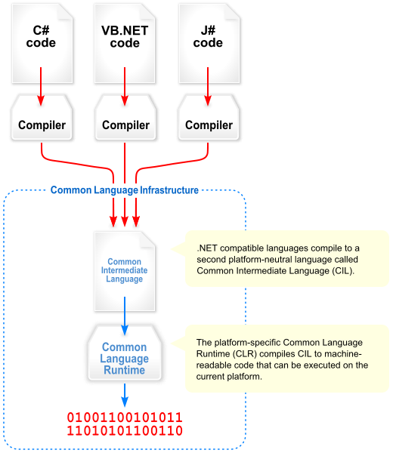
Microsoft’s C# and .NET Framework
C# has similar motivations as Java
Virtual machine is called the Common Language Runtime
Common Intermediate Language is the bytecode for C# and other languages in the .NET framework

Slide 39
We made it! ☺ 😎 😂
C:
Java:
Memory & data
Integers & floats
x86 assembly
Procedures & stacks
Executables
Arrays & structs
Memory & caches
Processes
Virtual memory
Memory allocation
Java vs. C
car *c = malloc(sizeof(car));
c->miles = 100;
c->gals = 17;
float mpg = get_mpg(c);
free(c);
Car c = new Car();
c.setMiles(100);
c.setGals(17);
float mpg = c.getMPG();
Assembly language:
get_mpg:
pushq %rbp
movq %rsp, %rbp
...
popq %rbp
ret
OS:
Machine code:
0111010000011000
100011010000010000000010
1000100111000010
110000011111101000011111
Computer system:

