Slide 1
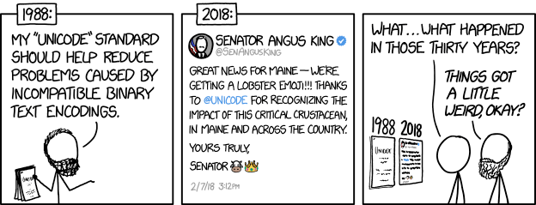
Integers II CSE 351 Autumn 2019
Instructor: Teaching Assistants:
Justin Hsia Andrew Hu Antonio Castelli Cosmo Wang
Diya Joy Ivy Yu Kaelin Laundry
Maurice Montag Melissa Birchfield Millicent Li
Suraj Jagadeesh
http://xkcd.com/1953/

Slide 2
Administrivia
hw4 due 10/7, hw5 due 10/9
Lab 1a due Monday (10/7)
Submit pointer.c and lab1Areflect.txt to Gradescope
Lab 1b released today, due 10/14
Bit puzzles on number representation
Can start after today’s lecture, but floating point will be introduced next week
Section worksheet from yesterday has helpful examples, too
Bonus slides at the end of today’s lecture have relevant examples

Slide 3
Extra Credit
All labs starting with Lab 1b have extra credit portions
These are meant to be fun extensions to the labs
Extra credit points don't affect your lab grades
From the course policies: “they will be accumulated over the course and will be used to bump up borderline grades at the end of the quarter.”
Make sure you finish the rest of the lab before attempting any extra credit

Slide 4
Integers
Binary representation of integers
Unsigned and signed
Casting in C
Consequences of finite width representations
Overflow, sign extension
Shifting and arithmetic operations
Notes:
4

Slide 5
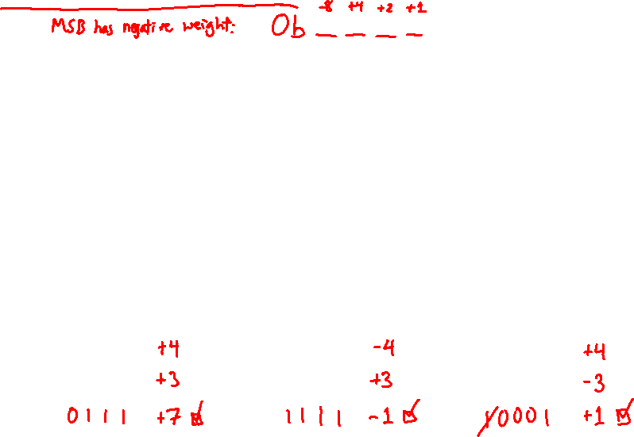
Two’s Complement Arithmetic
The same addition procedure works for both unsigned and two’s complement integers
Simplifies hardware: only one algorithm for addition
Algorithm: simple addition, discard the highest carry bit
Called modular addition: result is sum modulo $2^{w}$
4-bit Examples:
HW. | TC.
0100 +0011 | 4 +3
= 0111 | = 7
HW. | TC. |  | HW. | TC.
1100 +0011 | -4 +3 |  | 0100 +1101 | 4 -3
= 1111 | =-1 |  | =10001 | = 1
Notes:
Ask class to help with math
Drop the carry!

Slide 6
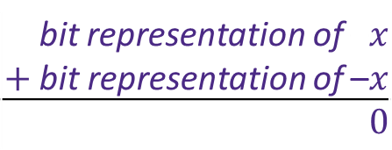
Why Does Two’s Complement Work?
For all representable positive integers $x$, we want:
What are the 8-bit negative encodings for the following?
bit representation of –$x$ $+$ bit representation of –$x$
$0$
(ignoring the carry-out bit)
00000001 + ????????
00000000
00000010 + ????????
00000000
11000011 + ????????
00000000

Slide 7
Why Does Two’s Complement Work?
For all representable positive integers $x$, we want:
What are the 8-bit negative encodings for the following?
bit representation of –$x$ $+$ bit representation of –$x$
$0$
(ignoring the carry-out bit)
00000001 + 11111111
100000000
00000010 + 11111110
100000000
11000011 + 00111101
100000000
These are the bitwise complement plus 1!
-x == ~x + 1

Slide 8
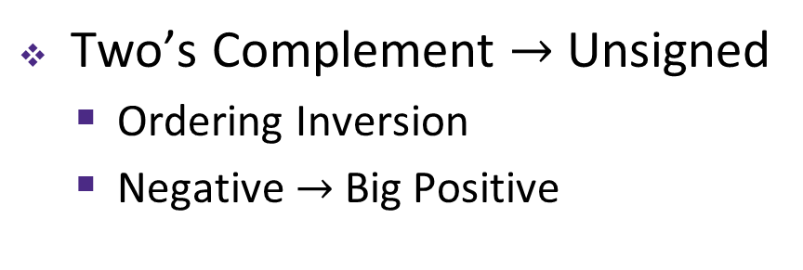
Signed/Unsigned Conversion Visualized
Two’s Complement $→$ Unsigned
Ordering Inversion
Negative $→$ Big Positive
UMax
UMax – 1
TMax + 1
Unsigned
Range
TMax
TMax
2’s Complement Range
0
0/UMin
–1
–2
TMin
Notes:
Tmax = Two’s complement max value
Umax = Unsigned max value

Slide 9

Values To Remember
Unsigned Values
UMin = 0b00…0 = $0$
UMax = 0b11…1 = $2^{w}−1$
Example: Values for $w=64$
Two’s Complement Values
TMin = 0b10…0 = $−2^{w−1}$
TMax = 0b01…1 = $2^{w−1}−1$
$−1$ = 0b11…1
 | Decimal | Hex
UMax | 18,446,744,073,709,551,615 | FF FF FF FF FF FF FF FF
TMax | 9,223,372,036,854,775,807 | 7F FF FF FF FF FF FF FF
TMin | -9,223,372,036,854,775,808 | 80 00 00 00 00 00 00 00
-1 | -1 | FF FF FF FF FF FF FF FF
0 | 0 | 00 00 00 00 00 00 00 00

Slide 10
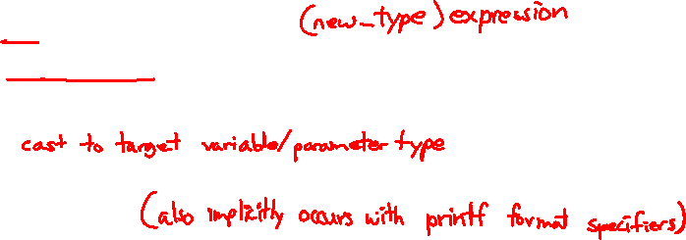
In C: Signed vs. Unsigned
Casting
Bits are unchanged, just interpreted differently!
int tx, ty;
unsigned int ux, uy;
Explicit casting
tx = (int) ux;
uy = (unsigned int) ty;
Implicit casting can occur during assignments or function calls
tx = ux;
uy = ty;
Notes:
These are user-chosen names, there is nothing special about starting your variable name with ‘t’ or ‘u’.
Natural language analogy: written “chat” means “to talk” in English or “cat” in French.

Slide 11
Casting Surprises
!!!
Integer literals (constants)
By default, integer constants are considered signed integers
Hex constants already have an explicit binary representation
Use “U” (or “u”) suffix to explicitly force unsigned
Examples: 0U, 4294967259u
Expression Evaluation
When you mixed unsigned and signed in a single expression, then signed values are implicitly cast to unsigned
Including comparison operators <, >, ==, <=, >=

Slide 12
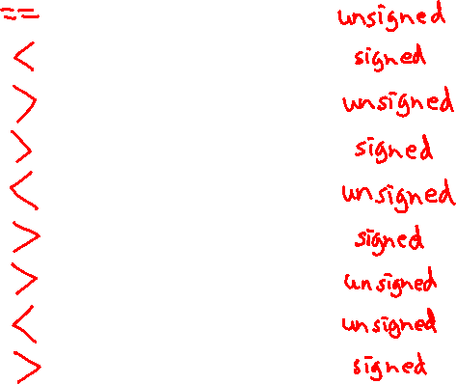
Casting Surprises
!!!
32-bit examples:
TMin = -2,147,483,648, TMax = 2,147,483,647
Left Constant | Order | Right Constant | Interpretation
0 0000 0000 0000 0000 0000 0000 0000 0000 |  | 0U 0000 0000 0000 0000 0000 0000 0000 0000
-1 1111 1111 1111 1111 1111 1111 1111 1111 |  | 0 0000 0000 0000 0000 0000 0000 0000 0000
-1 1111 1111 1111 1111 1111 1111 1111 1111 |  | 0U 0000 0000 0000 0000 0000 0000 0000 0000
2147483647 0111 1111 1111 1111 1111 1111 1111 1111 |  | -2147483648 1000 0000 0000 0000 0000 0000 0000 0000
2147483647U 0111 1111 1111 1111 1111 1111 1111 1111 |  | -2147483648 1000 0000 0000 0000 0000 0000 0000 0000
-1 1111 1111 1111 1111 1111 1111 1111 1111 |  | -2 1111 1111 1111 1111 1111 1111 1111 1110
(unsigned) -1 1111 1111 1111 1111 1111 1111 1111 1111 |  | -2 1111 1111 1111 1111 1111 1111 1111 1110
2147483647 0111 1111 1111 1111 1111 1111 1111 1111 |  | 2147483648U 1000 0000 0000 0000 0000 0000 0000 0000
2147483647 0111 1111 1111 1111 1111 1111 1111 1111 |  | (int) 2147483648U 1000 0000 0000 0000 0000 0000 0000 0000
Notes:
These all evaluate to TRUE (the Order indicates the correct ordering).

Slide 13
Integers
Binary representation of integers
Unsigned and signed
Casting in C
Consequences of finite width representations
Overflow, sign extension
Shifting and arithmetic operations
Notes:
13

Slide 14
Arithmetic Overflow
Bits | Unsigned | Signed
0000 | 0 | 0
0001 | 1 | 1
0010 | 2 | 2
0011 | 3 | 3
0100 | 4 | 4
0101 | 5 | 5
0110 | 6 | 6
0111 | 7 | 7
1000 | 8 | -8
1001 | 9 | -7
1010 | 10 | -6
1011 | 11 | -5
1100 | 12 | -4
1101 | 13 | -3
1110 | 14 | -2
1111 | 15 | -1
When a calculation produces a result that can’t be represented in the current encoding scheme
Integer range limited by fixed width
Can occur in both the positive and negative directions
C and Java ignore overflow exceptions
You end up with a bad value in your program and no warning/indication… oops!

Slide 15
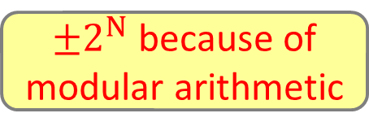
Overflow: Unsigned
Addition: drop carry bit ($−2^{N}$)
Subtraction: borrow ($+2^{N}$)
15
+ 2
17
1
1111
+ 0010
10001
15
0
14
1111
0000
1
13
1110
0001
2
1101
0010
12
1100
0011
3
Unsigned
11
1011
0100
4
1
- 2
-1
15
10001
- 0010
1111
1010
0101
10
1001
0110
5
9
1000
0111
6
8
7
$±2^{N}$ because of
modular arithmetic

Slide 16
Overflow: Two’s Complement
Addition: ($+$) + ($+$) = ($−$) result?
Subtraction: ($−$) + ($−$) = ($+$)?
6
+ 3
9
-7
0110
+ 0011
1001
– 1
0
– 2
1111
0000
+ 1
– 3
1110
0001
+ 2
1101
0010
– 4
1100
Two’s Complement
0011
+ 3
– 5
1011
0100
+ 4
-7
- 3
-10
6
1001
- 0011
0110
1010
0101
– 6
1001
0110
+ 5
– 7
1000
0111
+ 6
– 8
+ 7
For signed: overflow if operands have same sign and result’s sign is different

Slide 17
Sign Extension
What happens if you convert a signed integral data type to a larger one?
e.g. char $→$ short $→$ int $→$ long
4-bit $→$ 8-bit Example:
Positive Case
Add 0’s?
Negative Case?
4-bit: | 0010 | = | +2
8-bit: | ????0010 | = | ?
✓
00000010
+2

Slide 18
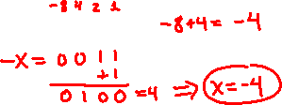
Polling Question
Which of the following 8-bit numbers has the same signed value as the 4-bit number 0b1100?
Underlined digit = MSB
Vote at http://PollEv.com/justinh
0b 0000 1100
0b 1000 1100
0b 1111 1100
0b 1100 1100
We’re lost…

Slide 19
Sign Extension
Task: Given a $w$-bit signed integer $X$, convert it to $w$+$k$-bit signed integer $X′$ with the same value
Rule: Add $k$ copies of sign bit
Let $x_{i}$ be the $i$-th digit of $X$ in binary
$X^{′}=x_{w−1},…,x_{w−1},x_{w−1},x_{w−2},…,x_{1},x_{0}$
$k$ copies of MSB
original $X$
$$w$$
$X$
• • •
• • •
$$Xʹ$$
• • •
• • •
$$k$$
$$w$$
Notes:
General algorithm for any number of bits

Slide 20
Sign Extension Example
Convert from smaller to larger integral data types
C automatically performs sign extension
Java too
short int x = 12345;
int ix = (int) x;
short int y = -12345;
int iy = (int) y;
Var | Decimal | Hex | Binary
x | 12345 | 30 39 | 00110000 00111001
ix | 12345 | 00 00 30 39 | 00000000 00000000 00110000 00111001
y | -12345 | CF C7 | 11001111 11000111
iy | -12345 | FF FF CF C7 | 11111111 11111111 11001111 11000111

Slide 21
Integers
Binary representation of integers
Unsigned and signed
Casting in C
Consequences of finite width representations
Overflow, sign extension
Shifting and arithmetic operations
Notes:
21

Slide 22
Shift Operations
Left shift (x<<n) bit vector x by n positions
Throw away (drop) extra bits on left
Fill with 0s on right
Right shift (x>>n) bit-vector x by n positions
Throw away (drop) extra bits on right
Logical shift (for unsigned values)
Fill with 0s on left
Arithmetic shift (for signed values)
Replicate most significant bit on left
Maintains sign of x
Notes:
Useful operator when working with bit representations
Especially Lab 1
1001

Slide 23
Shift Operations
 | x | 0010 0010
 | x<<3 | 0001 0000
logical: | x>>2 | 0000 1000
arithmetic: | x>>2 | 0000 1000
Left shift (x<<n)
Fill with 0s on right
Right shift (x>>n)
Logical shift (for unsigned values)
Fill with 0s on left
Arithmetic shift (for signed values)
Replicate most significant bit on left
Notes:
Shifts by n<0 or n$≥$w (w is bit width of x) are undefined
In C: behavior of >> is determined by compiler
In gcc / C lang, depends on data type of x (signed/unsigned)
In Java: logical shift is >>> and arithmetic shift is >>
 | x | 1010 0010
 | x<<3 | 0001 0000
logical: | x>>2 | 0010 1000
arithmetic: | x>>2 | 1110 1000

Slide 24
Shifting Arithmetic?
What are the following computing?
x>>n
0b 0100 >> 1 = 0b 0010
0b 0100 >> 2 = 0b 0001
Divide by 2^{n}
x<<n
0b 0001 << 1 = 0b 0010
0b 0001 << 2 = 0b 0100
Multiply by 2^{n}
Shifting is faster than general multiply and divide operations
Notes:
0100 (4) >> 1 = 0010 (2)
0001 (1) << 2 = 0100 (4)

Slide 25
Left Shifting Arithmetic 8-bit Example
No difference in left shift operation for unsigned and signed numbers (just manipulates bits)
Difference comes during interpretation: x*2^{n}?
Signed Unsigned
x = 25; 00011001 =
L1=x<<2; 0001100100 =
L2=x<<3; 00011001000 =
L3=x<<4; 000110010000 =
25 25
100 100
-56 200
-112 144
signed overflow
signed overflow
unsigned overflow

Slide 26
Right Shifting Arithmetic 8-bit Examples
Reminder: C operator >> does logical shift on unsigned values and arithmetic shift on signed values
Logical Shift: x/2^{n}?
xu = 240u; 11110000 =
R1u=xu>>3; 00011110000 =
R2u=xu>>5; 0000011110000 =
240
30
7
rounding (down)

Slide 27
Right Shifting Arithmetic 8-bit Examples
Reminder: C operator >> does logical shift on unsigned values and arithmetic shift on signed values
Arithmetic Shift: x/2^{n}?
xs = -16; 11110000 =
R1s=xu>>3; 11111110000 =
R2s=xu>>5; 1111111110000 =
-16
-2
-1
rounding (down)

Slide 28
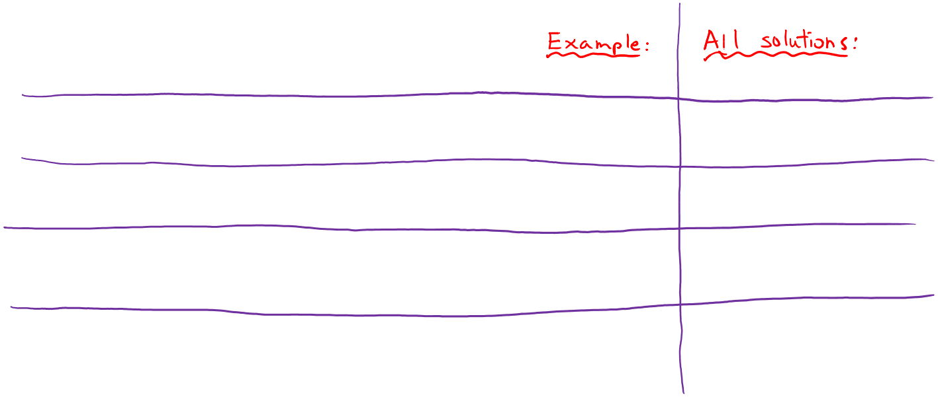
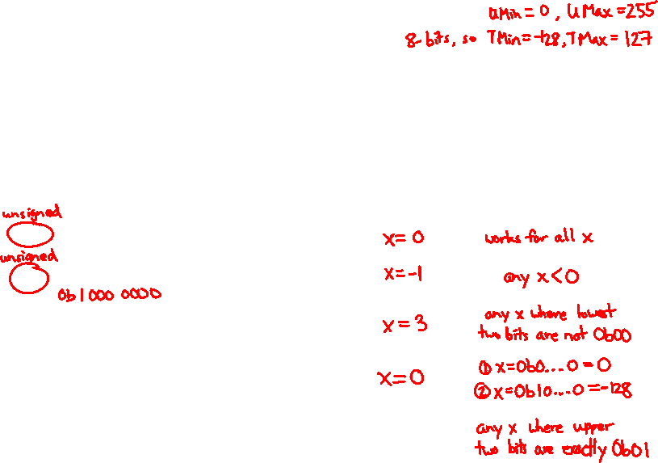
Practice Question
Assume we are using 8-bit arithmetic:
x == (unsigned char) x
x >= 128U
x != (x>>2)<<2
x == -x
Hint: there are two solutions
(x < 128U) && (x > 0x3F)
For the following expressions, find a value of signed char x, if there exists one, that makes the expression TRUE. Compare with your neighbor(s)!

Slide 29
Summary
Sign and unsigned variables in C
Bit pattern remains the same, just interpreted differently
Strange things can happen with our arithmetic when we convert/cast between sign and unsigned numbers
Type of variables affects behavior of operators (shifting, comparison)
We can only represent so many numbers in $w$ bits
When we exceed the limits, arithmetic overflow occurs
Sign extension tries to preserve value when expanding
Shifting is a useful bitwise operator
Right shifting can be arithmetic (sign) or logical (0)
Can be used in multiplication with constant or bit masking

Slide 30
BONUS SLIDES
Some examples of using shift operators in combination with bitmasks, which you may find helpful for Lab 1.
Extract the 2nd most significant byte of an int
Extract the sign bit of a signed int
Conditionals as Boolean expressions

Slide 31
Using Shifts and Masks
Extract the 2nd most significant byte of an int:
First shift, then mask: (x>>16) & 0xFF
Or first mask, then shift: (x & 0xFF0000)>>16
x | 00000001 | 00000010 | 00000011 | 00000100
x>>16 | 00000000 | 00000000 | 00000001 | 00000010
0xFF | 00000000 | 00000000 | 00000000 | 11111111
(x>>16) & 0xFF | 00000000 | 00000000 | 00000000 | 00000010
x | 00000001 | 00000010 | 00000011 | 00000100
0xFF0000 | 00000000 | 11111111 | 00000000 | 00000000
x & 0xFF0000 | 00000000 | 00000010 | 00000000 | 00000000
(x&0xFF0000)>>16 | 00000000 | 00000000 | 00000000 | 00000010

Slide 32
Using Shifts and Masks
Extract the sign bit of a signed int:
First shift, then mask: (x>>31) & 0x1
Assuming arithmetic shift here, but this works in either case
Need mask to clear 1s possibly shifted in
0
x | 00000001 | 00000010 | 00000011 | 00000100
x>>31 | 00000000 | 00000000 | 00000000 | 00000000
0x1 | 00000000 | 00000000 | 00000000 | 00000001
(x>>31) & 0x1 | 00000000 | 00000000 | 00000000 | 00000000
0
1
x | 10000001 | 00000010 | 00000011 | 00000100
x>>31 | 11111111 | 11111111 | 11111111 | 11111111
0x1 | 00000000 | 00000000 | 00000000 | 00000001
(x>>31) & 0x1 | 00000000 | 00000000 | 00000000 | 00000001
1

Slide 33
Using Shifts and Masks
Conditionals as Boolean expressions
For int x, what does (x<<31)>>31 do?
Can use in place of conditional:
In C: if(x) {a=y;} else {a=z;} equivalent to a=x?y:z;
a=(((x<<31)>>31)&y) | (((!x<<31)>>31)&z);
x=!!123 | 00000000 | 00000000 | 00000000 | 00000001
x<<31 | 10000000 | 00000000 | 00000000 | 00000000
(x<<31)>>31 | 11111111 | 11111111 | 11111111 | 11111111
!x | 00000000 | 00000000 | 00000000 | 00000000
!x<<31 | 00000000 | 00000000 | 00000000 | 00000000
(!x<<31)>>31 | 00000000 | 00000000 | 00000000 | 00000000
Notes:
Use !! to force to 0/1

