Slide 1

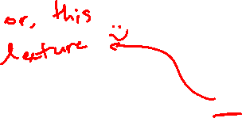
Memory Allocation I
CSE 351 Winter 2018
Instructor:
Mark Wyse
Teaching Assistants:
Kevin Bi
Parker DeWilde
Emily Furst
Sarah House
Waylon Huang
Vinny Palaniappan
Adapted from
https://xkcd.com/1093/

Slide 2
Administrative
Homework 5 due Wednesday
Lab 5 (on Mem Alloc), due 3/10

Slide 3




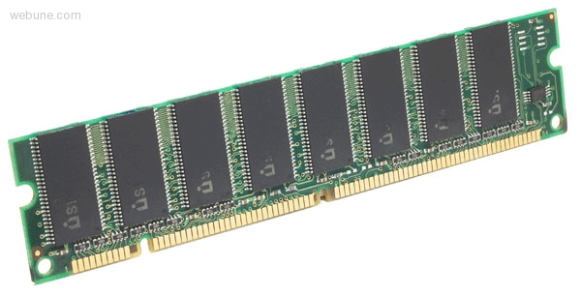

Roadmap
C:
Java:
Memory & data
Integers & floats
x86 assembly
Procedures & stacks
Executables
Arrays & structs
Memory & caches
Processes
Virtual memory
Memory allocation
Java vs. C
car *c = malloc(sizeof(car));
c->miles = 100;
c->gals = 17;
float mpg = get_mpg(c);
free(c);
Car c = new Car();
c.setMiles(100);
c.setGals(17);
float mpg =
c.getMPG();
Assembly language:
get_mpg:
pushq %rbp
movq %rsp, %rbp
...
popq %rbp
ret
OS:
Machine code:
0111010000011000
100011010000010000000010
1000100111000010
110000011111101000011111
Computer system:

Slide 4
Multiple Ways to Store Program Data
Static global data
  Fixed size at compile-time
  Entire lifetime of the program
  (loaded from executable)
  Portion is read-only
  (e.g. string literals)
Stack-allocated data
  Local/temporary variables
    Can be dynamically sized (in some versions of C)
  Known lifetime (deallocated on return)
Dynamic (heap) data
  Size known only at runtime (i.e. based on user-input)
  Lifetime known only at runtime (long-lived data structures)
int array[1024];
void foo(int n) {
int tmp;
int local_array[n];
int* dyn =
(int*)malloc(n*sizeof(int));
}

Slide 5
Memory Allocation
Dynamic memory allocation
  Introduction and goals
  Allocation and deallocation (free)
  Fragmentation
Explicit allocation implementation
  Implicit free lists
  Explicit free lists (Lab 5)
  Segregated free lists
Implicit deallocation: garbage collection
Common memory-related bugs in C

Slide 6

Dynamic Memory Allocation
Programmers use dynamic memory allocators to acquire virtual memory at run time
  For data structures whose size
  (or lifetime) is known only at runtime
  Manage the heap of a process’
  virtual memory:
Types of allocators
  Explicit allocator: programmer allocates and frees space
    Example: malloc and free in C
  Implicit allocator: programmer only allocates space (no free)
    Example: garbage collection in Java, Caml, and Lisp
User stack
Heap (via malloc)
Uninitialized data (.bss)
Initialized data (.data)
Program text (.text)
0
Notes:
http://en.wikipedia.org/wiki/Data_segment#Program_memory
.data is for data that is initialized at compile-time: string literals, and static/global variables initialized to some value.
.bss is for static/global variables with no explicit initialization in the code.
http://en.wikipedia.org/wiki/.bss
.data is fixed-size, have to know ahead of time how much you need

Slide 7
Dynamic Memory Allocation
Allocator organizes heap as a collection of variable-sized blocks, which are either allocated or free
  Allocator requests pages in the heap region; virtual memory hardware and OS kernel allocate these pages to the process
  Application objects are typically smaller than pages, so the allocator manages blocks within pages
    (Larger objects handled too;
    ignored here)
User stack
Top of heap
(brk ptr)
Heap (via malloc)
Uninitialized data (.bss)
Initialized data (.data)
Program text (.text)
0

Slide 8

Allocating Memory in C
Need to #include <stdlib.h>
void* malloc(size_t size)
  Allocates a continuous block of size bytes of uninitialized memory
  Returns a pointer to the beginning of the allocated block; NULL indicates failed request
    Typically aligned to an 8-byte (x86) or 16-byte (x86-64) boundary
    Returns NULL if allocation failed (also sets errno) or size==0
  Different blocks not necessarily adjacent
Good practices:
  ptr = (int*) malloc(n*sizeof(int));
    sizeof makes code more portable
    void* is implicitly cast into any pointer type; explicit typecast will help you catch coding errors when pointer types don’t match
Notes:
man 3 malloc

Slide 9
Allocating Memory in C
Need to #include <stdlib.h>
void* malloc(size_t size)
  Allocates a continuous block of size bytes of uninitialized memory
  Returns a pointer to the beginning of the allocated block; NULL indicates failed request
    Typically aligned to an 8-byte (x86) or 16-byte (x86-64) boundary
    Returns NULL if allocation failed (also sets errno) or size==0
  Different blocks not necessarily adjacent
Related functions:
  void* calloc(size_t nitems, size_t size)
    “Zeros out” allocated block
  void* realloc(void* ptr, size_t size)
    Changes the size of a previously allocated block (if possible)
  void* sbrk(intptr_t increment)
    Used internally by allocators to grow or shrink the heap
Notes:
man 3 malloc

Slide 10
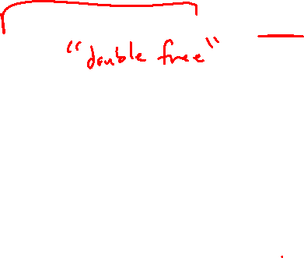
Freeing Memory in C
Need to #include <stdlib.h>
void free(void* p)
  Releases whole block pointed to by p to the pool of available memory
  Pointer p must be the address originally returned by m/c/realloc (i.e. beginning of the block), otherwise throws system exception
  Don’t call free on a block that has already been released or on NULL
Notes:
man 3 free
Free() doesn’t change the pointer passed as an argument, it now points to unallocated memory

Slide 11

Memory Allocation Example in C
void foo(int n, int m) {
int i, *p;
p = (int*) malloc(n*sizeof(int)); /* allocate block of n ints */
if (p == NULL) { /* check for allocation error */
perror("malloc");
exit(0);
}
for (i=0; i<n; i++) /* initialize int array */
p[i] = i;
/* add space for m ints to end of p block */
p = (int*) realloc(p,(n+m)*sizeof(int));
if (p == NULL) { /* check for allocation error */
perror("realloc");
exit(0);
}
for (i=n; i < n+m; i++) /* initialize new spaces */
p[i] = i;
for (i=0; i<n+m; i++) /* print new array */
printf("%d\n", p[i]);
free(p); /* free p */
}

Slide 12
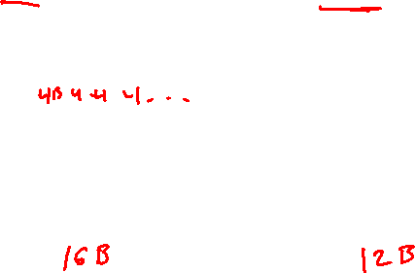
Notation
= one box, 4 bytes
We will draw memory divided into boxes
  Each box can hold an int (32 bits/4 bytes)
  Allocations will be in sizes that are a multiple of boxes,
  i.e. multiples of 4 bytes
  Book and old videos use word instead of box
    Holdover from 32-bit version of textbook 🙁
Allocated block
(4 boxes)
Free block
(3 boxes)
Free box
Allocated box
Notes:
Some notation for our discussion
4 boxes = 16 B
3 boxes = 12 B

Slide 13
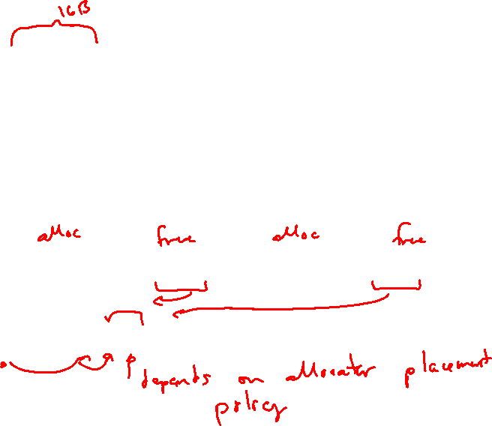
Allocation Example
= 4-byte box
p1 = malloc(16)
p2 = malloc(20)
p3 = malloc(24)
free(p2)
p4 = malloc(8)
Notes:
How do we know how much to free?
Allocator has to remember!
P4 malloc -> location of allocated bytes depends on allocator placement policy

Slide 14
Implementation Interface
Applications
  Can issue arbitrary sequence of malloc and free requests
  Must never access memory not currently allocated
  Must never free memory not currently allocated
    Also must only use free with previously malloc’ed blocks
Allocators
  Can’t control number or size of allocated blocks
  Must respond immediately to malloc
  Must allocate blocks from free memory
  Must align blocks so they satisfy all alignment requirements
  Can’t move the allocated blocks
Notes:
No overlap: application thinks they're separate pieces of data
No move: application holds pointers, can't go track them down
Respond immediately: can’t reorder or buffer
Allocate from free mem: blocks can’t overlap
Can’t move allocated blocks: defragmentation not allowed -> would break user pointers

Slide 15

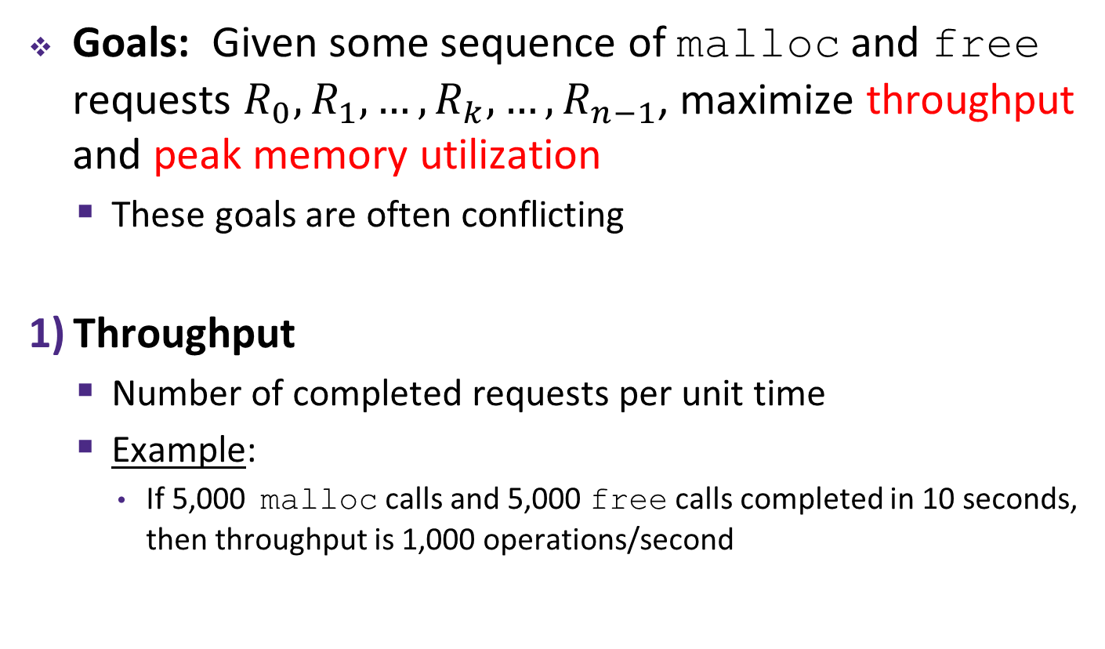
Performance Goals
Goals: Given some sequence of malloc and free requests $R_{0},R_{1},…,R_{k},…,R_{n−1}$, maximize throughput and peak memory utilization
  These goals are often conflicting
Throughput
  Number of completed requests per unit time
  Example:
    If 5,000 malloc calls and 5,000 free calls completed in 10 seconds, then throughput is 1,000 operations/second

Slide 16
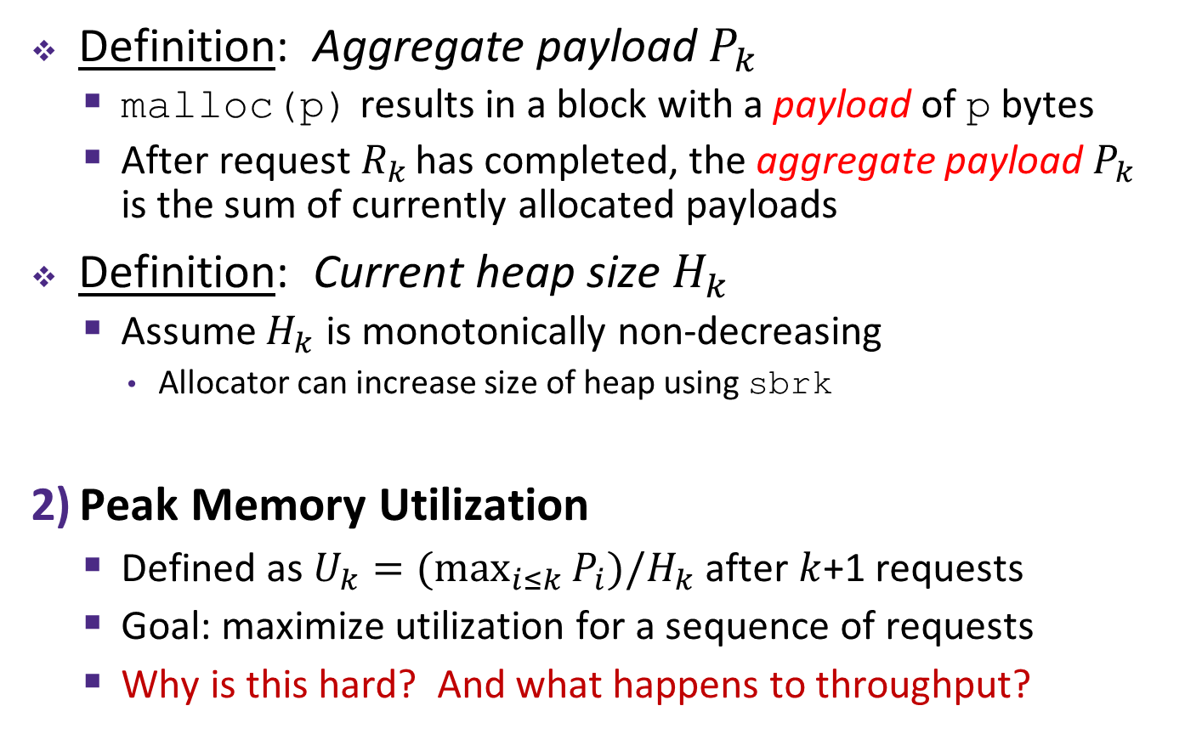
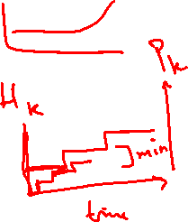
Performance Goals
Definition: Aggregate payload $P_{k}$
  malloc(p) results in a block with a payload of p bytes
  After request $R_{k}$ has completed, the aggregate payload $P_{k}$ is the sum of currently allocated payloads
Definition: Current heap size $H_{k}$
  Assume $H_{k}$ is monotonically non-decreasing
    Allocator can increase size of heap using sbrk
Peak Memory Utilization
  Defined as $U_{k}=(\max_{i≤k}{P_{i}})/H_{k}$ after $k$+1 requests
  Goal: maximize utilization for a sequence of requests
  Why is this hard? And what happens to throughput?
Notes:
Note: heap size can be decreased by using the brk(2) system call.
Packing analogy. -> pack fast or pack tight?

Slide 17
Fragmentation
Poor memory utilization is caused by fragmentation
  Sections of memory are not used to store anything useful, but cannot satisfy allocation requests
  Two types: internal and external
Recall: Fragmentation in structs
  Internal fragmentation was wasted space inside of the struct (between fields) due to alignment
  External fragmentation was wasted space between struct instances (e.g. in an array) due to alignment
Now referring to wasted space in the heap inside or between allocated blocks

Slide 18
Internal Fragmentation
For a given block, internal fragmentation occurs if payload is smaller than the block
Causes:
  Padding for alignment purposes
  Overhead of maintaining heap data structures (inside block, outside payload)
  Explicit policy decisions (e.g. return a big block to satisfy a small request)
Easy to measure because only depends on past requests
block
Internal
fragmentation
payload
Internal
fragmentation
Notes:
Explicit policy decisions: faster throughput to not individually size every block
Policy examples for performance: library book checkout duration, creating a new Google calendar event

Slide 19
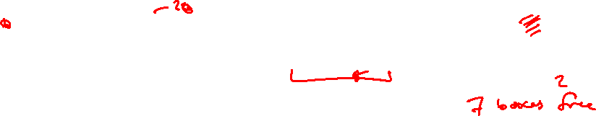
External Fragmentation
= 4-byte box
For the heap, external fragmentation occurs when allocation/free pattern leaves “holes” between blocks
  That is, the aggregate payload is non-continuous
  Can cause situations where there is enough aggregate heap memory to satisfy request, but no single free block is large enough
Don’t know what future requests will be
  Difficult to impossible to know if past placements will become problematic
p1 = malloc(16)
p2 = malloc(20)
p3 = malloc(24)
free(p2)
p4 = malloc(24)
Oh no! (What would happen now?)
Notes:
For p4 malloc, sbrk() will be called to extend heap
28B total storage free, but not contiguous for 24B so need to grow heap

Slide 20
Peer Instruction Question
Which of the following statements is FALSE?
Temporary arrays should not be allocated on the Heap
malloc returns an address filled with garbage
Peak memory utilization is a measure of both internal and external fragmentation
An allocation failure will cause your program to stop
We’re lost…
Notes:
Answer: D
Reason: allocation failure returns NULL
A: true, temporary should go on stack (if small enough)
B: true, allocates only, no initialization
C: true, aggregate payload / heap size

Slide 21
Implementation Issues
How do we know how much memory to free given just a pointer?
How do we keep track of the free blocks?
How do we pick a block to use for allocation (when many might fit)?
What do we do with the extra space when allocating a structure that is smaller than the free block it is placed in?
How do we reinsert a freed block into the heap?

Slide 22

Knowing How Much to Free
= 4-byte box (free)
= 4-byte box (allocated)
Standard method
  Keep the length of a block in the box preceding the block
    This box is often called the header field or header
  Requires an extra box for every allocated block
p0
p0 = malloc(16)
20
block size
data
free(p0)

Slide 23

Keeping Track of Free Blocks
= 4-byte box (free)
= 4-byte box (allocated)
Implicit free list using length – links all blocks using math
  No actual pointers, and must check each block if allocated or free
Explicit free list among only the free blocks, using pointers
Segregated free list
  Different free lists for different size “classes”
Blocks sorted by size
  Can use a balanced binary tree (e.g. red-black tree) with pointers within each free block, and the length used as a key
20
16
24
8
20
16
24
8
Notes:
2) Linked list

Slide 24
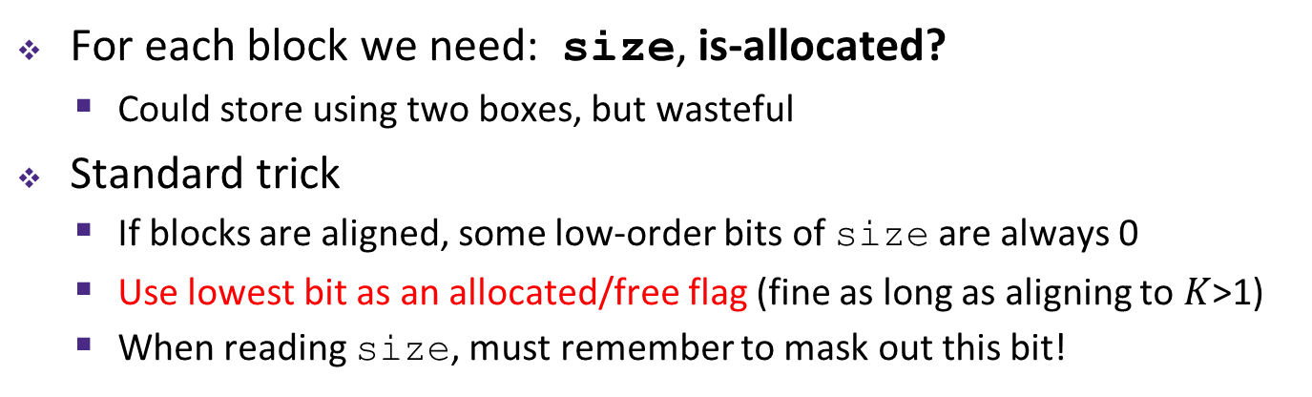
Implicit Free Lists
e.g. with 8-byte alignment, possible values for size:
00001000 = 8 bytes
00010000 = 16 bytes
00011000 = 24 bytes
. . .
For each block we need: size, is-allocated?
  Could store using two boxes, but wasteful
Standard trick
  If blocks are aligned, some low-order bits of size are always 0
  Use lowest bit as an allocated/free flag (fine as long as aligning to $K$>1)
  When reading size, must remember to mask out this bit!
4 bytes
Format of
allocated and
free blocks:
size
a
a = 1: allocated block
a = 0: free block
size: block size (in bytes)
payload: application data
(allocated blocks only)
If x is first box (header):
x = size | a;
a = x & 1;
size = x & ~1;
payload
optional
padding
Notes:
Size = 4B, is-allocated = 1-bit
Low-order bits are always 0 for aligned addresses!!
Where is p pointing?

Slide 25
Implicit Free List Example
Each block begins with header (size in bytes and allocated bit)
Sequence of blocks in heap (size|allocated):
8|0, 16|1, 32|0, 16|1
Start of heap
Free box
8|0
16|1
32|0
16|1
0|1
Allocated box
Allocated box
unused
8 bytes = 2 box alignment
8-byte alignment for payload
  May require initial padding (internal fragmentation)
  Note size: padding is considered part of previous block
Special one-box marker (0|1) marks end of list
  Zero size is distinguishable from all other blocks
Notes:
Box = 4B
Draw arrows from block to block for implicit free list

Slide 26
Implicit List: Finding a Free Block
(*p) gets the block header
(*p & 1) extracts the allocated bit
(*p & -2) extracts the size
First fit
  Search list from beginning, choose first free block that fits:
  Can take time linear in total number of blocks
  In practice can cause “splinters” at beginning of list
p = heap_start;
while ((p < end) && // not past end
((*p & 1) || // already allocated
(*p <= len))) { // too small
p = p + (*p & -2); // go to next block (UNSCALED +)
} // p points to selected block or end
p = heap_start
Free box
8|0
16|1
32|0
16|1
0|1
Allocated box
Allocated box
unused
Notes:
Why doesn’t “*p <= len” mask off the allocated bit too? Because this is the second condition in the || test, which means that the first condition (*p & 1) must have already been false, so we know that the allocated bit can’t be set and we don’t have to bother masking it off.
*note: splinters = lots of small blocks up front -> increases search time for larger blocks
Tends to concentrate small blocks at front of heap.

Slide 27
Implicit List: Finding a Free Block
Next fit
  Like first-fit, but search list starting where previous search finished
  Should often be faster than first-fit: avoids re-scanning unhelpful blocks
  Some research suggests that fragmentation is worse
Best fit
  Search the list, choose the best free block: large enough AND with fewest bytes left over
  Keeps fragments small—usually helps fragmentation
  Usually worse throughput

Slide 28
Peer Instruction Question
payload
size
Which allocation strategy and requests
remove external fragmentation in this
Heap? B3 was the last fulfilled request.
50
10
B2
(A)
Best-fit:
malloc(50), malloc(50)
30
10
B3
(B)
First-fit:
malloc(50), malloc(30)
50
(C)
Next-fit:
malloc(30), malloc(50)
B1
50
(D)
Next-fit:
malloc(50), malloc(30)
Start of heap

