Slide 1
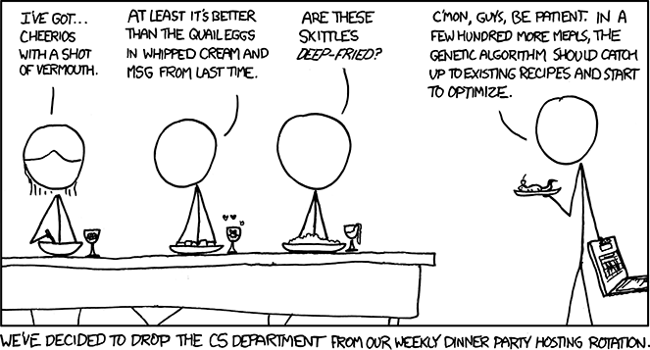
Virtual Memory Wrap-Up CSE 351 Winter 2018
Instructor:
Mark Wyse
Teaching Assistants:
Kevin Bi
Parker DeWilde
Emily Furst
Sarah House
Waylon Huang
Vinny Palaniappan
https://xkcd.com/720/

Slide 2
Administrative
Lab 4 due tonight!
By 11:59 pm!
Homework 5 due next Wednesday (3/7)
Lab 5 released tomorrow
Due Saturday, March 10 @ 11:59 pm
Final Exam
Wednesday, March 14, 2:30 – 4:20 pm, KNE 110
Topics: everything

Slide 3
Quick Review
What do Page Tables map?
Where are Page Tables located?
How many Page Tables are there?
Can your process tell if a page fault has occurred?
True / False: Virtual Addresses that are contiguous will always be contiguous in physical memory
TLB stands for _______________________ and stores _______________

Slide 4
Address Translation
VM is complicated, but also elegant and effective
Level of indirection to provide isolated memory & caching
TLB as a cache of page tables avoids two trips to memory for every memory access
Virtual Address
TLB
Lookup
TLB Miss
TLB Hit
Page Table
“Walk”
Protection
Check
Page not
in Mem
Page
in Mem
Access
Denied
Access
Permitted
Page Fault
(OS loads page)
Update
TLB
Protection
Fault
Physical
Address
Find in Disk
Find in Mem
SIGSEGV
Check cache
Notes:
Need to restart instruction.
Soft and hard page faults.

Slide 5
Memory Overview
movl 0x8043ab, %rdi
Disk
requested 32-bits
Page
Main memory
(DRAM)
CPU
Cache
Page
Line
MMU
Block
TLB

Slide 6
Context Switching Revisited
What needs to happen when the CPU switches processes?
Registers:
Save state of old process, load state of new process
Including the Page Table Base Register (PTBR)
Memory:
Nothing to do! Pages for processes already exist in memory/disk and protected from each other
TLB:
Invalidate all entries in TLB – mapping is for old process’ VAs
Cache:
Can leave alone because storing based on PAs – good for shared data

Slide 7
Page Table Reality
Just one issue… the numbers don’t work out for the story so far!
The problem is the page table for each process:
Suppose 64-bit VAs, 8 KiB pages, 8 GiB physical memory
How many page table entries is that?
About how long is each PTE?
Moral: Cannot use this naïve implementation of the virtual→physical page mapping – it’s way too big
Notes:
2^64/2^13 = 2^51
PPN = 20 bits; plus Valid, R/W/X; so ~ 3 B per PTE
So each page table takes up 2^52 + 2^51 B!

Slide 8
A Solution: Multi-level Page Tables
This is extra (non-testable) material
This is called a page walk
Page table base register
(PTBR)
n-1
Virtual Address
p-1
0
VPN 1
VPN 2
...
VPN k
VPO
Level 1
page table
Level 2
page table
Level k
page table
...
...
PPN
TLB
m-1
p-1
0
PPN
PPO
VPN
→
PTE
Physical Address
VPN
→
PTE
VPN
→
PTE

Slide 9
Multi-level Page Tables
This is extra (non-testable) material
A tree of depth $k$ where each node at depth $i$ has up to $2^{j}$ children if part $i$ of the VPN has $j$ bits
Hardware for multi-level page tables inherently more complicated
But it’s a necessary complexity – 1-level does not fit
Why it works: Most subtrees are not used at all, so they are never created and definitely aren’t in physical memory
Parts created can be evicted from cache/memory when not being used
Each node can have a size of ~1-100KB
But now for a $k$-level page table, a TLB miss requires $k+1$ cache/memory accesses
Fine so long as TLB misses are rare – motivates larger TLBs

Slide 10
Practice VM Question
Our system has the following properties
1 MiB of physical address space
4 GiB of virtual address space
32 KiB page size
4-entry fully associative TLB with LRU replacement
Fill in the following blanks:
________ | Total entries in page table | ________ | Minimum bit-width of PTBR
________ | TLBT bits | ________ | Max # of valid entries in a page table

Slide 11
Practice VM Question
One process uses a page-aligned square matrix mat[] of 32-bit integers in the code shown below:
#define MAT_SIZE = 2048
for(int i=0; i<MAT_SIZE; i++)
mat[i*(MAT_SIZE+1)] = i;
What is the largest stride (in bytes) between successive memory accesses (in the VA space)?

Slide 12
Practice VM Question
One process uses a page-aligned square matrix mat[] of 32-bit integers in the code shown below:
#define MAT_SIZE = 2048
for(int i=0; i<MAT_SIZE; i++)
mat[i*(MAT_SIZE+1)] = i;
What are the following hit rates for the first execution of the for loop?
________ | TLB Hit Rate | ________ | Page Table Hit Rate

Slide 13
BONUS SLIDES
For Fun: DRAMMER Security Attack
Why are we talking about this?
Recent: Announced in October 2016; Google released Android patch on November 8, 2016
Relevant: Uses your system’s memory setup to gain elevated privileges
Ties together some of what we’ve learned about virtual memory and processes
Interesting: It’s a software attack that uses only hardware vulnerabilities and requires no user permissions

Slide 14
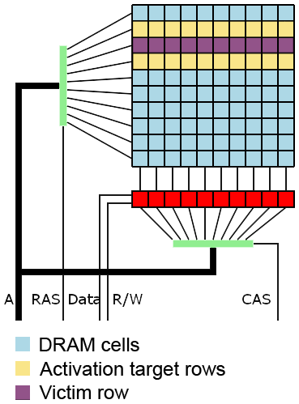
Underlying Vulnerability: Row Hammer
Dynamic RAM (DRAM) has gotten denser over time
DRAM cells physically closer and use smaller charges
More susceptible to “disturbance errors” (interference)
DRAM capacitors need to be “refreshed” periodically (~64 ms)
Lose data when loss of power
Capacitors accessed in rows
Rapid accesses to one row can flip bits in an adjacent row!
~ 100K to 1M times
By Dsimic (modified), CC BY-SA 4.0, https://commons.wikimedia.org/w/index.php?curid=38868341

Slide 15
Row Hammer Exploit
Force constant memory access
Read then flush the cache
clflush – flush cache line
Invalidates cache line containing the specified address
Not available in all machines or environments
Want addresses X and Y to fall in activation target row(s)
Good to understand how banks of DRAM cells are laid out
The row hammer effect was discovered in 2014
Only works on certain types of DRAM (2010 onwards)
These techniques target x86 machines
hammertime:
mov (X), %eax
mov (Y), %ebx
clflush (X)
clflush (Y)
jmp hammertime

Slide 16
Consequences of Row Hammer
Row hammering process can affect another process via memory
Circumvents virtual memory protection scheme
Memory needs to be in an adjacent row of DRAM
Worse: privilege escalation
Page tables live in memory!
Hope to change PPN to access other parts of memory, or change permission bits
Goal: gain read/write access to a page containing a page table, hence granting process read/write access to all of physical memory

Slide 17
Effectiveness?
Doesn’t seem so bad – random bit flip in a row of physical memory
Vulnerability affected by system setup and physical condition of memory cells
Improvements:
Double-sided row hammering increases speed & chance
Do system identification first (e.g. Lab 4)
Use timing to infer memory row layout & find “bad” rows
Allocate a huge chunk of memory and try many addresses, looking for a reliable/repeatable bit flip
Fill up memory with page tables first
fork extra processes; hope to elevate privileges in any page table

Slide 18
What’s DRAMMER?
No one previously made a huge fuss
Prevention: error-correcting codes, target row refresh, higher DRAM refresh rates
Often relied on special memory management features
Often crashed system instead of gaining control
Research group found a deterministic way to induce row hammer exploit in a non-x86 system (ARM)
Relies on predictable reuse patterns of standard physical memory allocators
Universiteit Amsterdam, Graz University of Technology, and University of California, Santa Barbara

Slide 19
DRAMMER Demo Video
It’s a shell, so not that sexy-looking, but still interesting
Apologies that the text is so small on the video
Notes:
https://youtu.be/x6hL-obNhAw

Slide 20
How did we get here?
Computing industry demands more and faster storage with lower power consumption
Ability of user to circumvent the caching system
clflush is an unprivileged instruction in x86
Other commands exist that skip the cache
Availability of virtual to physical address mapping
Example: /proc/self/pagemap on Linux (not human-readable)
Google patch for Android (Nov. 8, 2016)
Patched the ION memory allocator

Slide 21
More reading for those interested
DRAMMER paper: https://vvdveen.com/publications/drammer.pdf
Google Project Zero: https://googleprojectzero.blogspot.com/2015/03/exploiting-dram-rowhammer-bug-to-gain.html
First row hammer paper: https://users.ece.cmu.edu/~yoonguk/papers/kim-isca14.pdf
Wikipedia: https://en.wikipedia.org/wiki/Row_hammer

Slide 22
Quick Review Answers
What do Page Tables map?
VPN $→$ PPN or disk address
Where are Page Tables located?
In physical memory
How many Page Tables are there?
One per process
Can your program tell if a page fault has occurred?
Nope, but it has to wait a long time
What is thrashing?
Constantly paging out and paging in
True / False: Virtual Addresses that are contiguous will always be contiguous in physical memory
Could fall across a page boundary
TLB stands for Translation Lookaside Buffer and stores page table entries

