Slide 1
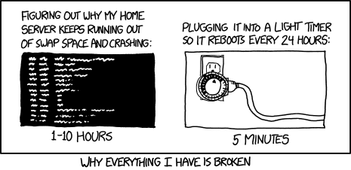
Virtual Memory II CSE 351 Winter 2018
Instructor:
Mark Wyse
Teaching Assistants:
Kevin Bi
Parker DeWilde
Emily Furst
Sarah House
Waylon Huang
Vinny Palaniappan
https://xkcd.com/1495/

Slide 2
Administrative
Lab 4 due Wednesday by 11:59 pm!
Homework 5 released today, due 3/7
Processes and Virtual Memory

Slide 3
Virtual Memory (VM)
Overview and motivation
VM as a tool for caching
Address translation
VM as a tool for memory management
VM as a tool for memory protection

Slide 4
Review: Terminology
Context switch
Switch between processes on the same CPU
Page in
Move pages of virtual memory from disk to physical memory
Page out
Move pages of virtual memory from physical memory to disk
Thrashing
Total working set size of processes is larger than physical memory and causes excessive paging in and out instead of doing useful computation

Slide 5
VM for Managing Multiple Processes
Key abstraction: each process has its own virtual address space
It can view memory as a simple linear array
With virtual memory, this simple linear virtual address space need not be contiguous in physical memory
Process needs to store data in another VP? Just map it to any PP!
Virtual Address Space for Process 1:
0
0
Physical
Address
Space (DRAM)
VP 1
VP 2
PP 2
...
N-1
Address
translation
PP 6
(e.g., read-only
library code)
Virtual Address Space for Process 2:
0
PP 8
VP 1
VP 2
...
...
N-1
M-1
Notes:
PP2 is inaccessible to Process 2
PP6 is shared by the processes (e.g., shared library code)

Slide 6
Simplifying Linking and Loading
Memory
invisible to
user code
Linking
Each program has similar virtual address space
Code, Data, and Heap always start at the same addresses
Loading
execve allocates virtual pages for .text and .data sections & creates PTEs marked as invalid
The .text and .data sections are copied, page by page, on demand by the virtual memory system
Kernel virtual memory
User stack
(created at runtime)
%rsp
(stack
pointer)
Memory-mapped region for
shared libraries
brk
Run-time heap
(created by malloc)
Read/write segment
(.data, .bss)
Loaded
from the
executable
file
Read-only segment
(.init, .text, .rodata)
0x400000
Unused
0

Slide 7
VM for Protection and Sharing
The mapping of VPs to PPs provides a simple mechanism to protect memory and to share memory between processes
Sharing: map virtual pages in separate address spaces to the same physical page (here: PP 6)
Protection: process can’t access physical pages to which none of its virtual pages are mapped (here: Process 2 can’t access PP 2)
Virtual Address Space for Process 1:
0
0
Physical
Address
Space (DRAM)
VP 1
VP 2
PP 2
...
N-1
Address
translation
PP 6
(e.g., read-only
library code)
Virtual Address Space for Process 2:
0
PP 8
VP 1
VP 2
...
...
N-1
M-1

Slide 8
Memory Protection Within Process
VM implements read/write/execute permissions
Extend page table entries with permission bits
MMU checks these permission bits on every memory access
If violated, raises exception and OS sends SIGSEGV signal to process (segmentation fault)
Physical
Address Space
Process i:
Valid
READ
WRITE
EXEC
PPN
VP 0:
Yes
Yes
No
No
PP 6
VP 1:
Yes
Yes
No
Yes
PP 4
VP 2:
Yes
Yes
Yes
No
PP 2
PP 2
•
•
•
PP 4
PP 6
Process j:
Valid
READ
WRITE
EXEC
PPN
VP 0:
Yes
Yes
Yes
No
PP 9
PP 8
VP 1:
Yes
Yes
No
No
PP 6
PP 9
VP 2:
Yes
Yes
Yes
No
PP 11
PP 11
Notes:
Each row is a Page Table Entry -> now with management bits
Why no Dirty bit? Typically handled by OS.

Slide 9
Address Translation: Page Hit
2
Cache/
Memory
CPU Chip
MMU
PTEA
1
PTE
CPU
VA
3
PA
4
Data
5
1) Processor sends virtual address to MMU (memory management unit)
2-3) MMU fetches PTE from page table in cache/memory (Uses PTBR to find beginning of page table for current process)
4) MMU sends physical address to cache/memory requesting data
5) Cache/memory sends data to processor
VA = Virtual Address PTEA = Page Table Entry Address PTE= Page Table Entry PA = Physical Address Data = Contents of memory stored at VA originally requested by CPU
Notes:
Page Hit == page is in physical memory (DRAM)

Slide 10
Address Translation: Page Fault
Exception
Page fault handler
4
CPU Chip
2
Cache/
Memory
Disk
MMU
PTEA
Victim page
1
5
CPU
VA
PTE
7
3
New page
6
1) Processor sends virtual address to MMU
2-3) MMU fetches PTE from page table in cache/memory
4) Valid bit is zero, so MMU triggers page fault exception
5) Handler identifies victim (and, if dirty, pages it out to disk)
6) Handler pages in new page and updates PTE in memory
7) Handler returns to original process, restarting faulting instruction
Notes:
Page Fault == page is not in physical memory (DRAM)

Slide 11
Hmm… Translation Sounds Slow
The MMU accesses memory twice: once to get the PTE for translation, and then again for the actual memory request
The PTEs may be cached in L1 like any other memory word
But they may be evicted by other data references
And a hit in the L1 cache still requires 1-3 cycles
What can we do to make this faster?
Solution: add another cache! 🎉

Slide 12
Speeding up Translation with a TLB
Translation Lookaside Buffer (TLB):
Small hardware cache in MMU
Maps virtual page numbers to physical page numbers
Contains complete page table entries for small number of pages
Modern Intel processors have 128 or 256 entries in TLB
Much faster than a page table lookup in cache/memory
TLB
VPN
→
PTE
VPN
→
PTE
VPN
→
PTE
Notes:
“The architecture of the IBM System/370” R.P. Case and A. Padegs Communications of the ACM. 21:1, 73-96, January 1978.
Perhaps the first paper to use the term translation lookaside buffer. The name arises from the historical name for a cache, which was a lookaside buffer as called by those developing the Atlas system at the University of Manchester; a cache of address translations thus became a translation lookaside buffer. Even though the term lookaside buffer fell out of favor, TLB seems to have stuck, for whatever reason.
“x86info -c” on Intel Core2 Duo CPU:
L1 Data TLB: 4KB pages, 4-way set associative, 16 entries
Data TLB: 4K pages, 4-way associative, 256 entries.
L1 Data TLB: 4MB pages, 4-way set associative, 16 entries
Data TLB: 4MB pages, 4-way associative, 32 entries

Slide 13
TLB Hit
TLB
VPN
→
PTE
VPN
→
PTE
VPN
→
PTE
CPU Chip
TLB
2
PTE
VPN
3
Cache/
Memory
1
MMU
CPU
VA
PA
4
Data
5
A TLB hit eliminates a memory access!
Notes:
TLB Hit == page has been used recently

Slide 14
TLB Miss
TLB
VPN
→
PTE
VPN
→
PTE
VPN
→
PTE
CPU Chip
TLB
4
2
PTE
VPN
Cache/
Memory
1
MMU
3
CPU
VA
PTEA
PA
5
Data
6
A TLB miss incurs an additional memory access (the PTE)
Fortunately, TLB misses are rare
Notes:
TLB Miss == page has not been used recently
Does a TLB miss require disk access?

Slide 15
Fetching Data on a Memory Read
Check TLB
Input: VPN, Output: PPN
TLB Hit: Fetch translation, return PPN
TLB Miss: Check page table (in memory)
Page Table Hit: Load page table entry into TLB
Page Fault: Fetch page from disk to memory, update corresponding page table entry, then load entry into TLB
Check cache
Input: physical address, Output: data
Cache Hit: Return data value to processor
Cache Miss: Fetch data value from memory, store it in cache, return it to processor

Slide 16
Address Translation
Virtual Address
TLB
Lookup
TLB Miss
TLB Hit
Page Table
“Walk”
Protection
Check
Page not
in Mem
Page
in Mem
Access
Denied
Access
Permitted
Page Fault
(OS loads page)
Update
TLB
Protection
Fault
Physical
Address
Find in Disk
Find in Mem
SIGSEGV
Check cache
Notes:
Need to restart instruction.
Soft and hard page faults.

Slide 17
Context Switching Revisited
What needs to happen when the CPU switches processes?
Registers:
Save state of old process, load state of new process
Including the Page Table Base Register (PTBR)
Memory:
Nothing to do! Pages for processes already exist in memory/disk and protected from each other
TLB:
Invalidate all entries in TLB – mapping is for old process’ VAs
Cache:
Can leave alone because storing based on PAs – good for shared data

Slide 18
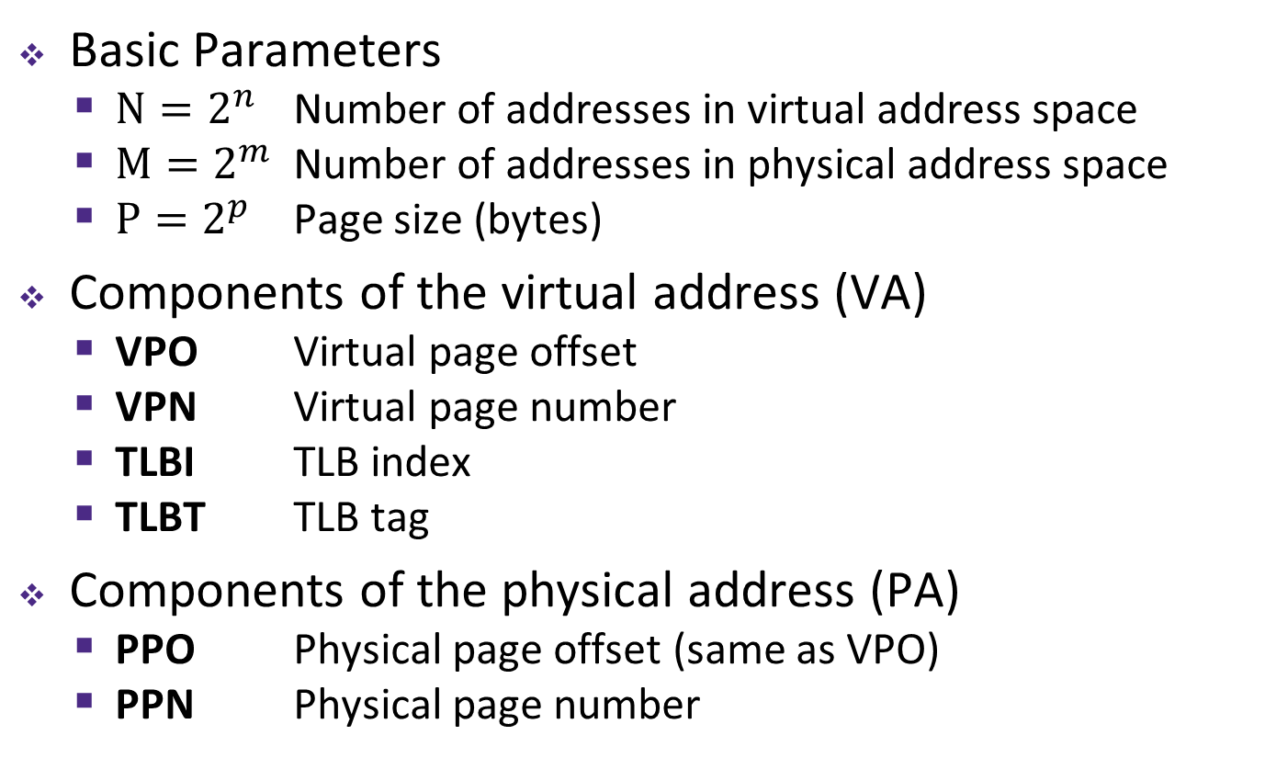
Summary of Address Translation Symbols
Basic Parameters
$N=2^{n}$ Number of addresses in virtual address space
$M=2^{m}$ Number of addresses in physical address space
$P=2^{p}$ Page size (bytes)
Components of the virtual address (VA)
VPO Virtual page offset
VPN Virtual page number
TLBI TLB index
TLBT TLB tag
Components of the physical address (PA)
PPO Physical page offset (same as VPO)
PPN Physical page number

Slide 19
Simple Memory System Example (small)
Addressing
14-bit virtual addresses
12-bit physical address
Page size = 64 bytes
13
12
11
10
9
8
7
6
5
4
3
2
1
0
VPN
VPO
Virtual Page Number
Virtual Page Offset
11
10
9
8
7
6
5
4
3
2
1
0
PPN
PPO
Physical Page Number
Physical Page Offset
Notes:
VA: n = 14 bits
PA: m = 12 bits
P = 64B -> p = 6 bits
VPN = n-p = 8 bits
VPO = PPO = 6 bits
PPN = m-p = 6 bits

Slide 20
Simple Memory System: Page Table
Only showing first 16 entries (out of _____)
Note: showing 2 hex digits for PPN even though only 6 bits
Note: other management bits not shown, but part of PTE
VPN | PPN | Valid
0 | 28 | 1
1 | – | 0
2 | 33 | 1
3 | 02 | 1
4 | – | 0
5 | 16 | 1
6 | – | 0
7 | – | 0
VPN | PPN | Valid
8 | 13 | 1
9 | 17 | 1
A | 09 | 1
B | – | 0
C | – | 0
D | 2D | 1
E | – | 0
F | 0D | 1
Notes:
Size of page table = 2^(n-p) entries
Total size = 2^(n-p) = 2^8 = 256 entries
One entry for every virtual page

Slide 21
Simple Memory System: TLB
16 entries total
4-way set associative
Why does the TLB ignore the page offset?
TLB tag
TLB index
13
12
11
10
9
8
7
6
5
4
3
2
1
0
virtual page number
virtual page offset
Set
Tag
PPN
Valid
Tag
PPN
Valid
Tag
PPN
Valid
Tag
PPN
Valid
0
03
–
0
09
0D
1
00
–
0
07
02
1
1
03
2D
1
02
–
0
04
–
0
0A
–
0
2
02
–
0
08
–
0
06
–
0
03
–
0
3
07
–
0
03
0D
1
0A
34
1
02
–
0
Notes:
Calculate VPN for valid TLB entry using Tag & Set
Address is a Virtual Address (VA)
16 entries / 4-way associative = 4 sets -> 2 bits for TLB Index (TLBI)
TLB ignores VPO because that is not part of its job!

Slide 22
Simple Memory System: Cache
Note: It is just coincidence that the PPN is the same width as the cache Tag
Direct-mapped with $K$ = 4 B, $C/K$ = 16
Physically addressed
cache tag
cache index
cache offset
11
10
9
8
7
6
5
4
3
2
1
0
physical page number
physical page offset
Index | Tag | Valid | B0 | B1 | B2 | B3
0 | 19 | 1 | 99 | 11 | 23 | 11
1 | 15 | 0 | – | – | – | –
2 | 1B | 1 | 00 | 02 | 04 | 08
3 | 36 | 0 | – | – | – | –
4 | 32 | 1 | 43 | 6D | 8F | 09
5 | 0D | 1 | 36 | 72 | F0 | 1D
6 | 31 | 0 | – | – | – | –
7 | 16 | 1 | 11 | C2 | DF | 03
Index | Tag | Valid | B0 | B1 | B2 | B3
8 | 24 | 1 | 3A | 00 | 51 | 89
9 | 2D | 0 | – | – | – | –
A | 2D | 1 | 93 | 15 | DA | 3B
B | 0B | 0 | – | – | – | –
C | 12 | 0 | – | – | – | –
D | 16 | 1 | 04 | 96 | 34 | 15
E | 13 | 1 | 83 | 77 | 1B | D3
F | 14 | 0 | – | – | – | –

Slide 23
Current State of Memory System
Page table (partial):
TLB:
VPN | PPN | V
0 | 28 | 1
1 | – | 0
2 | 33 | 1
3 | 02 | 1
4 | – | 0
5 | 16 | 1
6 | – | 0
7 | – | 0
VPN | PPN | V
8 | 13 | 1
9 | 17 | 1
A | 09 | 1
B | – | 0
C | – | 0
D | 2D | 1
E | – | 0
F | 0D | 1
Set | Tag | PPN | V | Tag | PPN | V | Tag | PPN | V | Tag | PPN | V
0 | 03 | – | 0 | 09 | 0D | 1 | 00 | – | 0 | 07 | 02 | 1
1 | 03 | 2D | 1 | 02 | – | 0 | 04 | – | 0 | 0A | – | 0
2 | 02 | – | 0 | 08 | – | 0 | 06 | – | 0 | 03 | – | 0
3 | 07 | – | 0 | 03 | 0D | 1 | 0A | 34 | 1 | 02 | – | 0
Cache:
Index | Tag | V | B0 | B1 | B2 | B3
0 | 19 | 1 | 99 | 11 | 23 | 11
1 | 15 | 0 | – | – | – | –
2 | 1B | 1 | 00 | 02 | 04 | 08
3 | 36 | 0 | – | – | – | –
4 | 32 | 1 | 43 | 6D | 8F | 09
5 | 0D | 1 | 36 | 72 | F0 | 1D
6 | 31 | 0 | – | – | – | –
7 | 16 | 1 | 11 | C2 | DF | 03
Index | Tag | V | B0 | B1 | B2 | B3
8 | 24 | 1 | 3A | 00 | 51 | 89
9 | 2D | 0 | – | – | – | –
A | 2D | 1 | 93 | 15 | DA | 3B
B | 0B | 0 | – | – | – | –
C | 12 | 0 | – | – | – | –
D | 16 | 1 | 04 | 96 | 34 | 15
E | 13 | 1 | 83 | 77 | 1B | D3
F | 14 | 0 | – | – | – | –
Notes:
TLB and Cache are separate pieces of hardware; page table stored in memory
Show correlation between TLB & page table (VPN 0x0D and 0x0F in particular)

Slide 24
Memory Request Example #1
Note: It is just coincidence that the PPN is the same width as the cache Tag
Virtual Address: 0x03D4
Physical Address:
TLBT
TLBI
13
12
11
10
9
8
7
6
5
4
3
2
1
0
0
0
0
0
1
1
1
1
0
1
0
1
0
0
VPN
VPO
VPN ______ | TLBT _____ | TLBI _____ | TLB Hit? ___ | Page Fault? ___ | PPN _____
CT
CI
CO
11
10
9
8
7
6
5
4
3
2
1
0
PPN
PPO
CT ______ | CI _____ | CO _____ | Cache Hit? ___ | Data (byte) _______
Notes:
TLB Hit, Cache Hit

Slide 25
Memory Request Example #2
Note: It is just coincidence that the PPN is the same width as the cache Tag
Virtual Address: 0x038F
Physical Address:
TLBT
TLBI
13
12
11
10
9
8
7
6
5
4
3
2
1
0
0
0
0
0
1
1
1
0
0
0
1
1
1
1
VPN
VPO
VPN ______ | TLBT _____ | TLBI _____ | TLB Hit? ___ | Page Fault? ___ | PPN _____
CT
CI
CO
11
10
9
8
7
6
5
4
3
2
1
0
PPN
PPO
CT ______ | CI _____ | CO _____ | Cache Hit? ___ | Data (byte) _______
Notes:
TLB Miss, page fault

Slide 26
Memory Request Example #3
Note: It is just coincidence that the PPN is the same width as the cache Tag
Virtual Address: 0x0020
Physical Address:
TLBT
TLBI
13
12
11
10
9
8
7
6
5
4
3
2
1
0
0
0
0
0
0
0
0
0
1
0
0
0
0
0
VPN
VPO
VPN ______ | TLBT _____ | TLBI _____ | TLB Hit? ___ | Page Fault? ___ | PPN _____
CT
CI
CO
11
10
9
8
7
6
5
4
3
2
1
0
PPN
PPO
CT ______ | CI _____ | CO _____ | Cache Hit? ___ | Data (byte) _______
Notes:
TLB Miss, Page Table Hit, Cache Miss

Slide 27
Memory Request Example #4
Note: It is just coincidence that the PPN is the same width as the cache Tag
Virtual Address: 0x036B
Physical Address:
TLBT
TLBI
13
12
11
10
9
8
7
6
5
4
3
2
1
0
0
0
0
0
1
1
0
1
1
0
1
0
1
1
VPN
VPO
VPN ______ | TLBT _____ | TLBI _____ | TLB Hit? ___ | Page Fault? ___ | PPN _____
CT
CI
CO
11
10
9
8
7
6
5
4
3
2
1
0
PPN
PPO
CT ______ | CI _____ | CO _____ | Cache Hit? ___ | Data (byte) _______
Notes:
TLB Hit, Cache Hit

Slide 28
Virtual Memory Summary
Programmer’s view of virtual memory
Each process has its own private linear address space
Cannot be corrupted by other processes
System view of virtual memory
Uses memory efficiently by caching virtual memory pages
Efficient only because of locality
Simplifies memory management and sharing
Simplifies protection by providing permissions checking

Slide 29
Memory System Summary
Memory Caches (L1/L2/L3)
Purely a speed-up technique
Behavior invisible to application programmer and (mostly) OS
Implemented totally in hardware
Virtual Memory
Supports many OS-related functions
Process creation, task switching, protection
Operating System (software)
Allocates/shares physical memory among processes
Maintains high-level tables tracking memory type, source, sharing
Handles exceptions, fills in hardware-defined mapping tables
Hardware
Translates virtual addresses via mapping tables, enforcing permissions
Accelerates mapping via translation cache (TLB)

