Slide 1

Virtual Memory I
CSE 351 Winter 2018
Instructor:
Mark Wyse
Teaching Assistants:
Kevin Bi
Parker DeWilde
Emily Furst
Sarah House
Waylon Huang
Vinny Palaniappan
http://rebrn.com/re/bad-chrome-1162082/

Slide 2
Administrative
Homework 4 due tonight
Lab 4 due next Wednesday (2/28)

Slide 3
Creating New Processes & Programs
Process 1
Process 2
“Memory”
“Memory”
Stack
Stack
Heap
fork()
Heap
Data
Data
Code
Code
“CPU”
“CPU”
Registers
Registers
exec*()
Chrome.exe

Slide 4
exit: Ending a process
void exit(int status)
  Exits a process
    Status code: 0 is used for a normal exit, nonzero for abnormal exit
Notes:
exit(3) and atexit(3) have more details.

Slide 5
Zombies
When a process terminates, it still consumes system resources
  Various tables maintained by OS
  Called a “zombie” (a living corpse, half alive and half dead)
Reaping is performed by parent on terminated child
  Parent is given exit status information and kernel then deletes zombie child process
What if parent doesn’t reap?
  If any parent terminates without reaping a child, then the orphaned child will be reaped by init process (pid == 1)
    Note: on more recent Linux systems, init has been renamed systemd
  In long-running processes (e.g. shells, servers) we need explicit reaping

Slide 6
wait: Synchronizing with Children
int wait(int *child_status)
  Suspends current process (i.e. the parent) until one of its children terminates
  Return value is the PID of the child process that terminated
    On successful return, the child process is reaped
  If child_status != NULL, then the *child_status value indicates why the child process terminated
    Special macros for interpreting this status – see man wait(2)
Note: If parent process has multiple children, wait will return when any of the children terminates
  waitpid can be used to wait on a specific child process
Notes:
child_status shouldn’t be examined directly – it should be examined using the macros WIFEXITED(), WEXITSTATUS(), etc. (see wait(2)).

Slide 7
Process Management Summary
fork makes two copies of the same process (parent & child)
  Returns different values to the two processes
exec* replaces current process from file (new program)
  Two-process program:
    First fork()
    if (pid == 0) { /* child code */ } else { /* parent code */ }
  Two different programs:
    First fork()
    if (pid == 0) { execv(…) } else { /* parent code */ }
wait or waitpid used to synchronize parent/child execution and to reap child process

Slide 8
Summary
Processes
  At any given time, system has multiple active processes
  On a one-CPU system, only one can execute at a time, but each process appears to have total control of the processor
  OS periodically “context switches” between active processes
    Implemented using exceptional control flow
Process management
  fork: one call, two returns
  execve: one call, usually no return
  wait or waitpid: synchronization
  exit: one call, no return

Slide 9

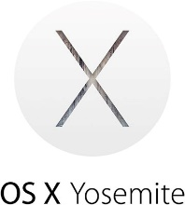

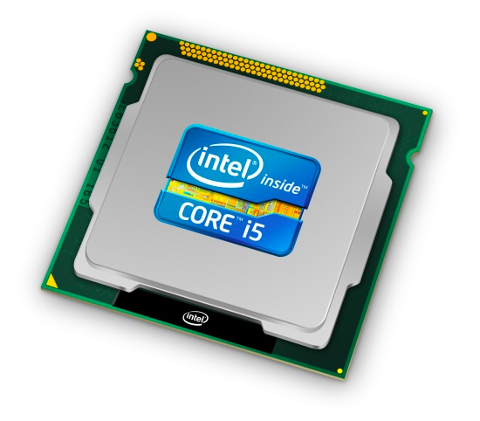
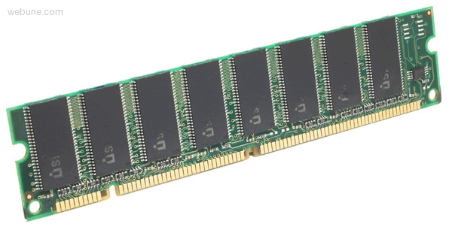
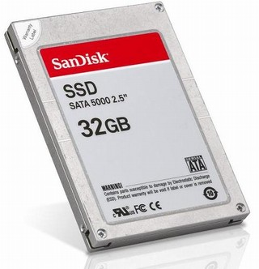
Roadmap
C:
Java:
Memory & data
Integers & floats
x86 assembly
Procedures & stacks
Executables
Arrays & structs
Memory & caches
Processes
Virtual memory
Memory allocation
Java vs. C
car *c = malloc(sizeof(car));
c->miles = 100;
c->gals = 17;
float mpg = get_mpg(c);
free(c);
Car c = new Car();
c.setMiles(100);
c.setGals(17);
float mpg =
c.getMPG();
Assembly language:
get_mpg:
pushq %rbp
movq %rsp, %rbp
...
popq %rbp
ret
OS:
Machine code:
0111010000011000
100011010000010000000010
1000100111000010
110000011111101000011111
Computer system:

Slide 10
Virtual Memory (VM*)
Overview and motivation
VM as a tool for caching
Address translation
VM as a tool for memory management
VM as a tool for memory protection
Warning: Virtual memory is pretty complex, but crucial for understanding how processes work and for debugging performance
*Not to be confused with “Virtual Machine” which is a whole other thing.

Slide 11
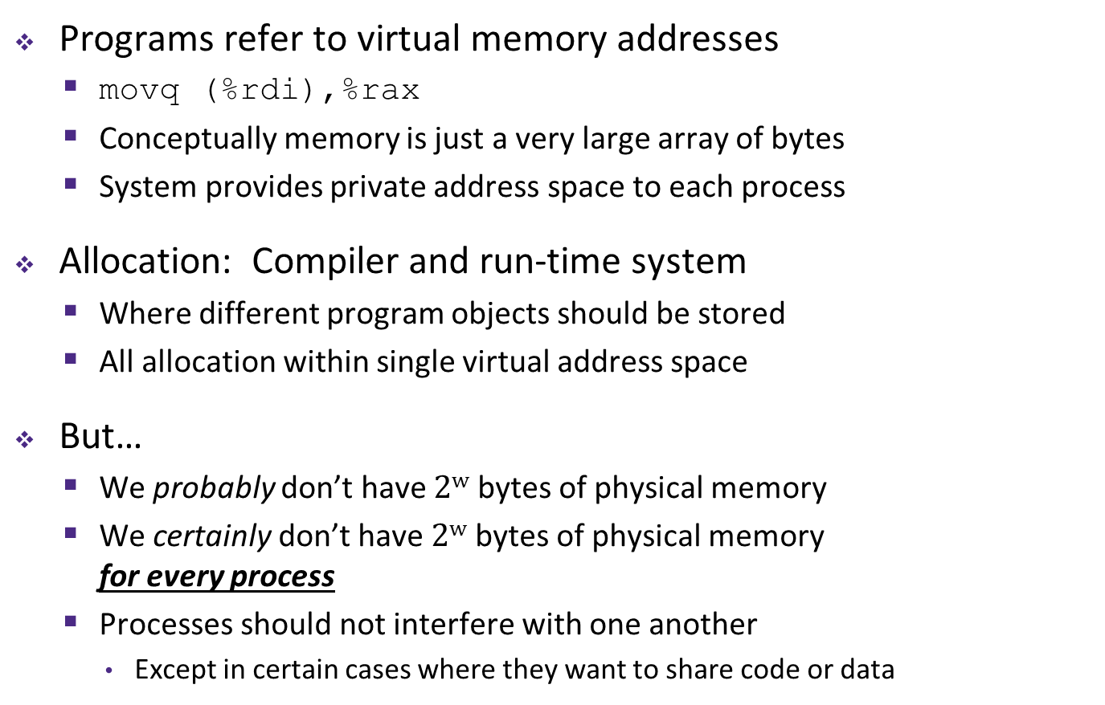
Memory as we know it so far… is virtual!
Programs refer to virtual memory addresses
  movq (%rdi),%rax
  Conceptually memory is just a very large array of bytes
  System provides private address space to each process
Allocation: Compiler and run-time system
  Where different program objects should be stored
  All allocation within single virtual address space
But…
  We probably don’t have $2w$ bytes of physical memory
  We certainly don’t have $2w$ bytes of physical memory
  for every process
  Processes should not interfere with one another
    Except in certain cases where they want to share code or data
0xFF∙∙∙∙∙∙F
0x00∙∙∙∙∙∙0

Slide 12
Problem 1: How Does Everything Fit?
64-bit virtual addresses can address
several exabytes
(18,446,744,073,709,551,616 bytes)
Physical main memory offers
a few gigabytes
(e.g. 8,589,934,592 bytes)
?
(Not to scale; physical memory would be smaller than the period at the end of this sentence compared to the virtual address space.)
1 virtual address space per process, with many processes…
Notes:
VM: 16 EB
Main memory: 8 GB

Slide 13
Problem 2: Memory Management
Physical main memory
We have multiple
processes:
Each process has…
Process 1
Process 2
Process 3
…
Process n
stack
heap
.text
.data
…
What goes where?
x

Slide 14
Problem 3: How To Protect
Physical main memory
Process i
Process j
Problem 4: How To Share?
Physical main memory
Process i
Process j

Slide 15
How can we solve these problems?
Fitting a huge address space into a tiny physical memory
Managing the address spaces of multiple processes
Protecting processes from stepping on each other’s memory
Allowing processes to share common parts of memory

Slide 16
Indirection
“Any problem in computer science can be solved by adding another level of indirection.” – David Wheeler, inventor of the subroutine
Without Indirection
With Indirection
P1
P2
Thing
P3
NewThing
P1
P2
Thing
P3
NewThing
What if I want to move Thing?
Notes:
Quote attributed to David Wheeler or Butler Lampson (http://en.wikipedia.org/wiki/Butler_Lampson)

Slide 17
Indirection
Indirection: The ability to reference something using a name, reference, or container instead of the value itself. A flexible mapping between a name and a thing allows changing the thing without notifying holders of the name.
  Adds some work (now have to look up 2 things instead of 1)
  But don’t have to track all uses of name/address (single source!)
Examples:
  Phone system: cell phone number portability
  Domain Name Service (DNS): translation from name to IP address
  Call centers: route calls to available operators, etc.
  Dynamic Host Configuration Protocol (DHCP): local network address assignment

Slide 18

Indirection in Virtual Memory
Virtual memory
mapping
Process 1
Physical memory
Virtual memory
Process $n$
Each process gets its own private virtual address space
Solves the previous problems!

Slide 19
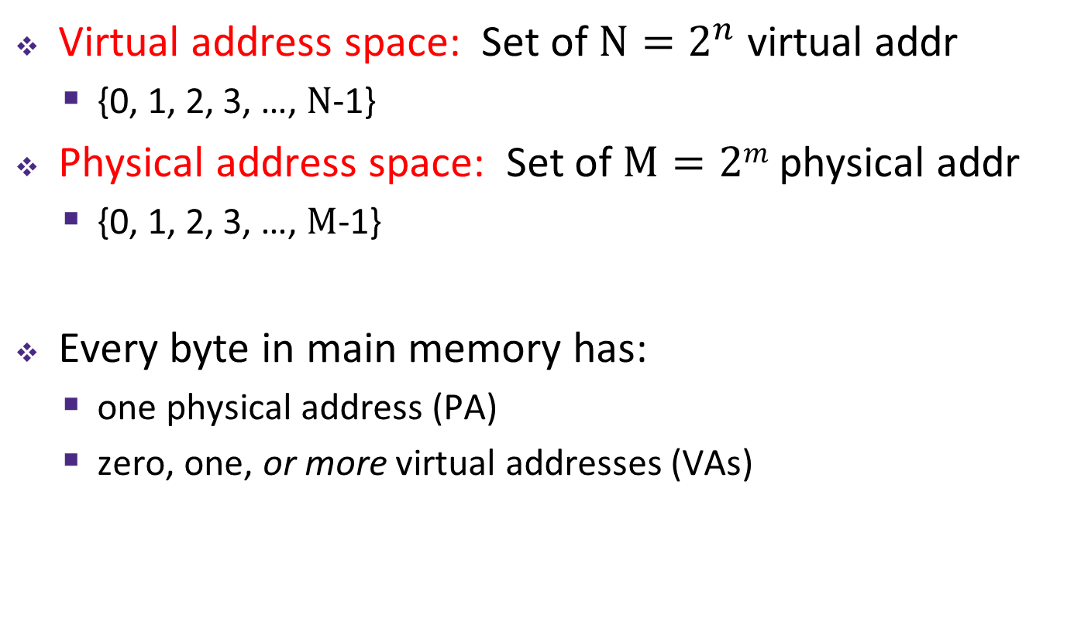
Address Spaces
Virtual address space: Set of $N=2^{n}$ virtual addr
  {0, 1, 2, 3, …, $N$-1}
Physical address space: Set of $M=2m$ physical addr
  {0, 1, 2, 3, …, $M$-1}
Every byte in main memory has:
  one physical address (PA)
  zero, one, or more virtual addresses (VAs)
Notes:
N and M are in Bytes
n and m are bits

Slide 20
Mapping
A virtual address (VA) can be mapped to either physical memory or disk
  Unused VAs may not have a mapping
  VAs from different processes may map to same location in memory/disk
Process 1’s Virtual
Address Space
Physical Memory
Process 2’s Virtual
Address Space
Disk
“Swap Space”

Slide 21
A System Using Physical Addressing
Main memory
0:
1:
2:
CPU
Physical address (PA)
3:
4:
0x4
5:
6:
7:
8:
...
M-1:
Data (int/float)
Used in “simple” systems with (usually) just one process:
  Embedded microcontrollers in devices like cars, elevators, and digital picture frames

Slide 22
A System Using Virtual Addressing
Main memory
0:
CPU Chip
1:
Virtual address
(VA)
Physical address
(PA)
2:
CPU
MMU
3:
4:
0x4100
0x4
5:
6:
7:
8:
Memory Management Unit
...
M-1:
Data (int/float)
Physical addresses are completely invisible to programs
  Used in all modern desktops, laptops, servers, smartphones…
  One of the great ideas in computer science
Notes:
VA = n-bits
PA = m-bits

Slide 23
Why Virtual Memory (VM)?
Efficient use of limited main memory (RAM)
  Use RAM as a cache for the parts of a virtual address space
    Some non-cached parts stored on disk
    Some (unallocated) non-cached parts stored nowhere
  Keep only active areas of virtual address space in memory
    Transfer data back and forth as needed
Simplifies memory management for programmers
  Each process “gets” the same full, private linear address space
Isolates address spaces (protection)
  One process can’t interfere with another’s memory
    They operate in different address spaces
  User process cannot access privileged information
    Different sections of address spaces have different permissions
Notes:
Adds disks to memory hierarchy
Simplifies memory for processes & programmers
Security/protection

Slide 24
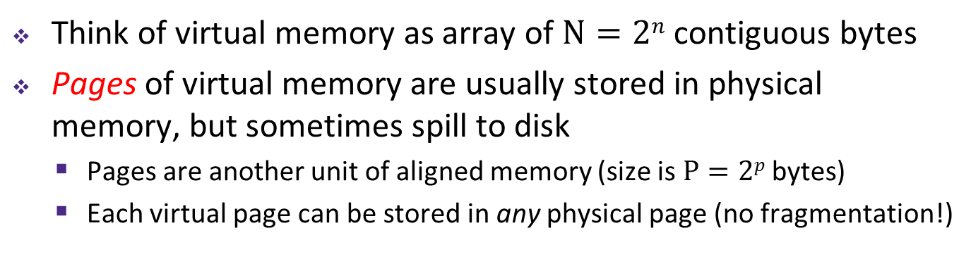
VM and the Memory Hierarchy
Think of virtual memory as array of $N=2n$ contiguous bytes
Pages of virtual memory are usually stored in physical memory, but sometimes spill to disk
  Pages are another unit of aligned memory (size is $P=2p$ bytes)
  Each virtual page can be stored in any physical page (no fragmentation!)
Virtual memory
Physical memory
0
Empty
PP 0
VP 0
Unallocated
0
PP 1
VP 1
Empty
Physical pages (PP's)
Virtual pages (VP's)
Unallocated
Empty
2^{m}-1
PP 2^{m-p}-1
Disk
VP 2^{n-p}-1
2^{n}-1
“Swap Space”
Notes:
Swap space: https://www.linux.com/news/all-about-linux-swap-space

Slide 25
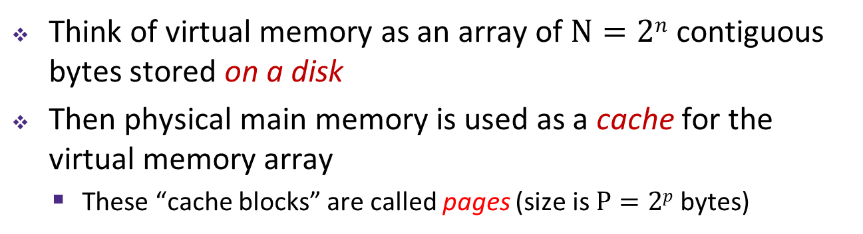
or: Virtual Memory as DRAM Cache for Disk
Think of virtual memory as an array of $N=2n$ contiguous bytes stored on a disk
Then physical main memory is used as a cache for the virtual memory array
  These “cache blocks” are called pages (size is $P=2p$ bytes)
Virtual memory
Physical memory
VP 0
Unallocated
0
VP 1
Cached
0
Empty
PP 0
Uncached
PP 1
Unallocated
Empty
Cached
Uncached
Empty
Cached
M-1
PP 2^{m-p}-1
VP 2^{n-p}-1
Uncached
N-1
Virtual pages (VPs)
“stored on disk”
Physical pages (PPs)
cached in DRAM

Slide 26
Memory Hierarchy: Core 2 Duo
Not drawn to scale
SRAM
Static Random Access Memory
DRAM
Dynamic Random Access Memory
~4 MB
~8 GB
~500 GB
L1
I-cache
L2 unified cache
Main Memory
Disk
32 KB
CPU
Reg
L1
D-cache
Throughput:
16 B/cycle
8 B/cycle
2 B/cycle
1 B/30 cycles
Latency:
3 cycles
14 cycles
100 cycles
millions
Miss Penalty
(latency)
33x
Miss Penalty
(latency)
10,000x

Slide 27
Virtual Memory Design Consequences
Large page size: typically 4-8 KB or 2-4 MB
  Can be up to 1 GB (for “Big Data” apps on big computers)
  Compared with 64-byte cache blocks
Fully associative
  Any virtual page can be placed in any physical page
  Requires a “large” mapping function – different from CPU caches
Highly sophisticated, expensive replacement algorithms in OS
  Too complicated and open-ended to be implemented in hardware
Write-back rather than write-through
  Really don’t want to write to disk every time we modify something in memory
  Some things may never end up on disk (e.g. stack for short-lived process)
Notes:
Fully associative: physical memory is a single set
Write-back: need to track dirty pages

Slide 28
Why does VM work on RAM/disk?
Avoids disk accesses because of locality
  Same reason that L1 / L2 / L3 caches work
The set of virtual pages that a program is “actively” accessing at any point in time is called its working set
  If (working set of one process ≤ physical memory):
    Good performance for one process (after compulsory misses)
  If (working sets of all processes > physical memory):
    Thrashing: Performance meltdown where pages are swapped between memory and disk continuously (CPU always waiting or paging)
    This is why your computer can feel faster when you add RAM
Notes:
Improving a program’s temporal locality can lead to a smaller working set (using data in one place in the program rather than many places).
Full quote: “Every problem in computer science can be solved by adding another level of indirection, but that usually will create another problem.”

Slide 29
Virtual Memory (VM)
Overview and motivation
VM as a tool for caching
Address translation
VM as a tool for memory management
VM as a tool for memory protection

Slide 30

Address Translation
How do we perform the virtual $→$ physical address translation?
Main memory
0:
CPU Chip
1:
Virtual address
(VA)
Physical address
(PA)
2:
CPU
MMU
3:
4:
0x4100
0x4
5:
6:
7:
8:
Memory Management Unit
...
M-1:
Data (int/float)

Slide 31

Address Translation: Page Tables
CPU-generated address can be split into:
  Request is Virtual Address (VA), want Physical Address (PA)
  Note that Physical Offset = Virtual Offset (page-aligned)
Use lookup table that we call the page table (PT)
  Replace Virtual Page Number (VPN) for Physical Page Number (PPN) to generate Physical Address
  Index PT using VPN: page table entry (PTE) stores the PPN plus management bits (e.g. Valid, Dirty, access rights)
  Has an entry for every virtual page – why?
$n$-bit address:
Virtual Page Number
Page Offset
Notes:
Page Offset = p bits
VPN = n-p bits
Splitting the address to VPN and Page Offset is analogous to splitting cache address to Block Number and Block Offset

Slide 32
Page Table Diagram
Physical memory
(DRAM)
Page tables stored in physical memory
  Too big to fit elsewhere – managed by MMU & OS
How many page tables in the system?
  One per process
Page Table
(DRAM)
VP 1
PP 0
Virtual page #
Valid
PPN/Disk Addr
VP 2
PP 1
PTE 0: 0
0
null
VP 7
PP 2
PTE 1: 1
1
PTE 2: 2
1
VP 4
PP 3
PTE 3: 3
0
PTE 4: 4
1
Virtual memory
(DRAM/disk)
PTE 5: 5
0
null
PTE 6: 6
0
VP 1
PTE 7: 7
1
...
...
VP 2
VP 3
VP 4
VP 6
VP 7
Notes:
Space allocated for pages in disk called Swap Space
Page Table has 2^(n-p) entries!
One for each page

Slide 33
Page Table Address Translation
CPU
Virtual address (VA)
Page table
base register
(PTBR)
Virtual page number (VPN)
Virtual page offset (VPO)
Page table address
for process
Page table
Valid
PPN
Valid bit = 0:
page not in memory
(page fault)
Physical page number (PPN)
Physical page offset (PPO)
In most cases, the MMU can perform this translation without software assistance
Physical address (PA)
Notes:
PTBR is another name for control register 3 (CR3) in x86: http://en.wikipedia.org/wiki/Control_register#CR3
PTBR is changed on a context switch
Each process has its own Page Table!

Slide 34
Page Hit
Page hit: VM reference is in physical memory
Page Table (DRAM)
Physical memory
(DRAM)
Virtual address
Valid
PPN/Disk Addr
PTE 0
0
null
VP 1
PP 0
1
VP 2
1
VP 7
0
VP 4
PP 3
1
0
null
0
Virtual memory
(DRAM/disk)
PTE 7
1
...
...
VP 1
VP 2
Example: Page size = 4 KB
VP 3
VP 4
Virtual Addr:
0x00740b
Physical Addr:
VP 6
VP 7
VPN:
PPN:
Notes:
4kB page = 2^12
3 hex digits
VPN = 0x007
VPO = PPO = 0x40b
PPN = 2
PTE (VPN) 7 points to PP 2
Physical Addr = 0x240b

Slide 35
Page Fault
Page fault: VM reference is NOT in physical memory
Page Table (DRAM)
Physical memory
(DRAM)
Virtual address
Valid
PPN/Disk Addr
PTE 0
0
null
VP 1
PP 0
1
VP 2
1
VP 7
0
VP 4
PP 3
1
0
null
0
Virtual memory
(DRAM/disk)
PTE 7
1
...
...
VP 1
VP 2
Example: Page size = 4 KB
Provide a virtual address request (in hex) that results in this particular page fault:
VP 3
VP 4
VP 6
VP 7
Virtual Addr:
Notes:
VA = 0x3000
note: last three hex digits can be anything! Need to access a PTE (VPN) that is cached in disk

Slide 36
Page Fault Exception
int a[1000];
int main ()
{
a[500] = 13;
}
User writes to memory location
That portion (page) of user’s memory
is currently on disk
Page fault handler must load page into physical memory
Returns to faulting instruction: mov is executed again!
  Successful on second try
80483b7: c7 05 10 9d 04 08 0d movl $0xd,0x8049d10
User code
OS Kernel code
exception: page fault
handle_page_fault:
movl
Create page and
load into memory
returns

Slide 37
Handling a Page Fault
Page miss causes page fault (an exception)
Page Table (DRAM)
Physical memory
(DRAM)
Virtual address
Valid
PPN/Disk Addr
PTE 0
0
null
VP 1
PP 0
1
VP 2
1
VP 7
0
VP 4
PP 3
1
0
null
Virtual memory
(DRAM/disk)
0
PTE 7
1
VP 1
...
...
VP 2
VP 3
VP 4
VP 6
VP 7

Slide 38
Handling a Page Fault
Page miss causes page fault (an exception)
Page fault handler selects a victim to be evicted (here VP 4)
Page Table (DRAM)
Physical memory
(DRAM)
Virtual address
Valid
PPN/Disk Addr
PTE 0
0
null
VP 1
PP 0
1
VP 2
1
VP 7
0
VP 4
PP 3
1
0
null
Virtual memory
(DRAM/disk)
0
PTE 7
1
VP 1
...
...
VP 2
VP 3
VP 4
VP 6
VP 7
Notes:
Check dirty bit on eviction!
Write back VP4 (PP3) to DRAM if dirty
2. Copy VP3 to DRAM

Slide 39
Handling a Page Fault
Page miss causes page fault (an exception)
Page fault handler selects a victim to be evicted (here VP 4)
Page Table (DRAM)
Physical memory
(DRAM)
Virtual address
Valid
PPN/Disk Addr
PTE 0
0
null
VP 1
PP 0
1
VP 2
1
VP 7
1
VP 3
PP 3
0
0
null
Virtual memory
(DRAM/disk)
0
PTE 7
1
VP 1
...
...
VP 2
VP 3
VP 4
VP 6
VP 7
Notes:
Note: entry for VP4 in Page Table has been invalidated!
Indicates that page is not cached in DRAM, but resides on disk

Slide 40
Handling a Page Fault
Page miss causes page fault (an exception)
Page fault handler selects a victim to be evicted (here VP 4)
Offending instruction is restarted: page hit!
Page Table (DRAM)
Physical memory
(DRAM)
Virtual address
Valid
PPN/Disk Addr
PTE 0
0
null
VP 1
PP 0
1
VP 2
1
VP 7
1
VP 3
PP 3
0
0
null
Virtual memory
(DRAM/disk)
0
PTE 7
1
VP 1
...
...
VP 2
VP 3
VP 4
VP 6
VP 7

Slide 41
Peer Instruction Question
How many bits wide are the following fields?
  16 KB pages
  48-bit virtual addresses
  16 GB physical memory
VPN PPN
(A)
34 24
(B)
32 18
(C)
30 20
(D)
34 20
Notes:
16 KB = 2^4 * 2^10 = 2^14 -> p = 14 bits
48-bit VA -> n = 48 bits
16 GB = 2^4 * 2^30 = 2^34 -> m = 34 bits
VPN = n-p = 34 bits -> 2^34 pages in virtual address space
PPN = m-p = 20 bits -> 2^20 pages in physical address space
Answer: D

Slide 42
Summary
Virtual memory provides:
  Ability to use limited memory (RAM) across multiple processes
  Illusion of contiguous virtual address space for each process
  Protection and sharing amongst processes
Indirection via address mapping by page tables
  Part of memory management unit and stored in memory
  Use virtual page number as index into lookup table that holds physical page number, disk address, or NULL (unallocated page)
  On page fault, throw exception and move page from swap space (disk) to main memory

