Slide 1
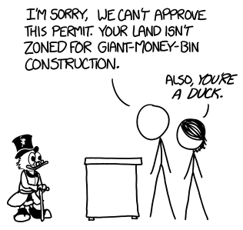
Caches III
CSE 351 Winter 2018
Instructor:
Mark Wyse
Teaching Assistants:
Kevin Bi
Parker DeWilde
Emily Furst
Sarah House
Waylon Huang
Vinny Palaniappan
https://what-if.xkcd.com/111/

Slide 2
Administrative
Midterm regrade requests due today
Lab 3 due today!
HW 4 out, due Friday, February 23
No lecture on Monday – President’s Day!
  OH also cancelled

Slide 3
Making memory accesses fast!
Cache basics
Principle of locality
Memory hierarchies
Cache organization
  Direct-mapped (sets; index + tag)
  Associativity (ways)
  Replacement policy
  Handling writes
Program optimizations that consider caches
Notes:
Divide addresses into “index” and “tag”

Slide 4

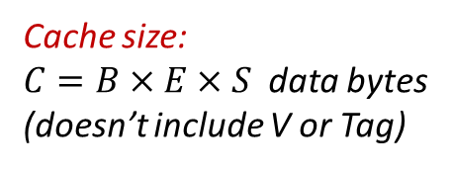
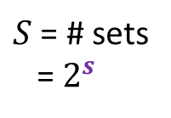


General Cache Organization ($S$, $E$, $B$)
$E$ = blocks/lines per set
set
“line” (block plus
management bits)
$S$ = # sets
= $2^{s}$
Cache size:
$C=B×E×S$ data bytes
(doesn’t include V or Tag)
V
Tag
0
1
2
B-1
valid bit
$B$ = bytes per block
Notes:
“Layers” of a cache:
Block (data)
Line (data + management bits)
Set (many lines based on associativity)
Cache (many sets based on cache size & associativity)
Valid bit lets us know if this line has been initialized (“is valid”).

Slide 5
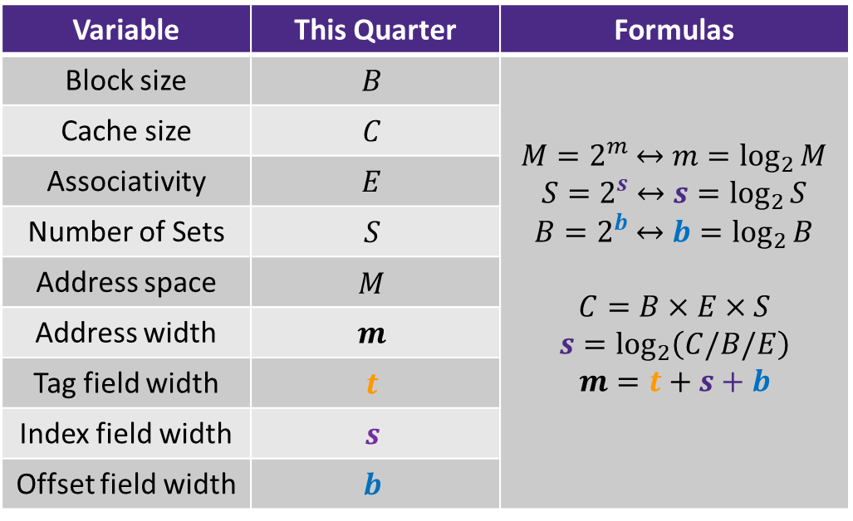
Notation Review
We just introduced a lot of new variable names!
  Please be mindful of block size notation when you look at past exam questions or are watching videos
Variable | This Quarter | Formulas
Block size | $$B$$ | $M=2^{m}$ $↔$ $m=\log_{2}{M}$ $S=2^{s}$ $↔$ $s=\log_{2}{S}$ $B=2^{b}$ $↔$ $b=\log_{2}{B}$ $$C=B×E×S$$ $$s=\log_{2}\left(C/B/E\right)$$ $$m=t+s+b$$
Cache size | $$C$$
Associativity | $$E$$
Number of Sets | $$S$$
Address space | $$M$$
Address width | $$m$$
Tag field width | $$t$$
Index field width | $$s$$
Offset field width | $$b$$

Slide 6






Cache Read
Locate set
Check if any line in set
is valid and has
matching tag: hit
Locate data starting
at offset
$E$ = blocks/lines per set
Address of byte in memory:
$t$ bits
$s$ bits
$b$ bits
$S$ = # sets
= $2^{s}$
tag
set
index
block
offset
data begins at this offset
v
tag
0
1
2
B-1
valid bit
$B$ = bytes per block

Slide 7
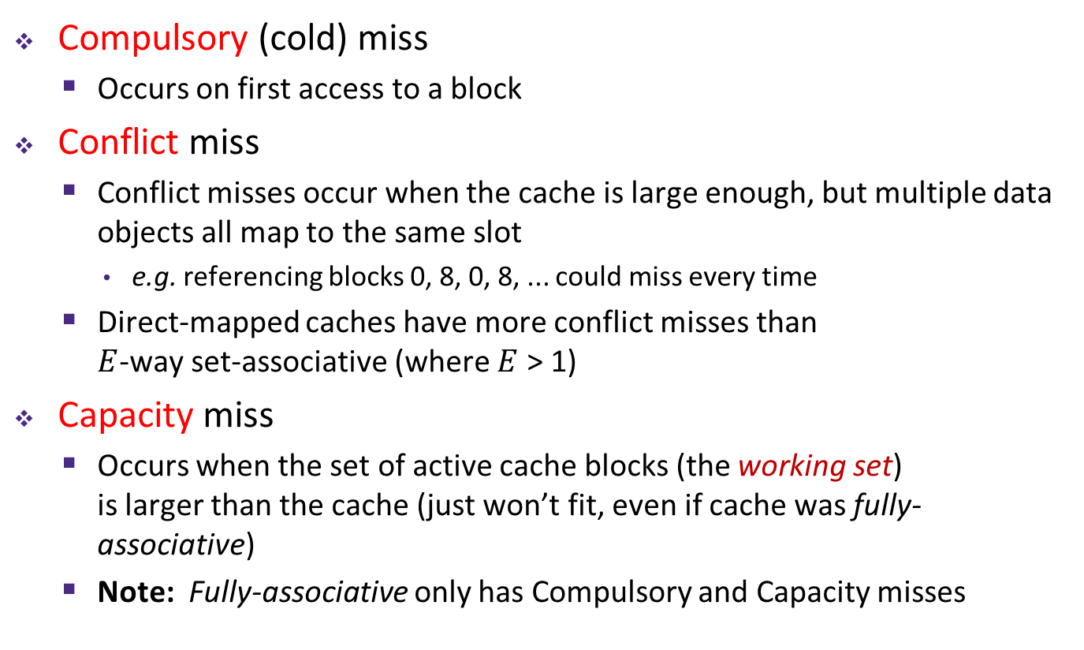
Types of Cache Misses: 3 C’s!
Compulsory (cold) miss
  Occurs on first access to a block
Conflict miss
  Conflict misses occur when the cache is large enough, but multiple data objects all map to the same slot
    e.g. referencing blocks 0, 8, 0, 8, ... could miss every time
  Direct-mapped caches have more conflict misses than
  $E$-way set-associative (where $E$ > 1)
Capacity miss
  Occurs when the set of active cache blocks (the working set)
  is larger than the cache (just won’t fit, even if cache was fully-associative)
  Note: Fully-associative only has Compulsory and Capacity misses

Slide 8
What about writes?
Multiple copies of data exist:
  L1, L2, possibly L3, main memory
What to do on a write-hit?
  Write-through: write immediately to next level
  Write-back: defer write to next level until line is evicted (replaced)
    Must track which cache lines have been modified (“dirty bit”)
What to do on a write-miss?
  Write-allocate: (“fetch on write”) load into cache, update line in cache
    Good if more writes or reads to the location follow
  No-write-allocate: (“write around”) just write immediately to memory
Typical caches:
  Write-back + Write-allocate, usually
  Write-through + No-write-allocate, occasionally
Notes:
Why? Reuse is common
Typically you would read, then write (incr)
Or after you initialize a value (say, to 0), likely read and write it again soon
We will study: Write-Back + Write-Allocate
Take 469/470 to learn more about caches and cache optimizations

Slide 9
Write-back, write-allocate example
Contents of memory stored at address G
Cache
G
0xBEEF
0
dirty bit
tag (there is only one set in this tiny cache, so the tag is the entire block address!)
Memory
F
In this example we are sort of
ignoring block offsets. Here a block
holds 2 bytes (16 bits, 4 hex digits).
Normally a block would be much
bigger and thus there would be
multiple items per block. While only
one item in that block would be
written at a time, the entire line would
be brought into cache.
0xCAFE
G
0xBEEF
Notes:
Note: not showing valid bit, but assume it is set (1) for all of example

Slide 10
Write-back, write-allocate example
mov 0xFACE, F
Cache
G
0xBEEF
0
dirty bit
Memory
F
0xCAFE
G
0xBEEF
Notes:
Write miss
Check cache for F -> miss
Block G is not dirty, so data in cache is same as data in memory
Fetch block into $, then write

Slide 11
Write-back, write-allocate example
mov 0xFACE, F
Cache
F
0xCAFE
U
0xBEEF
0xCAFE
0
0
dirty bit
Step 1: Bring F into cache
Memory
F
0xCAFE
G
0xBEEF

Slide 12
Write-back, write-allocate example
mov 0xFACE, F
Cache
F
0xCAFE
U
0xBEEF
0xFACE
0
1
dirty bit
Step 2: Write 0xFACE
to cache only and set
dirty bit
Memory
F
0xCAFE
G
0xBEEF
Notes:
Perform the write of 0xFACE into F in the $
Set the dirty bit because using write-back and writing new data to $

Slide 13
Write-back, write-allocate example
mov 0xFACE, F
mov 0xFEED, F
Cache
F
0xCAFE
U
0xBEEF
0xFACE
0
1
dirty bit
Write hit!
Write 0xFEED to
cache only
Memory
F
0xCAFE
G
0xBEEF
Notes:
Write hit example
F is in $
But, write a new value into the block
F remains dirty (dirty bit = 1)

Slide 14
Write-back, write-allocate example
mov 0xFACE, F
mov 0xFEED, F
mov G, %rax
Cache
F
0xCAFE
U
0xBEEF
0xFEED
0
1
dirty bit
Memory
F
0xCAFE
G
0xBEEF
Notes:
Read miss

Slide 15
Write-back, write-allocate example
mov 0xFACE, F
mov 0xFEED, F
mov G, %rax
Cache
G
0xBEEF
0
dirty bit
1. Write F back to memory
since it is dirty
2. Bring G into the cache so
we can copy it into %rax
Memory
F
0xFEED
G
0xBEEF
Notes:
Write back F to memory since it was dirty
Load G to $ (read miss)
Dirty bit remains unset (0) since data in $ is same as data in memory

Slide 16
Optimizations for the Memory Hierarchy
Write code that has locality!
  Spatial: access data contiguously
  Temporal: make sure access to the same data is not too far apart in time
How can you achieve locality?
  Adjust memory accesses in code (software) to improve miss rate (MR)
    Requires knowledge of both how caches work as well as your system’s parameters
  Proper choice of algorithm
  Loop transformations

Slide 17
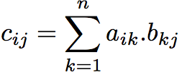
Example: Matrix Multiplication
C
A
B
c_{ij}
=
×
a_{i*}
b_{*j}
Notes:
Subscript indices given in (row,col).

Slide 18
Matrices in Memory
How do cache blocks fit into this scheme?
  Row major matrix in memory:
Cache blocks
COLUMN of matrix (blue) is spread among cache blocks shown in red

Slide 19



Naïve Matrix Multiply
# move along rows of A
for (i = 0; i < n; i++)
# move along columns of B
for (j = 0; j < n; j++)
# EACH k loop reads row of A, col of B
# Also read & write c(i,j) n times
for (k = 0; k < n; k++)
c[i*n+j] += a[i*n+k] * b[k*n+j];
C(i,j)
C(i,j)
A(i,:)
$$=$$
$$+$$
$$×$$
B(:,j)
Notes:
Note the += leads to an additional read of matrix C
Read A
Read B
Read C
Write C (guaranteed hit due to read of C)

Slide 20

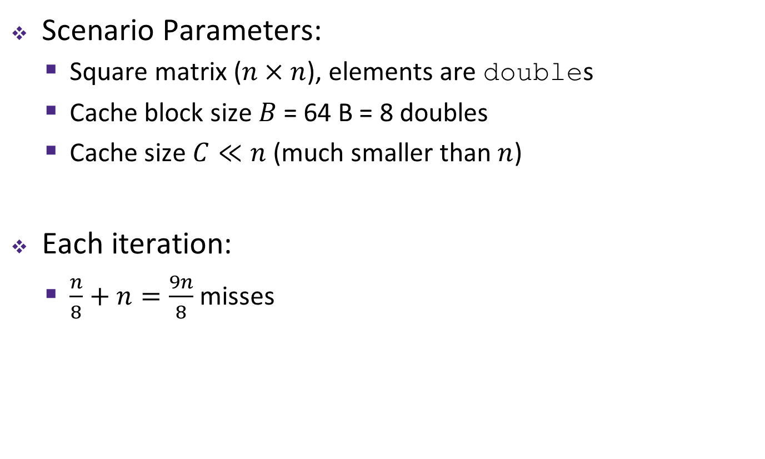

Cache Miss Analysis (Naïve)
Ignoring
matrix c
Scenario Parameters:
  Square matrix ($n×n$), elements are doubles
  Cache block size $B$ = 64 B = 8 doubles
  Cache size $C≪n$ (much smaller than $n$)
Each iteration:
  $\frac{n}{8}+n=\frac{9n}{8}$ misses
$$=$$
$$×$$
Notes:
Each cache block holds 8 matrix elements
A has good spatial locality
Stride 1
B has poor spatial locality
Stride n
By the time element n+1 is accessed, block has been kicked out of $
Iteration:
A = n/8
B = n

Slide 21

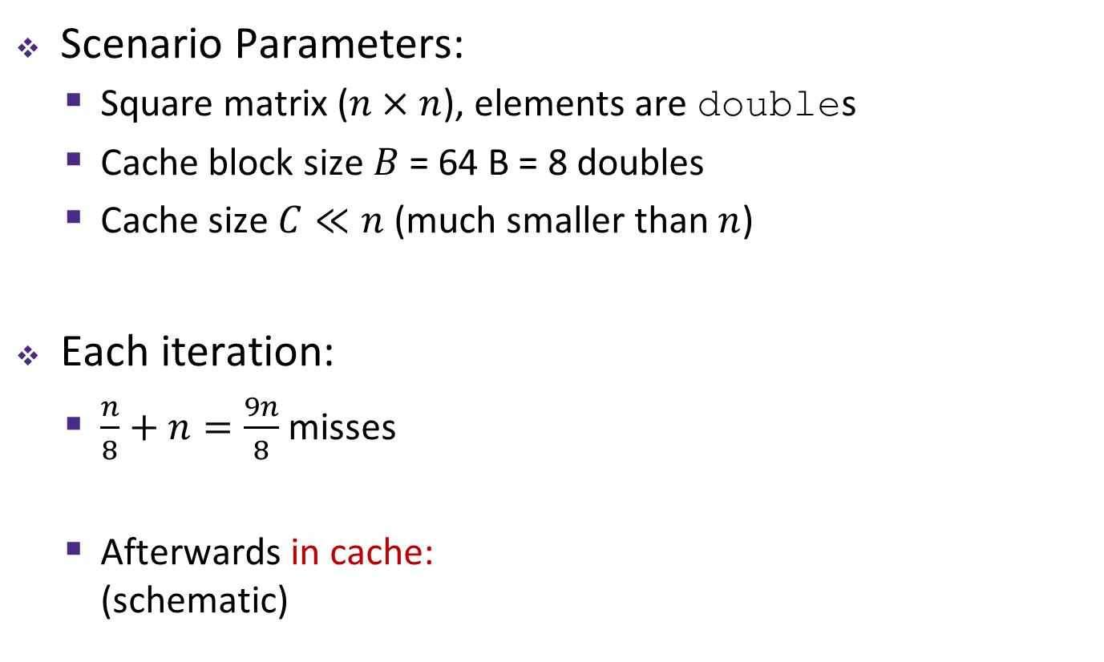

Cache Miss Analysis (Naïve)
Ignoring
matrix c
Scenario Parameters:
  Square matrix ($n×n$), elements are doubles
  Cache block size $B$ = 64 B = 8 doubles
  Cache size $C≪n$ (much smaller than $n$)
Each iteration:
  $\frac{n}{8}+n=\frac{9n}{8}$ misses
  Afterwards in cache:
  (schematic)
$$=$$
$$×$$
$$=$$
$$×$$
8 doubles wide
Notes:
Red portions show the blocks that are remaining in the $

Slide 22
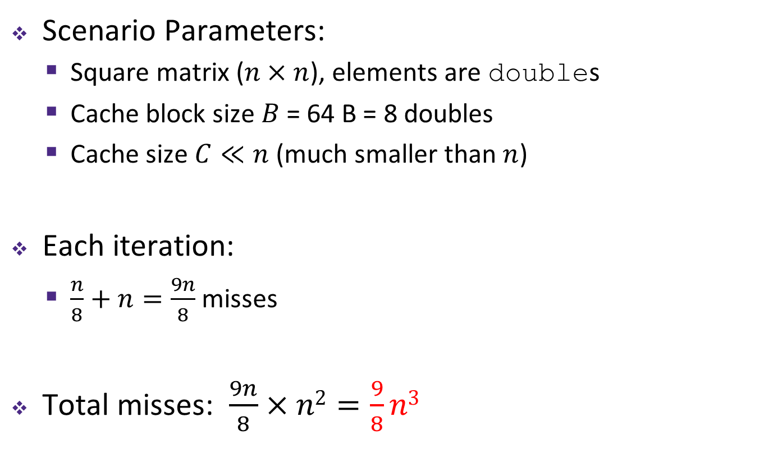
Cache Miss Analysis (Naïve)
Ignoring
matrix c
Scenario Parameters:
  Square matrix ($n×n$), elements are doubles
  Cache block size $B$ = 64 B = 8 doubles
  Cache size $C≪n$ (much smaller than $n$)
Each iteration:
  $\frac{n}{8}+n=\frac{9n}{8}$ misses
Total misses: $\frac{9n}{8}×n2=\frac{9}{8}n3$
$$=$$
$$×$$
once per element

Slide 23
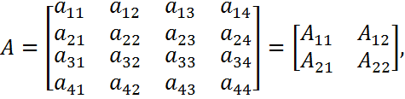


Linear Algebra to the Rescue (1)
This is extra (non-testable) material
Can get the same result of a matrix multiplication by splitting the matrices into smaller submatrices
(matrix “blocks”)
For example, multiply two 4×4 matrices:

Slide 24
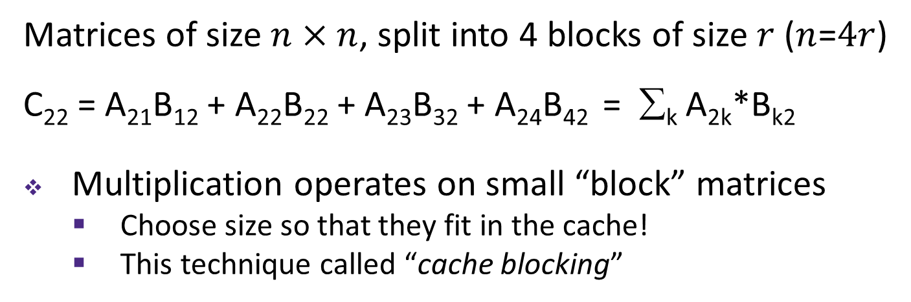
Linear Algebra to the Rescue (2)
This is extra (non-testable) material
C₁₁
C₁₂
C₁₃
C₁₄
A₁₁
A₁₂
A₁₃
A₁₄
B₁₁
B₁₂
B₁₃
B₁₄
C₂₁
C₂₂
C₂₃
C₂₄
A₂₁
A₂₂
A₂₃
A₂₄
B₂₁
B₂₂
B₂₃
B₂₄
C₃₁
C₃₂
C₄₃
C₃₄
A₃₁
A₃₂
A₃₃
A₃₄
B₃₂
B₃₂
B₃₃
B₃₄
C₄₁
C₄₂
C₄₃
C₄₄
A₄₁
A₄₂
A₄₃
A₁₄₄
B₄₁
B₄₂
B₄₃
B₄₄
Matrices of size $n×n$, split into 4 blocks of size $r$ ($n$=$4r$)
C₂₂ = A₂₁B₁₂ + A₂₂B₂₂ + A₂₃B₃₂ + A₂₄B₄₂ = ∑_{k} A_{2k}*B_{k2}
Multiplication operates on small “block” matrices
  Choose size so that they fit in the cache!
  This technique called “cache blocking”

Slide 25

Blocked Matrix Multiply
Blocked version of the naïve algorithm:
  $r$ = block matrix size (assume $r$ divides $n$ evenly)
# move by rxr BLOCKS now
for (i = 0; i < n; i += r)
for (j = 0; j < n; j += r)
for (k = 0; k < n; k += r)
# block matrix multiplication
for (ib = i; ib < i+r; ib++)
for (jb = j; jb < j+r; jb++)
for (kb = k; kb < k+r; kb++)
c[ib*n+jb] += a[ib*n+kb]*b[kb*n+jb];
Notes:
6 nested loops seems inefficient, but leads to faster code!
Outer three loops: loop over block matrices
Inner three loops: loop within block matrices

Slide 26




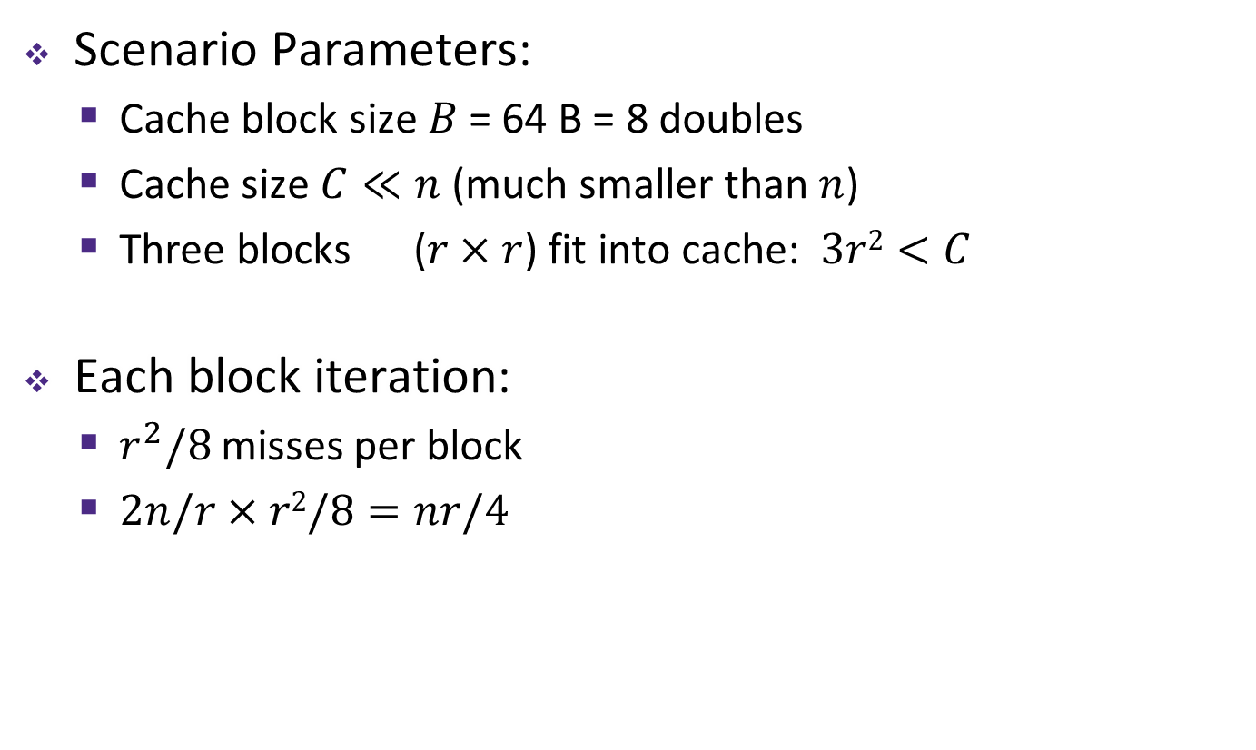
Cache Miss Analysis (Blocked)
Ignoring
matrix c
Scenario Parameters:
  Cache block size $B$ = 64 B = 8 doubles
  Cache size $C≪n$ (much smaller than $n$)
  Three blocks ($r×r$) fit into cache: $3r2<C$
Each block iteration:
  $r^{2}/8$ misses per block
  $2n/r×r2/8=nr/4$
$r2$ elements per block, 8 per cache block
$n$/$r$ blocks
$$=$$
$$×$$
$n$/$r$ blocks in row and column
Notes:
3r² < C: need to be able to fit three full blocks in the cache (one for c, one for a, one for b) while executing the algorithm

Slide 27
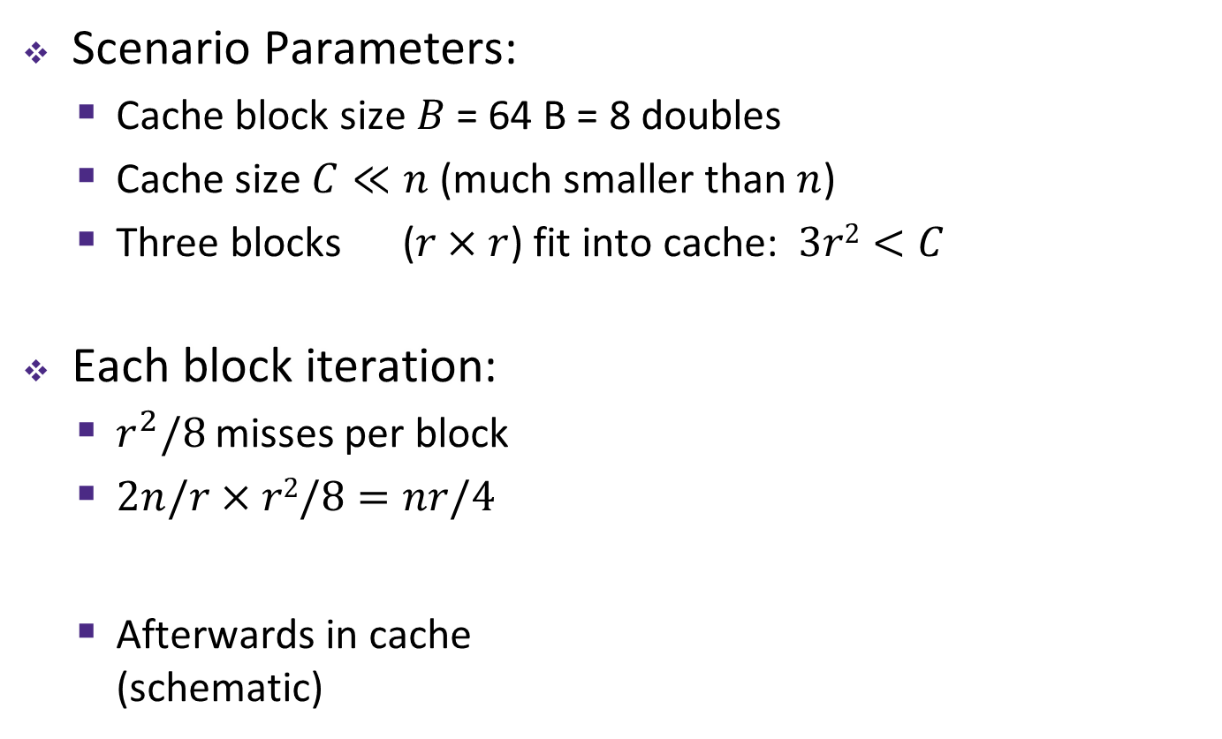

Cache Miss Analysis (Blocked)
Ignoring
matrix c
Scenario Parameters:
  Cache block size $B$ = 64 B = 8 doubles
  Cache size $C≪n$ (much smaller than $n$)
  Three blocks ($r×r$) fit into cache: $3r2<C$
Each block iteration:
  $r^{2}/8$ misses per block
  $2n/r×r2/8=nr/4$
  Afterwards in cache
  (schematic)
$r2$ elements per block, 8 per cache block
$n$/$r$ blocks
$$=$$
$$×$$
$n$/$r$ blocks in row and column
$$=$$
$$×$$
Notes:
3r² < C: need to be able to fit three full blocks in the cache (one for c, one for a, one for b) while executing the algorithm

Slide 28
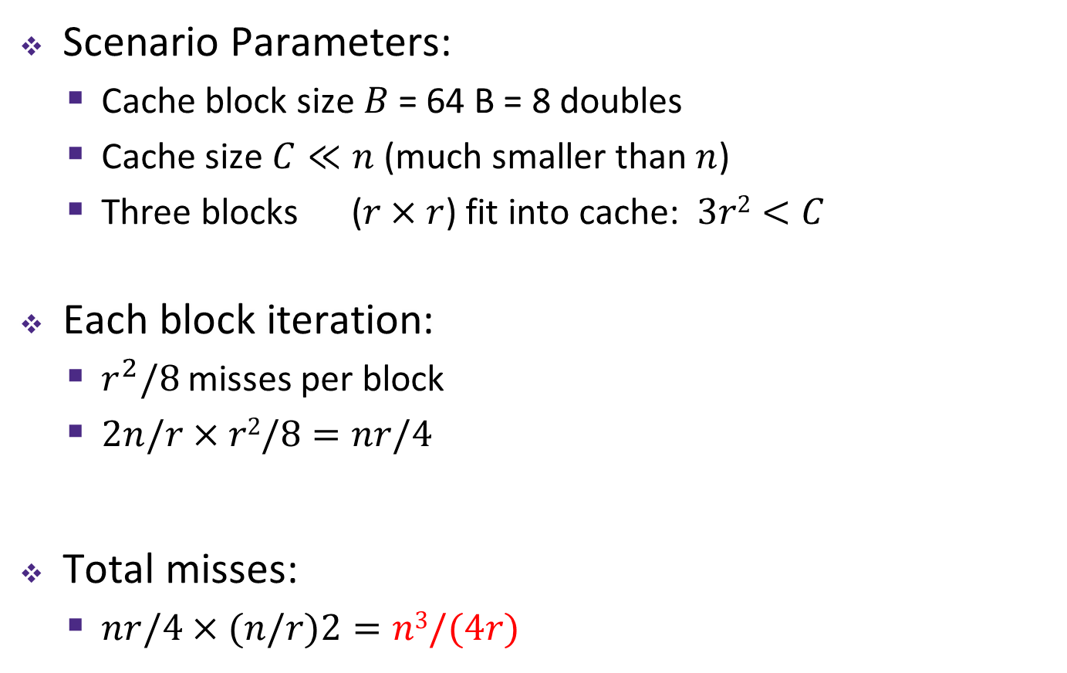
Cache Miss Analysis (Blocked)
Ignoring
matrix c
Scenario Parameters:
  Cache block size $B$ = 64 B = 8 doubles
  Cache size $C≪n$ (much smaller than $n$)
  Three blocks ($r×r$) fit into cache: $3r2<C$
Each block iteration:
  $r^{2}/8$ misses per block
  $2n/r×r2/8=nr/4$
Total misses:
  $nr/4×(n/r)2=n3/(4r)$
$r2$ elements per block, 8 per cache block
$n$/$r$ blocks
$$=$$
$$×$$
$n$/$r$ blocks in row and column
Notes:
3r² < C: need to be able to fit three full blocks in the cache (one for c, one for a, one for b) while executing the algorithm

Slide 29
Cache-Friendly Code
Programmer can optimize for cache performance
  How data structures are organized
  How data are accessed
    Nested loop structure
    Blocking is a general technique
All systems favor “cache-friendly code”
  Getting absolute optimum performance is very platform specific
    Cache size, cache block size, associativity, etc.
  Can get most of the advantage with generic code
    Keep working set reasonably small (temporal locality)
    Use small strides (spatial locality)
    Focus on inner loop code
Notes:
Generic Code -> good rules of thumb

Slide 30
The Memory Mountain
Core i7 Haswell
2.1 GHz
32 KB L1 d-cache
256 KB L2 cache
8 MB L3 cache
64 B block size
Aggressive prefetching
L1
Ridges
of temporal locality
L2
L3
Slopes
of spatial locality
Mem
Notes:
Increase stride size = less spatial locality = drop in throughput
Increase working set size = less temporal locality = fall out of respective caches
All caches on-chip

Slide 31
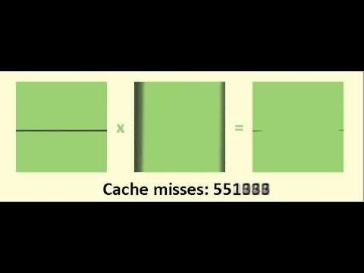
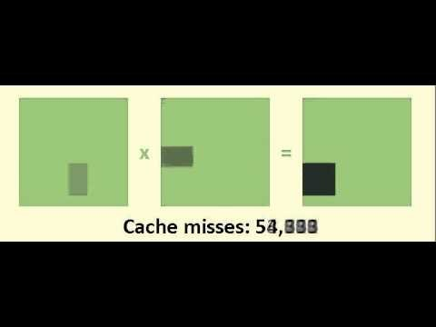
Matrix Multiply Visualization
Here $n$ = 100, $C$ = 32 KB, $r$ = 30
Naïve:
Blocked:
≈ 1,020,000
cache misses
≈ 90,000
cache misses

Slide 32
Anatomy of a Cache Question
Cache questions come in a few flavors:
  TIO Address Breakdown
  For fixed cache parameters, analyze the performance of the given code/sequence
  For given code/sequence, how does changing your cache parameters affect performance?
  Average Memory Access Time (AMAT)

Slide 33
Example Cache Parameters Problem
1 MB address space, 125 cycles to go to memory.
Fill in the following table:
Cache Size | 4 KB
Block Size | 16 B
Associativity | 4-way
Hit Time | 3 cycles
Miss Rate | 20%
Write Policy | Write-through
Replacement Policy | LRU
Tag Bits
Index Bits
Offset Bits
AMAT
10
6
4
AMAT =
3 + 0.2 * 125 = 28
Notes:
1 MB = 2^20 Bytes -> m = 20 bits
Miss Penalty (MP) = 125 cycles

Slide 34
Peer Instruction Question
We have a cache of size 2 KB with block size of 128 B. If our cache has 2 sets, what is its associativity?
2
4
8
16
We’re lost…
If addresses are 16 bits wide, how wide is the Tag field?
Notes:
Answer: C
2 KB = 2^11 B
128 B = 2^7 B
C/B = 2^(11-7) = 2^4 = 16 Blocks
E = Blocks/Sets = 16/2 = 8
t = m – s – b = 16 – log2(2) – log2(128) = 16 – 1 – 7 = 8 bits for tag

Slide 35
Peer Instruction Question
Which of the following cache statements is FALSE?
We can reduce compulsory misses by decreasing our block size
We can reduce conflict misses by increasing associativity
A write-back cache will save time for code with good temporal locality on writes
A write-through cache will always match data with the memory hierarchy level below it
We’re lost…
Notes:
Answer: A
A smaller block size pulls fewer bytes into $ on a miss, so this would increase compulsory misses
B: true, since higher associativity gives more options to place bocks before eviction
C: true, since frequently used blocks are rarely evicted, so fewer write-backs occur
D: true, since the main goal of a write-through cache is to keep its data consistent with the level below

Slide 36
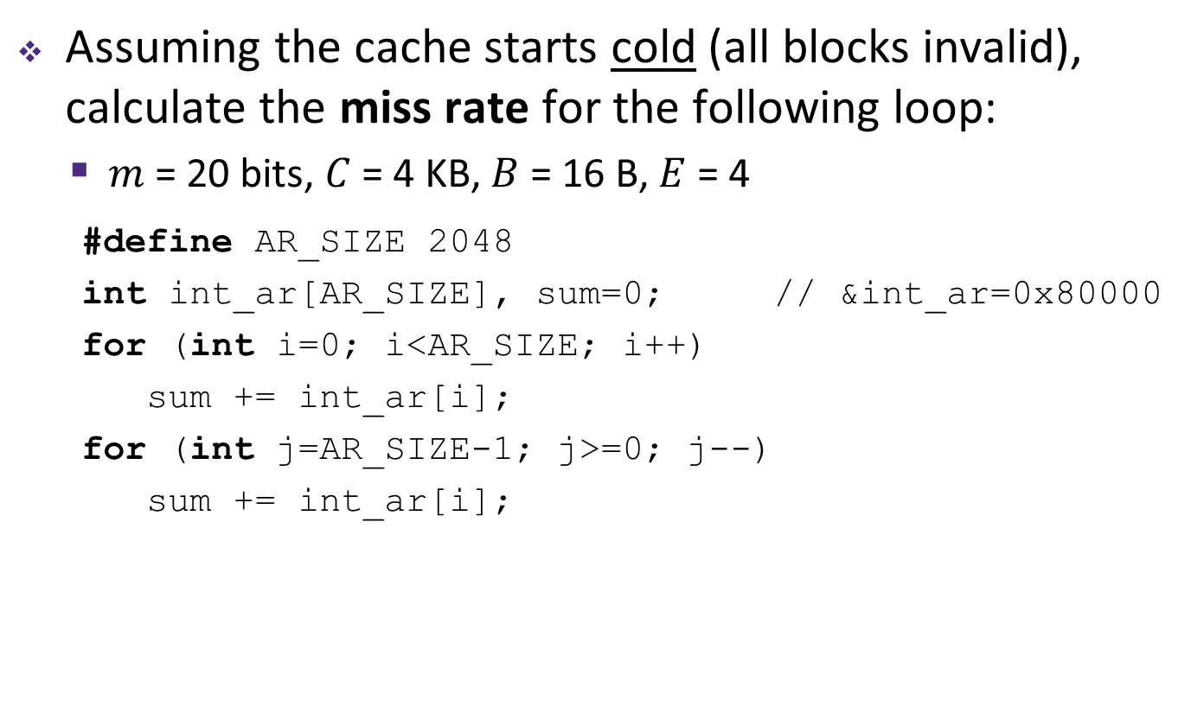
Example Code Analysis Problem
Assuming the cache starts cold (all blocks invalid), calculate the miss rate for the following loop:
  $m$ = 20 bits, $C$ = 4 KB, $B$ = 16 B, $E$ = 4
#define AR_SIZE 2048
int int_ar[AR_SIZE], sum=0; // &int_ar=0x80000
for (int i=0; i<AR_SIZE; i++)
sum += int_ar[i];
for (int j=AR_SIZE-1; j>=0; j--)
sum += int_ar[i];
Notes:
AR_SIZE 2048 = 2^11 ints = 2^13 Bytes
C = 2^12 Bytes = half of int_ar[]
m = 20: t = 10, s = 6, b = 4
Overall miss rate = ¾ * (¼) + ¼ * 0 = 3/16

Slide 37
Example Code Analysis Problem
Assuming the cache starts cold (all blocks invalid), calculate the miss rate for the following loop:
  $m$ = 20 bits, $C$ = 4 KB, $B$ = 16 B, $E$ = 4
#define AR_SIZE 2048
int int_ar[AR_SIZE], sum=0; // &int_ar=0x80000
for (int i=0; i<AR_SIZE; i++)
sum += int_ar[i];
for (int j=AR_SIZE-1; j>=0; j--)
sum += int_ar[i];
Notes:
AR_SIZE 2048 = 2^11 ints = 2^13 Bytes
C = 2^12 Bytes = half of int_ar[]
m = 20: t = 10, s = 6, b = 4
Overall miss rate = ¾ * (¼) + ¼ * 0 = 3/16

Slide 38
Suggested Problems
CS:APP 3rd
  Practice Problems 6.12-15
AU16 Final Question F5

Slide 39
Learning About Your Machine
Linux:
  lscpu
  ls /sys/devices/system/cpu/cpu0/cache/index0/
    Ex: cat /sys/devices/system/cpu/cpu0/cache/index*/size
Windows:
  wmic memcache get <query> (all values in KB)
  Ex: wmic memcache get MaxCacheSize
Modern processor specs: http://www.7-cpu.com/
Notes:
Linux Demo: type, level, size, ways_of_associativity
Windows Demo: Purpose, MaxCacheSize, BlockSize, Associativity

