Slide 1

Caches I
CSE 351 Winter 2018
Instructor:
Mark Wyse
Teaching Assistants:
Kevin Bi
Parker DeWilde
Emily Furst
Sarah House
Waylon Huang
Vinny Palaniappan
Alt text: I looked at some of the data dumps from vulnerable sites, and it was ... bad. I saw emails, passwords, password hints. SSL keys and session cookies. Important servers brimming with visitor IPs. Attack ships on fire off the shoulder of Orion, c-beams glittering in the dark near the Tannhäuser Gate. I should probably patch OpenSSL.
http://xkcd.com/1353/

Slide 2
Administrative
Lab 3 due Friday (2/16)
Midterm grades released later today
  Mean: 69%
  Median: 71%
  StDev: 13%
  Regrade requests done on Gradescope and due Friday (2/16)
Notes:
Midterm average goal was ~75%

Slide 3



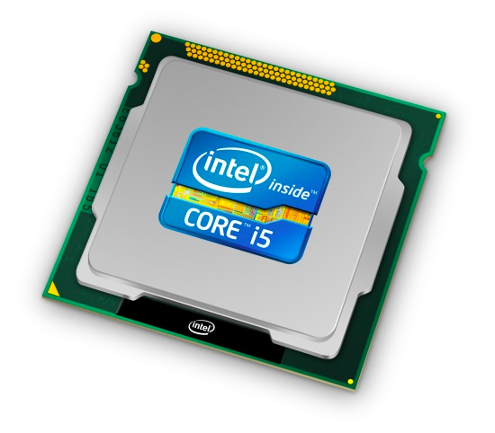
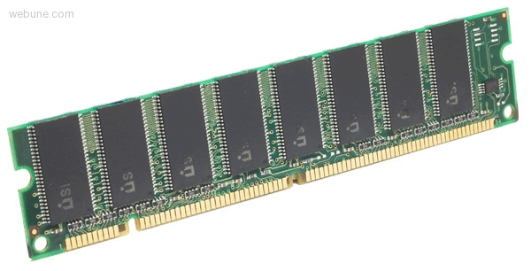

Roadmap
C:
Java:
Memory & data
Integers & floats
x86 assembly
Procedures & stacks
Executables
Arrays & structs
Memory & caches
Processes
Virtual memory
Memory allocation
Java vs. C
car *c = malloc(sizeof(car));
c->miles = 100;
c->gals = 17;
float mpg = get_mpg(c);
free(c);
Car c = new Car();
c.setMiles(100);
c.setGals(17);
float mpg =
c.getMPG();
Assembly language:
get_mpg:
pushq %rbp
movq %rsp, %rbp
...
popq %rbp
ret
OS:
Machine code:
0111010000011000
100011010000010000000010
1000100111000010
110000011111101000011111
Computer system:

Slide 4
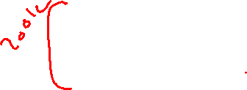
How does execution time grow with SIZE?
int array[SIZE];
int sum = 0;
for (int i = 0; i < 200000; i++) {
for (int j = 0; j < SIZE; j++) {
sum += array[j];
}
}
Time
Plot
SIZE
Notes:
What should we expect for this experiment?
Expect linear

Slide 5
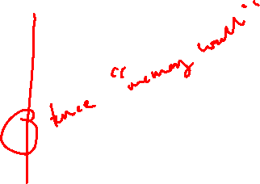
Actual Data
Data set > cache size
Time
Data set < cache size
SIZE
Notes:
Knee in the curve
After some size threshold
Memory “wall”
Steeper slope = execution time grows faster
Fits in cache, doesn’t fit in cache

Slide 6
Making memory accesses fast!
Cache basics
Principle of locality
Memory hierarchies
Cache organization
Program optimizations that consider caches

Slide 7
Processor-Memory Gap
1989 first Intel CPU with cache on chip
1998 Pentium III has two cache levels on chip
µProc
55%/year
(2X/1.5yr)
Processor-Memory
Performance Gap
(grows 50%/year)
“Moore’s Law”
DRAM
7%/year
(2X/10yrs)
Notes:
Earlier in course, we briefly talked about technology scaling

Slide 8

Problem: Processor-Memory Bottleneck
Processor performance
doubled about
every 18 months
Bus latency / bandwidth
evolved much slower
Main Memory
CPU
Reg
Core 2 Duo:
Can process at least
256 Bytes/cycle
Core 2 Duo:
Bandwidth
2 Bytes/cycle
Latency
100-200 cycles (30-60ns)
Problem: lots of waiting on memory
cycle: single machine step (fixed-time)
Notes:
What is a cycle
Only 2 hard problems in computer science: cache invalidation, naming things, and off-by-one errors.
Okay, so if one bite takes ~5-10 seconds
Going to memory: 15-30 minutes: going to grocery store

Slide 9
Problem: Processor-Memory Bottleneck
Processor performance
doubled about
every 18 months
Bus latency / bandwidth
evolved much slower
Main Memory
CPU
Reg
Cache
Core 2 Duo:
Can process at least
256 Bytes/cycle
Core 2 Duo:
Bandwidth
2 Bytes/cycle
Latency
100-200 cycles (30-60ns)
Solution: caches
cycle: single machine step (fixed-time)
Notes:
Have your avocados and eat them too

Slide 10

Cache 💰
Pronunciation: “cash”
  We abbreviate this as “$”
English: A hidden storage space
for provisions, weapons, and/or treasures
Computer: Memory with short access time used for the storage of frequently or recently used instructions (i-cache/I$) or data (d-cache/D$)
  More generally: Used to optimize data transfers between any system elements with different characteristics (network interface cache, I/O cache, etc.)

Slide 11

General Cache Mechanics
Smaller, faster, more expensive memory
Caches a subset of the blocks
Cache
7
9
14
3
Data is copied in block-sized transfer units
Memory
0
1
2
3
Larger, slower, cheaper memory.
Viewed as partitioned into “blocks”
4
5
6
7
8
9
10
11
12
13
14
15
Notes:
Note: these are not bytes: blocks

Slide 12

General Cache Concepts: Hit
Request: 14
Data in block b is needed
Block b is in cache:
Hit!
Cache
7
9
14
3
14
Data is returned to CPU
Memory
0
1
2
3
4
5
6
7
8
9
10
11
12
13
14
15
Notes:
1. access cache
2. return on hit

Slide 13
General Cache Concepts: Miss
Request: 12
Data in block b is needed
Block b is not in cache:
Miss!
Cache
7
9
14
3
12
Block b is fetched from
memory
12
Request: 12
Block b is stored in cache
Placement policy:
determines where b goes
Replacement policy:
determines which block
gets evicted (victim)
Memory
0
1
2
3
4
5
6
7
8
9
10
11
12
12
13
14
15
Data is returned to CPU
Notes:
1. access cache
2. miss
3. fill block to cache with fetch from memory
3. return data to CPU

Slide 14
Why Caches Work
Locality: Programs tend to use data and instructions with addresses near or equal to those they have used recently
Temporal locality:
  Recently referenced items are likely
  to be referenced again in the near future
Spatial locality:
  Items with nearby addresses tend
  to be referenced close together in time
How do caches take advantage of this?
block
block

Slide 15
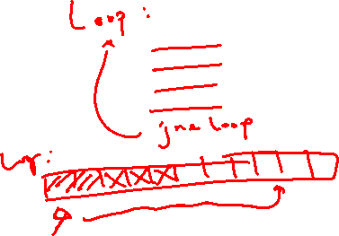
Example: Any Locality?
sum = 0;
for (i = 0; i < n; i++) {
sum += a[i];
}
return sum;
Data:
  Temporal: sum referenced in each iteration
  Spatial: array a[] accessed in stride-1 pattern
Instructions:
  Temporal: cycle through loop repeatedly
  Spatial: reference instructions in sequence

Slide 16
Locality Example #1
int sum_array_rows(int a[M][N])
{
int i, j, sum = 0;
for (i = 0; i < M; i++)
for (j = 0; j < N; j++)
sum += a[i][j];
return sum;
}

Slide 17
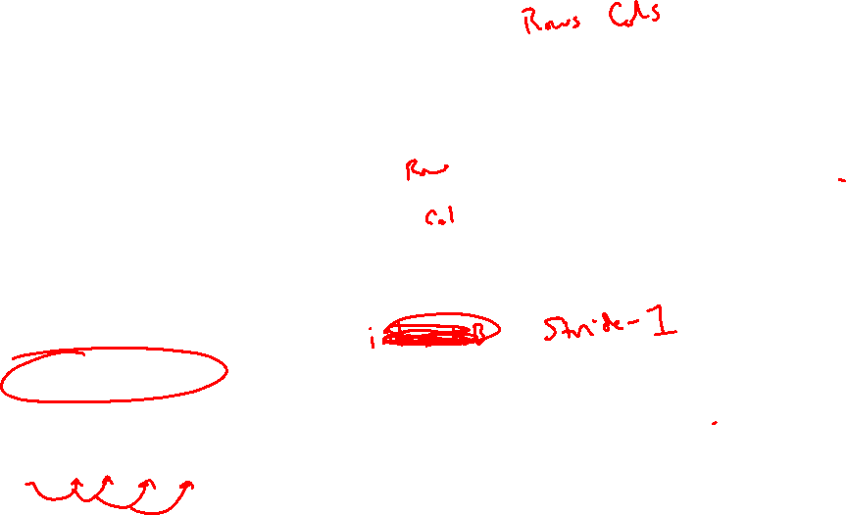
Locality Example #1
int sum_array_rows(int a[M][N])
{
int i, j, sum = 0;
for (i = 0; i < M; i++)
for (j = 0; j < N; j++)
sum += a[i][j];
return sum;
}
M = 3, N=4
a[0][0] |  | a[0][1] |  | a[0][2] |  | a[0][3]
a[1][0] |  | a[1][1] |  | a[1][2] |  | a[1][3]
a[2][0] |  | a[2][1] |  | a[2][2] |  | a[2][3]
Access Pattern:
stride = ?
1) | a[0][0]
2) | a[0][1]
3) | a[0][2]
4) | a[0][3]
5) | a[1][0]
6) | a[1][1]
7) | a[1][2]
8) | a[1][3]
9) | a[2][0]
10) | a[2][1]
11) | a[2][2]
12) | a[2][3]
Layout in Memory
a [0] [0] | a [0] [1] | a [0] [2] | a [0] [3] | a [1] [0] | a [1] [1] | a [1] [2] | a [1] [3] | a [2] [0] | a [2] [1] | a [2] [2] | a [2] [3]
76
92
108
Note: 76 is just one possible starting address of array a
Notes:
Stride-1

Slide 18

Locality Example #2
int sum_array_cols(int a[M][N])
{
int i, j, sum = 0;
for (j = 0; j < N; j++)
for (i = 0; i < M; i++)
sum += a[i][j];
return sum;
}
Notes:
Now, flip the iteration over rows and columns
Iterate the columns first

Slide 19
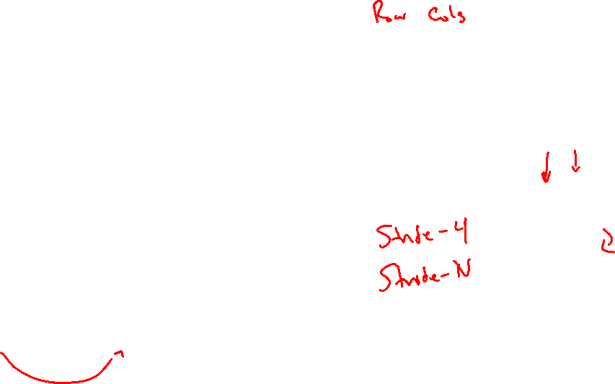
Locality Example #2
int sum_array_cols(int a[M][N])
{
int i, j, sum = 0;
for (j = 0; j < N; j++)
for (i = 0; i < M; i++)
sum += a[i][j];
return sum;
}
M = 3, N=4
a[0][0] |  | a[0][1] |  | a[0][2] |  | a[0][3]
a[1][0] |  | a[1][1] |  | a[1][2] |  | a[1][3]
a[2][0] |  | a[2][1] |  | a[2][2] |  | a[2][3]
Access Pattern:
stride = ?
1) | a[0][0]
2) | a[1][0]
3) | a[2][0]
4) | a[0][1]
5) | a[1][1]
6) | a[2][1]
7) | a[0][2]
8) | a[1][2]
9) | a[2][2]
10) | a[0][3]
11) | a[1][3]
12) | a[2][3]
Layout in Memory
a [0] [0] | a [0] [1] | a [0] [2] | a [0] [3] | a [1] [0] | a [1] [1] | a [1] [2] | a [1] [3] | a [2] [0] | a [2] [1] | a [2] [2] | a [2] [3]
76
92
108
Notes:
Stride-4 in this example
Stride-N in general

Slide 20
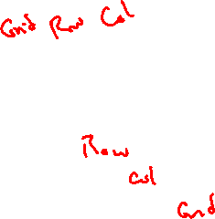
Locality Example #3
int sum_array_3D(int a[M][N][L])
{
int i, j, k, sum = 0;
for (i = 0; i < N; i++)
for (j = 0; j < L; j++)
for (k = 0; k < M; k++)
sum += a[k][i][j];
return sum;
}
What is wrong with this code?
How can it be fixed?
a[2][0][0] |  | a[2][0][1] |  | a[2][0][2] |  | a[2][0][3]
a[2][1][0] |  | a[2][1][1] |  | a[2][1][2] |  | a[2][1][3]
a[2][2][0] |  | a[2][2][1] |  | a[2][2][2] |  | a[2][2][3]
a[1][0][0] |  | a[1][0][1] |  | a[1][0][2] |  | a[1][0][3]
a[1][1][0] |  | a[1][1][1] |  | a[1][1][2] |  | a[1][1][3]
a[1][2][0] |  | a[1][2][1] |  | a[1][2][2] |  | a[1][2][3]
a[0][0][0] |  | a[0][0][1] |  | a[0][0][2] |  | a[0][0][3]
a[0][1][0] |  | a[0][1][1] |  | a[0][1][2] |  | a[0][1][3]
a[0][2][0] |  | a[0][2][1] |  | a[0][2][2] |  | a[0][2][3]
m = 2
m = 1
m = 0
Notes:
M = grids
N = rows
L = columns

Slide 21
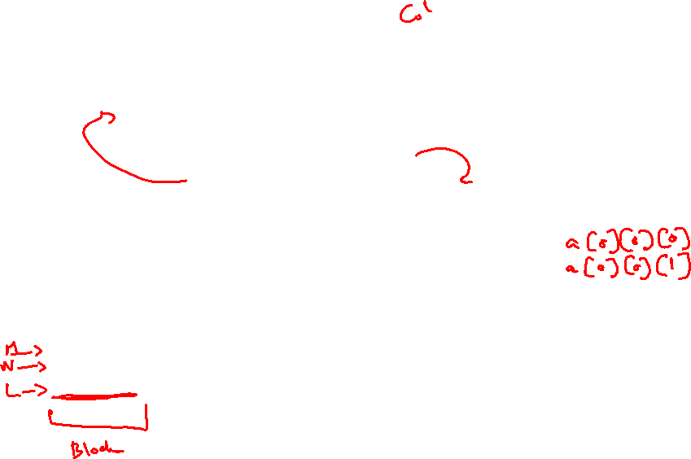

Locality Example #3
int sum_array_3D(int a[M][N][L])
{
int i, j, k, sum = 0;
for (i = 0; i < N; i++)
for (j = 0; j < L; j++)
for (k = 0; k < M; k++)
sum += a[k][i][j];
return sum;
}
What is wrong with this code?
How can it be fixed?
Layout in Memory (M = ?, N = 3, L = 4)
a [0] [0] [0] | a [0] [0] [1] | a [0] [0] [2] | a [0] [0] [3] | a [0] [1] [0] | a [0] [1] [1] | a [0] [1] [2] | a [0] [1] [3] | a [0] [2] [0] | a [0] [2] [1] | a [0] [2] [2] | a [0] [2] [3]
a [1] [0] [0] | a [1] [0] [1] | a [1] [0] [2] | a [1] [0] [3] | a [1] [1] [0] | a [1] [1] [1] | a [1] [1] [2] | a [1] [1] [3] | a [1] [2] [0] | a [1] [2] [1] | a [1] [2] [2] | a [1] [2] [3]
$$⋅ ⋅ ⋅$$
76
92
108
124
140
156
172
Notes:
Grid 0, Grid 1
i -> stride-L
j -> stride-1
k -> stride-N*L

Slide 22
Cache Performance Metrics
Huge difference between a cache hit and a cache miss
  Could be 100x speed difference between accessing cache and main memory (measured in clock cycles)
Miss Rate (MR)
  Fraction of memory references not found in cache (misses / accesses) = 1 - Hit Rate
Hit Time (HT)
  Time to deliver a block in the cache to the processor
    Includes time to determine whether the block is in the cache
Miss Penalty (MP)
  Additional time required because of a miss

Slide 23
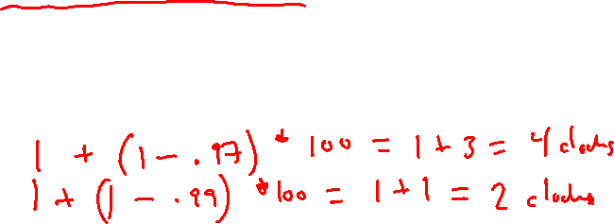
Cache Performance
Two things hurt the performance of a cache:
  Miss rate and miss penalty
  Average Memory Access Time (AMAT): average time to access memory considering both hits and misses
  AMAT = Hit time + Miss rate × Miss penalty
  (abbreviated AMAT = HT + MR × MP)
99% hit rate twice as good as 97% hit rate!
  Assume HT of 1 clock cycle and MP of 100 clock cycles
  97%: AMAT =
  99%: AMAT =
Notes:
97: 1 + 0.03*100 = 4 clock cycles
99: 1 + 0.01*100 = 2 clock cycles

Slide 24
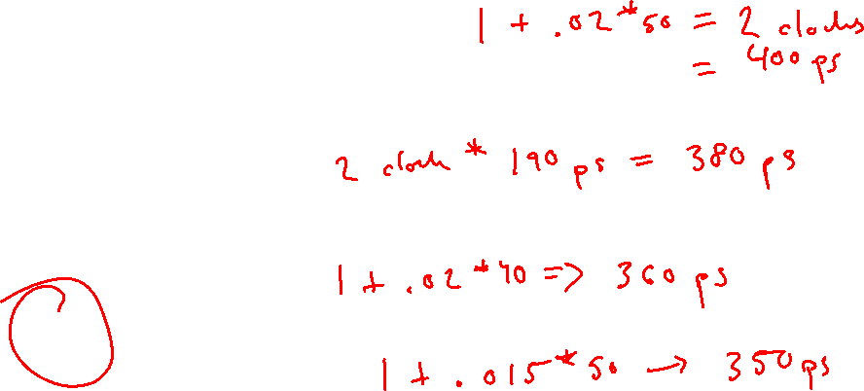
Peer Instruction Question
Processor specs: 200 ps clock, MP of 50 clock cycles, MR of 0.02 misses/instruction, and HT of 1 clock cycle
  AMAT = HT + MR*MP =
Which improvement would be best?
  190 ps clock
  Miss penalty of 40 clock cycles
  MR of 0.015 misses/instruction
Notes:
AMAT = 1 + 0.02 * 50 = 2 cycles = 400 ps
A (faster CPU): 380 ps
B (faster Memory, smaller Memory): 360 ps
C (write better code): 350 ps
Answer: C

Slide 25
Can we have more than one cache?
Why would we want to do that?
  Avoid going to memory!
Typical performance numbers:
  Miss Rate
    L1 MR = 3-10%
    L2 MR = Quite small (e.g. < 1%), depending on parameters, etc.
  Hit Time
    L1 HT = 4 clock cycles
    L2 HT = 10 clock cycles
  Miss Penalty
    P = 50-200 cycles for missing in L2 & going to main memory
    Trend: increasing!
Notes:
1. optimize L1 for fast Hit Time (HT)
2. optimize L2 for low Miss Rate (MR)

Slide 26
Memory Hierarchies
Some fundamental and enduring properties of hardware and software systems:
  Faster storage technologies almost always cost more per byte and have lower capacity
  The gaps between memory technology speeds are widening
    True for: registers ↔ cache, cache ↔ DRAM, DRAM ↔ disk, etc.
  Well-written programs tend to exhibit good locality
These properties complement each other beautifully
  They suggest an approach for organizing memory and storage systems known as a memory hierarchy

Slide 27

An Example Memory Hierarchy
<1 ns
registers
1 ns
on-chip L1
cache (SRAM)
Smaller,
faster,
costlier
per byte
5-10 ns
off-chip L2
cache (SRAM)
Larger,
slower,
cheaper
per byte
100 ns
main memory
(DRAM)
150,000 ns
SSD
local secondary storage
(local disks)
10,000,000 ns
(10 ms)
Disk
1-150 ms
remote secondary storage
(distributed file systems, web servers)
Notes:
Going to SSD is like walking down to California to get an avocado
Disk is like waiting a year for a new crop of avocados
Going across the world is like waiting for an avocado tree to grow up from a seed…

Slide 28
Summary
Memory Hierarchy
  Successively higher levels contain “most used” data from lower levels
  Exploits temporal and spatial locality
  Caches are intermediate storage levels used to optimize data transfers between any system elements with different characteristics
Cache Performance
  Ideal case: found in cache (hit)
  Bad case: not found in cache (miss), search in next level
  Average Memory Access Time (AMAT) = HT + MR × MP
    Hurt by Miss Rate and Miss Penalty

Slide 29
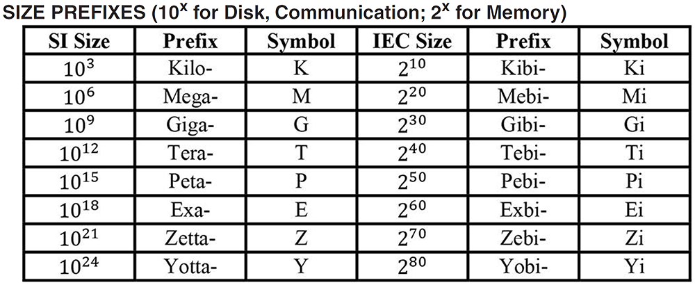
Aside: Units and Prefixes
Here focusing on large numbers (exponents > 0)
Note that 10³ ≈ 2¹⁰
SI prefixes are ambiguous if base 10 or 2
IEC prefixes are unambiguously base 2
Notes:
Disk capacity SI to IEC conversion
512 GB = 512 * 10^9
So, actual size is 512 * 10 ^9 / (2^30) Bytes = 477 GiB

