Slide 1
Buffer Overflows CSE 351 Winter 2018
Instructor:
Mark Wyse
Teaching Assistants:
Kevin Bi, Parker DeWilde, Emily Furst,
Sarah House, Waylon Huang, Vinny Palaniappan
http://xkcd.com/804/

Slide 2
Administrative
Homework 3 due Friday (2/9)
Lab 3 due next Friday (2/16)

Slide 3
Accessing Array Elements
Compute start of array element as: 12*index
sizeof(S3) = 12, including alignment padding
Element j is at offset 8 within structure
Assembler gives offset a+8
struct S3 {
short i;
float v;
short j;
} a[10];
 | a[0] |  |  |  |  | • • • |  |  |  | a[index] |  |  |  | • • |  |  | •
a+0 |  |  |  |  | a+12 |  |  |  | a+12*index
 |  |  |  |  | i | 2 bytes |  | v |  |  | j | 2 bytes
 |  |  |  | a+12*index
a+12*index+8
short get_j(int index)
{
return a[index].j;
}
# %rdi = index
leaq (%rdi,%rdi,2),%rax # 3*index
movzwl a+8(,%rax,4),%eax

Slide 4
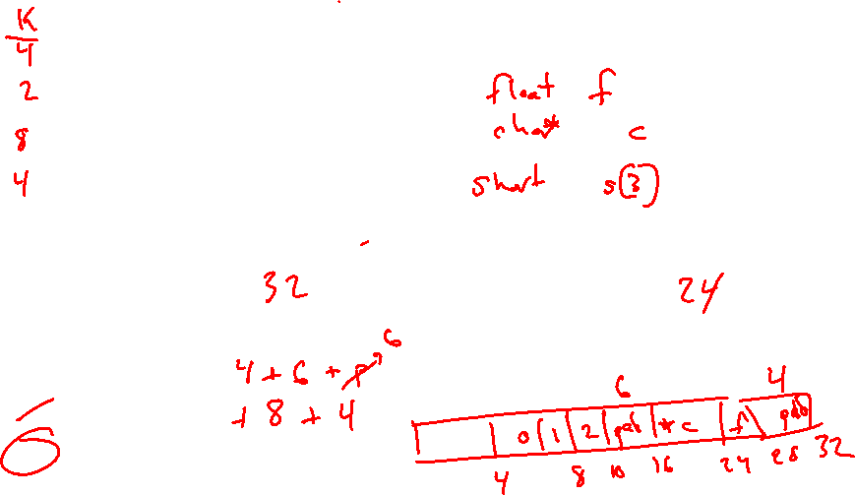
Peer Instruction Question
Minimize the size of the struct by re-ordering the vars
What are the old and new sizes of the struct?
sizeof(struct old) = _____ sizeof(struct new) = _____
16 bytes
22 bytes
28 bytes
32 bytes
We’re lost…
struct old {
int i;
short s[3];
char *c;
float f;
};
struct new {
int i;
______ ______;
______ ______;
______ ______;
};
Notes:
Compute K values, and Kmax
K = 4, 2, 8, 4
Kmax = 8
Question: what is the size of struct old?
Answer: 32 B
Draw pictures of the structs (incl. fragmentation)
Minimal ordering:
Float f
Char *c
Short s[3]
New size: 24 B
** could also switch order of c and s[3] in this particular example. Fragmentation type changes, but total size does not

Slide 5
Unions
Only allocates enough space for the largest element in union
Can only use one member at a time
struct S {
char c;
int i[2];
double v;
} *sp;
union U {
char c;
int i[2];
double v;
} *up;
 | c
 | i[0] |  |  |  | i[1]
 | v
up+0 |  |  | up+4 |  |  |  |  | up+8
 | c | 3 bytes |  |  | i[0] |  |  |  | i[1] |  |  |  | 4 bytes |  |  | v
sp+0 |  |  |  | sp+4 |  |  |  | sp+8 |  |  |  |  |  |  | sp+16 |  |  |  |  |  | sp+24
Notes:
Unions simply reinterpret the bytes stored
Storing into one member, then examining through another does not change the underlying bytes!!!
Unions are a clever way to easily examine the bits/bytes of a floating point number
Float -> unsigned int
Double -> unsigned long int

Slide 6
Summary
Arrays in C
Aligned to satisfy every element’s alignment requirement
Structures
Allocate bytes in order declared
Pad in middle and at end to satisfy alignment
Unions
Provide different views of the same memory location

Slide 7
Buffer Overflows
Address space layout (more details!)
Input buffers on the stack
Overflowing buffers and injecting code
Defenses against buffer overflows

Slide 8
Review: General Memory Layout
not drawn to scale
2^{N}-1
Stack
Stack
Local variables (procedure context)
Heap
Dynamically allocated as needed
malloc(), calloc(), new, …
Statically allocated Data
Read/write: global variables (Static Data)
Read-only: string literals (Literals)
Code/Instructions
Executable machine instructions
Read-only
Heap
Static Data
Literals
Instructions
0

Slide 9
x86-64 Linux Memory Layout
not drawn to scale
0x00007FFFFFFFFFFF
Stack
Stack
Runtime stack has 8 MiB limit
Heap
Dynamically allocated as needed
malloc(), calloc(), new, …
Statically allocated data (Data)
Read-only: string literals
Read/write: global arrays and variables
Code / Shared Libraries
Executable machine instructions
Read-only
48 bits
Heap
Shared
Libraries
Heap
Data
Hex Address
0x400000
Instructions
0x000000
Notes:
OS at addresses above the stack (e.g., top 1 GB)
There are multiple ways to dynamically allocate memory
Shared library code also lives in the middle of the address space
Bottom of instructions at lowest possible address

Slide 10
Memory Allocation Example
not drawn to scale
char big_array[1L<<24]; /* 16 MB */
char huge_array[1L<<31]; /* 2 GB */
int global = 0;
int useless() { return 0; }
int main()
{
void *p1, *p2, *p3, *p4;
int local = 0;
p1 = malloc(1L << 28); /* 256 MB */
p2 = malloc(1L << 8); /* 256 B */
p3 = malloc(1L << 32); /* 4 GB */
p4 = malloc(1L << 8); /* 256 B */
/* Some print statements ... */
}
Stack
Heap
Shared
Libraries
Heap
Data
Instructions
Where does everything go?
Notes:
big_array, huge_array, global: data
int local,
p1 is a stack address
*p1 is a heap address

Slide 11
Reminder: x86-64/Linux Stack Frame
Higher Addresses
Caller’s Stack Frame
Arguments (if > 6 args) for this call
Return address
Pushed by call instruction
Current/ Callee Stack Frame
Old frame pointer (optional)
Saved register context (when reusing registers)
Local variables (if can’t be kept in registers)
“Argument build” area (If callee needs to call another function -parameters for function about to call, if needed)
Caller
Frame
Arguments
7+
Frame pointer %rbp
Return Addr
Old %rbp
(Optional)
Saved
Registers
+
Local
Variables
Argument
Build
(Optional)
Stack pointer
%rsp
Lower Addresses
Notes:
A local array will be somewhere in the stack

Slide 12
Buffer Overflow in a Nutshell
Characteristics of the traditional Linux memory layout provide opportunities for malicious programs
Data and instructions both stored in the same memory
C does not check array bounds
Many Unix/Linux/C functions don’t check argument sizes
Allows overflowing (writing past the end) of buffers (arrays)
Notes:
http://en.wikipedia.org/wiki/Morris_worm

Slide 13
Buffer Overflow in a Nutshell
Buffer overflows on the stack can overwrite “interesting” data
Attackers just choose the right inputs
Simplest form (sometimes called “stack smashing”)
Unchecked length on string input into bounded array causes overwriting of stack data
Try to change the return address of the current procedure
Why is this a big deal?
It is (was?) the #1 technical cause of security vulnerabilities
Notes:
#1 overall cause is social engineering / user ignorance

Slide 14
String Library Code
Implementation of Unix function gets()
What could go wrong in this code?
/* Get string from stdin */
char* gets(char* dest) { int c = getchar();
char* p = dest;
while (c != EOF && c != '\n') {
*p++ = c;
c = getchar();
}
*p = '\0';
return dest;
}
pointer to start
of an array
same as:
*p = c;
p++;
Notes:
Don’t know size of dest buffer
EOF = end of file
‘\n’ = newline
getchar() reads a character from input stream

Slide 15
String Library Code
Implementation of Unix function gets()
No way to specify limit on number of characters to read
Similar problems with other Unix functions:
strcpy: Copies string of arbitrary length to a dst
scanf, fscanf, sscanf, when given %s specifier
/* Get string from stdin */
char* gets(char* dest) { int c = getchar();
char* p = dest;
while (c != EOF && c != '\n') {
*p++ = c;
c = getchar();
}
*p = '\0';
return dest;
}
Notes:
The man page for gets(3) now says “BUGS: Never use gets().”
The stop condition for reading looks for special characters

Slide 16
Vulnerable Buffer Code
/* Echo Line */ void echo() { char buf[8]; /* Way too small! */ gets(buf); puts(buf); }
Input buffer
Read input to buffer
Print from buffer
void call_echo() {
echo();
}
unix> ./buf-nsp
Enter string: 12345678901234567890123
12345678901234567890123
unix> ./buf-nsp
Enter string: 123456789012345678901234
Segmentation Fault
Notes:
If we overrun the buffer, it’s fine for a while...
But then we add one more character, and it seg-faults!
Why? (let’s see...)

Slide 17
Buffer Overflow Disassembly (buf-nsp)
echo:
00000000004005c6 <echo>:
4005c6: 48 83 ec 18 sub $0x18,%rsp
... ... calls printf ...
4005d9: 48 89 e7 mov %rsp,%rdi
4005dc: e8 dd fe ff ff callq 4004c0 <gets@plt>
4005e1: 48 89 e7 mov %rsp,%rdi
4005e4: e8 95 fe ff ff callq 400480 <puts@plt>
4005e9: 48 83 c4 18 add $0x18,%rsp
4005ed: c3 retq
call_echo:
00000000004005ee <call_echo>:
4005ee: 48 83 ec 08 sub $0x8,%rsp
4005f2: b8 00 00 00 00 mov $0x0,%eax
4005f7: e8 ca ff ff ff callq 4005c6 <echo>
4005fc: 48 83 c4 08 add $0x8,%rsp
400600: c3 retq
return address
Notes:
0x18 == 24 (base 10)
Amount of stack space is a compiler choice
Remember: return address gets placed on the stack
@plt means grab from “procedure linkage table” (specific to dynamic linking and loading)

Slide 18
Buffer Overflow Stack
Before call to gets
Stack frame for call_echo
Return address (8 bytes)
16 bytes unused
[7] | [6] | [5] | [4]
[3] | [2] | [1] | [0]
/* Echo Line */ void echo() { char buf[8]; /* Way too small! */ gets(buf); puts(buf); }
echo:
subq $0x18, %rsp
...
movq %rsp, %rdi
call gets
...
buf
⟵%rsp
Note: addresses increasing right-to-left, bottom-to-top
Notes:
(sorry) addresses go right-to-left, bottom-to-top

Slide 19
Buffer Overflow Example
Before call to gets
Stack frame for call_echo
00 | 00 | 00 | 00
00 | 40 | 05 | fc
16 bytes unused
[7] | [6] | [5] | [4]
[3] | [2] | [1] | [0]
void echo() { char buf[8];
gets(buf); . . . }
echo:
subq $24, %rsp
...
movq %rsp, %rdi
call gets
...
call_echo:
. . .
4005f7: callq 4005c6 <echo>
4005fc: add $0x8,%rsp
. . .
buf
⟵%rsp
Notes:
Little-endian

Slide 20
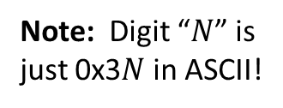
Buffer Overflow Example #1
After call to gets
Stack frame for call_echo
00 | 00 | 00 | 00
00 | 40 | 05 | fc
00 | 33 | 32 | 31
30 | 39 | 38 | 37
36 | 35 | 34 | 33
32 | 31 | 30 | 39
38 | 37 | 36 | 35
34 | 33 | 32 | 31
void echo() { char buf[8];
gets(buf); . . . }
echo:
subq $24, %rsp
...
movq %rsp, %rdi
call gets
...
call_echo:
. . .
4005f7: callq 4005c6 <echo>
4005fc: add $0x8,%rsp
. . .
buf
⟵%rsp
unix> ./buf-nsp
Enter string: 12345678901234567890123
12345678901234567890123
Note: Digit “$N$” is
just 0x3$N$ in ASCII!
Overflowed buffer, but did not corrupt state
Notes:
Null-terminated string
First char 31 is digit “1”

Slide 21
Buffer Overflow Example #2
After call to gets
Stack frame for call_echo
00 | 00 | 00 | 00
00 | 40 | 05 | 00
34 | 33 | 32 | 31
30 | 39 | 38 | 37
36 | 35 | 34 | 33
32 | 31 | 30 | 39
38 | 37 | 36 | 35
34 | 33 | 32 | 31
void echo() { char buf[8];
gets(buf); . . . }
echo:
subq $24, %rsp
...
movq %rsp, %rdi
call gets
...
call_echo:
. . .
4005f7: callq 4005c8 <echo>
4005fc: add $0x8,%rsp
. . .
buf
⟵%rsp
unix> ./buf-nsp
Enter string: 123456789012345678901234
Segmentation Fault
Overflowed buffer and corrupted return pointer

Slide 22
Buffer Overflow Example #2 Explained
After return from echo
Stack frame for call_echo
00 | 00 | 00 | 00
00 | 40 | 05 | 00
34 | 33 | 32 | 31
30 | 39 | 38 | 37
36 | 35 | 34 | 33
32 | 31 | 30 | 39
38 | 37 | 36 | 35
34 | 33 | 32 | 31
0000000000400500 <deregister_tm_clones>:
400500: mov $0x60104f,%eax
400505: push %rbp
400506: sub $0x601048,%rax
40050c: cmp $0xe,%rax
400510: mov %rsp,%rbp
400513: jbe 400530
400515: mov $0x0,%eax
40051a: test %rax,%rax
40051d: je 400530
40051f: pop %rbp
400520: mov $0x601048,%edi
400525: jmpq *%rax
400527: nopw 0x0(%rax,%rax,1)
40052e: nop
400530: pop %rbp
400531: retq
⟵%rsp
buf
“Returns” to unrelated code, but continues!
Eventually segfaults on retq of deregister_tm_clones.
Notes:
deregister_tm_clones deals with transactional memory, which is intended to make programming with threads simpler (parallelism and synchronization – waaaaaay beyond the scope of this course).

Slide 23
Malicious Use of Buffer Overflow: Code Injection Attacks
Stack after call to gets()
High Addresses
void foo(){
bar();
A:...
}
foo stack frame
return address A
A B
A (return address)
pad
int bar() {
char buf[64];
gets(buf);
...
return ...;
}
data written
by gets()
bar stack frame
exploit
code
buf starts here
B
Low Addresses
Input string contains byte representation of executable code
Overwrite return address A with address of buffer B
When bar() executes ret, will jump to exploit code
Notes:
If we overwrite A with B, execution will start at address B on return from function

Slide 24
Peer Instruction Question
smash_me is vulnerable to stack smashing!
What is the minimum number of characters that gets must read in order for us to change the return address to a stack address (in Linux)?
Previous stack frame
00 | 00 | 00 | 00
00 | 40 | 05 | fc
. . .
 |  |  | [0]
33
36
51
54
We’re lost…
smash_me:
subq $0x30, %rsp
...
movq %rsp, %rdi
call gets
...
Notes:
Assume the function is vulnerable (i.e., can execute code from the stack)
Stack address uses 6-bytes (48-bit address), 0x 0000 7FFF..........
Answer is D
48 bytes for stack space, plus 6 bytes of the return address

Slide 25
Exploits Based on Buffer Overflows
Buffer overflow bugs can allow remote machines to execute arbitrary code on victim machines
Distressingly common in real programs
Programmers keep making the same mistakes ☹
Recent measures make these attacks much more difficult
Examples across the decades
Original “Internet worm” (1988)
Still happens!!
Heartbleed (2014, affected 17% of servers)
Cloudbleed (2017)
Fun: Nintendo hacks
Using glitches to rewrite code: https://www.youtube.com/watch?v=TqK-2jUQBUY
FlappyBird in Mario: https://www.youtube.com/watch?v=hB6eY73sLV0

Slide 26
Example: the original Internet worm (1988)
Exploited a few vulnerabilities to spread
Early versions of the finger server (fingerd) used gets() to read the argument sent by the client:
finger droh@cs.cmu.edu
Worm attacked fingerd server with phony argument:
finger “exploit-code padding new-return-addr”
Exploit code: executed a root shell on the victim machine with a direct TCP connection to the attacker
Scanned for other machines to attack
Invaded ~6000 computers in hours (10% of the Internet)
see June 1989 article in Comm. of the ACM
The young author of the worm was prosecuted…
Notes:
“finger”: linux command to lookup info about a user
Can be executed on a remote host (hence the user@host usage)
TCP: transmission control protocol

Slide 27
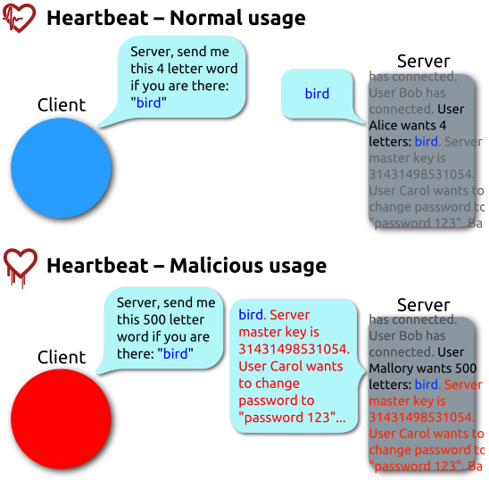
Heartbleed (2014)
Buffer over-read in OpenSSL
Open source security library
Bug in a small range of versions
“Heartbeat” packet
Specifies length of message
Server echoes it back
Library just “trusted” this length
Allowed attackers to read contents of memory anywhere they wanted
Est. 17% of Internet affected
“Catastrophic”
Github, Yahoo, Stack Overflow, Amazon AWS, ...
By FenixFeather - Own work, CC BY-SA 3.0, https://commons.wikimedia.org/w/index.php?curid=32276981
Notes:
Underlying cause: missing bounds check
Buffer over-read: more data can be read than should be allowed
Change from send me a 4 letter word to 500 letter word
Bug in implementation of OpenSSL, not in the underlying TLS protocol

Slide 28
Dealing with buffer overflow attacks
Avoid overflow vulnerabilities
Employ system-level protections
Have compiler use “stack canaries”

Slide 29
1) Avoid Overflow Vulnerabilities in Code
/* Echo Line */ void echo() { char buf[8]; /* Way too small! */ fgets(buf, 8, stdin); puts(buf); }
Use library routines that limit string lengths
fgets instead of gets (2nd argument to fgets sets limit)
strncpy instead of strcpy
Don’t use scanf with %s conversion specification
Use fgets to read the string
Or use %ns where n is a suitable integer
Notes:
8 is the character read limit
Way too small!!

Slide 30
2) System-Level Protections
High Addresses
Randomized stack offsets
At start of program, allocate random amount of space on stack
Shifts stack addresses for entire program
Addresses will vary from one run to another
Makes it difficult for hacker to predict beginning of inserted code
Example: Code from Slide 6 executed 5 times; address of variable local =
0x7ffd19d3f8ac
0x7ffe8a462c2c
0x7ffe927c905c
0x7ffefd5c27dc
0x7fffa0175afc
Stack repositioned each time program executes
Random
allocation
main’s stack frame
Other functions’ stack frames
B?
pad
exploit
code
B?
Low Addresses

Slide 31
2) System-Level Protections
Non-executable code segments
In traditional x86, can mark region of memory as either “read-only” or “writeable”
Can execute anything readable
x86-64 added explicit “execute” permission
Stack marked as non-executable
Do NOT execute code in Stack, Static Data, or Heap regions
Hardware support needed
Stack after call
to gets()
foo
stack
frame
B
pad
data written
by gets()
bar
stack
frame
exploit
code
B
Any attempt to execute this code will fail

Slide 32
3) Stack Canaries
Basic Idea: place special value (“canary”) on stack just beyond buffer
Secret value known only to compiler
“After” buffer but before return address
Check for corruption before exiting function
GCC implementation (now default)
-fstack-protector
Code back on Slide 14 (buf-nsp) compiled with –fno-stack-protector flag
unix>./buf
Enter string: 12345678
12345678
unix> ./buf
Enter string: 123456789
*** stack smashing detected ***

Slide 33
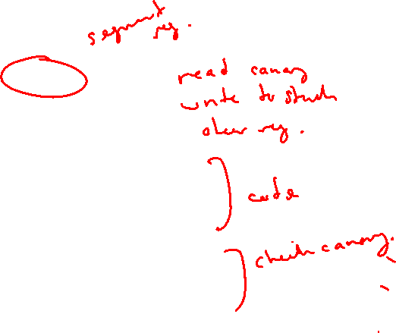
Protected Buffer Disassembly (buf)
echo:
400638: sub $0x18,%rsp
40063c: mov %fs:0x28,%rax
400645: mov %rax,0x8(%rsp)
40064a: xor %eax,%eax
... ... call printf ...
400656: mov %rsp,%rdi
400659: callq 400530 <gets@plt>
40065e: mov %rsp,%rdi
400661: callq 4004e0 <puts@plt>
400666: mov 0x8(%rsp),%rax
40066b: xor %fs:0x28,%rax
400674: je 40067b <echo+0x43>
400676: callq 4004f0 <__stack_chk_fail@plt>
40067b: add $0x18,%rsp
40067f: retq
Notes:
%fs:0x28 : read canary value
Store on stack
Erase from reg
Read canary from stack
Compare against original
If unchanged, return, else fail

Slide 34
Setting Up Canary
Before call to gets
Stack frame for call_echo
Return address (8 bytes)
Canary (8 bytes)
[7] | [6] | [5] | [4]
[3] | [2] | [1] | [0]
/* Echo Line */ void echo() { char buf[8]; /* Way too small! */ gets(buf); puts(buf); }
Segment register (don’t worry about it)
echo:
. . .
movq %fs:40, %rax # Get canary
movq %rax, 8(%rsp) # Place on stack
xorl %eax, %eax # Erase canary
. . .
buf
⟵%rsp

Slide 35
Checking Canary
After call to gets
Stack frame for call_echo
Return address (8 bytes)
Canary (8 bytes)
00 | 37 | 36 | 35
34 | 33 | 32 | 31
/* Echo Line */ void echo() { char buf[8]; /* Way too small! */ gets(buf); puts(buf); }
echo:
. . .
movq 8(%rsp), %rax # retrieve from Stack
xorq %fs:40, %rax # compare to canary
je .L2 # if same, OK
call __stack_chk_fail # else, FAIL
.L6: . . .
buf
⟵%rsp
Input: 1234567
Notes:
If input has an “8” appended, will overflow into Canary region

Slide 36
Summary
Avoid overflow vulnerabilities
Use library routines that limit string lengths
Employ system-level protections
Randomized Stack offsets
Code on the Stack is not executable
Have compiler use “stack canaries”

