Slide 1
Arrays
CSE 351 Winter 2018
Instructor:
Mark Wyse
Teaching Assistants:
Kevin Bi
Parker DeWilde
Emily Furst
Sarah House
Waylon Huang
Vinny Palaniappan
http://xkcd.com/1270/

Slide 2



Administrative
Lab 2 due tonight by 11:59 pm!
Homework 3 due next Friday (2/9)
Midterm (Monday 2/5)
  ID check, so come at 5pm
  Bring your UW Student ID (Husky Card)
  Review session 2:00-4:00pm on Saturday (2/3) in EEB 125

Slide 3

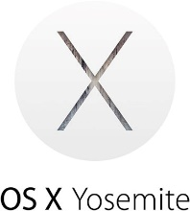

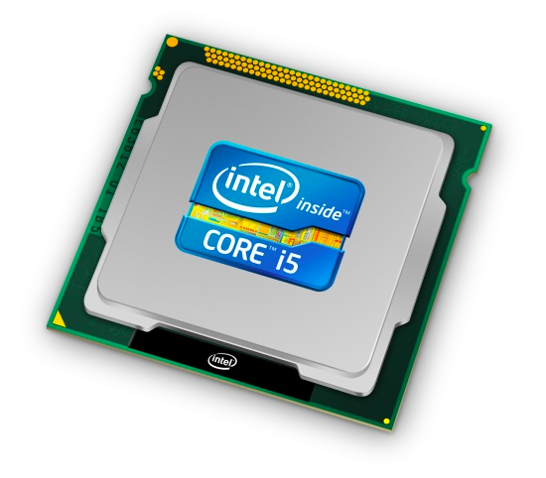
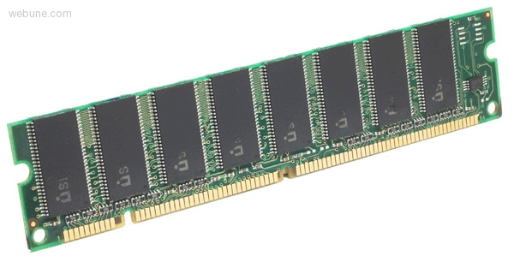
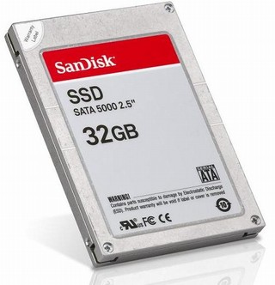
Roadmap
C:
Java:
Memory & data
Integers & floats
x86 assembly
Procedures & stacks
Executables
Arrays & structs
Memory & caches
Processes
Virtual memory
Memory allocation
Java vs. C
car *c = malloc(sizeof(car));
c->miles = 100;
c->gals = 17;
float mpg = get_mpg(c);
free(c);
Car c = new Car();
c.setMiles(100);
c.setGals(17);
float mpg =
c.getMPG();
Assembly language:
get_mpg:
pushq %rbp
movq %rsp, %rbp
...
popq %rbp
ret
OS:
Machine code:
0111010000011000
100011010000010000000010
1000100111000010
110000011111101000011111
Computer system:

Slide 4
Data Structures in Assembly
Arrays
  One-dimensional
  Multi-dimensional (nested)
  Multi-level
Structs
  Alignment
Unions

Slide 5
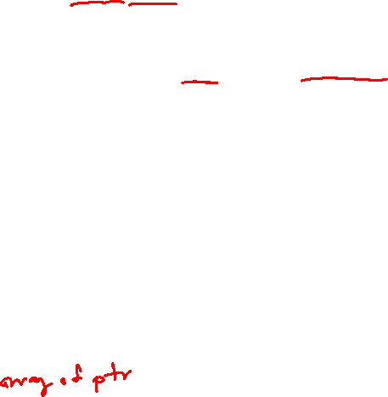

Array Allocation
Basic Principle
  T A[N]; $→$ array of data type T and length N
  Contiguously allocated region of N*sizeof(T) bytes
  Identifier A returns address of array (type T*)
char msg[12];
x
x + 12
int val[5];
x
x + 4
x + 8
x + 12
x + 16
x + 20
double a[3];
x
x + 8
x + 16
x + 24
char *p[3];
(or char* p[3];)
x
x + 8
x + 16
x + 24

Slide 6


Array Access
Basic Principle
  T A[N]; $→$ array of data type T and length N
  Identifier A returns address of array (type T*)
Reference Type Value
int x[5];
3
7
1
9
5
a
a+4
a+8
a+12
a+16
a+20
x[4] | int | 5
x | int* | a
x+1 | int* | a + 4
&x[2] | int* | a + 8
x[5] | int | ?? (whatever’s in memory at addr a+20)
*(x+1) | int | 7
x+i | int* | a + 4*i
Notes:
Ink: index of each array element
Remember: “x+1” performs pointer arithmetic

Slide 7
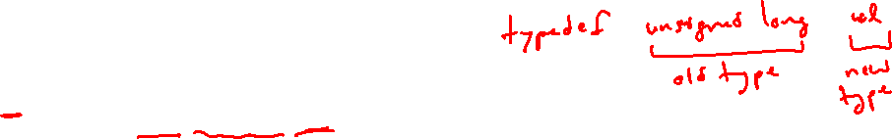
Array Example
typedef int zip_dig[5];
zip_dig cmu = { 1, 5, 2, 1, 3 };
zip_dig uw = { 9, 8, 1, 9, 5 };
zip_dig ucb = { 9, 4, 7, 2, 0 };
initialization
typedef: Declaration “zip_dig uw” equivalent to “int uw[5]”
Notes:
Let’s look at an example of using arrays.
Here are three arrays.
Typedef unsigned long int uli
Unsigned long int is the old data type
Uli is the new, equivalent data type

Slide 8
Array Example
typedef int zip_dig[5];
zip_dig cmu = { 1, 5, 2, 1, 3 };
zip_dig uw = { 9, 8, 1, 9, 5 };
zip_dig ucb = { 9, 4, 7, 2, 0 };
zip_dig cmu;
1
5
2
1
3
16
20
24
28
32
36
zip_dig uw;
9
8
1
9
5
36
40
44
48
52
56
zip_dig ucb;
9
4
7
2
0
56
60
64
68
72
76
Example arrays happened to be allocated in successive 20 byte blocks
  Not guaranteed to happen in general
Notes:
Each array is 20B
These arrays are not guaranteed to be allocated contiguously
- Other variables could have been allocated in-between

Slide 9
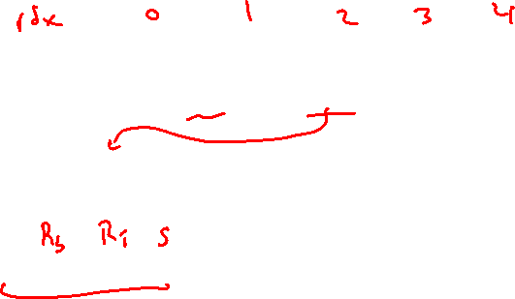
Array Accessing Example
typedef int zip_dig[5];
zip_dig uw;
9
8
1
9
5
36
40
44
48
52
56
int get_digit(zip_dig z, int digit)
{
return z[digit];
}
get_digit:
movl (%rdi,%rsi,4), %eax # z[digit]
Register %rdi contains starting address of array
Register %rsi contains array index
Desired digit at %rdi+4*%rsi, so use memory reference (%rdi,%rsi,4)
Notes:
Ink: write out index of each element in array
Movl: %rdi is Rb, %rsi is Ri, 4 is S: scale-factor

Slide 10
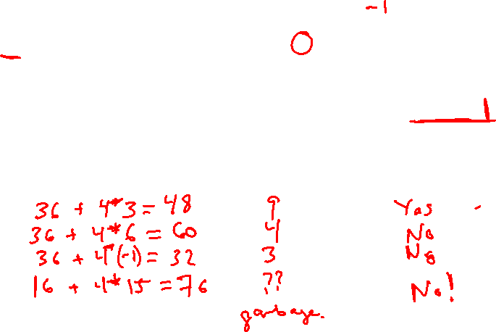
Referencing Examples
typedef int zip_dig[5];
zip_dig cmu;
1
5
2
1
3
16
20
24
28
32
36
zip_dig uw;
9
8
1
9
5
36
40
44
48
52
56
zip_dig ucb;
9
4
7
2
0
56
60
64
68
72
76
Reference Address Value Guaranteed?
  uw[3]
  uw[6]
  uw[-1]
  cmu[15]
No bounds checking
Example arrays happened to be allocated in successive 20 byte blocks
  Not guaranteed to happen in general
Notes:
Address = Rb + Ri*S
S = 4
uw[3] : 36 + 3*4 = 48, value 9, Yes
uw[6] : 36 + 6*4 = 60, value 9, No
uw[-1] : 36 + (-1)*4 = 32, value 3, No
cmu[15] : 16 + 15*4 = 76, unknown value, No

Slide 11
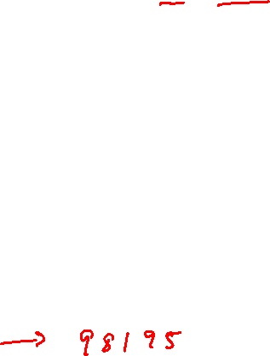
Array Loop Example
typedef int zip_dig[5];
int zd2int(zip_dig z)
{
int i;
int zi = 0;
for (i = 0; i < 5; i++) {
zi = 10 * zi + z[i];
}
return zi;
}
zi = 10*0 + 9 = 9
zi = 10*9 + 8 = 98
zi = 10*98 + 1 = 981
zi = 10*981 + 9 = 9819
zi = 10*9819 + 5 = 98195
9
8
1
9
5
Notes:
Now, let’s look at an example of indexing an array with a loop.
First, what does this loop do?
It converts an array of integers into a single integer, representing the zip code

Slide 12

Array Loop Example
zip_dig uw;
9
8
1
9
5
36
40
44
48
52
56
int zd2int(zip_dig z)
{
int i;
int zi = 0;
for (i = 0; i < 5; i++) {
zi = 10 * zi + z[i];
}
return zi;
}
Original:
Transformed:
  Eliminate loop variable i,
  use pointer zend instead
  Convert array code to
  pointer code
    Pointer arithmetic on z
  Express in do-while form
  (no test at entrance)
int zd2int(zip_dig z)
{
int zi = 0;
int *zend = z + 5;
do {
zi = 10 * zi + *z;
z++;
} while (z < zend);
return zi;
}
address just past
5th digit
Increments by 4 (size of int)
Notes:
15au: With –Og, gcc will generate different code for each of these. With –O1, the same code.

Slide 13
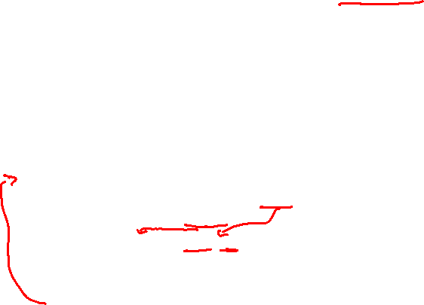
Array Loop Implementation
gcc with –O1
Registers:
  %rdi z
  %rax zi
  %rcx zend
Computations
  10*zi + *z
  z++
int zd2int(zip_dig z)
{
int zi = 0;
int *zend = z + 5;
do {
zi = 10 * zi + *z;
z++;
} while (z < zend);
return zi;
}
# %rdi = z
leaq 20(%rdi),%rcx #
movl $0,%eax #
.L17:
leal (%rax,%rax,4),%edx #
movl (%rdi),%eax #
leal (%rax,%rdx,2),%eax #
addq $4,%rdi #
cmpq %rdi,%rcx #
jne .L17 #
%rcx = zend = z + 5
%rax = zi = 0
%rdx = zi + 4*zi = 5*zi
%rax = *z
%rax = *z + 2(5*zi) = *z + 10*zi
z++ (pointer arithmetic)
zend – z
If != 0, goto Loop
Init
Computation
Jump if
zend – z != 0

Slide 14
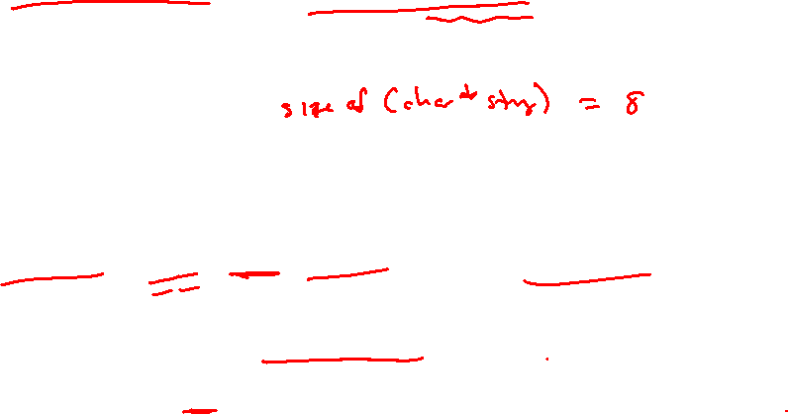
C Details: Arrays and Pointers
Arrays are (almost) identical to pointers
  char *string and char string[] are nearly identical declarations
  Differ in subtle ways: initialization, sizeof(), etc.
An array variable looks like a pointer to the first (0th) element
  ar[0] same as *ar; ar[2] same as *(ar+2)
An array variable is read-only (no assignment)
  Cannot use “ar = <anything>”

Slide 15
C Details: Arrays and Functions
Declared arrays only allocated while the scope is valid:
  char* foo() {
  char string[32]; ...;
  return string;
  }
An array is passed to a function as a pointer:
  Array size gets lost!
int foo(int ar[], unsigned int size) {
... ar[size-1] ...
}
BAD!
Really int *ar
Must explicitly
pass the size!
Notes:
return string
Returns an address on the stack that will be less than %rsp in the caller’s frame
Address is out of scope, and therefore incorrect to use!
Data will be overwritten by future stack frames
%rdi can only fit 8 bytes, so must pass a pointer

Slide 16
Data Structures in Assembly
Arrays
  One-dimensional
  Multi-dimensional (nested)
  Multi-level
Structs
  Alignment
Unions

Slide 17
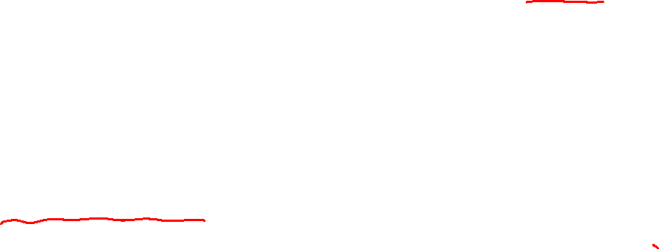
Nested Array Example
typedef int zip_dig[5];
zip_dig sea[4] =
{{ 9, 8, 1, 9, 5 },
{ 9, 8, 1, 0, 5 },
{ 9, 8, 1, 0, 3 },
{ 9, 8, 1, 1, 5 }};
Remember, T A[N] is an array with elements of type T, with length N
What is the layout in memory?
same as:
int sea[4][5];
Notes:
sea is a 2D array

Slide 18

Nested Array Example
typedef int zip_dig[5];
zip_dig sea[4] =
{{ 9, 8, 1, 9, 5 },
{ 9, 8, 1, 0, 5 },
{ 9, 8, 1, 0, 3 },
{ 9, 8, 1, 1, 5 }};
Remember, T A[N] is an array with elements of type T, with length N
sea[3][2];
Row 0
Row 1
Row 2
Row 3
9
8
1
9
5
9
8
1
0
5
9
8
1
0
3
9
8
1
1
5
76
96
116
136
156
“Row-major” ordering of all elements
Elements in the same row are contiguous
Guaranteed (in C)
Notes:
Colors for rows of sea[4]:
0: red
1: yellow
2: blue
3: green

Slide 19
Two-Dimensional (Nested) Arrays
Declaration: T A[R][C];
  2D array of data type T
  R rows, C columns
  Each element requires
  sizeof(T) bytes
Array size?
A[0][0]
• • •
A[0][C-1]
•
•
•
•
•
•
A[R-1][0]
• • •
A[R-1][C-1]
Notes:
Can visualize as a matrix with R rows, C columns

Slide 20
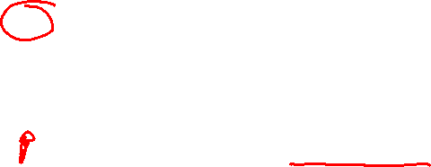
Two-Dimensional (Nested) Arrays
Declaration: T A[R][C];
  2D array of data type T
  R rows, C columns
  Each element requires
  sizeof(T) bytes
Array size:
  R*C*sizeof(T) bytes
Arrangement: row-major ordering
A[0][0]
• • •
A[0][C-1]
•
•
•
•
•
•
A[R-1][0]
• • •
A[R-1][C-1]
int A[R][C];
• • •
A
[0]
[0]
A
[0]
[C-1]
• • •
A
[1]
[0]
A
[1]
[C-1]
• • •
• • •
A
[R-1]
[0]
A
[R-1]
[C-1]
4*R*C bytes
Notes:
Start address: A
First address beyond the array: A + 4*R*C

Slide 21
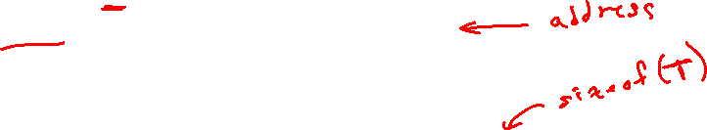
Nested Array Row Access
Row vectors
  Given T A[R][C],
    A[i] is an array of C elements (“row i”)
    Each element of type T requires K bytes
    A is address of array
    Starting address of row i =
A + i*(C * K)
int A[R][C];
A[0]
A[i]
A[R-1]
• • •
A
[0]
[0]
A
[0]
[C-1]
• • •
• • •
A
[i]
[0]
A
[i]
[C-1]
• • •
• • •
A
[R-1]
[0]
A
[R-1]
[C-1]
A
A+i*C*4
A+(R-1)*C*4
Notes:
K = sizeof(T)
Each row is C*4 bytes long

Slide 22
Nested Array Row Access Code
int* get_sea_zip(int index)
{
return sea[index];
}
int sea[4][5] =
{{ 9, 8, 1, 9, 5 },
{ 9, 8, 1, 0, 5 },
{ 9, 8, 1, 0, 3 },
{ 9, 8, 1, 1, 5 }};
get_sea_zip(int):
movslq %edi, %rdi
leaq (%rdi,%rdi,4), %rdx
leaq 0(,%rdx,4), %rax
addq $sea, %rax
ret
sea:
.long 9
.long 8
.long 1
.long 9
.long 5
.long 9
.long 8
...
What data type is sea[index]?
What is its starting address?
Notes:
Remember that static (global) variables are in memory, too...

Slide 23

Nested Array Row Access Code
int* get_sea_zip(int index)
{
return sea[index];
}
int sea[4][5] =
{{ 9, 8, 1, 9, 5 },
{ 9, 8, 1, 0, 5 },
{ 9, 8, 1, 0, 3 },
{ 9, 8, 1, 1, 5 }};
What data type is sea[index]?
What is its starting address?
# %rdi = index
leaq (%rdi,%rdi,4),%rax # 5 * index
leaq sea(,%rax,4),%rax # sea + (20 * index)
Translation?
Notes:
Address
A -> sea, Rows -> 4, Cols -> 4
Lea computes an address
Can use the label “sea” as a displacement (label is an address!)

Slide 24
Nested Array Row Access Code
int* get_sea_zip(int index)
{
return sea[index];
}
int sea[4][5] =
{{ 9, 8, 1, 9, 5 },
{ 9, 8, 1, 0, 5 },
{ 9, 8, 1, 0, 3 },
{ 9, 8, 1, 1, 5 }};
# %rdi = index
leaq (%rdi,%rdi,4),%rax # 5 * index
leaq sea(,%rax,4),%rax # sea + (20 * index)
Row Vector
  sea[index] is array of 5 ints
  Starting address = sea+20*index
Assembly Code
  Computes and returns address
  Compute as: sea+4*(index+4*index)= sea+20*index
Notes:
Returns an address!

Slide 25
Nested Array Element Access
Array Elements
  A[i][j] is element of type T, which requires K bytes
  Address of A[i][j] is
int A[R][C];
A[0]
A[i]
A[R-1]
• • •
A
[0]
[0]
A
[0]
[C-1]
• • •
• • • • • •
A
[i]
[j]
• • •
• • •
A
[R-1]
[0]
A
[R-1]
[C-1]
A
A + i*C*4
A + (R-1)*C*4
?

Slide 26
Nested Array Element Access
Array Elements
  A[i][j] is element of type T, which requires K bytes
  Address of A[i][j] is
  A + i*(C*K) + j*K == A + (i*C + j)*K
int A[R][C];
A[0]
A[i]
A[R-1]
• • •
A
[0]
[0]
A
[0]
[C-1]
• • •
• • • • • •
A
[i]
[j]
• • •
• • •
A
[R-1]
[0]
A
[R-1]
[C-1]
A
A + i*C*4
A + (R-1)*C*4
A + i*C*4 + j*4

Slide 27
Nested Array Element Access Code
int get_sea_digit
(int index, int digit)
{
return sea[index][digit];
}
int sea[4][5] =
{{ 9, 8, 1, 9, 5 },
{ 9, 8, 1, 0, 5 },
{ 9, 8, 1, 0, 3 },
{ 9, 8, 1, 1, 5 }};
leaq (%rdi,%rdi,4), %rax # 5*index
addl %rax, %rsi # 5*index+digit
movl sea(,%rsi,4), %eax # *(sea + 4*(5*index+digit))
Array Elements
  sea[index][digit] is an int (sizeof(int)=4)
  Address = sea + 5*4*index + 4*digit
Assembly Code
  Computes address as: sea + ((index+4*index) + digit)*4
  movl performs memory reference
Notes:
Lea and add compute part of address
Mov instruction gets the data
Address = “start of array” + “start of row” + “column of interest”

Slide 28
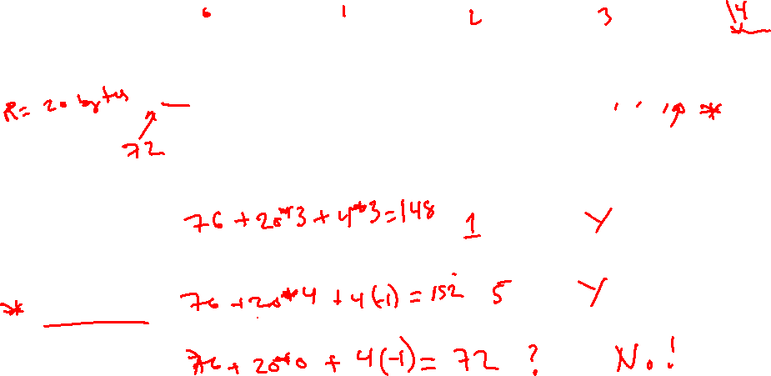
Strange Referencing Examples
typedef int zip_dig[5];
9
8
1
9
5
9
8
1
0
5
9
8
1
0
3
9
8
1
1
5
zip_dig sea[4];
76
96
116
136
156
Reference Address Value Guaranteed?
  sea[3][3]
  sea[2][5]
  sea[2][-1]
  sea[4][-1]
  sea[0][19]
  sea[0][-1]
  Code does not do any bounds checking
  Ordering of elements within array guaranteed

Slide 29
Data Structures in Assembly
Arrays
  One-dimensional
  Multi-dimensional (nested)
  Multi-level
Structs
  Alignment
Unions

Slide 30

Multi-Level Array Example
Multi-Level Array Declaration(s):
int cmu[5] = { 1, 5, 2, 1, 3 };
int uw[5] = { 9, 8, 1, 9, 5 };
int ucb[5] = { 9, 4, 7, 2, 0 };
int* univ[3] = {uw, cmu, ucb};
Is a multi-level array the
same thing as a 2D array?
NO
2D Array Declaration:
zip_dig univ2D[3] = {
{ 9, 8, 1, 9, 5 },
{ 1, 5, 2, 1, 3 },
{ 9, 4, 7, 2, 0 }
};
One array declaration = one contiguous block of memory
Notes:
No!
2D array is guaranteed contiguous
Total storage = 60B
Multi-level, each level can be allocated in different location in memory.
Total storage = 60B + 24B = 88B

Slide 31
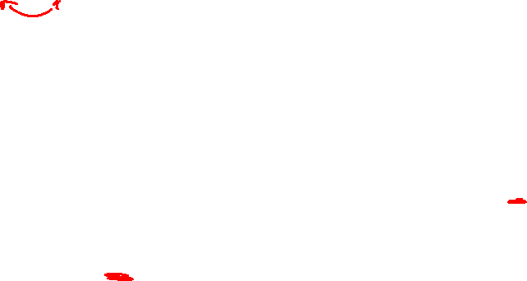
Multi-Level Array Example
int cmu[5] = { 1, 5, 2, 1, 3 };
int uw[5] = { 9, 8, 1, 9, 5 };
int ucb[5] = { 9, 4, 7, 2, 0 };
Variable univ denotes array of 3 elements
Each element is a pointer
  8 bytes each
Each pointer points to array of ints
int* univ[3] = {uw, cmu, ucb};
cmu
1
5
2
1
3
univ
16
20
24
28
32
36
160
36
uw
9
8
1
9
5
168
16
ucb
36
40
44
48
52
56
176
60
9
4
7
2
0
60
64
68
72
76
80
Note: this is how Java represents multi-dimensional arrays

Slide 32

Element Access in Multi-Level Array
int get_univ_digit
(int index, int digit)
{
return univ[index][digit];
}
cmu
univ
1
5
2
1
3
160
36
uw
16
20
24
28
32
36
168
16
9
8
1
9
5
176
60
ucb
36
40
44
48
52
56
9
4
7
2
0
60
64
68
72
76
80
salq $2, %rsi # rsi = 4*digit
addq univ(,%rdi,8), %rsi # p = univ[index] + 4*digit
movl (%rsi), %eax # return *p
ret
Computation
  Element access Mem[Mem[univ+8*index]+4*digit]
  Must do two memory reads
    First get pointer to row array
    Then access element within array
  But allows inner arrays to be different lengths (not in this example)
Notes:
Easier to “fit” smaller arrays in memory
Can “swap out” rows in multi-level arrays

Slide 33
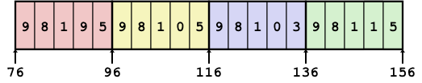
Array Element Accesses
Nested array
Multi-level array
int get_sea_digit
(int index, int digit)
{
return sea[index][digit];
}
int get_univ_digit
(int index, int digit)
{
return univ[index][digit];
}
cmu
univ
1
5
2
1
3
160
36
uw
16
20
24
28
32
36
168
16
9
8
1
9
5
176
60
ucb
36
40
44
48
52
56
9
4
7
2
0
60
64
68
72
76
80
Access looks the same, but it isn’t:
Mem[sea+20*index+4*digit]
Mem[Mem[univ+8*index]+4*digit]

Slide 34
Strange Referencing Examples
cmu
1
5
2
1
3
univ
16
20
24
28
32
36
160
36
uw
9
8
1
9
5
168
16
ucb
36
40
44
48
52
56
176
60
9
4
7
2
0
60
64
68
72
76
80
Reference Address Value Guaranteed?
  univ[2][3]
  univ[1][5]
  univ[2][-2]
  univ[3][-1]
  univ[1][12]
  C code does not do any bounds checking
  Location of each lower-level array in memory is not guaranteed

Slide 35
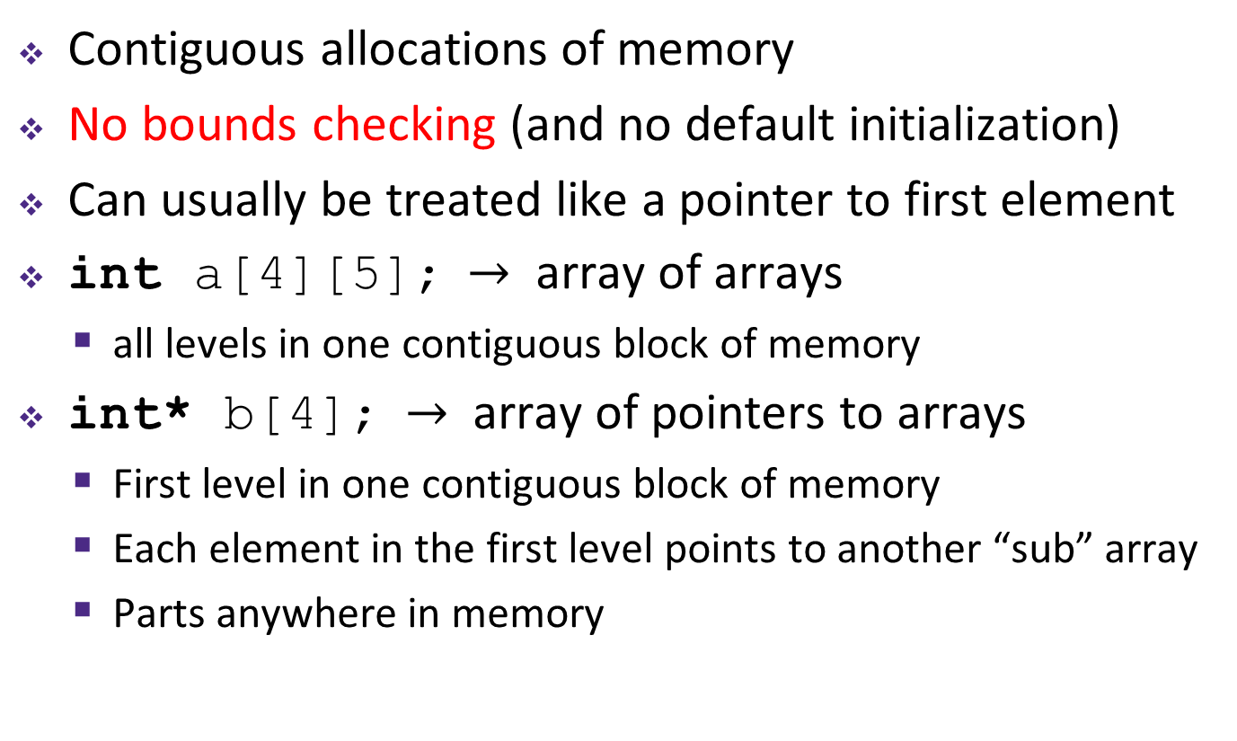
Summary
Contiguous allocations of memory
No bounds checking (and no default initialization)
Can usually be treated like a pointer to first element
int a[4][5]; $→$ array of arrays
  all levels in one contiguous block of memory
int* b[4]; $→$ array of pointers to arrays
  First level in one contiguous block of memory
  Each element in the first level points to another “sub” array
  Parts anywhere in memory

Slide 36
Referencing Examples
typedef int zip_dig[5];
zip_dig cmu;
1
5
2
1
3
16
20
24
28
32
36
zip_dig uw;
9
8
1
9
5
36
40
44
48
52
56
zip_dig ucb;
9
4
7
2
0
56
60
64
68
72
76
Reference Address Value Guaranteed?
  uw[3]
  uw[6]
  uw[-1]
  cmu[15]
36 + 4* 3 = 48 9 Yes
36 + 4* 6 = 60 4 No
36 + 4*-1 = 32 3 No
16 + 4*15 = 76 ?? No
No bounds checking
Example arrays happened to be allocated in successive 20 byte blocks
  Not guaranteed to happen in general

Slide 37
Array Loop Implementation
gcc with –O1
Registers:
  %rdi z
  %rax zi
  %rcx zend
Computations
  10*zi + *z implemented as: *z + 2*(5*zi)
  z++ increments by 4 (size of int)
int zd2int(zip_dig z)
{
int zi = 0;
int *zend = z + 5;
do {
zi = 10 * zi + *z;
z++;
} while (z < zend);
return zi;
}
# %rdi = z
leaq 20(%rdi),%rcx # rcx = zend = z+5
movl $0,%eax # rax = zi = 0
.L17:
leal (%rax,%rax,4),%edx # zi + 4*zi = 5*zi
movl (%rdi),%eax # eax = *z
leal (%rax,%rdx,2),%eax # zi = *z + 2*(5*zi)
addq $4,%rdi # z++
cmpq %rdi,%rcx # zend - z
jne .L17 # if != goto loop

Slide 38
Strange Referencing Examples
typedef int zip_dig[5];
9
8
1
9
5
9
8
1
0
5
9
8
1
0
3
9
8
1
1
5
zip_dig sea[4];
76
96
116
136
156
Reference Address Value Guaranteed?
  sea[3][3]
  sea[2][5]
  sea[2][-1]
  sea[4][-1]
  sea[0][19]
  sea[0][-1]
  Code does not do any bounds checking
  Ordering of elements within array guaranteed
  76+20*3+4*3 = 148 1 Yes
  76+20*2+4*5 = 136 9 Yes
  76+20*2+4*-1 = 112 5 Yes
  76+20*4+4*-1 = 152 5 Yes
  76+20*0+4*19 = 152 5 Yes
  76+20*0+4*-1 = 72 ?? No

Slide 39
Strange Referencing Examples
cmu
1
5
2
1
3
univ
16
20
24
28
32
36
160
36
uw
9
8
1
9
5
168
16
ucb
36
40
44
48
52
56
176
60
9
4
7
2
0
60
64
68
72
76
80
Reference Address Value Guaranteed?
  univ[2][3]
  univ[1][5]
  univ[2][-2]
  univ[3][-1]
  univ[1][12]
  C code does not do any bounds checking
  Location of each lower-level array in memory is not guaranteed
  60+4*3 = 72 2 Yes
  16+4*5 = 36 9 No
  60+4*-2 = 52 5 No
  #@%!^?? ?? No
  16+4*12 = 64 4 No

