Slide 1
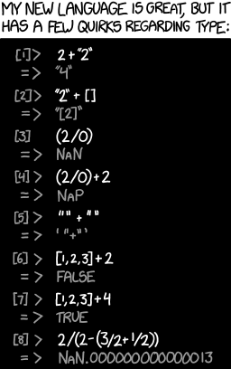
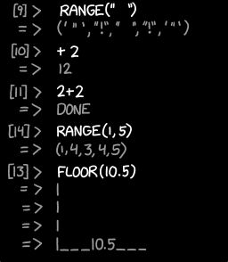
Procedures & Executables CSE 351 Winter 2018
Instructor:
Mark Wyse
Teaching Assistants:
Kevin Bi
Parker DeWilde
Emily Furst
Sarah House
Waylon Huang
Vinny Palaniappan
https://xkcd.com/1537/

Slide 2
Administrative
Lab 2 due Friday (2/2)
Lab 1 grading – see Piazza post
Midterm next Monday (2/5)
Check Piazza this week for last minute announcements
Bring your UW Student ID (Husky Card)
Review session 2:00-4:00pm on Saturday (2/3) in EEB 125

Slide 3
Procedures
Stack Structure
Calling Conventions
Passing control
Passing data
Managing local data
Register Saving Conventions
Illustration of Recursion

Slide 4
Register Saving Conventions
When procedure yoo calls who:
yoo is the caller
who is the callee
Can registers be used for temporary storage?
No! Contents of register %rdx overwritten by who!
This could be trouble – something should be done. Either:
Caller should save %rdx before the call (and restore it after the call)
Callee should save %rdx before using it (and restore it before returning)
yoo:
• • •
movq $15213, %rdx
call who
addq %rdx, %rax
• • •
ret
who:
• • •
subq $18213, %rdx
• • •
ret
?

Slide 5
Register Saving Conventions
“Caller-saved” registers
It is the caller’s responsibility to save any important data in these registers before calling another procedure (i.e. the callee can freely change data in these registers)
Caller saves values in its stack frame before calling Callee, then restores values after the call
“Callee-saved” registers
It is the callee’s responsibility to save any data in these registers before using the registers (i.e. the caller assumes the data will be the same across the callee procedure call)
Callee saves values in its stack frame before using, then restores them before returning to caller

Slide 6
x86-64 Linux Register Usage, part 1
%rax
Return value
Also caller-saved & restored
Can be modified by procedure
%rdi, ..., %r9
Arguments
Also caller-saved & restored
Can be modified by procedure
%r10, %r11
Caller-saved & restored
Can be modified by procedure
Return value
%rax
%rdi
%rsi
%rdx
Arguments
%rcx
%r8
%r9
%r10
Caller-saved
temporaries
%r11

Slide 7
x86-64 Linux Register Usage, part 2
%rbx, %r12, %r13, %r14
Callee-saved
Callee must save & restore
%rbp
Callee-saved
Callee must save & restore
May be used as frame pointer
Can mix & match
%rsp
Special form of callee save
Restored to original value upon exit from procedure
%rbx
%r12
Callee-saved
Temporaries
%r13
%r14
%rbp
Special
%rsp

Slide 8
x86-64 64-bit Registers: Usage Conventions
%rax
%r8
Return value - Caller saved
Argument #5 - Caller saved
%rbx
%r9
Callee saved
Argument #6 - Caller saved
%rcx
%r10
Argument #4 - Caller saved
Caller saved
%rdx
%r11
Argument #3 - Caller saved
Caller Saved
%rsi
%r12
Argument #2 - Caller saved
Callee saved
%rdi
%r13
Argument #1 - Caller saved
Callee saved
%rsp
%r14
Stack pointer
Callee saved
%rbp
%r15
Callee saved
Callee saved

Slide 9
Callee-Saved Example (step 1)
Initial Stack Structure
long call_incr2(long x) {
long v1 = 351;
long v2 = increment(&v1, 100);
return x+v2;
}
. . .
ret addr
%rsp
call_incr2:
pushq %rbx
subq $16, %rsp
movq %rdi, %rbx
movq $351, 8(%rsp)
movl $100, %esi
leaq 8(%rsp), %rdi
call increment
addq %rbx, %rax
addq $16, %rsp
popq %rbx
ret
Resulting Stack Structure
. . .
ret addr
Saved %rbx
351
%rsp+8
Unused
%rsp
Notes:
Modified example from earlier
Now call_incr takes an argument, long x, which is used in computing its result
x is in %rdi
Need to save it somewhere: use a callee-saved register
But call_incr is a callee, too!
Have to save %rbx for whoever called call_incr2

Slide 10
Callee-Saved Example (step 2)
Stack Structure
long call_incr2(long x) {
long v1 = 351;
long v2 = increment(&v1, 100);
return x+v2;
}
. . .
Rtn address
Saved %rbx
351
%rsp+8
call_incr2:
pushq %rbx
subq $16, %rsp
movq %rdi, %rbx
movq $351, 8(%rsp)
movl $100, %esi
leaq 8(%rsp), %rdi
call increment
addq %rbx, %rax
addq $16, %rsp
popq %rbx
ret
Unused
%rsp
Pre-return Stack Structure
. . .
Rtn address
%rsp
Notes:
Can you think of another way we could have done this?
Push %rdi onto the stack
Why did the compiler choose this way?
In this case it’s a wash, but if we ever use %rbx again, then it was worth it

Slide 11
Why Caller and Callee Saved?
We want one calling convention to simply separate implementation details between caller and callee
In general, neither caller-save nor callee-save is “best”:
If caller isn’t using a register, caller-save is better
If callee doesn’t need a register, callee-save is better
If “do need to save”, callee-save generally makes smaller programs
Functions are called from multiple places
So… “some of each” and compiler tries to “pick registers” that minimize amount of saving/restoring
Notes:
Remember: access to memory is slow

Slide 12
Register Conventions Summary
Caller-saved register values need to be pushed onto the stack before making a procedure call only if the Caller needs that value later
Callee may change those register values
Callee-saved register values need to be pushed onto the stack only if the Callee intends to use those registers
Caller expects unchanged values in those registers
Don’t forget to restore/pop the values later!

Slide 13
Procedures
Stack Structure
Calling Conventions
Passing control
Passing data
Managing local data
Register Saving Conventions
Illustration of Recursion

Slide 14
Recursive Function
/* Recursive popcount */
long pcount_r(unsigned long x) {
if (x == 0)
return 0;
else
return (x&1)+pcount_r(x >> 1);
}
pcount_r:
movl $0, %eax
testq %rdi, %rdi
je .L6
pushq %rbx
movq %rdi, %rbx
shrq %rdi
call pcount_r
andl $1, %ebx
addq %rbx, %rax
popq %rbx
.L6:
rep ret
Compiler Explorer:
https://godbolt.org/g/W8DxeR
Compiled with -O1 for brevity instead of -Og
Try -O2 instead!

Slide 15
Recursive Function: Base Case
/* Recursive popcount */
long pcount_r(unsigned long x) {
if (x == 0)
return 0;
else
return (x&1)+pcount_r(x >> 1);
}
Register | Use(s) | Type
%rdi | x | Argument
%rax | Return value | Return value
pcount_r:
movl $0, %eax
testq %rdi, %rdi
je .L6
pushq %rbx
movq %rdi, %rbx
shrq %rdi
call pcount_r
andl $1, %ebx
addq %rbx, %rax
popq %rbx
.L6:
rep ret
Trick because some AMD hardware doesn’t like jumping to ret
Notes:
First: look at the test:
test if %rdi == 0
If it does, then jump to the ret
Note: share ret between both cases, so set rax=0 before jump
Rep; ret is just because some HW doesn‘t like jumping to ret

Slide 16
Recursive Function: Callee Register Save
/* Recursive popcount */
long pcount_r(unsigned long x) {
if (x == 0)
return 0;
else
return (x&1)+pcount_r(x >> 1);
}
Register | Use(s) | Type
%rdi | x | Argument
pcount_r:
movl $0, %eax
testq %rdi, %rdi
je .L6
pushq %rbx
movq %rdi, %rbx
shrq %rdi
call pcount_r
andl $1, %ebx
addq %rbx, %rax
popq %rbx
.L6:
rep ret
Need original value of x after recursive call to pcount_r.
“Save” by putting in %rbx (callee saved), but need to save old value of %rbx before you change it.
The Stack
. . .
rtn <main+?>
saved %rbx
%rsp$→$
Notes:
%rdi (x) is argument for both pcount_r instances (recursive caller and callee).
Choosing “to save”

Slide 17
Recursive Function: Call Setup
/* Recursive popcount */
long pcount_r(unsigned long x) {
if (x == 0)
return 0;
else
return (x&1)+pcount_r(x >> 1);
}
Register | Use(s) | Type
%rdi | x (new) | Argument
%rbx | x (old) | Callee saved
pcount_r:
movl $0, %eax
testq %rdi, %rdi
je .L6
pushq %rbx
movq %rdi, %rbx
shrq %rdi
call pcount_r
andl $1, %ebx
addq %rbx, %rax
popq %rbx
.L6:
rep ret
The Stack
. . .
rtn <main+?>
saved %rbx
%rsp$→$

Slide 18
Recursive Function: Call
/* Recursive popcount */
long pcount_r(unsigned long x) {
if (x == 0)
return 0;
else
return (x&1)+pcount_r(x >> 1);
}
Register | Use(s) | Type
%rax | Recursive call return value | Return value
%rbx | x (old) | Callee saved
pcount_r:
movl $0, %eax
testq %rdi, %rdi
je .L6
pushq %rbx
movq %rdi, %rbx
shrq %rdi
call pcount_r
andl $1, %ebx
addq %rbx, %rax
popq %rbx
.L6:
rep ret
The Stack
. . .
rtn <main+?>
saved %rbx
rtn <pcount_r+22>
. . .
%rsp$→$
Notes:
Draw out example if x = 0b100

Slide 19
Recursive Function: Result
/* Recursive popcount */
long pcount_r(unsigned long x) {
if (x == 0)
return 0;
else
return (x&1)+pcount_r(x >> 1);
}
Register | Use(s) | Type
%rax | Return value | Return value
%rbx | x&1 | Callee saved
pcount_r:
movl $0, %eax
testq %rdi, %rdi
je .L6
pushq %rbx
movq %rdi, %rbx
shrq %rdi
call pcount_r
andl $1, %ebx
addq %rbx, %rax
popq %rbx
.L6:
rep ret
The Stack
. . .
rtn <main+?>
saved %rbx
%rsp$→$

Slide 20
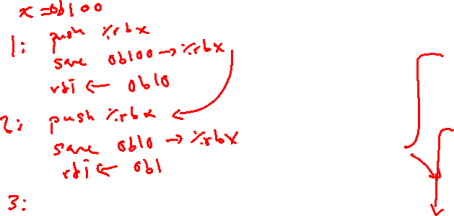
Recursive Function: Completion
/* Recursive popcount */
long pcount_r(unsigned long x) {
if (x == 0)
return 0;
else
return (x&1)+pcount_r(x >> 1);
}
Register | Use(s) | Type
%rax | Return value | Return value
%rbx | Previous %rbx value | Callee restored
pcount_r:
movl $0, %eax
testq %rdi, %rdi
je .L6
pushq %rbx
movq %rdi, %rbx
shrq %rdi
call pcount_r
andl $1, %ebx
addq %rbx, %rax
popq %rbx
.L6:
rep ret
The Stack
. . .
rtn <main+?>
saved %rbx
%rsp$→$

Slide 21
Observations About Recursion
Works without any special consideration
Stack frames mean that each function call has private storage
Saved registers & local variables
Saved return pointer
Register saving conventions prevent one function call from corrupting another’s data
Unless the code explicitly does so (e.g. buffer overflow)
Stack discipline follows call / return pattern
If P calls Q, then Q returns before P
Last-In, First-Out (LIFO)
Also works for mutual recursion (P calls Q; Q calls P)

Slide 22
x86-64 Stack Frames
Many x86-64 procedures have a minimal stack frame
Only return address is pushed onto the stack when procedure is called
A procedure needs to grow its stack frame when it:
Has too many local variables to hold in caller-saved registers
Has local variables that are arrays or structs
Uses & to compute the address of a local variable
Calls another function that takes more than six arguments
Is using caller-saved registers and then calls a procedure
Modifies/uses callee-saved registers

Slide 23
x86-64 Procedure Summary
Important Points
Procedures are a combination of instructions and conventions
Conventions prevent functions from disrupting each other
Stack is the right data structure for procedure call/return
If P calls Q, then Q returns before P
Recursion handled by normal calling conventions
Heavy use of registers
Faster than using memory
Use limited by data size and conventions
Minimize use of the Stack
Caller
Frame
Arguments
7+
Return Addr
%rbp
(Optional)
Old %rbp
Saved
Registers
+
Local
Variables
Argument
Build
%rsp

Slide 24
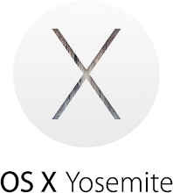
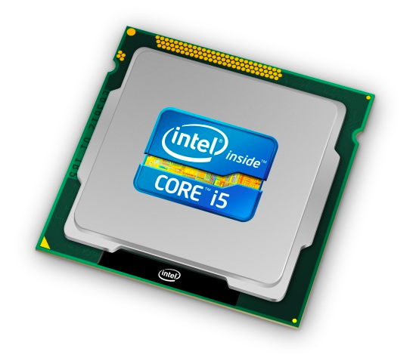
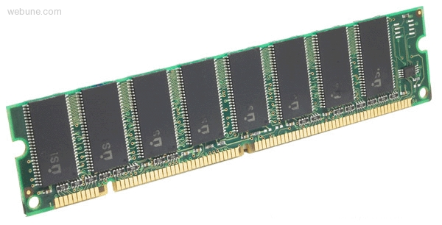
Roadmap
C:
Java:
Memory & data
Integers & floats
x86 assembly
Procedures & stacks
Executables
Arrays & structs
Memory & caches
Processes
Virtual memory
Memory allocation
Java vs. C
car *c = malloc(sizeof(car));
c->miles = 100;
c->gals = 17;
float mpg = get_mpg(c);
free(c);
Car c = new Car();
c.setMiles(100);
c.setGals(17);
float mpg = c.getMPG();
Assembly language:
get_mpg:
pushq %rbp
movq %rsp, %rbp
...
popq %rbp
ret
OS:
Machine code:
0111010000011000
100011010000010000000010
1000100111000010
110000011111101000011111
Computer system:

Slide 25
Building an Executable from a C File
Code in files p1.c p2.c
Compile with command: gcc -Og p1.c p2.c -o p
Put resulting machine code in file p
Run with command: ./p
text
C program (p1.c p2.c)
Compiler (gcc –Og -S)
text
Asm program (p1.s p2.s)
Assembler (gcc -c or as)
binary
Object program (p1.o p2.o)
Static libraries (.a)
Linker (gcc or ld)
binary
Executable program (p)
Loader (the OS)

Slide 26
Compiler
Input: Higher-level language code (e.g. C, Java)
foo.c
Output: Assembly language code (e.g. x86, ARM, MIPS)
foo.s
First there’s a preprocessor step to handle #directives
Macro substitution, plus other specialty directives
If curious/interested: http://tigcc.ticalc.org/doc/cpp.html
Super complex, whole courses devoted to these!
Compiler optimizations
“Level” of optimization specified by capital ‘O’ flag (e.g. -Og, -O3)
Options: https://gcc.gnu.org/onlinedocs/gcc/Optimize-Options.html

Slide 27
Compiling Into Assembly
C Code (sum.c)
x86-64 assembly (gcc –Og –S sum.c)
Generates file sum.s (see https://godbolt.org/g/o34FHp)
Warning: You may get different results with other versions of gcc and different compiler settings
void sumstore(long x, long y, long *dest) {
long t = x + y;
*dest = t;
}
sumstore(long, long, long*):
addq %rdi, %rsi
movq %rsi, (%rdx)
ret
Notes:
https://godbolt.org/g/5hQk8a

Slide 28
Assembler
Input: Assembly language code (e.g. x86, ARM, MIPS)
foo.s
Output: Object files (e.g. ELF, COFF)
foo.o
Contains object code and information tables
Reads and uses assembly directives
e.g. .text, .data, .quad
x86: https://docs.oracle.com/cd/E26502_01/html/E28388/eoiyg.html
Produces “machine language”
Does its best, but object file is not a completed binary
Example: gcc -c foo.s
Notes:
ELF = executable and linkable format
COFF = common object file format

Slide 29
Producing Machine Language
Simple cases: arithmetic and logical operations, shifts, etc.
All necessary information is contained in the instruction itself
What about the following?
Conditional jump
Accessing static data (e.g. global var or jump table)
call
Addresses and labels are problematic because final executable hasn’t been constructed yet!
So how do we deal with these in the meantime?

Slide 30
Object File Information Tables
Symbol Table holds list of “items” that may be used by other files
Non-local labels – function names for call
Static Data – variables & literals that might be accessed across files
Relocation Table holds list of “items” that this file needs the address of later (currently undetermined)
Any label or piece of static data referenced in an instruction in this file
Both internal and external
Each file has its own symbol and relocation tables

Slide 31
Object File Format
object file header: size and position of the other pieces of the object file
text segment: the machine code
data segment: data in the source file (binary)
relocation table: identifies lines of code that need to be “handled”
symbol table: list of this file’s labels and data that can be referenced
debugging information
More info: ELF format
http://www.skyfree.org/linux/references/ELF_Format.pdf

Slide 32
Linker
Input: Object files (e.g. ELF, COFF)
foo.o
Output: executable binary program
a.out
Combines several object files into a single executable (linking)
Enables separate compilation/assembling of files
Changes to one file do not require recompiling of whole program

Slide 33
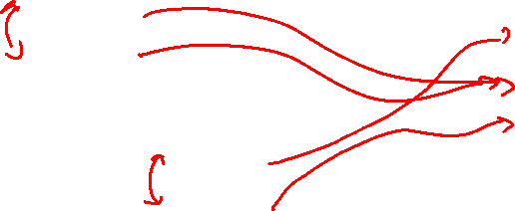
Linking
Take text segment from each .o file and put them together
Take data segment from each .o file, put them together, and concatenate this onto end of text segments
Resolve References
Go through Relocation Table; handle each entry
object file 1
info 1
a.out
data 1
Relocated data 1
text 1
Linker
Relocated data 2
object file 2
Relocated text 1
info 2
Relocated text 2
data 2
text 2

Slide 34
Disassembling Object Code
Disassembled:
Disassembler (objdump -d sum)
Useful tool for examining object code (man 1 objdump)
Analyzes bit pattern of series of instructions
Produces approximate rendition of assembly code
Can run on either a.out (complete executable) or .o file
0000000000400536 <sumstore>:
400536: 48 01 fe add %rdi,%rsi
400539: 48 89 32 mov %rsi,(%rdx)
40053c: c3 retq

Slide 35
What Can be Disassembled?
% objdump -d WINWORD.EXE
WINWORD.EXE: file format pei-i386
No symbols in "WINWORD.EXE".
Disassembly of section .text:
30001000 <.text>:
30001000: 55 push %ebp
30001001: 8b ec mov %esp,%ebp
30001003: 6a ff push $0xffffffff
30001005: 68 90 10 00 30 push $0x30001090
3000100a: 68 91 dc 4c 30 push $0x304cdc91
Reverse engineering forbidden by
Microsoft End User License Agreement
Anything that can be interpreted as executable code
Disassembler examines bytes and attempts to reconstruct assembly source

Slide 36
Loader
Input: executable binary program, command-line arguments
./a.out arg1 arg2
Output: <program is run>
Loader duties primarily handled by OS/kernel
More about this when we learn about processes
Memory sections (Instructions, Static Data, Stack) are set up
Registers are initialized

