Slide 1
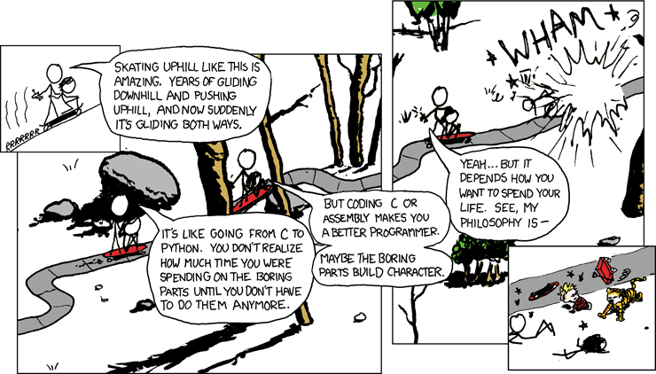
x86-64 Assembly
CSE 351 Winter 2018
Instructor:
Mark Wyse
Teaching Assistants:
Kevin Bi
Parker DeWilde
Emily Furst
Sarah House
Waylon Huang
Vinny Palaniappan
http://xkcd.com/409/

Slide 2
Administrivia
Lab 1 due today!
  Submit bits.c and pointer.c
Homework 2 due next Wednesday (1/24)
  On Integers, Floating Point, and x86-64

Slide 3

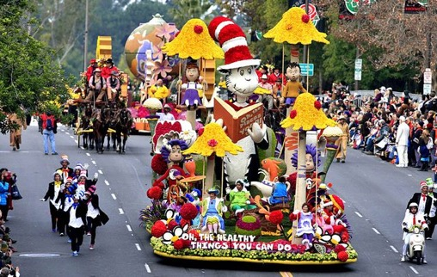
Floating point topics
Fractional binary numbers
IEEE floating-point standard
Floating-point operations and rounding
Floating-point in C
There are many more details that
we won’t cover
  It’s a 58-page standard…
Notes:
Start by talking about representing fractional numbers in binary in general
Then about the IEEE Standard for floating point representation, operations,
Will not cover:
All the details of the 58-page spec
Or expect you to perform operations
Want to show you how floating point values are represented
To give you a sense of the kinds of things that can go wrong with them

Slide 4
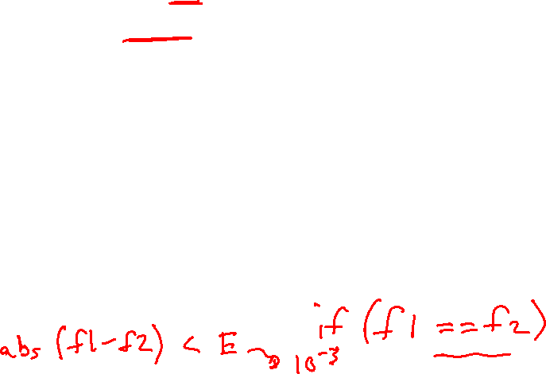
Floating Point in C
!!!
C offers two (well, 3) levels of precision
  float 1.0f single precision (32-bit)
  double 1.0 double precision (64-bit)
  long double 1.0L (“double double” or quadruple)
  precision (64-128 bits)
#include <math.h> to get INFINITY and NAN constants
Equality (==) comparisons between floating point numbers are tricky, and often return unexpected results, so just avoid them!
Notes:
Equality: instead, use abs(f1 – f2) < Error
Error is some arbitrary threshold

Slide 5
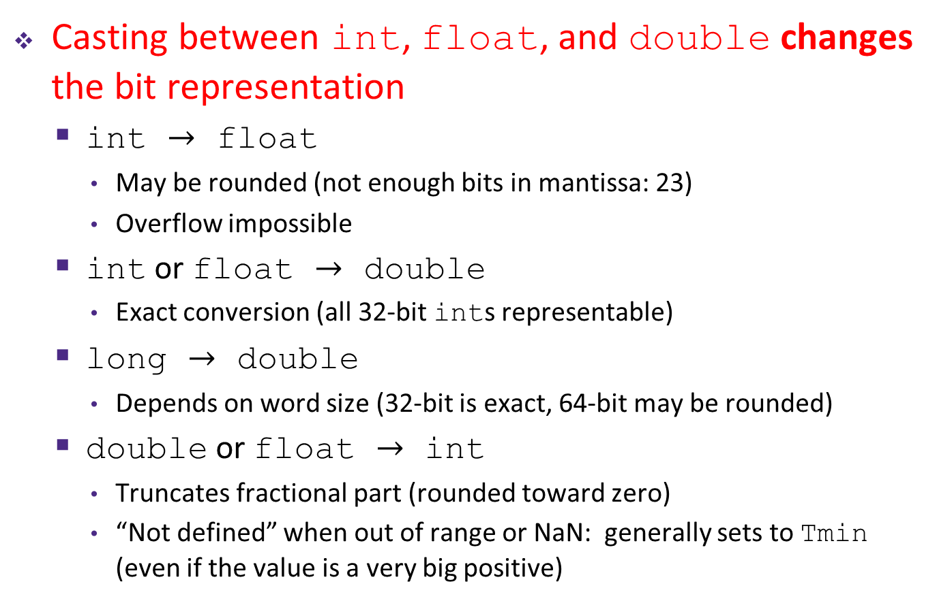
Floating Point Conversions in C
!!!
Casting between int, float, and double changes the bit representation
  int $→$ float
    May be rounded (not enough bits in mantissa: 23)
    Overflow impossible
  int or float $→$ double
    Exact conversion (all 32-bit ints representable)
  long $→$ double
    Depends on word size (32-bit is exact, 64-bit may be rounded)
  double or float $→$ int
    Truncates fractional part (rounded toward zero)
    “Not defined” when out of range or NaN: generally sets to Tmin
    (even if the value is a very big positive)

Slide 6
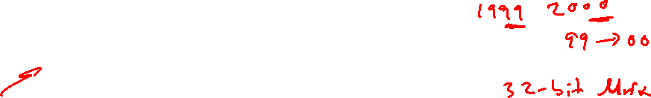
Number Representation Really Matters
1991: Patriot missile targeting error
  clock skew due to conversion from integer to floating point
1996: Ariane 5 rocket exploded ($1 billion)
  overflow converting 64-bit floating point to 16-bit integer
2000: Y2K problem
  limited (decimal) representation: overflow, wrap-around
2038: Unix epoch rollover
  Unix epoch = seconds since 12am, January 1, 1970
  signed 32-bit integer representation rolls over to TMin in 2038
Other related bugs:
  1982: Vancouver Stock Exchange (truncation instead of rounding)
  1994: Intel Pentium FDIV (floating point division) HW bug ($475 million)
  1997: USS Yorktown “smart” warship stranded: divide by zero
  1998: Mars Climate Orbiter crashed: unit mismatch ($193 million)
Notes:
This is the part where I try to scare you…
Patriot: failed to track a SCUD missile
Ariane 5: made it to 3700 m altitude before veering off course and exploding
Y2K: computers might interpret 00 as year 1900 instead of 2000
Also a leap year bug in software: assumed 2000 wasn’t one when it actually was
Unix: 64-bit OS’es now use a signed 64-bit counter, but still a big problem for embedded systems
New time rolls over 292 billion years from now (approx. 20 times the estimated age of the universe)
Yorktown: crew member entered a 0 into a DB field -> buffer overflow -> propulsion systems down
Ground based software produced a value in non-SI units, but orbiter expected SI units -> burned up in atmosphere

Slide 7
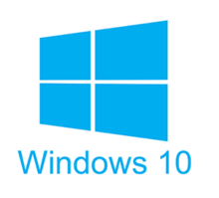
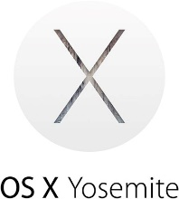

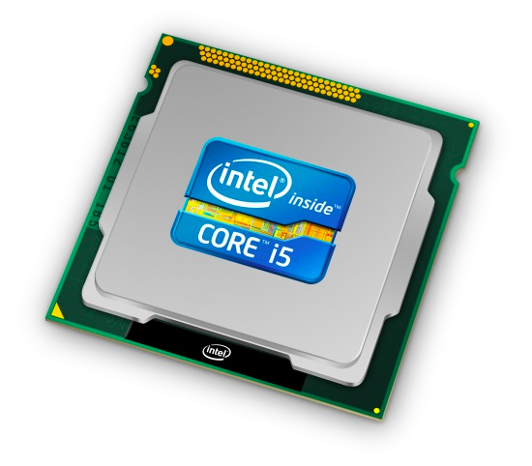
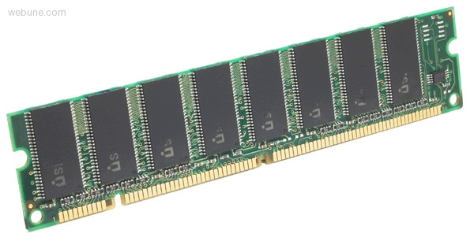
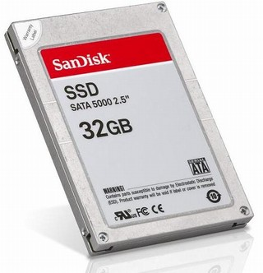
Roadmap
C:
Java:
Memory & data
Integers & floats
x86 assembly
Procedures & stacks
Executables
Arrays & structs
Memory & caches
Processes
Virtual memory
Memory allocation
Java vs. C
car *c = malloc(sizeof(car));
c->miles = 100;
c->gals = 17;
float mpg = get_mpg(c);
free(c);
Car c = new Car();
c.setMiles(100);
c.setGals(17);
float mpg =
c.getMPG();
Assembly language:
get_mpg:
pushq %rbp
movq %rsp, %rbp
...
popq %rbp
ret
OS:
Machine code:
0111010000011000
100011010000010000000010
1000100111000010
110000011111101000011111
Computer system:

Slide 8
Basics of Machine Programming & Architecture
What is an ISA (Instruction Set Architecture)?
A brief history of Intel processors and architectures
Intro to Assembly and Registers
Notes:
Overview of today’s lecture

Slide 9
Translation
Code Time
Compile Time
Run Time
User
program
in C
Hardware
C
compiler
Assembler
.c file
.exe file
What makes programs run fast(er)?
Notes:
Seen this picture before
Question is which steps or interfaces influence program performance?

Slide 10

HW Interface Affects Performance
Source code
Compiler
Architecture
Hardware
Different applications
or algorithms
Perform optimizations,
generate instructions
Instruction set
Different implementations
Intel Pentium 4
C Language
Program A
Intel Core i7
GCC
x86-64
AMD Ryzen
Program B
AMD Epyc
Clang
Intel Xeon
Your program
ARMv8 (AArch64/A64)
ARM Cortex-A53
Apple A7
Notes:
Different programs written in C, have different algorithms
Algorithms perform differently
Compilers figure out what instructions to generate
do different optimizations
Different architectures expose different interfaces
Hardware implementations have different performance

Slide 11
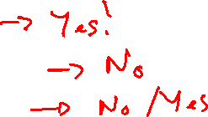
Definitions
Architecture (ISA): The parts of a processor design that one needs to understand to write assembly code
  “What is directly visible to software”
Microarchitecture: Implementation of the architecture
  CSE/EE 469, 470
Are the following part of the architecture?
  Number of registers?
  How about CPU frequency?
  Cache size? Memory size?
Notes:
Registers?
Yes. Each has a unique name that the assembly programmer must know in order to use.
Frequency?
Nope, same program, just faster!
Is size of memory part of architecture?
No! Don’t’ have to change your program if you add more memory

Slide 12
Instruction Set Architectures
The ISA defines:
  The system’s state (e.g. registers, memory, program counter)
  The instructions the CPU can execute
  The effect that each of these instructions will have on the system state
CPU
PC
Memory
Registers
Notes:
Textbook: “the format and behavior of a machine-level program is defined by the ISA, defining the processor state, the format of the instructions, and the effect each of these instructions will have on the state.”

Slide 13
Instruction Set Philosophies
Complex Instruction Set Computing (CISC): Add more and more elaborate and specialized instructions as needed
  Lots of tools for programmers to use, but hardware must be able to handle all instructions
  x86-64 is CISC, but only a small subset of instructions encountered with Linux programs
Reduced Instruction Set Computing (RISC): Keep instruction set small and regular
  Easier to build fast hardware
  Let software do the complicated operations by composing simpler ones

Slide 14
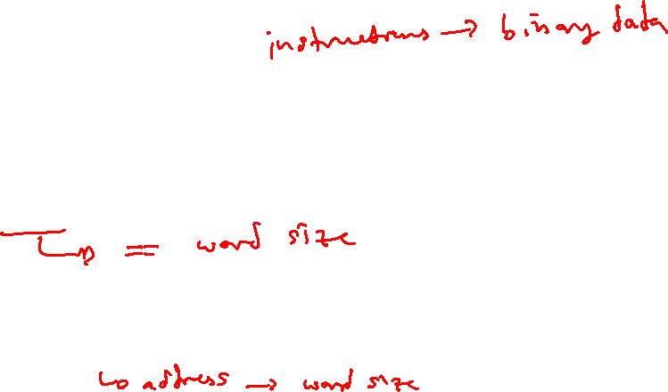
General ISA Design Decisions
Instructions
  What instructions are available? What do they do?
  How are they encoded?
Registers
  How many registers are there?
  How wide are they?
Memory
  How do you specify a memory location?
Notes:
Instructions = binary data
Registers: word size
Address is word size

Slide 15



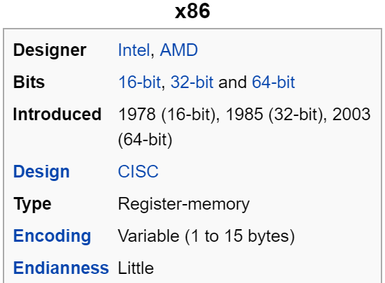
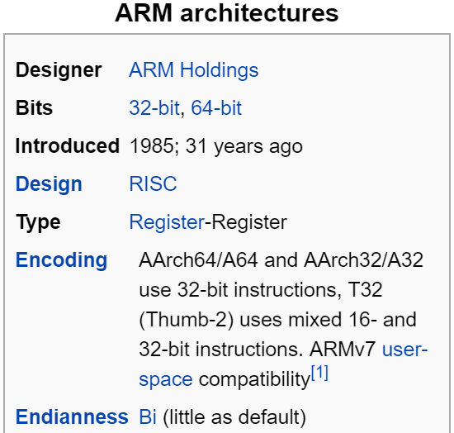
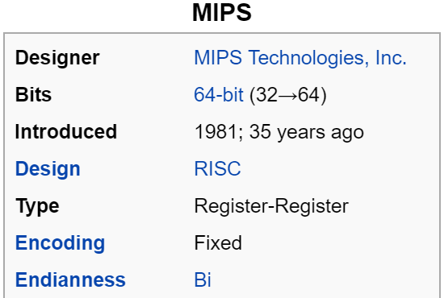

Mainstream ISAs
Macbooks & PCs
(Core i3, i5, i7, M)
x86-64 Instruction Set
Smartphone-like devices
(iPhone, iPad, Raspberry Pi)
ARM Instruction Set
Digital home & networking equipment
(Blu-ray, PlayStation 2)
MIPS Instruction Set
Notes:
x86 backwards-compatible all the way to 8086 architecture (introduced in 1978!), has had many, many new features added since.
x86 dominates the server, desktop, and laptop markets.
ARM stands for Advanced RISC Machine.
MIPS was originally an acronym for Microprocessor without Interlocked Pipeline Stages. Developed by MIPS Technologies (formerly MIPS Computer Systems, Inc).

Slide 16
Intel/AMD x86 Evolution: Milestones
Name | Date | Transistors | MHz
8086 | 1978 | 29K | 5-10
First 16-bit Intel processor. Basis for IBM PC & DOS 1 MB address space
386 | 1985 | 275K | 16-33
First 32-bit Intel processor, referred to as IA32 Added “flat addressing,” capable of running Unix
Pentium (P5) | 1993 | 3.2M | 60
First superscalar IA32
Athlon (K7) | 1999 | 22M | 500-2333
First desktop processor with 1 GHz clock (at roughly same time as Pentium III)
Athlon 64 (K8) | 2003 | 106M | 1600-3200
First x86-64 processor architecture
Pentium 4E | 2004 | 125M | 2800-3800
First 64-bit Intel x86 processor
Notes:
AMD started out as a second source supplier of microchips from Fairchild and National Semiconductor
1975, AMD produces Am9080, a clone of the Intel 8080
1976, AMD cross-licensing agreement with Intel
1982, AMD began volume producing Intel processors
2006, AMD acquires ATI and enters GPU business

Slide 17
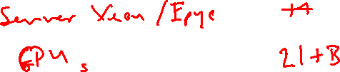
Intel/AMD x86 Evolution: Milestones
Name | Date | Transistors | MHz
Core 2 | 2006 | 291M | 1060-3500
First multi-core Intel Processor
Core i7 | 2008 | 731M | 1700-3900
Four cores
AMD Phenom (K10) | 2008 | 758M | 1800-2600
First “true” quad core, with all cores on same silicon die
Core i7 (Coffee Lake) | 2017 | ? | 2800-4700
Ryzen 7 (Zen) | 2017 | 4.8B | 3000-4200
Notes:
Each generation added features:
Instructions to support multimedia operations
SIMD extensions
Instructions to enable more efficient conditional operations
Hardware support for virtualization (virtual machines)
More cores!

Slide 18
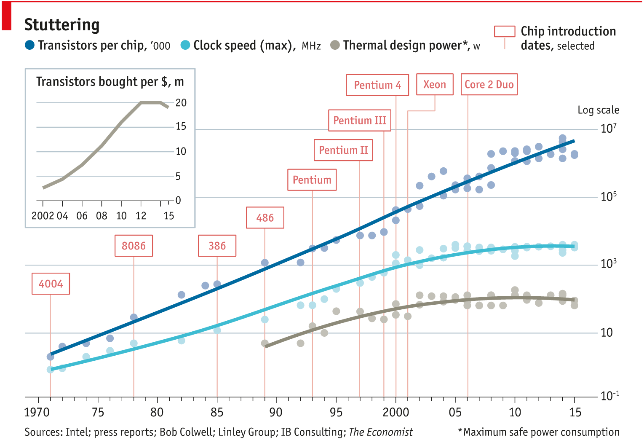

Technology Scaling
Breakdown!
http://www.economist.com/technology-quarterly/2016-03-12/after-moores-law
Notes:
Observations
Transistors still getting smaller, but at a slower rate
Clock frequency has leveled off
Power has leveled off
Breakdown! In 2005-2007
Dennard Scaling stalled
Power density of chips is literally “too hot to handle”

Slide 19
Transition to 64-bit
Intel attempted radical shift from IA32 to IA64 (2001)
  Completely new architecture (Itanium)
  Execute IA32 code only as legacy
  Performance disappointing
AMD solution: “AMD64” (2003)
  x86-64, evolutionary step from IA32
Intel pursued IA64
  Couldn’t admit its mistake with Itanium
Intel announces “EM64T” extension to IA32 (2004)
  Extended Memory 64-bit Technology
  Nearly identical to AMD64!
Notes:
Itanium was too hard to write a compiler for
We will focus on x86-64 in this class!
Older classes, and 2nd edition of book, had both IA32 and x86-64

Slide 20

Assembly Programmer’s View
CPU
Memory
Registers
Addresses
PC
Code
Data
Stack
Data
Condition
Codes
Instructions
Programmer-visible state
  PC: the Program Counter (%rip in x86-64)
    Address of next instruction
  Named registers
    Together in “register file”
    Heavily used program data
  Condition codes
    Store status information about most recent arithmetic operation
    Used for conditional branching
Memory
  Byte-addressable array
  Code and user data
  Includes the Stack (for supporting procedures)
Notes:
Preview for the coming lectures

Slide 21

Three Basic Kinds of Instructions
Transfer data between memory and register
  Load data from memory into register
    %reg = Mem[address]
  Store register data into memory
    Mem[address] = %reg
Perform arithmetic operation on register or memory data
  c = a + b; z = x << y; i = h & g;
Control flow: what instruction to execute next
  Unconditional jumps to/from procedures
  Conditional branches
    Remember: Memory is indexed just like an array of bytes!

Slide 22

x86-64 Assembly “Data Types”
Integral data of 1, 2, 4, or 8 bytes
  Data values
  Addresses (untyped pointers)
Floating point data of 4, 8, 10 or 2x8 or 4x4 or 8x2
  Different registers for those (e.g. %xmm1, %ymm2)
  Come from extensions to x86 (SSE, AVX, …)
No aggregate types such as arrays or structures
  Just contiguously allocated bytes in memory
Two common syntaxes
  “AT&T”: used by our course, slides, textbook, gnu tools, …
  “Intel”: used by Intel documentation, Intel tools, …
  Must know which you’re reading
Not covered
In 351
Notes:
Assembly program doesn’t actually have notion of “data types,” but since encoding is so different between integral and floating point data, there are actually different instructions built into assembly because the hardware needs to deal with these numbers differently when performing arithmetic.

Slide 23
What is a Register?
A location in the CPU that stores a small amount of data, which can be accessed very quickly (once every clock cycle)
Registers have names, not addresses
  In assembly, they start with % (e.g. %rsi)
Registers are at the heart of assembly programming
  They are a precious commodity in all architectures, but especially x86

Slide 24
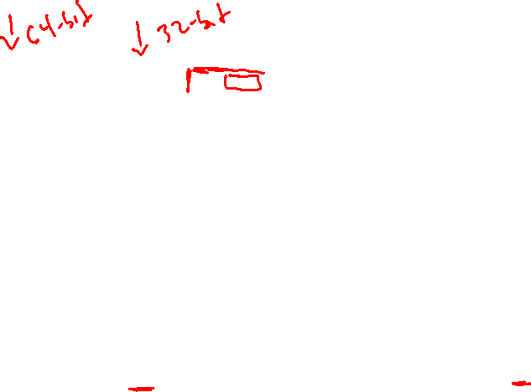
x86-64 Integer Registers – 64 bits wide
%rax
%r8
%eax
%r8d
%rbx
%r9
%ebx
%r9d
%rcx
%r10
%ecx
%r10d
%rdx
%r11
%edx
%r11d
%rsi
%r12
%esi
%r12d
%rdi
%r13
%edi
%r13d
%rsp
%r14
%esp
%r14d
%rbp
%r15
%ebp
%r15d
  Can reference low-order 4 bytes (also low-order 2 & 1 bytes)
Notes:
Names are largely arbitrary, reasons behind them are not super relevant to us
But there are conventions about how they are used
One is particularly important to not misuse: %rsp
Stack pointer; we’ll get to this when we talk about procedures
Why is %rbp now general-purpose in x86-64? http://www.codemachine.com/article_x64deepdive.html
r8-r15: still names not indexes
Each is 8-bytes wide
What if we only want 4 bytes?
We can use these alternate names to use just half of the bytes

Slide 25

Some History: IA32 Registers – 32 bits wide
%eax
%ax
%ah
%al
accumulate
%ecx
%cx
%ch
%cl
counter
%edx
%dx
%dh
%dl
data
general purpose
%ebx
base
%bx
%bh
%bl
%esi
%si
source index
%edi
destination index
%di
%sp
stack pointer
%esp
%ebp
%bp
base pointer
16-bit virtual registers
(backwards compatibility)
Name Origin
(mostly obsolete)
Notes:
Only 6 registers that we can do whatever we want with
Remember how I said we’ve been upgrading x86 since 1978, when it was 16-bit?
Originally just %ax, …
Could even reference single bytes (high, low)
There used to be more conventions about how they were used
Just to make it easier when people were writing assembly by hand
Now irrelevant

Slide 26
Memory vs. Registers
Addresses vs. Names
  0x7FFFD024C3DC %rdi
Big vs. Small
  ~ 8 GB (16 x 8 B) = 128 B
Slow vs. Fast
  ~50-100 ns sub-nanosecond timescale
Dynamic vs. Static
  Can “grow” as needed fixed number in hardware
  while program runs

Slide 27
Operand types
Immediate: Constant integer data
  Examples: $0x400, $-533
  Like C literal, but prefixed with ‘$’
  Encoded with 1, 2, 4, or 8 bytes
  depending on the instruction
Register: 1 of 16 integer registers
  Examples: %rax, %r13
  But %rsp reserved for special use
  Others have special uses for particular instructions
Memory: Consecutive bytes of memory at a computed address
  Simplest example: (%rax)
  Various other “address modes”
%rax
%rcx
%rdx
%rbx
%rsi
%rdi
%rsp
%rbp
%rN
Notes:
These are the types of operands an assembly instruction can use
Not all instructions can use all types!
Not all combinations can be used
E.g., no memory to memory moves

Slide 28
Summary
x86-64 is a complex instruction set computing (CISC) architecture
Registers are named locations in the CPU for holding and manipulating data
  x86-64 uses 16 64-bit wide registers
Assembly operands include immediates, registers, and data at specified memory locations

Slide 29
Floating Point Summary
Floats also suffer from the fixed number of bits available to represent them
  Can get overflow/underflow
  “Gaps” produced in representable numbers means we can lose precision, unlike ints
    Some “simple fractions” have no exact representation (e.g. 0.2)
    “Every operation gets a slightly wrong result”
Floating point arithmetic not associative or distributive
  Mathematically equivalent ways of writing an expression may compute different results
Never test floating point values for equality!
Careful when converting between ints and floats!

Slide 30
Floating Point Summary
Converting between integral and floating point data types does change the bits
  Floating point rounding is a HUGE issue!
    Limited mantissa bits cause inaccurate representations
    Floating point arithmetic is NOT associative or distributive

