Slide 1
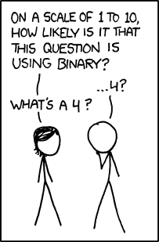
Memory, Data, & Addressing I
CSE 351 Winter 2018
Instructor:
Mark Wyse
Teaching Assistants:
Kevin Bi
Parker DeWilde
Emily Furst
Sarah House
Waylon Huang
Vinny Palaniappan
http://xkcd.com/953/
Notes:
Close the doors!

Slide 2
Administrivia
Pre-Course Survey due tonight @ 11:59pm
Lab 0 due Monday (1/8)
Homework 1 due Wednesday (1/10)
All course materials can be found on the website/schedule
Course Overloads – fill out the Google Form linked in lecture 1!
Make sure you’re also enrolled in CSE391
(EEs and non-majors included!)
Notes:
Overloads: handled by CSE advising, fill out the form, they will decide who gets spots.
If not in course yet, don’t worry, you will get a fair chance to submit these assignments.

Slide 3
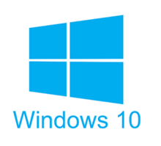
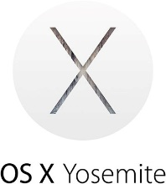

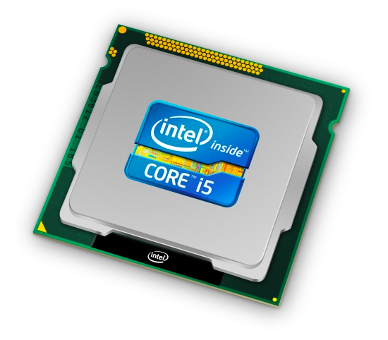
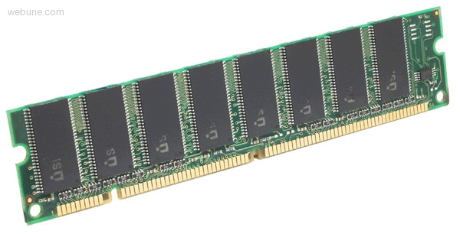
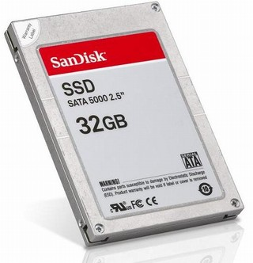
Roadmap
C:
Java:
Memory & data
Integers & floats
x86 assembly
Procedures & stacks
Executables
Arrays & structs
Memory & caches
Processes
Virtual memory
Memory allocation
Java vs. C
car *c = malloc(sizeof(car));
c->miles = 100;
c->gals = 17;
float mpg = get_mpg(c);
free(c);
Car c = new Car();
c.setMiles(100);
c.setGals(17);
float mpg =
c.getMPG();
Assembly language:
get_mpg:
pushq %rbp
movq %rsp, %rbp
...
popq %rbp
ret
OS:
Machine code:
0111010000011000
100011010000010000000010
1000100111000010
110000011111101000011111
Computer system:
Notes:
Today we’ll be talking about the basic execution model, and focusing on how data gets stored in memory and addressed

Slide 4

Hardware: Logical View
Memory
CPU
Bus
Disks
USB
Etc.
Net
Notes:
CPU: all computations done here (workhorse)
Memory: big array of bytes, (local storage)
Big pipe between CPU and memory, in order to keep CPU fed
Bus: connect everything else to each other
Bus just means you broadcast on it (to everyone)
Same root as the other kind of “bus”
“interconnection”
Disks bigger storage, slower, farther away, persistent
Network, etc.

Slide 5
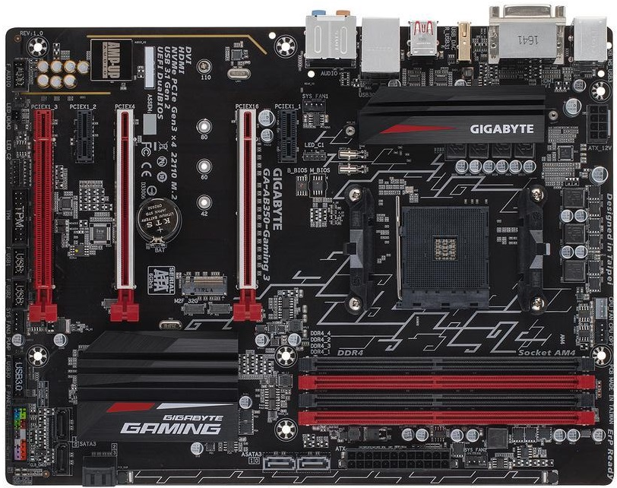

Hardware: Physical View
Bus connections
CPU
(socket)
I/O controller
Memory
Storage connections

Slide 6
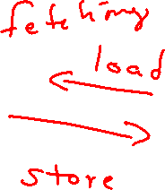
Hardware: 351 View (version 0)
Memory
instructions
?
CPU
data
CPU executes instructions; memory stores data
To execute an instruction, the CPU must:
  fetch an instruction;
  fetch the data used by the instruction; and, finally,
  execute the instruction on the data…
  which may result in writing data back to memory
Notes:
The CPU and Memory are what this course focuses on.
Instructions = “constant fetching”
Data = “load” and “store”

Slide 7
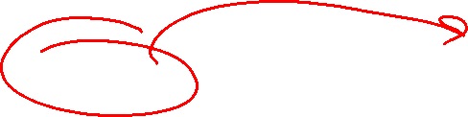
Hardware: 351 View (version 1)
Memory
instructions
i-cache
take 470…
this week…
CPU
data
registers
The CPU holds instructions temporarily in the instruction cache
The CPU holds data temporarily in a fixed number of registers
Instruction and operand fetching is hardware-controlled
Data movement is programmer-controlled (in assembly)
We’ll learn about the instructions the CPU executes –
take CSE/EE 469 and 470 to find out how it actually executes them
Notes:
How it executes is architecture and microarchitecture of the CPU
Out-of-order, speculative execution
If you’ve been keeping up with the Meltdown and Spectre CPU bugs

Slide 8
Hardware: 351 View (version 1)
Memory
instructions
i-cache
take 470…
this week…
How are data and instructions represented?
CPU
data
registers
The CPU holds instructions temporarily in the instruction cache
The CPU holds data temporarily in a fixed number of registers
Instruction and operand fetching is hardware-controlled
Data movement is programmer-controlled (in assembly)
We’ll learn about the instructions the CPU executes –
take CSE/EE 469 and 470 to find out how it actually executes them
How does a program find its data in memory?

Slide 9
Question 1:
Memory
Binary Encoding!
instructions
i-cache
take 470…
this week…
How are data and instructions represented?
CPU
data
registers
Notes:
Okay so first…

Slide 10
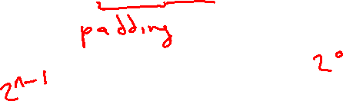
Question 1: Some Additional Details
Because storage is finite in reality, everything is stored as “fixed” length
  Data is moved and manipulated in fixed-length chunks
  Multiple fixed lengths (e.g. 1 byte, 4 bytes, 8 bytes)
  Leading zeros now must be included up to “fill out” the fixed length
Example: the “eight-bit” representation of the number 4 is 0b00000100
Least Significant Bit (LSB)
Most Significant Bit (MSB)
Notes:
Extra 0’s = “padding”
MSB = 2^n-1, “most weight”
LSB = 2^0, “least weight”

Slide 11
Question 2:
Memory
instructions
i-cache
take 470…
this week…
CPU
data
registers
How does a program find its data in memory?

Slide 12
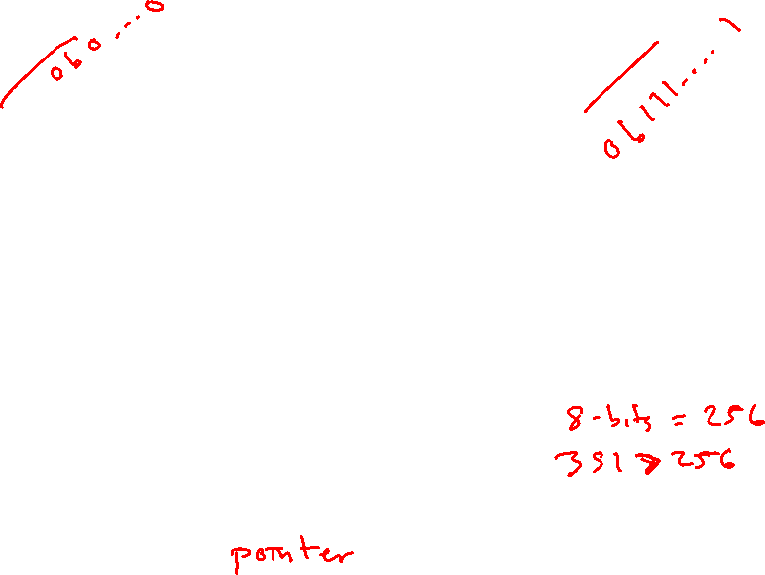
Byte-Oriented Memory Organization
00•••0
FF•••F
 |  |  |  |  |  | • • •
Conceptually, memory is a single, large array of bytes,
each with a unique address (index)
  The value of each byte in memory can be read and written
Programs refer to bytes in memory by their addresses
  Domain of possible addresses = address space
But not all values fit in a single byte… (e.g. 351)
  Many operations actually use multi-byte values
We can store addresses as data to “remember” where other data is in memory
Notes:
Each byte can be read and written
Address space determined by how many bits in the address
00…….0 = “lowest address”
FF……F = “highest address”
So what if things don’t fit in a single byte?
How many things does 1 byte allow us to address?
Last bullet = “pointers”!!

Slide 13
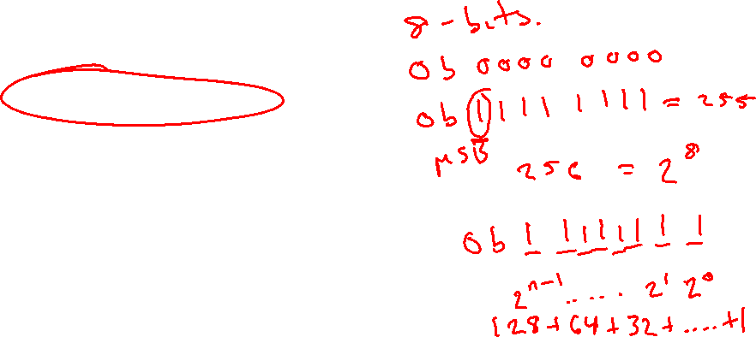
Peer Instruction Question
If we choose to use 8-bit addresses, how big is our address space?
  i.e. How much space can we “refer to” using our addresses?
256 bits
256 bytes
8 bits
8 bytes
We’re lost…
Notes:
Answer: B. 256 bytes
8 bits can represent 2^8 things, each addr is a byte
Byte Addressable Memory!
Ink out the answer

Slide 14
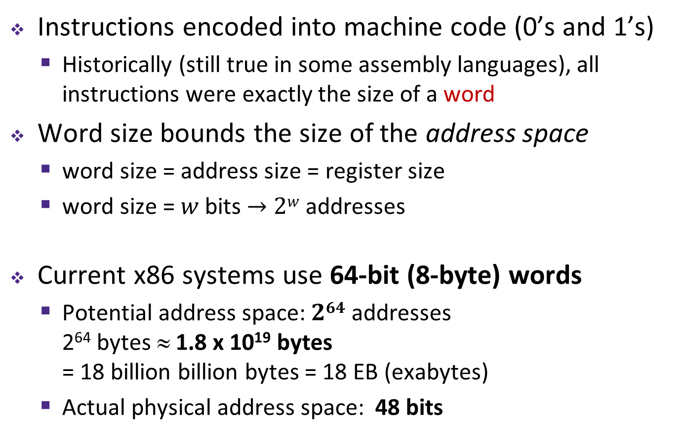
Machine “Words”
Instructions encoded into machine code (0’s and 1’s)
  Historically (still true in some assembly languages), all instructions were exactly the size of a word
Word size bounds the size of the address space
  word size = address size = register size
  word size = $w$ bits $→$ $2w$ addresses
Current x86 systems use 64-bit (8-byte) words
  Potential address space: $264$ addresses
  2⁶⁴ bytes ≈ 1.8 x 10¹⁹ bytes
  = 18 billion billion bytes = 18 EB (exabytes)
  Actual physical address space: 48 bits
Notes:
Instead, we typically talk about addresses in terms of “words”
Use same word size anywhere that you typically store addresses
Word size is a “design decision”
You could count the world population with 33 fingers (using population number of 7.454 billion)

Slide 15

Word-Oriented Memory Organization
64-bit
Words
32-bit
Words
Addr.
(hex)
Bytes
Addresses still specify
locations of bytes in memory
  Addresses of successive words
  differ by word size (in bytes):
  e.g. 4 (32-bit) or 8 (64-bit)
  Address of word 0, 1, … 10?
0x00
Addr
=
??
0x01
0x02
Addr
=
??
0x03
0x04
Addr
=
??
0x05
0x06
0x07
0x08
Addr
=
??
0x09
0x0A
Addr
=
??
0x0B
0x0C
Addr
=
??
0x0D
0x0E
0x0F
Notes:
What do we use to address bigger chunks of bytes?

Slide 16

Word-Oriented Memory Organization
64-bit
Words
32-bit
Words
Addr.
(hex)
Bytes
Addresses still specify
locations of bytes in memory
  Addresses of successive words
  differ by word size (in bytes):
  e.g. 4 (32-bit) or 8 (64-bit)
  Address of word 0, 1, … 10?
Address of word
= address of first byte in word
  The address of any chunk of
  memory is given by the address
  of the first byte
  Alignment
0x00
Addr
=
??
0x01
0x02
0000
Addr
=
??
0x03
0x04
0000
Addr
=
??
0x05
0x06
0004
0x07
0x08
Addr
=
??
0x09
0x0A
Addr
=
??
0008
0x0B
0008
0x0C
Addr
=
??
0x0D
0x0E
0012
0x0F
Notes:
Use the first byte of the word
Still count by bytes
Aside: isn’t this wasteful?
Yes, but remember how much we can address with 64 bits? Probably don’t need to worry too much.

Slide 17

A Picture of Memory (64-bit view)
A “64-bit (8-byte) word-aligned” view of memory:
  In this type of picture, each row is composed of 8 bytes
  Each cell is a byte
  A 64-bit pointer
  will fit on one row
one word
0x00
0x01
0x02
0x03
0x04
0x05
0x06
0x07
Address
0x00
0x
0x
0x
0x
0x
0x
0x
0x
0x
Notes:
0x00 = “beginning of memory”
In this course, we’ll be doing everything in 64-bits
What’s the second row’s address going to be?
0x08
Third?
0x10

Slide 18
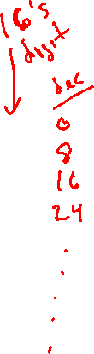
A Picture of Memory (64-bit view)
A “64-bit (8-byte) word-aligned” view of memory:
  In this type of picture, each row is composed of 8 bytes
  Each cell is a byte
  A 64-bit pointer
  will fit on one row
one word
0x00
0x01
0x02
0x03
0x04
0x05
0x06
0x07
Address
0x00
0x08
0x10
0x18
0x20
0x28
0x08
0x09
0x0A
0x0B
0x0C
0x0D
0x0E
0x0F
0x30
0x38
0x40
0x48
Notes:
16’s digit is the digit after the x

Slide 19
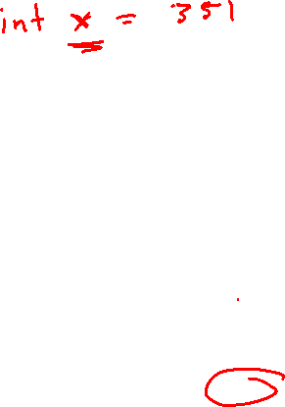
Addresses and Pointers
64-bit example
(pointers are 64-bits wide)
big-endian
An address is a location in memory
A pointer is a data object that holds an address
  Address can point to any data
Value 351 stored at
address 0x08
  351₁₀ = 15F₁₆
  = 0x 00 ... 00 01 5F
Pointer stored at
0x38 points to
address 0x08
Address
0x00
00
00
00
00
00
00
01
5F
0x08
0x10
0x18
0x20
0x28
0x30
00
00
00
00
00
00
00
08
0x38
0x40
0x48
Notes:
Note that everything is just padded with extra 0s
15F₁₆ = 1 x 16^2 + 5 x 16^1 + 15 x 16^0 = 256 * 80 * 15

Slide 20
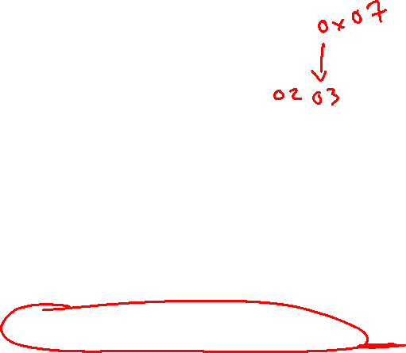
Addresses and Pointers
64-bit example
(pointers are 64-bits wide)
big-endian
An address is a location in memory
A pointer is a data object that holds an address
  Address can point to any data
Pointer stored at
0x48 points to
address 0x38
  Pointer to a pointer!
Is the data stored
at 0x08 a pointer?
  Could be, depending
  on how you use it
Address
0x00
00
00
00
00
00
00
01
5F
0x08
0x10
0x18
0x20
0x28
0x30
00
00
00
00
00
00
00
08
0x38
0x40
00
00
00
00
00
00
00
38
0x48
Notes:
Note that everything is just padded with extra 0s

Slide 21
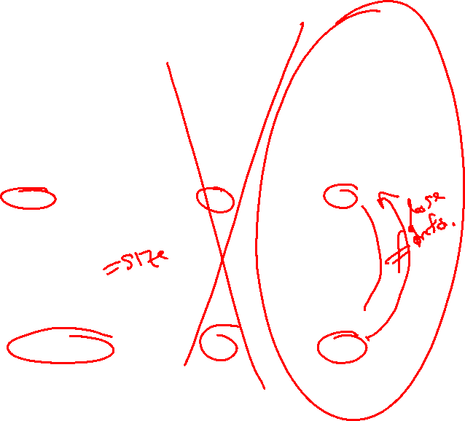
Data Representations
Sizes of data types (in bytes)
Java Data Type | C Data Type | 32-bit (old) | x86-64
boolean | bool | 1 | 1
byte | char | 1 | 1
char |  | 2 | 2
short | short int | 2 | 2
int | int | 4 | 4
float | float | 4 | 4
 | long int | 4 | 8
double | double | 8 | 8
long | long | 8 | 8
 | long double | 8 | 16
(reference) | pointer * | 4 | 8
(reference) | pointer * | 4 | 8
address size = word size
To use “bool” in C, you must #include <stdbool.h>
Notes:
This mapping is mostly an arbitrary historical artifact except for address sizes.
We will focus on x86-64
Ink – cross out 32-bit column

Slide 22
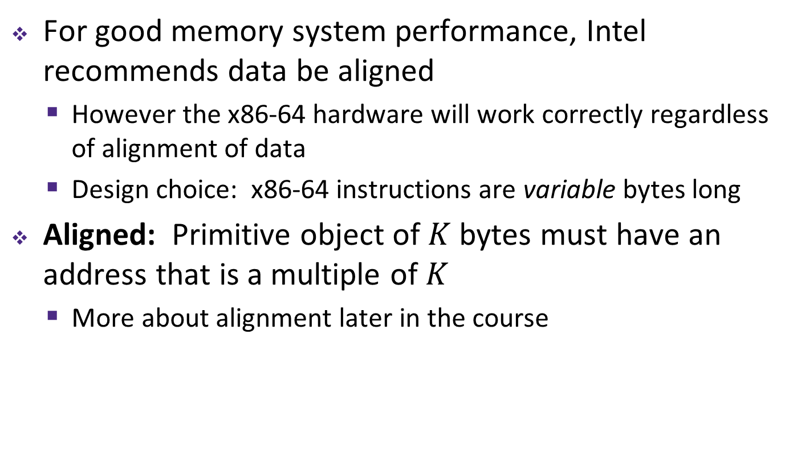
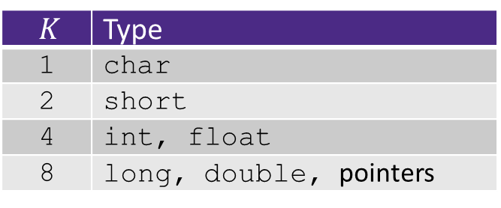
More on Memory Alignment in x86-64
For good memory system performance, Intel recommends data be aligned
  However the x86-64 hardware will work correctly regardless of alignment of data
  Design choice: x86-64 instructions are variable bytes long
Aligned: Primitive object of $K$ bytes must have an address that is a multiple of $K$
  More about alignment later in the course
$K$ | Type
1 | char
2 | short
4 | int, float
8 | long, double, pointers
Notes:
Alignment: used to reduce the number of memory system transactions
More transactions may lower performance (may not be noticeable, though)
Padding used in structs, will come back to this later.

Slide 23
Byte Ordering
How should bytes within a word be ordered in memory?
  Example: store the 4-byte (32-bit) int:
  0x a1 b2 c3 d4
By convention, ordering of bytes called endianness
  The two options are big-endian and little-endian
    In which address does the least significant byte go?
    Based on Gulliver’s Travels: tribes cut eggs on different sides (big, little)
Notes:
In which address does LSB go? “Biggest or littlest?”
Question: anyone know where term ‘Endian’ comes from?
Byte ordering only applies when working with multi-byte data!!
Only applies intra-data
Ordering of items in an array is preserved, but the ordering of bytes within each entry in array will differ

Slide 24
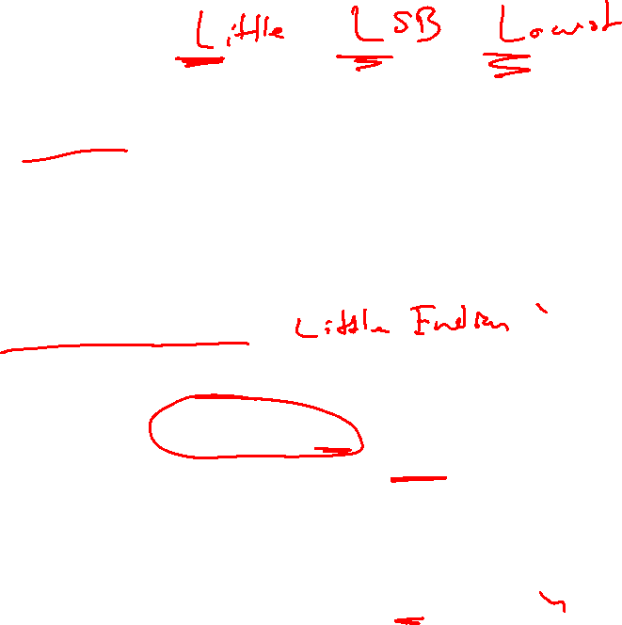
Byte Ordering
Big-endian (SPARC, z/Architecture)
  Least significant byte has highest address
Little-endian (x86, x86-64)
  Least significant byte has lowest address
Bi-endian (ARM, PowerPC)
  Endianness can be specified as big or little (default)
Example: 4-byte data 0xa1b2c3d4 at address 0x100
0x100
0x101
0x102
0x103
Big-Endian
01
a1
23
b2
45
c3
67
d4
0x100
0x101
0x102
0x103
Little-Endian
67
d4
45
c3
23
b2
01
a1
Notes:
Big Endian
Most significant is first
Little Endian
Looks backwards
x86 is Little Endian!!! This will probably be confusing for a while; it still gets me occasionally.
Let’s look at some more examples…
Trick: L-L-L
Little endian = LSB = Lowest address

Slide 25
Byte Ordering Examples
IA32, x86-64
(little-endian)
SPARC
(big-endian)
int x = 12345;
// or x = 0x3039;
0x00
39
00
0x00
0x01
30
00
0x01
0x02
00
30
0x02
0x03
00
39
0x03
long int y = 12345;
// or y = 0x3039;
(A long int is
the size of a word)
32-bit
IA32
64-bit
x86-64
32-bit
SPARC
64-bit
SPARC
0x00
39
39
0x00
0x00
00
00
0x00
0x01
30
30
0x01
0x01
00
00
0x01
0x02
00
00
0x02
0x02
30
00
0x02
0x03
00
00
0x03
0x03
39
00
0x03
00
0x04
00
0x04
00
0x05
00
0x05
00
0x06
30
0x06
00
0x07
39
0x07
Notes:
Long = 4 bytes on 32-bit, 8 bytes on 64-bit machine

Slide 26
Peer Instruction Question:
We store the value 0x 01 02 03 04 as a word at address 0x100 in a big-endian, 64-bit machine
What is the byte of data stored at address 0x104?
0x04
0x40
0x01
0x10
We’re lost…
64-bit
SPARC
0x100
0x101
0x102
0x103
0x104
0x105
0x106
0x107
Notes:
Answer: C
Ink it out, similar to last slide
First, pad 0x01020304 to be a 64-bit word: 0x 00 00 00 00 01 02 03 04
Now, store this 64-bit word to address 0x100, on a big-endian machine
Recall previous slide, it will look like the SPARC 64-bit diagram.
Occupies addresses 0x100 through 0x107, and the LSB is in the highest address (0x107)

Slide 27
Endianness
Endianness only applies to memory storage
Often programmer can ignore endianness because it is handled for you
  Bytes wired into correct place when reading or storing from memory (hardware)
  Compiler and assembler generate correct behavior (software)
Endianness still shows up:
  Logical issues: accessing different amount of data than how you stored it (e.g. store int, access byte as a char)
  Need to know exact values to debug memory errors
  Manual translation to and from machine code (in 351)
Notes:
You will encounter endianness first hand in the programming labs!!!
Lab 3 in particular

Slide 28
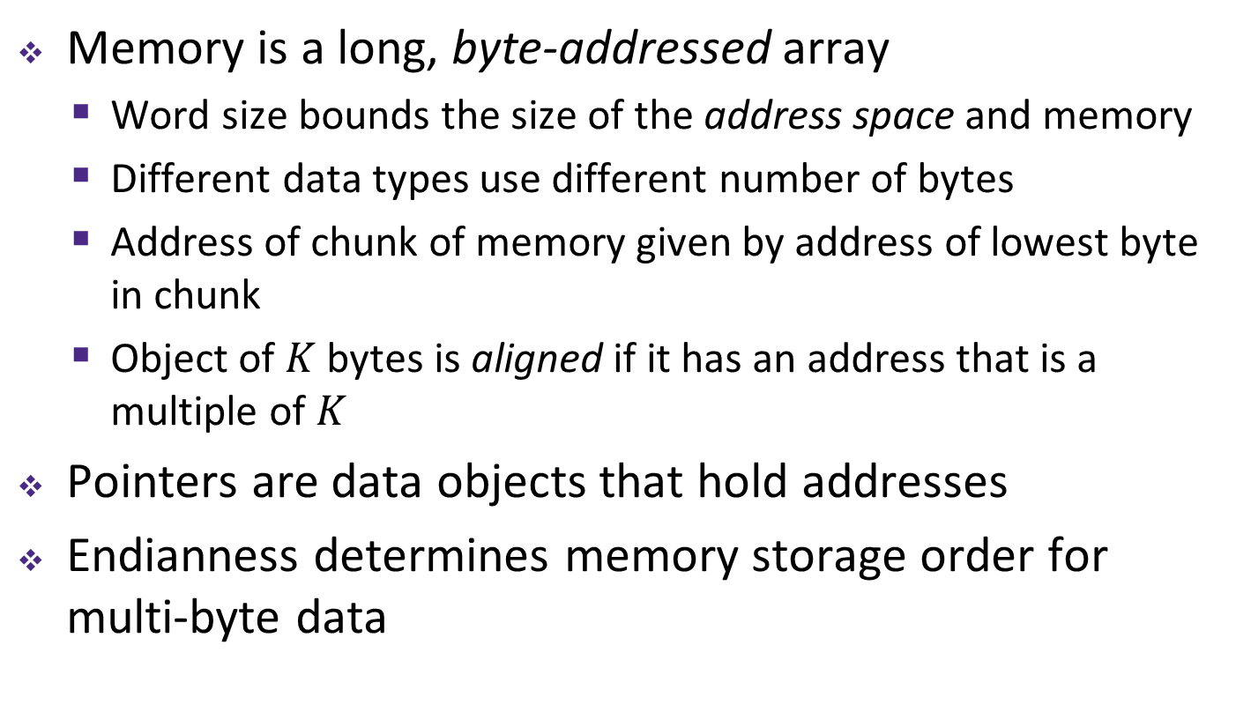
Summary
Memory is a long, byte-addressed array
  Word size bounds the size of the address space and memory
  Different data types use different number of bytes
  Address of chunk of memory given by address of lowest byte in chunk
  Object of $K$ bytes is aligned if it has an address that is a multiple of $K$
Pointers are data objects that hold addresses
Endianness determines memory storage order for multi-byte data

