Slide 1
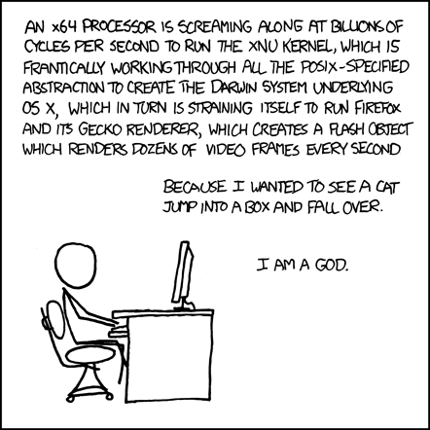
The Hardware/Software Interface CSE 351 Winter 2018
Instructor:
Mark Wyse
Teaching Assistants:
Kevin Bi
Parker DeWilde
Emily Furst
Sarah House
Waylon Huang
Vinny Palaniappan
http://xkcd.com/676/
Notes:
This comic illustrates how complex computer systems are, and all the things that have to happen for a program to execute
By the end of this course, you’ll understand, mm, almost half of that, but it’s the good bits

Slide 2
Welcome to CSE351!
See the key abstractions “under the hood” to describe “what really happens” when a program runs
How is it that “everything is 1s and 0s”?
Where does all the data get stored and how do you find it?
How can more than one program run at once?
What happens to a Java or C program before the hardware executes it?
And much, much, much more…
An introduction that will:
Profoundly change/augment your view of computers and programs
Connect your source code down to the hardware
Leave you impressed that computers ever work

Slide 3
Who: Course Staff
Your Instructor: call me Mark
TAs:
Available in section, office hours, via email, on Piazza
An invaluable source of information and help
Get to know us
We are here to help you succeed!
Notes:
Call me: Mark or Wyse
Not a Dr., not a Professor, no need for a Mr.

Slide 4
About Me
CSE PhD student, Computer Architecture
Washington native
Food lover – I’ll try to cook almost anything
Post-Grad Scholar at AMD Research during 2017
Also, 18 of past 24 months
Future GPU microarchitecture for compute applications
Teaching 351 for the first time!
TA’d in Wi13, Wi14, and Su14 (Coursera offering)
Notes:
CSE 351 content is my bread and butter
I focus on how processors work, how to make them better
Simulation, debugging at assembly stream level, design decisions with caches in mind

Slide 5
Who are You?
~ 115 students registered, single lecture
See me if you are interested in taking the class but are not yet registered
CSE majors, EE majors, and more
Most of you will find almost everything in the course new
Get to know each other and help each other out!
Learning is much more fun with friends
Working well with others is a valuable life skill
Diversity of perspectives expands your horizons

Slide 6
Registration
If you need to register for the course:
https://goo.gl/forms/L7dG4a9RYfJzucZ72
There is an option for EE – 351 only
Non-majors: select ‘Other’ for major
Continue to attend lectures!
Go to a section with open space tomorrow
See me after class to write down UW-ID

Slide 7
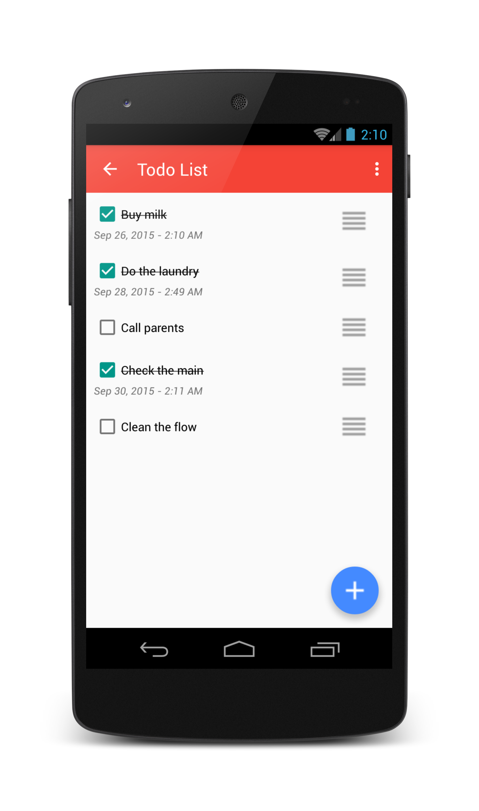
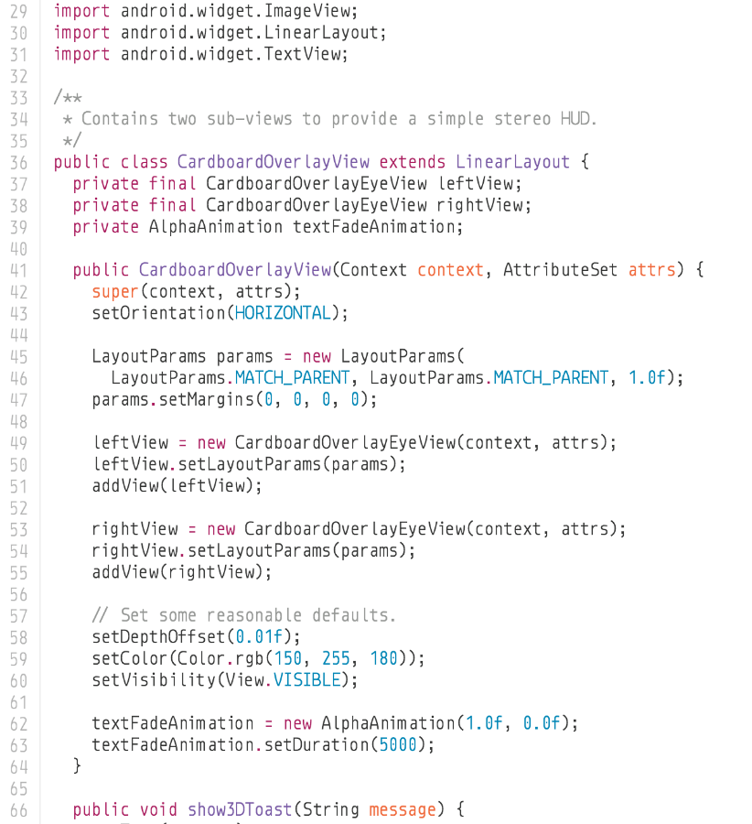
The Hardware/Software Interface
Why do we need a hardware/software interface?
Why do we need to understand both sides of this interface?
1000001101111100001001000001110000000000
0111010000011000
10001011010001000010010000010100
10001011010001100010010100010100
100011010000010000000010
1000100111000010
110000011111101000011111
11110111011111000010010000011100
10001001010001000010010000011000
1000001101111100001001000001110000000000
0111010000011000
10001011010001000010010000010100
10001011010001100010010100010100
100011010000010000000010
1000100111000010
110000011111101000011111
11110111011111000010010000011100
HW/SW Interface
Notes:
This class: how to get from higher-level languages down to machine
Many layers of abstraction in the way
Seems like magic right now
Hardware: laptops, hoards of computers in datacenters, mobile phones, smart watches… all pretty much the same design
Software: a ToDo List app
Interface: describes what a thing can do
SW how to tell the HW what to do
Many layers
Understand the interface:
Understand how the computer works, debug, improve performance,

Slide 8
C/Java, assembly, and machine code
if (x != 0) y = (y+z)/x;
High Level Language
(e.g. C, Java)
Assembly Language
Machine Code
Compiler
cmpl $0, -4(%ebp)
je .L2
movl -12(%ebp), %eax
movl -8(%ebp), %edx
leal (%edx,%eax), %eax
movl %eax, %edx
sarl $31, %edx
idivl -4(%ebp)
movl %eax, -8(%ebp)
.L2:
Assembler
1000001101111100001001000001110000000000
0111010000011000
10001011010001000010010000010100
10001011010001100010010100010100
100011010000010000000010
1000100111000010
110000011111101000011111
11110111011111000010010000011100
10001001010001000010010000011000
Notes:
In C or Java, we can write this one line
In x86 assembly, that one line turns into many instructions
9 instructions
Cmpl == compare
An file containing assembly language is a text file!
Each assembly instruction can then be encoded into a binary form by the Assembler
Machine code
Microcode
Machine code is what the processor understands
It is a stream of bits
Architects define the binary encodings for each assembly instruction

Slide 9
C/Java, assembly, and machine code
if (x != 0) y = (y+z)/x;
All program fragments are equivalent
You’d rather write C! (more human-friendly)
Hardware executes strings of bits
The machine instructions are actually much shorter than the number of bits we would need to represent the characters in the assembly language
In reality everything is voltages and electrical signals
Compiler
cmpl $0, -4(%ebp)
je .L2
movl -12(%ebp), %eax
movl -8(%ebp), %edx
leal (%edx,%eax), %eax
movl %eax, %edx
sarl $31, %edx
idivl -4(%ebp)
movl %eax, -8(%ebp)
.L2:
Assembler
1000001101111100001001000001110000000000
0111010000011000
10001011010001000010010000010100
10001011010001100010010100010100
100011010000010000000010
1000100111000010
110000011111101000011111
11110111011111000010010000011100
10001001010001000010010000011000
Notes:
Rather write C (or some even friendlier high level language)!
Processor understands the binary data of Machine Code
So, why don‘t we just have a compiler from the high level language all the way down to binary?
Why are these instructions so weird?
To get at that, we need to go back and look at history

Slide 10
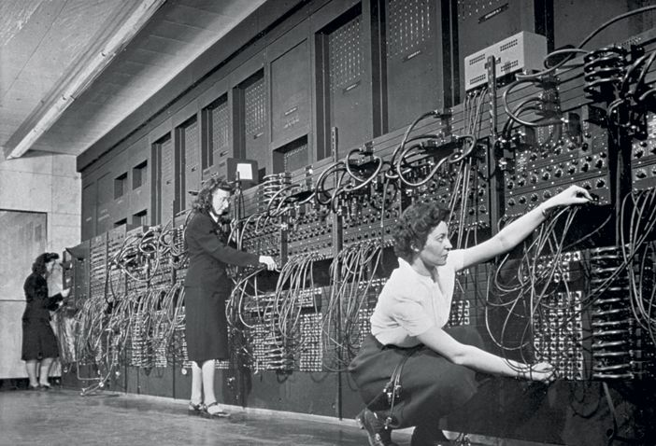
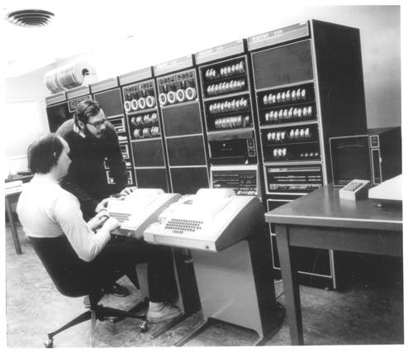
HW/SW Interface: Historical Perspective
Hardware started out quite primitive
1940s
1970s
Jean Jennings (left), Marlyn Wescoff (center), and Ruth Lichterman program ENIAC at the University of Pennsylvania, circa 1946. Photo: Corbis
http://fortune.com/2014/09/18/walter-isaacson-the-women-of-eniac/
https://s-media-cache-ak0.pinimg.com/564x/91/37/23/91372375e2e6517f8af128aab655e3b4.jpg
Notes:
In 1946, programming meant changing where a bunch of wires were plugged in
Changing the Electrical connections of the machine == programming the thing!
By 1970, these guys (one of whom is Ritchie, who wrote the C book), are typing instructions into a PDP-11

Slide 11
HW/SW Interface: Historical Perspective
Hardware started out quite primitive
Programmed with very basic instructions (primitives)
e.g. a single instruction for adding two integers
Software was also very basic
Closely reflected the actual hardware it was running on
Specify each step manually
Architecture Specification (Interface)
Hardware
Notes:
Everything the computer can do, exposed as instructions
This meant software is also pretty simple, basically lists of instructions to execute
Manually specify each instruction
As computers got more complex, we needed help

Slide 12
HW/SW Interface: Assemblers
Life was made a lot better by assemblers
1 assembly instruction = 1 machine instruction
More human-readable syntax
Assembly instructions are character strings, not bit strings
Can use symbolic names
Assembler specification
User program in assembly language
Assembler
Hardware
Notes:
Someone realized they could write a program that would turn scripts into programs
Easier to write
Still basically a one-to-one mapping
As we got more sophisticated, built more sophisticated languages…

Slide 13
HW/SW Interface: Higher-Level Languages
Higher level of abstraction
1 line of a high-level language is compiled into many (sometimes very many) lines of assembly language
C language specification
User program in C
C Compiler
Assembler
Hardware
Notes:
Translation from higher-level languages down to machine code.
New features: functions! Data structures! Classes!

Slide 14
HW/SW Interface: Compiled Programs
Code Time
Compile Time
Run Time
User program in C
C Compiler
Assembler
Hardware
.c file
.exe file
Note: The compiler and assembler are just programs, developed using this
same process.
Notes:
Now, when you write a program, it gets compiled in multiple stages
Some people spend a lot of time making compilers really good at this
Take a little longer compiling, optimize program.

Slide 15
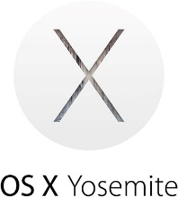
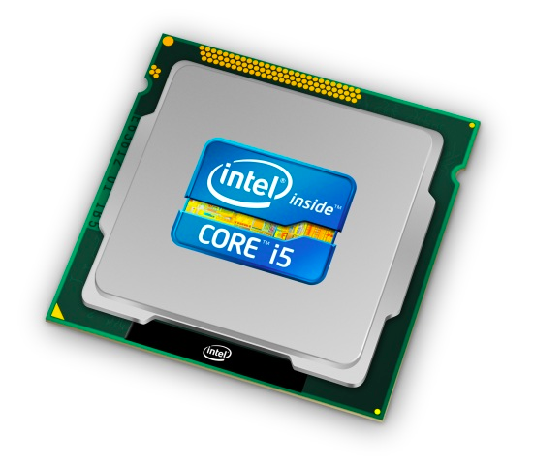
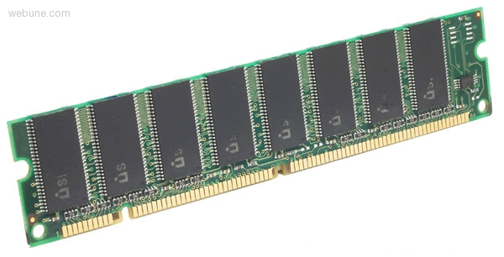
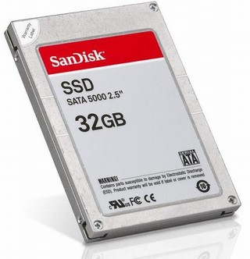
Roadmap
C:
Java:
Memory & data
Integers & floats
x86 assembly
Procedures & stacks
Executables
Arrays & structs
Memory & caches
Processes
Virtual memory
Memory allocation
Java vs. C
car *c = malloc(sizeof(car));
c->miles = 100;
c->gals = 17;
float mpg = get_mpg(c);
free(c);
Car c = new Car();
c.setMiles(100);
c.setGals(17);
float mpg = c.getMPG();
Assembly language:
get_mpg:
pushq %rbp
movq %rsp, %rbp
...
popq %rbp
ret
OS:
Machine code:
0111010000011000
100011010000010000000010
1000100111000010
110000011111101000011111
Computer system:
Notes:
Click through animation – what is the roadmap for this course?

Slide 16
Course Perspective
CSE351 will make you a better programmer
Purpose is to show how software really works
Understanding of some of the abstractions that exist between programs and the hardware they run on, why they exist, and how they build upon each other
Understanding the underlying system makes you more effective
Better debugging
Better basis for evaluating performance
How multiple activities work in concert (e.g. OS and user programs)
“Stuff everybody learns and uses and forgets not knowing”
CSE351 presents a world-view that will empower you
The intellectual and software tools to understand the trillions+ of 1s and 0s that are “flying around” when your program runs
Notes:
Not just a course for hardware enthusiasts!
What every programmer needs to know (plus many more details)

Slide 17
Lecture Outline
Course Introduction
Course Policies
https://courses.cs.washington.edu/courses/cse351/18wi/syllabus/
Binary

Slide 18
Communication
Website: http://cs.uw.edu/351
Schedule, policies, materials, videos, assignments, etc.
Discussion: http://piazza.com/washington/winter2018/cse351
Announcements made here
Ask and answer questions – staff will monitor and contribute
Office Hours: spread throughout the week
Can also e-mail to make individual appointments
Anonymous feedback:
Comments about anything related to the course where you would feel better not attaching your name
Can send to individual staff member of whole staff

Slide 19
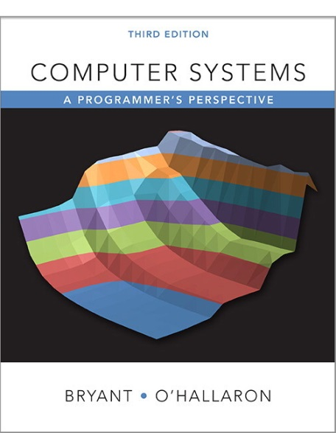
Textbooks
Computer Systems: A Programmer’s Perspective
Randal E. Bryant and David R. O’Hallaron
Website: http://csapp.cs.cmu.edu
Must be 3rd edition
http://csapp.cs.cmu.edu/3e/changes3e.html
http://csapp.cs.cmu.edu/3e/errata.html
This book really matters for the course!
How to solve labs
Practice problems and homework
A good C book – any will do
The C Programming Language (Kernighan and Ritchie)
C: A Reference Manual (Harbison and Steele)

Slide 20
Course Components
Lectures (26)
Introduce the concepts; supplemented by textbook
Sections (10)
Applied concepts, important tools and skills for labs, clarification of lectures, exam review and preparation
Online homework assignments (5)
Problems to solidify understanding; submitted as Canvas quizzes
Programming lab assignments (5.5)
Provide in-depth understanding (via practice) of an aspect of system
Exams (2)
Midterm: Monday, February 5, in class
Final: Wednesday, March 14, 2:30-4:20pm (UW assigned time/location)

Slide 21
Grading
Homework: 20% total
Autograded; 20 submission attempts
Group work okay
Labs: 35% total
Graded by TAs; last submission graded
Individual work only
Exams: Midterm (15%) and Final (30%)
Many old exams on course website (soon)
More details on course website

Slide 22
Due Dates and Late Work Policy
Homework
No late days/submissions.
Labs
Turn in by the deadline, or 20% per day penalty
No penalty-free late days
20% off per day, through 4th day after due date
Score = min(graded score, 100% - 20% * num_late_days)
num_late_days = ceil(hours late / 24)
E.g., if you receive 89%, but you turned it in within 24 hours after due date, your score will be 80%
Complete assignments by their due date!

Slide 23
Collaboration and Academic Integrity
All submissions are expected to be yours and yours alone
You are encouraged to discuss your assignments with other students (ideas), but we expect that what you turn in is yours
It is NOT acceptable to copy solutions from other students or to copy (or start your) solutions from the Web (including Github)
Our goal is that *YOU* learn the material so you will be prepared for exams, interviews, and the future

Slide 24
Course Environment and Culture
Simple rules for our course:
Respect one another
Ask questions
Have fun!
If at any point you feel uncomfortable, disrespected, excluded, etc. by any staff member or another student, please report the incident so we may address the issue and maintain a supportive and inclusive learning environment.
Contact: staff (direct or anonymous), CSE undergraduate advising, UW Office of the Ombud

Slide 25
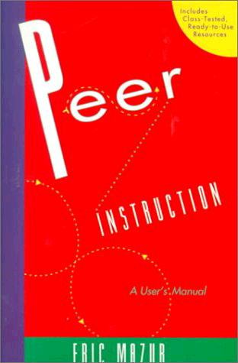
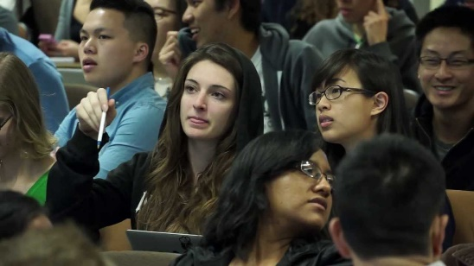
Peer Instruction
Increase real-time learning in lecture, test your understanding, increase student interactions
Lots of research supports its effectiveness
Multiple choice question at end of lecture “segment”
1 minute to decide on your own
2-4 minutes in pairs to reach consensus
Learn through discussion
In-person voting during lecture
May switch to PollEverywhere if the in-person thing doesn’t work well

Slide 26
Some fun topics that we will touch on
Which of the following seems the most interesting to you? (show of hands)
What is a GFLOP and why is it used in computer benchmarks?
How and why does running many programs for a long time eat into your memory (RAM)?
What is stack overflow and how does it happen?
Why does your computer slow down when you run out of disk space?
What was the flaw behind the original Internet worm, the Heartbleed bug, and the Cloudbleed bug?
What is the meaning behind the different CPU specifications? (e.g. # of cores, # and size of cache, supported memory types)

Slide 27
Tips for Success in 351
Attend all lectures and sections
Avoid devices during lecture (i.e., listen, engage, and ask questions)
Learn by doing
Can answer many questions by writing small programs
Visit Piazza often
Ask questions and try to answer fellow students’ questions
Go to office hours
Even if you don’t have specific questions in mind
Find a study and homework group
Start assignments early
Don’t be afraid to ask questions
Notes:
What is panopto?

Slide 28
To-Do List
Admin
Explore/read website thoroughly: http://cs.uw.edu/351
Check that you are enrolled in Piazza
Get your machine set up for this class (VM or attu) as soon as possible
Assignments
Pre-Course Survey due Friday (1/5)
Lab 0 due Monday (1/8)
HW 1 due Wednesday (1/10)

Slide 29
Other Details
Consider taking CSE 391 Unix Tools, 1 credit
Useful skills to know and relevant to this course
Available to all CSE majors and anyone registered in this CSE351
If you are interested in taking this, attend the first lecture!!

Slide 30
Lecture Outline
Course Introduction
Course Policies
Binary
Decimal, Binary, and Hexadecimal
Base Conversion
Binary Encoding

Slide 31
Decimal Numbering System
Ten symbols: 0, 1, 2, 3, 4, 5, 6, 7, 8, 9
Represent larger numbers as a sequence of digits
Each digit is one of the available symbols
Example: 7061 in decimal (base 10)
7061₁₀ = (7 $×$ 10³) + (0 $×$ 10²) + (6 $×$ 10¹) + (1 $×$ 10⁰)
Notes:
Ones digit, Tens digit, Hundreds digit, etc.

Slide 32
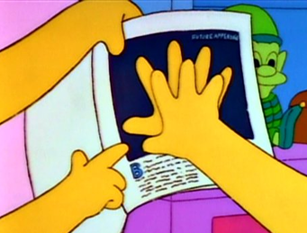
Octal Numbering System
Eight symbols: 0, 1, 2, 3, 4, 5, 6, 7
Notice that we no longer use 8 or 9
Base comparison:
Base 10: 0, 1, 2, 3, 4, 5, 6, 7, 8, 9, 10, 11, 12…
Base 8: 0, 1, 2, 3, 4, 5, 6, 7, 10, 11, 12, 13, 14…
Example: What is 7061₈ in base 10?
7061₈ = (7 $×$ 8³) + (0 $×$ 8²) + (6 $×$ 8¹) + (1 $×$ 8⁰) = 3633₁₀

Slide 33
Peer Instruction Question
What is 34₈ in base 10?
32₁₀
34₁₀
7₁₀
28₁₀
35₁₀
Think on your own for a minute, then discuss with your neighbor(s)
Notes:
Answer: D
3 * 8^1 + 4 * 8^0 = 24 + 4 = 28 in base 10

Slide 34
Binary and Hexadecimal
Binary is base 2
Symbols: 0, 1
Convention: 2₁₀ = 10₂ = 0b10
Example: What is 0b110 in base 10?
0b110 = 110₂ = (1 $×$ 2²) + (1 $×$ 2¹) + (0 $×$ 2⁰) = 6₁₀
Hexadecimal (hex, for short) is base 16
Symbols? 0, 1, 2, 3, 4, 5, 6, 7, 8, 9, …?
Convention: 16₁₀ = 10₁₆ = 0x10
Example: What is 0xA5 in base 10?
0xA5 = A5₁₆ = (10 $×$ 16¹) + (5 $×$ 16⁰) = 165₁₀
9, A, B, C, D, E, F
Notes:
0b is pronounced ‘zero-bee’
0x is pronounced ‘zero-ex’
Example:
A is a symbol
10 in (10 x 16^1) is a value

Slide 35
Peer Instruction Question
Which of the following orderings is correct?
0xC < 0b1010 < 11
0xC < 11 < 0b1010
11 < 0b1010 < 0xC
0b1010 < 11 < 0xC
0b1010 < 0xC < 11
Think on your own for a minute, then discuss with your neighbor(s)
Notes:
Vote by asking for volunteer
Poll if nobody will volunteer
Answer: D
0xC = 12
0b1010 = 10
11 = 11
Can walk through converting binary to decimal value

Slide 36
Converting to Base 10
Can convert from any base to base 10
0b110 = 110₂ = (1 $×$ 2²) + (1 $×$ 2¹) + (0 $×$ 2⁰) = 6₁₀
0xA5 = A5₁₆ = (10 $×$ 16¹) + (5 $×$ 16⁰) = 165₁₀
We learned to think in base 10, so this is fairly natural for us
Challenge: Convert into other bases (e.g. 2, 16)

Slide 37
Challenge Question
Convert 13₁₀ into binary
Hints:
2³ = 8
2² = 4
2¹ = 2
2⁰ = 1
Think on your own for a minute, then discuss with your neighbor(s)
13₁₀ = ?
13 = 8 + 4 + 1
Binary: 0b 1 1 0 1
Dec: 8 4 1
Notes:
Answer: 0b1101
Step through if needed

Slide 38
Converting from Decimal to Binary
Given a decimal number N:
List increasing powers of 2 from right to left until $≥$ N
Then from left to right, ask is that (power of 2) $≤$ N?
If YES, put a 1 below and subtract that power from N
If NO, put a 0 below and keep going
Example: 13 to binary
2⁴=16 | 2³=8 | 2²=4 | 2¹=2 | 2⁰=1
0
1
1
0
1
Notes:
0, 1, 1, 0, 1

Slide 39
Converting from Decimal to Base B
Given a decimal number N:
List increasing powers of B from right to left until $≥$ N
Then from left to right, ask is that (power of B) $≤$ N?
If YES, put how many of that power go into N and subtract from N
If NO, put a 0 below and keep going
Example: 165 to hex
16²=256 | 16¹=16 | 16⁰=1
0
A
5
Notes:
Is 256 less than 165? No
Is 16 less than 165? Yes
10 (A) 16’s = 160
Remainder is 5
0, A, 5

Slide 40
Converting Binary $↔$ Hexadecimal
Hex $→$ Binary
Substitute hex digits, then drop any leading zeros
Example: 0x2D to binary
0x2 is 0b0010, 0xD is 0b1101
Drop two leading zeros, answer is 0b101101
Binary $→$ Hex
Pad with leading zeros until multiple of 4, then substitute each group of 4
Example: 0b101101
Pad to 0b 0010 1101
Substitute to get 0x2D
Base 10 | Base 2 | Base 16
0 | 0000 | 0
1 | 0001 | 1
2 | 0010 | 2
3 | 0011 | 3
4 | 0100 | 4
5 | 0101 | 5
6 | 0110 | 6
7 | 0111 | 7
8 | 1000 | 8
9 | 1001 | 9
10 | 1010 | A
11 | 1011 | B
12 | 1100 | C
13 | 1101 | D
14 | 1110 | E
15 | 1111 | F

Slide 41
Binary $→$ Hex Practice
Convert 0b100110110101101
How many digits?
Pad:
Substitute:
Base 10 | Base 2 | Base 16
0 | 0000 | 0
1 | 0001 | 1
2 | 0010 | 2
3 | 0011 | 3
4 | 0100 | 4
5 | 0101 | 5
6 | 0110 | 6
7 | 0111 | 7
8 | 1000 | 8
9 | 1001 | 9
10 | 1010 | A
11 | 1011 | B
12 | 1100 | C
13 | 1101 | D
14 | 1110 | E
15 | 1111 | F
15
0100 1101 1010 1101
0x4DAD

Slide 42
Base Comparison
Why does all of this matter?
Humans think about numbers in base 10, but computers “think” about numbers in base 2
Binary encoding is what allows computers to do all of the amazing things that they do!
You should have this table memorized by the end of the class
Might as well start now!
Base 10 | Base 2 | Base 16
0 | 0000 | 0
1 | 0001 | 1
2 | 0010 | 2
3 | 0011 | 3
4 | 0100 | 4
5 | 0101 | 5
6 | 0110 | 6
7 | 0111 | 7
8 | 1000 | 8
9 | 1001 | 9
10 | 1010 | A
11 | 1011 | B
12 | 1100 | C
13 | 1101 | D
14 | 1110 | E
15 | 1111 | F
Notes:
Memorize this table!

Slide 43
Numerical Encoding
AMAZING FACT: You can represent anything countable using numbers!
Need to agree on an encoding
Kind of like learning a new language
Examples:
Decimal Integers: 0$→$0b0, 1$→$0b1, 2$→$0b10, etc.
English Letters: CSE$→$0x435345, yay$→$0x796179
Emoticons: 😃 0x0, 😞 0x1, 😎 0x2, 😇 0x3, 😈 0x4, 🙋 0x5
Notes:
Base 2 is too hard for humans to read, so we use base 16 as a convenient way to hold what is effectively binary data in our brains.

Slide 44
Binary Encoding
With N binary digits, how many “things” can you represent?
Need N binary digits to represent $n$ things, where 2^{N} $≥n$
Example: 5 binary digits for alphabet because 2⁵ = 32 > 26
A binary digit is known as a bit
A group of 4 bits (1 hex digit) is called a nibble
A group of 8 bits (2 hex digits) is called a byte
1 bit $→$ 2 things, 1 nibble $→$ 16 things, 1 byte $→$ 256 things
Notes:
2^N things with N binary digits

Slide 45
So What’s It Mean?
A sequence of bits can have many meanings!
Consider the hex sequence 0x4E6F21
Common interpretations include:
The decimal number 5140257
The characters “No!”
The background color of this slide
The real number 7.203034 $×$ 10⁻³⁹
It is up to the program/programmer to decide how to interpret the sequence of bits

Slide 46
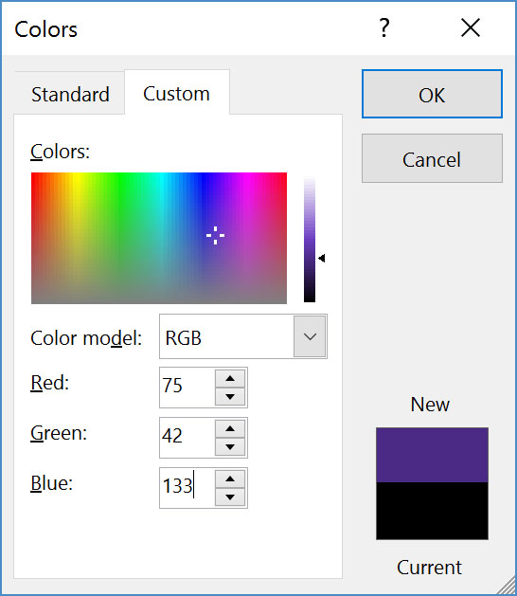
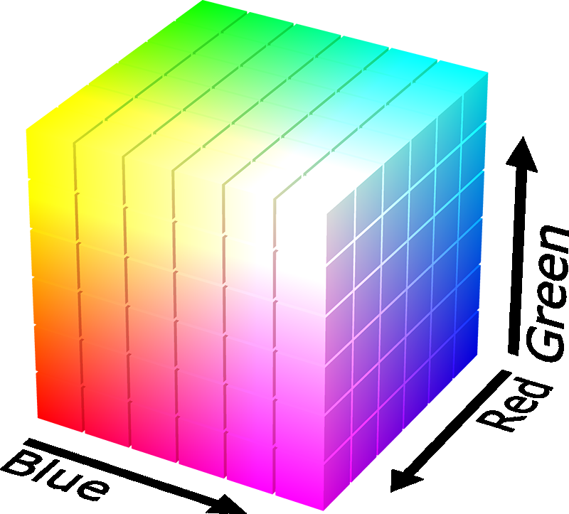
Binary Encoding – Colors
RGB – Red, Green, Blue
Additive color model (light): byte (8 bits) for each color
Commonly seen in hex (in HTML, photo editing, etc.)
Examples: Blue$→$0x0000FF, Gold$→$0xFFD700, White$→$0xFFFFFF, Deep Pink$→$0xFF1493

Slide 47
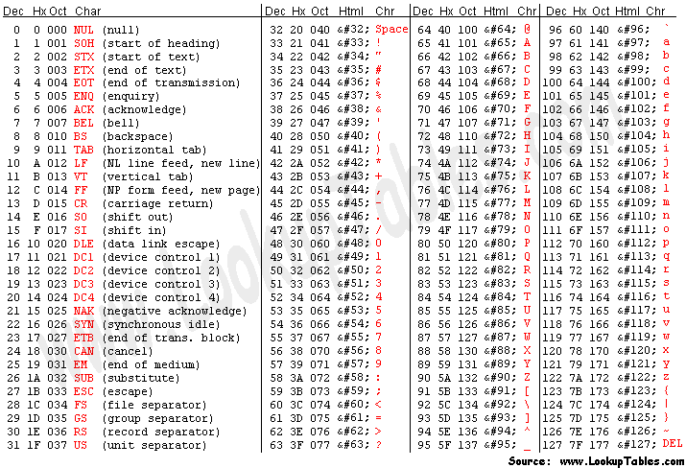
Binary Encoding – Characters/Text
ASCII Encoding (www.asciitable.com)
American Standard Code for Information Interchange

Slide 48
Binary Encoding – Files and Programs
At the lowest level, all digital data is stored as bits!
Layers of abstraction keep everything comprehensible
Data/files are groups of bits interpreted by program
Program is actually groups of bits being interpreted by your CPU
Computer Memory Demo (if time)
From vim: %!xxd
From emacs: M-x hexl-mode

Slide 49
Summary
Humans think about numbers in decimal; computers think about numbers in binary
Base conversion to go between them
Hexadecimal is more human-readable than binary
All information on a computer is binary
Binary encoding can represent anything!
Computer/program needs to know how to interpret the bits

