Slide 1
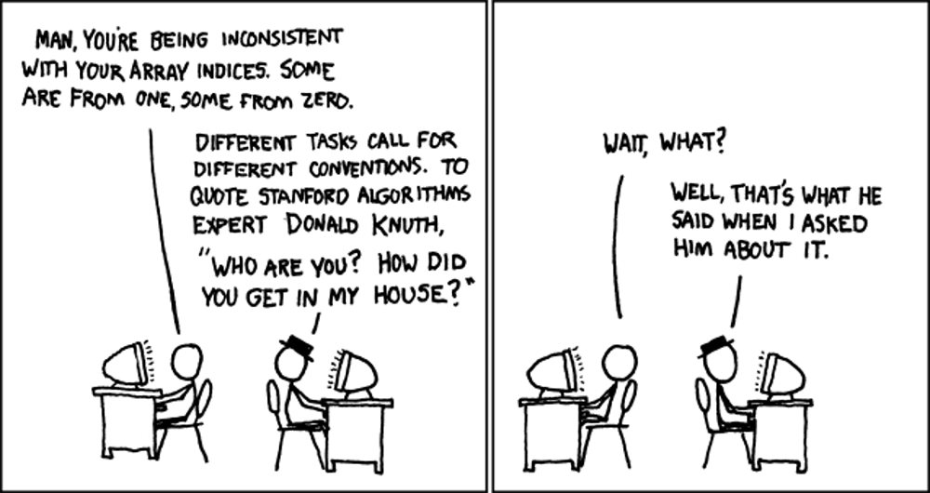
Buffer Overflows CSE 351 Summer 2018
Instructor:
Justin Hsia
Teaching Assistants:
Josie Lee
Natalie Andreeva
Teagan Horkan
http://xkcd.com/163/

Slide 2
Administrivia
Mid-quarter survey due tonight (7/20)
Homework 3 due Monday (7/23)
Lab 3 due next Friday (7/27)
Midterm grades (out of 100) released
Solutions posted on website
Rubric and grades found on Gradescope
Regrade requests will be open until Sunday (7/22) @ 5 pm
Must include reason based on solutions and rubric

Slide 3
Buffer Overflows
Address space layout (more details!)
Input buffers on the stack
Overflowing buffers and injecting code
Defenses against buffer overflows

Slide 4
Review: General Memory Layout
not drawn to scale
2^{N}-1
Stack
Stack
Local variables (procedure context)
Heap
Dynamically allocated as needed
malloc(), calloc(), new, …
Statically allocated Data
Read/write: global variables (Static Data)
Read-only: string literals (Literals)
Code/Instructions
Executable machine instructions
Read-only
Heap
Static Data
Literals
Instructions
0

Slide 5
x86-64 Linux Memory Layout
not drawn to scale
0x00007FFFFFFFFFFF
Stack
Stack
Runtime stack has 8 MiB limit
Heap
Dynamically allocated as needed
malloc(), calloc(), new, …
Statically allocated data (Data)
Read-only: string literals
Read/write: global arrays and variables
Code / Shared Libraries
Executable machine instructions
Read-only
Heap
Shared
Libraries
Heap
Data
Hex Address
0x400000
Instructions
0x000000

Slide 6
Memory Allocation Example
not drawn to scale
char big_array[1L<<24]; /* 16 MB */
char huge_array[1L<<31]; /* 2 GB */
int global = 0;
int useless() { return 0; }
int main()
{
void *p1, *p2, *p3, *p4;
int local = 0;
p1 = malloc(1L << 28); /* 256 MB */
p2 = malloc(1L << 8); /* 256 B */
p3 = malloc(1L << 32); /* 4 GB */
p4 = malloc(1L << 8); /* 256 B */
/* Some print statements ... */
}
Stack
Heap
Shared
Libraries
Heap
Data
Instructions
Where does everything go?
Notes:
big_array, huge_array, global: data
int local,

Slide 7
Memory Allocation Example
not drawn to scale
char big_array[1L<<24]; /* 16 MB */
char huge_array[1L<<31]; /* 2 GB */
int global = 0;
int useless() { return 0; }
int main()
{
void *p1, *p2, *p3, *p4;
int local = 0;
p1 = malloc(1L << 28); /* 256 MB */
p2 = malloc(1L << 8); /* 256 B */
p3 = malloc(1L << 32); /* 4 GB */
p4 = malloc(1L << 8); /* 256 B */
/* Some print statements ... */
}
Stack
Heap
Shared
Libraries
Heap
Data
Instructions
Where does everything go?
Notes:
big_array, huge_array, global: data
int local,

Slide 8
Reminder: x86-64/Linux Stack Frame
Higher Addresses
Caller’s Stack Frame
Arguments (if > 6 args) for this call
Current/Callee Stack Frame
Return address
Pushed by call instruction
Old frame pointer (optional)
Saved register context (when reusing registers)
Local variables (if can’t be kept in registers)
“Argument build” area (if callee needs to call another function - parameters for function about to be called, if needed)
Caller
Frame
Arguments
7+
Frame pointer %rbp
Return Addr
Old %rbp
(optional)
Saved
Registers
+
Local
Variables
Argument
Build
(Optional)
Stack pointer
%rsp
Lower Addresses

Slide 9
Buffer Overflow in a Nutshell
Characteristics of the traditional Linux memory layout provide opportunities for malicious programs
Stack grows “backwards” in memory
Data and instructions both stored in the same memory
C does not check array bounds
Many Unix/Linux/C functions don’t check argument sizes
Allows overflowing (writing past the end) of buffers (arrays)
Notes:
http://en.wikipedia.org/wiki/Morris_worm

Slide 10
Buffer Overflow in a Nutshell
Buffer overflows on the stack can overwrite “interesting” data
Attackers just choose the right inputs
Simplest form (sometimes called “stack smashing”)
Unchecked length on string input into bounded array causes overwriting of stack data
Try to change the return address of the current procedure
Why is this a big deal?
It is (was?) the #1 technical cause of security vulnerabilities
#1 overall cause is social engineering / user ignorance

Slide 11
String Library Code
Implementation of Unix function gets()
What could go wrong in this code?
/* Get string from stdin */
char* gets(char* dest) { int c = getchar();
char* p = dest;
while (c != EOF && c != '\n') {
*p++ = c;
c = getchar();
}
*p = '\0';
return dest;
}
pointer to start
of an array
same as:
*p = c;
p++;

Slide 12
String Library Code
Implementation of Unix function gets()
No way to specify limit on number of characters to read
Similar problems with other Unix functions:
strcpy: Copies string of arbitrary length to a dst
scanf, fscanf, sscanf, when given %s specifier
/* Get string from stdin */
char* gets(char* dest) { int c = getchar();
char* p = dest;
while (c != EOF && c != '\n') {
*p++ = c;
c = getchar();
}
*p = '\0';
return dest;
}
Notes:
The man page for gets(3) now says “BUGS: Never use gets().”

Slide 13
Vulnerable Buffer Code
/* Echo Line */ void echo() { char buf[8]; /* Way too small! */ gets(buf); puts(buf); }
void call_echo() {
echo();
}
unix> ./buf-nsp
Enter string: 12345678901234567890123
12345678901234567890123
unix> ./buf-nsp
Enter string: 123456789012345678901234
Segmentation Fault
Notes:
If we overrun the buffer, it’s fine for a while...
But then we add one more character, and it seg-faults!
Why? (let’s see...)

Slide 14
Disassembly (buf-nsp)
echo:
00000000004005c6 <echo>:
4005c6: 48 83 ec 18 sub $0x18,%rsp
... ... calls printf ...
4005d9: 48 89 e7 mov %rsp,%rdi
4005dc: e8 dd fe ff ff callq 4004c0 <gets@plt>
4005e1: 48 89 e7 mov %rsp,%rdi
4005e4: e8 95 fe ff ff callq 400480 <puts@plt>
4005e9: 48 83 c4 18 add $0x18,%rsp
4005ed: c3 retq
call_echo:
00000000004005ee <call_echo>:
4005ee: 48 83 ec 08 sub $0x8,%rsp
4005f2: b8 00 00 00 00 mov $0x0,%eax
4005f7: e8 ca ff ff ff callq 4005c6 <echo>
4005fc: 48 83 c4 08 add $0x8,%rsp
400600: c3 retq
return address
Notes:
@plt means grab from “procedure linkage table” (specific to dynamic linking and loading)

Slide 15
Buffer Overflow Stack
Before call to gets
Stack frame for call_echo
Return address (8 bytes)
16 bytes unused
[7] | [6] | [5] | [4]
[3] | [2] | [1] | [0]
/* Echo Line */ void echo() { char buf[8]; /* Way too small! */ gets(buf); puts(buf); }
echo:
subq $24, %rsp
...
movq %rsp, %rdi
call gets
...
buf
⟵%rsp
Note: addresses increasing right-to-left, bottom-to-top
Notes:
(sorry) addresses go right-to-left, bottom-to-top

Slide 16
Buffer Overflow Example
Before call to gets
Stack frame for call_echo
00 | 00 | 00 | 00
00 | 40 | 05 | fc
16 bytes unused
[7] | [6] | [5] | [4]
[3] | [2] | [1] | [0]
void echo() { char buf[8];
gets(buf); . . . }
echo:
subq $24, %rsp
...
movq %rsp, %rdi
call gets
...
call_echo:
. . .
4005f7: callq 4005c6 <echo>
4005fc: add $0x8,%rsp
. . .
buf
⟵%rsp
Notes:
Little-endian

Slide 17
Buffer Overflow Example #1
After call to gets
Stack frame for call_echo
00 | 00 | 00 | 00
00 | 40 | 05 | fc
00 | 33 | 32 | 31
30 | 39 | 38 | 37
36 | 35 | 34 | 33
32 | 31 | 30 | 39
38 | 37 | 36 | 35
34 | 33 | 32 | 31
void echo() { char buf[8];
gets(buf); . . . }
echo:
subq $24, %rsp
...
movq %rsp, %rdi
call gets
...
call_echo:
. . .
4005f7: callq 4005c6 <echo>
4005fc: add $0x8,%rsp
. . .
buf
⟵%rsp
unix> ./buf-nsp
Enter string: 12345678901234567890123
12345678901234567890123
Note: Digit “$N$” is
just 0x3$N$ in ASCII!
Overflowed buffer, but did not corrupt state
Notes:
Null-terminated string

Slide 18
Buffer Overflow Example #2
After call to gets
Stack frame for call_echo
00 | 00 | 00 | 00
00 | 40 | 05 | 00
34 | 33 | 32 | 31
30 | 39 | 38 | 37
36 | 35 | 34 | 33
32 | 31 | 30 | 39
38 | 37 | 36 | 35
34 | 33 | 32 | 31
void echo() { char buf[8];
gets(buf); . . . }
echo:
subq $24, %rsp
...
movq %rsp, %rdi
call gets
...
call_echo:
. . .
4005f7: callq 4005c8 <echo>
4005fc: add $0x8,%rsp
. . .
buf
⟵%rsp
unix> ./buf-nsp
Enter string: 123456789012345678901234
Segmentation Fault
Overflowed buffer and corrupted return pointer

Slide 19
Buffer Overflow Example #2
After return from echo
Stack frame for call_echo
00 | 00 | 00 | 00
00 | 40 | 05 | 00
34 | 33 | 32 | 31
30 | 39 | 38 | 37
36 | 35 | 34 | 33
32 | 31 | 30 | 39
38 | 37 | 36 | 35
34 | 33 | 32 | 31
0000000000400500 <deregister_tm_clones>:
400500: mov $0x60104f,%eax
400505: push %rbp
400506: sub $0x601048,%rax
40050c: cmp $0xe,%rax
400510: mov %rsp,%rbp
400513: jbe 400530
400515: mov $0x0,%eax
40051a: test %rax,%rax
40051d: je 400530
40051f: pop %rbp
400520: mov $0x601048,%edi
400525: jmpq *%rax
400527: nopw 0x0(%rax,%rax,1)
40052e: nop
400530: pop %rbp
400531: retq
⟵%rsp
buf
“Returns” to unrelated code, but continues!
Eventually segfaults on retq of deregister_tm_clones.
Notes:
deregister_tm_clones deals with transactional memory, which is intended to make programming with threads simpler (parallelism and synchronization – waaaaaay beyond the scope of this course).

Slide 20
Malicious Use of Buffer Overflow: Code Injection Attacks
Stack after call to gets()
High Addresses
void foo(){
bar();
A:...
}
foo stack frame
return address A
A B
A (return addr)
pad
int bar() {
char buf[64];
gets(buf);
...
return ...;
}
data written
by gets()
bar stack frame
exploit code
buf starts here
B
Low Addresses
Input string contains byte representation of executable code
Overwrite return address A with address of buffer B
When bar() executes ret, will jump to exploit code

Slide 21
Peer Instruction Question
smash_me is vulnerable to stack smashing!
What is the minimum number of characters that gets must read in order for us to change the return address to a stack address (in Linux)?
Vote at http://PollEv.com/justinh
Previous stack frame
00 | 00 | 00 | 00
00 | 40 | 05 | fc
. . .
 |  |  | [0]
33
36
51
54
We’re lost…
smash_me:
subq $0x30, %rsp
...
movq %rsp, %rdi
call gets
...

Slide 22
Exploits Based on Buffer Overflows
Buffer overflow bugs can allow remote machines to execute arbitrary code on victim machines
Distressingly common in real programs
Programmers keep making the same mistakes ☹
Recent measures make these attacks much more difficult
Examples across the decades
Original “Internet worm” (1988)
Still happens!!
Heartbleed (2014, affected 17% of servers)
Cloudbleed (2017)
Fun: Nintendo hacks
Using glitches to rewrite code: https://www.youtube.com/watch?v=TqK-2jUQBUY
FlappyBird in Mario: https://www.youtube.com/watch?v=hB6eY73sLV0

Slide 23
The original Internet worm (1988)
Exploited a few vulnerabilities to spread
Early versions of the finger server (fingerd) used gets() to read the argument sent by the client:
finger droh@cs.cmu.edu
Worm attacked fingerd server with phony argument:
finger "exploit-code padding new-return-addr"
Exploit code: executed a root shell on the victim machine with a direct TCP connection to the attacker
Scanned for other machines to attack
Invaded ~6000 computers in hours (10% of the Internet)
see June 1989 article in Comm. of the ACM
The young author of the worm was prosecuted…
Notes:
TCP: transmission control protocol

Slide 24
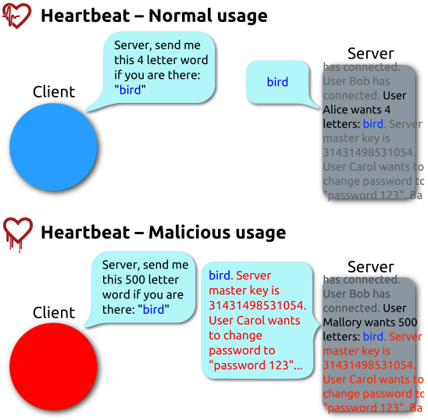
Heartbleed (2014)
Buffer over-read in OpenSSL
Open source security library
Bug in a small range of versions
“Heartbeat” packet
Specifies length of message
Server echoes it back
Library just “trusted” this length
Allowed attackers to read contents of memory anywhere they wanted
Est. 17% of Internet affected
“Catastrophic”
Github, Yahoo, Stack Overflow, Amazon AWS, ...
By FenixFeather - Own work, CC BY-SA 3.0, https://commons.wikimedia.org/w/index.php?curid=32276981

Slide 25
Dealing with buffer overflow attacks
Avoid overflow vulnerabilities
Employ system-level protections
Have compiler use “stack canaries”

Slide 26
1) Avoid Overflow Vulnerabilities
/* Echo Line */ void echo() { char buf[8]; /* Way too small! */ fgets(buf, 8, stdin); puts(buf); }
Use library routines that limit string lengths
fgets instead of gets (2nd argument to fgets sets limit)
strncpy instead of strcpy
Don’t use scanf with %s conversion specification
Use fgets to read the string
Or use %ns where n is a suitable integer

Slide 27
2) System-Level Protections
High Addresses
Randomized stack offsets
At start of program, allocate random amount of space on stack
Shifts stack addresses for entire program
Addresses will vary from one run to another
Makes it difficult for hacker to predict beginning of inserted code
Example: Code from Slide 6 executed 5 times; address of variable local =
0x7ffd19d3f8ac
0x7ffe8a462c2c
0x7ffe927c905c
0x7ffefd5c27dc
0x7fffa0175afc
Stack repositioned each time the program executes
Random
allocation
main’s stack frame
Other functions’ stack frames
B?
pad
exploit
code
B?
Low Addresses

Slide 28
2) System-Level Protections
Non-executable code segments
In traditional x86, can mark region of memory as either “read-only” or “writeable”
Can execute anything readable
x86-64 added explicit “execute” permission
Stack marked as non-executable
Do NOT execute code in Stack, Static Data, or Heap regions
Hardware support needed
Stack after call
to gets()
foo
stack
frame
B
pad
data written
by gets()
bar
stack
frame
exploit
code
B
Any attempt to execute this code will fail

Slide 29
3) Stack Canaries
Basic Idea: place special value (“canary”) on stack just beyond buffer
Secret value known only to compiler
“After” buffer but before return address
Check for corruption before exiting function
GCC implementation (now default)
-fstack-protector
Code back on Slide 14 (buf-nsp) compiled with –fno-stack-protector flag
unix>./buf
Enter string: 12345678
12345678
unix> ./buf
Enter string: 123456789
*** stack smashing detected ***

Slide 30
Protected Disassembly (buf)
This is extra (non-testable) material
echo:
400638: sub $0x18,%rsp
40063c: mov %fs:0x28,%rax
400645: mov %rax,0x8(%rsp)
40064a: xor %eax,%eax
... ... call printf ...
400656: mov %rsp,%rdi
400659: callq 400530 <gets@plt>
40065e: mov %rsp,%rdi
400661: callq 4004e0 <puts@plt>
400666: mov 0x8(%rsp),%rax
40066b: xor %fs:0x28,%rax
400674: je 40067b <echo+0x43>
400676: callq 4004f0 <__stack_chk_fail@plt>
40067b: add $0x18,%rsp
40067f: retq

Slide 31
Setting Up Canary
This is extra (non-testable) material
Before call to gets
Stack frame for call_echo
Return address (8 bytes)
Canary (8 bytes)
[7] | [6] | [5] | [4]
[3] | [2] | [1] | [0]
/* Echo Line */ void echo() { char buf[8]; /* Way too small! */ gets(buf); puts(buf); }
Segment register (don’t worry about it)
echo:
. . .
movq %fs:40, %rax # Get canary
movq %rax, 8(%rsp) # Place on stack
xorl %eax, %eax # Erase canary
. . .
buf
⟵%rsp

Slide 32
Checking Canary
This is extra (non-testable) material
After call to gets
Stack frame for call_echo
Return address (8 bytes)
Canary (8 bytes)
00 | 37 | 36 | 35
34 | 33 | 32 | 31
/* Echo Line */ void echo() { char buf[8]; /* Way too small! */ gets(buf); puts(buf); }
echo:
. . .
movq 8(%rsp), %rax # retrieve from Stack
xorq %fs:40, %rax # compare to canary
je .L2 # if same, OK
call __stack_chk_fail # else, FAIL
.L6: . . .
buf
⟵%rsp
Input: 1234567

Slide 33
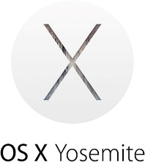
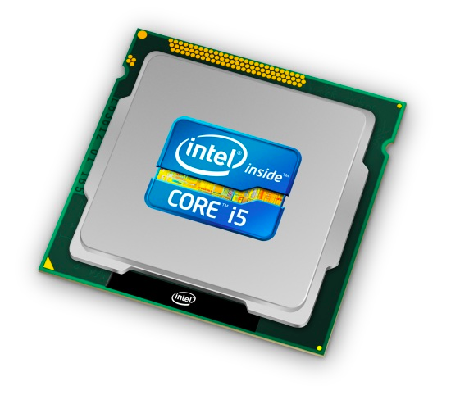
Roadmap
C:
Java:
Memory & data
Integers & floats
x86 assembly
Procedures & stacks
Executables
Arrays & structs
Memory & caches
Processes
Virtual memory
Memory allocation
Java vs. C
car *c = malloc(sizeof(car));
c->miles = 100;
c->gals = 17;
float mpg = get_mpg(c);
free(c);
Car c = new Car();
c.setMiles(100);
c.setGals(17);
float mpg = c.getMPG();
Assembly language:
get_mpg:
pushq %rbp
movq %rsp, %rbp
...
popq %rbp
ret
OS:
Machine code:
0111010000011000
100011010000010000000010
1000100111000010
110000011111101000011111
Computer system:

Slide 34
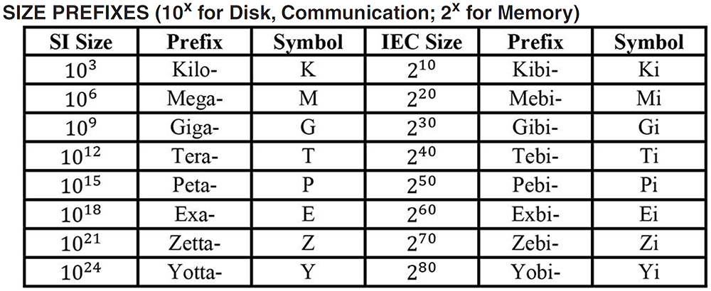
Aside: Units and Prefixes
Here focusing on large numbers (exponents > 0)
Note that 10³ ≈ 2¹⁰
SI prefixes are ambiguous if base 10 or 2
IEC prefixes are unambiguously base 2
Notes:
Disk capacity SI to IEC conversion

Slide 35
How to Remember?
Will be given to you on Final reference sheet
Mnemonics
There unfortunately isn’t one well-accepted mnemonic
But that shouldn’t stop you from trying to come with one!
Killer Mechanical Giraffe Teaches Pet, Extinct Zebra to Yodel
Kirby Missed Ganondorf Terribly, Potentially Exterminating Zelda and Yoshi
xkcd: Karl Marx Gave The Proletariat Eleven Zeppelins, Yo
https://xkcd.com/992/
Post your best on Piazza!

Slide 36
How does execution time grow with SIZE?
int array[SIZE];
int sum = 0;
for (int i = 0; i < 200000; i++) {
for (int j = 0; j < SIZE; j++) {
sum += array[j];
}
}
Time
Plot
SIZE
Notes:
What should we expect for this experiment?

Slide 37
Actual Data
Time
SIZE
Notes:
Knee in the curve
After some size threshold
Memory “wall”
Steeper slope = execution time grows faster
Fits in cache, doesn’t fit in cache

Slide 38
Where Is It?
Variable/Label | Section of Memory
big_array
global
huge_array
local
main
p1
*p1
useless

