Slide 1
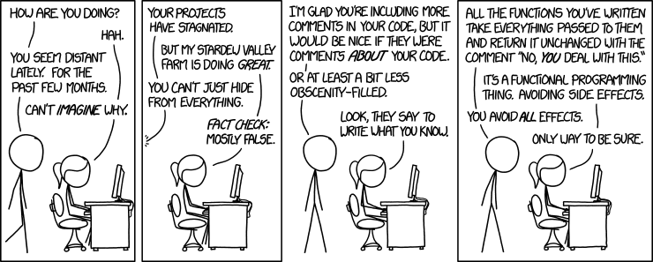
Building an Executable CSE 351 Summer 2018
Instructor:
Justin Hsia
Teaching Assistants:
Josie Lee Natalie Andreeva Teagan Horkan
http://xkcd.com/1790/

Slide 2
Administrivia
Lab 2 due Monday (7/16)
Homework 3 due 7/23
Midterm Wednesday (7/18, in lecture)
Make a cheat sheet! – two-sided letter page, handwritten
Check Piazza for announcements
Review session 5:00-6:30 pm on Monday (7/16) in EEB 105

Slide 3
Procedures
Stack Structure
Calling Conventions
Passing control
Passing data
Managing local data
Register Saving Conventions
Illustration of Recursion

Slide 4
Recursive Function
/* Recursive popcount */
long pcount_r(unsigned long x) {
if (x == 0)
return 0;
else
return (x&1)+pcount_r(x >> 1);
}
pcount_r:
movl $0, %eax
testq %rdi, %rdi
je .L6
pushq %rbx
movq %rdi, %rbx
shrq %rdi
call pcount_r
andl $1, %ebx
addq %rbx, %rax
popq %rbx
.L6:
rep ret
Compiler Explorer:
https://godbolt.org/g/W8DxeR
Compiled with -O1 for brevity instead of -Og
Try -O2 instead!

Slide 5
Recursive Function: Base Case
/* Recursive popcount */
long pcount_r(unsigned long x) {
if (x == 0)
return 0;
else
return (x&1)+pcount_r(x >> 1);
}
Register | Use(s) | Type
%rdi | x | Argument
%rax | Return value | Return value
pcount_r:
movl $0, %eax
testq %rdi, %rdi
je .L6
pushq %rbx
movq %rdi, %rbx
shrq %rdi
call pcount_r
andl $1, %ebx
addq %rbx, %rax
popq %rbx
.L6:
rep ret
Trick because some AMD hardware doesn’t like jumping to ret
Notes:
First: look at the test:
test if %rdi == 0
If it does, then jump to the ret
Note: share ret between both cases, so set rax=0 before jump
Rep; ret is just because some HW doesn‘t like jumping to ret

Slide 6
Recursive Function: Callee Register Save
/* Recursive popcount */
long pcount_r(unsigned long x) {
if (x == 0)
return 0;
else
return (x&1)+pcount_r(x >> 1);
}
Register | Use(s) | Type
%rdi | x | Argument
pcount_r:
movl $0, %eax
testq %rdi, %rdi
je .L6
pushq %rbx
movq %rdi, %rbx
shrq %rdi
call pcount_r
andl $1, %ebx
addq %rbx, %rax
popq %rbx
.L6:
rep ret
Need original value of x after recursive call to pcount_r.
“Save” by putting in %rbx (callee saved), but need to save old value of %rbx before you change it.
The Stack
. . .
rtn <main+?>
saved %rbx
%rsp$→$
Notes:
%rdi (x) is argument for both pcount_r instances (recursive caller and callee).
Choosing “to save”

Slide 7
Recursive Function: Call Setup
/* Recursive popcount */
long pcount_r(unsigned long x) {
if (x == 0)
return 0;
else
return (x&1)+pcount_r(x >> 1);
}
Register | Use(s) | Type
%rdi | x (new) | Argument
%rbx | x (old) | Callee saved
pcount_r:
movl $0, %eax
testq %rdi, %rdi
je .L6
pushq %rbx
movq %rdi, %rbx
shrq %rdi
call pcount_r
andl $1, %ebx
addq %rbx, %rax
popq %rbx
.L6:
rep ret
The Stack
. . .
rtn <main+?>
saved %rbx
%rsp$→$

Slide 8
Recursive Function: Call
/* Recursive popcount */
long pcount_r(unsigned long x) {
if (x == 0)
return 0;
else
return (x&1)+pcount_r(x >> 1);
}
Register | Use(s) | Type
%rax | Recursive call return value | Return value
%rbx | x (old) | Callee saved
pcount_r:
movl $0, %eax
testq %rdi, %rdi
je .L6
pushq %rbx
movq %rdi, %rbx
shrq %rdi
call pcount_r
andl $1, %ebx
addq %rbx, %rax
popq %rbx
.L6:
rep ret
The Stack
. . .
rtn <main+?>
saved %rbx
rtn <pcount_r+22>
. . .
%rsp$→$
Notes:
Draw out example if x = 0b100

Slide 9
Recursive Function: Result
/* Recursive popcount */
long pcount_r(unsigned long x) {
if (x == 0)
return 0;
else
return (x&1)+pcount_r(x >> 1);
}
Register | Use(s) | Type
%rax | Return value | Return value
%rbx | x&1 | Callee saved
pcount_r:
movl $0, %eax
testq %rdi, %rdi
je .L6
pushq %rbx
movq %rdi, %rbx
shrq %rdi
call pcount_r
andl $1, %ebx
addq %rbx, %rax
popq %rbx
.L6:
rep ret
The Stack
. . .
rtn <main+?>
saved %rbx
%rsp$→$

Slide 10
Recursive Function: Completion
/* Recursive popcount */
long pcount_r(unsigned long x) {
if (x == 0)
return 0;
else
return (x&1)+pcount_r(x >> 1);
}
Register | Use(s) | Type
%rax | Return value | Return value
%rbx | Previous %rbx value | Callee restored
pcount_r:
movl $0, %eax
testq %rdi, %rdi
je .L6
pushq %rbx
movq %rdi, %rbx
shrq %rdi
call pcount_r
andl $1, %ebx
addq %rbx, %rax
popq %rbx
.L6:
rep ret
The Stack
. . .
rtn <main+?>
saved %rbx
%rsp$→$

Slide 11
Observations About Recursion
Works without any special consideration
Stack frames mean that each function call has private storage
Saved registers & local variables
Saved return pointer
Register saving conventions prevent one function call from corrupting another’s data
Unless the code explicitly does so (e.g. buffer overflow)
Stack discipline follows call / return pattern
If P calls Q, then Q returns before P
Last-In, First-Out (LIFO)
Also works for mutual recursion (P calls Q; Q calls P)

Slide 12
x86-64 Stack Frames
Many x86-64 procedures have a minimal stack frame
Only return address is pushed onto the stack when procedure is called
A procedure needs to grow its stack frame when it:
Has too many local variables to hold in caller-saved registers
Has local variables that are arrays or structs
Uses & to compute the address of a local variable
Calls another function that takes more than six arguments
Is using caller-saved registers and then calls a procedure
Modifies/uses callee-saved registers

Slide 13
x86-64 Procedure Summary
Important Points
Procedures are a combination of instructions and conventions
Conventions prevent functions from disrupting each other
Stack is the right data structure for procedure call/return
If P calls Q, then Q returns before P
Recursion handled by normal calling conventions
Heavy use of registers
Faster than using memory
Use limited by data size and conventions
Minimize use of the Stack
Caller
Frame
Arguments
7+
%rbp
Return Addr
Old %rbp
(optional)
Saved
Registers
+
Local
Variables
Argument
Build
(Optional)
%rsp

Slide 14
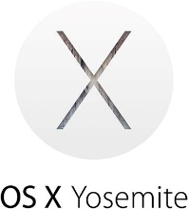
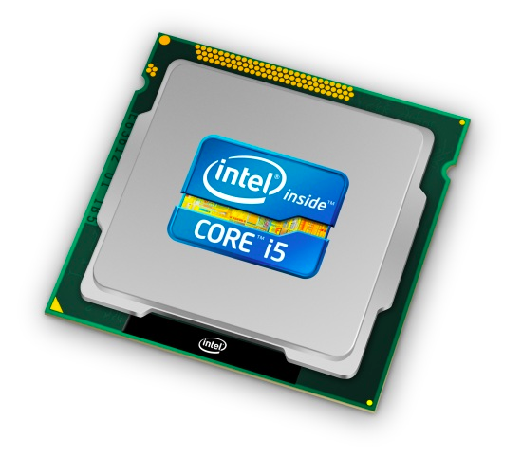
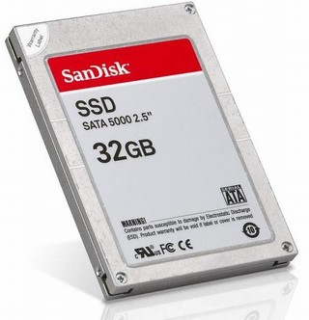
Roadmap
C:
Java:
Memory & data
Integers & floats
x86 assembly
Procedures & stacks
Executables
Arrays & structs
Memory & caches
Processes
Virtual memory
Memory allocation
Java vs. C
car *c = malloc(sizeof(car));
c->miles = 100;
c->gals = 17;
float mpg = get_mpg(c);
free(c);
Car c = new Car();
c.setMiles(100);
c.setGals(17);
float mpg = c.getMPG();
Assembly language:
get_mpg:
pushq %rbp
movq %rsp, %rbp
...
popq %rbp
ret
OS:
Machine code:
0111010000011000
100011010000010000000010
1000100111000010
110000011111101000011111
Computer system:

Slide 15
Building an Executable from a C File
Code in files p1.c p2.c
Compile with command: gcc -Og p1.c p2.c -o p
Put resulting machine code in file p
Run with command: ./p
text
C program (p1.c p2.c)
Compiler (gcc –Og -S)
text
Asm program (p1.s p2.s)
Assembler (gcc -c or as)
binary
Object program (p1.o p2.o)
Static libraries (.a)
Linker (gcc or ld)
binary
Executable program (p)
Loader (the OS)

Slide 16
Compiler
Input: Higher-level language code (e.g. C, Java)
foo.c
Output: Assembly language code (e.g. x86, ARM, MIPS)
foo.s
First there’s a preprocessor step to handle #directives
Macro substitution, plus other specialty directives
If curious/interested: http://tigcc.ticalc.org/doc/cpp.html
Super complex, whole courses devoted to these!
Compiler optimizations
“Level” of optimization specified by capital ‘O’ flag (e.g. -Og, -O3)
Options: https://gcc.gnu.org/onlinedocs/gcc/Optimize-Options.html

Slide 17
Compiling Into Assembly
C Code (sum.c)
x86-64 assembly (gcc –Og –S sum.c)
Generates file sum.s (see https://godbolt.org/g/o34FHp)
Warning: You may get different results with other versions of gcc and different compiler settings
void sumstore(long x, long y, long *dest) {
long t = x + y;
*dest = t;
}
sumstore(long, long, long*):
addq %rdi, %rsi
movq %rsi, (%rdx)
ret
Notes:
https://godbolt.org/g/5hQk8a

Slide 18
Assembler
Input: Assembly language code (e.g. x86, ARM, MIPS)
foo.s
Output: Object files (e.g. ELF, COFF)
foo.o
Contains object code and information tables
Reads and uses assembly directives
e.g. .text, .data, .quad
x86: https://docs.oracle.com/cd/E26502_01/html/E28388/eoiyg.html
Produces “machine language”
Does its best, but object file is not a completed binary
Example: gcc -c foo.s
Notes:
ELF = executable and linkable format
COFF = common object file format

Slide 19
Producing Machine Language
Simple cases: arithmetic and logical operations, shifts, etc.
All necessary information is contained in the instruction itself
What about the following?
Conditional jump
Accessing static data (e.g. global var or jump table)
call
Addresses and labels are problematic because final executable hasn’t been constructed yet!
So how do we deal with these in the meantime?

Slide 20
Object File Information Tables
Symbol Table holds list of “items” that may be used by other files
Non-local labels – function names for call
Static Data – variables & literals that might be accessed across files
Relocation Table holds list of “items” that this file needs the address of later (currently undetermined)
Any label or piece of static data referenced in an instruction in this file
Both internal and external
Each file has its own symbol and relocation tables

Slide 21
Object File Format
object file header: size and position of the other pieces of the object file
text segment: the machine code
data segment: data in the source file (binary)
relocation table: identifies lines of code that need to be “handled”
symbol table: list of this file’s labels and data that can be referenced
debugging information
More info: ELF format
http://www.skyfree.org/linux/references/ELF_Format.pdf

Slide 22
Linker
Input: Object files (e.g. ELF, COFF)
foo.o
Output: executable binary program
a.out
Combines several object files into a single executable (linking)
Enables separate compilation/assembling of files
Changes to one file do not require recompiling of whole program

Slide 23
Linking
Put together text segments from each .o file
Put together data segments from each .o file and concatenate this onto the end of the text segments
Resolve References
Go through Relocation Table; handle each entry
object file 1
info 1
a.out
data 1
Relocated data 1
text 1
Linker
Relocated data 2
object file 2
Relocated text 1
info 2
Relocated text 2
data 2
text 2

Slide 24
Disassembling Object Code
Disassembled:
Disassembler (objdump -d sum)
Useful tool for examining object code (man 1 objdump)
Analyzes bit pattern of series of instructions
Produces approximate rendition of assembly code
Can run on either a.out (complete executable) or .o file
0000000000400536 <sumstore>:
400536: 48 01 fe add %rdi,%rsi
400539: 48 89 32 mov %rsi,(%rdx)
40053c: c3 retq

Slide 25
What Can be Disassembled?
% objdump -d WINWORD.EXE
WINWORD.EXE: file format pei-i386
No symbols in "WINWORD.EXE".
Disassembly of section .text:
30001000 <.text>:
30001000: 55 push %ebp
30001001: 8b ec mov %esp,%ebp
30001003: 6a ff push $0xffffffff
30001005: 68 90 10 00 30 push $0x30001090
3000100a: 68 91 dc 4c 30 push $0x304cdc91
Reverse engineering forbidden by
Microsoft End User License Agreement
Anything that can be interpreted as executable code
Disassembler examines bytes and attempts to reconstruct assembly source

Slide 26
Loader
Input: executable binary program, command-line arguments
./a.out arg1 arg2
Output: <program is run>
Loader duties primarily handled by OS/kernel
More about this when we learn about processes
Memory sections (Instructions, Static Data, Literals, Stack) are set up
Registers are initialized

Slide 27
Roadmap
C:
Java:
Memory & data
Integers & floats
x86 assembly
Procedures & stacks
Executables
Arrays & structs
Memory & caches
Processes
Virtual memory
Memory allocation
Java vs. C
car *c = malloc(sizeof(car));
c->miles = 100;
c->gals = 17;
float mpg = get_mpg(c);
free(c);
Car c = new Car();
c.setMiles(100);
c.setGals(17);
float mpg = c.getMPG();
Assembly language:
get_mpg:
pushq %rbp
movq %rsp, %rbp
...
popq %rbp
ret
OS:
Machine code:
0111010000011000
100011010000010000000010
1000100111000010
110000011111101000011111
Computer system:

Slide 28
Data Structures in Assembly
Arrays
One-dimensional
Multi-dimensional (nested)
Multi-level
Structs
Alignment
Unions

Slide 29
Array Allocation
Basic Principle
T A[N]; $→$ array of data type T and length N
Contiguously allocated region of N*sizeof(T) bytes
Identifier A returns address of array (type T*)
char msg[12];
x
x + 12
int val[5];
x
x + 4
x + 8
x + 12
x + 16
x + 20
double a[3];
x
x + 8
x + 16
x + 24
char* p[3]; (or char *p[3];)
x
x + 8
x + 16
x + 24

Slide 30
Array Access
Basic Principle
T A[N]; $→$ array of data type T and length N
Identifier A returns address of array (type T*)
Reference Type Value
int x[5];
3
7
1
9
5
a
a+4
a+8
a+12
a+16
a+20
x[4] | int | 5
x | int* | a
x+1 | int* | a + 4
&x[2] | int* | a + 8
x[5] | int | ?? (whatever’s in memory at addr x+20)
*(x+1) | int | 7
x+i | int* | a + 4*i

Slide 31
Array Example
typedef int zip_dig[5];
zip_dig cmu = { 1, 5, 2, 1, 3 };
zip_dig uw = { 9, 8, 1, 9, 5 };
zip_dig ucb = { 9, 4, 7, 2, 0 };
initialization
typedef: Declaration “zip_dig uw” equivalent to “int uw[5]”

Slide 32
Array Example
typedef int zip_dig[5];
zip_dig cmu = { 1, 5, 2, 1, 3 };
zip_dig uw = { 9, 8, 1, 9, 5 };
zip_dig ucb = { 9, 4, 7, 2, 0 };
zip_dig cmu;
1
5
2
1
3
16
20
24
28
32
36
zip_dig uw;
9
8
1
9
5
36
40
44
48
52
56
zip_dig ucb;
9
4
7
2
0
56
60
64
68
72
76
Example arrays happened to be allocated in successive 20 byte blocks
Not guaranteed to happen in general

Slide 33
Array Accessing Example
typedef int zip_dig[5];
zip_dig uw;
9
8
1
9
5
36
40
44
48
52
56
int get_digit(zip_dig z, int digit)
{
return z[digit];
}
get_digit:
movl (%rdi,%rsi,4), %eax # z[digit]
Register %rdi contains starting address of array
Register %rsi contains array index
Desired digit at %rdi+4*%rsi, so use memory reference (%rdi,%rsi,4)

Slide 34
Referencing Examples
typedef int zip_dig[5];
zip_dig cmu;
1
5
2
1
3
16
20
24
28
32
36
zip_dig uw;
9
8
1
9
5
36
40
44
48
52
56
zip_dig ucb;
9
4
7
2
0
56
60
64
68
72
76
Reference Address Value Guaranteed?
uw[3]
uw[6]
uw[-1]
cmu[15]
No bounds checking
Example arrays happened to be allocated in successive 20 byte blocks
Not guaranteed to happen in general

Slide 35
Array Loop Example
typedef int zip_dig[5];
int zd2int(zip_dig z)
{
int i;
int zi = 0;
for (i = 0; i < 5; i++) {
zi = 10 * zi + z[i];
}
return zi;
}
zi = 10*0 + 9 = 9
zi = 10*9 + 8 = 98
zi = 10*98 + 1 = 981
zi = 10*981 + 9 = 9819
zi = 10*9819 + 5 = 98195
9
8
1
9
5

Slide 36
Array Loop Example
zip_dig uw;
9
8
1
9
5
36
40
44
48
52
56
int zd2int(zip_dig z)
{
int i;
int zi = 0;
for (i = 0; i < 5; i++) {
zi = 10 * zi + z[i];
}
return zi;
}
Original:
Transformed:
Eliminate loop variable i, use pointer zend instead
Convert array code to pointer code
Pointer arithmetic on z
Express in do-while form (no test at entrance)
int zd2int(zip_dig z)
{
int zi = 0;
int *zend = z + 5;
do {
zi = 10 * zi + *z;
z++;
} while (z < zend);
return zi;
}
address just past
5th digit
Increments by 4 (size of int)
Notes:
15au: With –Og, gcc will generate different code for each of these. With –O1, the same code.

Slide 37
Array Loop Implementation
gcc with –O1
Registers:
%rdi z
%rax zi
%rcx zend
Computations
int zd2int(zip_dig z)
{
int zi = 0;
int *zend = z + 5;
do {
zi = 10 * zi + *z;
z++;
} while (z < zend);
return zi;
}
# %rdi = z
leaq 20(%rdi),%rcx #
movl $0,%eax #
.L17:
leal (%rax,%rax,4),%edx #
movl (%rdi),%eax #
leal (%rax,%rdx,2),%eax #
addq $4,%rdi #
cmpq %rdi,%rcx #
jne .L17 #

Slide 38
C Details: Arrays and Pointers
Arrays are (almost) identical to pointers
char *string and char string[] are nearly identical declarations
Differ in subtle ways: initialization, sizeof(), etc.
An array name looks like a pointer to the first (0th) element
ar[0] same as *ar; ar[2] same as *(ar+2)
An array variable is read-only (no assignment)
Cannot use "ar = <anything>"

Slide 39
C Details: Arrays and Functions
Declared arrays only allocated while the scope is valid:
char* foo() { char string[32]; ...; return string; }
An array is passed to a function as a pointer:
Array size gets lost!
int foo(int ar[], unsigned int size) { ... ar[size-1] ... }
BAD!
Really int *ar
Must explicitly
pass the size!

