Slide 1
x86-64 Programming I CSE 351 Summer 2018
Instructor:
Justin Hsia
Teaching Assistants:
Josie Lee
Natalie Andreeva
Teagan Horkan
http://www.smbc-comics.com/?id=2999

Slide 2
Administrivia
Lab 1b due on Thursday (7/5)
Submit bits.c, lab1reflect.txt
Josie has OH on Thursday 1–3 pm
Homework 2 due next Wednesday (7/11)
On Integers, Floating Point, and x86-64
No lecture on Wednesday!
Section Thursday on Floating Point

Slide 3
Floating Point Summary
Floats also suffer from the fixed number of bits available to represent them
Can get overflow/underflow
“Gaps” produced in representable numbers means we can lose precision, unlike ints
Some “simple fractions” have no exact representation (e.g. 0.2)
“Every operation gets a slightly wrong result”
Floating point arithmetic not associative or distributive
Mathematically equivalent ways of writing an expression may compute different results
Never test floating point values for equality!
Careful when converting between ints and floats!

Slide 4
Number Representation Really Matters
1991: Patriot missile targeting error
clock skew due to conversion from integer to floating point
1996: Ariane 5 rocket exploded ($1 billion)
overflow converting 64-bit floating point to 16-bit integer
2000: Y2K problem
limited (decimal) representation: overflow, wrap-around
2038: Unix epoch rollover
Unix epoch = seconds since 12am, January 1, 1970
signed 32-bit integer representation rolls over to TMin in 2038
Other related bugs:
1982: Vancouver Stock Exchange 10% error in less than 2 years
1994: Intel Pentium FDIV (float division) HW bug ($475 million)
1997: USS Yorktown “smart” warship stranded: divide by zero
1998: Mars Climate Orbiter crashed: unit mismatch ($193 million)
Notes:
This is the part where I try to scare you…

Slide 5
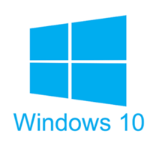
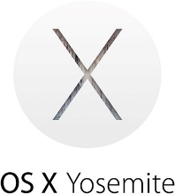
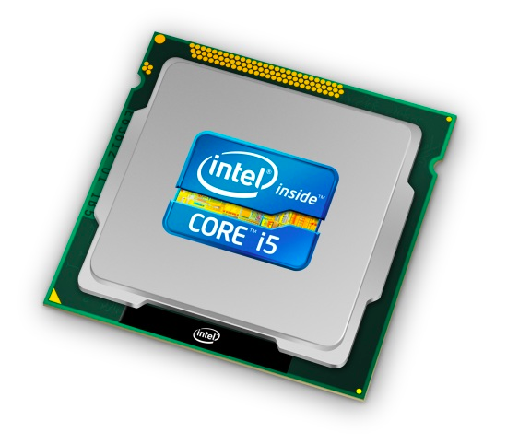
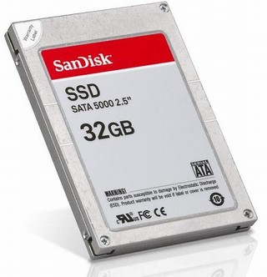
Roadmap
C:
Java:
Memory & data
Integers & floats
x86 assembly
Procedures & stacks
Executables
Arrays & structs
Memory & caches
Processes
Virtual memory
Memory allocation
Java vs. C
car *c = malloc(sizeof(car));
c->miles = 100;
c->gals = 17;
float mpg = get_mpg(c);
free(c);
Car c = new Car();
c.setMiles(100);
c.setGals(17);
float mpg = c.getMPG();
Assembly language:
get_mpg:
pushq %rbp
movq %rsp, %rbp
...
popq %rbp
ret
OS:
Machine code:
0111010000011000
100011010000010000000010
1000100111000010
110000011111101000011111
Computer system:

Slide 6
Translation
Code Time
Compile Time
Run Time
User program in C
Hardware
C
compiler
Assembler
.c file
.exe file
What makes programs run fast(er)?

Slide 7
HW Interface Affects Performance
Source code
Compiler
Architecture
Hardware
Different applications
or algorithms
Perform optimizations,
generate instructions
Instruction set
Different implementations
Intel Pentium 4
C Language
Program A
Intel Core 2
GCC
x86-64
Intel Core i7
Program B
AMD Opteron
Clang
AMD Athlon
Your program
ARMv8 (AArch64/A64)
ARM Cortex-A53
Apple A7
Notes:
Different programs written in C, have different algorithms
Compilers figure out what instructions to generate
do different optimizations
Different architectures expose different interfaces
Hardware implementations have different performance

Slide 8
Instruction Set Architectures
The ISA defines:
The system’s state (e.g. registers, memory, program counter)
The instructions the CPU can execute
The effect that each of these instructions will have on the system state
CPU
PC
Memory
Registers
Notes:
Textbook: “the format and behavior of a machine-level program is defined by the ISA, defining the processor state, the format of the instructions, and the effect each of these instructions will have on the state.”

Slide 9
Instruction Set Philosophies
Complex Instruction Set Computing (CISC): Add more and more elaborate and specialized instructions as needed
Lots of tools for programmers to use, but hardware must be able to handle all instructions
x86-64 is CISC, but only a small subset of instructions encountered with Linux programs
Reduced Instruction Set Computing (RISC): Keep instruction set small and regular
Easier to build fast hardware
Let software do the complicated operations by composing simpler ones

Slide 10
General ISA Design Decisions
Instructions
What instructions are available? What do they do?
How are they encoded?
Registers
How many registers are there?
How wide are they?
Memory
How do you specify a memory location?
Notes:
Registers: word size

Slide 11
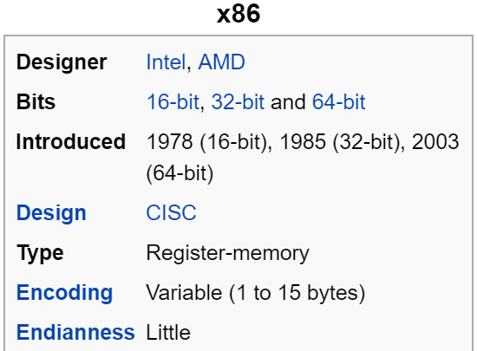
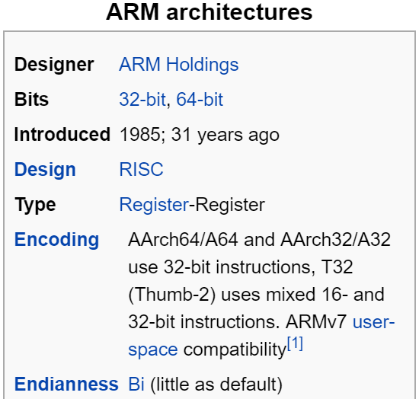
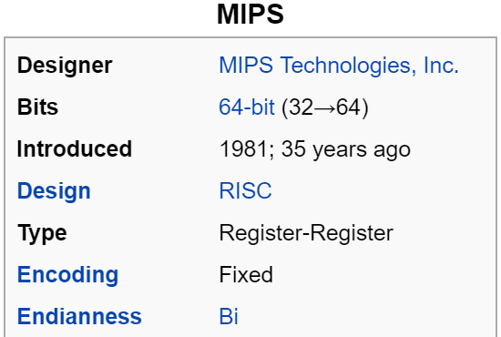
Mainstream ISAs
Macbooks & PCs
(Core i3, i5, i7, M)
x86-64 Instruction Set
Smartphone-like devices
(iPhone, iPad, Raspberry Pi)
ARM Instruction Set
Digital home & networking equipment
(Blu-ray, PlayStation 2)
MIPS Instruction Set
Notes:
x86 backwards-compatible all the way to 8086 architecture (introduced in 1978!), has had many, many new features added since.
x86 dominates the server, desktop, and laptop markets.
ARM stands for Advanced RISC Machine.
MIPS was originally an acronym for Microprocessor without Interlocked Pipeline Stages. Developed by MIPS Technologies (formerly MIPS Computer Systems, Inc).

Slide 12
Definitions
Architecture (ISA): The parts of a processor design that one needs to understand to write assembly code
“What is directly visible to software”
Microarchitecture: Implementation of the architecture
CSE/EE 469, 470
Are the following part of the architecture?
Number of registers?
How about CPU frequency?
Cache size? Memory size?
Notes:
Registers?
Yes. Each has a unique name that the assembly programmer must know in order to use.
Frequency?
Nope, same program, just faster!
Is size of memory part of architecture?
No! Don’t’ have to change your program if you add more memory

Slide 13
Writing Assembly Code? In 2018???
Chances are, you’ll never write a program in assembly, but understanding assembly is the key to the machine-level execution model:
Behavior of programs in the presence of bugs
When high-level language model breaks down
Tuning program performance
Understand optimizations done/not done by the compiler
Understanding sources of program inefficiency
Implementing systems software
What are the “states” of processes that the OS must manage
Using special units (timers, I/O co-processors, etc.) inside processor!
Fighting malicious software
Distributed software is in binary form
Notes:
Compilers are much better and more patient than you are
I hope that you are never writing a program in assembly
Not even to eke the very last bit of performance out
Because compilers are much better at it
Understanding assembly will help you
Like how C will help you better appreciate the magic that Java does for you
Similarly, understanding assembly will help you understand what the machine is doing for you
Sometimes you actually do have to poke around with GDB in the assembly (this is what gets shipped to you!)

Slide 14
Assembly Programmer’s View
CPU
Memory
Registers
Addresses
PC
Code
Data
Stack
Data
Condition
Codes
Instructions
Programmer-visible state
PC: the Program Counter (%rip in x86-64)
Address of next instruction
Named registers
Together in “register file”
Heavily used program data
Condition codes
Store status information about most recent arithmetic operation
Used for conditional branching
Memory
Byte-addressable array
Code and user data
Includes the Stack (for supporting procedures)
Notes:
Preview for the coming lectures

Slide 15
x86-64 Assembly “Data Types”
Integral data of 1, 2, 4, or 8 bytes
Data values
Addresses (untyped pointers)
Floating point data of 4, 8, or 2x8, 4x4, or 8x2
Different registers for those (e.g. %xmm1, %ymm2)
Come from extensions to x86 (SSE, AVX, …)
No aggregate types such as arrays or structures
Just contiguously allocated bytes in memory
Two common syntaxes
“AT&T”: used by our course, slides, textbook, gnu tools, …
“Intel”: used by Intel documentation, Intel tools, …
Must know which you’re reading
Not covered
In 351
Notes:
Assembly program doesn’t actually have notion of “data types,” but since encoding is so different between integral and floating point data, there are actually different instructions built into assembly because the hardware needs to deal with these numbers differently when performing arithmetic.

Slide 16
What is a Register?
A location in the CPU that stores a small amount of data, which can be accessed very quickly (once every clock cycle)
Registers have names, not addresses
In assembly, they start with % (e.g. %rsi)
Registers are at the heart of assembly programming
They are a precious commodity in all architectures, but especially x86

Slide 17
x86-64 Integer Registers – 64 bits wide
%rax
%r8
%eax
%r8d
%rbx
%r9
%ebx
%r9d
%rcx
%r10
%ecx
%r10d
%rdx
%r11
%edx
%r11d
%rsi
%r12
%esi
%r12d
%rdi
%r13
%edi
%r13d
%rsp
%r14
%esp
%r14d
%rbp
%r15
%ebp
%r15d
Can reference low-order 4 bytes (also low-order 2 & 1 bytes)
Notes:
Names are largely arbitrary, reasons behind them are not super relevant to us
But there are conventions about how they are used
One is particularly important to not misuse: %rsp
Stack pointer; we’ll get to this when we talk about procedures
Why is %rbp now general-purpose in x86-64? http://www.codemachine.com/article_x64deepdive.html
r8-r15: still names not indexes
Each is 8-bytes wide
What if we only want 4 bytes?
We can use these alternate names to use just half of the bytes

Slide 18
History: IA32 Registers – 32 bits wide
%eax
%ax
%ah
%al
accumulate
%ecx
%cx
%ch
%cl
counter
%edx
%dx
%dh
%dl
data
general purpose
%ebx
base
%bx
%bh
%bl
%esi
%si
source index
%edi
destination index
%di
%sp
stack pointer
%esp
%ebp
%bp
base pointer
16-bit virtual registers
(backwards compatibility)
Name Origin
(mostly obsolete)
Notes:
Only 6 registers that we can do whatever we want with
Remember how I said we’ve been upgrading x86 since 1978, when it was 16-bit?
Originally just %ax, …
Could even reference single bytes (high, low)
There used to be more conventions about how they were used
Just to make it easier when people were writing assembly by hand
Now irrelevant

Slide 19
Memory vs. Registers
Addresses vs. Names
0x7FFFD024C3DC %rdi
Big vs. Small
~ 8 GiB (16 x 8 B) = 128 B
Slow vs. Fast
~50-100 ns sub-nanosecond timescale
Dynamic vs. Static
Can “grow” as needed fixed number in hardware while program runs

Slide 20
Three Basic Kinds of Instructions
Transfer data between memory and register
Load data from memory into register
%reg = Mem[address]
Store register data into memory
Mem[address] = %reg
Perform arithmetic operation on register or memory data
c = a + b; z = x << y; i = h & g;
Control flow: what instruction to execute next
Unconditional jumps to/from procedures
Conditional branches
Remember: Memory is indexed just like an array of bytes!

Slide 21
Operand types
Immediate: Constant integer data
Examples: $0x400, $-533
Like C literal, but prefixed with '$'
Encoded with 1, 2, 4, or 8 bytes depending on the instruction
Register: 1 of 16 integer registers
Examples: %rax, %r13
But %rsp reserved for special use
Others have special uses for particular instructions
Memory: Consecutive bytes of memory at a computed address
Simplest example: (%rax)
Various other “address modes”
%rax
%rcx
%rdx
%rbx
%rsi
%rdi
%rsp
%rbp
%rN

Slide 22
Moving Data
General form: mov_ source, destination
Missing letter (_) specifies size of operands
Note that due to backwards-compatible support for 8086 programs (16-bit machines!), “word” means 16 bits = 2 bytes in x86 instruction names
movb src, dst
Move 1-byte “byte”
movw src, dst
Move 2-byte “word”
movl src, dst
Move 4-byte “long word”
movq src, dst
Move 8-byte “quad word”

Slide 23
movq Operand Combinations
 | Source | Dest | Src, Dest | C Analog
movq | Imm | Reg | movq $0x4, %rax
 |  | Mem | movq $-147, (%rax)
 | Reg | Reg | movq %rax, %rdx
 |  | Mem | movq %rax, (%rdx)
 | Mem | Reg | movq (%rax), %rdx
var_a = 0x4;
*p_a = -147;
var_d = var_a;
*p_d = var_a;
var_d = *p_a;
Cannot do memory-memory transfer with a single instruction
How would you do it?

Slide 24
x86-64 Introduction
Arithmetic operations
Memory addressing modes
swap example
Address computation instruction (lea)

Slide 25
Some Arithmetic Operations
Binary (two-operand) instructions:
Beware argument order
No notion of datatypes
Just bits!
Only arithmetic vs. logical shifts
How do you implement “r3 = r1 + r2”?
Maximum of one memory operand
Format | Computation
addq src, dst | dst = dst + src | (dst += src)
subq src, dst | dst = dst – src
imulq src, dst | dst = dst * src | signed mult
sarq src, dst | dst = dst >> src | Arithmetic
shrq src, dst | dst = dst >> src | Logical
shlq src, dst | dst = dst << src | (same as salq)
xorq src, dst | dst = dst ^ src
andq src, dst | dst = dst & src
orq src, dst | dst = dst | src
operand size specifier
Notes:
r3 = r1 + r2
mov r1, r3
add r2, r3

Slide 26
Some Arithmetic Operations
Unary (one-operand) Instructions:
See CSPP Section 3.5.5 for more instructions: mulq, cqto, idivq, divq
Format | Computation
incq dst | dst = dst + 1 | increment
decq dst | dst = dst – 1 | decrement
negq dst | dst = –dst | negate
notq dst | dst = ~dst | bitwise complement
Notes:
Why have a different inc operator?
Smaller bit representation!
Maybe faster implementation

Slide 27
Arithmetic Example
Register | Use(s)
%rdi | 1st argument (x)
%rsi | 2nd argument (y)
%rax | return value
long simple_arith(long x, long y)
{
long t1 = x + y;
long t2 = t1 * 3;
return t2;
}
y += x;
y *= 3;
long r = y;
return r;
simple_arith:
addq %rdi, %rsi
imulq $3, %rsi
movq %rsi, %rax
ret
Notes:
Function calling convention (get to it later) says which registers to use for arguments and return value
Compiler knows
Arithmetic ops are like “+=“
And it doesn’t need intermediate values anyway
So it transforms it to...
HW1
Now you’re all set!
It’ll ask you to go backwards, from Assembly to C

Slide 28
Example of Basic Addressing Modes
void swap(long *xp, long *yp)
{
long t0 = *xp;
long t1 = *yp;
*xp = t1;
*yp = t0;
}
swap:
movq (%rdi), %rax
movq (%rsi), %rdx
movq %rdx, (%rdi)
movq %rax, (%rsi)
ret

Slide 29
Understanding swap()
void swap(long *xp, long *yp)
{
long t0 = *xp;
long t1 = *yp;
*xp = t1;
*yp = t0;
}
Registers
Memory
%rdi
%rsi
%rax
%rdx
swap:
movq (%rdi), %rax
movq (%rsi), %rdx
movq %rdx, (%rdi)
movq %rax, (%rsi)
ret
Register Variable
%rdi ⇔ xp
%rsi ⇔ yp
%rax ⇔ t0
%rdx ⇔ t1

Slide 30
Understanding swap()
Registers
Memory
Word
Address
%rdi
0x120
123
123
0x120
%rsi
0x100
0x118
0x110
%rax
0x108
%rdx
456
0x100
swap:
movq (%rdi), %rax # t0 = *xp
movq (%rsi), %rdx # t1 = *yp
movq %rdx, (%rdi) # *xp = t1
movq %rax, (%rsi) # *yp = t0
ret
Notes:
But actually, pointers are just addresses!
Showing here 8-byte words of memory, addresses jump by 8

Slide 31
Understanding swap()
Registers
Memory
Word
Address
%rdi
0x120
123
123
0x120
%rsi
0x100
0x118
0x110
%rax
123
0x108
%rdx
456
0x100
swap:
movq (%rdi), %rax # t0 = *xp
movq (%rsi), %rdx # t1 = *yp
movq %rdx, (%rdi) # *xp = t1
movq %rax, (%rsi) # *yp = t0
ret

Slide 32
Understanding swap()
Registers
Memory
Word
Address
%rdi
0x120
123
123
0x120
%rsi
0x100
0x118
0x110
%rax
123
0x108
%rdx
456
456
0x100
swap:
movq (%rdi), %rax # t0 = *xp
movq (%rsi), %rdx # t1 = *yp
movq %rdx, (%rdi) # *xp = t1
movq %rax, (%rsi) # *yp = t0
ret

Slide 33
Understanding swap()
Registers
Memory
Word
Address
%rdi
0x120
456
123
0x120
%rsi
0x100
0x118
0x110
%rax
123
0x108
%rdx
456
456
0x100
swap:
movq (%rdi), %rax # t0 = *xp
movq (%rsi), %rdx # t1 = *yp
movq %rdx, (%rdi) # *xp = t1
movq %rax, (%rsi) # *yp = t0
ret

Slide 34
Understanding swap()
Registers
Memory
Word
Address
%rdi
0x120
456
123
0x120
%rsi
0x100
0x118
0x110
%rax
123
0x108
%rdx
456
123
0x100
swap:
movq (%rdi), %rax # t0 = *xp
movq (%rsi), %rdx # t1 = *yp
movq %rdx, (%rdi) # *xp = t1
movq %rax, (%rsi) # *yp = t0
ret

Slide 35
Summary
x86-64 is a complex instruction set computing (CISC) architecture
Registers are named locations in the CPU for holding and manipulating data
x86-64 uses 16 64-bit wide registers
Assembly operands include immediates, registers, and data at specified memory locations

