Slide 1
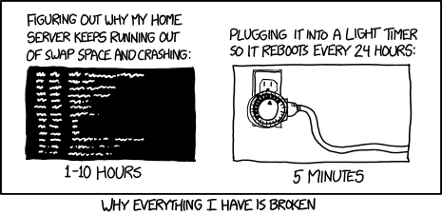
Virtual Memory II CSE 351 Autumn 2018
Instructor:
Justin Hsia
Teaching Assistants:
Akshat Aggarwal
An Wang
Andrew Hu
Brian Dai
Britt Henderson
James Shin
Kevin Bi
Kory Watson
Riley Germundson
Sophie Tian
Teagan Horkan
https://xkcd.com/1495/

Slide 2
Administrivia
Lab 4 due next Monday (11/26)
Homework 5 released tomorrow (11/19)
Processes and Virtual Memory
There is lecture on Wednesday
VM wrap-up, VM review problems, plus fun slides on a VM exploit
“Virtual Section” on Virtual Memory
Worksheet and solutions released on Wednesday
Videos of Justin working through problems

Slide 3
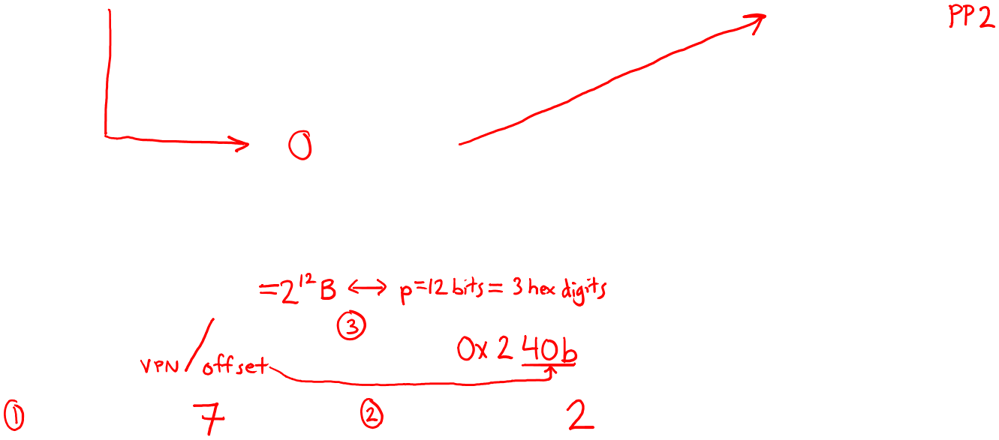
Page Hit
Page hit: VM reference is in physical memory
Page Table (DRAM)
Physical memory
(DRAM)
Virtual address
Valid
PPN/Disk Addr
PTE 0
0
null
VP 1
PP 0
1
VP 2
1
VP 7
0
VP 4
PP 3
1
0
null
0
Virtual memory (DRAM/disk)
PTE 7
1
...
...
VP 1
VP 2
Example: Page size = 4 KiB
VP 3
VP 4
Virtual Addr:
0x00740b
Physical Addr:
VP 6
VP 7
VPN:
PPN:
Notes:
4kB page = 2^12
3 hex digits

Slide 4
Page Fault
Page fault: VM reference is NOT in physical memory
Page Table (DRAM)
Physical memory
(DRAM)
Virtual address
Valid
PPN/Disk Addr
PTE 0
0
null
VP 1
PP 0
1
VP 2
1
VP 7
0
VP 4
PP 3
1
0
null
0
Virtual memory (DRAM/disk)
PTE 7
1
...
...
VP 1
VP 2
Example: Page size = 4 KiB
Provide a virtual address request (in hex) that results in this particular page fault:
VP 3
VP 4
VP 6
VP 7
Virtual Addr:

Slide 5
Page Fault Exception
int a[1000];
int main ()
{
a[500] = 13;
}
User writes to memory location
That portion (page) of user’s memory is currently on disk
Page fault handler must load page into physical memory
Returns to faulting instruction: mov is executed again!
Successful on second try
80483b7: c7 05 10 9d 04 08 0d movl $0xd,0x8049d10
User code
OS Kernel code
exception: page fault
handle_page_fault:
movl
Create page and
load into memory
returns

Slide 6
Handling a Page Fault
Page miss causes page fault (an exception)
Page Table (DRAM)
Physical memory
(DRAM)
Virtual address
Valid
PPN/Disk Addr
PTE 0
0
null
VP 1
PP 0
1
VP 2
1
VP 7
0
VP 4
PP 3
1
0
null
Virtual memory (DRAM/disk)
0
PTE 7
1
VP 1
...
...
VP 2
VP 3
VP 4
VP 6
VP 7

Slide 7
Handling a Page Fault
Page miss causes page fault (an exception)
Page fault handler selects a victim to be evicted (here VP 4)
Page Table (DRAM)
Physical memory
(DRAM)
Virtual address
Valid
PPN/Disk Addr
PTE 0
0
null
VP 1
PP 0
1
VP 2
1
VP 7
0
VP 4
PP 3
1
0
null
Virtual memory (DRAM/disk)
0
PTE 7
1
VP 1
...
...
VP 2
VP 3
VP 4
VP 6
VP 7
Notes:
Check dirty bit on eviction!

Slide 8
Handling a Page Fault
Page miss causes page fault (an exception)
Page fault handler selects a victim to be evicted (here VP 4)
Page Table (DRAM)
Physical memory
(DRAM)
Virtual address
Valid
PPN/Disk Addr
PTE 0
0
null
VP 1
PP 0
1
VP 2
1
VP 7
1
VP 3
PP 3
0
0
null
Virtual memory (DRAM/disk)
0
PTE 7
1
VP 1
...
...
VP 2
VP 3
VP 4
VP 6
VP 7

Slide 9
Handling a Page Fault
Page miss causes page fault (an exception)
Page fault handler selects a victim to be evicted (here VP 4)
Offending instruction is restarted: page hit!
Page Table (DRAM)
Physical memory
(DRAM)
Virtual address
Valid
PPN/Disk Addr
PTE 0
0
null
VP 1
PP 0
1
VP 2
1
VP 7
1
VP 3
PP 3
0
0
null
Virtual memory (DRAM/disk)
0
PTE 7
1
VP 1
...
...
VP 2
VP 3
VP 4
VP 6
VP 7

Slide 10
Peer Instruction Question
How many bits wide are the following fields?
16 KiB pages
48-bit virtual addresses
16 GiB physical memory
Vote at: http://PollEv.com/justinh
VPN PPN
(A)
34 24
(B)
32 18
(C)
30 20
(D)
34 20

Slide 11
Virtual Memory (VM)
Overview and motivation
VM as a tool for caching
Address translation
VM as a tool for memory management
VM as a tool for memory protection

Slide 12
VM for Managing Multiple Processes
Key abstraction: each process has its own virtual address space
It can view memory as a simple linear array
With virtual memory, this simple linear virtual address space need not be contiguous in physical memory
Process needs to store data in another VP? Just map it to any PP!
Virtual Address Space for Process 1:
0
0
Physical
Address
Space (DRAM)
VP 1
VP 2
PP 2
...
N-1
Address
translation
PP 6
(e.g., read-only
library code)
Virtual Address Space for Process 2:
0
PP 8
VP 1
VP 2
...
...
N-1
M-1

Slide 13
Simplifying Linking and Loading
Memory
invisible to
user code
Linking
Each program has similar virtual address space
Code, Data, and Heap always start at the same addresses
Loading
execve allocates virtual pages for .text and .data sections & creates PTEs marked as invalid
The .text and .data sections are copied, page by page, on demand by the virtual memory system
Kernel virtual memory
User stack
(created at runtime)
%rsp
(stack
pointer)
Memory-mapped region for
shared libraries
brk
Run-time heap
(created by malloc)
Read/write segment
(.data, .bss)
Loaded
from the
executable
file
Read-only segment
(.init, .text, .rodata)
0x400000
Unused
0

Slide 14
VM for Protection and Sharing
The mapping of VPs to PPs provides a simple mechanism to protect memory and to share memory between processes
Sharing: map virtual pages in separate address spaces to the same physical page (here: PP 6)
Protection: process can’t access physical pages to which none of its virtual pages are mapped (here: Process 2 can’t access PP 2)
Virtual Address Space for Process 1:
0
0
Physical
Address
Space (DRAM)
VP 1
VP 2
PP 2
...
N-1
Address
translation
PP 6
(e.g., read-only
library code)
Virtual Address Space for Process 2:
0
PP 8
VP 1
VP 2
...
...
N-1
M-1

Slide 15
Memory Protection Within Process
VM implements read/write/execute permissions
Extend page table entries with permission bits
MMU checks these permission bits on every memory access
If violated, raises exception and OS sends SIGSEGV signal to process (segmentation fault)
Physical
Address Space
Process i:
Valid
READ
WRITE
EXEC
PPN
VP 0:
Yes
Yes
No
No
PP 6
VP 1:
Yes
Yes
No
Yes
PP 4
VP 2:
Yes
Yes
Yes
No
PP 2
PP 2
•
•
•
PP 4
PP 6
Process j:
Valid
READ
WRITE
EXEC
PPN
VP 0:
Yes
Yes
Yes
No
PP 9
PP 8
VP 1:
Yes
Yes
No
No
PP 6
PP 9
VP 2:
Yes
Yes
Yes
No
PP 11
PP 11
Notes:
Why no Dirty bit? Typically handled by OS.

Slide 16
Review Question
What should the permission bits be for pages from the following sections of virtual memory?
Section | Read | Write | Execute
Stack
Heap
Static Data
Literals
Instructions

Slide 17
Address Translation: Page Hit
2
Cache/
Memory
CPU Chip
MMU
PTEA
1
PTE
CPU
VA
3
PA
4
Data
5
1) Processor sends virtual address to MMU (memory management unit)
2-3) MMU fetches PTE from page table in cache/memory (Uses PTBR to find beginning of page table for current process)
4) MMU sends physical address to cache/memory requesting data
5) Cache/memory sends data to processor
VA = Virtual Address PTEA = Page Table Entry Address PTE= Page Table Entry PA = Physical Address Data = Contents of memory stored at VA originally requested by CPU

Slide 18
Address Translation: Page Fault
Exception
Page fault handler
4
CPU Chip
2
Cache/
Memory
Disk
MMU
PTEA
Victim page
1
5
CPU
VA
PTE
7
3
New page
6
1) Processor sends virtual address to MMU
2-3) MMU fetches PTE from page table in cache/memory
4) Valid bit is zero, so MMU triggers page fault exception
5) Handler identifies victim (and, if dirty, pages it out to disk)
6) Handler pages in new page and updates PTE in memory
7) Handler returns to original process, restarting faulting instruction

Slide 19
Hmm… Translation Sounds Slow
The MMU accesses memory twice: once to get the PTE for translation, and then again for the actual memory request
The PTEs may be cached in L1 like any other memory word
But they may be evicted by other data references
And a hit in the L1 cache still requires 1-3 cycles
What can we do to make this faster?
Solution: add another cache! 🎉

Slide 20
Speeding up Translation with a TLB
Translation Lookaside Buffer (TLB):
Small hardware cache in MMU
Maps virtual page numbers to physical page numbers
Contains complete page table entries for small number of pages
Modern Intel processors have 128 or 256 entries in TLB
Much faster than a page table lookup in cache/memory
TLB
VPN
→
PTE
VPN
→
PTE
VPN
→
PTE
Notes:
“The architecture of the IBM System/370” R.P. Case and A. Padegs Communications of the ACM. 21:1, 73-96, January 1978.
Perhaps the first paper to use the term translation lookaside buffer. The name arises from the historical name for a cache, which was a lookaside buffer as called by those developing the Atlas system at the University of Manchester; a cache of address translations thus became a translation lookaside buffer. Even though the term lookaside buffer fell out of favor, TLB seems to have stuck, for whatever reason.
“x86info -c” on Intel Core2 Duo CPU:
L1 Data TLB: 4KB pages, 4-way set associative, 16 entries
Data TLB: 4K pages, 4-way associative, 256 entries.
L1 Data TLB: 4MB pages, 4-way set associative, 16 entries
Data TLB: 4MB pages, 4-way associative, 32 entries

Slide 21
TLB Hit
TLB
VPN
→
PTE
VPN
→
PTE
VPN
→
PTE
CPU Chip
TLB
2
PTE
VPN
3
Cache/
Memory
1
MMU
CPU
VA
PA
4
Data
5
A TLB hit eliminates a memory access!

Slide 22
TLB Miss
TLB
VPN
→
PTE
VPN
→
PTE
VPN
→
PTE
CPU Chip
TLB
4
2
PTE
VPN
Cache/
Memory
1
MMU
3
CPU
VA
PTEA
PA
5
Data
6
A TLB miss incurs an additional memory access (the PTE)
Fortunately, TLB misses are rare
Notes:
Does a TLB miss require disk access?

Slide 23
Fetching Data on a Memory Read
Check TLB
Input: VPN, Output: PPN
TLB Hit: Fetch translation, return PPN
TLB Miss: Check page table (in memory)
Page Table Hit: Load page table entry into TLB
Page Fault: Fetch page from disk to memory, update corresponding page table entry, then load entry into TLB
Check cache
Input: physical address, Output: data
Cache Hit: Return data value to processor
Cache Miss: Fetch data value from memory, store it in cache, return it to processor

Slide 24
Address Translation
Virtual Address
TLB
Lookup
TLB Miss
TLB Hit
Check the
Page Table
Protection
Check
Page not
in Mem
Page
in Mem
Access
Denied
Access
Permitted
Page Fault
(OS loads page)
Update
TLB
Protection
Fault
Physical
Address
Find in Disk
Find in Mem
SIGSEGV
Check cache
Notes:
Need to restart instruction.
Soft and hard page faults.

Slide 25
Context Switching Revisited
What needs to happen when the CPU switches processes?
Registers:
Save state of old process, load state of new process
Including the Page Table Base Register (PTBR)
Memory:
Nothing to do! Pages for processes already exist in memory/disk and protected from each other
TLB:
Invalidate all entries in TLB – mapping is for old process’ VAs
Cache:
Can leave alone because storing based on PAs – good for shared data

Slide 26
Summary of Address Translation Symbols
Basic Parameters
$N=2^{n}$ Number of addresses in virtual address space
$M=2^{m}$ Number of addresses in physical address space
$P=2^{p}$ Page size (bytes)
Components of the virtual address (VA)
VPO Virtual page offset
VPN Virtual page number
TLBI TLB index
TLBT TLB tag
Components of the physical address (PA)
PPO Physical page offset (same as VPO)
PPN Physical page number

Slide 27
Virtual Memory Summary
Programmer’s view of virtual memory
Each process has its own private linear address space
Cannot be corrupted by other processes
System view of virtual memory
Uses memory efficiently by caching virtual memory pages
Efficient only because of locality
Simplifies memory management and sharing
Simplifies protection by providing permissions checking

Slide 28
Memory System Summary
Memory Caches (L1/L2/L3)
Purely a speed-up technique
Behavior invisible to application programmer and (mostly) OS
Implemented totally in hardware
Virtual Memory
Supports many OS-related functions
Process creation, task switching, protection
Operating System (software)
Allocates/shares physical memory among processes
Maintains high-level tables tracking memory type, source, sharing
Handles exceptions, fills in hardware-defined mapping tables
Hardware
Translates virtual addresses via mapping tables, enforcing permissions
Accelerates mapping via translation cache (TLB)

