Slide 1
Parallelism [optional lecture] CSE 351 Autumn 2017
Instructor:
Justin Hsia
Teaching Assistants:
Lucas Wotton
Michael Zhang
Parker DeWilde
Ryan Wong
Sam Gehman
Sam Wolfson
Savanna Yee
Vinny Palaniappan
https://xkcd.com/1425/

Slide 2
Administrivia
Lab 5 due Friday (12/8)
Hard deadline on Sunday (12/10)
Course evaluations now open
See Piazza post @366 for links (separate for Lec A/B)
Final Exam: Wed, 12/13, 12:30-2:20pm in KNE 120
Review Session: Mon, 12/11, 5-8pm in EEB 105
You get TWO double-sided handwritten 8.5$×$11” cheat sheets
Additional practice problems on website

Slide 3
Concurrency vs. Parallelism
Concurrency in CS is “the ability of different parts or units of a program, algorithm, or problem to be executed out-of-order or in partial order, without affecting the final outcome.” – Wikipedia
Concurrent computing is when the execution of multiple computations (or processes) overlap
Parallel computing is when the execution of multiple computations (or processes) occur simultaneously
These terms are related, but independent

Slide 4
Concurrency in Hardware and Software
Choice of hardware setup and software design are independent
Concurrent software can also run on serial hardware
Sequential software can also run on parallel hardware

Slide 5
Types of Parallelism
Why Parallelism?
Thread-Level Parallelism
Data-Level Parallelism
Instruction-Level Parallelism

Slide 6
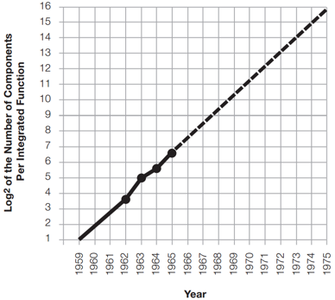
Moore’s Law
In 1965, Gordon Moore observed that transistor density had ~doubled each year
~16/chip in 1962 to ~128/chip in 1965
Predicted doubling would continue every year for a decade
Became a self-fulfilling prophecy for industry
Up to ~65,000/chip in 1975
Rate slowed after 1975 to doubling every ~2 years
Now slowing further

Slide 7
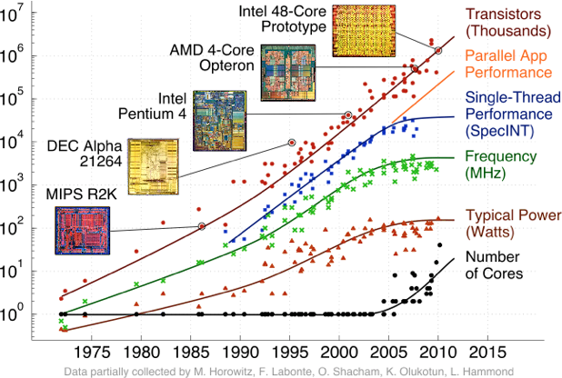
Transistor and Chip Scaling
In order to fulfill Moore’s Law, need to fit more transistors per chip
Decrease transistor size to increase chip density & speed
Increase chips size, but limited by defect rate
Computers today are obscenely powerful compared to their forebears!

Slide 8
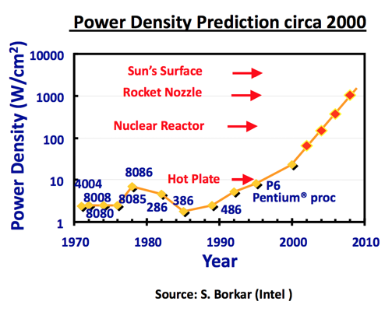
Running into Physical Limits
Power densities over time
Roughly constant from 1958 to late 1990s
Grow rapidly starting in late 1990s
Since 2000, transistors too small (a few molecules thick) to shrink further
Current leakage makes power scale with frequency
Power = C × V² × f
Heat Death:
Processors stopped around 4 GHz
Notes:
More speed = more power
Moore’s Law continues, though slower
Still fitting more transistors, but can’t speed them up any further

Slide 9
The Rise of Multi-core
Multi-core: Stick multiple processors on single chip
Modern laptops and desktops usually have ~4 CPUs
Each CPU can run a separate process or thread
Speed boost on parallelizable tasks
The Challenges:
Requires new programming language (and hardware) tools for maximum effectiveness
Concurrent & parallel programs can be tricky to get right

Slide 10
Types of Parallelism
Why Parallelism?
Thread-Level Parallelism
Multithreading
Synchronization
Cache Coherence
Data-Level Parallelism
Instruction-Level Parallelism

Slide 11
Introducing Threads
Separate the concept of a process from that of a minimal “thread of control”
Usually called a thread (or a lightweight process), this is a sequential execution stream within a process
In most modern OS’s:
Process: address space, OS resources/process attributes
Thread: stack, stack pointer, program counter, registers
Threads are the unit of scheduling and processes are their containers
thread
Notes:
Faster context switching between threads
System can support more threads

Slide 12
Hardware Support for Multithreading
Two copies of PC and Registers inside processor hardware:
Looks like two processors to software (hardware thread 0, hardware thread 1)
Control logic decides which thread to execute an instruction from next
Processor
Control
Datapath
PC 0
PC 1
Registers 0
Registers 1
(ALU)
Notes:
Example: Intel’s proprietary “Hyper-threading”
https://en.wikipedia.org/wiki/Hyper-threading

Slide 13
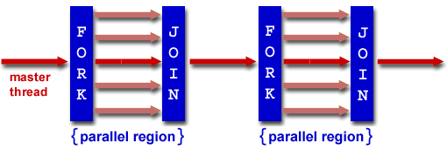
Multithreading a Process
Must explicitly tell machine how to do this
There are many parallel/concurrent programming models
POSIX Threads (pthread) model
#include <pthread.h>, compiled with -pthread flag in gcc
Fork-Join model (taught in CSE332)
#include <omp.h>, compiled with -fopenmp flag in gcc

Slide 14
Multithreading Limits
“52-Card Pickup is a children’s game… that is usually played as a practical joke”
Scatter a deck of cards, then someone picks up
In our variant, want ordered deck of cards
Picking up the cards by yourself takes time
A team completes the work more quickly

Slide 15
Multithreading Limits
Why wouldn’t a team of 100 people complete the 52-Card Pickup game much faster than a team of just 50?
There’s only so many things to be done – only so much can be parallelized
Some tasks need to wait on others – are inherently sequential
Notes:
Aside: might be difficult to find 99 friends & get them to crowd around a deck of cards!

Slide 16
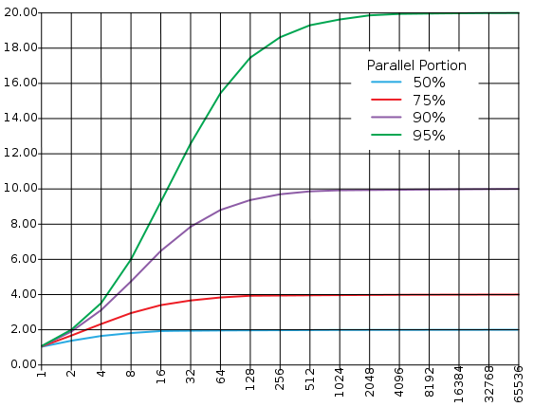
Amdahl’s Law
The amount of speedup that can be achieved through parallelism is limited by the non-parallel portion
Programs can almost never be completely parallelized; some serial portion remains
Time
Speedup
Parallel
portion
Serial
portion
1
2
3
4
5
Number of Processors
Number of Processors

Slide 17
Multithreading: Synchronization
Two memory accesses form a data race if different threads access the same location, and at least one is a write, and they occur one after another
Means that the result of a program can vary depending on chance (which thread ran first?)
Avoid data races by synchronizing writing and reading to get deterministic behavior

Slide 18
Data Race Analogy: Buying Milk
Your fridge has no milk:
You and your roommate will return from classes at some point and check the fridge
Whoever gets home first will check the fridge, go and buy milk, and return
What if the other person gets back while the first person is buying milk?
You’ve just bought twice as much milk as you need!
It would’ve helped to have left a note…

Slide 19
Lock Synchronization
Use a “Lock” to grant access to a critical section so that only one thread can operate there at a time
Pseudocode:
Check Lock
Set Lock
Critical section
(e.g. change shared variables)
Unset Lock
Can loop/idle here if locked
Notes:
Split “check lock” into: read lock value, conditional jump
“set lock” is write lock value

Slide 20
Lock Problem
Thread 1
read lock (check)
conditional jump
write lock (set)
critical section…
Thread 2
read lock (check)
conditional jump
write lock (set)
critical section…
Time
Both threads think they have set the lock!
Exclusive access not guaranteed!

Slide 21
Hardware Synchronization
Hardware support is required to prevent an interloper (another thread) from changing the value
Atomic read/write memory operation
No other access to the location allowed between the read and write
One idea:
When you Read Lock, save a copy in hardware
When you try to Set Lock, stop if the Lock value has changed

Slide 22
Multiprocessing: Caches
Each core shares the same Memory, but has local L1 (and sometimes L2) caches:
Logically:
Processor
Processor
Processor
…
Cache
Cache
Cache
Interconnection Network
Memory
I/O

Slide 23
Shared Memory and Caches Scenario
What if?
Processor 0 reads Mem[1000] (value 351)
Processor 1 reads Mem[1000]
Processor $n$ writes Mem[1000] with 333
Processor 0
Processor 1
Processor $n$
…
Cache 0
Cache 1
Cache $n$
Interconnection Network
Memory
I/O

Slide 24
Keeping Multiple Caches Coherent
Architect’s job: keep cache values coherent with shared memory
Idea: on cache miss or write, notify other processors via interconnection network
If reading, many processors can have copies
If writing, invalidate all other copies
4th “C” of cache misses: coherence miss!

Slide 25
Types of Parallelism
Why Parallelism?
Thread-Level Parallelism
Data-Level Parallelism
SIMD
Loop Unrolling
Instruction-Level Parallelism

Slide 26
Data-Level Parallelism
Data-Level Parallelism: Executing one operation on multiple data “streams”
Examples: Vector dot product (e.g. in filtering) or matrix multiply (e.g. in image processing)
$y\left[i\right]≔c\left[i\right]×x[i]$, $0≤i<n$
Sources of performance improvement:
Single instruction for entire operation
Each operation is independent
Concurrency in memory access as well (pull all data at once)
Notes:
Data-Level Parallelism: Executing one operation on multiple data “streams”

Slide 27
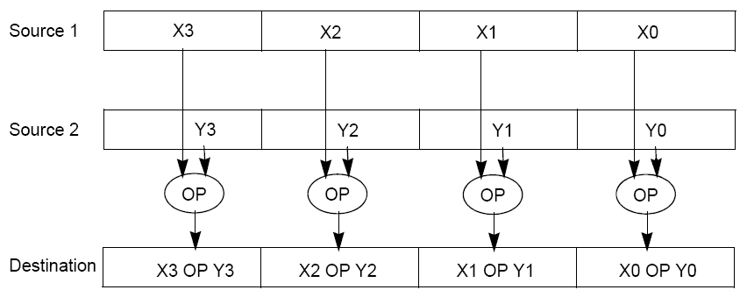
Intel’s Streaming SIMD Extensions (SSE)
SIMD: single instruction, multiple data
SSE is a SIMD instruction set for x86
Mostly for float data (digital signal & graphics processing)
Uses special %xmm registers that are 128 bits wide
If your machine supports SSE, gcc may add these automatically!
Notes:
Compile lab0.c with -O3 flag, then search assembly for ‘xmm’:
$ gcc -O3 -fno-asynchronous-unwind-tables -S lab0.c

Slide 28
Taking Advantage of SIMD
SIMD wants adjacent values in memory that can be operated in parallel
These are usually specified in programs as loops:
How can we reveal more data level parallelism than is available in a single iteration of a loop?
Unroll the loop and adjust iteration rate:
for(i=0; i<1000; i++)
x[i] = x[i] + s;
for(i=0; i<1000; i+=4) {
x[i] = x[i] + s;
x[i+1] = x[i+1] + s;
x[i+2] = x[i+2] + s;
x[i+3] = x[i+3] + s;
}
Notes:
Loop unrolling actually happens in assembly, not C.
Loop unrolling has other execution benefits, but won’t make sense without knowing datapath and pipelining.

Slide 29
Types of Parallelism
Why Parallelism?
Data-Level Parallelism
Thread-Level Parallelism
Instruction-Level Parallelism
Pipelining

Slide 30
Executing an Instruction
Very generally, what steps do you take to figure out the result of the next x86-64 instruction?
Fetch the instruction 400540: 48 01 fe
Decode the instruction addq %rdi, %rsi
Gather data values read R[%rdi], R[%rsi]
Perform operation calc R[%rdi]+R[%rsi]
Store result save into %rsi

Slide 31
Datapath
Datapath: part of the processor that contains the hardware necessary to perform operations required by the processor (“the brawn”)
Each “stage” of instruction execution is roughly associated with a piece of the datapath
Each hardware piece can only perform one action at a time
rd
Register
File
ALU
Access I$
PC
rs
Access D$
rt
+4
imm
MUX
1. Instruction
Fetch
2. Decode /
Register Read
3. Execute
4. Memory
5. Write Back

Slide 32
Analogy: Doing Laundry
Andrea, Brian, Caroline, and Danny each have one load of clothes to wash, dry, fold, and put away
Washer takes 30 minutes
Dryer takes 30 minutes
“Folder” takes 30 minutes
“Stasher” takes 30 minutes to put clothes into drawers
A
B
C
D

Slide 33
Sequential Laundry
Time
Sequential laundry takes 8 hours for 4 loads
6 PM
7
8
9
10
11
12
1
2 AM
30
30
30
30
30
30
30
30
30
30
30
30
30
30
30
30
A
Task
Order
B
C
D

Slide 34
Pipelined Laundry
Time
Pipelined laundry takes 3.5 hours for 4 loads!
6 PM
7
8
9
10
11
12
1
2 AM
30
30
30
30
30
30
30
A
Task
Order
B
C
D

Slide 35
Pipelining Notes
Time
Pipelining doesn’t help latency of single task, just throughput of entire workload
Multiple tasks operating simultaneously using different resources
Potential speedup = number of pipeline stages
6 PM
7
8
9
30
30
30
30
30
30
30
A
Task
Order
B
C
D
Pipelining allows us to execute parts of multiple instructions at the same time using the same hardware!
This is known as instruction-level parallelism

Slide 36
Multiple Issue
With extra copy of main components of datapath, it’s possible to issue multiple instructions simultaneously!
Need to make sure that simultaneously-executing instructions are dependent on each other
A processor that can execute more than one instruction per clock cycle is called superscalar
Even crazier: out-of-order execution
Notes:
Similar to how we accomplished multithreading with extra hardware

Slide 37
Summary
In the pursuit of processing power, parallelism is the most promising path!
Requires specialized hardware and programming techniques
Lots of potential issues, so difficult to get right
Many kinds of parallelism that can be used in conjunction with each other:
Thread-level parallelism (TLP)
Data-level parallelism (DLP)
Instruction-level parallelism (ILP)
… many other kinds not mentioned today!

