Slide 1
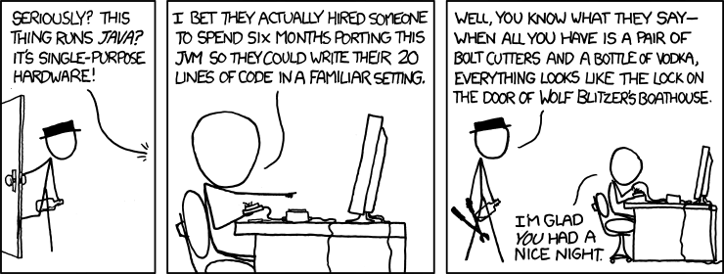
Java and C CSE 351 Autumn 2017
Instructor:
Justin Hsia
Teaching Assistants:
Lucas Wotton Michael Zhang Parker DeWilde Ryan Wong
Sam Gehman Sam Wolfson Savanna Yee Vinny Palaniappan
https://xkcd.com/801/

Slide 2
Administrivia
Lab 5 due Friday (12/8)
Hard deadline on Sunday (12/10)
Course evaluations now open
See Piazza post @366 for links (separate for Lec A/B)
Final Exam: Wed, 12/13, 12:30-2:20pm in KNE 120
Review Session: Mon, 12/11, 5-8pm in EEB 105
You get TWO double-sided handwritten 8.5$×$11” cheat sheets
Additional practice problems on website

Slide 3
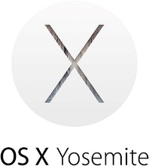
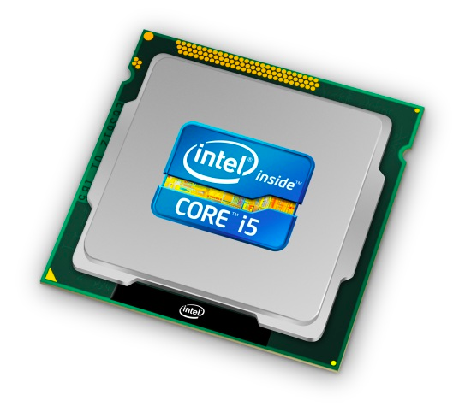
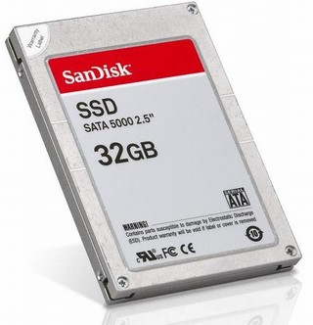
Roadmap
C:
Java:
Memory & data
Integers & floats
x86 assembly
Procedures & stacks
Executables
Arrays & structs
Memory & caches
Processes
Virtual memory
Memory allocation
Java vs. C
car *c = malloc(sizeof(car));
c->miles = 100;
c->gals = 17;
float mpg = get_mpg(c);
free(c);
Car c = new Car();
c.setMiles(100);
c.setGals(17);
float mpg = c.getMPG();
Assembly language:
get_mpg:
pushq %rbp
movq %rsp, %rbp
...
popq %rbp
ret
OS:
Machine code:
0111010000011000
100011010000010000000010
1000100111000010
110000011111101000011111
Computer system:

Slide 4
Java vs. C
Reconnecting to Java (hello CSE143!)
But now you know a lot more about what really happens when we execute programs
We’ve learned about the following items in C; now we’ll see what they look like for Java:
Representation of data
Pointers / references
Casting
Function / method calls including dynamic dispatch

Slide 5
Worlds Colliding
CSE351 has given you a “really different feeling” about what computers do and how programs execute
We have occasionally contrasted to Java, but CSE143 may still feel like “a different world”
It’s not – it’s just a higher-level of abstraction
Connect these levels via how-one-could-implement-Java in 351 terms

Slide 6
Meta-point to this lecture
None of the data representations we are going to talk about are guaranteed by Java
In fact, the language simply provides an abstraction (Java language specification)
Tells us how code should behave for different language constructs, but we can't easily tell how things are really represented
But it is important to understand an implementation of the lower levels – useful in thinking about your program

Slide 7
Data in Java
Integers, floats, doubles, pointers – same as C
“Pointers” are called “references” in Java, but are much more constrained than C’s general pointers
Java’s portability-guarantee fixes the sizes of all types
Example: int is 4 bytes in Java regardless of machine
No unsigned types to avoid conversion pitfalls
Added some useful methods in Java 8 (also use bigger signed types)
null is typically represented as 0 but “you can’t tell”
Much more interesting:
Arrays
Characters and strings
Objects

Slide 8
Data in Java: Arrays
Every element initialized to 0 or null
Length specified in immutable field at start of array (int – 4 bytes)
array.length returns value of this field
Since it has this info, what can it do?
C:
int array[5];
??
??
??
??
??
0
4
20
Java:
int[] array = new int[5];
5
00
00
00
00
00
0
4
20
24

Slide 9
Data in Java: Arrays
Every element initialized to 0 or null
Length specified in immutable field at start of array (int – 4 bytes)
array.length returns value of this field
Every access triggers a bounds-check
Code is added to ensure the index is within bounds
Exception if out-of-bounds
C:
int array[5];
To speed up bounds-checking:
Length field is likely in cache
Compiler may store length field in register for loops
Compiler may prove that some checks are redundant
??
??
??
??
??
0
4
20
Java:
int[] array = new int[5];
5
00
00
00
00
00
0
4
20
24

Slide 10
Data in Java: Characters & Strings
Two-byte Unicode instead of ASCII
Represents most of the world’s alphabets
String not bounded by a ‘\0’ (null character)
Bounded by hidden length field at beginning of string
All String objects read-only (vs. StringBuffer)
Example: the string “CSE351”
C:
(ASCII)
43
53
45
33
35
31
\0
0
1
4
7
Java:
(Unicode)
6
43
00
53
00
45
00
33
00
35
00
31
00
0
4
8
16
Notes:
Unicode in C: http://www.cprogramming.com/tutorial/unicode.html
UTF-16: http://www.oracle.com/us/technologies/java/supplementary-142654.html

Slide 11
Data in Java: Objects
Data structures (objects) are always stored by reference, never stored “inline”
Include complex data types (arrays, other objects, etc.) using references
C:
a[] stored “inline” as part of struct
Java:
a stored by reference in object
struct rec {
int i;
int a[3];
struct rec *p;
};
class Rec {
int i;
int[] a = new int[3];
Rec p; ...
}
i
a
p
i
a
p
0
4
12
20
0
4
16
24
3
0
4
16

Slide 12
Pointer/reference fields and variables
In C, we have “->” and “.” for field selection depending on whether we have a pointer to a struct or a struct
(*r).a is so common it becomes r->a
In Java, all non-primitive variables are references to objects
We always use r.a notation
But really follow reference to r with offset to a, just like r->a in C
So no Java field needs more than 8 bytes
C:
Java:
struct rec *r = malloc(...);
struct rec r2;
r->i = val;
r->a[2] = val;
r->p = &r2;
r = new Rec();
r2 = new Rec();
r.i = val;
r.a[2] = val;
r.p = r2;

Slide 13
Pointers/References
Pointers in C can point to any memory address
References in Java can only point to [the starts of] objects
Can only be dereferenced to access a field or element of that object
C:
Java:
struct rec {
int i;
int a[3];
struct rec *p;
};
struct rec* r = malloc(…);
some_fn(&(r->a[1])); // ptr
class Rec {
int i;
int[] a = new int[3];
Rec p;
}
Rec r = new Rec();
some_fn(r.a, 1); // ref, index
r
r
i
a
p
X
i
a
p
0
4
12
20
0
4
16
24
3
int[3]
0
4
16
Notes:
http://programmers.stackexchange.com/questions/141834/how-is-a-java-reference-different-from-a-c-pointer

Slide 14
Casting in C (example from Lab 5)
Can cast any pointer into any other pointer
Changes dereference and arithemetic behavior
struct BlockInfo {
size_t sizeAndTags;
struct BlockInfo* next;
struct BlockInfo* prev;
};
typedef struct BlockInfo BlockInfo;
...
int x;
BlockInfo *b;
BlockInfo *newBlock;
...
newBlock = (BlockInfo *) ( (char *) b + x );
...
Cast b into char * to do unscaled addition
Cast back into BlockInfo * to use as BlockInfo struct
s
n
p
s
n
p
0
8
16
24
x
Notes:
Dereference behavior includes size of data pulled and interpretation of bits.

Slide 15
Type-safe casting in Java
Can only cast compatible object references
Based on class hierarchy
class Boat extends Vehicle {
int propellers;
}
class Object {
...
}
class Vehicle {
int passengers;
}
class Car extends Vehicle {
int wheels;
}
Vehicle v = new Vehicle(); // super class of Boat and Car
Boat b1 = new Boat(); // |--> sibling
Car c1 = new Car(); // |--> sibling
Vehicle v1 = new Car();
Vehicle v2 = v1;
Car c2 = new Boat();
Car c3 = new Vehicle();
Boat b2 = (Boat) v;
Car c4 = (Car) v2;
Car c5 = (Car) b1;

Slide 16
Type-safe casting in Java
Can only cast compatible object references
Based on class hierarchy
class Boat extends Vehicle {
int propellers;
}
class Object {
...
}
class Vehicle {
int passengers;
}
class Car extends Vehicle {
int wheels;
}
Vehicle v = new Vehicle(); // super class of Boat and Car
Boat b1 = new Boat(); // |--> sibling
Car c1 = new Car(); // |--> sibling
Vehicle v1 = new Car();
Vehicle v2 = v1;
Car c2 = new Boat();
Car c3 = new Vehicle();
Boat b2 = (Boat) v;
Car c4 = (Car) v2;
Car c5 = (Car) b1;
✓ Everything needed for Vehicle also in Car
✓ v1 is declared as type Vehicle
✗ Compiler error: Incompatible type – elements in Car that are not in Boat (siblings)
✗ Compiler error: Wrong direction – elements Car not in Vehicle (wheels)
✗ Runtime error: Vehicle does not contain all elements in Boat (propellers)
✓ v2 refers to a Car at runtime
✗ Compiler error: Unconvertable types – b1 is declared as type Boat
Notes:
How do we implement/enforce this? (particularly with catching runtime errors)

Slide 17
Java Object Definitions
class Point { double x; double y;
Point() { x = 0; y = 0; }
boolean samePlace(Point p) { return (x == p.x) && (y == p.y);
} }
...
Point p = new Point();
...
fields
constructor
method(s)
creation

Slide 18
Java Objects and Method Dispatch
Point object
p
header
vtable ptr
x
y
vtable for class Point:
code for Point()
code for samePlace()
q
Point object
header
vtable ptr
x
y
Virtual method table (vtable)
Like a jump table for instance (“virtual”) methods plus other class info
One table per class
Object header : GC info, hashing info, lock info, etc.
Why no size?

Slide 19
Java Constructors
When we call new: allocate space for object (data fields and references), initialize to zero/null, and run constructor method
Java:
C pseudo-translation:
Point p = new Point();
Point* p = calloc(1,sizeof(Point));
p->header = ...;
p->vtable = &Point_vtable;
p->vtable[0](p);
Point object
p
header
vtable ptr
x
y
vtable for class Point:
code for Point()
code for samePlace()

Slide 20
Java Methods
Static methods are just like functions
Instance methods:
Can refer to this;
Have an implicit first parameter for this; and
Can be overridden in subclasses
The code to run when calling an instance method is chosen at runtime by lookup in the vtable
Java:
C pseudo-translation:
p.samePlace(q);
p->vtable[1](p, q);
p
Point object
header
vtable ptr
x
y
vtable for class Point:
code for Point()
code for samePlace()

Slide 21
Subclassing
class 3DPoint extends Point { double z; boolean samePlace(Point p2) { return false; } void sayHi() { System.out.println("hello"); } }
Where does “z” go? At end of fields of Point
Point fields are always in the same place, so Point code can run on 3DPoint objects without modification
Where does pointer to code for two new methods go?
No constructor, so use default Point constructor
To override “samePlace”, use same vtable position
Add new pointer at end of vtable for new method “sayHi”

Slide 22
Subclassing
class 3DPoint extends Point { double z; boolean samePlace(Point p2) { return false; } void sayHi() { System.out.println("hello"); } }
z tacked on at end
3DPoint object
header
vtable
x
y
z
sayHi tacked on at end
Code for sayHi
vtable for 3DPoint:
(not Point)
constructor
samePlace
sayHi
Old code for constructor
New code for samePlace

Slide 23
Dynamic Dispatch
Point object
header
vtable ptr
x
y
Point vtable:
code for Point’s samePlace()
p ???
code for Point()
3DPoint object
header
vtable
x
y
z
code for sayHi()
3DPoint vtable:
code for 3DPoint’s samePlace()
Java:
C pseudo-translation:
Point p = ???;
return p.samePlace(q);
// works regardless of what p is
return p->vtable[1](p, q);

Slide 24
Ta-da!
In CSE143, it may have seemed “magic” that an inherited method could call an overridden method
You were tested on this endlessly
The “trick” in the implementation is this part: p->vtable[i](p,q)
In the body of the pointed-to code, any calls to (other) methods of this will use p->vtable
Dispatch determined by p, not the class that defined a method

Slide 25
Practice Question
Assume: 64-bit pointers and that a Java object header is 8 B
What are the sizes of the things being pointed at by ptr_c and ptr_j?
struct c {
int i;
char s[3];
int a[3];
struct c *p;
};
struct c* ptr_c;
class jobj {
int i;
String s = “hi”;
int[] a = new int[3];
jobj p;
}
jobj ptr_j = new jobj();

Slide 26
We made it! ☺ 😎 😂
C:
Java:
Memory & data
Integers & floats
x86 assembly
Procedures & stacks
Executables
Arrays & structs
Memory & caches
Processes
Virtual memory
Memory allocation
Java vs. C
car *c = malloc(sizeof(car));
c->miles = 100;
c->gals = 17;
float mpg = get_mpg(c);
free(c);
Car c = new Car();
c.setMiles(100);
c.setGals(17);
float mpg = c.getMPG();
Assembly language:
get_mpg:
pushq %rbp
movq %rsp, %rbp
...
popq %rbp
ret
OS:
Machine code:
0111010000011000
100011010000010000000010
1000100111000010
110000011111101000011111
Computer system:

