Slide 1
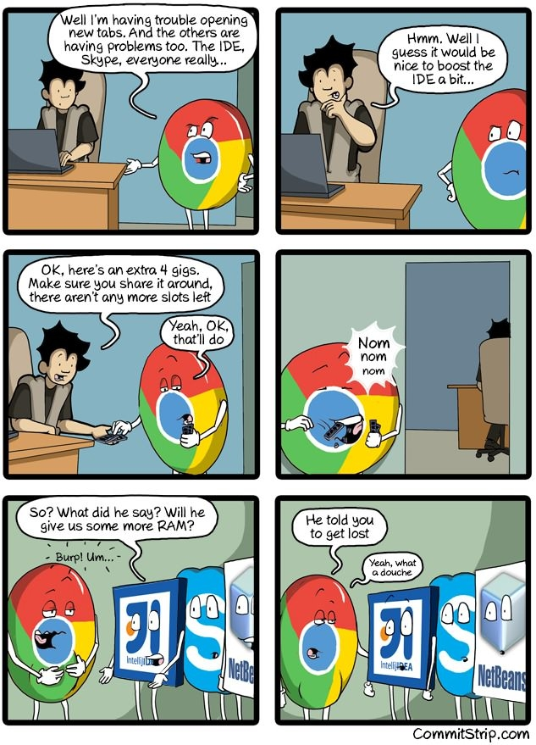
Virtual Memory I CSE 351 Autumn 2017
Instructor:
Justin Hsia
Teaching Assistants:
Lucas Wotton
Michael Zhang
Parker DeWilde
Ryan Wong
Sam Gehman
Sam Wolfson
Savanna Yee
Vinny Palaniappan
http://rebrn.com/re/bad-chrome-1162082/

Slide 2
Administrivia
Homework 4 due tonight
Lab 4 due after Thanksgiving (11/27)
Next week’s section: “Virtual section”
Worksheet and solutions released like normal
Videos of TAs working through problems will also be released

Slide 3
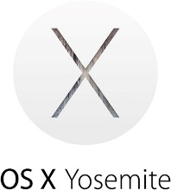
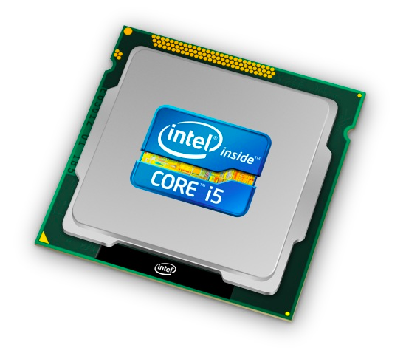
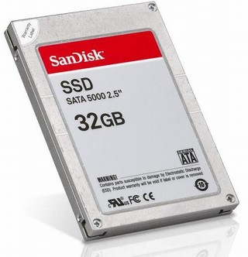
Roadmap
C:
Java:
Memory & data
Integers & floats
x86 assembly
Procedures & stacks
Executables
Arrays & structs
Memory & caches
Processes
Virtual memory
Memory allocation
Java vs. C
car *c = malloc(sizeof(car));
c->miles = 100;
c->gals = 17;
float mpg = get_mpg(c);
free(c);
Car c = new Car();
c.setMiles(100);
c.setGals(17);
float mpg = c.getMPG();
Assembly language:
get_mpg:
pushq %rbp
movq %rsp, %rbp
...
popq %rbp
ret
OS:
Machine code:
0111010000011000
100011010000010000000010
1000100111000010
110000011111101000011111
Computer system:

Slide 4
Virtual Memory (VM*)
Overview and motivation
VM as a tool for caching
Address translation
VM as a tool for memory management
VM as a tool for memory protection
Warning: Virtual memory is pretty complex, but crucial for understanding how processes work and for debugging performance
*Not to be confused with “Virtual Machine” which is a whole other thing.

Slide 5
Memory as we know it so far… is virtual!
Programs refer to virtual memory addresses
movq (%rdi),%rax
Conceptually memory is just a very large array of bytes
System provides private address space to each process
Allocation: Compiler and run-time system
Where different program objects should be stored
All allocation within single virtual address space
But…
We probably don’t have $2w$ bytes of physical memory
We certainly don’t have $2w$ bytes of physical memory for every process
Processes should not interfere with one another
Except in certain cases where they want to share code or data
0xFF∙∙∙∙∙∙F
0x00∙∙∙∙∙∙0

Slide 6
Problem 1: How Does Everything Fit?
64-bit virtual addresses can address
several exabytes
(18,446,744,073,709,551,616 bytes)
Physical main memory offers
a few gigabytes
(e.g. 8,589,934,592 bytes)
?
(Not to scale; physical memory would be smaller than the period at the end of this sentence compared to the virtual address space.)
1 virtual address space per process, with many processes…

Slide 7
Problem 2: Memory Management
Physical main memory
We have multiple processes:
Each process has…
Process 1
Process 2
Process 3
…
Process n
stack
heap
.text
.data
…
What goes where?
x

Slide 8
Problem 3: How To Protect
Physical main memory
Process i
Process j
Problem 4: How To Share?
Physical main memory
Process i
Process j

Slide 9
How can we solve these problems?
Fitting a huge address space into a tiny physical memory
Managing the address spaces of multiple processes
Protecting processes from stepping on each other’s memory
Allowing processes to share common parts of memory

Slide 10
Indirection
“Any problem in computer science can be solved by adding another level of indirection.” – David Wheeler, inventor of the subroutine
Without Indirection
With Indirection
P1
P2
Thing
P3
NewThing
P1
P2
Thing
P3
NewThing
What if I want to move Thing?
Notes:
Quote attributed to David Wheeler or Butler Lampson (http://en.wikipedia.org/wiki/Butler_Lampson)

Slide 11
Indirection
Indirection: The ability to reference something using a name, reference, or container instead of the value itself. A flexible mapping between a name and a thing allows changing the thing without notifying holders of the name.
Adds some work (now have to look up 2 things instead of 1)
But don’t have to track all uses of name/address (single source!)
Examples:
Phone system: cell phone number portability
Domain Name Service (DNS): translation from name to IP address
Call centers: route calls to available operators, etc.
Dynamic Host Configuration Protocol (DHCP): local network address assignment

Slide 12
Indirection in Virtual Memory
Virtual memory
mapping
Process 1
Physical memory
Virtual memory
Process $n$
Each process gets its own private virtual address space
Solves the previous problems!

Slide 13
Address Spaces
Virtual address space: Set of $N=2^{n}$ virtual addr
{0, 1, 2, 3, …, $N$-1}
Physical address space: Set of $M=2m$ physical addr
{0, 1, 2, 3, …, $M$-1}
Every byte in main memory has:
one physical address (PA)
zero, one, or more virtual addresses (VAs)

Slide 14
Mapping
A virtual address (VA) can be mapped to either physical memory or disk
Unused VAs may not have a mapping
VAs from different processes may map to same location in memory/disk
Process 1’s Virtual
Address Space
Physical Memory
Process 2’s Virtual
Address Space
Disk
“Swap Space”

Slide 15
A System Using Physical Addressing
Main memory
0:
1:
2:
CPU
Physical address (PA)
3:
4:
0x4
5:
6:
7:
8:
...
M-1:
Data (int/float)
Used in “simple” systems with (usually) just one process:
Embedded microcontrollers in devices like cars, elevators, and digital picture frames

Slide 16
A System Using Virtual Addressing
Main memory
0:
CPU Chip
1:
Virtual address
(VA)
Physical address
(PA)
2:
CPU
MMU
3:
4:
0x4100
0x4
5:
6:
7:
8:
Memory Management Unit
...
M-1:
Data (int/float)
Physical addresses are completely invisible to programs
Used in all modern desktops, laptops, servers, smartphones…
One of the great ideas in computer science

Slide 17
Why Virtual Memory (VM)?
Efficient use of limited main memory (RAM)
Use RAM as a cache for the parts of a virtual address space
Some non-cached parts stored on disk
Some (unallocated) non-cached parts stored nowhere
Keep only active areas of virtual address space in memory
Transfer data back and forth as needed
Simplifies memory management for programmers
Each process “gets” the same full, private linear address space
Isolates address spaces (protection)
One process can’t interfere with another’s memory
They operate in different address spaces
User process cannot access privileged information
Different sections of address spaces have different permissions
Notes:
Adds disks to memory hierarchy
Simplifies memory for processes & programmers
Security/protection

Slide 18
VM and the Memory Hierarchy
Think of virtual memory as array of $N=2n$ contiguous bytes
Pages of virtual memory are usually stored in physical memory, but sometimes spill to disk
Pages are another unit of aligned memory (size is $P=2p$ bytes)
Each virtual page can be stored in any physical page (no fragmentation!)
Virtual memory
Physical memory
0
Empty
PP 0
VP 0
Unallocated
0
PP 1
VP 1
Empty
Physical pages (PP's)
Virtual pages (VP's)
Unallocated
Empty
2^{m}-1
PP 2^{m-p}-1
Disk
VP 2^{n-p}-1
2^{n}-1
“Swap Space”
Notes:
Swap space: https://www.linux.com/news/all-about-linux-swap-space

Slide 19
or: Virtual Memory as DRAM Cache for Disk
Think of virtual memory as an array of $N=2n$ contiguous bytes stored on a disk
Then physical main memory is used as a cache for the virtual memory array
These “cache blocks” are called pages (size is $P=2p$ bytes)
Virtual memory
Physical memory
VP 0
Unallocated
0
VP 1
Cached
0
Empty
PP 0
Uncached
PP 1
Unallocated
Empty
Cached
Uncached
Empty
Cached
M-1
PP 2^{m-p}-1
VP 2^{n-p}-1
Uncached
N-1
Virtual pages (VPs)
“stored on disk”
Physical pages (PPs)
cached in DRAM

Slide 20
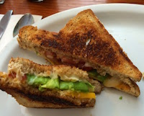
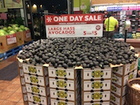
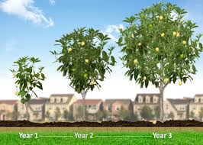
Memory Hierarchy: Core 2 Duo
Not drawn to scale
SRAM
Static Random Access Memory
DRAM
Dynamic Random Access Memory
~4 MB
~8 GB
~500 GB
L1
I-cache
L2 unified cache
Main Memory
Disk
32 KB
CPU
Reg
L1
D-cache
Throughput:
16 B/cycle
8 B/cycle
2 B/cycle
1 B/30 cycles
Latency:
3 cycles
14 cycles
100 cycles
millions
Miss Penalty
(latency)
33x
Miss Penalty
(latency)
10,000x

Slide 21
Virtual Memory Design Consequences
Large page size: typically 4-8 KiB or 2-4 MiB
Can be up to 1 GiB (for “Big Data” apps on big computers)
Compared with 64-byte cache blocks
Fully associative
Any virtual page can be placed in any physical page
Requires a “large” mapping function – different from CPU caches
Highly sophisticated, expensive replacement algorithms in OS
Too complicated and open-ended to be implemented in hardware
Write-back rather than write-through
Really don’t want to write to disk every time we modify something in memory
Some things may never end up on disk (e.g. stack for short-lived process)

Slide 22
Why does VM work on RAM/disk?
Avoids disk accesses because of locality
Same reason that L1 / L2 / L3 caches work
The set of virtual pages that a program is “actively” accessing at any point in time is called its working set
If (working set of one process ≤ physical memory):
Good performance for one process (after compulsory misses)
If (working sets of all processes > physical memory):
Thrashing: Performance meltdown where pages are swapped between memory and disk continuously (CPU always waiting or paging)
This is why your computer can feel faster when you add RAM
Notes:
Improving a program’s temporal locality can lead to a smaller working set (using data in one place in the program rather than many places).
Full quote: “Every problem in computer science can be solved by adding another level of indirection, but that usually will create another problem.”

Slide 23
Virtual Memory (VM)
Overview and motivation
VM as a tool for caching
Address translation
VM as a tool for memory management
VM as a tool for memory protection

Slide 24
Address Translation
How do we perform the virtual $→$ physical address translation?
Main memory
0:
CPU Chip
1:
Virtual address
(VA)
Physical address
(PA)
2:
CPU
MMU
3:
4:
0x4100
0x4
5:
6:
7:
8:
Memory Management Unit
...
M-1:
Data (int/float)

Slide 25
Address Translation: Page Tables
CPU-generated address can be split into:
Request is Virtual Address (VA), want Physical Address (PA)
Note that Physical Offset = Virtual Offset (page-aligned)
Use lookup table that we call the page table (PT)
Replace Virtual Page Number (VPN) for Physical Page Number (PPN) to generate Physical Address
Index PT using VPN: page table entry (PTE) stores the PPN plus management bits (e.g. Valid, Dirty, access rights)
Has an entry for every virtual page – why?
$n$-bit address:
Virtual Page Number
Page Offset

Slide 26
Page Table Diagram
Physical memory
(DRAM)
Page tables stored in physical memory
Too big to fit elsewhere – managed by MMU & OS
How many page tables in the system?
One per process
Page Table
(DRAM)
VP 1
PP 0
Virtual page #
Valid
PPN/Disk Addr
VP 2
PP 1
PTE 0: 0
0
null
VP 7
PP 2
PTE 1: 1
1
PTE 2: 2
1
VP 4
PP 3
PTE 3: 3
0
PTE 4: 4
1
Virtual memory (DRAM/disk)
PTE 5: 5
0
null
PTE 6: 6
0
VP 1
PTE 7: 7
1
...
...
VP 2
VP 3
VP 4
VP 6
VP 7
Notes:
Space allocated for pages in disk called Swap Space

Slide 27
Page Table Address Translation
CPU
Virtual address (VA)
Page table base register
(PTBR)
Virtual page number (VPN)
Virtual page offset (VPO)
Page table address
for process
Page table
Valid
PPN
Valid bit = 0:
page not in memory
(page fault)
Physical page number (PPN)
Physical page offset (PPO)
In most cases, the MMU can perform this translation without software assistance
Physical address (PA)
Notes:
PTBR is another name for control register 3 (CR3) in x86: http://en.wikipedia.org/wiki/Control_register#CR3

Slide 28
Page Hit
Page hit: VM reference is in physical memory
Page Table (DRAM)
Physical memory
(DRAM)
Virtual address
Valid
PPN/Disk Addr
PTE 0
0
null
VP 1
PP 0
1
VP 2
1
VP 7
0
VP 4
PP 3
1
0
null
0
Virtual memory (DRAM/disk)
PTE 7
1
...
...
VP 1
VP 2
Example: Page size = 4 KiB
VP 3
VP 4
Virtual Addr:
0x00740b
Physical Addr:
VP 6
VP 7
VPN:
PPN:
Notes:
4kB page = 2^12
3 hex digits

Slide 29
Page Fault
Page fault: VM reference is NOT in physical memory
Page Table (DRAM)
Physical memory
(DRAM)
Virtual address
Valid
PPN/Disk Addr
PTE 0
0
null
VP 1
PP 0
1
VP 2
1
VP 7
0
VP 4
PP 3
1
0
null
0
Virtual memory (DRAM/disk)
PTE 7
1
...
...
VP 1
VP 2
Example: Page size = 4 KiB
Provide a virtual address request (in hex) that results in this particular page fault:
VP 3
VP 4
VP 6
VP 7
Virtual Addr:

Slide 30
Page Fault Exception
int a[1000];
int main ()
{
a[500] = 13;
}
User writes to memory location
That portion (page) of user’s memory is currently on disk
Page fault handler must load page into physical memory
Returns to faulting instruction: mov is executed again!
Successful on second try
80483b7: c7 05 10 9d 04 08 0d movl $0xd,0x8049d10
User code
OS Kernel code
exception: page fault
handle_page_fault:
movl
Create page and
load into memory
returns

Slide 31
Handling a Page Fault
Page miss causes page fault (an exception)
Page Table (DRAM)
Physical memory
(DRAM)
Virtual address
Valid
PPN/Disk Addr
PTE 0
0
null
VP 1
PP 0
1
VP 2
1
VP 7
0
VP 4
PP 3
1
0
null
Virtual memory (DRAM/disk)
0
PTE 7
1
VP 1
...
...
VP 2
VP 3
VP 4
VP 6
VP 7

Slide 32
Handling a Page Fault
Page miss causes page fault (an exception)
Page fault handler selects a victim to be evicted (here VP 4)
Page Table (DRAM)
Physical memory
(DRAM)
Virtual address
Valid
PPN/Disk Addr
PTE 0
0
null
VP 1
PP 0
1
VP 2
1
VP 7
0
VP 4
PP 3
1
0
null
Virtual memory (DRAM/disk)
0
PTE 7
1
VP 1
...
...
VP 2
VP 3
VP 4
VP 6
VP 7
Notes:
Check dirty bit on eviction!

Slide 33
Handling a Page Fault
Page miss causes page fault (an exception)
Page fault handler selects a victim to be evicted (here VP 4)
Page Table (DRAM)
Physical memory
(DRAM)
Virtual address
Valid
PPN/Disk Addr
PTE 0
0
null
VP 1
PP 0
1
VP 2
1
VP 7
1
VP 3
PP 3
0
0
null
Virtual memory (DRAM/disk)
0
PTE 7
1
VP 1
...
...
VP 2
VP 3
VP 4
VP 6
VP 7

Slide 34
Handling a Page Fault
Page miss causes page fault (an exception)
Page fault handler selects a victim to be evicted (here VP 4)
Offending instruction is restarted: page hit!
Page Table (DRAM)
Physical memory
(DRAM)
Virtual address
Valid
PPN/Disk Addr
PTE 0
0
null
VP 1
PP 0
1
VP 2
1
VP 7
1
VP 3
PP 3
0
0
null
Virtual memory (DRAM/disk)
0
PTE 7
1
VP 1
...
...
VP 2
VP 3
VP 4
VP 6
VP 7

Slide 35
Peer Instruction Question
How many bits wide are the following fields?
16 KiB pages
48-bit virtual addresses
16 GiB physical memory
Vote at: http://PollEv.com/justinh
VPN PPN
(A)
34 24
(B)
32 18
(C)
30 20
(D)
34 20

Slide 36
Summary
Virtual memory provides:
Ability to use limited memory (RAM) across multiple processes
Illusion of contiguous virtual address space for each process
Protection and sharing amongst processes
Indirection via address mapping by page tables
Part of memory management unit and stored in memory
Use virtual page number as index into lookup table that holds physical page number, disk address, or NULL (unallocated page)
On page fault, throw exception and move page from swap space (disk) to main memory

