Slide 1
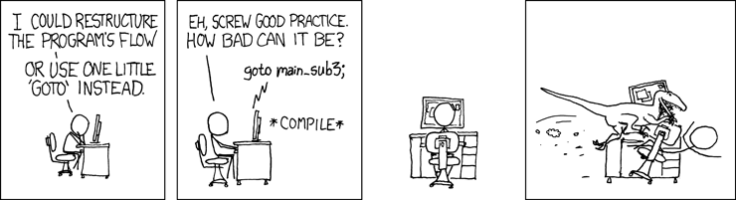
Processes
CSE 351 Autumn 2017
Instructor:
Justin Hsia
Teaching Assistants:
Lucas Wotton Michael Zhang Parker DeWilde Ryan Wong
Sam Gehman Sam Wolfson Savanna Yee Vinny Palaniappan
http://xkcd.com/292/

Slide 2
Administrivia
Homework 4 due Friday (11/17)
Lab 4 due after Thanksgiving (11/27)
  Parts of this lab are new, so don’t hesitate to ask if anything is unclear or seem buggy!

Slide 3
Processes
Processes and context switching
Creating new processes
  fork(), exec*(), and wait()
Zombies

Slide 4
What is a process?
It’s an illusion!
Process 1
Memory
Stack
Heap
Data
Code
CPU
Registers
%rip
Disk
Chrome.exe

Slide 5
What is a process?
Another abstraction in our computer system
  Provided by the OS
  OS uses a data structure to represent each process
  Maintains the interface between the program and the underlying hardware (CPU + memory)
What do processes have to do with exceptional control flow?
  Exceptional control flow is the mechanism the OS uses to enable multiple processes to run on the same system
What is the difference between:
  A processor? A program? A process?
Notes:
The data structure is the process control block (PCB).

Slide 6
Processes
A process is an instance of a running program
  One of the most profound ideas in computer science
  Not the same as “program” or “processor”
Process provides each program with two key abstractions:
  Logical control flow
    Each program seems to have exclusive use of the CPU
    Provided by kernel mechanism called context switching
  Private address space
    Each program seems to have exclusive use of main memory
    Provided by kernel mechanism called virtual memory
Memory
Stack
Heap
Data
Code
CPU
Registers

Slide 7
What is a process?
It’s an illusion!
Computer
Process 3
Process 2
“Memory”
Stack
“Memory”
Heap
Process 1
Data
Process 4
Stack
Code
Heap
“CPU”
“Memory”
Data
“Memory”
Code
Registers
Stack
“CPU”
Stack
Heap
Heap
Data
Registers
Data
Code
Code
CPU
“CPU”
“CPU”
Registers
Registers
Disk
/Applications/
Chrome.exe
Slack.exe
PowerPoint.exe

Slide 8
What is a process?
It’s an illusion!
Computer
Process 3
Process 2
“Memory”
Stack
“Memory”
Heap
Process 1
Data
Process 4
Stack
Code
Heap
“CPU”
“Memory”
Data
“Memory”
Code
Registers
Stack
“CPU”
Stack
Heap
Heap
Data
Registers
Data
Code
Code
CPU
“CPU”
“CPU”
Operating
System
Registers
Registers
Disk
/Applications/
Chrome.exe
Slack.exe
PowerPoint.exe

Slide 9
Multiprocessing: The Illusion
Memory
Memory
Memory
Stack
Stack
Stack
Heap
Heap
…
Heap
Data
Data
Data
Code
Code
Code
CPU
CPU
CPU
Registers
Registers
Registers
Computer runs many processes simultaneously
  Applications for one or more users
    Web browsers, email clients, editors, …
  Background tasks
    Monitoring network & I/O devices

Slide 10
Multiprocessing: The Reality
Memory
Stack
Stack
Stack
Heap
Heap
…
Heap
Data
Data
Data
Code
Code
Code
Saved registers
Saved registers
Saved registers
CPU
Registers
Single processor executes multiple processes concurrently
  Process executions interleaved, CPU runs one at a time
  Address spaces managed by virtual memory system (later in course)
  Execution context (register values, stack, …) for other processes saved in memory

Slide 11
Multiprocessing
Memory
Stack
Stack
Stack
Heap
Heap
…
Heap
Data
Data
Data
Code
Code
Code
Saved registers
Saved registers
Saved registers
CPU
Registers
Context switch
  Save current registers in memory

Slide 12
Multiprocessing
Memory
Stack
Stack
Stack
Heap
Heap
…
Heap
Data
Data
Data
Code
Code
Code
Saved registers
Saved registers
Saved registers
CPU
Registers
Context switch
  Save current registers in memory
  Schedule next process for execution

Slide 13
Multiprocessing
Memory
Stack
Stack
Stack
Heap
Heap
…
Heap
Data
Data
Data
Code
Code
Code
Saved registers
Saved registers
Saved registers
CPU
Registers
Context switch
  Save current registers in memory
  Schedule next process for execution
  Load saved registers and switch address space

Slide 14
Multiprocessing: The (Modern) Reality
Memory
Stack
Stack
Stack
Heap
Heap
…
Heap
Data
Data
Data
Code
Code
Code
Saved registers
Saved registers
Saved registers
CPU
CPU
Multicore processors
  Multiple CPUs (“cores”) on single chip
  Share main memory (and some of the caches)
  Each can execute a separate process
    Kernel schedules processes to cores
    Still constantly swapping processes
Registers
Registers

Slide 15
Concurrent Processes
Assume only one CPU
Each process is a logical control flow
Two processes run concurrently (are concurrent) if their instruction executions (flows) overlap in time
  Otherwise, they are sequential
Example: (running on single core)
  Concurrent: A & B, A & C
  Sequential: B & C
Process A
Process B
Process C
time

Slide 16
User’s View of Concurrency
Assume only one CPU
Control flows for concurrent processes are physically disjoint in time
  CPU only executes instructions for one process at a time
However, the user can think of concurrent processes as executing at the same time, in parallel
Process A
Process B
Process C
Process A
Process B
Process C
User View
time

Slide 17
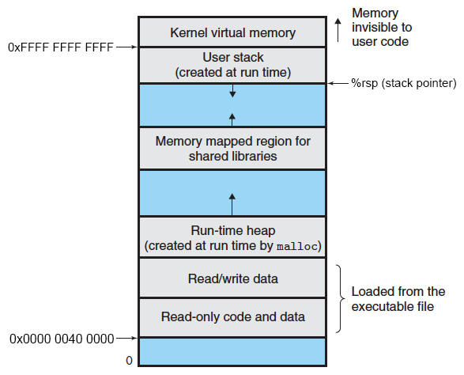
Context Switching
Assume only one CPU
Processes are managed by a shared chunk of OS code
called the kernel
  The kernel is not a separate process, but rather runs as part of a user process
In x86-64 Linux:
  Same address in each process
  refers to same shared
  memory location

Slide 18
Context Switching
Assume only one CPU
Processes are managed by a shared chunk of OS code
called the kernel
  The kernel is not a separate process, but rather runs as part of a user process
Context switch passes control flow from one process to another and is performed using kernel code
Process A
Process B
user code
Exception
kernel code
context switch
time
user code
kernel code
context switch
user code

Slide 19
Processes
Processes and context switching
Creating new processes
  fork() , exec*(), and wait()
Zombies

Slide 20
Creating New Processes & Programs
Process 1
Process 2
“Memory”
“Memory”
Stack
Stack
Heap
fork()
Heap
Data
Data
Code
Code
“CPU”
“CPU”
Registers
Registers
exec*()
Chrome.exe

Slide 21
Creating New Processes & Programs
fork-exec model (Linux):
  fork() creates a copy of the current process
  exec*() replaces the current process’ code and address space with the code for a different program
    Family: execv, execl, execve, execle, execvp, execlp
  fork() and execve() are system calls
Other system calls for process management:
  getpid()
  exit()
  wait(), waitpid()
Notes:
Review: system calls are traps (intentional exception).
http://en.wikipedia.org/wiki/Fork-exec: “Microsoft Windows does not support the fork-exec model, as it does not have a system call analogous to fork(). The spawn() family of functions declared in process.h can replace it in cases where the call to fork() is followed directly by exec().”

Slide 22
fork: Creating New Processes
pid_t fork(void)
  Creates a new “child” process that is identical to the calling “parent” process, including all state (memory, registers, etc.)
  Returns 0 to the child process
  Returns child’s process ID (PID) to the parent process
Child is almost identical to parent:
  Child gets an identical
  (but separate) copy of the
  parent’s virtual address
  space
  Child has a different PID
  than the parent
fork is unique (and often confusing) because it is called once but returns “twice”
pid_t pid = fork();
if (pid == 0) {
printf("hello from child\n");
} else {
printf("hello from parent\n");
}

Slide 23
Understanding fork
Process X (parent)
Process Y (child)
pid_t pid = fork();
if (pid == 0) {
printf("hello from child\n");
} else {
printf("hello from parent\n");
}
pid_t pid = fork();
if (pid == 0) {
printf("hello from child\n");
} else {
printf("hello from parent\n");
}

Slide 24
Understanding fork
Process X (parent)
Process Y (child)
pid_t pid = fork();
if (pid == 0) {
printf("hello from child\n");
} else {
printf("hello from parent\n");
}
pid_t pid = fork();
if (pid == 0) {
printf("hello from child\n");
} else {
printf("hello from parent\n");
}
pid_t pid = fork();
if (pid == 0) {
printf("hello from child\n");
} else {
printf("hello from parent\n");
}
pid_t pid = fork();
if (pid == 0) {
printf("hello from child\n");
} else {
printf("hello from parent\n");
}
pid = Y
pid = 0

Slide 25
Understanding fork
Process X (parent)
Process Y (child)
pid_t pid = fork();
if (pid == 0) {
printf("hello from child\n");
} else {
printf("hello from parent\n");
}
pid_t pid = fork();
if (pid == 0) {
printf("hello from child\n");
} else {
printf("hello from parent\n");
}
pid_t pid = fork();
if (pid == 0) {
printf("hello from child\n");
} else {
printf("hello from parent\n");
}
pid_t pid = fork();
if (pid == 0) {
printf("hello from child\n");
} else {
printf("hello from parent\n");
}
pid = Y
pid = 0
hello from parent
hello from child
Which one appears first?

Slide 26
Fork Example
void fork1() {
int x = 1;
pid_t pid = fork();
if (pid == 0)
printf("Child has x = %d\n", ++x);
else
printf("Parent has x = %d\n", --x);
printf("Bye from process %d with x = %d\n", getpid(), x);
}
Both processes continue/start execution after fork
  Child starts at instruction after the call to fork (storing into pid)
Can’t predict execution order of parent and child
Both processes start with x=1
  Subsequent changes to x are independent
Shared open files: stdout is the same in both parent and child

Slide 27
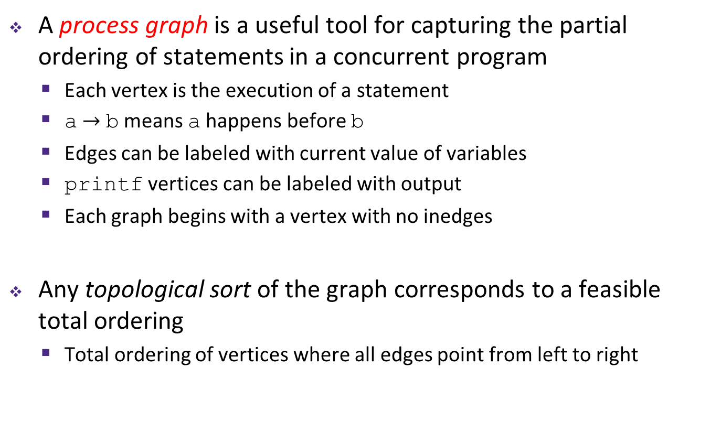
Modeling fork with Process Graphs
A process graph is a useful tool for capturing the partial ordering of statements in a concurrent program
  Each vertex is the execution of a statement
  a $→$ b means a happens before b
  Edges can be labeled with current value of variables
  printf vertices can be labeled with output
  Each graph begins with a vertex with no inedges
Any topological sort of the graph corresponds to a feasible total ordering
  Total ordering of vertices where all edges point from left to right

Slide 28
Fork Example: Possible Output
void fork1() {
int x = 1;
pid_t pid = fork();
if (pid == 0)
printf("Child has x = %d\n", ++x);
else
printf("Parent has x = %d\n", --x);
printf("Bye from process %d with x = %d\n", getpid(), x);
}
x=2
Child
Bye
++x
printf
printf
x=0
Parent
Bye
x=1
fork
--x
printf
printf

Slide 29
Peer Instruction Question
Are the following sequences of outputs possible?
  Vote at http://PollEv.com/justinh
Seq 1:
L0
L1
Bye
Bye
Bye
L2
Seq 2:
L0
Bye
L1
L2
Bye
Bye
void nestedfork() {
printf("L0\n");
if (fork() == 0) {
printf("L1\n");
if (fork() == 0) {
printf("L2\n");
}
}
printf("Bye\n");
}
No No
No Yes
Yes No
Yes Yes
We’re lost…

Slide 30
Fork-Exec
Note: the return values of fork and exec* should be checked for errors
fork-exec model:
  fork() creates a copy of the current process
  exec*() replaces the current process’ code and address space with the code for a different program
    Whole family of exec calls – see exec(3) and execve(2)
// Example arguments: path="/usr/bin/ls",
// argv[0]="/usr/bin/ls", argv[1]="-ahl", argv[2]=NULL
void fork_exec(char *path, char *argv[]) {
pid_t pid = fork();
if (pid != 0) {
printf("Parent: created a child %d\n", pid);
} else {
printf("Child: about to exec a new program\n");
execv(path, argv);
}
printf("This line printed by parent only!\n");
}
Notes:
man 3 exec
man 2 execve - v is for “vector” (of arguments), e is for “environment”
Note: the return values of fork() and execv() should be checked for errors!

Slide 31
Exec-ing a new program
Stack
Very high-level diagram of what happens when you run the command “ls” in a Linux shell:
This is the loading part of CALL!
Heap
Data
Code: /usr/bin/bash
fork()
parent
child
child
Stack
Stack
Stack
exec*()
Heap
Heap
Data
Data
Data
Code: /usr/bin/bash
Code: /usr/bin/bash
Code: /usr/bin/ls
Notes:
DEMO: ps -ef and pstree.

Slide 32
execve Example
This is extra (non-testable) material
Execute “/usr/bin/ls –l lab4” in child process using current environment:
myargv[argc] = NULL
myargv[2]
myargv[1]
myargv[0]
(argc == 3)
“lab4”
“-l”
myargv
“/usr/bin/ls”
envp[n] = NULL
envp[n-1]
...
envp[0]
“PWD=/homes/iws/jhsia”
environ
“USER=jhsia”
if ((pid = fork()) == 0) { /* Child runs program */
if (execve(myargv[0], myargv, environ) < 0) {
printf("%s: Command not found.\n", myargv[0]);
exit(1);
}
}
Run the printenv command in a Linux shell to see your own environment variables

Slide 33
Structure of the Stack when a new program starts
Null-terminated
environment variable strings
Bottom of stack
Null-terminated
command-line arg strings
envp[n] == NULL
envp[n-1]
environ
(global var)
...
envp[0]
argv[argc] = NULL
envp
(in %rdx)
argv[argc-1]
...
argv
(in %rsi)
argv[0]
argc
(in %rdi)
Stack frame for
libc_start_main
Top of stack
This is extra (non-testable) material
Future stack frame for
main

Slide 34
exit: Ending a process
void exit(int status)
  Exits a process
    Status code: 0 is used for a normal exit, nonzero for abnormal exit
Notes:
exit(3) and atexit(3) have more details.

Slide 35
Processes
Processes and context switching
Creating new processes
  fork(), exec*(), and wait()
Zombies

Slide 36
Zombies
When a process terminates, it still consumes system resources
  Various tables maintained by OS
  Called a “zombie” (a living corpse, half alive and half dead)
Reaping is performed by parent on terminated child
  Parent is given exit status information and kernel then deletes zombie child process
What if parent doesn’t reap?
  If any parent terminates without reaping a child, then the orphaned child will be reaped by init process (pid == 1)
    Note: on more recent Linux systems, init has been renamed systemd
  In long-running processes (e.g. shells, servers) we need explicit reaping

Slide 37
wait: Synchronizing with Children
int wait(int *child_status)
  Suspends current process (i.e. the parent) until one of its children terminates
  Return value is the PID of the child process that terminated
    On successful return, the child process is reaped
  If child_status != NULL, then the *child_status value indicates why the child process terminated
    Special macros for interpreting this status – see man wait(2)
Note: If parent process has multiple children, wait will return when any of the children terminates
  waitpid can be used to wait on a specific child process
Notes:
child_status shouldn’t be examined directly – it should be examined using the macros WIFEXITED(), WEXITSTATUS(), etc. (see wait(2)).

Slide 38
wait: Synchronizing with Children
void fork_wait() {
int child_status;
if (fork() == 0) {
printf("HC: hello from child\n");
exit(0);
} else {
printf("HP: hello from parent\n");
wait(&child_status);
printf("CT: child has terminated\n");
}
printf("Bye\n");
}
forks.c
HC
exit
printf
Feasible output:
HC
HP
CT
Bye
Infeasible output:
HP
CT
Bye
HC
CT
Bye
HP
fork
printf
wait
printf

Slide 39
Example: Zombie
void fork7() {
if (fork() == 0) {
/* Child */
printf("Terminating Child, PID = %d\n",
getpid());
exit(0);
} else {
printf("Running Parent, PID = %d\n",
getpid());
while (1); /* Infinite loop */
}
}
linux> ./forks 7 &
[1] 6639
Running Parent, PID = 6639
Terminating Child, PID = 6640
linux> ps
PID TTY TIME CMD
6585 ttyp9 00:00:00 tcsh
6639 ttyp9 00:00:03 forks
6640 ttyp9 00:00:00 forks <defunct>
6641 ttyp9 00:00:00 ps
linux> kill 6639
[1] Terminated
linux> ps
PID TTY TIME CMD
6585 ttyp9 00:00:00 tcsh
6642 ttyp9 00:00:00 ps
forks.c
ps shows child process as “defunct”
Killing parent allows child to be reaped by init

Slide 40
Example:
void fork8() {
if (fork() == 0) {
/* Child */
printf("Running Child, PID = %d\n",
getpid());
while (1); /* Infinite loop */
} else {
printf("Terminating Parent, PID = %d\n",
getpid());
exit(0);
}
}
Non-terminating
Child
forks.c
linux> ./forks 8
Terminating Parent, PID = 6675
Running Child, PID = 6676
linux> ps
PID TTY TIME CMD
6585 ttyp9 00:00:00 tcsh
6676 ttyp9 00:00:06 forks
6677 ttyp9 00:00:00 ps
linux> kill 6676
linux> ps
PID TTY TIME CMD
6585 ttyp9 00:00:00 tcsh
6678 ttyp9 00:00:00 ps
Child process still active even though parent has terminated
Must kill explicitly, or else will keep running indefinitely
Notes:
Give ps / pstree demo if you haven’t yet!!
On attu: ps -ef | grep bomb

Slide 41
Process Management Summary
fork makes two copies of the same process (parent & child)
  Returns different values to the two processes
exec* replaces current process from file (new program)
  Two-process program:
    First fork()
    if (pid == 0) { /* child code */ } else { /* parent code */ }
  Two different programs:
    First fork()
    if (pid == 0) { execv(…) } else { /* parent code */ }
wait or waitpid used to synchronize parent/child execution and to reap child process

Slide 42
Summary
Processes
  At any given time, system has multiple active processes
  On a one-CPU system, only one can execute at a time, but each process appears to have total control of the processor
  OS periodically “context switches” between active processes
    Implemented using exceptional control flow
Process management
  fork: one call, two returns
  execve: one call, usually no return
  wait or waitpid: synchronization
  exit: one call, no return

Slide 43
BONUS SLIDES
Detailed examples:
Consecutive forks
wait() example
waitpid() example

Slide 44
Example: Two consecutive forks
Bye
void fork2() {
printf("L0\n");
fork();
printf("L1\n");
fork();
printf("Bye\n");
}
printf
L1
Bye
printf
fork
printf
Bye
printf
L0
L1
Bye
printf
fork
printf
fork
printf
Feasible output:
L0
L1
Bye
Bye
L1
Bye
Bye
Infeasible output:
L0
Bye
L1
Bye
L1
Bye
Bye
Notes:
Forks.c

Slide 45
Example: Three consecutive forks
Both parent and child can continue forking
void fork3() {
printf("L0\n");
fork();
printf("L1\n");
fork();
printf("L2\n");
fork();
printf("Bye\n");
}
Bye
L2
Bye
Bye
L1
L2
Bye
Bye
L2
Bye
Bye
L0
L1
L2
Bye

Slide 46
wait() Example
If multiple children completed, will take in arbitrary order
Can use macros WIFEXITED and WEXITSTATUS to get information about exit status
void fork10() {
pid_t pid[N];
int i;
int child_status;
for (i = 0; i < N; i++)
if ((pid[i] = fork()) == 0)
exit(100+i); /* Child */
for (i = 0; i < N; i++) {
pid_t wpid = wait(&child_status);
if (WIFEXITED(child_status))
printf("Child %d terminated with exit status %d\n",
wpid, WEXITSTATUS(child_status));
else
printf("Child %d terminated abnormally\n", wpid);
}
}

Slide 47
waitpid(): Waiting for a Specific Process
pid_t waitpid(pid_t pid,int &status,int options)
  suspends current process until specific process terminates
  various options (that we won’t talk about)
void fork11() {
pid_t pid[N];
int i;
int child_status;
for (i = 0; i < N; i++)
if ((pid[i] = fork()) == 0)
exit(100+i); /* Child */
for (i = 0; i < N; i++) {
pid_t wpid = waitpid(pid[i], &child_status, 0);
if (WIFEXITED(child_status))
printf("Child %d terminated with exit status %d\n",
wpid, WEXITSTATUS(child_status));
else
printf("Child %d terminated abnormally\n", wpid);
}
}

