Slide 1
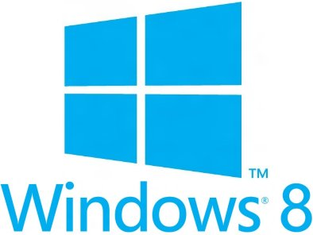
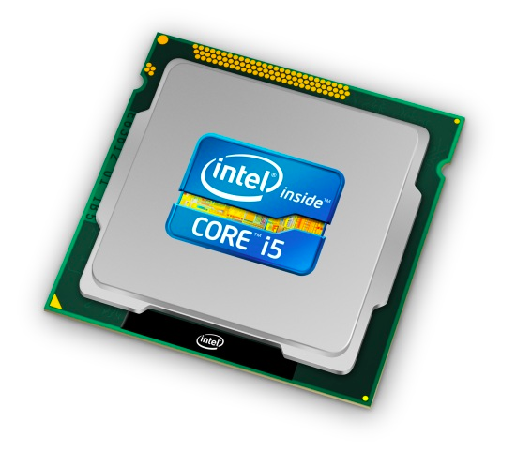
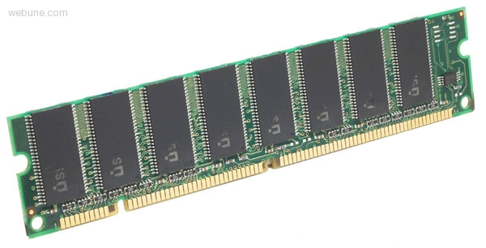
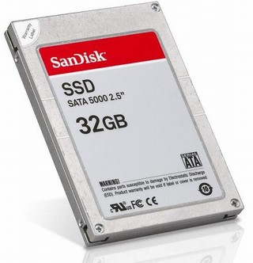
We made it! ☺
Memory & data
Integers & floats
Machine code & C
x86 assembly
Procedures & stacks
Arrays & structs
Memory & caches
Processes
Virtual memory
Memory allocation
Java vs. C
C:
Java:
car *c = malloc(sizeof(car));
c->miles = 100;
c->gals = 17;
float mpg = get_mpg(c);
free(c);
Car c = new Car();
c.setMiles(100);
c.setGals(17);
float mpg = c.getMPG();
Assembly language:
get_mpg:
pushq %rbp
movq %rsp, %rbp
...
popq %rbp
ret
OS:
Machine code:
0111010000011000
100011010000010000000010
1000100111000010
110000011111101000011111
Computer system:

Slide 2
Today
Imploring you to do your course evaluations, please!
I’m Just a Program
End-to-end review
Victory lap and high-level concepts (major 🔑 points)
More useful for “5 years from now” than “next week’s final”
Question time

Slide 3
Final Exam
Wednesday, June 8, 2:30pm-4:20pm
Right here in Miller 301.
We’ve covered a lot this quarter!
I know it’s a lot to review
But probably less time pressure than midterm
Will cover material from the entire course
Focuses primarily on the material from the second half
But we’ve been building on the earlier stuff, so expect to still see concepts and material from the first half
Best way to get a feel for it is to look at past exams (that’s what I’m doing!)

Slide 4
Course Evaluations
Really matters, and 90-100% response rate makes them much more useful than 60%
Have to guess what sampling bias is for “missing 40%”
We really do take them seriously and use them to improve!
This is my first time teaching, so I especially need your feedback!
I’ve been sticking to mostly what has been done before, but we need you all to help us figure out how to make it better and more useful!
Evaluations close this Sunday, June 5th at 11:59pm
I don’t know why it’s so early, but please please please do it!
I still can’t see them until after I submit grades. ☺
But you can’t see the final until after… ;)

Slide 5
I’m Just a Bill (I mean, Program)
How Code Becomes A Program.
Schoolhouse Rock!, 1976, “I’m Just a Bill”, written by Dave Frishberg

Slide 6
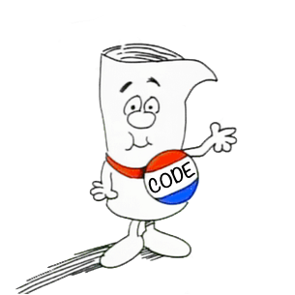
How Code Becomes A Program.
Source code
in high-level language
Assembly
(x86-64)
Compiler
Assembler
Binary Executable
Hardware

Slide 7
Instruction Set Architecture
Source code
Compiler
Architecture
Hardware
Different applications
or algorithms
Perform optimizations,
generate instructions
Instruction set
Different implementations
Intel Pentium 4
C Language
Program A
Intel Core 2
GCC
x86-64
Intel Core i7
Program B
AMD Opteron
Clang
AMD Athlon
Your program
ARMv8 (AArch64/A64)
ARM Cortex-A53
Apple A7
Notes:
Different programs written in C, have different algorithms
Compilers figure out what instructions to generate
do different optimizations
Different architectures expose different interfaces
Hardware implementations have different performance

Slide 8
Assembly Programmer’s View
CPU
Memory
Addresses
Registers
%rip
Data
Code
Data
Stack
Condition
Codes
Instructions
Programmer-Visible State
%rip: Instruction pointer
Address of next instruction
Also called “PC” (“program counter”)
Named registers
Heavily used program data
Together, called “register file”
Condition codes
Used for conditional branching
Memory
Byte addressable array
2⁶⁴ virtual addresses (18 exabytes)
Private, all to you yourself…

Slide 9
Program’s View
CPU
Memory
Registers
%rip
2^{N}-1
High addresses
Stack
local variables; procedure context
Condition
Codes
Dynamic Data (Heap)
variables allocated with new or malloc
Static Data
static variables
(global variables in C)
Literals
Large constants (e.g., “example”)
Instructions
0
Low addresses

Slide 10
Program’s View
Instructions
Data movement
mov, movz, movz
push, pop
Arithmetic
add, sub, imul
Control flow
cmp, test
jmp, je, jgt, ...
call, ret
Operand types
Literal: $8
Register: %rdi, %al
Memory: D(Rb,Ri,S) = D+Rb+Ri*S
lea: not a memory access!
Memory
2^{N}-1
High addresses
Stack
local variables; procedure context
Dynamic Data (Heap)
variables allocated with new or malloc
Static Data
static variables
(global variables in C)
Literals
Large constants (e.g., “example”)
Instructions
0
Low addresses

Slide 11
Program’s View
Procedures
Essential abstraction
Recursion…
Stack discipline
Stack frame per call
Local variables
Calling convention
How to pass arguments
Diane’s Silk Dress Costs $89
How to return data
Return address
Caller-saved / callee-saved registers
Memory
2^{N}-1
High addresses
Stack
local variables; procedure context
Dynamic Data (Heap)
variables allocated with new or malloc
Static Data
static variables
(global variables in C)
Literals
Large constants (e.g., “example”)
Instructions
0
Low addresses

Slide 12
Program’s View
Heap data
Variable size
Variable lifetime
Allocator
Balance throughput and memory utilization
Data structures to keep track of free blocks.
Garbage collection
Must always free memory
Garbage collectors help by finding anything reachable
Failing to free results in memory leaks.
Memory
2^{N}-1
High addresses
Stack
local variables; procedure context
Dynamic Data (Heap)
variables allocated with new or malloc
Static Data
static variables
(global variables in C)
Literals
Large constants (e.g., “example”)
Instructions
0
Low addresses

Slide 13
But remember… it’s all an illusion!
😮
CPU
Memory
Registers
%rip
2^{N}-1
High addresses
Stack
local variables; procedure context
Condition
Codes
Context switches
Don’t really have CPU to yourself
Virtual Memory
Don’t really have 2⁶⁴ bytes of memory all to yourself.
Allows for indirection (remap physical pages, sharing…)
Dynamic Data (Heap)
variables allocated with new or malloc
Static Data
static variables
(global variables in C)
Literals
Large constants (e.g., “example”)
Instructions
0
Low addresses

Slide 14
But remember… it’s all an illusion!
😮
Process 3
Process 2
CPU
Memory
%rip
Registers
2^{N}-1
CPU
High addresses
Stack
Registers
Condition
Codes
Memory
%rip
2^{N}-1
Stack
High addresses
Condition
Codes
Dynamic Data (Heap)
Dynamic Data (Heap)
Static Data
Static Data
Literals
Literals
Instructions
0
Low addresses
Instructions
0
Fork
Creates copy of the process
Exec
Replace with new program
Wait
Wait for child to die (to reap it, and prevent zombies)
Low addresses
Process 1
CPU
Memory
%rip
Registers
2^{N}-1
High addresses
Stack
Condition
Codes
Dynamic Data (Heap)
Static Data
Literals
Hardware
Instructions
0
Low addresses

Slide 15
Virtual Memory
CPU Chip
TLB
2
PTE
VPN
3
Page Table
Memory
1
MMU
CPU
VA
PA
4
Data
5
Address Translation
Every memory access must first be converted from virtual to physical!!
Indirection: just change the address mapping when switching processes!
Luckily, TLB (and page size) makes it pretty fast.

Slide 16
But memory is also a lie!
“Memory”
L3 Cache
Main Memory
DRAM
CPU
L2 Cache
Registers
L1 Cache
%rip
Condition
Codes
Illusion of one flat array of bytes
But caches invisibly make accesses (to physical addresses) faster!
Locality: temporal vs spatial
Caches
Need to be fast, so direct-mapped/indexed (sets)
Need to be flexible, so associative (ways)
😮

Slide 17
C: The Low Level-High Level Language
Along the way, we learned about C data types…
Primitive types: fixed sizes & alignments
Endianness: only applies to memory; is the first byte the least significant (little endian) or most (big)?
Pointers: addresses with a type
Always point at the beginning of the
Arrays
Contiguous chunks of memory
2D arrays = still one continuous chunk
Nested arrays: array of pointers to other arrays
Buffer Overflow: No array bounds checks in C!!!
How do we protect against them?
Structs

Slide 18
Nested Array Example
typedef int zip_dig[5];
zip_dig sea[4] =
{{ 9, 8, 1, 9, 5 },
{ 9, 8, 1, 0, 5 },
{ 9, 8, 1, 0, 3 },
{ 9, 8, 1, 1, 5 }};
Remember, T A[N] is an array with elements of type T, with length N
sea[3][2];
Row 0
Row 1
Row 2
Row 3
9
8
1
9
5
9
8
1
0
5
9
8
1
0
3
9
8
1
1
5
76
96
116
136
156
“Row-major” ordering of all elements
Elements in the same row are contiguous
Guaranteed (in C)

Slide 19
Multi-Level Array Example
Variable univ denotes array of 3 elements
Each element is a pointer
8 bytes each
Each pointer points to array of ints
int cmu[5] = { 1, 5, 2, 1, 3 };
int uw[5] = { 9, 8, 1, 9, 5 };
int ucb[5] = { 9, 4, 7, 2, 0 };
int* univ[3] = {uw, cmu, ucb};
cmu
1
5
2
1
3
univ
16
20
24
28
32
36
160
36
uw
9
8
1
9
5
168
16
ucb
36
40
44
48
52
56
176
60
9
4
7
2
0
60
64
68
72
76
80
Note: this is how Java represents multi-dimensional arrays.

Slide 20
Array Element Accesses
Nested array
Multi-level array
int get_sea_digit
(int index, int digit)
{
return sea[index][digit];
}
int get_univ_digit
(int index, int digit)
{
return univ[index][digit];
}
cmu
univ
1
5
2
1
3
160
36
uw
16
20
24
28
32
36
168
16
9
8
1
9
5
176
60
ucb
36
40
44
48
52
56
9
4
7
2
0
60
64
68
72
76
80
Access looks the same, but it isn’t:
Mem[sea+20*index+4*digit]
Mem[Mem[univ+8*index]+4*digit]

Slide 21
C: The Low Level-High Level Language
Structs
Each primitive element must be aligned
Overall struct must be aligned to alignment of largest primitive member, size must be multiple of that as well.
Fragmentation
Internal fragmentation: space between members
External fragmentation: space after last member, inside the struct
struct Foo {
int a;
double b;
char c;
};
sizeof(Foo) ==
int a
double b
c

Slide 22
Java: A High Level Language
Java Virtual Machine is an interpreter
Just need to port the JVM to your machine, then it can run your program
It has its own “Assembly Program’s View”
Holds pointer ‘this’
Other arguments to method
Memory
Other local variables
Call stack
Heap
0
1
2
3
4
n
variable table
operand stack
constant pool

Slide 23
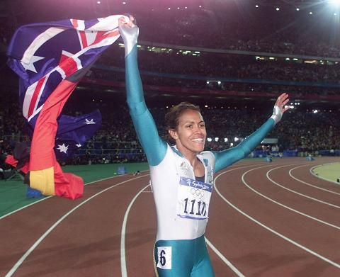
Victory Lap
A victory lap is an extra trip
around the track
By the exhausted victors
(that’s us) ☺
Review course goals
Slides from Lecture 1
What makes CSE351 special

Slide 24
Next 7 slides copied without change from Lecture 1
They should make much more sense now!

Slide 25
Welcome!
10 weeks to see the key abstractions “under the hood” to describe “what really happens” when a program runs
How is it that “everything is 1s and 0s”?
Where does all the data get stored and how do you find it?
How can more than one program run at once?
What happens to a Java or C program before the hardware can execute it?
What is The Stack and The Heap?
And much, much, much more…
An introduction that will:
Profoundly change/augment your view of computers and programs
Connect your source code down to the hardware
Leave you impressed that computers ever work.
Notes:
By the end, you’ll understand the all the complex things that happen to execute your programs
And you’ll be amazed by the complexity, and impressed that anything ever works!

Slide 26
C/Java, assembly, and machine code
if (x != 0) y = (y+z)/x;
The three program fragments are equivalent
You'd rather write C! (more human-friendly)
Hardware likes bit strings!
Everything is voltages
The machine instructions are actually much shorter than the number of bits we would need to represent the characters in the assembly language
⬇
cmpl $0, -4(%ebp)
je .L2
movl -12(%ebp), %eax
movl -8(%ebp), %edx
leal (%edx, %eax), %eax
movl %eax, %edx
sarl $31, %edx
idivl -4(%ebp)
movl %eax, -8(%ebp)
.L2:
⬇
1000001101111100001001000001110000000000
0111010000011000
10001011010001000010010000010100
10001011010001100010010100010100
100011010000010000000010
1000100111000010
110000011111101000011111
11110111011111000010010000011100
10001001010001000010010000011000
Notes:
So, why don‘t we just have a compiler from the high level language all the way down to binary?
Why are these instructions so weird?
To get at that, we need to go back and look at history

Slide 27
The Big Theme: Abstractions and Interfaces
Computing is about abstractions
(but we can’t forget reality)
What are the abstractions that we use?
What do you need to know about them?
When do they break down and you have to peek under the hood?
What bugs can they cause and how do you find them?
How does the hardware (0s and 1s, processor executing instructions) relate to the software (C/Java programs)?
Become a better programmer and begin to understand the important concepts that have evolved in building ever more complex computer systems

Slide 28
Little Theme 1: Representation
All digital systems represent everything as 0s and 1s
The 0 and 1 are really two different voltage ranges in the wires
Or magnetic positions on a disc, or hole depths on a DVD, or even DNA…
“Everything” includes:
Numbers – integers and floating point
Characters – the building blocks of strings
Instructions – the directives to the CPU that make up a program
Pointers – addresses of data objects stored away in memory
These encodings are stored throughout a computer system
In registers, caches, memories, disks, etc.
They all need addresses
A way to find them
Find a new place to put a new item
Reclaim the place in memory when data no longer needed
Notes:
Draw picture of voltage level?

Slide 29
Little Theme 2: Translation
There is a big gap between how we think about programs and data and the 0s and 1s of computers
Need languages to describe what we mean
These languages need to be translated one level at a time
We know Java as a programming language
Have to work our way down to the 0s and 1s of computers
Try not to lose anything in translation!
We’ll encounter Java byte-codes, C language, assembly language, and machine code (for the X86 family of CPU architectures)
Not in that order, but will all connect by the last lecture!!!

Slide 30
Little Theme 3: Control Flow
How do computers orchestrate everything they are doing?
Within one program:
How do we implement if/else, loops, switches?
What do we have to keep track of when we call a procedure, and then another, and then another, and so on?
How do we know what to do upon “return”?
Across programs and operating systems:
Multiple user programs
Operating system has to orchestrate them all
Each gets a share of computing cycles
They may need to share system resources (memory, I/O, disks)
Yielding and taking control of the processor
Voluntary or “by force”?

Slide 31
Course Perspective
CSE351 will make you a better programmer
Purpose is to show how software really works
Understanding the underlying system makes you more effective
Better debugging
Better basis for evaluating performance
How multiple activities work in concert (e.g., OS and user programs)
Not just a course for hardware enthusiasts!
What every CSE major needs to know (plus many more details)
See many patterns that come up over and over in computing (like caching)
Like other 300-level courses, “stuff everybody learns and uses and forgets not knowing”
CSE351 presents a world-view that will empower you
The intellectual tools and software tools to understand the trillions+ of 1s and 0s that are “flying around” when your program runs

Slide 32
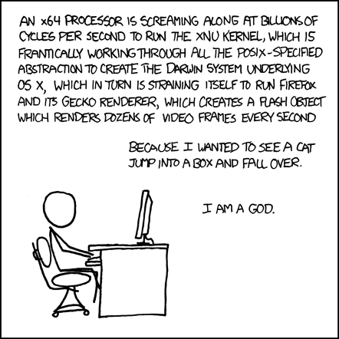
http://xkcd.com/676/

Slide 33
And of course don’t forget…

Slide 34
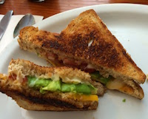
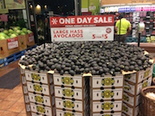
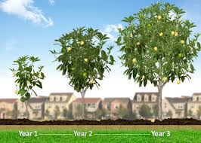
Memory Hierarchy
<1 ns
5-10 s
registers
1 ns
on-chip L1
cache (SRAM)
Smaller,
faster,
costlier
per byte
5-10 ns
off-chip L2
cache (SRAM)
1-2 min
Larger,
slower,
cheaper
per byte
100 ns
main memory
(DRAM)
15-30 min
150,000 ns
SSD
31 days
local secondary storage
(local disks)
10,000,000 ns (10 ms)
Disk
66 months = 1.3 years
1-150 ms
remote secondary storage
(distributed file systems, web servers)
1 - 15 years
Notes:
Going to SSD is like walking down to California to get an avocado
Disk is like waiting a year for a new crop of avocados
Going across the world is like waiting for an avocado tree to grow up from a seed…

Slide 35
Thanks for a great quarter!
Thanks to your awesome TAs!
Everything that went smoothly was probably because of them!
Anything that didn’t was because I didn’t ask them how to do it. ;)
Thanks for laughing occasionally at stupid jokes!
Don’t be a stranger!
(although fingers crossed, I’ll graduate one of these days and you’ll have to find me somewhere else)

