Slide 1
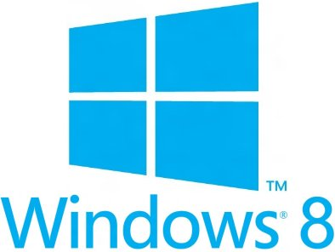


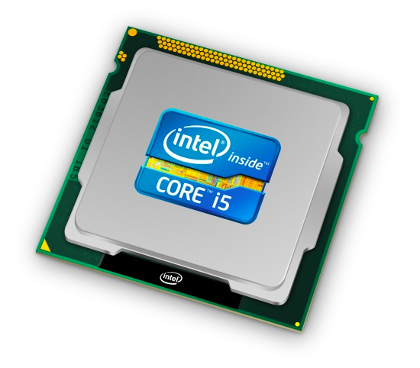
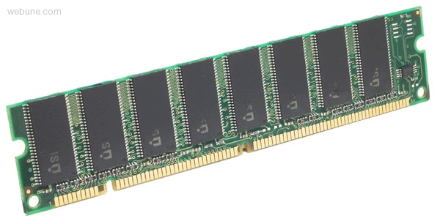
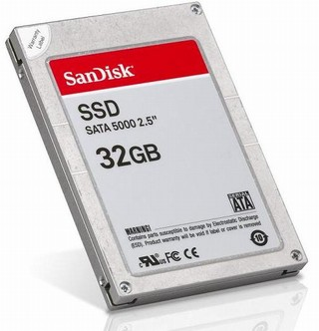
Roadmap
Memory & data
Integers & floats
Machine code & C
x86 assembly
Procedures & stacks
Arrays & structs
Memory & caches
Processes
Virtual memory
Memory allocation
Java vs. C
C:
Java:
car *c = malloc(sizeof(car));
c->miles = 100;
c->gals = 17;
float mpg = get_mpg(c);
free(c);
Car c = new Car();
c.setMiles(100);
c.setGals(17);
float mpg =
c.getMPG();
Assembly language:
get_mpg:
pushq %rbp
movq %rsp, %rbp
...
popq %rbp
ret
OS:
Machine code:
0111010000011000
100011010000010000000010
1000100111000010
110000011111101000011111
Computer system:

Slide 2
Assembly Programmer’s View
CPU
Memory
Registers
Addresses
PC
Code
Data
Stack
Data
Condition
Codes
Instructions
Programmer-Visible State
  PC: Program counter
    Address of next instruction
    Called instruction pointer (%rip) on x86-64
  Named registers
    Heavily used program data
    Together, called “register file”
  Condition codes
    Store status information about most recent arithmetic operation
    Used for conditional branching
  Memory
    Byte addressable array
    Code and user data
    Includes Stack (for supporting procedures, we’ll come back to that)

Slide 3
x86-64 Instructions
Data movement
  mov, movs, movz, ...
Arithmetic
  add, sub, shl, sar, lea, ...
Control flow
  cmp, test, j_, set_, ...
Stack/procedures
  push, pop, call, ret, ...

Slide 4
Turning C into Object Code
Code in files p1.c p2.c
Compile with command: gcc -Og p1.c p2.c -o p
  Use basic optimizations (-Og) [New to recent versions of GCC]
  Put resulting machine code in file p
text
C program (p1.c p2.c)
Compiler (gcc –Og -S)
text
Asm program (p1.s p2.s)
Assembler (gcc or as)
binary
Object program (p1.o p2.o)
Static libraries (.a)
Linker (gcc or ld)
binary
Executable program (p)

Slide 5
Machine Instruction Example
*dest = t;
C Code
  Store value t where dest points
Assembly
  Move 8-byte value to memory
    Quad words in x86-64 parlance
  Operands:
    t: Register %rsi
    dest: Register %rdx
    *dest: Memory M[%rdx]
Object Code
  3-byte instruction
  Stored at address 0x40059e
movq %rsi, (%rdx)
0x400539: 48 89 32

Slide 6
Assembling
Assembly has labels.
Executable has addresses.
pcount_r:
movl $0, %eax
testq %rdi, %rdi
je .L6
pushq %rbx
movq %rdi, %rbx
shrq %rdi
call pcount_r
andl $1, %ebx
addq %rbx, %rax
popq %rbx
.L6:
rep ret
00000000004004f6 <pcount_r>:
4004f6: b8 00 00 00 00 mov $0x0,%eax
4004fb: 48 85 ff test %rdi,%rdi
4004fe: 74 13 je 400513 <pcount_r+0x1d>
400500: 53 push %rbx
400501: 48 89 fb mov %rdi,%rbx
400504: 48 d1 ef shr %rdi
400507: e8 ea ff ff ff callq 4004f6 <pcount_r>
40050c: 83 e3 01 and $0x1,%ebx
40050f: 48 01 d8 add %rbx,%rax
400512: 5b pop %rbx
400513: f3 c3 repz retq
assembler
gcc -g pcount.c –o pcount
objdump -d pcount
gcc -S pcount.c

Slide 7
A Picture of Memory (64-bit view)
A “64-bit (8-byte) word-aligned” view of memory:
  In this type of picture, each row is composed of 8 bytes
  Each cell is a byte
  A 64-bit pointer will fit
  on one row
(note hex
addresses)
0x00
0x01
0x02
0x03
0x04
0x05
0x06
0x07
0x00
0x08
0x10
0x18
0x20
0x28
0x08
0x09
0x0A
0x0B
0x0C
0x0D
0x0E
0x0F
0x30
0x38
0x40
0x48

Slide 8
A Picture of Memory (64-bit view)
00000000004004f6 <pcount_r>:
4004f6: b8 00 00 00 00 mov $0x0,%eax
4004fb: 48 85 ff test %rdi,%rdi
4004fe: 74 13 je 400513 <pcount_r+0x1d>
400500: 53 push %rbx
400501: 48 89 fb mov %rdi,%rbx
400504: 48 d1 ef shr %rdi
400507: e8 ea ff ff ff callq 4004f6 <pcount_r>
40050c: 83 e3 01 and $0x1,%ebx
40050f: 48 01 d8 add %rbx,%rax
400512: 5b pop %rbx
400513: f3 c3 repz retq
0|8 | 1|9 | 2|a | 3|b | 4|c | 5|d | 6|e | 7|f
 |  |  |  |  |  |  |  | 0x00
 |  |  |  |  |  |  |  | 0x08
 |  |  |  |  |  |  |  | 0x10
... |  |  |  |  |  |  |  | ...
 |  |  |  |  |  | b8 | 00 | 0x4004f0
00 | 00 | 00 | 48 | 85 | ff | 74 | 13 | 0x4004f8
53 | 48 | 89 | fb | 48 | d1 | ef | e8 | 0x400500
ea | ff | ff | ff | 83 | e3 | 01 | 48 | 0x400508
01 | d8 | 5b | f3 | c3 |  |  |  | 0x400510
Just For Fun
This call actually uses a relative address:
ea ff ff ff = -22 (little endian)
Notes:
Note that it’s not word-aligned!
But look how compact it is

