Slide 1
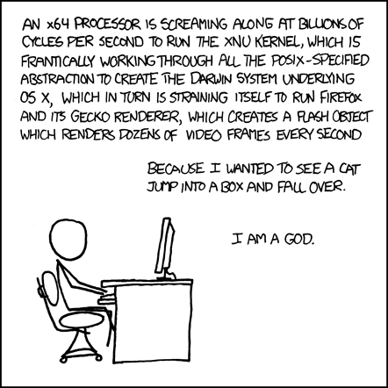
The Hardware/Software Interface CSE 351 Autumn 2016
Instructor:
Justin Hsia
Teaching Assistants:
Chris Ma
Hunter Zahn John Kaltenbach Kevin Bi
Sachin Mehta
Suraj Bhat
Thomas Neuman
Waylon Huang Xi Liu Yufang Sun
http://xkcd.com/676/
Notes:
This comic illustrates how complex computer systems are, and all the things that have to happen for a program to execute
By the end of this course, you’ll understand, mm, almost half of that, but it’s the good bits

Slide 2
Welcome to CSE351!
See the key abstractions “under the hood” to describe “what really happens” when a program runs
How is it that “everything is 1s and 0s”?
Where does all the data get stored and how do you find it?
How can more than one program run at once?
What happens to a Java or C program before the hardware can execute it?
And much, much, much more…
An introduction that will:
Profoundly change/augment your view of computers and programs
Connect your source code down to the hardware
Leave you impressed that computers ever work

Slide 3
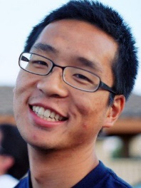
Who: Course Staff
Your Instructor: just call me Justin
Just arrived from California (UC Berkeley and the Bay Area)
I like: teaching, the outdoors, board games, and ultimate
Excited to be teaching at UW for the first time!
10 TAs:
Available in sections, in office hours, via email, on Piazza
Your course navigators
Get to know us
We are here to help you succeed
And to make the course better – with your help

Slide 4
Acknowledgements
Many thanks to the people whose course content we are liberally reusing with at most minor changes
CMU: Randy Bryant, David O’Halloran, Gregory Kesden, Markus Püschel
Harvard: Matt Welsh (now at Google-Seattle)
UW: Gaetano Borriello, Luis Ceze, Peter Hornyack, Hal Perkins, Ben Wood, John Zahorjan, Katelin Bailey, Ruth Anderson, Dan Grossman, Brandon Holt
Not listed: hundreds of TAs

Slide 5
Who are You?
~ 220 students registered, split across two lectures
See me if you are interested in taking the class but are not yet registered
CSE majors, EE majors, and more
Most of you will find almost everything in the course new
Submit Start-of-Quarter Survey so we can find out more
Get to know each other and help each other out!
Learning is much more fun with friends
Working well with others is a valuable life skill
Diversity of perspectives expands your horizons

Slide 6
Communication
Website: http://cs.uw.edu/351
Schedule, policies, sections, links, assignments, etc.
Discussion: https://piazza.com/washington/fall2016/cse351
Announcements made here
Ask and answer questions – staff will monitor and contribute
Office Hours: spread throughout the week
Can also e-mail to make individual appointments
Anonymous feedback:
Comments about anything related to the course where you would feel better not attaching your name
Can send to individual staff member of whole staff

Slide 7
Course Components
Lectures (29)
Introduce the concepts; supplemented by textbook
Sections (9-10)
Applied concepts, important tools and skills for labs, clarification of lectures, exam review and preparation
Written homework assignments (4)
Mostly problems from textbook to solidify understanding
Programming lab assignments (6)
Provide in-depth understanding (via practice) of an aspect of system
Exams (2)
Midterm: Wednesday, November 2, in lecture
Final: Tuesday, December 13, 12:30-2:20pm (joint)

Slide 8
Policies
Exams: Midterm (15%) and Final (30%)
Many old exams on course website (though new instructor)
Homework: weighted according to effort (20% total)
We’ll try to make these about the same
Labs: weighted according to effort (35% total)
These will likely increase in weight as the quarter progresses
Other important policies: (details on website)
3 allowed late days for the quarter
Collaboration and academic integrity
Assignment and exam re-grades

Slide 9
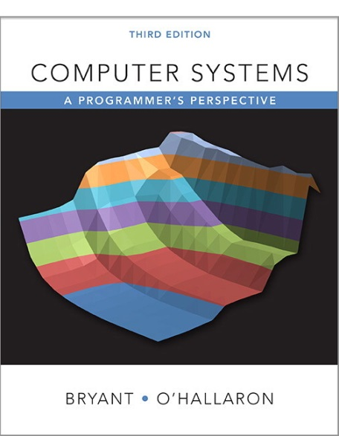
Textbooks
Computer Systems: A Programmer’s Perspective
Randal E. Bryant and David R. O’Hallaron
Website: http://csapp.cs.cmu.edu
Must be 3rd edition
http://csapp.cs.cmu.edu/3e/changes3e.html
http://csapp.cs.cmu.edu/3e/errata.html
This book really matters for the course!
How to solve labs
Practice problems typical of exam problems
A good C book – any will do
The C Programming Language (Kernighan and Ritchie)
C: A Reference Manual (Harbison and Steele)

Slide 10
Videos / Online course
Gaetano Borriello and Luis Ceze made videos in 2013 covering the course content for an online version
And self-check quiz questions
A great resource – I encourage you to watch them
Generally optional unless class is cancelled or something
Occasionally may “require before class” so you don’t get lost in an example
Warning: some content has since changed
Now “all 64-bit” so some videos may have extra information no longer relevant
When in doubt, go with current lectures (but do ask first)

Slide 11
Other details
Consider taking CSE 391 Unix Tools, 1 credit
Useful skills to know and relevant to this class
Available to all CSE majors and everyone registered in CSE351
Everything starts now!
Including section and office hours this week

Slide 12
To-Do List
Explore website thoroughly: http://cs.uw.edu/351
Check that you are enrolled in Piazza
Start-of-Course survey [Catalyst] due Friday (9/30)
Section 1 is tomorrow
Install the virtual machine (VM) before coming to section
Bring your computer with you to section
Lab 0 released today, due Monday (10/3) @ 5pm
Basic exercises to start getting familiar with C – need the VM
Credit/no-credit
Do ASAP, attending Section 1 will help

Slide 13
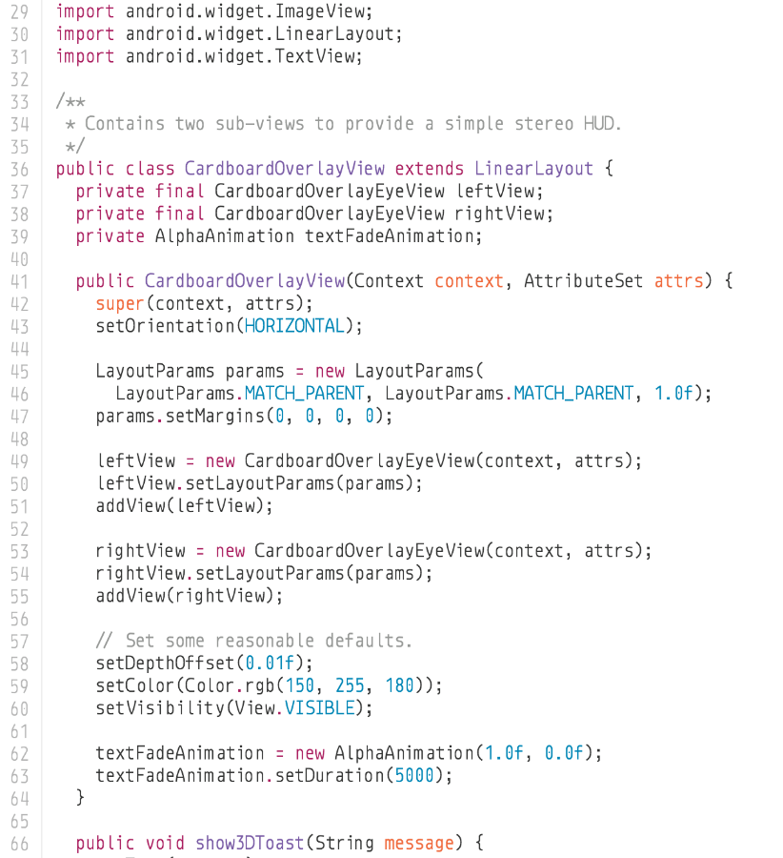
The Hardware/Software Interface
What do we mean by hardware? software?
What is an interface?
Why do we need a hardware/software interface?
Why do we need to understand both sides of this interface?
1000001101111100001001000001110000000000
0111010000011000
10001011010001000010010000010100
10001011010001100010010100010100
100011010000010000000010
1000100111000010
110000011111101000011111
11110111011111000010010000011100
10001001010001000010010000011000
1000001101111100001001000001110000000000
0111010000011000
10001011010001000010010000010100
10001011010001100010010100010100
100011010000010000000010
1000100111000010
110000011111101000011111
11110111011111000010010000011100
HW/SW Interface
Notes:
This class: how to get from higher-level languages down to machine
Many layers of abstraction in the way
Seems like magic right now
Hardware: laptops, hoards of computers in datacenters, mobile phones, smart watches… all pretty much the same design
Software: angry birds!
Interface: describes what a thing can do
SW how to tell the HW what to do
Many layers
Understand the interface:
Understand how the computer works, debug, improve performance,

Slide 14
C/Java, assembly, and machine code
if (x != 0) y = (y+z)/x;
High Level Language
(e.g. C, Java)
Assembly Language
Machine Code
Compiler
cmpl $0, -4(%ebp)
je .L2
movl -12(%ebp), %eax
movl -8(%ebp), %edx
leal (%edx, %eax), %eax
movl %eax, %edx
sarl $31, %edx
idivl -4(%ebp)
movl %eax, -8(%ebp)
.L2:
Assembler
1000001101111100001001000001110000000000
0111010000011000
10001011010001000010010000010100
10001011010001100010010100010100
100011010000010000000010
1000100111000010
110000011111101000011111
11110111011111000010010000011100
10001001010001000010010000011000
Notes:
In C or Java, we can write this one line
In x86 assembly, that one line turns into many instructions
9 instructions
Cmpl == compare
Finally, assembly gets turned into binary
Same number of lines

Slide 15
C/Java, assembly, and machine code
if (x != 0) y = (y+z)/x;
All program fragments are equivalent
You’d rather write C! (more human-friendly)
Hardware executes strings of bits
In reality everything is voltages
The machine instructions are actually much shorter than the number of bits we would need to represent the characters in the assembly language
Compiler
cmpl $0, -4(%ebp)
je .L2
movl -12(%ebp), %eax
movl -8(%ebp), %edx
leal (%edx, %eax), %eax
movl %eax, %edx
sarl $31, %edx
idivl -4(%ebp)
movl %eax, -8(%ebp)
.L2:
Assembler
1000001101111100001001000001110000000000
0111010000011000
10001011010001000010010000010100
10001011010001100010010100010100
100011010000010000000010
1000100111000010
110000011111101000011111
11110111011111000010010000011100
10001001010001000010010000011000
Notes:
So, why don‘t we just have a compiler from the high level language all the way down to binary?
Why are these instructions so weird?
To get at that, we need to go back and look at history

Slide 16
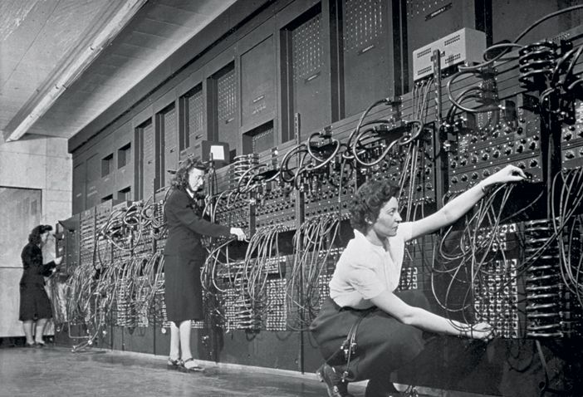
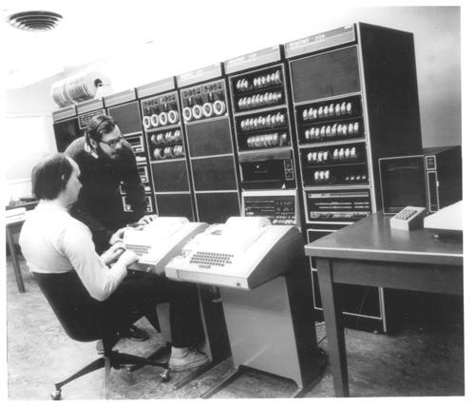
HW/SW Interface: Historical Perspective
Hardware started out quite primitive
1940s
1970s
Jean Jennings (left), Marlyn Wescoff (center), and Ruth Lichterman program ENIAC at the University of Pennsylvania, circa 1946. Photo: Corbis
http://fortune.com/2014/09/18/walter-isaacson-the-women-of-eniac/
https://s-media-cache-ak0.pinimg.com/564x/91/37/23/91372375e2e6517f8af128aab655e3b4.jpg
Notes:
In 1946, programming meant changing where a bunch of wires were plugged in
By 1970, these guys (one of whom is Ritchie, who wrote the C book), are typing instructions into a PDP-11

Slide 17
HW/SW Interface: Historical Perspective
Hardware started out quite primitive
Programmed with very basic instructions (primitives)
e.g., a single instruction for adding two integers
Software was also very basic
Closely reflected the actual hardware it was running on
Specify each step manually
Architecture Specification (Interface)
Hardware
Notes:
Everything the computer can do, exposed as instructions
This meant software is also pretty simple, basically lists of instructions to execute
Manually specify each instruction
As computers got more complex, we needed help

Slide 18
HW/SW Interface: Assemblers
Life was made a lot better by assemblers
1 assembly instruction = 1 machine instruction
More human-readable syntax
Assembly instructions are character strings, not bit strings
Can use symbolic names
Assembler specification
User program in assembly language
Assembler
Hardware
Notes:
Someone realized they could write a program that would turn scripts into programs
Easier to write
Still basically a one-to-one mapping
As we got more sophisticated, built more sophisticated languages…

Slide 19
HW/SW Interface: Higher-Level Languages
Higher level of abstraction
1 line of a high-level language is compiled into many (sometimes very many) lines of assembly language
C language specification
User program in C
C Compiler
Assembler
Hardware
Notes:
Translation from higher-level languages down to machine code.
New features: functions! Data structures! Classes!

Slide 20
HW/SW Interface: Compiled Programs
Code Time
Compile Time
Run Time
User program in C
C Compiler
Assembler
Hardware
.c file
.exe file
Note: The compiler and assembler are just programs, developed using this
same process.
Notes:
Now, when you write a program, it gets compiled in multiple stages
Some people spend a lot of time making compilers really good at this
Take a little longer compiling, optimize program.

Slide 21
Big Theme: Abstractions and Interfaces
Computing is about abstractions
(but we can’t forget reality)
What are the abstractions that we use?
What do you need to know about them?
When do they break down and you have to peek under the hood?
What bugs can they cause and how do you find them?
How does the hardware relate to the software?
Become a better programmer and begin to understand the important concepts that have evolved in building ever more complex computer systems

Slide 22
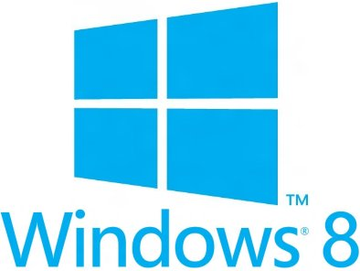
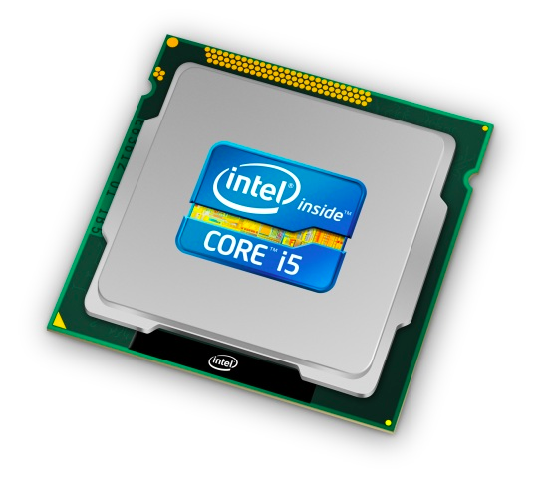
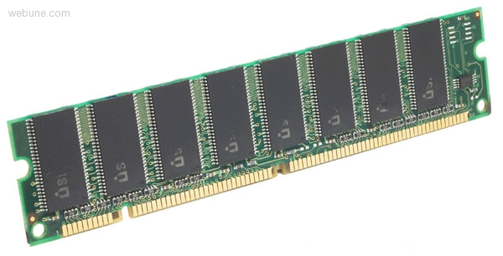
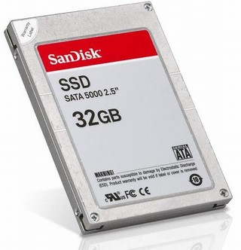
Roadmap
Memory & data
Integers & floats
Machine code & C
x86 assembly
Procedures & stacks
Arrays & structs
Memory & caches
Processes
Virtual memory
Memory allocation
Java vs. C
C:
Java:
car *c = malloc(sizeof(car));
c->miles = 100;
c->gals = 17;
float mpg = get_mpg(c);
free(c);
Car c = new Car();
c.setMiles(100);
c.setGals(17);
float mpg = c.getMPG();
Assembly language:
get_mpg:
pushq %rbp
movq %rsp, %rbp
...
popq %rbp
ret
OS:
Machine code:
0111010000011000
100011010000010000000010
1000100111000010
110000011111101000011111
Computer system:
Notes:
Memory: how everything is just a big array of bytes
Integers: how numbers are represented in binary
Machine code: and how programs are represented in binary!
The x86-64 Architecture which is what all your laptops, google’s datacenters, even possibly phones
Procedures: high-level language constructs like function calls, recursion, work thanks to The Stack
More complex data structures like arrays and structs
How the operating system lets you run multiple things at once
Like when I’m writing code, chatting on slack, browsing, and listening to Spotify
How all programs share the same resources with virtual memory
How programs find places to put their data
Tying it all back to Java, such as how “new” works

Slide 23
Little Theme 1: Representation
All digital systems represent everything as 0s and 1s
The 0 and 1 are really two different voltage ranges in the wires
Or magnetic positions on a disc, or hole depths on a DVD, or even DNA…
“Everything” includes:
Numbers – integers and floating point
Characters – the building blocks of strings
Instructions – the directives to the CPU that make up a program
Pointers – addresses of data objects stored away in memory
Encodings are stored throughout a computer system
In registers, caches, memories, disks, etc.
They all need addresses (a way to locate)
Find a new place to put a new item
Reclaim the place in memory when data no longer needed

Slide 24
Little Theme 2: Translation
There is a big gap between how we think about programs and data and the 0s and 1s of computers
Need languages to describe what we mean
These languages need to be translated one level at a time
We know Java as a programming language
Have to work our way down to the 0s and 1s of computers
Try not to lose anything in translation!
We’ll encounter Java byte-codes, C language, assembly language, and machine code (for the x86 family of CPU architectures)
Not in that order, but will all connect by the last lecture!!!

Slide 25
Little Theme 3: Control Flow
How do computers orchestrate everything they are doing?
Within one program:
How do we implement if/else, loops, switches?
What do we have to keep track of when we call a procedure, and then another, and then another, and so on?
How do we know what to do upon “return”?
Across programs and operating systems:
Multiple user programs
Operating system has to orchestrate them all
Each gets a share of computing cycles
They may need to share system resources (memory, I/O, disks)
Yielding and taking control of the processor
Voluntary or “by force”?

Slide 26
Writing Assembly Code? In 2016???
Chances are, you’ll never write a program in assembly
Compilers are much better and more patient than you are
But understanding assembly is the key to the machine-level execution model
Behavior of programs in presence of bugs
High-level language model breaks down
Tuning program performance
Understand optimizations done/not done by the compiler
Understanding sources of program inefficiency
Implementing system software
Operating systems must manage process state
Fighting malicious software
Using special units (timers, I/O co-processors, etc.) inside processor!
Notes:
I hope that you are never writing a program in assembly
Not even to eke the very last bit of performance out
Because compilers are much better at it
Understanding assembly will help you
Like how C will help you better appreciate the magic that Java does for you
Similarly, understanding assembly will help you understand what the machine is doing for you
Sometimes you actually do have to poke around with GDB in the assembly (this is what gets shipped to you!)

Slide 27
Course Outcomes
Understanding of some of the abstractions that exist between programs and the hardware they run on, why they exist, and how they build upon each other
Knowledge of some of the details of underlying implementations
Less important later, but cannot “get it” without “doing it” and “doing it” requires details
Become more effective programmers
Understand some of the many factors that influence program performance
More efficient at finding and eliminating bugs
Facility with more languages that we use to describe programs and data
Better understand new hardware
Prepare for later classes in CSE
Notes:
More effective programmer
Understand performance
Find bugs easier
Low-level languages that are still used regularly
New hardware
The last 10 years have seen a drastic shift from desktop machines to mobile phones, etc
There are differences between writing code for these different machines
Understanding how they work will make you better able to take advantage of the next wave!

Slide 28
CSE351’s role in the CSE Curriculum
Pre-requisites
142 and 143 – Intro Programming I and II
Recommended: 391 – System and Software Tools
Complementary to:
CSE311$→$CSE369$→$CSE371: hardware design “below us”
EE/CSE474 embedded systems: CSE351 invaluable but not a pre-req [EE]
CSE331/332/341: high-level software design and structures
Essential pre-req for:
CSE401 – Compilers: write a program to do CSE351 translations
CSE333: building well-structured systems in C/C++
Beyond 333: OS, networks, distributed systems, graphics, …

Slide 29
Course Perspective
CSE351 will make you a better programmer
Purpose is to show how software really works
Understanding the underlying system makes you more effective
Better debugging
Better basis for evaluating performance
How multiple activities work in concert (e.g., OS and user programs)
Not just a course for hardware enthusiasts!
What every CSE major needs to know (plus many more details)
See many patterns that come up over and over in computing (like caching)
“Stuff everybody learns and uses and forgets not knowing”
CSE351 presents a world-view that will empower you
The intellectual and software tools to understand the trillions+ of 1s and 0s that are “flying around” when your program runs

Slide 30
Some fun topics that we will touch on
Which of the following seems the most interesting to you? (vote at http://PollEv.com/justinhsia468)
What is a GFLOP and why is it used in computer benchmarks?
How and why does running many programs for a long time eat into your memory (RAM)?
What is stack overflow and how does it happen?
Why does your computer slow down when you run out of disk space?
What was the flaw behind the original Internet worm and the Heartbleed bug?
What is the meaning behind the different CPU specifications? (e.g. # of cores, # and size of cache, supported memory types)
Notes:
http://tinyurl.com/zlarys2
turtle

