Slide 1
Final exam: Wednesday, March 20, 2:30pm
Here in Mary Gates 389, 2:30pm – 4:20pm
Focus will be on material covered in lecture and in labs during the second half of the course
Use textbook to supplement / fill in details; if you see something in the textbook that we didn’t cover in class, then it’s not on the exam
Questions will be similar to homeworks and past exams
How to prepare:
Study lecture slides (review coursecasts if you missed something)
Understand the homework problems and solutions
Review the practice problems in the book
Look at previous exams
Q&A session: Tuesday, at ??
But please post questions to the discussion board before then
Notes:
http://www.cs.washington.edu/education/courses/cse351/13wi/past-exams.html

Slide 2
CSE 351 grading
Your overall grade in the class is calculated from:
Homeworks (20%)
Labs (40%)
Midterm exam (15%)
Final exam (25%)
http://www.cs.washington.edu/education/courses/cse351/13wi/policies.html

Slide 3
The Big Theme: Interfaces and Abstractions
Computing is about abstractions
(but we can’t forget reality)
What are the abstractions that we use?
What do YOU need to know about them?
When do they break down and you have to peek under the hood?
What bugs can they cause and how do you find them?
How does the hardware (0s and 1s, processor executing instructions) relate to the software (C/Java programs)?
Become a better programmer and begin to understand the important concepts that have evolved in building ever more complex computer systems

Slide 4
Little Theme 1: Representation
All digital systems represent everything as 0s and 1s
The 0 and 1 are really two different voltage ranges in the wires
“Everything” includes:
Numbers – integers and floating point
Characters – the building blocks of strings
Instructions – the directives to the CPU that make up a program
Pointers – addresses of data objects stored away in memory
These encodings are stored throughout a computer system
In registers, caches, memories, disks, etc.
They all need addresses
A way to find them
Find a new place to put a new item
Reclaim the place in memory when data no longer needed

Slide 5
Little Theme 2: Translation
There is a big gap between how we think about programs and data and the 0s and 1s of computers
Need languages to describe what we mean
Languages need to be translated one step at a time
Words, phrases and grammars
We know Java as a programming language
Have to work our way down to the 0s and 1s of computers
Try not to lose anything in translation!
We’ll encounter Java byte-codes, C language, assembly language, and machine code (for the X86 family of CPU architectures)

Slide 6
Little Theme 3: Control Flow
How do computers orchestrate the many things they are doing – seemingly in parallel
What do we have to keep track of when we call a method, and then another, and then another, and so on
How do we know what to do upon “return”
User programs and operating systems
Multiple user programs
Operating system has to orchestrate them all
Each gets a share of computing cycles
They may need to share system resources (memory, I/O, disks)
Yielding and taking control of the processor
Voluntary or “by force”?

Slide 7
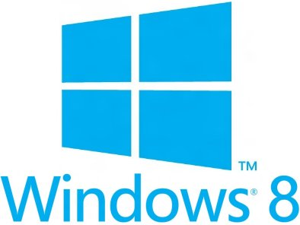
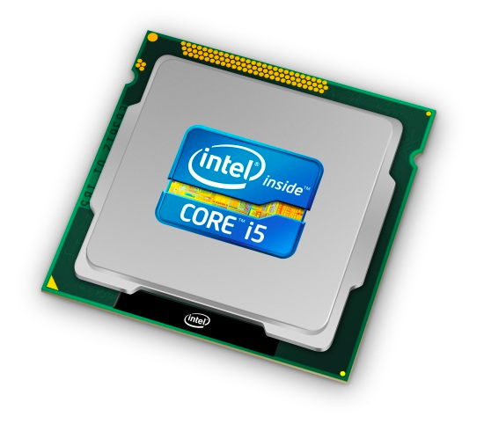
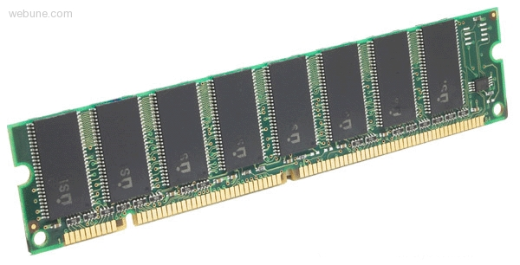
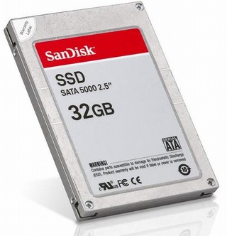
Roadmap
Data & addressing
Integers & floats
Machine code & C
x86 assembly programming
Procedures & stacks
Arrays & structs
Memory & caches
Processes
Virtual memory
Memory allocation
Java vs. C
C:
Java:
car *c = malloc(sizeof(car));
c->miles = 100;
c->gals = 17;
float mpg = get_mpg(c);
free(c);
Car c = new Car();
c.setMiles(100);
c.setGals(17);
float mpg = c.getMPG();
Assembly language:
get_mpg:
pushq %rbp
movq %rsp, %rbp
...
popq %rbp
ret
OS:
Machine code:
0111010000011000
100011010000010000000010
1000100111000010
110000011111101000011111
Computer system:

Slide 8
Course Perspective
This course will make you a better programmer
Purpose is to show how software really works
By understanding the underlying system, one can be more effective as a programmer
Better debugging
Better basis for evaluating performance
How multiple activities work in concert (e.g., OS and user programs)
Not just a course for dedicated hackers
What every CSE major needs to know
Job interviewers love to ask questions from 351!
Provide a context in which to place the other CSE courses you’ll take

Slide 9
If you liked this class, then consider…
CSE477/481/490/etc.
Capstone and Project Courses
CSE352
HW Design
CSE333
Systems Prog
CSE451
Op Systems
CSE401
Compilers
CSE461
Networks
CSE484
Security
CSE466
Emb Systems
Performance
Distributed Systems
Execution Model
Concurrency
Machine
Code
Comp. Arch.
Real-Time Control
CSE351
The HW/SW Interface: underlying principles linking hardware and software
CS 143
Intro Prog II

