Slide 1
The Hardware/Software Interface CSE351 Winter 2013
Virtual Memory I

Slide 2
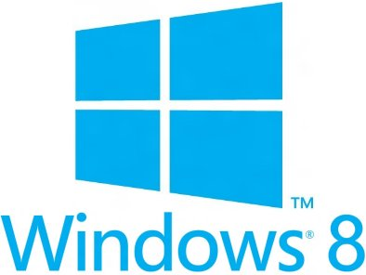
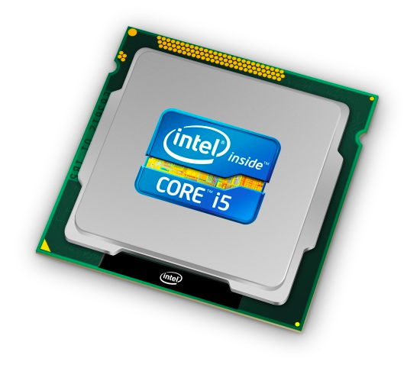
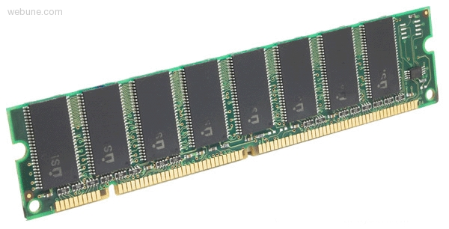
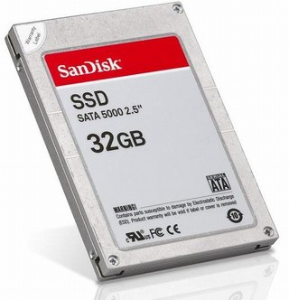
Roadmap
Data & addressing
Integers & floats
Machine code & C
x86 assembly programming
Procedures & stacks
Arrays & structs
Memory & caches
Processes
Virtual memory
Memory allocation
Java vs. C
C:
Java:
car *c = malloc(sizeof(car));
c->miles = 100;
c->gals = 17;
float mpg = get_mpg(c);
free(c);
Car c = new Car();
c.setMiles(100);
c.setGals(17);
float mpg = c.getMPG();
Assembly language:
get_mpg:
pushq %rbp
movq %rsp, %rbp
...
popq %rbp
ret
OS:
Machine code:
0111010000011000
100011010000010000000010
1000100111000010
110000011111101000011111
Computer system:

Slide 3
Virtual Memory (VM)
Overview and motivation
VM as tool for caching
Address translation
VM as tool for memory management
VM as tool for memory protection

Slide 4
Processes
Definition: A process is an instance of a running program
One of the most important ideas in computer science
Not the same as “program” or “processor”
Process provides each program with two key abstractions:
Logical control flow
Each process seems to have exclusive use of the CPU
Private virtual address space
Each process seems to have exclusive use of main memory
How are these illusions maintained?
Process executions interleaved (multi-tasking) – last time
Address spaces managed by virtual memory system – today!

Slide 5
Virtual Memory (Previous Lectures)
Programs refer to virtual memory addresses
movl (%ecx),%eax
Conceptually memory is just a very large array of bytes
Each byte has its own address
System provides address space private to particular “process”
Allocation: Compiler and run-time system
Where different program objects should be stored
All allocation within single virtual address space
What problems does virtual memory solve?
FF∙∙∙∙∙∙F
00∙∙∙∙∙∙0

Slide 6
Problem 1: How Does Everything Fit?
64-bit addresses:
16 Exabyte
Physical main memory:
Few Gigabytes
?
And there are many processes ….

Slide 7
Problem 2: Memory Management
Physical main memory
Process 1
Process 2
Process 3
…
Process n
stack
heap
.text
.data
…
What goes where?
x

Slide 8
Problem 3: How To Protect
Physical main memory
Process i
Process j
Problem 4: How To Share?
Physical main memory
Process i
Process j

Slide 9
How would you solve those problems?

Slide 10
Indirection
“Any problem in computer science can be solved by adding another level of indirection”
Without Indirection
With Indirection
Name
Thing
Name
Thing
Thing
Notes:
Quote attributed to David Wheeler or Butler Lampson (http://en.wikipedia.org/wiki/Butler_Lampson)

Slide 11
Indirection
Indirection: the ability to reference something using a name, reference, or container instead the value itself. A flexible mapping between a name and a thing allows changing the thing without notifying holders of the name.
Without Indirection
With Indirection
Examples: Domain Name Service (DNS) name->IP address, phone system (e.g., cell phone number portability), snail mail (e.g., mail forwarding), 911 (routed to local office), DHCP, call centers that route calls to available operators, etc.
Name
Thing
Name
Thing
Thing

Slide 12
Solution: Level Of Indirection
Virtual memory
mapping
Process 1
Physical memory
Virtual memory
Process n
Each process gets its own private virtual address space
Solves the previous problems

Slide 13
Address Spaces
Virtual address space: Set of N = 2^{n} virtual addresses {0, 1, 2, 3, …, N-1}
Physical address space: Set of M = 2^{m} physical addresses (n > m) {0, 1, 2, 3, …, M-1}
Every byte in main memory: one physical address; zero, one, or more virtual addresses

Slide 14
Mapping
Physical Memory
Virtual Address
A virtual address can be mapped to either physical memory or disk.
Disk

Slide 15
A System Using Physical Addressing
Main memory
0:
1:
Physical address
(PA)
2:
CPU
3:
4
4:
5:
6:
7:
8:
...
M-1:
Data word
Used in “simple” systems like embedded microcontrollers in devices like cars, elevators, and digital picture frames

Slide 16
A System Using Virtual Addressing
Main memory
0:
CPU Chip
1:
Virtual address
(VA)
Physical address
(PA)
2:
CPU
MMU
3:
4
4:
4100
5:
6:
7:
8:
...
M-1:
Data word
Used in all modern desktops, laptops, servers
One of the great ideas in computer science

Slide 17
VM and the Memory Hierarchy
Think of virtual memory as an array of N = 2^{n} contiguous bytes stored on a disk
Then physical main memory (DRAM) is used as a cache for the virtual memory array
The cache blocks are called pages (size is P = 2^{p} bytes)
Virtual memory
Physical memory
VP 0
Unallocated
0
VP 1
Cached
0
Empty
PP 0
Uncached
PP 1
Unallocated
Empty
Cached
Uncached
Empty
Cached
M-1
PP 2^{m-p}-1
VP 2^{n-p}-1
Uncached
N-1
Virtual pages (VPs)
stored on disk
Physical pages (PPs)
cached in DRAM

Slide 18
Memory Hierarchy: Core 2 Duo
Not drawn to scale
L1/L2 cache: 64 B blocks
~4 MB
~4 GB
~500 GB
L1
I-cache
L2 unified cache
Main Memory
Disk
32 KB
CPU
Reg
L1
D-cache
Throughput:
16 B/cycle
8 B/cycle
2 B/cycle
1 B/30 cycles
Latency:
3 cycles
14 cycles
100 cycles
millions
Miss penalty (latency): 33x
Miss penalty (latency): 10,000x

Slide 19
DRAM Cache Organization
DRAM cache organization driven by the enormous miss penalty
DRAM is about 10x slower than SRAM
Disk is about 10,000x slower than DRAM
(for first byte; faster for next byte)
Consequences?
Block size?
Associativity?
Write-through or write-back?

Slide 20
DRAM Cache Organization
DRAM cache organization driven by the enormous miss penalty
DRAM is about 10x slower than SRAM
Disk is about 10,000x slower than DRAM
(for first byte; faster for next byte)
Consequences
Large page (block) size: typically 4-8 KB, sometimes 4 MB
Fully associative
Any VP can be placed in any PP
Requires a “large” mapping function – different from CPU caches
Highly sophisticated, expensive replacement algorithms
Too complicated and open-ended to be implemented in hardware
Write-back rather than write-through

Slide 21
Indexing into the “DRAM Cache”
Main memory
0:
CPU Chip
1:
Virtual address
(VA)
Physical address
(PA)
2:
CPU
MMU
3:
4
4:
4100
5:
6:
7:
8:
...
M-1:
Data word
How do we perform the VA -> PA translation?

Slide 22
Address Translation: Page Tables
A page table (PT) is an array of page table entries (PTEs) that maps virtual pages to physical pages.
Physical memory
(DRAM)
Physical page
number or
disk address
Valid
VP 1
PP 0
PTE 0
0
null
VP 2
1
VP 7
VP 4
PP 3
1
0
1
0
null
Virtual memory (disk)
0
PTE 7
1
VP 1
Memory resident
page table
(DRAM)
VP 2
VP 3
VP 4
How many page tables are in the system?
One per process
VP 6
VP 7

Slide 23
Address Translation With a Page Table
Virtual address (VA)
Page table base register
(PTBR)
Virtual page number (VPN)
Virtual page offset (VPO)
Page table address
for process
Page table
Valid
Physical page number (PPN)
Valid bit = 0:
page not in memory
(page fault)
In most cases, the hardware (the MMU) can perform this translation on its own, without software assistance
Physical page number (PPN)
Physical page offset (PPO)
Physical address (PA)
Notes:
PTBR is another name for control register 3 (CR3) in x86: http://en.wikipedia.org/wiki/Control_register#CR3

Slide 24
Page Hit
Page hit: reference to VM byte that is in physical memory
Physical memory
(DRAM)
Physical page
number or
disk address
Virtual address
Valid
VP 1
PP 0
PTE 0
0
null
VP 2
1
VP 7
VP 4
PP 3
1
0
1
0
null
Virtual memory
(disk)
0
PTE 7
1
VP 1
Memory resident
page table
(DRAM)
VP 2
VP 3
VP 4
VP 6
VP 7

Slide 25
Page Fault
Page fault: reference to VM byte that is NOT in physical memory
Physical memory
(DRAM)
Physical page
number or
disk address
Virtual address
Valid
VP 1
PP 0
PTE 0
0
null
VP 2
1
VP 7
VP 4
PP 3
1
0
1
0
null
Virtual memory
(disk)
0
PTE 7
1
VP 1
Memory resident
page table
(DRAM)
VP 2
VP 3
What happens when a page fault occurs?
VP 4
VP 6
VP 7

Slide 26
Fault Example: Page Fault
int a[1000];
main ()
{
a[500] = 13;
}
User writes to memory location
That portion (page) of user’s memory is currently on disk
Page handler must load page into physical memory
Returns to faulting instruction: mov is executed again!
Successful on second try
80483b7: c7 05 10 9d 04 08 0d movl $0xd,0x8049d10
User Process
OS
exception: page fault
movl
Create page and
load into memory
returns

Slide 27
Handling Page Fault
Page miss causes page fault (an exception)
Physical memory
(DRAM)
Physical page
number or
disk address
Virtual address
Valid
VP 1
PP 0
PTE 0
0
null
VP 2
1
VP 7
VP 4
PP 3
1
0
1
0
null
Virtual memory
(disk)
0
PTE 7
1
VP 1
Memory resident
page table
(DRAM)
VP 2
VP 3
VP 4
VP 6
VP 7

Slide 28
Handling Page Fault
Page miss causes page fault (an exception)
Page fault handler selects a victim to be evicted (here VP 4)
Physical memory
(DRAM)
Physical page
number or
disk address
Virtual address
Valid
VP 1
PP 0
PTE 0
0
null
VP 2
1
VP 7
VP 4
PP 3
1
0
1
0
null
Virtual memory
(disk)
0
PTE 7
1
VP 1
Memory resident
page table
(DRAM)
VP 2
VP 3
VP 4
VP 6
VP 7

Slide 29
Handling Page Fault
Page miss causes page fault (an exception)
Page fault handler selects a victim to be evicted (here VP 4)
Physical memory
(DRAM)
Physical page
number or
disk address
Virtual address
Valid
VP 1
PP 0
PTE 0
0
null
VP 2
1
VP 7
VP 3
PP 3
1
1
0
0
null
Virtual memory
(disk)
0
PTE 7
1
VP 1
Memory resident
page table
(DRAM)
VP 2
VP 3
VP 4
VP 6
VP 7

Slide 30
Handling Page Fault
Page miss causes page fault (an exception)
Page fault handler selects a victim to be evicted (here VP 4)
Offending instruction is restarted: page hit!
Physical memory
(DRAM)
Physical page
number or
disk address
Virtual address
Valid
VP 1
PP 0
PTE 0
0
null
VP 2
1
VP 7
VP 3
PP 3
1
1
0
0
null
Virtual memory
(disk)
0
PTE 7
1
VP 1
Memory resident
page table
(DRAM)
VP 2
VP 3
VP 4
VP 6
VP 7

Slide 31
Why does it work?

Slide 32
Why does it work? Locality
Virtual memory works well because of locality
Same reason that L1 / L2 / L3 caches work
The set of virtual pages that a program is “actively” accessing at any point in time is called its working set
Programs with better temporal locality will have smaller working sets
If (working set size < main memory size):
Good performance for one process after compulsory misses
If (SUM(working set sizes) > main memory size):
Thrashing: Performance meltdown where pages are swapped (copied) in and out continuously

