Slide 1
The Hardware/Software Interface CSE351 Winter 2013
Memory and Caches I

Slide 2
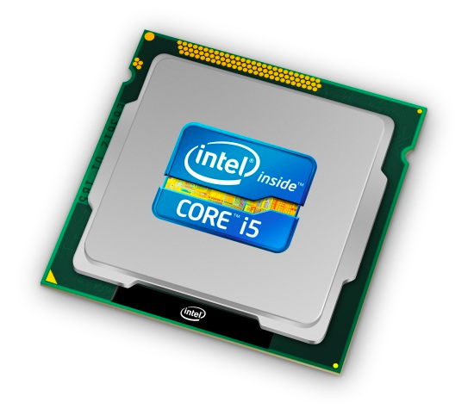
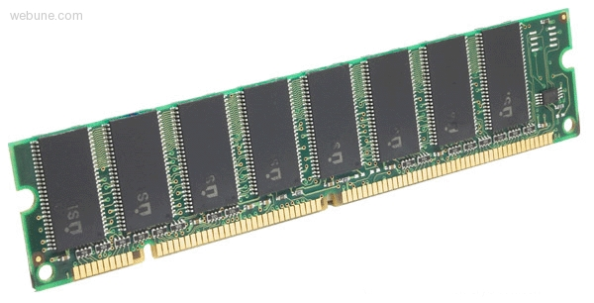
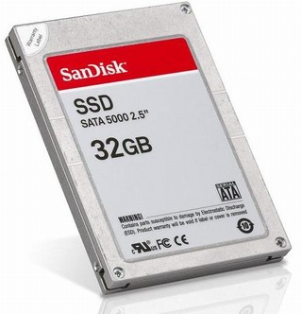
Roadmap
Data & addressing
Integers & floats
Machine code & C
x86 assembly programming
Procedures & stacks
Arrays & structs
Memory & caches
Processes
Virtual memory
Memory allocation
Java vs. C
C:
Java:
car *c = malloc(sizeof(car));
c->miles = 100;
c->gals = 17;
float mpg = get_mpg(c);
free(c);
Car c = new Car();
c.setMiles(100);
c.setGals(17);
float mpg = c.getMPG();
Assembly language:
get_mpg:
pushq %rbp
movq %rsp, %rbp
...
popq %rbp
ret
OS:
Machine code:
0111010000011000
100011010000010000000010
1000100111000010
110000011111101000011111
Computer system:

Slide 3
Themes of CSE 351
Interfaces and abstractions
So far: data type abstractions in C; x86 instruction set architecture (interface to hardware)
Today: abstractions of memory
Soon: process and virtual memory abstractions
Representation
Integers, floats, addresses, arrays, structs
Translation
Understand the assembly code that will be generated from C code
Control flow
Procedures and stacks; buffer overflows

Slide 4
Making memory accesses fast!
Cache basics
Principle of locality
Memory hierarchies
Cache organization
Program optimizations that consider caches

Slide 5
How does execution time grow with SIZE?
int array[SIZE];
int A = 0;
for (int i = 0 ; i < 200000 ; ++ i) {
for (int j = 0 ; j < SIZE ; ++ j) {
A += array[j];
}
}
TIME
Plot
SIZE

Slide 6
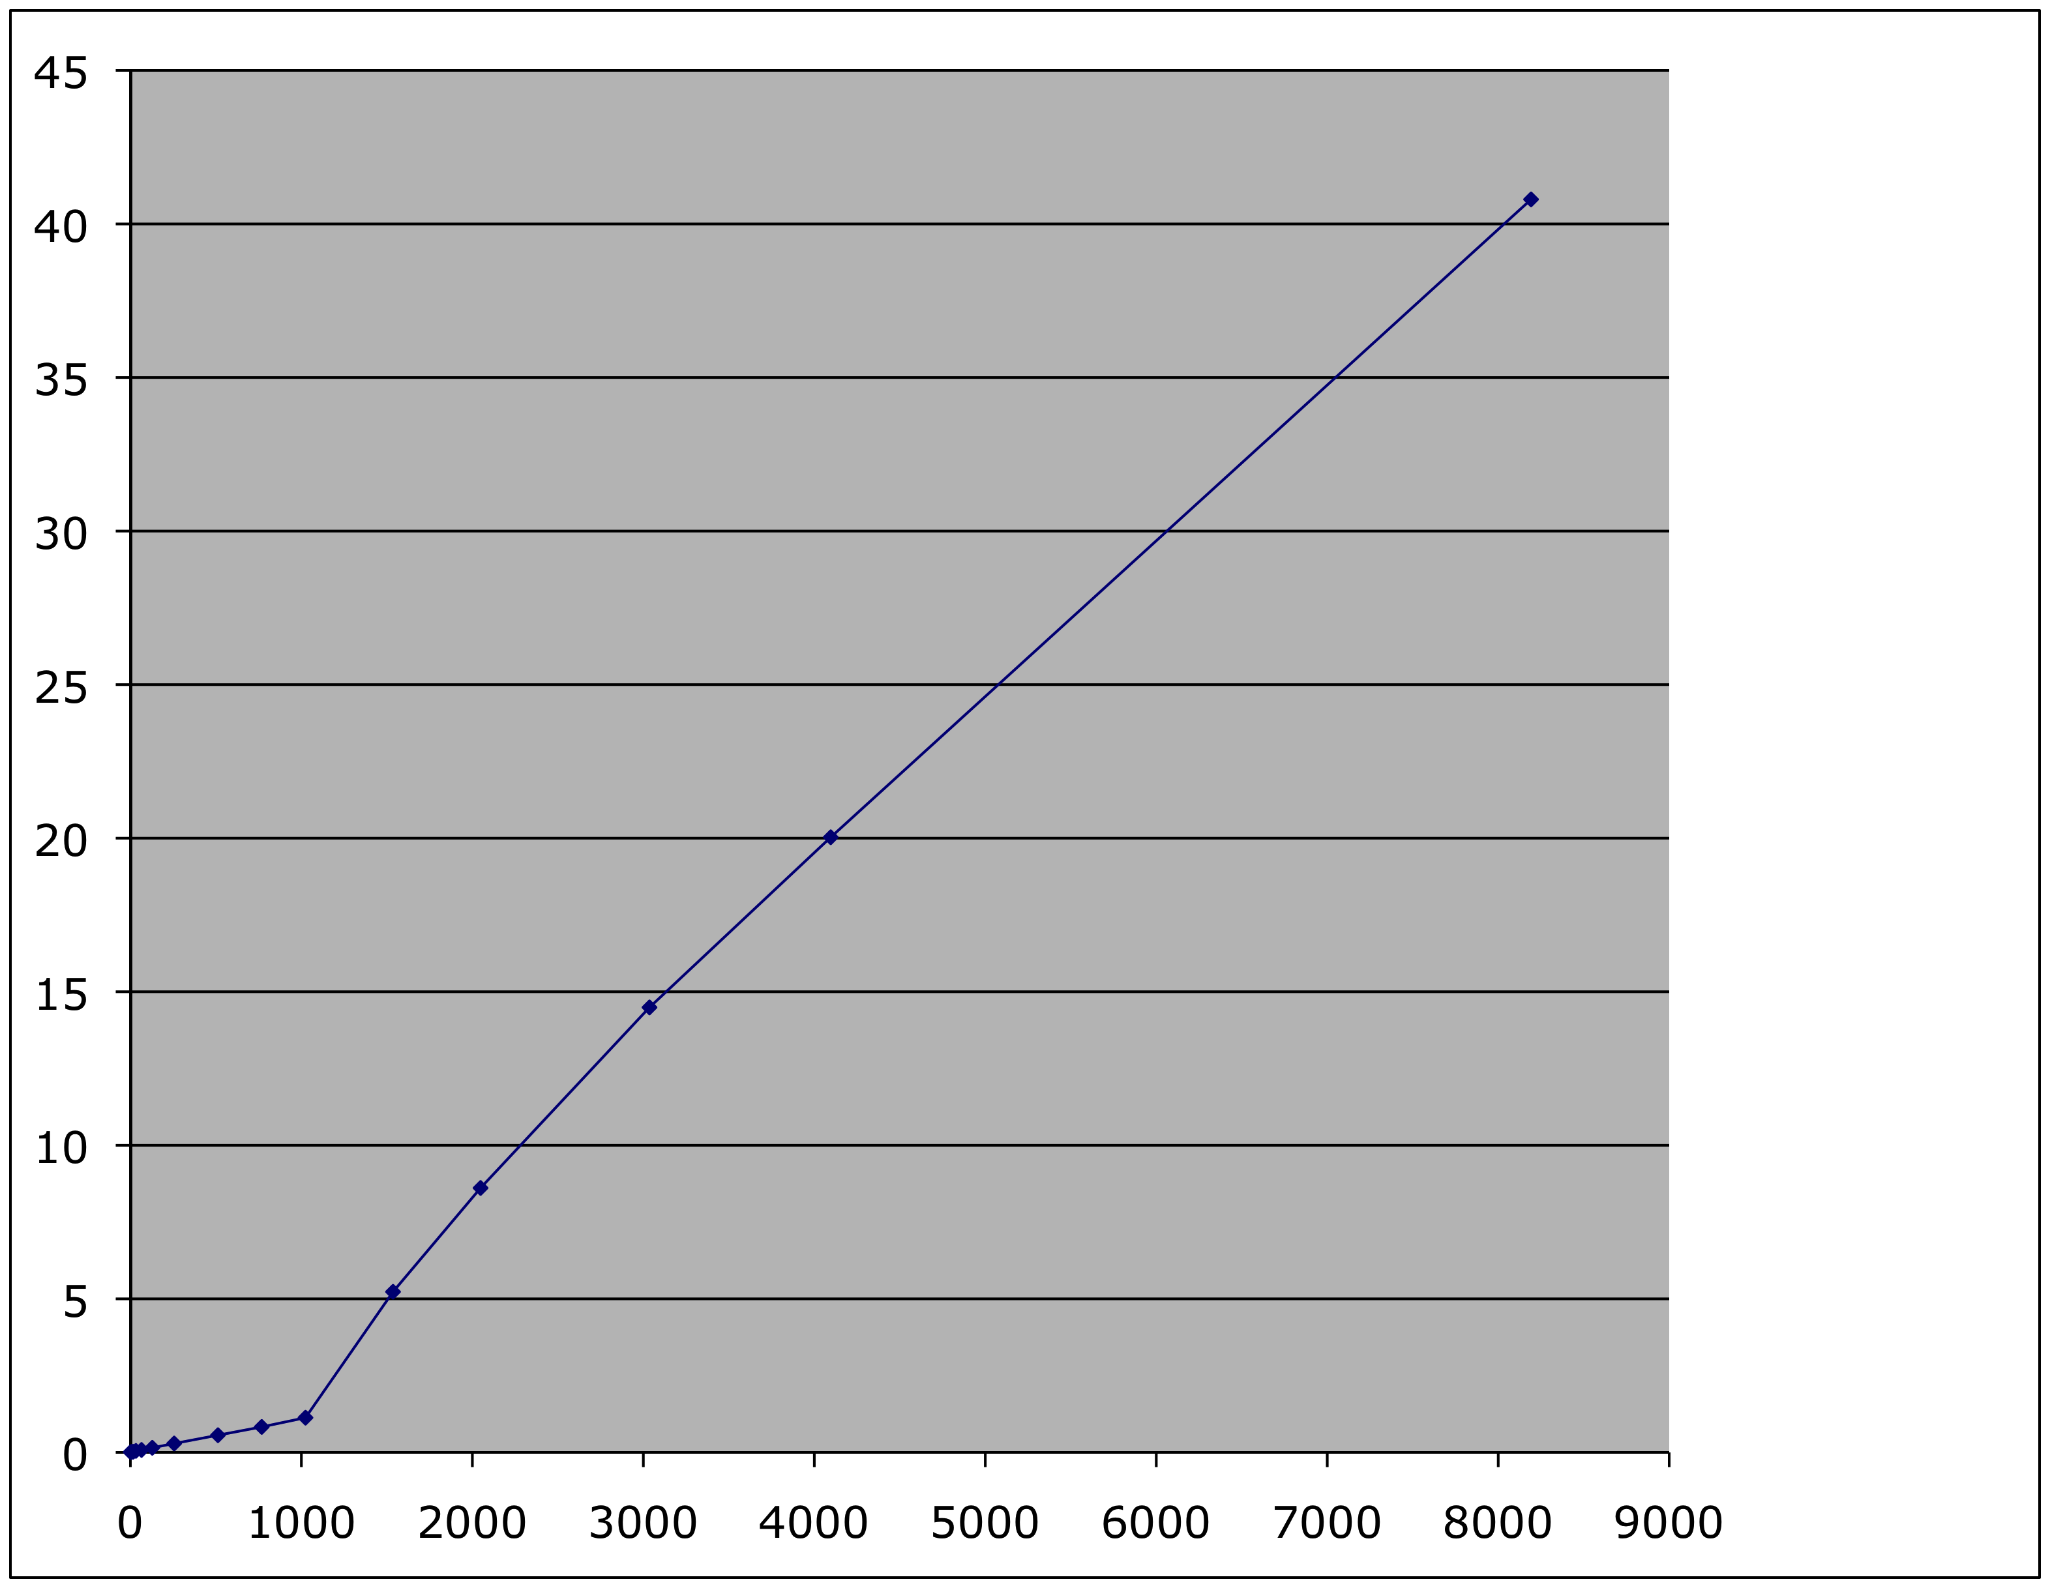
Actual Data
Time
SIZE

Slide 7
Problem: Processor-Memory Bottleneck
Processor performance
doubled about
every 18 months
Bus bandwidth
evolved much slower
Main Memory
CPU
Reg
Core 2 Duo:
Can process at least
256 Bytes/cycle
Core 2 Duo:
Bandwidth
2 Bytes/cycle
Latency
100 cycles
Problem: lots of waiting on memory

Slide 8
Problem: Processor-Memory Bottleneck
Processor performance
doubled about
every 18 months
Bus bandwidth
evolved much slower
Main Memory
CPU
Reg
Cache
Core 2 Duo:
Can process at least
256 Bytes/cycle
Core 2 Duo:
Bandwidth
2 Bytes/cycle
Latency
100 cycles
Solution: caches

Slide 9
Cache
English definition: a hidden storage space for provisions, weapons, and/or treasures
CSE definition: computer memory with short access time used for the storage of frequently or recently used instructions or data (i-cache and d-cache) more generally, used to optimize data transfers between system elements with different characteristics (network interface cache, I/O cache, etc.)

Slide 10
General Cache Mechanics
Smaller, faster, more expensive
memory caches a subset of
the blocks
Cache
8
9
14
3
Data is copied in block-sized transfer units
Larger, slower, cheaper memory
viewed as partitioned into “blocks”
Memory
0
1
2
3
4
5
6
7
8
9
10
11
12
13
14
15

Slide 11
General Cache Concepts: Hit
Request: 14
Data in block b is needed
Block b is in cache:
Hit!
Cache
8
9
14
3
14
Memory
0
1
2
3
4
5
6
7
8
9
10
11
12
13
14
15

Slide 12
General Cache Concepts: Miss
Request: 12
Data in block b is needed
Block b is not in cache:
Miss!
Cache
8
9
14
3
12
Block b is fetched from
memory
12
Request: 12
Block b is stored in cache
Placement policy: determines where b goes
Replacement policy: determines which block gets evicted (victim)
Memory
0
1
2
3
4
5
6
7
8
9
10
11
12
12
13
14
15

Slide 13
Cost of Cache Misses
Huge difference between a hit and a miss
Could be 100x, if just L1 and main memory
Would you believe 99% hits is twice as good as 97%?
Consider: Cache hit time of 1 cycle Miss penalty of 100 cycles
Average access time:
97% hits: 1 cycle + 0.03 * 100 cycles = 4 cycles
99% hits: 1 cycle + 0.01 * 100 cycles = 2 cycles
This is why “miss rate” is used instead of “hit rate”

Slide 14
Why Caches Work
Locality: Programs tend to use data and instructions with addresses near or equal to those they have used recently
Temporal locality:
Recently referenced items are likely to be referenced again in the near future
Why is this important?
Spatial locality:
Items with nearby addresses tend to be referenced close together in time
How do caches take advantage of this?
block
block

Slide 15
Example: Locality?
int sum = 0;
for (i = 0; i < n; i++)
sum += a[i];
return sum;
Data:
Temporal: sum referenced in each iteration
Spatial: array a[] accessed in stride-1 pattern
Instructions:
Temporal: cycle through loop repeatedly
Spatial: reference instructions in sequence; number of instructions is small
Being able to assess the locality of code is a crucial skill for a programmer

Slide 16
Locality Example #1
int sum_array_rows(int a[M][N])
{
int i, j, sum = 0;
for (i = 0; i < M; i++)
for (j = 0; j < N; j++)
sum += a[i][j];
return sum;
}
a[0][0]
a[0][1]
a[0][2]
a[0][3]
a[1][0]
a[1][1]
a[1][2]
a[1][3]
a[2][0]
a[2][1]
a[2][2]
a[2][3]
1: a[0][0]
2: a[0][1]
3: a[0][2]
4: a[0][3]
5: a[1][0]
6: a[1][1]
7: a[1][2]
8: a[1][3]
9: a[2][0]
10: a[2][1]
11: a[2][2]
12: a[2][3]
stride-1

Slide 17
Locality Example #2
int sum_array_cols(int a[M][N])
{
int i, j, sum = 0;
for (j = 0; j < N; j++)
for (i = 0; i < M; i++)
sum += a[i][j];
return sum;
}
a[0][0]
a[0][1]
a[0][2]
a[0][3]
a[1][0]
a[1][1]
a[1][2]
a[1][3]
a[2][0]
a[2][1]
a[2][2]
a[2][3]
1: a[0][0]
2: a[1][0]
3: a[2][0]
4: a[0][1]
5: a[1][1]
6: a[2][1]
7: a[0][2]
8: a[1][2]
9: a[2][2]
10: a[0][3]
11: a[1][3]
12: a[2][3]
stride-N

Slide 18
Memory Hierarchies
Some fundamental and enduring properties of hardware and software systems:
Faster storage technologies almost always cost more per byte and have lower capacity
The gaps between memory technology speeds are widening
True for: registers ↔ cache, cache ↔ DRAM, DRAM ↔ disk, etc.
Well-written programs tend to exhibit good locality
These properties complement each other beautifully
They suggest an approach for organizing memory and storage systems known as a memory hierarchy

Slide 19
An Example Memory Hierarchy
registers
CPU registers hold words retrieved from L1 cache
on-chip L1
cache (SRAM)
Smaller,
faster,
costlier
per byte
L1 cache holds cache lines retrieved from L2 cache
off-chip L2
cache (SRAM)
L2 cache holds cache lines retrieved from main memory
Larger,
slower,
cheaper
per byte
main memory
(DRAM)
Main memory holds disk blocks retrieved from local disks
local secondary storage
(local disks)
Local disks hold files retrieved from disks on remote network servers
remote secondary storage
(distributed file systems, web servers)

Slide 20
Memory Hierarchies
Fundamental idea of a memory hierarchy:
For each k, the faster, smaller device at level k serves as a cache for the larger, slower device at level k+1.
Why do memory hierarchies work?
Because of locality, programs tend to access the data at level k more often than they access the data at level k+1.
Thus, the storage at level k+1 can be slower, and thus larger and cheaper per bit.
Big Idea: The memory hierarchy creates a large pool of storage that costs as much as the cheap storage near the bottom, but that serves data to programs at the rate of the fast storage near the top.

Slide 21
Cache Performance Metrics
Miss Rate
Fraction of memory references not found in cache (misses / accesses) = 1 - hit rate
Typical numbers (in percentages):
3% - 10% for L1
Can be quite small (e.g., < 1%) for L2, depending on size, etc.
Hit Time
Time to deliver a line in the cache to the processor
Includes time to determine whether the line is in the cache
Typical hit times: 1 - 2 clock cycles for L1; 5 - 20 clock cycles for L2
Miss Penalty
Additional time required because of a miss
Typically 50 - 200 cycles for L2 (trend: increasing!)

Slide 22
Examples of Caching in the Hierarchy
Cache Type
What is Cached?
Where is it Cached?
Latency (cycles)
Managed By
Registers
4/8-byte words
CPU core
0
Compiler
TLB
Address translations
On-Chip TLB
0
Hardware
L1 cache
64-bytes block
On-Chip L1
1
Hardware
L2 cache
64-bytes block
Off-Chip L2
10
Hardware
Virtual Memory
4-KB page
Main memory
100
Hardware+OS
Buffer cache
Parts of files
Main memory
100
OS
Network cache
Parts of files
Local disk
10,000,000
File system client
Browser cache
Web pages
Local disk
10,000,000
Web browser
Web cache
Web pages
Remote server disks
1,000,000,000
Web server

Slide 23
Memory Hierarchy: Core 2 Duo
Not drawn to scale
L1/L2 cache: 64 B blocks
~4 MB
~4 GB
~500 GB
L1
I-cache
L2 unified cache
Main Memory
Disk
32 KB
CPU
Reg
L1
D-cache
Throughput:
16 B/cycle
8 B/cycle
2 B/cycle
1 B/30 cycles
Latency:
3 cycles
14 cycles
100 cycles
millions
Notes:
Caches: cat /sys/devices/system/cpu/cpu1/cache/index0/size
cat /sys/devices/system/cpu/cpu1/cache/index1/size
Memory: cat /proc/meminfo
Disk: df –h

