Slide 1
What is Rust?
Based on Oleg Ianchenko’s slides and Matthew Giordano’s CSE493L
Notes:
Lets get started for today,
Very excited to talk about,
What is rust? Why is rust? Is rust good? Spoiler alert: my answer is yes
At the end of the day we will get to some rust examples as well
Really quick: who has taken 351? 332? 333?

Slide 2

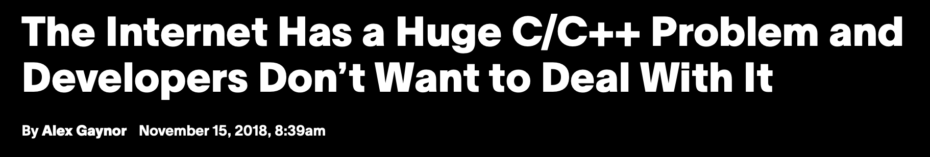
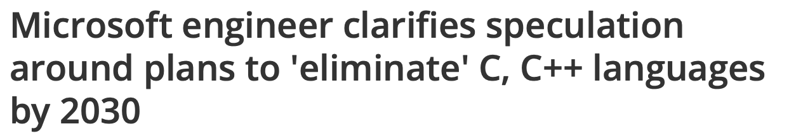
Notes:
So you may have seen some headlines in the news like this,
And this,
And this, in recent years
What’s the big deal with C? Why does the government and internet have an issue with C? Why are there speculations to C usage at microsoft? And why are we talking about C if this is supposed to be the rust lecture?
Because everything we do in rust, we will compare to C++ and C: Why? We find out later
Say that rust is a newer language so thats why we are discussing it

Slide 3
What is C/C++?
C
General purpose language developed in 1972 by Dennis Ritchie (also wrote Unix)
Known for efficiency, portability, and low-level memory access
Essential usage in OS and embedded systems development
Foundation for many modern languages, including C++, Java, and Python
C++
At a high level, C but with OOP features
Notes:
Intro C for people who have only taken intro series
Both are considered lower level than java, what we all learned in intro to programming.

Slide 4
C is Good
Direct program control over underlying data layout (unlike Java)
Direct mapping of high level constructs to underlying machine instructions
Predictable performance
Explicit memory allocation/deallocation
Linux: 40 million lines of C
Android: 12 million lines of C
Notes:
C is good for a couple of reasons:
You get Direct program control over underlying data layout
You get direct mapping of high level constructs to underlying machine instructions, so you can predict almost 1 for 1 what your C code will turn into in terms of assembly
This gives you predictable performance
Explicit allocation and deallocation: a pro in many cases, no garbage collector so no unexpected slowdowns, or overhead related to tracking memory
Finally, C is very popular
Malloc/free: for C, any data that compiler does not know the size of (namely non-fixed size data structures like arrays that can be initialized to whatever size you want), ints, floats,

Slide 5
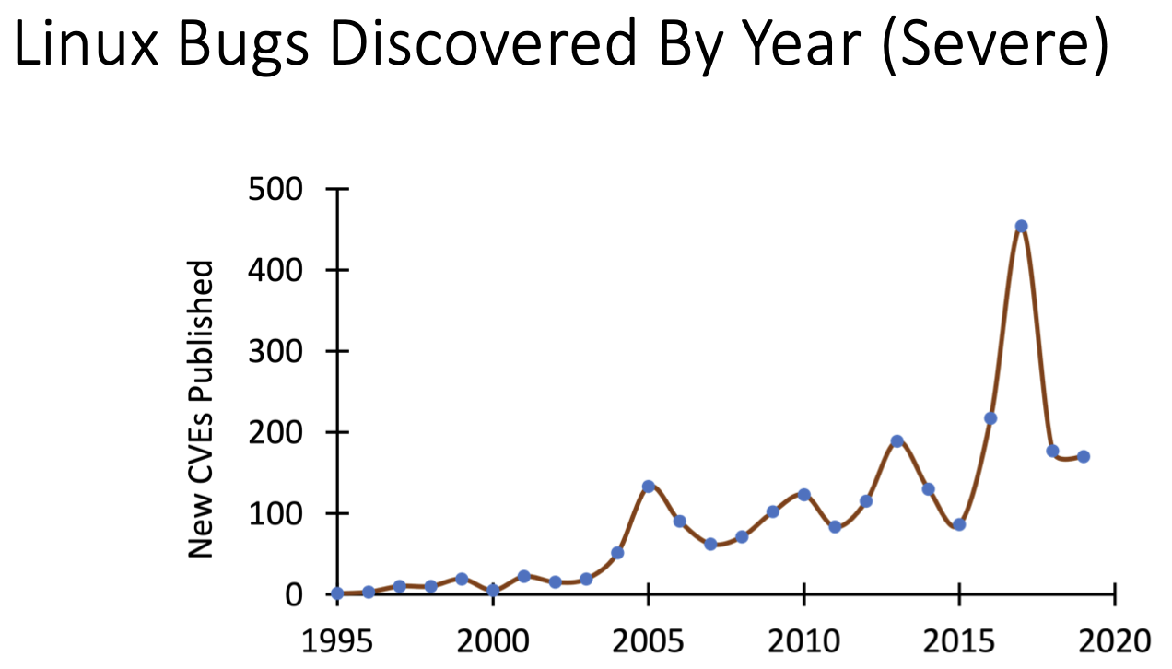
C is Bad
Direct program control over underlying data layout (unlike Java)
There are no “high level” constructs
Explicit memory allocation/deallocation
Notes:
C is also bad pretty much for the same exact reasons I listed
You HAVE to have direct program control over underlying data layout (this is hard and its easy to make errors)
There are no “high level” constructs in C, there are no objects and classes and such. It’s messy. C++ fixes this to some degree but its not perfect
Explicit memory allocation/deallocation is very, very error prone
Use after free bugs
Double free bugs
Passing reference to something on the stack that gets deallocated
Finally, look at the graph of linux bugs per year. The trend isn’t going down, despite linux’s age. And you would expect the trend to go down and stabilize as the bugs are found and fixed.
This is in part due to new hardware and drivers and coming out, meaning new bugs
This should scare you however, there’s hundreds and hundreds of bugs in linux, and basically all the world’s infrastructure relies on it.

Slide 6

C is Bad
What if we forget to initialize data?
Undefined behavior
Will be set to whatever was in the heap/stack before!
What if we return a pointer to data on the stack?
Undefined behavior
What if we use a pointer after we free it?
Undefined behavior
What if we free a pointer twice?
ahhhhhh
Notes:
And here are some specific examples of where C can go wrong
…
And the worst part is a lot of these bugs are things you can statically detect and prevent.
For most systems level programming, the potential problems you can run into in C are not worth the benefits you get from C, especially today when you have an alternative that is just as performant as C.
Undefined behavior: code is not defined in the language, what happens depends on what compiler you are using. Maybe you get a compiler warning, maybe you won’t.
Stack: part of memory that is automatically allocated, constantly changing. Each function has its own stack.
Heap: dynamically allocated portion of memory, where your malloc’d memory goes.
Pointer: a reference to something in memory.

Slide 7

C is Old
No pattern matching
No closures
No first class functions
No currying, at all!
Notes:
Related to this class, a lot of the programming language features we learned about are simply not available in C.
No pattern matching
No closures
No first class functions, meaning, no currying at all.
I think C is geriatric

Slide 8
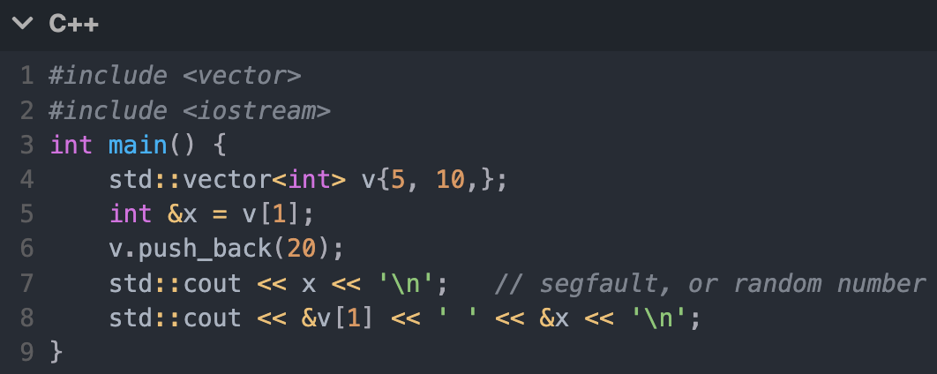
What about C++?
C++ is also bad
Notes:
C++ doesn’t fix these issues, it hides them, and undefined behavior is still present. Does anyone see a bug in this cpp code?
All we do is
Make a vector
Get a reference to the first element
Adding something new to the reference
Print the reference
Segfault ???? whats happening
the vector push back actually moved the contents of the vector somewhere else (reallocate somewhere else in memory, reference is invalid)
x is a stale reference
why the heck are we allowed to still use it??
This should scare you. There could be hundreds of lines between the segfault and the pushback, and it only happens very rarely when the vector gets reallocated.
But then, why are we still allowed to use x then?
The compiler should be able to tell us that we should not be able to use x after we modify v.

Slide 9

Concurrency is Exceptionally Difficult…
Concurrency bugs…
are often runtime errors, and require extensive test suites to catch
are hard to avoid, with concurrency being important for performance
C does nothing to protect you against data races
Testing provides weak guarantees for concurrent systems*, can we do better? How?
* Do not interpret this as “you shouldn’t write tests for concurrent programs”!!!!! Always test your code!!!

Slide 10
The Categories of Code
Invalid Code
Undefined Behavior
b = “Hello” + []
Type errors
a = 10 + + 29
Data Races
Concurrency with carefully reasoned locking
Syntax errors
e = 10 + 30
Null dereferences
All exception / edge cases caught and handled
Valid, Unsafe Code
Valid, Safe Code
Notes:
If we have all these problems, it might be worth categorizing code into several bins here that each behave a little bit differently in C vs in Rust
Left: valid, safe code. Code that works, data races handled, no bugs
Right: invalid code, syntax errors that the compiler checks against.
Middle: code that passes the compiler check that are valid, but are wrong.

Slide 11
The Categories of Code
Invalid Code
Compiler Checked!
Test Checked
Test Checked ?
Valid, Unsafe Code
Valid, Safe Code
Notes:
Middle category: currently needed to be checked by testing, but should be:

Slide 12
The Categories of Code
Invalid Code
Compiler Checked!
Compiler Checked
Test Checked ?
Valid, Unsafe Code
Valid, Safe Code
Notes:
Checked by a compiler

Slide 13

A Stronger System
If we impose more rules onto what code is and isn’t “valid”, the compiler becomes our proof of correctness tool
What rules do we pick? What problems do we want to solve?
Notes:
So what we want is a stronger compiler that is our proof of correctness tool: In order to do this we need to define some new rules to make this possible.
We need to constrain our programming in order to let a compiler prove nothing bad will happen to us.

Slide 14

Introducing Rust!
Rust is a modern systems programming language focusing on safety, speed, and concurrency. It accomplishes these goals by being memory safe without using garbage collection.
– Rust By Example
Rust programmers are called ‘Rustaceans’

Slide 15

Rust
Created in 2006 by Graydon Hoare (no relation)
Sponsored by Mozilla in 2009
Multi-paradigm, general purpose programming language
Adopted by major companies and governance via Rust Foundation
Rust became the second ‘main’ language in Linux Kernel 6.1
Characteristics
Aims to support efficient, fearless, concurrent systems programming
Memory safe with rich type system
Ergonomic developer experience
Interoperable with C/C++
Notes:
2025 stack overflow most used language
Other Hoare is Tony Hoare (famous computer scientist)
Ergonomic developer experience

Slide 16

Data Race
2 instructions from different threads access the same memory
at least one is a write
no synchronization mandating an order between the accesses
Notes:
So the BIG THING rust tries to make easier is writing concurrent systems programs. This is super relevant in the modern day. Basically every machine is multi-core, multi-threaded machines so writing concurrent safe systems programs is essential for all our multi-core hardware to run correctly.
And the big problem concurrent programs run into is a data race: multiple accesses, as long as one is a write, you have a data race.
in particular, recall from the definition of a data race that
in order to prevent data races forever, we need to ensure that data cannot be shared if at least one reference will be written
Just want to define what a data race is if you don’t know.

Slide 17
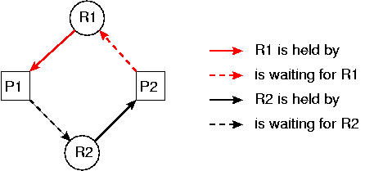
Deadlock
How to synchronize accesses so there is an order?
Locking!
Locking isn’t always safe though.
Notes:
Signpost: chill if you don’t understand, ask questions later

Slide 18
A Stronger Concurrent System
Concurrency problems arise when data is accessed and modified at the same time.
fn incr(&val):
val += 1
fn main():
a = 0
thread_run(incr, &a)
thread_run(incr, &a)
assert a == 2
Thread 1
Thread 2
val
val
a
0
Main thread
Notes:
shared mutable access to the same variable causes data races
But the first rule we should add is a stronger concurrent system: concurrency problems (specifically data races) arise when data is accessed and modified at the same time.
If we have two threads that both modify A, this could cause a data race.
If we have a main function that spawns two threads that both call this increment function, this can cause a ->
Signpost: if you never worked with concurrent systems before, I’ll do my best, sorry if you don’t understand I’ll try my best to explain

Slide 19
A Stronger Concurrent System
Concurrency problems arise when data is accessed and modified at the same time.
fn incr(&val):
val += 1
fn main():
a = 0
thread_run(incr, &a)
thread_run(incr, &a)
assert a == 2
Thread 1
Thread 2
val
val
Compiler can detect this!
a
0
Main thread
Disallow creating multiple ways of mutating a single piece of data!
Notes:
Cause a data race.
So what we can do is: disallow multiple shared accesses to the same variable.
Compiler can detect that both &a’s are both being accessed mutably, and in parallel, and deny this from happening. In other words, don’t allow two mutable references to the same variable

Slide 20
A Stronger Concurrent System
Multiple access is only a problem if you are planning to write data via a reference. Let’s introduce “mutable references” (&mut) and “immutable references” (&).
fn incr(&mut val):
val += 1
fn main():
a = 0
thread_run(incr, &mut a)
thread_run(incr, &mut a)
assert a == 2
Note, we now need to tell the compiler to expect a reference it can write to
Two mutable references → compiler error!
Notes:
So what can we do instead? We can introduce explicitly, mutable and immutable references to TELL the compiler what it can expect.
This might remind you of other languages that have a const, like in C, where by default references are immutable until you label them mutable.
So now lets annotate this incr function as taking a mutable reference to a value, and now since we are creating two MUTABLE references to a value the compiler should tell us this is buggy code.
Now what about single threaded code? Where you know theres no data races, there’s only one thread? This is the cost you make, the compromise, you have to change how you write single threaded code.

Slide 21
A Stronger Concurrent System
Multiple access is only a problem if you are planning to write data via a reference. Let’s introduce “mutable references” (&mut) and “immutable references” (&).
fn func(&val):
print(val)
fn main():
a = 0
thread_run(func, &a)
thread_run(func, &a)
assert a == 2
Compiler knows we won’t be writing to &val
Two “reader” references → this code is race safe → no compiler error!
Notes:
So if you passed in an immutable reference instead of a mutable reference, compiler should detect this is allowed, two concurrent reads is allowed.
In fact, the overall rule should be in an execution overall: you can have multiple immutable references to data, or only 1 mutable reference to data.

Slide 22
A Stronger Concurrent System
Multiple access is only a problem if you are planning to write data via a reference. Let’s introduce “mutable references” (&mut) and “immutable references” (&).
fn incr(&mut val):
return val + 1
fn main():
a = 0
thread_run(incr, &a)
thread_run(incr, &a)
assert a == 2
“Read only” references, but you are trying to write to a variable!
This is a type error!

Slide 23
A Stronger Concurrent System
Multiple access is only a problem if you are planning to write data via a reference. Let’s introduce “mutable references” (&mut) and “immutable references” (&).
fn func(&val):
print(val)
fn main():
a = 0
thread_run(incr, &mut a)
thread_run(incr, &mut a)
assert a == 2
You can use a “write” reference as just a “read” reference, the compiler can coerce a &mut down to just a &

Slide 24

A Stronger Memory System
Can the compiler help us manage memory?
Java, Python, Go, C# are all garbage collected (GC) languages, GCs are slow.
C / C++ require explicit freeing of memory, which is hard to do correctly at times.
Notes:
What else do we want out of this language with stricter rules?
We want a stronger memory system. GC languages are slow, explicit freeing of memory is buggy, so what can we do instead?

Slide 25
A Stronger Memory System
Memory is safe to access when assigned to, and freed when we are done using it.
Can we reason about when we can use certain memory?
fn main() {
int* a = (int*) malloc(sizeof(int));
print(*a);
*a = 10;
/* a bunch of operations */
print(*a);
free(a);
print(*a);
}
Is this a safe use of a?
Notes:
no! a hasn’t been initialized
if you’re lucky, you’ll get a warning, but if you pass a into a function that warning will go away
We can reason about when memory is safe to access: Is this right here a safe use of printing a? Right after we malloc it? Answer is no. It hasn’t been initialized there’s no value

Slide 26
A Stronger Memory System
Memory is safe to access when assigned to, and freed when we are done using it.
Can we reason about when we can use certain memory?
fn main() {
int* a = (int*) malloc(sizeof(int));
print(*a);
*a = 10;
/* a bunch of operations */
print(*a);
free(a);
print(*a);
}
Is this a safe use of a?
No, it is yet to be initialized.
Notes:
no! a hasn’t been initialized
if you’re lucky, you’ll get a warning, but if you pass a into a function that warning will go away

Slide 27
A Stronger Memory System
Memory is safe to access when assigned to, and freed when we are done using it.
Can we reason about when we can use certain memory?
fn main() {
int* a = (int*) malloc(sizeof(int));
print(*a);
*a = 10;
/* a bunch of operations */
print(*a);
free(a);
print(*a);
}
Is this a safe use of a?
Notes:
So after we initialize a, do some random, arbitrary stuff and we print a, is this fine here? yes

Slide 28
A Stronger Memory System
Memory is safe to access when assigned to, and freed when we are done using it.
Can we reason about when we can use certain memory?
fn main() {
int* a = (int*) malloc(sizeof(int));
print(*a);
*a = 10;
/* a bunch of operations */
print(*a);
free(a);
print(*a);
}
Is this a safe use of a?
Yes!

Slide 29
A Stronger Memory System
Memory is safe to access when assigned to, and freed when we are done using it.
Can we reason about when we can use certain memory?
fn main() {
int* a = (int*) malloc(sizeof(int));
print(*a);
*a = 10;
/* a bunch of operations */
print(*a);
free(a);
print(*a);
}
Is this a safe use of a?
Notes:
But if we try to print after we free?

Slide 30
A Stronger Memory System
Memory is safe to access when assigned to, and freed when we are done using it.
Can we reason about when we can use certain memory?
fn main() {
int* a = (int*) malloc(sizeof(int));
print(*a);
*a = 10;
/* a bunch of operations */
print(*a);
free(a);
print(*a);
}
No!
Is this a safe use of a?
Notes:
No it is not safe to print after freeing a. The compiler should be able to reason about this, because we can reason about it.

Slide 31
A Stronger Memory System
Memory is safe to access when assigned to, and freed when we are done using it.
Can we reason about when we can use certain memory?
fn main() {
int* a = (int*) malloc(sizeof(int));
print(*a);
*a = 10;
/* a bunch of operations */
print(*a);
free(a);
print(*a);
}
Idea: let’s associate memory with a single owner variable, the owner is the instance that is responsible for freeing.
a owns the memory that stores 10.
Notes:
So the idea in rust is to associate memory with a single owner variable that is responsible for managing the memory that it holds.
This a binding is the owner of the malloced memory. When a goes out of scope, that memory should be freed.

Slide 32
A Stronger Memory System
Memory is safe to access when assigned to, and freed when we are done using it.
Can we reason about when we can use certain memory?
fn main() {
int* a = (int*) malloc(sizeof(int));
print(*a);
*a = 10;
/* a bunch of operations */
print(*a);
free(a);
print(*a);
}
Observe: When a leaves the scope, then there is no way of accessing it’s associated memory, and therefore we can clean it up!
We don’t need to free anymore, as the memory will be freed automatically at the end of main!
Notes:
note that this is not garbage collection. this is the compiler inserting frees after the last use of a variable
this means that the last use of a variable has to be known at compile time
still “manual memory management” but it’s the compiler deciding when to insert the mallocs and frees instead of you
So we don’t need to manually call free anymore, the compiler will automatically insert a free statement at the end of the function block. This is not garbage collection done at runtime, this is still static memory management. Only the compiler is inserting the free command instead of you.

Slide 33
Looks Familiar?
Remember scope based accessibility in Ocaml?
From a coding perspective, Ocaml and Rust have a similar scope system
Though architecturally different under the hood
Ocaml uses a GC to achieve the same effect as Rust
Notes:
Connection to Ocaml variable/tags from the rust memory system
ARCHITECTURALLY VERY VERY DIFFERENT but to the user, same experience

Slide 34
A Stronger Type System
Types are how programmers communicate with with the compiler.
Binaries don’t have any type information in them, the processor just accesses memory via an address and an expected data offset / length
Strong types enforce invariants.
Notes:
Lifetimes
Struct in C that stores malloced data, cant have a dangling pointer
Ownership
LL in C with pop returns pointer, need to write in comment thats like “whos responsible for freeing the data associated with the pointer?” and thats stupid
Finally, we also need a strong type system in order to get all of this to work. Strong types enforce invariants.

Slide 35
A Stronger Type System
If you create a reference to a variable, the compiler must be able to prove that the reference goes out of scope before the thing it points to does.
No casting! No undefined behavior!
Notes:
Lifetimes
Struct in C that stores malloced data, cant have a dangling pointer
Ownership
LL in C with pop returns pointer, need to write in comment thats like “whos responsible for freeing the data associated with the pointer?” and thats stupid
Why we do this? We want to prevent creating a reference to something, the thing goes out of scope, but the reference is still alive. We saw in the Cpp example of an example of this and how it can cause all sorts of problems that are hard to debug.
Doing this will be difficult to do in practice, proving references go out of scope before the thing it points to.

Slide 36
Hello World in Rust
fn main() {
println!("Hello, World!");
}
fn main() {
let unit = "CSE";
let course_num: u16 = 334;
let term = String::from("Winter 2026");
println!("Hello {} {}, {} edition", unit, course_num, term);
}
hello_cse334.rs
$ rustc hello_cse334.rs
$ ./hello_cse334
Hello CSE 334, Winter 2026 edition
Notes:
15 minutes
Instead of makefile, there is proprietary tool chain
Cargo: tool that handles all dependencies, all package management, all compile, configs, etc. (cargo check, cargo test, cargo clippy, cargo format, cargo run)
Types are inferred: still statically typed, but don’t need to be labeled the compiler will figure it out
No undefined behavior in rust: there are things that happen behind the scenes for even basic operations: integer addition will be checked for overflow and will panic if it does for example
Println! Has the exclamation mark because it is a macro, and this is because functions in rust always accept a static number of arguments and this is not true for printing
Rustc is rust compiler

Slide 37
Pattern Matching
match io::stdin().read_line() {
Ok(line) => {
...
},
Err(reason) => {
...
},
};
Notes:
15 minutes
Ok() Err() are the possible values for Result<> type.
There’s also Some(), None Option type in Rust as well

Slide 38
Closures
let mut s = String::from("hi");
let mut closure = || {
s.push(‘!’);
println!("{s}");
};
closure();
println!("{s}");
let mut s = String::from("hi");
let mut closure = move || {
s.push(‘!’);
println!("{s}");
};
closure();
println!("{s}"); ❌ error
~~~
Move keyword forces closure to take ownership of captured variables
Variables borrowed by reference
Notes:
15 minutes

Slide 39
Why you should care
The world is leaving C/C++ in the dust
Rust, Go, many others….

Slide 40
First Class Functions

