Slide 1
CSE 341 Section 5
HW2 Debrief, Currying, Modules

Slide 2
Agenda
HW2 Debrief
Currying
Modules
Q&A

Slide 3
Homework 2 Recap
If-then-else vs. case expression
If-then-else is prefered:
match x with
0 => “zero”
| _ => “not-zero”
Case statement is preferred:
if null xs
then “empty”
else if null (tl xs)
then “one elt”
else “more than one elt”

Slide 4
Homework 2 Recap
Wildcards
Use wildcards when we don’t use the value in the pattern
match arith with
Const x => Const 1 (* we don’t use x! *)
| Mult(x, y) => Const x (* we don’t use y! *)
match arith with
Const _ => Const 1
| Mult(x,_) => Const x

Slide 5
Key Concepts Review
Currying
Have a function take the first conceptual argument and return another function that takes the second conceptual argument and so on.
Modules
A powerful tool for enforcing abstraction and safety
Keep type representation opaque to outside client => guaranteed that invariants are protected

Slide 6
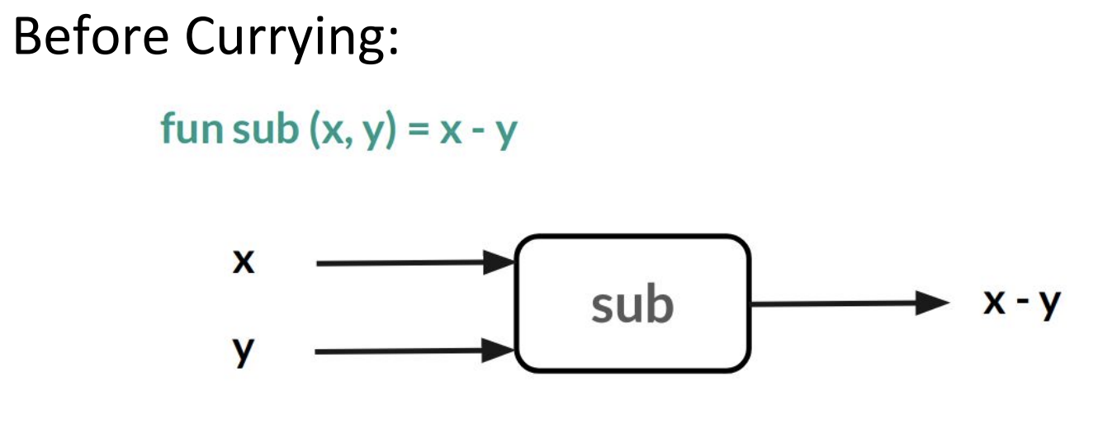
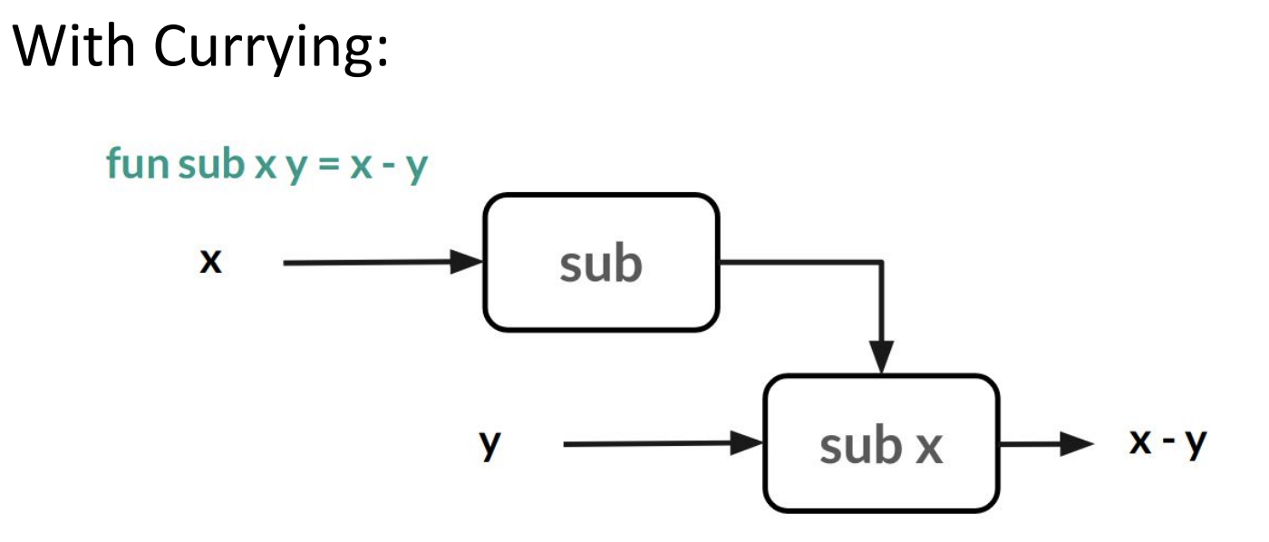
Currying
Recall every ML function takes exactly one argument

Slide 7
Currying
Currying is particularly convenient for creating similar functions with iterators. Here is a curried version of a fold function for lists:
Now we could use this fold to define a function that sums a list elements like this:
. fun sum1 xs = fold (fn (x,y) => x+y) 0 xs .
But that is unnecessarily complicated compared to just using partial application:
. val sum2 = fold (fn (x,y) => x+y) 0 .

Slide 8
Currying
Let’s practice! (a), (b), (e), (i) on Worksheet

Slide 9
Modules
Can group bindings into separate modules
Good for maintaining invariants by hiding implementation details from client
. structure MyModule = struct bindings end .
Inside a module, can use earlier bindings as usual
Can have any kind of binding (val, datatype, exception, ...)
Outside a module, refer to earlier modules’ bindings via
. ModuleName.bindingName .
Just like List.foldl and Char.toLower; now you can define your own modules

Slide 10
Modules
Remember: structure Foo :> BAR is allowed if Foo provides:
every non-abstract type in BAR (as specified)
every abstract type in BAR (in some way)
every val-binding in BAR (can have more general types)
every exception in BAR
Foo can also define things that are not defined in BAR!

Slide 11
Modules
Let’s practice! (a) on Worksheet

Slide 12
Question Time
Feel free to ask questions about material, review questions, etc.

