Slide 1
CSE 341 Section 3
HW1 Tips
Tail Recursion
Pattern-Matching

Slide 2
Agenda
HW1 tips
Avoid reimplementation of functions
Pattern-matching over expression trees
A little tail recursion
What is and isn’t tail recursive?
How can we make functions tail recursive?

Slide 3
Homework 1 Check-In
Things to keep in mind:
Easy to miss things when learning a new language!
Test as you go & design your tests carefully
Read the spec before, during, and after each problem. It’s worth the extra time!
Check for correctness and redundancy/style (and review the CSE 341 Style Guide before submitting!)
Functional programming emphasizes code reuse
Avoid re-implementing functionality where possible
Will become even more important later with higher-order function

Slide 4
Key Concepts Review
Custom datatypes
all of (records), one of (variants)
Pattern matching
Powerful way to break apart data
Tail recursion
Space efficiency of loops with recursive functions

Slide 5
val-Pattern Matching
Remember our unit test?
Just a pattern match!
“Match the left hand side against the value ‘template’ true, binding any variables (there aren’t any!)”
(* Neat trick for creating hard-fail tests: *)
val true = ((4 div 4) = 1);

Slide 6
Adventures in pattern matching
Shape example
Function-pattern syntax if we get to it

Slide 7
Pattern Matching
We can pattern match over datatypes
Beware “non-exhaustive matching”
Pattern matching can avoid “empty list” exceptions!
Most functions pattern match over a single argument
SML has special syntax for this common case!
Use is a matter of taste
Let’s work through some examples!

Slide 8
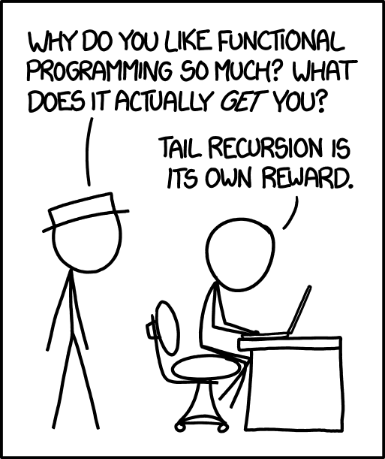
Tail Recursion
What is it?
Briefly: if a function will immediately return after making a call, we can reuse the stack space of the current function.

Slide 9
Tail Recursion
Quickcheck!
Discuss the problems with your breakout rooms!

Slide 10
Tail Recursion
Was length tail recursive?
Was all_positive tail recursive?
Why tail recursion?

