Slide 1
Concurrency: Processes CSE 333 Spring 2021
Instructor: Justin Hsia, Travis McGaha
Teaching Assistants:
Atharva Deodhar Callum Walker Cosmo Wang
Dylan Hartono Elizabeth Haker Eric Marnadi
Kyrie Dowling Leo Liao Markus Schiffer
Neha Nagvekar Nonthakit Chaiwong Ramya Challa

Slide 2
About how long did Exercise 12 take you?
pollev.com/cse333travis
[0, 2) hours
[2, 4) hours
[4, 6) hours
[6, 8) hours
8+ Hours
I didn’t submit / I prefer not to say

Slide 3
Administrivia
hw4 due tomorrow (6/3)
Submissions accepted until Sunday (6/6) @ 11:59 pm
Course evaluations!
Please fill them out. They help all staff members improve their skills as educators and allow us to improve the course for future offerings. ☺
More info on ed

Slide 4
Lecture Outline
Review: Processes vs Threads
fork() details
Concurrent Server with Processes
Conclusion

Slide 5
Previous Lectures
searchserver
Sequential
Concurrent via forking threads – pthread_create()
Concurrent via forking processes – fork()
Concurrent via non-blocking, event-driven I/O – select()
We won’t get to this ☹
Reference: Computer Systems: A Programmer’s Perspective, Chapter 12 (CSE 351 book)

Slide 6
Review: Address Spaces
0xFF…FF
OS kernel [protected]
A process has its own address space
Includes segments for different parts of memory
A process usually has one or more threads
A thread tracks its current state using the stack pointer (SP) and program counter (PC)
New processes are created with:
Stack
SP
Shared Libraries
Heap (malloc/free)
Read/Write Segment .data, .bss
Read-Only Segment .text, .rodata
pid_t fork();
PC
0x00…00

Slide 7


Main Uses of fork()
Fork a child to handle some work
Server forks to handle a new connection
Web browser forks to render a new website
Mainly for security purposes (separate address spaces)
Fork a child that then exec’s a new program
Shell forks and execs the program you want to run
333 grading script forks and execs your executable
Fork a “background” process that is not interactive
Runs independently, doesn’t need a user to be logged in
Called a “Daemon” Process in Linux
Notes:
If you’re curious: Chrome has a process called a Zygote that spawns new processes, one for each website and one for each renderer
https://chromium.googlesource.com/chromium/chromium/+/refs/heads/trunk/content/zygote/zygote_linux.h

Slide 8
Process Isolation
Process Isolation is a set of mechanisms implemented to protect processes from each other and protect the kernel from user processes.
Processes have separate address spaces
Processes have privilege levels to restrict access to resources
If one process crashes, others will keep running
Inter-Process Communication (IPC) is limited, but possible
Pipes via pipe()
Sockets via socketpair()
Shared Memory via shm_open()
Notes:
We typically want processes when we don’t want tasks to interfere with each other
Details of all this is typically covered more in OS

Slide 9
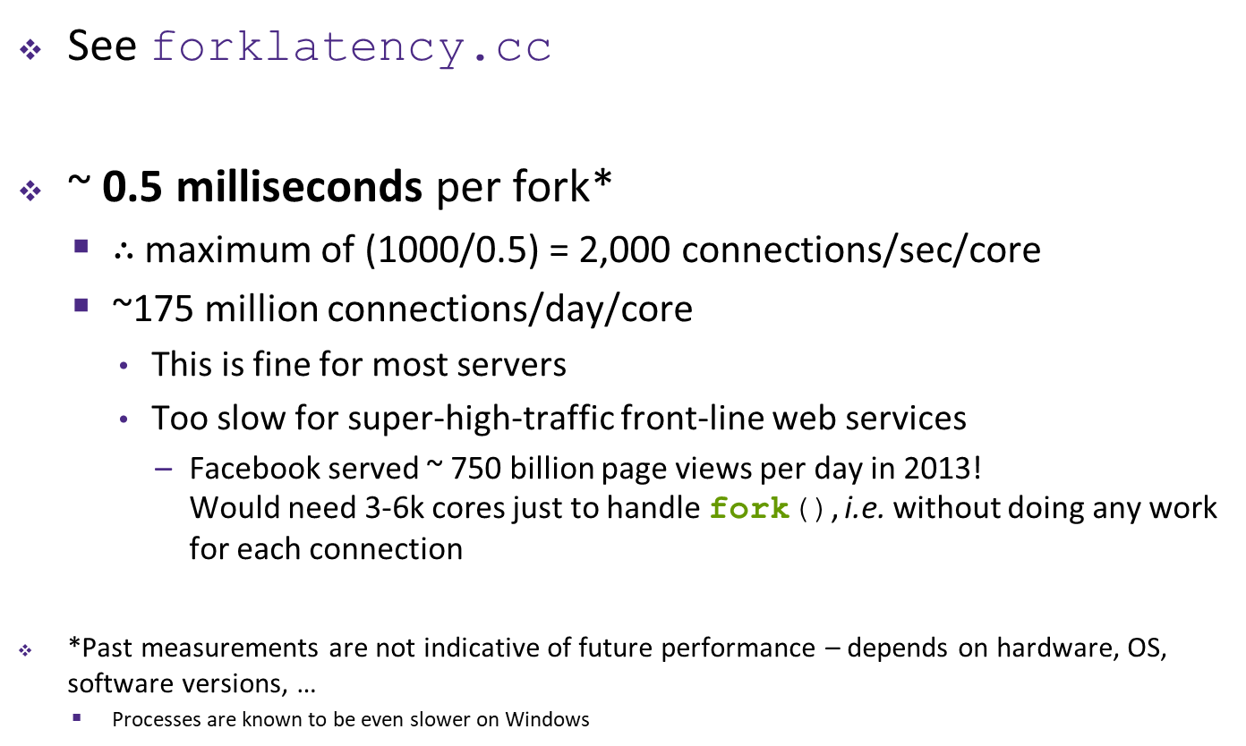
How Fast is fork()?
See forklatency.cc
~ 0.5 milliseconds per fork*
$∴$ maximum of (1000/0.5) = 2,000 connections/sec/core
~175 million connections/day/core
This is fine for most servers
Too slow for super-high-traffic front-line web services
Facebook served ~ 750 billion page views per day in 2013! Would need 3-6k cores just to handle fork(), i.e. without doing any work for each connection
*Past measurements are not indicative of future performance – depends on hardware, OS, software versions, …
Processes are known to be even slower on Windows
Notes:
Two programs to test threadlatency.cc and forklatency.cc
Can run simultaneously on local machine and attu to “race.”

Slide 10
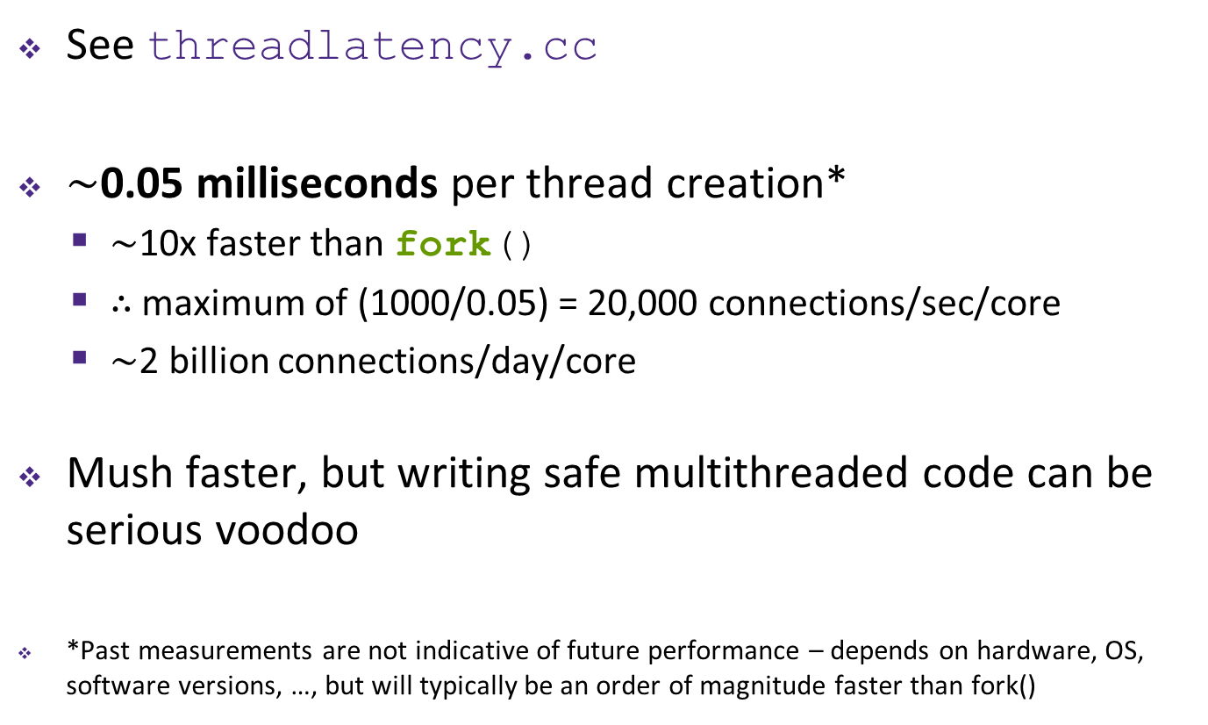
How Fast is pthread_create()?
See threadlatency.cc
$\sim$0.05 milliseconds per thread creation*
$\sim$10x faster than fork()
$∴$ maximum of (1000/0.05) = 20,000 connections/sec/core
$\sim$2 billion connections/day/core
Mush faster, but writing safe multithreaded code can be serious voodoo
*Past measurements are not indicative of future performance – depends on hardware, OS, software versions, …, but will typically be an order of magnitude faster than fork()

Slide 11
Lecture Outline
Review: Processes vs Threads
fork() details
Concurrent Server with Processes
Conclusion

Slide 12
Creating New Processes
Creates a new process (the “child”) that is an exact clone* of the current process (the “parent”)
*Everything is cloned except threads. Sockets, file descriptors, virtual address space, variables, etc.
The new process has a separate virtual address space from the parent
pid_t fork();
Notes:
Since threads aren’t cloned, you typically don’t want to call fork() while you have multiple threads running

Slide 13
fork() and Address Spaces
OS kernel [protected]
OS kernel [protected]
Fork causes the OS to clone the address space
The copies of the memory segments are (nearly) identical
The new process has copies of the parent’s data, stack-allocated variables, open file descriptors, etc.
Stack
Stack
SP
SP
Shared Libraries
Shared Libraries
Heap (malloc/free)
Heap (malloc/free)
Read/Write Segment .data, .bss
Read/Write Segment .data, .bss
Read-Only Segment .text, .rodata
Read-Only Segment .text, .rodata
PC
PC
PARENT
fork()
CHILD

Slide 14
fork()
fork() has peculiar semantics
The parent invokes fork()
The OS clones the parent
Both the parent and the child return from fork
Parent receives child’s pid
Child receives a 0
parent
fork()
OS

Slide 15
fork()
fork() has peculiar semantics
The parent invokes fork()
The OS clones the parent
Both the parent and the child return from fork
Parent receives child’s pid
Child receives a 0
parent
child
clone
OS

Slide 16
fork()
fork() has peculiar semantics
The parent invokes fork()
The OS clones the parent
Both the parent and the child return from fork
Parent receives child’s pid
Child receives a 0
See fork_example.cc
parent
child
child pid
0
OS
Notes:
DEMO: (two windows tiled horizontally and connected to the same attu machine)
Brief code walkthrough of fork_example.cc
(term1) run ./fork_example
(term2) run ps u – see user’s running processes
(term2) run ps u – run again after the child comes alive
(term2) run ps u – run again after the child exits to show zombie designation
(term1) edit fork_example.cc to have the parent only wait 5 seconds and

Slide 17
Concurrent Server with Processes
The parent process blocks on accept(), waiting for a new client to connect
When a new connection arrives, the parent calls fork() to create a child process
The child process handles that new connection and exit()’s when the connection terminates
Remember that children become “zombies” after death
Option A: Parent calls wait() to “reap” children
Option B: Use a double-fork trick
Notes:
Note: For starting a daemon process, the double fork trick is out of date. `systemd` handles setting this stuff up for you Note: There seems to be a function called setsid() that is necessary for setting up daemons
Not Discussed because talking about sessions and process groups would be a lot to talk about…… Good short explanation of sessions, process groups, etc here: https://stackoverflow.com/a/5386753

Slide 18
Double-fork Trick
server

Slide 19
Double-fork Trick
client
connect
server
accept()

Slide 20
Double-fork Trick
client
server
fork() child
server
Notes:
Because fork() copies file descriptors, child has connection to client, too.

Slide 21
Double-fork Trick
client
server
fork() grandchild
server
server

Slide 22
Double-fork Trick
client
server
child exit()’s / parent wait()’s
server

Slide 23
Double-fork Trick
client
server
server
parent closes its
client connection

Slide 24
Double-fork Trick
client
server
server

Slide 25
Double-fork Trick
client
server
server
fork() child
server
fork() grandchild
exit()
client
server

Slide 26
Double-fork Trick
client
server
server
client
server

Slide 27
Double-fork Trick
client
server
client
server
client
server
server
client
server
client
server
client
server
client
server
client
server
client
server

Slide 28
Review Question
pollev.com/cse333travis
What will happen when one of the grandchildren processes finishes?
A. Zombie until grandparent exits
B. Zombie until grandparent reaps
C. Zombie until init reaps
D. ZOMBIE FOREVER!!!
E. We’re lost…
Notes:
DEMO: can run pstree (or pstree | more if on attu) to show init/systemd

Slide 29
Review Question
pollev.com/cse333travis
What will happen when one of the grandchildren processes finishes?
A. Zombie until grandparent exits
B. Zombie until grandparent reaps
C. Zombie until init reaps
D. ZOMBIE FOREVER!!!
E. We’re lost…
with wait
Double fork is done to have process cleaned up without waiting/blocking program
Notes:
DEMO: can run pstree (or pstree | more if on attu) to show init/systemd

Slide 30
Concurrent with Processes Pseudocode
See searchserver_processes/
... // Server set up
while (1) {
sock_fd = accept();
pid = fork();
if (pid == 0) {
// ??? process
} else {
// ??? process
}
}

Slide 31
Concurrent with Processes Pseudocode
See searchserver_processes/
... // Server set up
while (1) {
sock_fd = accept();
pid = fork();
if (pid == 0) {
// Child process
} else {
// Parent process
}
}

Slide 32
Concurrent with Processes Pseudocode
See searchserver_processes/
... // Server set up
while (1) {
sock_fd = accept();
pid = fork();
if (pid == 0) {
// Child process
pid = fork();
if (pid == 0) {
// ??? process
}
} else {
// Parent process
}
}

Slide 33
Concurrent with Processes Pseudocode
See searchserver_processes/
... // Server set up
while (1) {
sock_fd = accept();
pid = fork();
if (pid == 0) {
// Child process
pid = fork();
if (pid == 0) {
// Grand-child process
HandleClient(sock_fd, ...);
}
} else {
// Parent process
}
}

Slide 34
Concurrent with Processes Pseudocode
See searchserver_processes/
... // Server set up
while (1) {
sock_fd = accept();
pid = fork();
if (pid == 0) {
// Child process
pid = fork();
if (pid == 0) {
// Grand-child process
HandleClient(sock_fd, ...);
}
// Clean up resources...
exit();
} else {
// Parent process
}
}

Slide 35
Concurrent with Processes Pseudocode
See searchserver_processes/
... // Server set up
while (1) {
sock_fd = accept();
pid = fork();
if (pid == 0) {
// Child process
pid = fork();
if (pid == 0) {
// Grand-child process
HandleClient(sock_fd, ...);
}
// Clean up resources...
exit();
} else {
// Parent process
// Wait for child to immediately die
wait();
close(sock_fd);
}
}

Slide 36
Lecture Outline
Review: Processes vs Threads
fork() details
Concurrent Server with Processes
Conclusion

Slide 37
Why Concurrent Processes?
Advantages:
No shared memory between processes
No need for language support; OS provides “fork”
Concurrent execution leads to better CPU, network utilization
Disadvantages:
Processes are heavyweight
Relatively slow to fork
Context switching latency is high
Communication between processes is complicated

Slide 38
Aside: Thread Pools
In real servers, we’d like to avoid overhead needed to create a new thread or process for every request
We wrote a Thread Pool implementation for you in HW4
Idea: Thread Pools:
Create a fixed set of worker threads when the server starts
When a request arrives, add it to a queue of tasks (using locks)
Each thread tries to remove a task from the queue (using locks)
When a thread is finished with one task, it tries to get a new task from the queue (using locks)

