Slide 1
Concurrency: Intro and Threads
CSE 333 Spring 2021
Instructor: Justin Hsia, Travis McGaha
Teaching Assistants:
Atharva Deodhar Callum Walker Cosmo Wang
Dylan Hartono Elizabeth Haker Eric Marnadi
Kyrie Dowling Leo Liao Markus Schiffer
Neha Nagvekar Nonthakit Chaiwong Ramya Challa

Slide 2
How far are you in HW4?
pollev.com/cse333travis
I have passed the test_suite
I’ve finished ServerSocket
I’m working on ServerSocket right now
I have read the spec and some of the code
I haven’t looked at it yet
I didn’t submit / I prefer not to say
Side question:
Favourite CSE 333 topic so far?

Slide 3
Administrivia
HW4 due 1 week from tomorrow (06/03)
  You can use two late days on HW4.
Exercise 12 to be released Friday.
  Due Wednesday 6/02 @ 11 am
  The Last Exercise

Slide 4
Some Common HW4 Bugs
Your server works, but is really, really slow
  Check the 2nd argument to the QueryProcessor constructor
Funny things happen after the first request
  Make sure you’re not destroying the HTTPConnection object too early (e.g. falling out of scope in a while loop)
Server crashes on a blank request
  Make sure that you handle the case that read() (or WrappedRead()) returns 0
Notes:
Asking the QueryProcessor to double-check the index every time

Slide 5
Lecture Outline
From Query Processing to a Search Server
Intro to Concurrency
Threads and other concurrency methods
Search Server with pthreads

Slide 6
Building a Web Search Engine
We have:
  Some indexes
    A map from <word> to <list of documents containing the word>
    This is probably sharded over multiple files
  A query processor
    Accepts a query composed of multiple words
    Looks up each word in the index
    Merges the result from each word into an overall result set
Notes:
https://en.wikipedia.org/wiki/Shard_(database_architecture)

Slide 7
Search Engine Architecture
index file
index file
query processor
client
index file
Notes:
So let’s bolt an HTTP server on top of our query processor! What might that look like?

Slide 8
Search Engine (Pseudocode)
doclist Lookup(string word) {
bucket = hash(word);
hitlist = file.read(bucket);
foreach hit in hitlist {
doclist.append(file.read(hit));
}
return doclist;
}
main() {
SetupServerToReceiveConnections();
while (1) {
string query_words[] = GetNextQuery();
results = Lookup(query_words[0]);
foreach word in query[1..n] {
results = results.intersect(Lookup(word));
}
Display(results);
}
}
Notes:
Point out where we’re blocked on disk I/O (Lookup) and network I/O (GetNextQuery/Display)
Do demo of searchserver_sequential here.
(0) terminal 1: searchserver 3333
nc localhost 3333
<search terms>
secretbreakword

Slide 9
Execution Timeline: a Multi-Word Query
results.intersect()
main()
GetNextQuery()
network I/O
disk I/O
disk I/O
disk I/O
network I/O
Lookup()
Lookup()
Lookup()
Display()
CPU
GetNextQuery()
CPU
results.intersect()
• • •
time
query
Notes:
NOT TO SCALE: disk and network I/O are orders of magnitude larger
Assuming 3 words in query: ocean whale ravenous

Slide 10
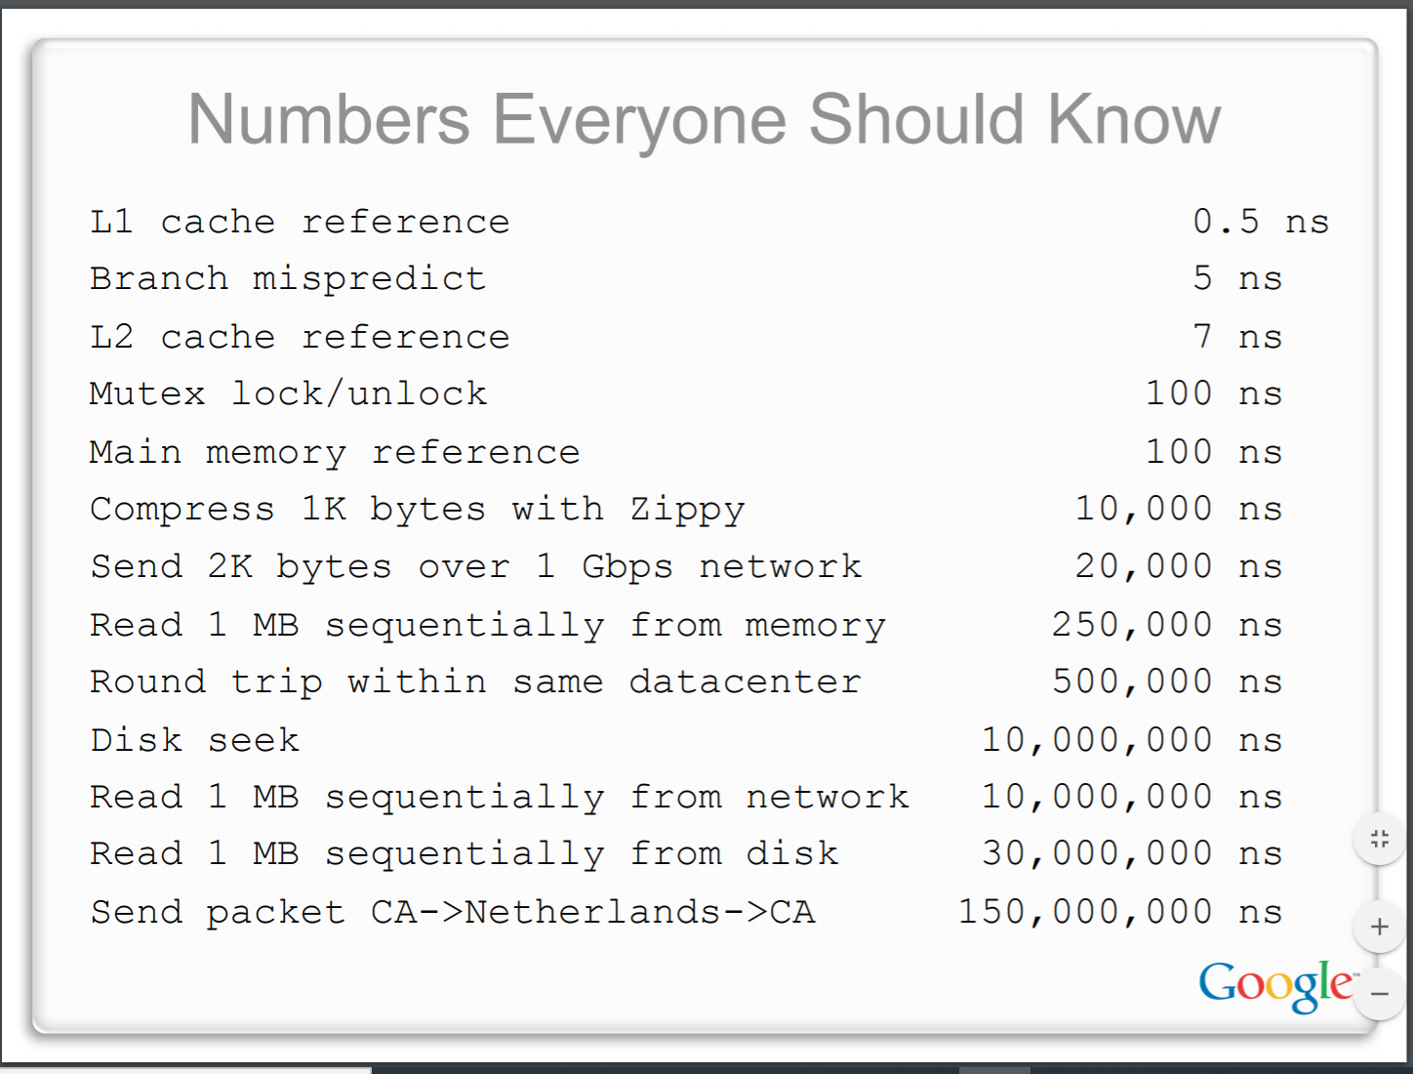
What About I/O-caused Latency?
Jeff Dean’s “Numbers Everyone Should Know” (LADIS ‘09)
Notes:
Takeaway from this slide, it takes a long time to preform I/O on Disk/Network
We saw this same slide in L8 (buffering) and L19 (networking intro).
Again, let’s focus on the orders of magnitude and not on the constants.
Jeff Dean. LADIS09, slide 28. https://www.cs.cornell.edu/projects/ladis2009/talks/dean-keynote-ladis2009.pdf.
More information on these numbers: http://highscalability.com/blog/2011/1/26/google-pro-tip-use-back-of-the-envelope-calculations-to-choo.html

Slide 11
Execution Timeline: To Scale
disk I/O
network I/O
disk I/O
network I/O
disk I/O
main()
CPU
• • •
CPU
time
query

Slide 12
Multiple (Single-Word) Queries
# is the Query Number
#.a -> GetNextQuery()
#.b -> network I/O
#.c -> Lookup() & file.read()
#.d -> Disk I/O
#.e -> Intersect()
& Display()
CPU 3.a | I/O 3.b | CPU 3.c | I/O 3.d | CPU 3.e
CPU 2.a | I/O 2.b | CPU 2.c | I/O 2.d | CPU 2.e
query 3
CPU 1.a | I/O 1.b | CPU 1.c | I/O 1.d | CPU 1.e
query 2
query 1
time
Notes:
NOT TO SCALE: red boxes are orders of magnitude bigger than blue boxes
Now assuming only 1 word per query:
.a – GetNextQuery()
.b – network I/O to get query
.c – Lookup() and file.read()
.d – disk I/O
.e – intersect(), Display()

Slide 13
Multiple Queries: To Scale
I/O 1.b | I/O 1.d
I/O 1.b | I/O 1.d
query 3
I/O 1.b | I/O 1.d
query 2
query 1
time

Slide 14
Uh-Oh (1 of 2)
client
index file
client
index file
query processor
client
client
index file
client

Slide 15
Uh-Oh (2 of 2)
Only one I/O request at a time is “in flight”
The CPU is idle most of the time!
(picture not to scale)
CPU 3.a | I/O 3.b | CPU 3.c | I/O 3.d | CPU 3.e
CPU 2.a | I/O 2.b | CPU 2.c | I/O 2.d | CPU 2.e
query 3
CPU 1.a | I/O 1.b | CPU 1.c | I/O 1.d | CPU 1.e
query 2
Queries don’t run until earlier queries finish
query 1
time

Slide 16
Sequential Can Be Inefficient
Only one query is being processed at a time
  All other queries queue up behind the first one
  And clients queue up behind the queries …
Even while processing one query, the CPU is idle the vast majority of the time
  It is blocked waiting for I/O to complete
    Disk I/O can be very, very slow (10 million times slower …)
At most one I/O operation is in flight at a time
  Missed opportunities to speed I/O up
    Separate devices in parallel, better scheduling of a single device, etc.
Notes:
What we’ve covered so far is known as “sequential programming”
“Clients queuing up behind queries is the head-of-line blocking we saw in HTTP2”

Slide 17
Lecture Outline
From Query Processing to a Search Server
Intro to Concurrency
Concurrent Programming Styles
Threads
Search Server with pthreads

Slide 18
Concurrency
Our search engine could run concurrently:
  Example: Execute queries one at a time, but issue I/O requests against different files/disks simultaneously
    Could read from several index files at once, processing the I/O results as they arrive
  Example: Our web server could execute multiple queries at the same time
    While one is waiting for I/O, another can be executing on the CPU
Concurrency != parallelism
  Concurrency is doing multiple tasks at a time
  Parallelism is executing multiple CPU instructions simultaneously
Notes:
Concurrency is one person cooking multiple dishes at the same time. Parallelism is having multiple people (possibly cooking the same dish).

Slide 19
A Concurrent Implementation
Use multiple “workers”
  As a query arrives, create a new “worker” to handle it
    The “worker” reads the query from the network, issues read requests against files, assembles results and writes to the network
    The “worker” uses blocking I/O; the “worker” alternates between consuming CPU cycles and blocking on I/O
  The OS context switches between “workers”
    While one is blocked on I/O, another can use the CPU
    Multiple “workers’” I/O requests can be issued at once
So what should we use for our “workers”?

Slide 20
Lecture Outline
From Query Processing to a Search Server
Intro to Concurrency
Threads and other concurrency methods
Search Server with pthreads

Slide 21
Review: Processes
The components of a “process” are:
  Resources such as file descriptors and sockets
  An address space (page tables, ect.)
Different Processes have independent components:
  Most importantly: Isolated address spaces.
An address space of a process can hold stack(s) that distinguish different “threads” of execution

Slide 22
Introducing Threads
Separate the concept of a process from the “thread of execution”
  Threads are contained within a process
  Usually called a thread, this is a sequential execution stream within a process
In most modern OS’s:
  Threads are the unit of scheduling.
thread
Notes:
Once we have the idea of “threads” separate from “processes”, we arrive at a world where a process can have multiple threads.
Faster context switching between threads
System can support more threads

Slide 23
Multi-threaded Search Engine (Pseudocode)
main() {
while (1) {
string query_words[] = GetNextQuery();
CreateThread(ProcessQuery(query_words));
}
}
doclist Lookup(string word) {
bucket = hash(word);
hitlist = file.read(bucket);
foreach hit in hitlist
doclist.append(file.read(hit));
return doclist;
}
ProcessQuery(string query_words[]) {
results = Lookup(query_words[0]);
foreach word in query[1..n]
results = results.intersect(Lookup(word));
Display(results);
}
Notes:
This code looks much like our sequential search engine, with some refactoring!

Slide 24
Multi-threaded Search Engine (Execution)
CPU 3.a | I/O 3.b | CPU 3.c | I/O 3.d | CPU 3.e
query 3
CPU 2.a | I/O 2.b
CPU 2.c | I/O 2.d
CPU 2.e
query 2
CPU 1.a | I/O 1.b | CPU 1.c | I/O 1.d | CPU 1.e
query 1
time
Notes:
Still on one CPU/one core – just no overlapping CPU executions (blue). B is network I/O, d is disk I/O
Can make progress on multiple queries concurrently
No need to wait for one to finish
Makes efficient use of resources & CPU

Slide 25
Why Threads?
Advantages:
  You (mostly) write sequential-looking code
  Threads can run in parallel if you have multiple CPUs/cores
Disadvantages:
  If threads share data, you need locks or other synchronization
    Very bug-prone and difficult to debug
  Threads can introduce overhead
    Lock contention, context switch overhead, and other issues
  Need language support for threads
Notes:
https://en.wikipedia.org/wiki/Thread_(computing)#Programming_language_support
(Translation: what exactly a thread is and how it works needs to be specified by the language)
- Overhead: Difference between 1 person changing a lightbulb vs getting together 20 people to do it

Slide 26
Threads vs. Processes
In most modern OS’s:
  A Process has a unique: address space, OS resources,
  & security attributes
  A Thread has a unique: stack, stack pointer, program counter,
  & registers
  Threads are the unit of scheduling and processes are their containers; every process has at least one thread running in it

Slide 27
Threads vs. Processes
OS kernel [protected]
OS kernel [protected]
Stack_{parent}
Stack_{parent}
Stack_{child}
Shared Libraries
pthread_create()
Shared Libraries
Heap (malloc/free)
Heap (malloc/free)
Read/Write Segments
.data, .bss
Read/Write Segments
.data, .bss
Read-Only Segments
.text, .rodata
Read-Only Segments
.text, .rodata

Slide 28
Threads vs. Processes
OS kernel [protected]
OS kernel [protected]
OS kernel [protected]
Stack_{parent}
Stack_{parent}
Stack_{child}
Shared Libraries
fork()
Shared Libraries
Shared Libraries
Heap (malloc/free)
Heap (malloc/free)
Heap (malloc/free)
Read/Write Segments
.data, .bss
Read/Write Segments
.data, .bss
Read/Write Segments
.data, .bss
Read-Only Segments
.text, .rodata
Read-Only Segments
.text, .rodata
Read-Only Segments
.text, .rodata

Slide 29
Alternative: Processes
What if we forked processes instead of threads?
Advantages:
  No shared memory between processes
  No need for language support; OS provides “fork”
  Processes are isolated. If one crashes, other processes keep going
Disadvantages:
  More overhead than threads during creation and context switching
  Cannot easily share memory between processes – typically communicate through the file system
Notes:
- Isolation. Consider the difference between a roommate and a neighbor

Slide 30
Alternate: Different I/O Handling
Use asynchronous or non-blocking I/O
Your program begins processing a query
  When your program needs to read data to make further progress, it registers interest in the data with the OS and then switches to a different query
  The OS handles the details of issuing the read on the disk, or waiting for data from the console (or other devices, like the network)
  When data becomes available, the OS lets your program know
Your program (almost never) blocks on I/O
Notes:
A synchronous: we will be notified somehow when it is done
Non-blocking: we will have to come back and poll() to see if results are ready yet

Slide 31
Non-blocking I/O
Reading from the network can truly block your program
  Remote computer may wait arbitrarily long before sending data
Non-blocking I/O (network, console)
  Your program enables non-blocking I/O on its file descriptors
  Your program issues read() and write() system calls
    If the read/write would block, the system call returns immediately
  Program can ask the OS which file descriptors are readable/writeable
    Program can choose to block while no file descriptors are ready
Notes:
Set file descriptor to non-blocking using fcntl() with the O_NONBLOCK flag.
Returns with special error code EWOULDBLOCK or EAGAIN
select() or poll() to find out when is a good time to retry.

Slide 32
pollev.com/cse333travis
If I wanted to make a web browser, what concurrency model should I use within a single “tab”?
  Note that a web browser may need to request many resources over the network and combine them together to load a page
Do it sequentially
Use threads
Use processes
We’re lost…

Slide 33
pollev.com/cse333travis
If I wanted to make a web browser, what concurrency model should I use within a single “tab”?
  Note that a web browser may need to request many resources over the network and combine them together to load a page
Concurrency will make more efficient use of time
We will need to share the data we request across “workers”
We want to be fast
Do it sequentially
Use threads
Use processes
We’re lost…

Slide 34
Outline (next two lectures)
We’ll look at different searchserver implementations
  Sequential
  Concurrent via dispatching threads – pthread_create()
  Concurrent via forking processes – fork()
Reference: Computer Systems: A Programmer’s Perspective, Chapter 12 (CSE 351 book)

Slide 35
Sequential
Pseudocode:
See searchserver_sequential/
listen_fd = Listen(port);
while (1) {
client_fd = accept(listen_fd);
buf = read(client_fd);
resp = ProcessQuery(buf);
write(client_fd, resp);
close(client_fd);
}

Slide 36
Why Sequential?
Advantages:
  Super(?) simple to build/write
Disadvantages:
  Incredibly poor performance
    One slow client will cause all others to block
    Poor utilization of resources (CPU, network, disk)

Slide 37
Threads
Threads are like lightweight processes
  They execute concurrently like processes
    Multiple threads can run simultaneously on multiple CPUs/cores
  Unlike processes, threads cohabitate the same address space
    Threads within a process see the same heap and globals and can communicate with each other through variables and memory
      But, they can interfere with each other – need synchronization for shared resources
    Each thread has its own stack

Slide 38
Single-Threaded Address Spaces
OS kernel [protected]
Before creating a thread
  One thread of execution running in the address space
    One PC, stack, SP
  That main thread invokes a function to create a new thread
    Typically pthread_create()
Stack_{parent}
SP_{parent}
Shared Libraries
Heap (malloc/free)
Read/Write Segments
.data, .bss
Read-Only Segments
.text, .rodata
PC_{parent}

Slide 39
Multi-threaded Address Spaces
OS kernel [protected]
After creating a thread
  Two threads of execution running in the address space
    Original thread (parent) and new thread (child)
    New stack created for child thread
    Child thread has its own values of the PC and SP
  Both threads share the other segments (code, heap, globals)
    They can cooperatively modify shared data
Stack_{parent}
SP_{parent}
Stack_{child}
SP_{child}
Shared Libraries
Heap (malloc/free)
Read/Write Segments
.data, .bss
Read-Only Segments
.text, .rodata
PC_{child}
PC_{parent}

Slide 40
Lecture Outline
From Query Processing to a Search Server
Intro to Concurrency
Threads
Search Server with pthreads

Slide 41
POSIX Threads (pthreads)
The POSIX APIs for dealing with threads
  Declared in pthread.h
    Not part of the C/C++ language (cf. Java)
  To enable support for multithreading, must include -pthread flag when compiling and linking with gcc command
    gcc –g –Wall –std=c11 –pthread –o main main.c
Notes:
Note that Windows is technically posix-compliant!

Slide 42

Creating and Terminating Threads
  Creates a new thread into *thread, with attributes *attr (NULL means default attributes)
  Returns 0 on success and an error number on error (can check against error constants)
  The new thread runs start_routine(arg)
  Equivalent of exit(retval); for a thread instead of a process
  The thread will automatically exit once it returns from start_routine()
int pthread_create(
pthread_t* thread,
const pthread_attr_t* attr,
void* (*start_routine)(void*),
void* arg);
void pthread_exit(void* retval);
Notes:
The fork in fork-join.

