Slide 1
About how long did Exercise 9 take you?
pollev.com/cse333justin
[0, 2) hours
[2, 4) hours
[4, 6) hours
[6, 8) hours
8+ Hours
I didn’t submit / I prefer not to say

Slide 2
Client-side Networking
CSE 333 Spring 2021
Instructor: Justin Hsia, Travis McGaha
Teaching Assistants:
Atharva Deodhar Callum Walker Cosmo Wang
Dylan Hartono Elizabeth Haker Eric Marnadi
Kyrie Dowling Leo Liao Markus Schiffer
Neha Nagvekar Nonthakit Chaiwong Ramya Challa

Slide 3
Administrivia
Homework 3 is due Thursday (5/20)
  Usual reminders: don’t forget to tag, clone elsewhere, and recompile
Homework 4 will be released on Friday (5/21)
Exercise 10 released today and due Monday (5/24)
  Client-side TCP connection
  Section this week will help!

Slide 4
Resolving DNS Names
The POSIX way is to use getaddrinfo()
  A complicated system call found in #include <netdb.h>
  Basic idea:
    Tell getaddrinfo() which host and port you want resolved
      String representation for host: DNS name or IP address
    Set up a “hints” structure with constraints you want respected
    getaddrinfo() gives you a list of results packed into an “addrinfo” structure/linked list
      Returns 0 on success; returns negative number on failure
    Free the struct addrinfo later using freeaddrinfo()
int getaddrinfo(const char* hostname,
const char* service,
const struct addrinfo* hints,
struct addrinfo** res);
Notes:
http://man7.org/linux/man-pages/man3/getaddrinfo.3.html
https://en.wikipedia.org/wiki/Getaddrinfo

Slide 5
getaddrinfo
getaddrinfo() arguments:
  hostname – domain name or IP address string
  service – port # (e.g., "80") or service name (e.g., "www")
  or NULL/nullptr
struct addrinfo {
int ai_flags; // additional flags
int ai_family; // AF_INET, AF_INET6, AF_UNSPEC
int ai_socktype; // SOCK_STREAM, SOCK_DGRAM, 0
int ai_protocol; // IPPROTO_TCP, IPPROTO_UDP, 0
size_t ai_addrlen; // length of socket addr in bytes
struct sockaddr* ai_addr; // pointer to socket addr
char* ai_canonname; // canonical name
struct addrinfo* ai_next; // can form a linked list
};

Slide 6
DNS Lookup Procedure
Create a struct addrinfo hints
Zero out hints for “defaults”
Set specific fields of hints as desired
Call getaddrinfo() using &hints
Resulting linked list res will have all fields appropriately set
See dnsresolve.cc
struct addrinfo {
int ai_flags; // additional flags
int ai_family; // AF_INET, AF_INET6, AF_UNSPEC
int ai_socktype; // SOCK_STREAM, SOCK_DGRAM, 0
int ai_protocol; // IPPROTO_TCP, IPPROTO_UDP, 0
size_t ai_addrlen; // length of socket addr in bytes
struct sockaddr* ai_addr; // pointer to socket addr
char* ai_canonname; // canonical name
struct addrinfo* ai_next; // can form a linked list
};
Notes:
CODE WALKTHROUGH: dnsresolve.cc
DEMO: ./dnsresolve (shows usage message)
./dnsresolve www.google.com
./dnsresolve attu.cs.washington.edu

Slide 7
Socket API: Client TCP Connection
There are five steps:
  Figure out the IP address and port to connect to
  Create a socket
  Connect the socket to the remote server
  .read() and write() data using the socket
  Close the socket

Slide 8
Step 2: Creating a Socket
Use the socket() system call
  Creating a socket doesn’t bind it to a local address or port yet
  Returns file descriptor or -1 on error
int socket(int domain, int type, int protocol);
socket.cc
#include <arpa/inet.h>
#include <stdlib.h>
#include <string.h>
#include <unistd.h>
#include <iostream>
int main(int argc, char** argv) {
int socket_fd = socket(AF_INET, SOCK_STREAM, 0);
if (socket_fd == -1) {
std::cerr << strerror(errno) << std::endl;
return EXIT_FAILURE;
}
close(socket_fd);
return EXIT_SUCCESS;
}
Notes:
Analogy: tin can telephone – socket produces your tin can/Styrofoam cup
domain: AF_INET, AF_INET6
type: SOCK_STREAM, SOCK_DGRAM, 0
protocol: IPPROTO_TCP, IPPROTO_UDP, 0

Slide 9
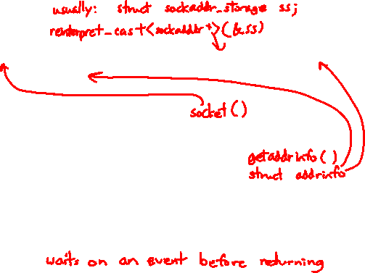
Step 3: Connect to the Server
The connect() system call establishes a connection to a remote host
    sockfd: Socket file description from Step 2
    addr and addrlen: Usually from one of the address structures returned by getaddrinfo in Step 1 (DNS lookup)
    Returns 0 on success and -1 on error
connect() may take some time to return
  It is a blocking call by default
  The network stack within the OS will communicate with the remote host to establish a TCP connection to it
    This involves ~2 round trips across the network
int connect(int sockfd, const struct sockaddr* addr,
socklen_t addrlen);

Slide 10
Connect Example
See connect.cc
// Get an appropriate sockaddr structure.
struct sockaddr_storage addr;
size_t addrlen;
LookupName(argv[1], port, &addr, &addrlen);
// Create the socket.
int socket_fd = socket(addr.ss_family, SOCK_STREAM, 0);
if (socket_fd == -1) {
cerr << "socket() failed: " << strerror(errno) << endl;
return EXIT_FAILURE;
}
// Connect the socket to the remote host.
int res = connect(socket_fd,
reinterpret_cast<sockaddr*>(&addr),
addrlen);
if (res == -1) {
cerr << "connect() failed: " << strerror(errno) << endl;
}

Slide 11
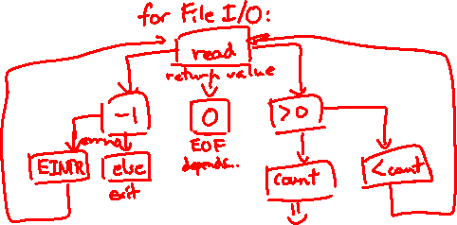
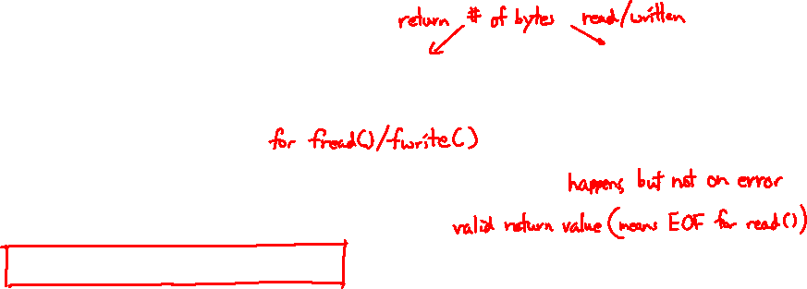
How do we error check read() and write()?
pollev.com/cse333justin
ferror()
Return value less than expected
Return value of 0 or NULL
Return value of -1
We’re lost…

Slide 12
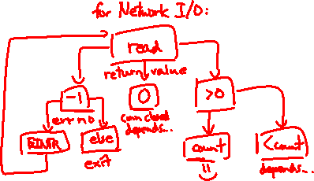

Step 4: read()
If there is data that has already been received by the network stack, then read will return immediately with it
  read() might return with less data than you asked for
If there is no data waiting for you, by default read() will block until something arrives
  How might this cause deadlock?
  Can read() return 0?

Slide 13
Step 4: read()
Assume we have:
  int socket_fd; // fd of connected socket
  char readbuf[BUF]; // read buffer
  int res; // to store read result
Write C++ code to read in BUF characters from socket_fd
  If error occurs, send error message to user and exit()
Notes:
While students are working, prep demo (needs two terminals).
CODE WALKTHROUGH: sendreceive.cc

Slide 14
Step 4: write()
write() queues your data in a send buffer in the OS and then returns
  The OS transmits the data over the network in the background
  When write() returns, the receiver probably has not yet received the data!
If there is no more space left in the send buffer, by default write() will block

Slide 15
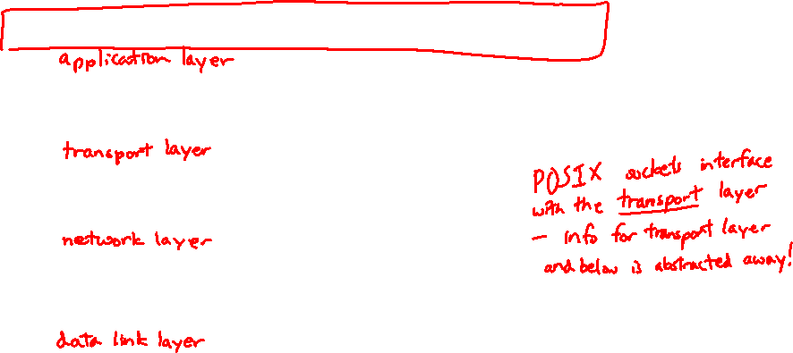
When we call write(), what data do we need to pass to it when writing over the network?
pollev.com/cse333justin
A. Any data our application needs to send
B. All of the above + TCP info
(sequence number, port, …)
C. All of the above + IP info
(source & dest IP addresses…)
D. All of the above + Ethernet info
(source & dest MAC addresses)
E. We’re lost…

Slide 16
Read/Write Example
See sendreceive.cc
while (1) {
int wres = write(socket_fd, readbuf, res);
if (wres == 0) {
cerr << "socket closed prematurely" << endl;
close(socket_fd);
return EXIT_FAILURE;
}
if (wres == -1) {
if (errno == EINTR)
continue;
cerr << "socket write failure: " << strerror(errno) << endl;
close(socket_fd);
return EXIT_FAILURE;
}
break;
}
Notes:
sendreceive demo:
(term1) ./sendreceive
(term2) nc -l 3333; (term1) ./sendreceive 127.0.0.1 3333; (term2) hello, world!
(term2) nc -l 3333; (term1) ./sendreceive 127.0.0.1 3333; (term2) Ctrl-D
(term1) ./sendreceive 127.0.0.1 1111
(term1) ./sendreceive 127.0.0.0 3333

Slide 17
Step 5: close()
  Nothing special here – it’s the same function as with file I/O
  Shuts down the socket and frees resources and file descriptors associated with it on both ends of the connection
int close(int fd);

Slide 18
Extra Exercise #1
Write a program that:
  Reads DNS names, one per line, from stdin
  Translates each name to one or more IP addresses
  Prints out each IP address to stdout, one per line

