Slide 1
About how long did Exercise 8 take you?
pollev.com/cse333justin
[0, 2) hours
[2, 4) hours
[4, 6) hours
[6, 8) hours
8+ Hours
I didn’t submit / I prefer not to say

Slide 2
C++ Inheritance I CSE 333 Spring 2021
Instructor: Justin Hsia, Travis McGaha
Teaching Assistants:
Atharva Deodhar Callum Walker Cosmo Wang
Dylan Hartono Elizabeth Haker Eric Marnadi
Kyrie Dowling Leo Liao Markus Schiffer
Neha Nagvekar Nonthakit Chaiwong Ramya Challa

Slide 3
Administrivia
Mid-quarter survey open now on Canvas and due on Wednesday (5/12)
Exercise 9 released on Wednesday
C++ smart pointers and inheritance
New exercise, expect to be on the longer side (like Ex4)
hw3 is due in two Thursdays (5/20)
Get started early!
Videos for overview and demo (#807) and file debugging (spec)
Partner sign-ups close at end of Wednesday (5/12)
Midterm grading will take a while
Lots of acceptable answers for reflection questions

Slide 4
Overview of Next Two Lectures
C++ inheritance
Review of basic idea (pretty much the same as in Java)
What’s different in C++ (compared to Java)
Static vs. dynamic dispatch – virtual functions and vtables (optional)
Pure virtual functions, abstract classes, why no Java “interfaces”
Assignment slicing, using class hierarchies with STL
Casts in C++
Reference: C++ Primer, Chapter 15

Slide 5
Lecture Outline
Inheritance motivation & C++ Syntax
Polymorphism & Dynamic Dispatch
Virtual Tables & Virtual Table Pointers

Slide 6
Stock Portfolio Example
A portfolio represents a person’s financial investments
Each asset has a cost (i.e., how much was paid for it) and a market value (i.e., how much it is worth)
The difference between the cost and market value is the profit (or loss)
Different assets compute market value in different ways
A stock that you own has a ticker symbol (e.g., “GOOG”), a number of shares, share price paid, and current share price
A dividend stock is a stock that also has dividend payments
Cash is an asset that never incurs a profit or loss
(Credit: thanks to Marty Stepp for this example)
Notes:
GOOG – Google
INTC – Intel Corporation

Slide 7
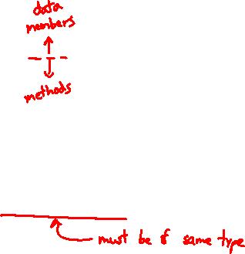
Design Without Inheritance
One class per asset type:
Redundant!
Cannot treat multiple investments together
e.g., can’t have an array or vector of different assets
See sample code in initial/ directory
Stock
symbol_ total_shares_ total_cost_ current_price_
GetMarketValue() GetProfit() GetCost()
DividendStock
symbol_ total_shares_ total_cost_ current_price_ dividends_
GetMarketValue() GetProfit() GetCost()
Cash
amount_
GetMarketValue()
Notes:
optional: show useassets.cc for more example code with unique_ptr<>.

Slide 8

Inheritance
A parent-child “is-a” relationship between classes
A child (derived class) extends a parent (base class)
Terminology:
Mean the same things. You’ll hear both.
Java | C++
Superclass | Base Class
Subclass | Derived Class

Slide 9

Inheritance
A parent-child “is-a” relationship between classes
A child (derived class) extends a parent (base class)
Benefits:
Code reuse
Children can automatically inherit code from parents
Polymorphism
Ability to redefine existing behavior but preserve the interface
Children can override the behavior of the parent
Others can make calls on objects without knowing which part of the inheritance tree it is in
Extensibility
Children can add behavior

Slide 10
Design With Inheritance
Asset (abstract)
GetMarketValue() GetProfit() GetCost()
Stock
symbol_ total_shares_ total_cost_ current_price_
GetMarketValue() GetProfit() GetCost()
Cash
amount_
GetMarketValue()
DividendStock
symbol_ total_shares_ total_cost_ current_price_ dividends_
GetMarketValue() GetProfit() GetCost()

Slide 11
Like Java: Access Modifiers
public: visible to all other classes
protected: visible to current class and its derived classes
private: visible only to the current class
Use protected for class members only when
Class is designed to be extended by derived classes
Derived classes must have access but clients should not be allowed

Slide 12
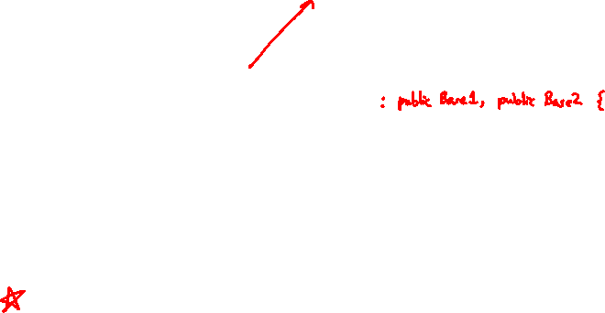
Class Derivation List
Comma-separated list of classes to inherit from:
Focus on single inheritance, but multiple inheritance possible
Almost always you will want public inheritance
Acts like extends does in Java
Any member that is non-private in the base class is the same in the derived class; both interface and implementation inheritance
Except that constructors, destructors, copy constructor, and assignment operator are never inherited
#include "BaseClass.h"
class Name : public BaseClass { ... };

Slide 13
Back to Stocks
BASE DERIVED
Stock
symbol_ total_shares_ total_cost_ current_price_
GetMarketValue() GetProfit() GetCost()
DividendStock
symbol_ total_shares_ total_cost_ current_price_ dividends_
GetMarketValue() GetProfit() GetCost()

Slide 14
Back to Stocks
A derived class:
Inherits the behavior and state (specification) of the base class
Overrides some of the base class’ member functions (opt.)
Extends the base class with new member functions, variables (opt.)
Stock
symbol_ total_shares_ total_cost_ current_price_
GetMarketValue() GetProfit() GetCost()
 | DividendStock
 | dividends_
 | GetMarketValue() GetProfit() GetCost() PayDividend()
Stock
symbol_ total_shares_ total_cost_ current_price_
GetMarketValue() GetProfit() GetCost()

Slide 15
Lecture Outline
Inheritance motivation & C++ Syntax
Polymorphism & Dynamic Dispatch
Virtual Tables & Virtual Table Pointers

Slide 16

Polymorphism in C++
In Java: PromisedType var = new ActualType();
var is a reference (different term than C++ reference) to an object of ActualType on the Heap
ActualType must be the same class or a subclass of PromisedType
In C++: PromisedType* var_p = new ActualType();
var_p is a pointer to an object of ActualType on the Heap
ActualType must be the same or a derived class of PromisedType
(also works with references)
PromisedType defines the interface (i.e., what can be called on var_p), but ActualType may determine which version gets invoked
Notes:
Analogy reminder: labeled box (e.g. box labeled “cell phone” could hold Android or iPhone)

Slide 17

Dynamic Dispatch (like Java)
Usually, when a derived function is available for an object, we want the derived function to be invoked
This requires a run time decision of what code to invoke
A member function invoked on an object should be the most-derived function accessible to the object’s visible type
Can determine what to invoke from the object itself
Example:
void PrintStock(Stock* s) { s->Print(); }
Calls the appropriate Print() without knowing the actual type of *s, other than it is some sort of Stock

Slide 18
Requesting Dynamic Dispatch (C++)
Prefix the member function declaration with the virtual keyword
Derived/child functions don’t need to repeat virtual, but was traditionally good style to do so
This is how method calls work in Java (no virtual keyword needed)
You almost always want functions to be virtual
override keyword (C++11)
Tells compiler this method should be overriding an inherited virtual function – always use if available
Prevents overloading vs. overriding bugs
Both of these are technically optional in derived classes
Be consistent and follow local conventions (Google Style Guide says no virtual if override)
Notes:
override (C++11) is similar to (@override in Java)
Walk through code in inherit.tar

Slide 19
Dynamic Dispatch Example
When a member function is invoked on an object:
The most-derived function accessible to the object’s visible type is invoked (decided at run time based on actual type of the object)
double DividendStock::GetMarketValue() const {
return get_shares() * get_share_price() + dividends_;
}
double "DividendStock"::GetProfit() const { // inherited
return GetMarketValue() – GetCost();
}
DividendStock.cc
double Stock::GetMarketValue() const {
return get_shares() * get_share_price();
}
double Stock::GetProfit() const {
return GetMarketValue() – GetCost();
}
Stock.cc
Notes:
Which GetMarketValue() gets called in DividendStock::GetProfit()?
DividendStock::GetMarketValue()

Slide 20
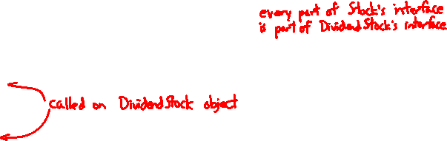
Dynamic Dispatch Example
#include "Stock.h"
#include "DividendStock.h"
DividendStock dividend();
DividendStock* ds = &dividend;
Stock* s = &dividend; // why is this allowed?
// Invokes DividendStock::GetMarketValue()
ds->GetMarketValue();
// Invokes DividendStock::GetMarketValue()
s->GetMarketValue();
// invokes Stock::GetProfit(), since that method is inherited. // Stock::GetProfit() invokes DividendStock::GetMarketValue(), // since that is the most-derived accessible function.
s->GetProfit();

Slide 21
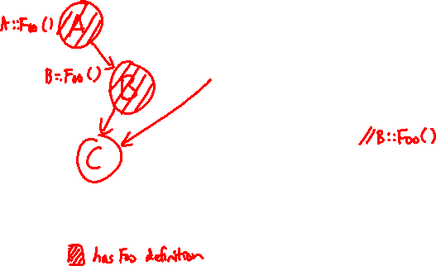
Most-Derived
class A {
public:
// Foo will use dynamic dispatch
virtual void Foo();
};
class B : public A {
public:
// B::Foo overrides A::Foo
virtual void Foo();
};
class C : public B {
// C inherits B::Foo()
};
void Bar() {
A* a_ptr;
C c;
a_ptr = &c;
// Whose Foo() is called?
a_ptr->Foo();
}

Slide 22
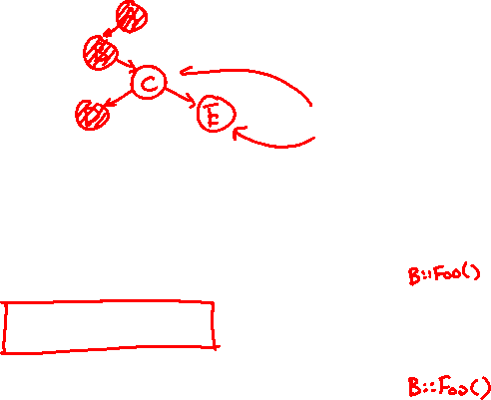
Whose Foo() is called?
pollev.com/cse333justin
class A {
public:
virtual void Foo();
};
class B : public A {
public:
virtual void Foo();
};
class C : public B {
};
class D : public C {
public:
virtual void Foo();
};
class E : public C {
};
Q1 Q2
A. A B
B. A D
C. B B
D. B D
E. We’re lost…
void Bar() {
A* a_ptr;
C c;
E e;
// Q1:
a_ptr = &c;
a_ptr->Foo();
// Q2:
a_ptr = &e;
a_ptr->Foo();
}

Slide 23
Lecture Outline
Inheritance motivation & C++ Syntax
Polymorphism & Dynamic Dispatch
Virtual Tables & Virtual Table Pointers

Slide 24
How Can This Possibly Work?
The compiler produces Stock.o from just Stock.cc
It doesn’t know that DividendStock exists during this process
So then how does the emitted code know to call Stock::GetMarketValue() or DividendStock::GetMarketValue() or something else that might not exist yet?
Function pointers!!!
Stock.h
virtual double Stock::GetMarketValue() const;
virtual double Stock::GetProfit() const;
double Stock::GetMarketValue() const {
return get_shares() * get_share_price();
}
double Stock::GetProfit() const {
return GetMarketValue() – GetCost();
}
Stock.cc

Slide 25
vtables and the vptr
If a class contains any virtual methods, the compiler emits:
A (single) virtual function table (vtable) for the class
Contains a function pointer for each virtual method in the class
The pointers in the vtable point to the most-derived function for that class
A virtual table pointer (vptr) for each object instance
A pointer to a virtual table as a “hidden” member variable
When the object’s constructor is invoked, the vptr is initialized to point to the vtable for the object’s class
Thus, the vptr “remembers” what class the object is

Slide 26
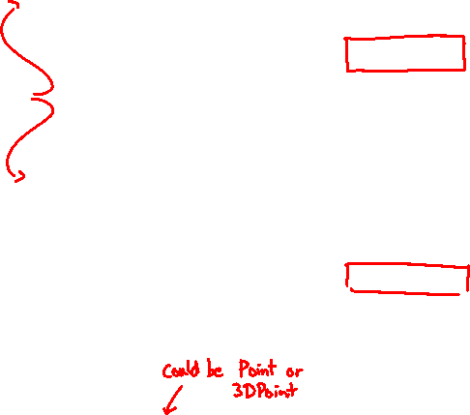
351 Throwback: Dynamic Dispatch
Point object
header
vtable ptr
x
y
Point vtable:
code for Point’s samePlace()
p ???
code for Point()
3DPoint object
header
vtable
x
y
z
code for sayHi()
3DPoint vtable:
code for 3DPoint’s samePlace()
Java:
C pseudo-translation:
Point p = ???;
return p.samePlace(q);
// works regardless of what p is
return p->vtable[1](p, q);

Slide 27
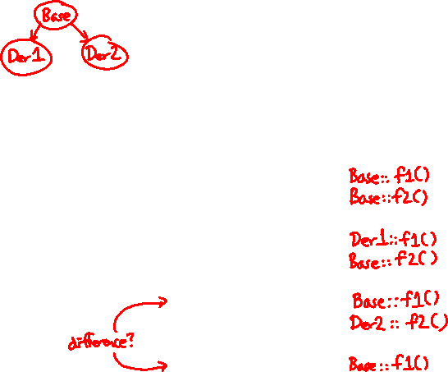
vtable/vptr Example
class Base {
public:
virtual void f1();
virtual void f2();
};
class Der1 : public Base {
public:
virtual void f1();
};
class Der2 : public Base {
public:
virtual void f2();
};
Base b;
Der1 d1;
Der2 d2;
Base* b0ptr = &b;
Base* b1ptr = &d1;
Base* b2ptr = &d2;
b0ptr->f1(); //
b0ptr->f2(); //
b1ptr->f1(); //
b1ptr->f2(); //
b2ptr->f1(); //
b2ptr->f2(); //
d2.f1(); //

Slide 28
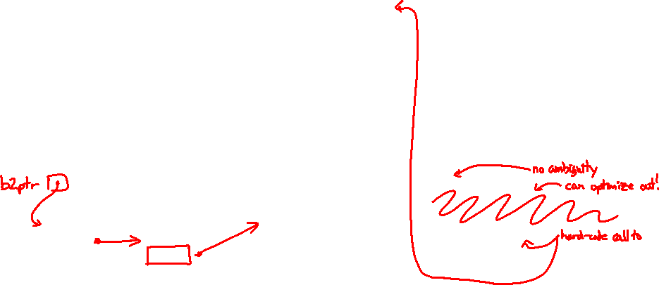
vtable/vptr Example
object
instances
class
vtables
compiled
code
Base b;
Der1 d1;
Der2 d2;
Base* b2ptr = &d2;
b2ptr->f1();
// b2ptr -->
// d2.vptr -->
// Der2.vtable.f1 -->
// Base::f1()
d2.f1();
// d2.vptr -->
// Der2.vtable.f1 -->
// Base::f1()
Base
f1()
f2()
Base::f1()
push %rbp
...
b
vptr
Base::f2()
push %rbp
...
Der1
f1()
f2()
d1
vptr
Der1::f1()
push %rbp
...
Der2
f1()
f2()
Der2::f2()
push %rbp
...
d2
vptr

Slide 29

Let’s Look at Some Actual Code
Let’s examine the following code using objdump
g++ -Wall –g –std=c++17 -o vtable vtable.cc
objdump -CDS vtable > vtable.d
vtable.cc
class Base {
public:
virtual void f1();
virtual void f2();
};
class Der1 : public Base {
public:
virtual void f1();
};
int main(int argc, char** argv) {
Der1 d1;
Base* bptr = &d1;
bptr->f1();
d1.f1();
}
Notes:
-C = demangle (makes C++ function names readable)
-D = disassemble-all
-S = source
DEMO:
wc -l vtable.d
vim vtable.d
Search for “vtable”: in vtable for Base/Der1 show that although objdump is trying to interpret them as instructions, these are really instruction addresses in little endian. f2() address is the same between Base & Der1, while f1() address is different.
Search for “int main”: d1.f1() is hard-coded callq instruction, bptr->f1() is indirect jump on vtable entry (*%rax).

