Slide 1
Which concept has given you the most difficulty so far in the context of Homework 2?
pollev.com/cse333justin
The data structures
C-string manipulations
POSIX I/O
Dynamic memory allocation
GDB
Style considerations
Prefer not to say

Slide 2
C++ STL, Smart Pointers Intro CSE 333 Spring 2021
Instructor: Justin Hsia, Travis McGaha
Teaching Assistants:
Atharva Deodhar Callum Walker Cosmo Wang
Dylan Hartono Elizabeth Haker Kyrie Dowling
Leo Liao Markus Schiffer Neha Nagvekar
Nonthakit Chaiwong Ramya Challa

Slide 3
Administrivia
Exercise 7 is due Monday (5/3)
Last day to commit & tag hw2 is Sunday (5/2)
Make sure these are in the repo you specified on the partner Google form
Midterm starts Tuesday (5/4) and runs until end of Friday
Topics: everything from lecture, exercises, project, etc. up through hw2 and ex7
Written answers – short-answer questions and text file uploads
Gradescope quiz – can open, close, & submit as much as you want
Some discussion allowed if following the Gilligan’s Island Rule
Optional exercise resubmission to earn lost points back

Slide 4
Lecture Outline
STL (finish)
List
Map
Smart Pointers Intro

Slide 5
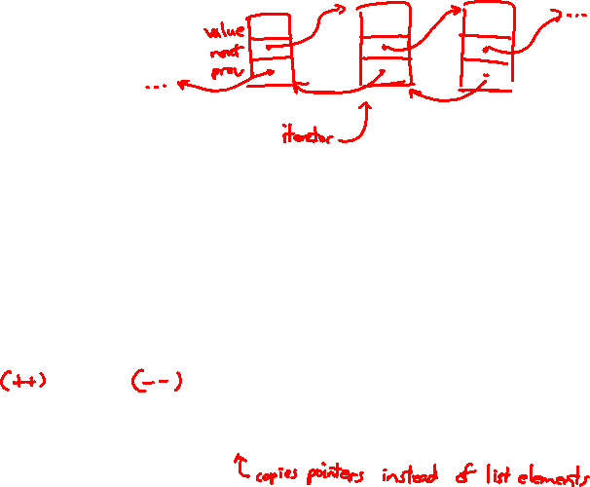
STL list
A generic doubly-linked list
http://www.cplusplus.com/reference/stl/list/
Elements are not stored in contiguous memory locations
Does not support random access (e.g., cannot do list[5])
Some operations are much more efficient than vectors
Constant time insertion, deletion anywhere in list
Can iterate forward or backwards
Has a built-in sort member function
Doesn’t copy! Manipulates list structure instead of element values

Slide 6
list Example
listexample.cc
#include <list>
#include <algorithm>
#include "Tracer.h"
using namespace std;
void PrintOut(const Tracer& p) {
cout << " printout: " << p << endl;
}
int main(int argc, char** argv) {
Tracer a, b, c;
list<Tracer> lst;
lst.push_back(c);
lst.push_back(a);
lst.push_back(b);
cout << "sort:" << endl;
lst.sort();
cout << "done sort!" << endl;
for_each(lst.begin(), lst.end(), &PrintOut);
return EXIT_SUCCESS;
}
Notes:
DEMO: run ./listexample
Only 6 Tracers created total – no moving needed during push_back
No copying/moving during sort()

Slide 7
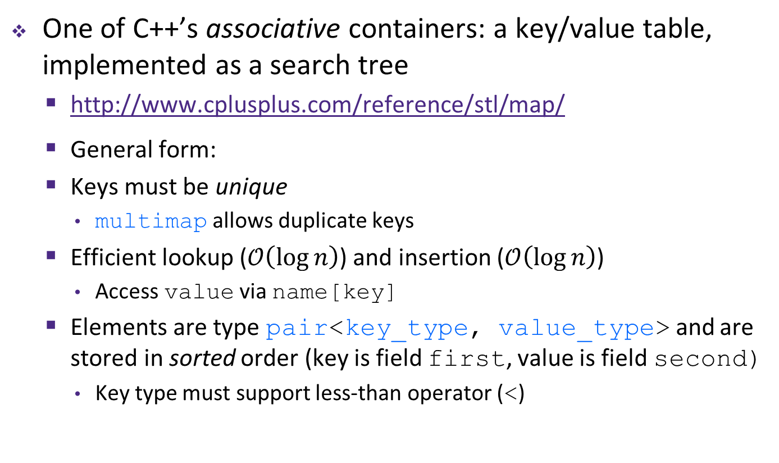
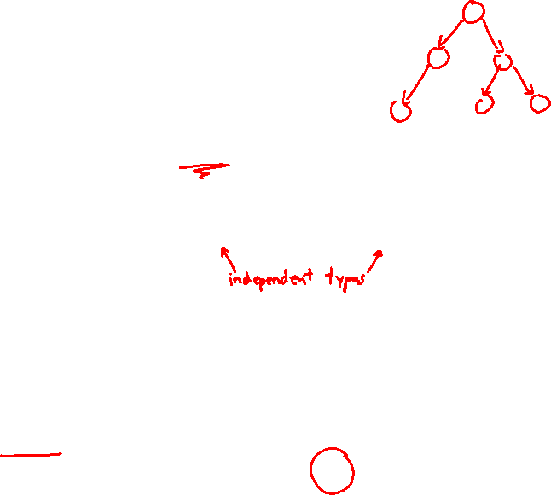
STL map
One of C++’s associative containers: a key/value table, implemented as a search tree
http://www.cplusplus.com/reference/stl/map/
General form:
Keys must be unique
multimap allows duplicate keys
Efficient lookup ($𝒪\left(\log{n}\right)$) and insertion ($𝒪\left(\log{n}\right)$)
Access value via name[key]
Elements are type pair<key_type, value_type> and are stored in sorted order (key is field first, value is field second)
Key type must support less-than operator (<)
map<key_type, value_type> name;

Slide 8
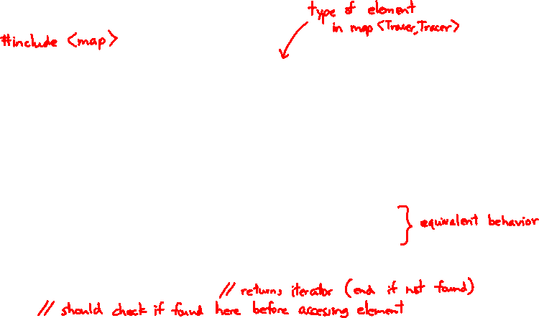
map Example
mapexample.cc
void PrintOut(const pair<Tracer, Tracer>& p) {
cout << "printout: [" << p.first << "," << p.second << "]" << endl;
}
int main(int argc, char** argv) {
Tracer a, b, c, d, e, f;
map<Tracer, Tracer> table;
map<Tracer, Tracer>::iterator it;
table.insert(pair<Tracer, Tracer>(a, b));
table[c] = d;
table[e] = f;
cout << "table[e]:" << table[e] << endl;
it = table.find(c);
cout << "PrintOut(*it), where it = table.find(c)" << endl;
PrintOut(*it);
cout << "iterating:" << endl;
for_each(table.begin(), table.end(), &PrintOut);
return EXIT_SUCCESS;
}
Notes:
DEMO: run ./mapexample
Tracer output – lots of copying!!!

Slide 9
Basic map Usage
animals.cc
Notes:
DEMO: cp mapexample.cc animals.cc
Say “maps are great for dictionaries and for lookup, so let’s store the noises that animals make”
Delete #include <Tracer.h> and Tracer a,b,c,d,e,f lines
Change map name from ‘table’ to ‘animals’
Delete all lines from ‘animals’ to ‘iterating’
Add animals: dog/woof, cat/meow, fish/blub, seal/ow ow ow
Try to find fox: auto it = animals.find(“fox”);
if ( it == animals.end() ) { cout << “not found” << endl; } else { cout << “found” << endl; }
Update PrintOut()
Compile and run animals.cc
Go back and add animals[“fox”]; // map creates entry if you try to access a key that doesn’t exist
Recompile and run animals.cc

Slide 10

Basic map Usage
animals.cc
https://www.youtube.com/watch?v=jofNR_WkoCE
Notes:
DEMO: cp mapexample.cc animals.cc
Say “maps are great for dictionaries and for lookup, so let’s store the noises that animals make”
Delete #include <Tracer.h> and Tracer a,b,c,d,e,f lines
Change map name from ‘table’ to ‘animals’
Delete all lines from ‘animals’ to ‘iterating’
Add animals: dog/woof, cat/meow, fish/blub, seal/ow ow ow
Try to find fox: auto it = animals.find(“fox”);
if ( it == animals.end() ) { cout << “not found” << endl; } else { cout << “found” << endl; }
Update PrintOut()
Compile and run animals.cc
Go back and add animals[“fox”]; // map creates entry if you try to access a key that doesn’t exist
Recompile and run animals.cc

Slide 11
Homegrown pair<>
Notes:
DEMO: after finishing, go to cplusplus.com and search for “pair” to compare against actual template declaration.

Slide 12

Unordered Containers (C++11)
unordered_map, unordered_set
And related classes unordered_multimap, unordered_multiset
Average case for key access is $𝒪\left(1\right)$
But range iterators can be less efficient than ordered map/set
See C++ Primer, online references for details

Slide 13
Lecture Outline
STL (finish)
List
Map
Smart Pointers Intro

Slide 14
Motivation
We noticed that STL was doing an enormous amount of copying
A solution: store pointers in containers instead of objects
But who’s responsible for deleting and when???

Slide 15
C++ Smart Pointers
A smart pointer is an object that stores a pointer to a heap-allocated object
A smart pointer looks and behaves like a regular C++ pointer
By overloading *, ->, [], etc.
These can help you manage memory
The smart pointer will delete the pointed-to object at the right time including invoking the object’s destructor
When that is depends on what kind of smart pointer you use
With correct use of smart pointers, you no longer have to remember when to delete new’d memory!

Slide 16
A Toy Smart Pointer
We can implement a simple one with:
A constructor that accepts a pointer
A destructor that deletes the pointer
Overloaded * and -> operators that access the pointer

Slide 17
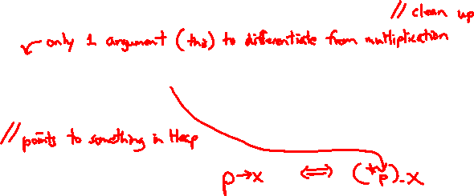
ToyPtr Class Template
ToyPtr.cc
#ifndef TOYPTR_H_
#define TOYPTR_H_
template <typename T> class ToyPtr {
public:
ToyPtr(T* ptr) : ptr_(ptr) { } // constructor
~ToyPtr() { delete ptr_; } // destructor
T& operator*() { return *ptr_; } // * operator
T* operator->() { return ptr_; } // -> operator
private:
T* ptr_; // the pointer itself
};
#endif // TOYPTR_H_
Notes:
The -> operator automatically dereferences its return value before calling its argument using the built-in pointer dereference, not operator*, so you could have the following class:

Slide 18
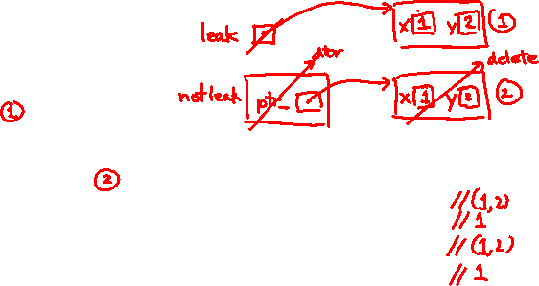
ToyPtr Example
usetoy.cc
#include <iostream>
#include "ToyPtr.h"
// simply struct to use
typedef struct { int x = 1, y = 2; } Point;
std::ostream& operator<<(std::ostream& out, const Point& rhs) {
return out << "(" << rhs.x << "," << rhs.y << ")";
}
int main(int argc, char** argv) {
// Create a raw ("dumb") pointer
Point* leak = new Point;
// Create a "smart" pointer (OK, it's still pretty dumb)
ToyPtr<Point> notleak(new Point);
std::cout << " *leak: " << *leak << std::endl;
std::cout << " leak->x: " << leak->x << std::endl;
std::cout << " *notleak: " << *notleak << std::endl;
std::cout << "notleak->x: " << notleak->x << std::endl;
return EXIT_SUCCESS;
}
Notes:
bash$ ./usepoint
bash$ valgrind --leak-check=full ./usepoint

Slide 19
What Makes This a Toy?
Can’t handle:
Arrays
Copying
Reassignment
Comparison
… plus many other subtleties…
Luckily, others have built non-toy smart pointers for us!
More next lecture!

Slide 20
Extra Exercise #1
Take one of the books from HW2’s test_tree and:
Read in the book, split it into words (you can use your hw2)
For each word, insert the word into an STL map
The key is the word, the value is an integer
The value should keep track of how many times you’ve seen the word, so each time you encounter the word, increment its map element
Thus, build a histogram of word count
Print out the histogram in order, sorted by word count
Bonus: Plot the histogram on a log-log scale (use Excel, gnuplot, etc.)
x-axis: log(word number), y-axis: log(word count)

Slide 21
Extra Exercise #2
Implement Triple, a class template that contains three “things,” i.e., it should behave like std::pair but hold 3 objects instead of 2
The “things” can be of different types
Write a program that:
Instantiates several Triples that contain ToyPtr<int>s
Insert the Triples into a vector
Reverse the vector
Doesn’t have any memory errors (use Valgrind!)
Note: You will need to update ToyPtr.h – how?

