Slide 1
About how long did Exercise 4 take you?
pollev.com/cse333justin
[0, 2) hours
[2, 4) hours
[4, 6) hours
[6, 8) hours
8+ Hours
I didn’t submit / I prefer not to say

Slide 2
C++ Constructor Insanity
CSE 333 Spring 2021
Instructor: Justin Hsia, Travis McGaha
Teaching Assistants:
Atharva Deodhar Callum Walker Cosmo Wang
Dylan Hartono Elizabeth Haker Kyrie Dowling
Leo Liao Markus Schiffer Neha Nagvekar
Nonthakit Chaiwong Ramya Challa

Slide 3
Administrivia
Exercise 6 released today, due Monday
  Write a substantive class in C++ (uses a lot of what we will talk about in lecture today)
Homework 2 due next Thursday (4/29)
  File system crawler, indexer, and search engine
  Note: libhw1.a (yours or ours) and the .h files from hw1 need to be in right directory (~yourgit/hw1/)
  Note: use Ctrl-D to exit searchshell, test on directory of small self-made files
  Partner sign-ups close at end of tonight (4/21) PDT!

Slide 4


struct vs. class
STYLE
TIP
In C, a struct can only contain data fields
  No methods and all fields are always accessible
In C++, struct and class are (nearly) the same!
  Both can have methods and member visibility (public/private/protected)
  Minor difference: members are default public in a struct and default private in a class
Common style convention:
  Use struct for simple bundles of data
  Use class for abstractions with data + functions

Slide 5
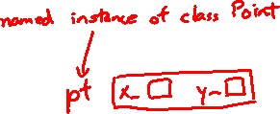
Memory Diagrams for Objects
An object is an instance of a class that maintains its state independent from other objects
  This state is the collection of its data members
  Conceptually, an object acts like a collection of data fields (plus class metadata)
    Layout is not specified or guaranteed, unlike structs in C
Drawn out as variables within variables:
class Point {
...
private:
int x_; // data member
int y_; // data member
}; // class Point

Slide 6
Lecture Outline
Constructors
Copy Constructors
Assignment
Destructors

Slide 7

Constructors
A constructor (ctor) initializes a newly-instantiated object
  A class can have multiple constructors that differ in parameters
  A constructor must be invoked when creating a new instance of an object – which one depends on how the object is instantiated
Written with the class name as the method name:
  C++ will automatically create a synthesized default constructor if you have no user-defined constructors
    Takes no arguments and calls the default ctor on all non-“plain old data” (non-POD) member variables
    Synthesized default ctor will fail if you have non-initialized const or reference data members
Point(const int x, const int y);

Slide 8
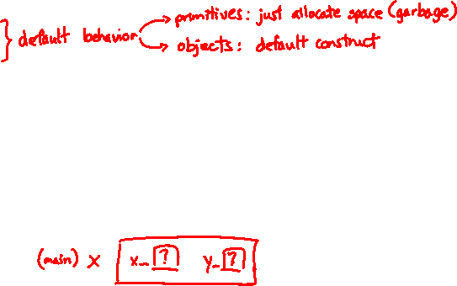
Synthesized Default Constructor Example
class SimplePoint {
public:
// no constructors declared!
int get_x() const { return x_; } // inline member function
int get_y() const { return y_; } // inline member function
double Distance(const SimplePoint& p) const;
void SetLocation(int x, int y);
private:
int x_; // data member
int y_; // data member
}; // class SimplePoint
SimplePoint.h
#include "SimplePoint.h"
... // definitions for Distance() and SetLocation()
int main(int argc, char** argv) {
SimplePoint x; // invokes synthesized default constructor
return EXIT_SUCCESS;
}
SimplePoint.cc
Notes:
Demo: run $ make SimplePoint, then $ ./SimplePoint
- should be garbage, but newer version of gcc may show 0’s (in which case you should skip the demo)
const after member function names: guaranteed not to change _this_

Slide 9

Synthesized Default Constructor
If you define any constructors, C++ assumes you have defined all the ones you intend to be available and will not add any others
#include "SimplePoint.h"
// defining a constructor with two arguments
SimplePoint::SimplePoint(const int x, const int y) {
x_ = x;
y_ = y;
}
void foo() {
SimplePoint x; // compiler error: if you define any
// ctors, C++ will NOT synthesize a
// default constructor for you.
SimplePoint y(1, 2); // works: invokes the 2-int-arguments
// constructor
}

Slide 10
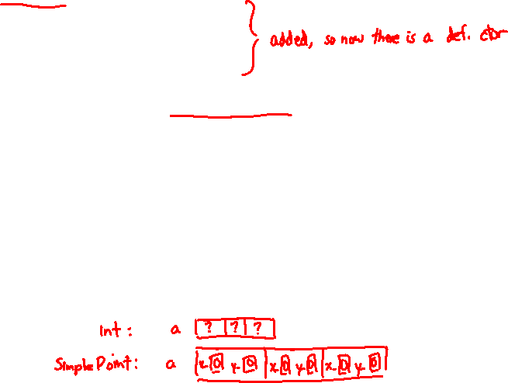
Multiple Constructors (overloading)
#include "SimplePoint.h"
// default constructor
SimplePoint::SimplePoint() {
x_ = 0;
y_ = 0;
}
// constructor with two arguments
SimplePoint::SimplePoint(const int x, const int y) {
x_ = x;
y_ = y;
}
void foo() {
SimplePoint x; // invokes the default constructor
SimplePoint y(1, 2); // invokes the 2-int-arguments ctor
SimplePoint a[3]; // invokes the default ctor 3 times
}

Slide 11
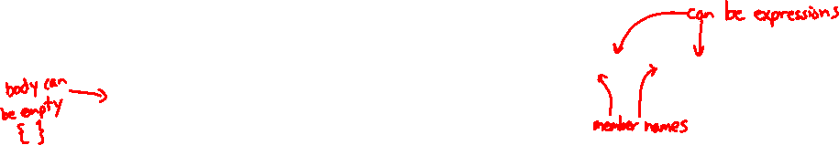
Initialization Lists
C++ lets you optionally declare an initialization list as part of a constructor definition
  Initializes fields according to parameters in the list
  The following two are (nearly) identical:
Point::Point(const int x, const int y) {
x_ = x;
y_ = y;
std::cout << "Point constructed: (" << x_ << ",";
std::cout << y_<< ")" << std::endl;
}
// constructor with an initialization list
Point::Point(const int x, const int y) : x_(x), y_(y) {
std::cout << "Point constructed: (" << x_ << ",";
std::cout << y_<< ")" << std::endl;
}

Slide 12
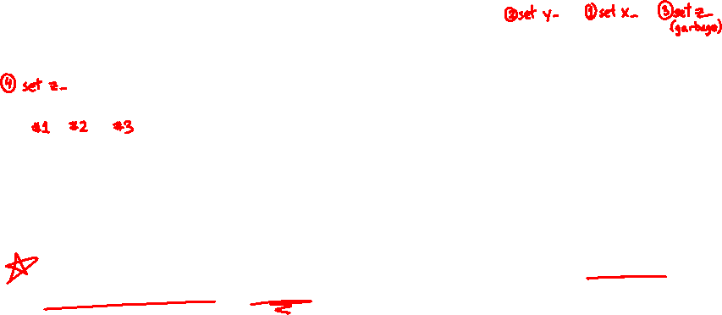
Initialization vs. Construction
STYLE
TIP
  Data members in initializer list are initialized in the order they are defined in the class, not by the initialization list ordering (!)
    Data members that don’t appear in the initialization list are default initialized/constructed before body is executed
  Initialization preferred to assignment to avoid extra steps
    Real code should never mix the two styles
class Point3D {
public:
// constructor with 3 int arguments
Point3D(const int x, const int y, const int z) : y_(y), x_(x) {
z_ = z;
}
private:
int x_, y_, z_; // data members
}; // class Point3D
First, initialization list is applied.
Next, constructor body is executed.

Slide 13
Lecture Outline
Constructors
Copy Constructors
Assignment
Destructors

Slide 14
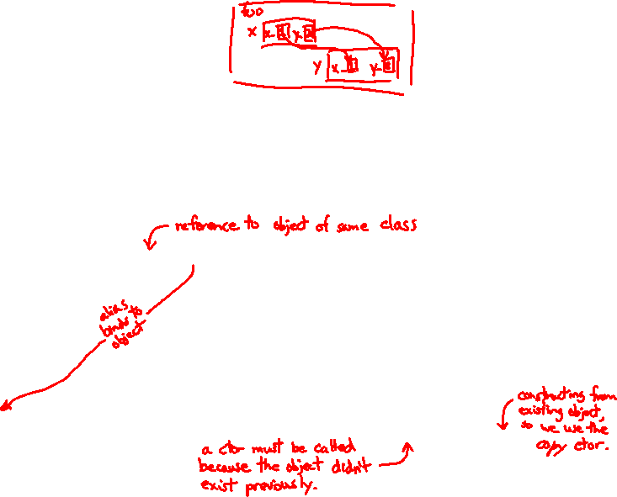
Copy Constructors
STYLE
TIP
C++ has the notion of a copy constructor (cctor)
  Used to create a new object as a copy of an existing object
Point::Point(const int x, const int y) : x_(x), y_(y) { }
// copy constructor
Point::Point(const Point& copyme) {
x_ = copyme.x_;
y_ = copyme.y_;
}
void foo() {
Point x(1, 2); // invokes the 2-int-arguments constructor
Point y(x); // invokes the copy constructor
// could also be written as "Point y = x;"
}
  Initializer lists can also be used in copy constructors (preferred)

Slide 15
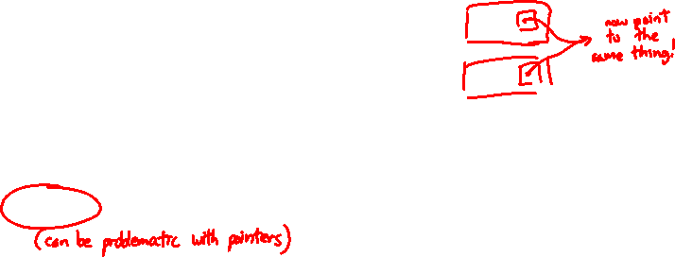
Synthesized Copy Constructor
If you don’t define your own copy constructor, C++ will synthesize one for you
  It will do a shallow copy of all of the fields (i.e., member variables) of your class
  Sometimes the right thing; sometimes the wrong thing
#include "SimplePoint.h"
... // definitions for Distance() and SetLocation()
int main(int argc, char** argv) {
SimplePoint x;
SimplePoint y(x); // invokes synthesized copy constructor
...
return EXIT_SUCCESS;
}

Slide 16
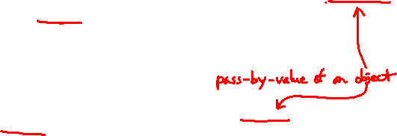
When Do Copies Happen?
The copy constructor is invoked if:
  You initialize an object from
  another object of the same
  type:
  You pass a non-reference
  object as a value parameter
  to a function:
  You return a non-reference
  object value from a function:
Point x; // default ctor
Point y(x); // copy ctor
Point z = y; // copy ctor
void foo(Point x) { ... }
Point y; // default ctor
foo(y); // copy ctor
Point foo() {
Point y; // default ctor
return y; // copy ctor
}

Slide 17
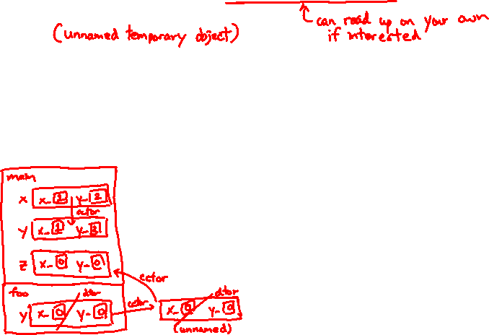
Compiler Optimization
The compiler sometimes uses a “return by value optimization” or “move semantics” to eliminate unnecessary copies
  Sometimes you might not see a constructor get invoked when you might expect it
Point foo() {
Point y; // default ctor
return y; // copy ctor? optimized?
}
int main(int argc, char** argv) {
Point x(1, 2); // two-ints-argument ctor
Point y = x; // copy ctor
Point z = foo(); // copy ctor? optimized?
}

Slide 18
Lecture Outline
Constructors
Copy Constructors
Assignment
Destructors

Slide 19

Assignment != Construction
“=” is the assignment operator
  Assigns values to an existing, already constructed object
Point w; // default ctor
Point x(1, 2); // two-ints-argument ctor
Point y(x); // copy ctor
Point z = w; // copy ctor
y = x; // assignment operator

Slide 20
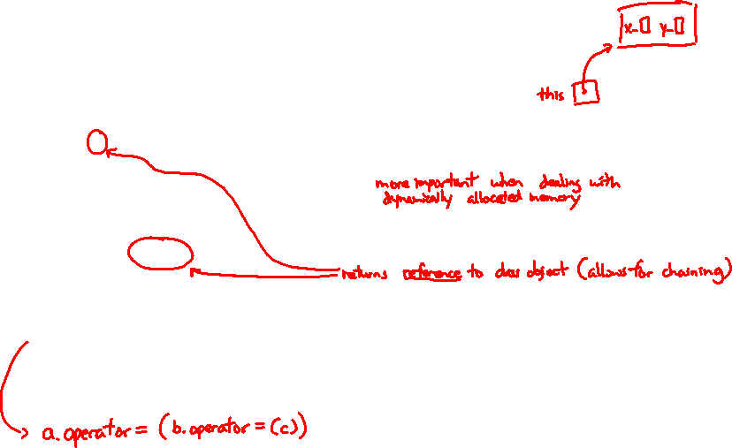
Overloading the “=” Operator
STYLE
TIP
You can choose to define the “=” operator
  But there are some rules you should follow:
Point& Point::operator=(const Point& rhs) {
if (this != &rhs) { // (1) always check against this
x_ = rhs.x_;
y_ = rhs.y_;
}
return *this; // (2) always return *this from op=
}
Point a; // default constructor
a = b = c; // works because = return *this
a = (b = c); // equiv. to above (= is right-associative)
(a = b) = c; // "works" because = returns a non-const

Slide 21
Synthesized Assignment Operator
If you don’t define the assignment operator, C++ will synthesize one for you
  It will do a shallow copy of all of the fields (i.e., member variables) of your class
  Sometimes the right thing; sometimes the wrong thing
#include "SimplePoint.h"
... // definitions for Distance() and SetLocation()
int main(int argc, char** argv) {
SimplePoint x;
SimplePoint y(x);
y = x; // invokes synthesized assignment operator
return EXIT_SUCCESS;
}

Slide 22
Lecture Outline
Constructors
Copy Constructors
Assignment
Destructors

Slide 23
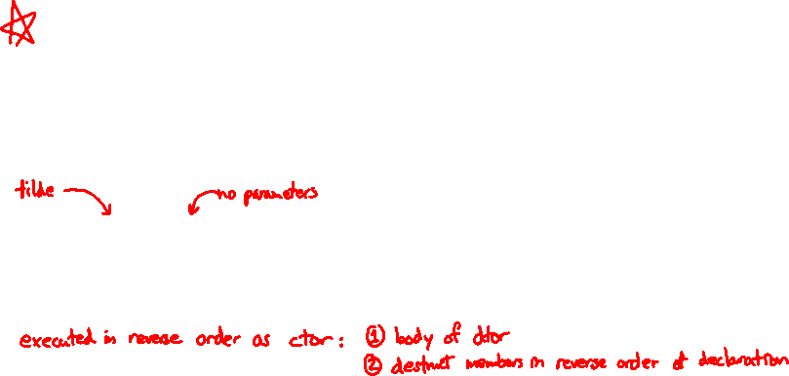
Destructors
C++ has the notion of a destructor (dtor)
  Invoked automatically when a class instance is deleted, goes out of scope, etc. (even via exceptions or other causes!)
  Place to put your cleanup code – free any dynamic storage or other resources owned by the object
  Standard C++ idiom for managing dynamic resources
    Slogan: “Resource Acquisition Is Initialization” (RAII)
Point::~Point() { // destructor
// do any cleanup needed when a Point object goes away
// (nothing to do here since we have no dynamic resources)
}

Slide 24
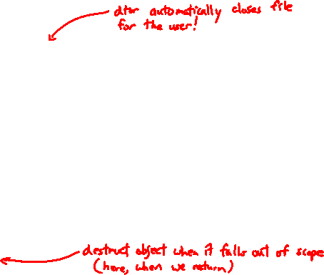
Destructor Example
class FileDescriptor {
public:
FileDescriptor(char* file) { // Constructor
fd_ = open(file, O_RDONLY);
// Error checking omitted
}
~FileDescriptor() { close(fd_); } // Destructor
int get_fd() const { return fd_; } // inline member function
private:
int fd_; // data member
}; // class FileDescriptor
FileDescriptor.h
#include "FileDescriptor.h"
int main(int argc, char** argv) {
FileDescriptor fd(foo.txt);
return EXIT_SUCCESS;
}

Slide 25

pollev.com/cse333justin
How many times does the destructor get invoked?
  Assume Point with everything defined (ctor, cctor, =, dtor)
  Assume no compiler optimizations
A. 1
B. 2
C. 3
D. 4
E. We’re lost…
test.cc
Point PrintRad(Point& pt) {
Point origin(0, 0);
double r = origin.Distance(pt);
double theta = atan2(pt.get_y(), pt.get_x());
cout << "r = " << r << endl;
cout << "theta = " << theta << " rad" << endl;
return pt;
}
int main(int argc, char** argv) {
Point pt(3, 4);
PrintRad(pt);
return EXIT_SUCCESS;
}

Slide 26
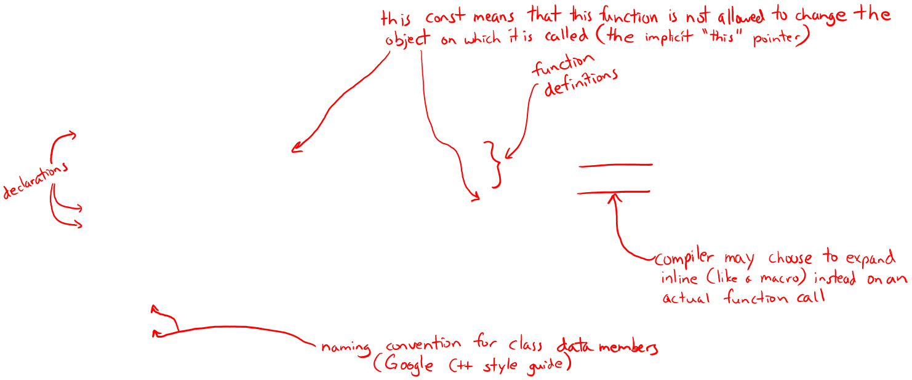
Class Definition (from last lecture)
Point.h
#ifndef POINT_H_
#define POINT_H_
class Point {
public:
Point(int x, int y); // constructor
int get_x() const { return x_; } // inline member function
int get_y() const { return y_; } // inline member function
double Distance(const Point& p) const; // member function
void SetLocation(int x, int y); // member function
private:
int x_; // data member
int y_; // data member
}; // class Point
#endif // POINT_H_
Notes:
const after member function names: guaranteed not to change _this_

Slide 27
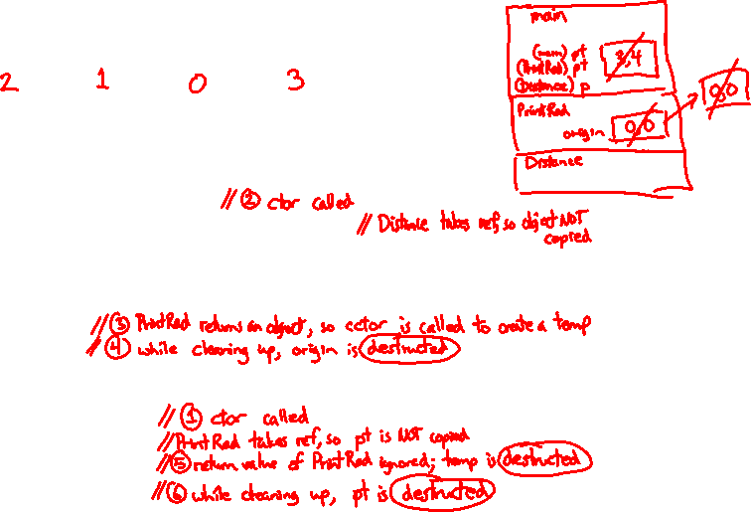
pollev.com/cse333justin
How many times does the destructor get invoked?
ctor | cctor | op= | dtor
test.cc
Point PrintRad(Point& pt) {
Point origin(0, 0);
double r = origin.Distance(pt);
double theta = atan2(pt.get_y(), pt.get_x());
cout << "r = " << r << endl;
cout << "theta = " << theta << " rad" << endl;
return pt;
}
int main(int argc, char** argv) {
Point pt(3, 4);
PrintRad(pt);
return EXIT_SUCCESS;
}

Slide 28

Preview for Next Lecture
class FileDescriptor {
public:
FileDescriptor(char* file) { // Constructor
fd_ = open(file, O_RDONLY);
// Error checking omitted
}
~FileDescriptor() { close(fd_); } // Destructor
int get_fd() const { return fd_; } // inline member function
private:
int fd_; // data member
}; // class FileDescriptor
FileDescriptor.h
#include "FileDescriptor.h"
int main(int argc, char** argv) {
FileDescriptor fd1(foo.txt);
FileDescriptor fd2(fd); // Invokes synthesized cctor
return EXIT_SUCCESS;
}
What happens when we return and destruct our objects?
(This won’t crash the program, but what if we were using heap allocation instead of file descriptors?)

Slide 29
Extra Exercise #1
Modify your Point3D class from Lec 10 Extra #1
  Disable the copy constructor and assignment operator
  Attempt to use copy & assignment in code and see what error the compiler generates
  Write a CopyFrom() member function and try using it instead
    (See details about CopyFrom() in next lecture)

Slide 30
Extra Exercise #2
Write a C++ class that:
  Is given the name of a file as a constructor argument
  Has a GetNextWord() method that returns the next whitespace- or newline-separated word from the file as a copy of a string object, or an empty string once you hit EOF
  Has a destructor that cleans up anything that needs cleaning up

