Slide 1
Which concept has given you the most difficulty so far in the context of Homework 1?
pollev.com/cse333justin
Pointers
Output parameters
Dynamic memory allocation
Structs
GDB
Style considerations
Prefer not to say

Slide 2
Makefiles & C++ Preview CSE 333 Spring 2021
Instructor: Justin Hsia, Travis McGaha
Teaching Assistants:
Atharva Deodhar Callum Walker Cosmo Wang
Dylan Hartono Elizabeth Haker Kyrie Dowling
Leo Liao Markus Schiffer Neha Nagvekar
Nonthakit Chaiwong Ramya Challa

Slide 3
Administrivia
Exercise 4 posted Monday, due next Monday
Implement lite versions of C std I/O functions using POSIX
Read a directory and open/copy text files found there
Homework 1 due tomorrow night (4/15)
Watch for pointer to local (stack) variables
Use a debugger (e.g., gdb) if you’re getting segfaults
Clean up “to do” comments, but leave “STEP #” markers
Late days: don’t tag hw1-final until you are really ready
Homework 2 will be released on Friday (4/16)
Partners allowed – see Ed post #354 for sign-up & matching forms

Slide 4
System Calls Simplified Overview
The operating system (OS) is a super complicated “program overseer” program for the computer
The only software that is directly trusted with hardware access
If a user process wants to access an OS feature, they must invoke a system call
A system call involves context switching into the OS/kernel, which has some overhead
The OS will handle hardware/special functionality directly (in privileged mode) while user processes wait and don’t touch anything themselves
OS will eventually finish, return result to user process, and context switch back

Slide 5

System Call Analogy #1
The OS is a very wise and knowledgeable wizard
It has access to many dangerous and powerful artifacts, but it doesn’t trust others to use them
If a civilian/Muggle wants to have a magical task performed, they must request it from the wizard
Requests take time to setup and start – prep and safety
The wizard will handle/use the powerful artifacts; the civilian is NOT ALLOWED TO TOUCH ANYTHING
The wizard will take a second to analyze results and clean up artifacts before giving results back to the civilian

Slide 6



System Call Analogy #2
The OS is a bank manager overseeing safety deposit boxes in the vault
Is the only one allowed in the vault and has the keys to the safety deposit boxes
If a client wants to access a deposit box (i.e., add or remove items), they must request that the bank manager do it for them
Takes time to locate and travel to box and find the right key
Client must wait in the lobby while the bank manager accesses the box – prevents messing with requested box or other boxes
Takes time to put box away, return from vault, and let client know that request was fulfilled

Slide 7

strace
A useful Linux utility that shows the sequence of system calls that a process makes:
bash$ strace ls 2>&1 | less
execve("/usr/bin/ls", ["ls"], [/* 41 vars */]) = 0
brk(NULL) = 0x15aa000
mmap(NULL, 4096, PROT_READ|PROT_WRITE, MAP_PRIVATE|MAP_ANONYMOUS, -1, 0) = 0x7f03bb741000
access("/etc/ld.so.preload", R_OK) = -1 ENOENT (No such file or directory)
open("/etc/ld.so.cache", O_RDONLY|O_CLOEXEC) = 3
fstat(3, {st_mode=S_IFREG|0644, st_size=126570, ...}) = 0
mmap(NULL, 126570, PROT_READ, MAP_PRIVATE, 3, 0) = 0x7f03bb722000
close(3) = 0
open("/lib64/libselinux.so.1", O_RDONLY|O_CLOEXEC) = 3
read(3, "\177ELF\2\1\1\0\0\0\0\0\0\0\0\0\3\0>\0\1\0\0\0\300j\0\0\0\0\0\0"..., 832) = 832
fstat(3, {st_mode=S_IFREG|0755, st_size=155744, ...}) = 0
mmap(NULL, 2255216, PROT_READ|PROT_EXEC, MAP_PRIVATE|MAP_DENYWRITE, 3, 0) = 0x7f03bb2fa000
mprotect(0x7f03bb31e000, 2093056, PROT_NONE) = 0
mmap(0x7f03bb51d000, 8192, PROT_READ|PROT_WRITE, MAP_PRIVATE|MAP_FIXED|MAP_DENYWRITE, 3, 0x23000) = 0x7f03bb51d000
... etc ...

Slide 8
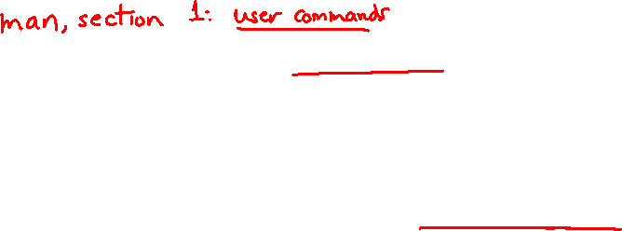
If You’re Curious
Download the Linux kernel source code
Available from http://www.kernel.org/
man, section 2: Linux system calls
man 2 intro
man 2 syscalls
man, section 3: glibc/libc library functions
man 3 intro
The book: The Linux Programming Interface by Michael Kerrisk (keeper of the Linux man pages)
Notes:
man 1 – user commands
man 2 – Linux system calls
man 3 – library functions

Slide 9
Lecture Outline
Make and Build Tools
Makefile Basics
C++ Preview

Slide 10
make
make is a classic program for controlling what gets (re)compiled and how
Many other such programs exist (e.g., ant, maven, IDE “projects”)
make has tons of fancy features, but only two basic ideas:
Scripts for executing commands
Dependencies for avoiding unnecessary work
To avoid “just teaching make features” (boring and narrow), let’s focus more on the concepts…

Slide 11
Building Software
Programmers spend a lot of time “building”
Creating programs from source code
Both programs that they write and other people write
Programmers like to automate repetitive tasks
Repetitive: gcc -Wall -g -std=c17 -o widget foo.c bar.c baz.c
Retype this every time: 😭
Use up-arrow or history: 😐 (still retype after logout)
Have an alias or bash script: 🙂
Have a Makefile: 😊 (you’re ahead of us)

Slide 12

“Real” Build Process
On larger projects, you can’t or don’t want to have one big (set of) command(s) that are all run every time you change anything. To do things “smarter,” consider:
It could be worse: If gcc didn’t combine steps for you, you’d need to preprocess, compile, and link on your own (along with anything you used to generate the C files)
Source files could have multiple outputs (e.g., javadoc). You may have to type out the source file name(s) multiple times
You don’t want to have to document the build logic when you distribute source code; make it relatively simple for others to build
You don’t want to recompile everything every time you change something (especially if you have 10⁵-10⁷ files of source code)
A script can handle 1-3 (use a variable for filenames for 2), but 4 is trickier

Slide 13

Recompilation Management
The “theory” behind avoiding unnecessary compilation is a dependency dag (directed, acyclic graph)
To create a target $t$, you need sources $s_{1}, s_{2}, …, s_{n}$ and a command $c$ that directly or indirectly uses the sources
It $t$ is newer than every source (file-modification times), assume there is no reason to rebuild it
Recursive building: if some source $s_{i}$ is itself a target for some other sources, see if it needs to be rebuilt…
Cycles “make no sense”!

Slide 14
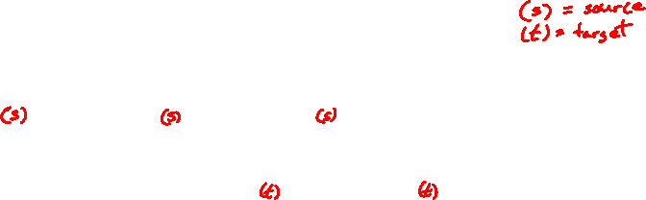
Theory Applied to C
Compiling a .c creates a .o – the .o depends on the .c and all included files (.h, recursively/transitively)
foo.h
foo.c
bar.c
Source files
Statically-linked libraries
libZ.a
foo.o
bar.o
Object files
bar
Executable

Slide 15
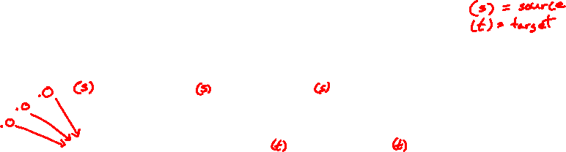
Theory Applied to C
Compiling a .c creates a .o – the .o depends on the .c and all included files (.h, recursively/transitively)
An archive (library, .a) depends on included .o files
foo.h
foo.c
bar.c
Source files
Statically-linked libraries
libZ.a
foo.o
bar.o
Object files
bar
Executable

Slide 16
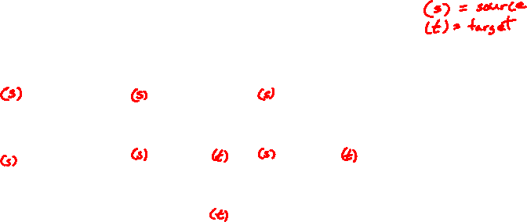
Theory Applied to C
Compiling a .c creates a .o – the .o depends on the .c and all included files (.h, recursively/transitively)
An archive (library, .a) depends on included .o files
Creating an executable (“linking”) depends on .o files and archives
Archives linked by -L<path> -l<name> (e.g., -L. -lfoo to get libfoo.a from current directory)
foo.h
foo.c
bar.c
Source files
Statically-linked libraries
libZ.a
foo.o
bar.o
Object files
bar
Executable

Slide 17
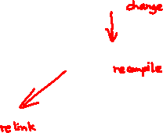
Theory Applied to C
If one .c file changes, just need to recreate one .o file, maybe a library, and re-link
If a .h file changes, may need to rebuild more
Many more possibilities!
foo.h
foo.c
bar.c
Source files
Statically-linked libraries
libZ.a
foo.o
bar.o
Object files
bar
Executable

Slide 18
Lecture Outline
Make and Build Tools
Makefile Basics
C++ Preview

Slide 19

make Basics
A makefile contains a bunch of triples:
Colon after target is required
Command lines must start with a TAB, NOT SPACES
Multiple commands for same target are executed in order
Can split commands over multiple lines by ending lines with ‘\’
Example:
target: sources
command
$←$ Tab $→$
foo.o: foo.c foo.h bar.h
gcc -Wall -o foo.o -c foo.c

Slide 20
Using make
Defaults:
If no -f specified, use a file named Makefile in current dir
If no target specified, will use the first one in the file
Will interpret commands in your default shell
Set SHELL variable in makefile to ensure
Target execution:
Check each source in the source list:
If the source is a target in the makefile, then process it recursively
If some source does not exist, then error
If any source is newer than the target (or target does not exist), run command (presumably to update the target)
bash$ make -f <makefileName> target
Notes:
Configure needs to figure things out like “where is the compiler?”.

Slide 21
“Phony” Targets
A make target whose command does not create a file of the target’s name (i.e., a “recipe”)
As long as target file doesn’t exist, the command(s) will be executed because the target must be “remade”
e.g., target clean is a convention to remove generated files to “start over” from just the source
e.g., target all is a convention to build all “final products” in the makefile
Lists all of the “final products” as sources
clean:
rm foo.o bar.o baz.o widget *~
Notes:
https://www.gnu.org/software/make/manual/html_node/Phony-Targets.html

Slide 22
“all” Example
5
6
1
all: prog B.class someLib.a
# notice no commands this time
prog: foo.o bar.o main.o
gcc –o prog foo.o bar.o main.o
B.class: B.java
javac B.java
someLib.a: foo.o baz.o
ar r foo.o baz.o
foo.o: foo.c foo.h header1.h header2.h
gcc -c -Wall foo.c
# similar targets for bar.o, main.o, baz.o, etc...
2
4
3
7
8
Notes:
Note how .h files are not listed in the gcc command. They are implicitly added via #include

Slide 23
make Variables
You can define variables in a makefile:
All values are strings of text, no “types”
Variable names are case-sensitive and can’t contain ‘:’, ‘#’, ‘=’, or whitespace
Example:
Advantages:
Easy to change things (especially in multiple commands)
It’s common to use variables to hold lists of filenames
Can also specify/overwrite variables on the command line: (e.g., make CC=clang CFLAGS=-g)
CC = gcc
CFLAGS = -Wall -std=c17
OBJFILES = foo.o bar.o baz.o
widget: $(OBJFILES)
$(CC) $(CFLAGS) -o widget $(OBJFILES)

Slide 24

Makefile Writing Tips
STYLE
TIP
STYLE
TIP
When creating a Makefile, first draw the dependencies!!!!
C Dependency Rules:
.c and .h files are never targets, only sources.
Each .c file will be compiled into a corresponding .o file
Header files will be implicitly used via #include
Executables will typically be built from one or more .o file
Good Conventions:
Include a clean rule
If you have more than one “final target,” include an all rule
The first/top target should be your singular “final target” or all

Slide 25
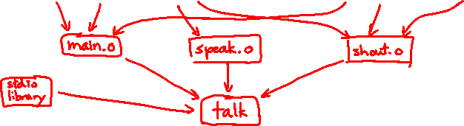
Writing a Makefile Example
“talk” program (find files on web with lecture slides)
main.c
speak.h
speak.c
shout.h
shout.c
speak.c
main.c
#include "speak.h"
...
#include "speak.h"
#include "shout.h"
int main(int argc, char** argv) {…
shout.c
#include "speak.h"
#include "shout.h"
...

Slide 26

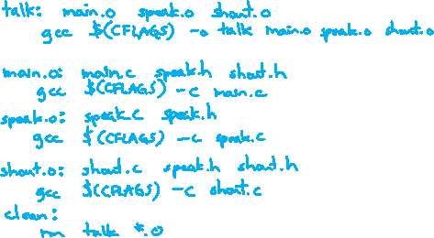
Writing a Makefile Example
“talk” program (find files on web with lecture slides)
main.c
speak.h
speak.c
shout.h
shout.c
main.o
speak.o
shout.o
talk

Slide 27
Revenge of the Funny Characters
Special variables:
$@ for target name
$^ for all sources
$< for left-most source
Lots more! – see the documentation
Examples:
# CC and CFLAGS defined above
widget: foo.o bar.o
$(CC) $(CFLAGS) -o $@ $^
foo.o: foo.c foo.h bar.h
$(CC) $(CFLAGS) -c $<

Slide 28
And more…
There are a lot of “built-in” rules – see documentation
There are “suffix” rules and “pattern” rules
Example:
Remember that you can put any shell command – even whole scripts!
You can repeat target names to add more dependencies
Often this stuff is more useful for reading makefiles than writing your own (until some day…)
%.class: %.java
javac $< # we need the $< here

Slide 29
Lecture Outline
Make and Build Tools
Makefile Basics
C++ Preview

Slide 30
Programming Terminology Review
Encapsulation and Abstraction: Hiding implementation details (restricting access) and associating behaviors (methods) with data
Polymorphism: The provision of a single interface to entities of different types
Generics: Algorithms written in terms of types to-be-specified-later

Slide 31
Encapsulation and Abstraction (C)
Used header file conventions and the static specifier to separate “private” functions, definitions, and constants from “public”
Used forward-declared structs and opaque pointers (i.e., void*) to hide implementation-specific details
Can’t associate behaviors with encapsulated state
Functions that operate on a LinkedList not actually tied to the struct
Really difficult to mimic – implemented primarily via coding conventions

Slide 32
Encapsulation and Abstraction (C++)
Support for classes and objects!
Public, private, and protected access specifiers
Methods and instance variables ("this")
(Multiple!) inheritance
Polymorphism
Static polymorphism: multiple functions or methods with the same name, but different argument types (overloading)
Works for all functions, not just class members
Dynamic (subtype) polymorphism: derived classes can override methods of parents, and methods will be dispatched correctly

Slide 33
Generics (C)
Generic linked list and hash table by using void* payload
Function pointers to generalize different behavior for data structures
Comparisons, deallocation, pickling up state, etc.
Emulated generic data structures primarily by disabling type system

Slide 34
Generics (C++)
Templates facilitate generic data types
Parametric polymorphism: same idea as Java generics, but different in details, particularly implementation
A vector of ints: vector<int> x;
A vector of floats: vector<float> x;
A vector of (vectors of floats): vector<vector<float>> x;
Specialized casts to increase type safety

Slide 35
Namespaces (C)
Names are global and visible everywhere
Can use static to prevent a name from being visible outside a source file (as close as C gets to “private”)
Naming conventions help avoid collisions in the global namespace
e.g., LinkedList_Allocate, HTIterator_Next, etc.
Avoid collisions primarily via coding conventions

Slide 36
Namespaces (C++)
Explicit namespaces!
The linked list module could define an “LL” namespace while the hash table module could define an “HT” namespace
Both modules could define an Iterator class
One would be globally named LL::Iterator and the other would be globally named HT::Iterator
Classes also allow duplicate names without collisions
Classes can also define their own pseudo-namespace, very similar to Java static inner classes

Slide 37
Standard Library (C)
C does not provide any standard data structures
We had to implement our own linked list and hash table
Hopefully, you can use somebody else’s libraries
But C’s lack of abstraction, encapsulation, and generics means you’ll probably end up tweak them or tweak your code to use them
YOU implement the data structures that you need

Slide 38
Standard Library (C++)
Generic containers: bitset, queue, list, associative array (including hash table), deque, set, stack, and vector
And iterators for most of these
A string class: hides the implementation of strings
Streams: allows you to stream data to and from objects, consoles, files, strings, and so on
Generic algorithms: sort, filter, remove duplicates, etc.

Slide 39
Error Handling (C)
Error handling is a pain
Define error codes and return them
Either directly return or via a “global” like errno
No type checking: does 1 mean EXIT_FAILURE or true?
Customers and implementors need to constantly test return values
e.g., if a() calls b(), which calls c()
a depends on b to propagate an error in c back to it
Error handling is a pain – mixture of coding conventions and discipline

Slide 40
Error Handling (C++)
Supports exceptions!
try / throw / catch
If used with discipline, can simplify error processing
If used carelessly, can complicate memory management
Consider: a() calls b(), which calls c()
If c() throws an exception that b() doesn’t catch, you might not get a chance to clean up resources allocated inside b()
We will largely avoid in 333
You still benefit from having more interpretable errors!
But much C++ code still needs to work with C & old C++ libraries, so still uses return codes, exit(), etc.

Slide 41
Some Tasks Still Hurt in C++
Memory management
C++ has no garbage collector
You still have to manage memory allocation & deallocation and track
It’s still possible to have leaks, double frees, and so on
But there are some things that help
“Smart pointers”
Classes that encapsulate pointers and track reference counts
Deallocate memory when the reference count goes to zero
C++’s constructors and destructors permit a pattern known as “Resource Allocation Is Initialization” (RAII)
Useful for releasing memory, locks, database transactions, etc.

Slide 42
Some Tasks Still Hurt in C++
C++ doesn’t guarantee type or memory safety
You can still:
Forcibly cast pointers between incompatible types
Walk off the end of an array and smash memory
Have dangling pointers
Conjure up a pointer to an arbitrary address of your choosing

Slide 43
How to Think About C++
Set of styles and ways to use C++
Style guides
Good styles and robust engineering practices
Set of styles and ways to use C
Notes:
Technically there are things you can do in c but not c++
Main is not a function is an example of this.

Slide 44


Or…
In the hands of a disciplined programmer, C++ is a powerful tool
But if you’re not so disciplined about how you use C++…

Slide 45
On the topic of compilation…
This is cool trivia, but totally unnecessary to know. Hopefully you enjoy it :)
What’s the best compilation message?
C will let you do many things, many of which you should not do.
This is an example of something you should NEVER do.
You can write a program that runs and prints!
Not portable though…
bash$ gcc –g – Wall –std=c11 –o msg msg.c msg.c:1:6: warning: 'main' is usually a function [-Wmain]
not_a_function.c
const int main[] = { -443987883, 440, 113408, -1922629632, 4149, 2013696, 84869120, 15544, 266023168, 1818576901, 1126199148, 857752915, 169947955, 1936269379, 1701344288, 1936024096, -1878384268, 521126749, 1096237312, 1447165833 }
Credit to this blog: http://jroweboy.github.io/c/asm/2015/01/26/when-is-main-not-a-function.html

