Slide 1
About where are you on Homework 1?
pollev.com/cse333justin
Haven’t started yet
Working on Part A (LinkedList)
Working on Part B (HashTable)
Finished or about finished
Prefer not to say
Notes:
Don’t wait – Part B is longer and harder than Part A
OH get crowded – come prepared to describe your incorrect behavior and what you think the issue is and what you’ve tried

Slide 2
Linking, File I/O CSE 333 Spring 2021
Instructor: Justin Hsia, Travis McGaha
Teaching Assistants:
Atharva Deodhar Callum Walker Cosmo Wang
Dylan Hartono Elizabeth Haker Kyrie Dowling
Leo Liao Markus Schiffer Neha Nagvekar
Nonthakit Chaiwong Ramya Challa

Slide 3

Administrivia
Exercise 3 posted Wednesday, due Monday (4/12)
Homework 1 due next Thursday (4/15)
Watch that HashTable doesn’t violate the modularity of LinkedList
Watch for pointer to local (stack) variables
Draw memory diagrams!
Use a debugger (e.g., gdb) and valgrind
Fill out your bug journal as you go!
Please leave “STEP #” markers for graders!
Late days: don’t tag hw1-final until you are really ready
Extra Credit: if you add unit tests, put them in a new file and adjust the Makefile

Slide 4
Preprocessor Tricks: Macros
You can pass arguments to macros
Beware of operator precedence issues!
Use parentheses
#define ODD(x) ((x) % 2 != 0)
void foo() {
if ( ODD(5) )
printf("5 is odd!\n");
}
void foo() {
if ( ((5) % 2 != 0) )
printf("5 is odd!\n");
}
cpp
#define ODD(x) ((x) % 2 != 0)
#define WEIRD(x) x % 2 != 0
ODD(5 + 1);
WEIRD(5 + 1);
((5 + 1) % 2 != 0);
5 + 1 % 2 != 0;
cpp

Slide 5
Preprocessor Tricks: Defining Tokens
Besides #defines in the code, preprocessor values can be given as part of the gcc command:
assert can be controlled the same way – defining NDEBUG causes assert to expand to “empty”
It’s a macro – see assert.h
bash$ gcc -Wall -g -DTRACE -o ifdef ifdef.c
bash$ gcc -Wall -g -DNDEBUG -o faster useassert.c

Slide 6
Preprocessor Tricks: Conditional Compilation
You can change what gets compiled
In this example, #define TRACE before #ifdef to include debug printfs in compiled code
#ifdef TRACE
#define ENTER(f) printf("Entering %s\n", f);
#define EXIT(f) printf("Exiting %s\n", f);
#else
#define ENTER(f)
#define EXIT(f)
#endif
// print n
void pr(int n) {
ENTER("pr");
printf("\n = %d\n", n);
EXIT("pr");
}
ifdef.c

Slide 7

What will happen when we try to compile and run?
pollev.com/cse333justin
A. Output "333"
B. Output "334"
C. Compiler message about EVEN
D. Compiler message about BAZ
E. We’re lost…
bash$ gcc -Wall –DFOO -DBAR -o condcomp condcomp.c
bash$ ./condcomp
#ifdef FOO
#define EVEN(x) !(x%2)
#endif
#ifndef DBAR
#define BAZ 333
#endif
int main(int argc, char** argv) {
int i = EVEN(42) + BAZ;
printf("%d\n",i);
return EXIT_SUCCESS;
}

Slide 8
Lecture Outline
Visibility of Symbols
extern, static
File I/O with the C standard library

Slide 9

Namespace Problem
If we define a global variable named “counter” in one C file, is it visible in a different C file in the same program?
Yes, if you use external linkage
The name “counter” refers to the same variable in both files
The variable is defined in one file and declared in the other(s)
When the program is linked, the symbol resolves to one location
No, if you use internal linkage
The name “counter” refers to a different variable in each file
The variable must be defined in each file
When the program is linked, the symbols resolve to two locations

Slide 10
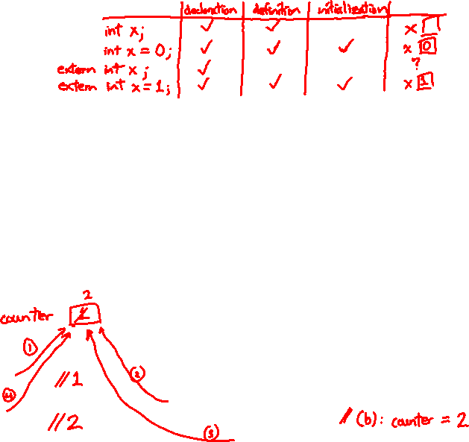
External Linkage
extern makes a declaration of something externally-visible
Works slightly differently for variables and functions…
#include <stdio.h>
#include <stdlib.h>
// A global variable, defined and
// initialized here in foo.c.
// It has external linkage by
// default.
int counter = 1;
int main(int argc, char** argv) {
printf("%d\n", counter);
bar();
printf("%d\n", counter);
return EXIT_SUCCESS;
}
#include <stdio.h>
// "counter" is defined and
// initialized in foo.c.
// Here, we declare it, and
// specify external linkage
// by using the extern specifier.
extern int counter;
void bar() {
counter++;
printf("(b): counter = %d\n",
counter);
}
bar.c
foo.c

Slide 11
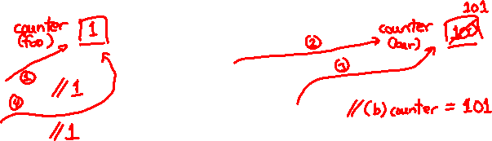
Internal Linkage
static (in the global context) restricts a definition to visibility within that file
#include <stdio.h>
#include <stdlib.h>
// A global variable, defined and
// initialized here in foo.c.
// We force internal linkage by
// using the static specifier.
static int counter = 1;
int main(int argc, char** argv) {
printf("%d\n", counter);
bar();
printf("%d\n", counter);
return EXIT_SUCCESS;
}
#include <stdio.h>
// A global variable, defined and
// initialized here in bar.c.
// We force internal linkage by
// using the static specifier.
static int counter = 100;
void bar() {
counter++;
printf("(b): counter = %d\n",
counter);
}
bar.c
foo.c

Slide 12
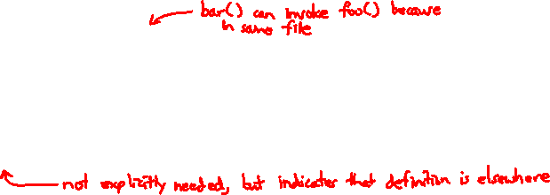
Function Visibility
// By using the static specifier, we are indicating
// that foo() should have internal linkage. Other
// .c files cannot see or invoke foo().
static int foo(int x) {
return x*3 + 1;
}
// Bar is "extern" by default. Thus, other .c files
// could declare our bar() and invoke it.
int bar(int x) {
return 2*foo(x);
}
bar.c
#include <stdio.h>
#include <stdlib.h>
extern int bar(int x); // "extern" is default, usually omit
int main(int argc, char** argv) {
printf("%d\n", bar(5));
return EXIT_SUCCESS;
}
main.c

Slide 13


Linkage Issues
STYLE
TIP
Every global (variables and functions) is extern by default
Unless you add the static specifier, if some other module uses the same name, you’ll end up with a collision!
Best case: compiler (or linker) error
Worst case: stomp all over each other
It’s good practice to:
Use static to “defend” your globals
Hide your private stuff!
Place external declarations in a module’s header file
Header is the public specification

Slide 14
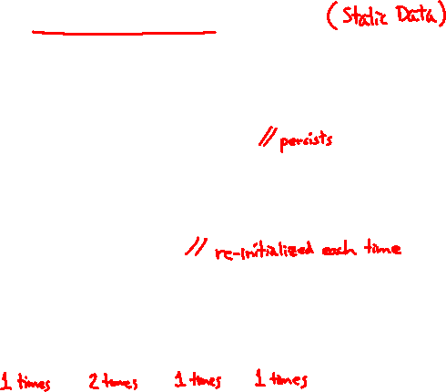
Static Confusion…
C has a different use for the word “static”: to create a persistent local variable
The storage for that variable is allocated when the program loads, in either the .data or .bss segment
Retains its value across multiple function invocations
void foo() {
static int count = 1;
printf("foo has been called %d times\n", count++);
}
void bar() {
int count = 1;
printf("bar has been called %d times\n", count++);
}
int main(int argc, char** argv) {
foo(); foo(); bar(); bar(); return EXIT_SUCCESS;
}
static_extent.c

Slide 15
Additional C Topics
Teach yourself!
man pages are your friend!
String library functions in the C standard library
#include <string.h>
strlen(), strcpy(), strdup(), strcat(), strcmp(), strchr(), strstr(), …
#include <stdlib.h> or #include <stdio.h>
atoi(), atof(), sprint(), sscanf()
How to declare, define, and use a function that accepts a variable-number of arguments (varargs)
unions and what they are good for
enums and what they are good for
Pre- and post-increment/decrement
Harder: the meaning of the “volatile” storage class

Slide 16
Lecture Outline
Visibility of Symbols
extern, static
File I/O with the C standard library
This is essential material for the next part of the project (hw2)!

Slide 17
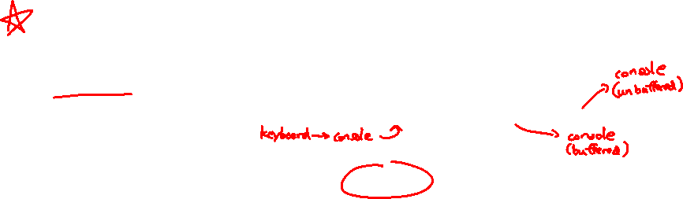
File I/O
We’ll start by using C’s standard library
These functions are part of glibc on Linux
They are implemented using Linux system calls (POSIX)
C’s stdio defines the notion of a stream
A sequence of characters that flows to and from a device
Can be either text or binary; Linux does not distinguish
Is buffered by default; libc reads ahead of your program
Three streams provided by default: stdin, stdout, stderr
You can open additional streams to read and write to files
C streams are manipulated with a FILE* pointer, which is defined in stdio.h
Notes:
stdin – for reading user input from the keyboard
stdout – for printing non-error output to the console
stderr – for printing error output to the console
Can redirect the default streams using the freopen() function.

Slide 18

C Stream Functions (1 of 2)
Some stream functions (complete list in stdio.h):
FILE* fopen(filename, mode);
Opens a stream to the specified file in specified file access mode
int fclose(stream);
Closes the specified stream (and file)
int fprintf(stream, format, ...);
Writes a formatted C string
printf(...); is equivalent to fprintf(stdout, ...);
int fscanf(stream, format, ...);
Reads data and stores data matching the format string
FILE* fopen(filename, mode);
int fclose(stream);
int fprintf(stream, format, ...);
int fscanf(stream, format, ...);
Notes:
Open http://www.cplusplus.com/reference/cstdio/ to demo how to look up reference information.
FILE* stream
char* filename, format, mode;

Slide 19
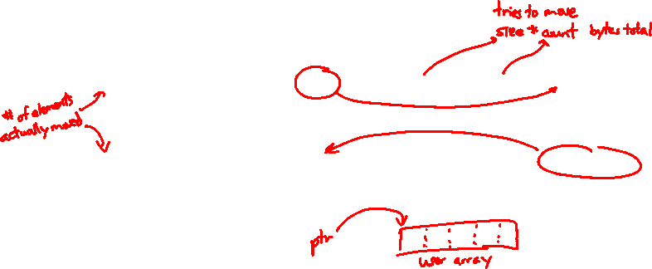
C Stream Functions (2 of 2)
Some stream functions (complete list in stdio.h):
FILE* fopen(filename, mode);
Opens a stream to the specified file in specified file access mode
int fclose(stream);
Closes the specified stream (and file)
int fprintf(stream, format, ...);
Writes an array of count elements of size bytes from ptr to stream
int fscanf(stream, format, ...);
Reads an array of count elements of size bytes from stream to ptr
FILE* fopen(filename, mode);
int fclose(stream);
size_t fwrite(ptr, size, count, stream);
size_t fread(ptr, size, count, stream);
Notes:
FILE* stream
char* filename, format, mode;

Slide 20
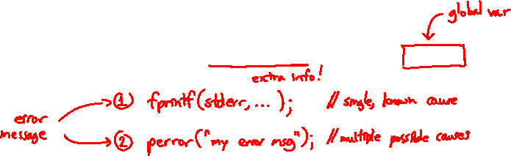
C Stream Error Checking/Handling
Some error functions (complete list in stdio.h):
int ferror(stream);
Checks if the error indicator associated with the specified stream is set
void clearerr(stream);
Resets error and EOF indicators for the specified stream
void perror(message);
Prints message followed by an error message related to errno to stderr
int ferror(stream);
int clearerr(stream);
void perror(message);
Notes:
FILE* stream
char* filename, format, mode;

Slide 21
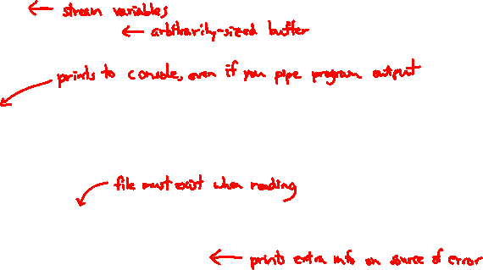
C Streams Example
cp_example.c
#include <stdio.h>
#include <stdlib.h>
#include <errno.h>
#define READBUFSIZE 128
int main(int argc, char** argv) {
FILE *fin, *fout;
char readbuf[READBUFSIZE];
size_t readlen;
if (argc != 3) {
fprintf(stderr, "usage: ./cp_example infile outfile\n");
return EXIT_FAILURE; // defined in stdlib.h
}
// Open the input file
fin = fopen(argv[1], "rb"); // "rb" -> read, binary mode
if (fin == NULL) {
perror("fopen for read failed");
return EXIT_FAILURE;
}
...

Slide 22
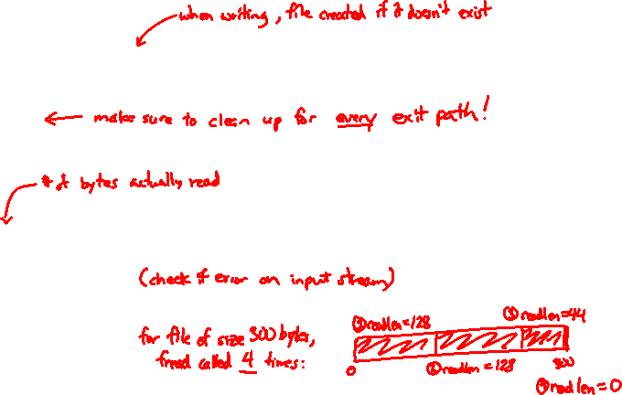
C Streams Example
cp_example.c
int main(int argc, char** argv) {
... // previous slide’s code
// Open the output file
fout = fopen(argv[2], "wb"); // "wb" -> write, binary mode
if (fout == NULL) {
perror("fopen for write failed");
fclose(fin);
return EXIT_FAILURE;
}
// Read from the file, write to fout
while ((readlen = fread(readbuf, 1, READBUFSIZE, fin)) > 0) {
// Test to see if we encountered an error while reading
if (ferror(fin)) {
perror("fread failed");
fclose(fin);
fclose(fout);
return EXIT_FAILURE;
}
... // next slide’s code
}
Notes:
size_t fread ( void * ptr, size_t size, size_t count, FILE * stream );

Slide 23
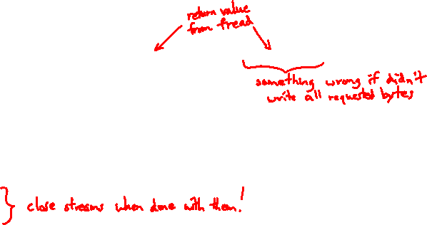
C Streams Example
cp_example.c
int main(int argc, char** argv) {
... // two slides ago’s code
... // previous slide’s code
if (fwrite(readbuf, 1, readlen, fout) < readlen) {
perror("fwrite failed");
fclose(fin);
fclose(fout);
return EXIT_FAILURE;
}
}
fclose(fin);
fclose(fout);
return EXIT_SUCCESS;
}
Notes:
DEMO:
- Usage msg: $ ./cp_example
- Behavior: $ ./cp_example cp_example.c temp.c
- Read fail (doesn’t exist): $ ./cp_example foo bar
- Read fail (permissions): $ chmod 200 temp.c $ ./cp_example temp.c temp2.c
- Write fail (doesn’t exist): $ chmod 400 temp.c $ ./cp_example cp_example.c temp.c

Slide 24
Extra Exercise #1
Modify the linked list code from Lecture 4 Extra Exercise #3
Add static declarations to any internal functions you implemented in linkedlist.h
Add a header guard to the header file

Slide 25
Extra Exercise #2
Write a program that:
Uses argc/argv to receive the name of a text file
Reads the contents of the file a line at a time
Parses each line, converting text into a uint32_t
Builds an array of the parsed uint32_t’s
Sorts the array
Prints the sorted array to stdout
Hint: use man to read about getline, sscanf, realloc, and qsort
bash$ cat in.txt
1213
3231
000005
52
bash$ ./extra1 in.txt
5
52
1213
3231
bash$

Slide 26
Extra Exercise #3
Write a program that:
Loops forever; in each loop:
Prompt the user to input a filename
Reads a filename from stdin
Opens and reads the file
Prints its contents to stdout in the format shown:
Hints:
Use man to read about fgets
Or, if you’re more courageous, try man 3 readline to learn about libreadline.a and Google to learn how to link to it
00000000 50 4b 03 04 14 00 00 00 00 00 9c 45 26 3c f1 d5
00000010 68 95 25 1b 00 00 25 1b 00 00 0d 00 00 00 43 53
00000020 45 6c 6f 67 6f 2d 31 2e 70 6e 67 89 50 4e 47 0d
00000030 0a 1a 0a 00 00 00 0d 49 48 44 52 00 00 00 91 00
00000040 00 00 91 08 06 00 00 00 c3 d8 5a 23 00 00 00 09
00000050 70 48 59 73 00 00 0b 13 00 00 0b 13 01 00 9a 9c
00000060 18 00 00 0a 4f 69 43 43 50 50 68 6f 74 6f 73 68
00000070 6f 70 20 49 43 43 20 70 72 6f 66 69 6c 65 00 00
00000080 78 da 9d 53 67 54 53 e9 16 3d f7 de f4 42 4b 88
00000090 80 94 4b 6f 52 15 08 20 52 42 8b 80 14 91 26 2a
000000a0 21 09 10 4a 88 21 a1 d9 15 51 c1 11 45 45 04 1b
... etc ...

