Slide 1
About how long did Exercise 1 take you?
pollev.com/cse333justin
[0, 2) hours
[2, 4) hours
[4, 6) hours
[6, 8) hours
8+ Hours
I didn’t submit / I prefer not to say

Slide 2
Pointers, Pointers, Pointers…
CSE 333 Spring 2021
Instructors: Justin Hsia, Travis McGaha
Teaching Assistants:
Atharva Deodhar Callum Walker Cosmo Wang
Dylan Hartono Elizabeth Haker Kyrie Dowling
Leo Liao Markus Schiffer Neha Nagvekar
Nonthakit Chaiwong Ramya Challa

Slide 3
Administrivia (1/3)
Exercise 2 out today and due Wednesday (4/7) morning
Exercise grading
  Autograder scores visible immediately after deadline; sample solutions released same day as deadline
  Grades (out of 8):
    Autograder: Compilation (1), Correctness (3), Linter (1), Valgrind (1)
    Manual: Other Style (2)
  Style things to watch for:
    FOLLOW THE SPEC (especially the Style Guide section)
    Check the Google C++ Style Guide
    Make a judgment call and document
  Keep style tips in mind, as you will need to use them in hw

Slide 4
Administrivia (2/3)
Pre-quarter survey (Canvas quiz) due tonight
Homework 0 due Monday
  Logistics and infrastructure for projects
    clint and valgrind are useful for exercises, too
  Should have set up an SSH key and cloned GitLab repo by now
    Do this ASAP so we have time to fix things if necessary
Homework 1 out later today, due in 2 weeks (Thu 4/15)
  Linked list and hash table implementations in C
  Get starter code using git pull in your course repo
    Might have “merge conflict” if your local copy has unpushed changes
      If git drops you into vi(m), :q to quit or :wq if you want to save changes
Notes:
Adm for lec03 if a Monday start

Slide 5
Administrivia (3/3)
Documentation:
  man pages, books
  Reference websites: cplusplus.org, man7.org, gcc.gnu.org, etc.
Folklore:
  Google-ing, Stack Overflow, that rando in Discord
Tradeoffs? Relative strengths & weaknesses?

Slide 6
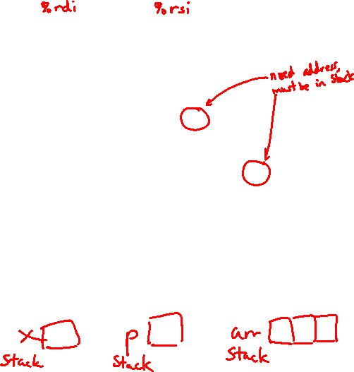
Box-and-Arrow Diagrams
boxarrow.c
int main(int argc, char** argv) {
int x = 1;
int arr[3] = {2, 3, 4};
int* p = &arr[1];
printf("&x: %p; x: %d\n", &x, x);
printf("&arr[0]: %p; arr[0]: %d\n", &arr[0], arr[0]);
printf("&arr[2]: %p; arr[2]: %d\n", &arr[2], arr[2]);
printf("&p: %p; p: %p; *p: %d\n", &p, p, *p);
return EXIT_SUCCESS;
}
address | name | value
Notes:
Draw out (ink) boxes for x, arr, and p. Where are these located?

Slide 7
Box-and-Arrow Diagrams
boxarrow.c
int main(int argc, char** argv) {
int x = 1;
int arr[3] = {2, 3, 4};
int* p = &arr[1];
printf("&x: %p; x: %d\n", &x, x);
printf("&arr[0]: %p; arr[0]: %d\n", &arr[0], arr[0]);
printf("&arr[2]: %p; arr[2]: %d\n", &arr[2], arr[2]);
printf("&p: %p; p: %p; *p: %d\n", &p, p, *p);
return EXIT_SUCCESS;
}
address | name | value
&x | x | value
&arr[2] | arr[2] | value
&arr[1] | arr[1] | value
&arr[0] | arr[0] | value
&p | p | value
stack frame for main()
Notes:
These are local variables, so located on the Stack in some ordering.
Let’s fill in the values.

Slide 8
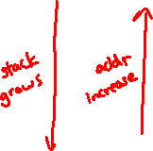
Box-and-Arrow Diagrams
boxarrow.c
int main(int argc, char** argv) {
int x = 1;
int arr[3] = {2, 3, 4};
int* p = &arr[1];
printf("&x: %p; x: %d\n", &x, x);
printf("&arr[0]: %p; arr[0]: %d\n", &arr[0], arr[0]);
printf("&arr[2]: %p; arr[2]: %d\n", &arr[2], arr[2]);
printf("&p: %p; p: %p; *p: %d\n", &p, p, *p);
return EXIT_SUCCESS;
}
address | name | value
&x | x | 1
&arr[2] | arr[2] | 4
&arr[1] | arr[1] | 3
&arr[0] | arr[0] | 2
&p | p | &arr[1]
Notes:
Now let’s fill in the addresses.
Don’t forget about ASLR – address randomization!

Slide 9
Box-and-Arrow Diagrams
boxarrow.c
int main(int argc, char** argv) {
int x = 1;
int arr[3] = {2, 3, 4};
int* p = &arr[1];
printf("&x: %p; x: %d\n", &x, x);
printf("&arr[0]: %p; arr[0]: %d\n", &arr[0], arr[0]);
printf("&arr[2]: %p; arr[2]: %d\n", &arr[2], arr[2]);
printf("&p: %p; p: %p; *p: %d\n", &p, p, *p);
return EXIT_SUCCESS;
}
address | name | value
0x7fff…4c | x | 1
0x7fff…48 | arr[2] | 4
0x7fff…44 | arr[1] | 3
0x7fff…40 | arr[0] | 2
0x7fff…38 | p | 0x7fff…44
Notes:
Don’t forget about ASLR – address randomization!
Draw arrow from value of p to address of arr[1].

Slide 10
Lecture Outline
Pointer Arithmetic
Pointers as Parameters
Pointers and Arrays
Function Pointers

Slide 11

Pointer Arithmetic
Pointers are typed
  Tells the compiler the size of the data you are pointing to
  Exception: void* is a generic pointer (i.e., a placeholder)
Pointer arithmetic is scaled by sizeof(*p)
  Works nicely for arrays
  Does not work on void*, since void doesn’t have a size!
    Not allowed, though confusingly GCC allows it as an extension ☹️
Valid pointer arithmetic:
  Add/subtract an integer to/from a pointer
  Subtract two pointers (within stack frame or malloc block)
  Compare pointers (<, <=, ==, !=, >, >=), including NULL
  … but plenty of valid-but-inadvisable operations, too
Notes:
Everything else is illegal since it doesn’t make sense for addresses.

Slide 12

At this point in the code, what values are stored in arr[]?
pollev.com/cse333justin
int main(int argc, char** argv) {
int arr[3] = {2, 3, 4};
int* p = &arr[1];
int** dp = &p; // pointer to a pointer
*(*dp) += 1;
p += 1;
*(*dp) += 1;
return EXIT_SUCCESS;
}
boxarrow2.c
{2, 3, 4}
{3, 4, 5}
{2, 6, 4}
{2, 4, 5}
We’re lost…
0x7fff…78 | arr[2] | 4
0x7fff…74 | arr[1] | 3
0x7fff…70 | arr[0] | 2
0x7fff…68 | p | 0x7fff…74
0x7fff…60 | dp | 0x7fff…68

Slide 13

Practice Solution
Note: arrow points to next instruction to be executed.
boxarrow2.c
int main(int argc, char** argv) {
int arr[3] = {2, 3, 4};
int* p = &arr[1];
int** dp = &p; // pointer to a pointer
*(*dp) += 1;
p += 1;
*(*dp) += 1;
return EXIT_SUCCESS;
}
0x7fff…78 | arr[2] | 4
0x7fff…74 | arr[1] | 3
0x7fff…70 | arr[0] | 2
4
address | name | value
0x7fff…68 | p | 0x7fff…74
0x7fff…60 | dp | 0x7fff…68
Notes:
Don’t forget about ASLR – address randomization!

Slide 14
Practice Solution
Note: arrow points to next instruction to be executed.
boxarrow2.c
int main(int argc, char** argv) {
int arr[3] = {2, 3, 4};
int* p = &arr[1];
int** dp = &p; // pointer to a pointer
*(*dp) += 1;
p += 1;
*(*dp) += 1;
return EXIT_SUCCESS;
}
0x7fff…78 | arr[2] | 4
0x7fff…74 | arr[1] | 4
0x7fff…70 | arr[0] | 2
address | name | value
0x7fff…68 | p | 0x7fff…74
0x7fff…60 | dp | 0x7fff…68
Notes:
Don’t forget about ASLR – address randomization!

Slide 15
Practice Solution
Note: arrow points to next instruction to be executed.
boxarrow2.c
int main(int argc, char** argv) {
int arr[3] = {2, 3, 4};
int* p = &arr[1];
int** dp = &p; // pointer to a pointer
*(*dp) += 1;
p += 1;
*(*dp) += 1;
return EXIT_SUCCESS;
}
0x7fff…78 | arr[2] | 4
0x7fff…74 | arr[1] | 4
0x7fff…70 | arr[0] | 2
address | name | value
0x7fff…68 | p | 0x7fff…78
0x7fff…60 | dp | 0x7fff…68
Notes:
Don’t forget about ASLR – address randomization!

Slide 16
Practice Solution
Note: arrow points to next instruction to be executed.
boxarrow2.c
int main(int argc, char** argv) {
int arr[3] = {2, 3, 4};
int* p = &arr[1];
int** dp = &p; // pointer to a pointer
*(*dp) += 1;
p += 1;
*(*dp) += 1;
return EXIT_SUCCESS;
}
5
0x7fff…78 | arr[2] | 4
0x7fff…74 | arr[1] | 4
0x7fff…70 | arr[0] | 2
address | name | value
0x7fff…68 | p | 0x7fff…78
0x7fff…60 | dp | 0x7fff…68
Notes:
Don’t forget about ASLR – address randomization!

Slide 17
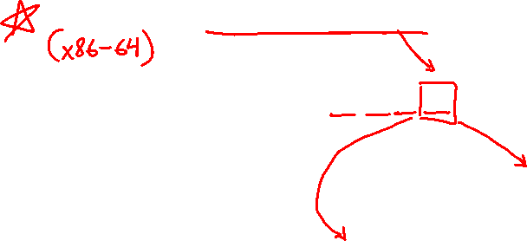
Endianness
Memory is byte-addressed, so endianness determines what ordering that multi-byte data gets read and stored in memory
  Big-endian: Least significant byte has highest address
  Little-endian: Least significant byte has lowest address
Example: 4-byte data 0xa1b2c3d4 at address 0x100
0x100
0x101
0x102
0x103
Big-Endian
a1
b2
c3
d4
0x100
0x101
0x102
0x103
Little-Endian
d4
c3
b2
a1

Slide 18
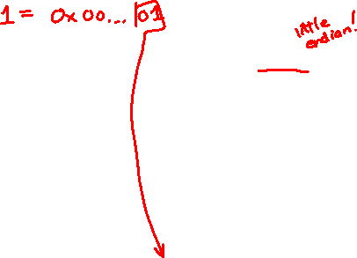
Pointer Arithmetic Example
Note: Arrow points to next instruction.
int main(int argc, char** argv) {
int arr[3] = {1, 2, 3};
int* int_ptr = &arr[0];
char* char_ptr = (char*) int_ptr;
int_ptr += 1;
int_ptr += 2; // uh oh
char_ptr += 1;
char_ptr += 2;
return EXIT_SUCCESS;
}
Stack
(assume x86-64)
arr[2]
arr[1]
arr[0]
char_ptr
int_ptr
pointerarithmetic.c
Notes:
The provided code has printf statements after every pointer manipulation.
x86-64 is little-endian!

Slide 19
Pointer Arithmetic Example
Note: Arrow points to next instruction.
int main(int argc, char** argv) {
int arr[3] = {1, 2, 3};
int* int_ptr = &arr[0];
char* char_ptr = (char*) int_ptr;
int_ptr += 1;
int_ptr += 2; // uh oh
char_ptr += 1;
char_ptr += 2;
return EXIT_SUCCESS;
}
Stack
(assume x86-64)
arr[2] | 03 | 00 | 00 | 00
arr[1] | 02 | 00 | 00 | 00
arr[0] | 01 | 00 | 00 | 00
char_ptr
int_ptr
pointerarithmetic.c
Notes:
The provided code has printf statements after every pointer manipulation.
x86-64 is little-endian!

Slide 20
Pointer Arithmetic Example
Note: Arrow points to next instruction.
int main(int argc, char** argv) {
int arr[3] = {1, 2, 3};
int* int_ptr = &arr[0];
char* char_ptr = (char*) int_ptr;
int_ptr += 1;
int_ptr += 2; // uh oh
char_ptr += 1;
char_ptr += 2;
return EXIT_SUCCESS;
}
Stack
(assume x86-64)
arr[2] | 03 | 00 | 00 | 00
arr[1] | 02 | 00 | 00 | 00
arr[0] | 01 | 00 | 00 | 00
char_ptr
int_ptr
pointerarithmetic.c
Notes:
The provided code has printf statements after every pointer manipulation.
x86-64 is little-endian!

Slide 21
Pointer Arithmetic Example
Note: Arrow points to next instruction.
int main(int argc, char** argv) {
int arr[3] = {1, 2, 3};
int* int_ptr = &arr[0];
char* char_ptr = (char*) int_ptr;
int_ptr += 1;
int_ptr += 2; // uh oh
char_ptr += 1;
char_ptr += 2;
return EXIT_SUCCESS;
}
Stack
(assume x86-64)
arr[2] | 03 | 00 | 00 | 00
arr[1] | 02 | 00 | 00 | 00
arr[0] | 01 | 00 | 00 | 00
char_ptr
int_ptr
pointerarithmetic.c
Notes:
The provided code has printf statements after every pointer manipulation.
x86-64 is little-endian!

Slide 22
Pointer Arithmetic Example
Note: Arrow points to next instruction.
int main(int argc, char** argv) {
int arr[3] = {1, 2, 3};
int* int_ptr = &arr[0];
char* char_ptr = (char*) int_ptr;
int_ptr += 1;
int_ptr += 2; // uh oh
char_ptr += 1;
char_ptr += 2;
return EXIT_SUCCESS;
}
Stack
(assume x86-64)
arr[2] | 03 | 00 | 00 | 00
arr[1] | 02 | 00 | 00 | 00
arr[0] | 01 | 00 | 00 | 00
char_ptr
int_ptr
pointerarithmetic.c
int_ptr: 0x0x7ffffffde010
*int_ptr: 1
Notes:
The provided code has printf statements after every pointer manipulation.
x86-64 is little-endian!

Slide 23
Pointer Arithmetic Example
Note: Arrow points to next instruction.
int main(int argc, char** argv) {
int arr[3] = {1, 2, 3};
int* int_ptr = &arr[0];
char* char_ptr = (char*) int_ptr;
int_ptr += 1;
int_ptr += 2; // uh oh
char_ptr += 1;
char_ptr += 2;
return EXIT_SUCCESS;
}
Stack
(assume x86-64)
arr[2] | 03 | 00 | 00 | 00
arr[1] | 02 | 00 | 00 | 00
arr[0] | 01 | 00 | 00 | 00
char_ptr
int_ptr
pointerarithmetic.c
int_ptr: 0x0x7ffffffde014
*int_ptr: 2
Notes:
The provided code has printf statements after every pointer manipulation.
x86-64 is little-endian!

Slide 24
Pointer Arithmetic Example
Note: Arrow points to next instruction.
int main(int argc, char** argv) {
int arr[3] = {1, 2, 3};
int* int_ptr = &arr[0];
char* char_ptr = (char*) int_ptr;
int_ptr += 1;
int_ptr += 2; // uh oh
char_ptr += 1;
char_ptr += 2;
return EXIT_SUCCESS;
}
Stack
(assume x86-64)
arr[2] | 03 | 00 | 00 | 00
arr[1] | 02 | 00 | 00 | 00
arr[0] | 01 | 00 | 00 | 00
char_ptr
int_ptr
pointerarithmetic.c
int_ptr: 0x0x7ffffffde01c
*int_ptr: ???
Notes:
The provided code has printf statements after every pointer manipulation.
x86-64 is little-endian!

Slide 25
Pointer Arithmetic Example
Note: Arrow points to next instruction.
int main(int argc, char** argv) {
int arr[3] = {1, 2, 3};
int* int_ptr = &arr[0];
char* char_ptr = (char*) int_ptr;
int_ptr += 1;
int_ptr += 2; // uh oh
char_ptr += 1;
char_ptr += 2;
return EXIT_SUCCESS;
}
Stack
(assume x86-64)
arr[2] | 03 | 00 | 00 | 00
arr[1] | 02 | 00 | 00 | 00
arr[0] | 01 | 00 | 00 | 00
char_ptr
int_ptr
pointerarithmetic.c
char_ptr: 0x0x7ffffffde010
*char_ptr: 1
Notes:
The provided code has printf statements after every pointer manipulation.
x86-64 is little-endian!

Slide 26
Pointer Arithmetic Example
Note: Arrow points to next instruction.
int main(int argc, char** argv) {
int arr[3] = {1, 2, 3};
int* int_ptr = &arr[0];
char* char_ptr = (char*) int_ptr;
int_ptr += 1;
int_ptr += 2; // uh oh
char_ptr += 1;
char_ptr += 2;
return EXIT_SUCCESS;
}
Stack
(assume x86-64)
arr[2] | 03 | 00 | 00 | 00
arr[1] | 02 | 00 | 00 | 00
arr[0] | 01 | 00 | 00 | 00
char_ptr
int_ptr
pointerarithmetic.c
char_ptr: 0x0x7ffffffde011
*char_ptr: 0
Notes:
The provided code has printf statements after every pointer manipulation.
x86-64 is little-endian!

Slide 27
Pointer Arithmetic Example
Note: Arrow points to next instruction.
int main(int argc, char** argv) {
int arr[3] = {1, 2, 3};
int* int_ptr = &arr[0];
char* char_ptr = (char*) int_ptr;
int_ptr += 1;
int_ptr += 2; // uh oh
char_ptr += 1;
char_ptr += 2;
return EXIT_SUCCESS;
}
Stack
(assume x86-64)
arr[2] | 03 | 00 | 00 | 00
arr[1] | 02 | 00 | 00 | 00
arr[0] | 01 | 00 | 00 | 00
char_ptr
int_ptr
pointerarithmetic.c
char_ptr: 0x0x7ffffffde013
*char_ptr: 0
Notes:
The provided code has printf statements after every pointer manipulation.
x86-64 is little-endian!

Slide 28
Lecture Outline
Pointer Arithmetic
Pointers as Parameters
Pointers and Arrays
Function Pointers

Slide 29
C is Call-By-Value
C (and Java) pass arguments by value
  Callee receives a local copy of the argument
    Register or Stack
  If the callee modifies a parameter, the caller’s copy isn’t modified
void swap(int a, int b) {
int tmp = a;
a = b;
b = tmp;
}
int main(int argc, char** argv) {
int a = 42, b = -7;
swap(a, b);
...

Slide 30
Broken Swap
Note: Arrow points to next instruction.
OS kernel [protected]
Stack
main
brokenswap.c
void swap(int a, int b) {
int tmp = a;
a = b;
b = tmp;
}
int main(int argc, char** argv) {
int a = 42, b = -7;
swap(a, b);
...
Heap
Read/Write Segment
.data, .bss
Read-Only Segment
.text, .rodata

Slide 31
Broken Swap
OS kernel [protected]
Stack
main
a
42
b
-7
brokenswap.c
void swap(int a, int b) {
int tmp = a;
a = b;
b = tmp;
}
int main(int argc, char** argv) {
int a = 42, b = -7;
swap(a, b);
...
Heap
Read/Write Segment
.data, .bss
Read-Only Segment
.text, .rodata

Slide 32

Broken Swap
OS kernel [protected]
Stack
main
a
42
b
-7
swap
a
42
b
-7
brokenswap.c
tmp
??
void swap(int a, int b) {
int tmp = a;
a = b;
b = tmp;
}
int main(int argc, char** argv) {
int a = 42, b = -7;
swap(a, b);
...
Heap
Read/Write Segment
.data, .bss
Read-Only Segment
.text, .rodata

Slide 33

Broken Swap
OS kernel [protected]
Stack
main
a
42
b
-7
swap
a
42
b
-7
brokenswap.c
tmp
42
void swap(int a, int b) {
int tmp = a;
a = b;
b = tmp;
}
int main(int argc, char** argv) {
int a = 42, b = -7;
swap(a, b);
...
Heap
Read/Write Segment
.data, .bss
Read-Only Segment
.text, .rodata

Slide 34

Broken Swap
OS kernel [protected]
Stack
main
a
42
b
-7
swap
a
-7
b
-7
brokenswap.c
tmp
42
void swap(int a, int b) {
int tmp = a;
a = b;
b = tmp;
}
int main(int argc, char** argv) {
int a = 42, b = -7;
swap(a, b);
...
Heap
Read/Write Segment
.data, .bss
Read-Only Segment
.text, .rodata

Slide 35
Broken Swap
OS kernel [protected]
Stack
main
a
42
b
-7
swap
a
-7
b
42
brokenswap.c
tmp
42
void swap(int a, int b) {
int tmp = a;
a = b;
b = tmp;
}
int main(int argc, char** argv) {
int a = 42, b = -7;
swap(a, b);
...
Heap
Read/Write Segment
.data, .bss
Read-Only Segment
.text, .rodata

Slide 36
Broken Swap
OS kernel [protected]
Stack
main
a
42
b
-7
brokenswap.c
void swap(int a, int b) {
int tmp = a;
a = b;
b = tmp;
}
int main(int argc, char** argv) {
int a = 42, b = -7;
swap(a, b);
...
Heap
Read/Write Segment
.data, .bss
Read-Only Segment
.text, .rodata

Slide 37
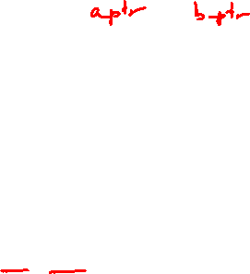
Faking Call-By-Reference in C
Can use pointers to approximate call-by-reference
  Callee still receives a copy of the pointer (i.e. call-by-value), but it can modify something in the caller’s scope by dereferencing the pointer parameter
void swap(int a, int b) {
int tmp = a;
a = b;
b = tmp;
}
int main(int argc, char** argv) {
int a = 42, b = -7;
swap(a, b);
...
void swap(int* a, int* b) {
int tmp = *a;
*a = *b;
*b = tmp;
}
int main(int argc, char** argv) {
int a = 42, b = -7;
swap(&a, &b);
...

Slide 38
Fixed Swap
Note: Arrow points to next instruction.
OS kernel [protected]
Stack
main
a
42
b
-7
swap.c
void swap(int* a, int* b) {
int tmp = *a;
*a = *b;
*b = tmp;
}
int main(int argc, char** argv) {
int a = 42, b = -7;
swap(&a, &b);
...
Heap
Read/Write Segment
.data, .bss
Read-Only Segment
.text, .rodata

Slide 39
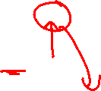
Fixed Swap
OS kernel [protected]
Stack
main
a
42
b
-7
swap
a
b
swap.c
tmp
??
void swap(int* a, int* b) {
int tmp = *a;
*a = *b;
*b = tmp;
}
int main(int argc, char** argv) {
int a = 42, b = -7;
swap(&a, &b);
...
Heap
Read/Write Segment
.data, .bss
Read-Only Segment
.text, .rodata

Slide 40

Fixed Swap
OS kernel [protected]
Stack
main
a
42
b
-7
swap
a
b
swap.c
tmp
42
void swap(int* a, int* b) {
int tmp = *a;
*a = *b;
*b = tmp;
}
int main(int argc, char** argv) {
int a = 42, b = -7;
swap(&a, &b);
...
Heap
Read/Write Segment
.data, .bss
Read-Only Segment
.text, .rodata

Slide 41
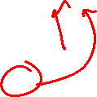
Fixed Swap
OS kernel [protected]
Stack
main
a
-7
b
-7
swap
a
b
swap.c
tmp
42
void swap(int* a, int* b) {
int tmp = *a;
*a = *b;
*b = tmp;
}
int main(int argc, char** argv) {
int a = 42, b = -7;
swap(&a, &b);
...
Heap
Read/Write Segment
.data, .bss
Read-Only Segment
.text, .rodata

Slide 42
Fixed Swap
OS kernel [protected]
Stack
main
a
-7
b
42
swap
a
b
swap.c
tmp
42
void swap(int* a, int* b) {
int tmp = *a;
*a = *b;
*b = tmp;
}
int main(int argc, char** argv) {
int a = 42, b = -7;
swap(&a, &b);
...
Heap
Read/Write Segment
.data, .bss
Read-Only Segment
.text, .rodata

Slide 43
Fixed Swap
OS kernel [protected]
Stack
main
a
-7
b
42
swap.c
void swap(int* a, int* b) {
int tmp = *a;
*a = *b;
*b = tmp;
}
int main(int argc, char** argv) {
int a = 42, b = -7;
swap(&a, &b);
...
Heap
Read/Write Segment
.data, .bss
Read-Only Segment
.text, .rodata

Slide 44
Output Parameters
Warning: Misuse of output parameters is the largest cause of errors in this course!
Output parameter
  A pointer parameter used to store (via dereference) a function output outside of the function’s stack frame
  Typically points to/modifies something in the Caller’s scope
  Useful if you want to have multiple return values
Setup and usage:
  Caller creates space for the data (e.g., type var;)
  Caller passes in a pointer to Callee (e.g., &var)
  Callee takes in output parameter (e.g., type* outparam)
  Callee uses parameter to set output (e.g., *outparam = value;)
  Caller accesses output via modified data (e.g., var)
Notes:
*Output parameters will show up a lot in HW 1

Slide 45
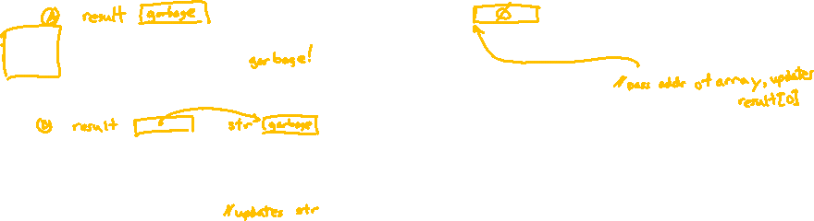
pollev.com/cse333justin
    Which is an incorrect way to invoke
    generateString()?
    Of the working ways, which would be preferred?
C.
D.
E. We’re lost…
void generateString(char** output) {
*output = "Hello there\n";
}
char** result;
generateString(result);
printf(*result);
char* result[1] = {NULL};
generateString(result);
printf(result[0]);
char* str;
char** result = &str;
generateString(result);
printf(str);
char* result;
generateString(&result);
printf(result);

Slide 46
Preferred Usage
Note: Arrow points to next instruction.
genstr.c
OS kernel [protected]
void generateString(char** output);
int main(int argc, char** argv) {
char* result;
generateString(&result);
printf(result);
return EXIT_SUCCESS;
}
void generateString(char** output) {
*output = "Hello there\n";
}
Stack
main
result
??
genStr
output
Heap
Read/Write Segment
.data, .bss
  Works correctly (unlike A)
  Minimizes memory usage (unlike B)
  Intent is clear (unlike C)
Read-Only Segment
.text, .rodata
"Hello there\n"

Slide 47
Lecture Outline
Pointer Arithmetic
Pointers as Parameters
Pointers and Arrays
Function Pointers

Slide 48
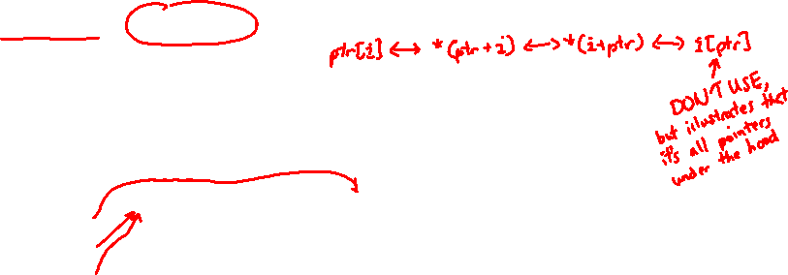
Pointers and Arrays
A pointer can point to an array element
  You can use array indexing notation on pointers
    ptr[i] is *(ptr+i) with pointer arithmetic – reference the data i elements forward from ptr
  An array name’s value is the beginning address of the array
    Like a pointer to the first element of array, but can’t change
int a[] = {10, 20, 30, 40, 50};
int* p1 = &a[3]; // refers to a's 4th element
int* p2 = &a[0]; // refers to a's 1st element
int* p3 = a; // refers to a's 1st element
*p1 = 100;
*p2 = 200;
p1[1] = 300;
p2[1] = 400;
p3[2] = 500; // final: 200, 400, 500, 100, 300

Slide 49

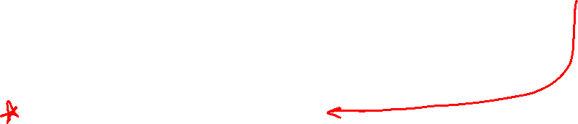
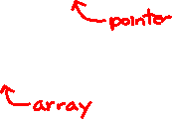
Array Parameters
STYLE
TIP
Array parameters are actually passed as pointers to the first array element
  The [] syntax for parameter types is just for convenience
    Use whichever best helps the reader
This code:
Equivalent to:
void f(int a[]);
int main( ... ) {
int a[5];
...
f(a);
return EXIT_SUCCESS;
}
void f(int a[]) {
void f(int* a);
int main( ... ) {
int a[5];
...
f(&a[0]);
return EXIT_SUCCESS;
}
void f(int* a) {

Slide 50
Lecture Outline
Pointer Arithmetic
Pointers as Parameters
Pointers and Arrays
Function Pointers

Slide 51
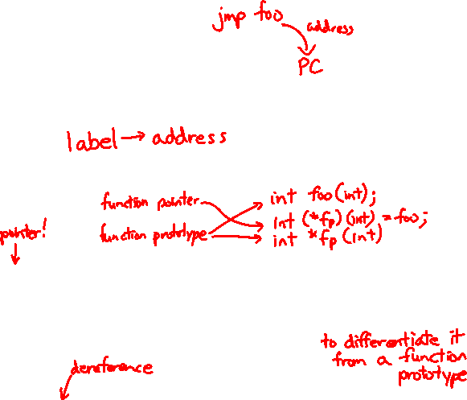
Function Pointers
Based on what you know about assembly, what is a function name, really?
  Can use pointers that store addresses of functions!
Generic format:
  Looks like a function prototype with extra * in front of name
  Why are parentheses around (* name) needed?
Using the function:
  Calls the pointed-to function with the given arguments and return the return value
returnType (* name)(type1, …, typeN)
(*name)(arg1, …, argN)
Notes:
Add a hint slide next time: can omit & and * when using a function name as an argument or calling a function via a pointer

Slide 52

Function Pointer Example
map() performs operation on each element of an array
#define LEN 4
int negate(int num) {return -num;}
int square(int num) {return num*num;}
// perform operation pointed to on each array element
void map(int a[], int len, int (* op)(int n)) {
for (int i = 0; i < len; i++) {
a[i] = (*op)(a[i]); // dereference function pointer
}
}
int main(int argc, char** argv) {
int arr[LEN] = {-1, 0, 1, 2};
int (* op)(int n); // function pointer called 'op'
op = square; // function name returns addr (like array)
map(arr, LEN, op);
...
funcptr parameter
funcptr dereference
funcptr definition
funcptr assignment
map.c

Slide 53
Function Pointer Example
C allows you to omit & on a function name (like arrays) and omit * when calling pointed-to function
#define LEN 4
int negate(int num) {return -num;}
int square(int num) {return num*num;}
// perform operation pointed to on each array element
void map(int a[], int len, int (* op)(int n)) {
for (int i = 0; i < len; i++) {
a[i] = op(a[i]); // dereference function pointer
}
}
int main(int argc, char** argv) {
int arr[LEN] = {-1, 0, 1, 2};
map(arr, LEN, square);
...
implicit funcptr dereference (no * needed)
no & needed for func ptr argument

Slide 54
Extra Exercise #1
Use a box-and-arrow diagram for the following program and explain what it prints out:
#include <stdio.h>
int foo(int* bar, int** baz) {
*bar = 5;
*(bar+1) = 6;
*baz = bar + 2;
return *((*baz)+1);
}
int main(int argc, char** argv) {
int arr[4] = {1, 2, 3, 4};
int* ptr;
arr[0] = foo(&arr[0], &ptr);
printf("%d %d %d %d %d\n",
arr[0], arr[1], arr[2], arr[3], *ptr);
return 0;
}

Slide 55
Extra Exercise #2
Write a program that determines and prints out whether the computer it is running on is little-endian or big-endian.
  Hint: pointerarithmetic.c from today’s lecture or show_bytes.c from 351

Slide 56
Extra Exercise #3
Write a function that:
  Arguments: [1] an array of ints and [2] an array length
  Malloc’s an int* array of the same element length
  Initializes each element of the newly-allocated array to point to the corresponding element of the passed-in array
  Returns a pointer to the newly-allocated array

Slide 57
Extra Exercise #4
Write a function that:
  Accepts a function pointer and an integer as arguments
  Invokes the pointed-to function with the integer as its argument

