Slide 1
Intro, C Refresher CSE 333 Spring 2021
Instructors: Travis McGaha, Justin Hsia
Teaching Assistants:
Arthava Deodhar Callum Walker Cosmo Wang
Dylan Hartono Elizabeth Haker Kyrie Dowling
Leo Liao Markus Schiffer Neha Nagvekar
Nonthakit Chaiwong Ramya Challa

Slide 2
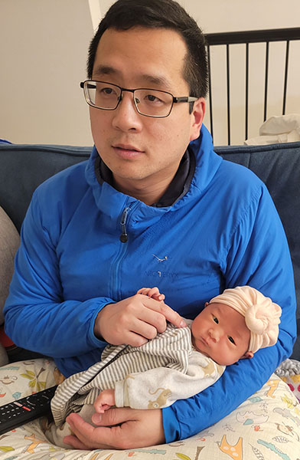
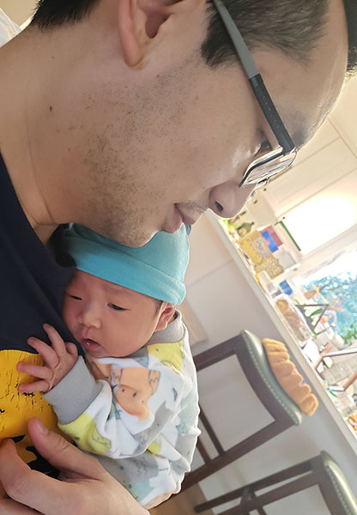
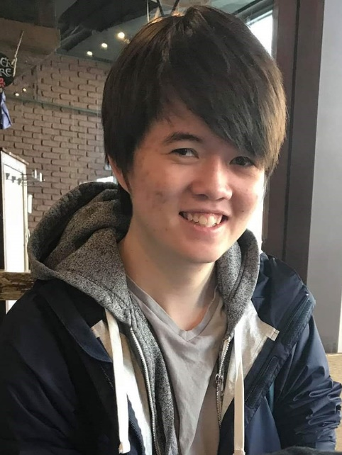
Introductions: Instructors (2 for 1!)
Justin (he/him)
From California (UC Berkeley and the Bay Area)
I like: teaching, the outdoors, board games, and ultimate
Taking care of newborn:
Travis (he/him)
Recent UW CSE BS/MS graduate
I like: teaching, music, video games, video essays, and reading
I’m on the job market!

Slide 3


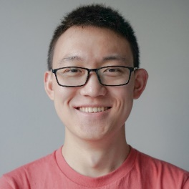










Introductions: Teaching Assistants
Available in section, office hours, and discussion group
An invaluable source of information and help
Get to know us (instructors + TAs)
We are here to help you succeed!
Atharva
Callum
Cosmo
Dylan
Elizabeth
Kyrie
Markus
Leo
Neha
Nonthakit
Ramya
Justin
Travis

Slide 4
Introductions: Students
~190 students registered, split across two lectures
(Possibly) Largest offering ever!
There are no overload forms or waiting lists for CSE courses
Majors must add using the UW system as space becomes available
Non-majors should work with undergraduate advisors (in the Gates Center) to handle enrollment details
Expected background
Prereq: CSE 351 – C, pointers, memory model, linker, system calls
Indirect Prereq: CSE 143 – Classes, Inheritance, Basic Data structures, and general good style practices
CSE 391 or Linux skills needed for CSE 351 assumed

Slide 5
Lecture Outline
Course Policies
https://courses.cs.washington.edu/courses/cse333/21sp/syllabus.html
Digest here, but you must read the full details online
Course Introduction
C Reintroduction

Slide 6
Communication
Website: http://cs.uw.edu/333
Schedule, policies, materials, assignments, etc.
Discussion: https://edstem.org/us/courses/4899/discussion/
Announcements made here
Ask and answer questions – staff will monitor and contribute
Office Hours: spread throughout the week
Can fill out Google Form to schedule individual 1-on-1 appointments
Anonymous feedback:
Comments about anything related to the course where you would feel better not attaching your name

Slide 7
Course Components
Lectures (28)
Introduce the concepts; take notes!!!
Sections (10)
Applied concepts, important tools and skills for assignments, clarification of lectures, exam review and preparation
Programming Exercises (12)
One due roughly every 4-5 days
We are checking for: correctness, memory issues, code style/quality
Programming Projects (0+4)
Warm-up, then 4 “homework” that build on each other
Takehome Exams (2)
Midterm: will be around May 7
Final: will be around June 9
Notes:
Project: web search

Slide 8
Grading
Exercises: 30% total
Submitted via GradeScope (under your UW email)
Graded on correctness and style by autograders and TAs
Projects: 45% total
Submitted via GitLab; must tag commit that you want graded
Binaries provided if you didn’t get previous part working
Exams: Midterm (10%) and Final (10%)
Take-home; not traditional 333 exams
Course-wide Participation: 5%
Many ways to earn credit here, relatively lenient on this
More details on course website
You must read the syllabus there – you are responsible for it

Slide 9
Deadlines and Student Conduct
Late policies
Exercises: no late submissions accepted, due 11 am
Homework: 4 late day “tokens” for quarter, max 2 per homework
Need to get things done on time – difficult to catch up!
Academic Integrity (read the full policy on the web)
I trust you implicitly and will follow up if that trust is violated
In short: don’t attempt to gain credit for something you didn’t do and don’t help others do so either
This does not mean suffer in silence – learn from the course staff and peers, talk, share ideas; but don’t share or copy work that is supposed to be yours

Slide 10
Hooked on Gadgets
Gadgets reduce focus and learning
Bursts of info (e.g., emails, IMs, etc.) are addictive
Heavy multitaskers have more trouble focusing and shutting out irrelevant information
http://www.npr.org/2016/04/17/474525392/attention-students-put-your-laptops-away
Seriously, you will learn more if you use paper instead!!!
Suggestions to try
Disable notifications on your primary machine
Do Not Disturb mode on your smartphone
Close (not minimize) your non-class browser windows & tabs
Notes:
NPR segment: play until 2:28

Slide 11
Lecture Outline
Course Policies
https://courses.cs.washington.edu/courses/cse333/21sp/syllabus/
Summary here, but you must read the full details online
Course Introduction
C Reintroduction

Slide 12
Course Map: 100,000 foot view
C application
C++ application
Java application
C standard library (glibc)
C++ STL/boost/ standard library
JRE
OS / app interface
(system calls)
CPU memory storage network GPU clock audio radio peripherals
operating system
HW/SW interface
(x86 + devices)
hardware
Notes:
OS is CSE 451, line below is CSE 351, line above is us

Slide 13
Systems Programming
The programming skills, engineering discipline, and knowledge you need to build a system
Programming: C / C++
Discipline: testing, debugging, performance analysis
Knowledge: long list of interesting topics
Concurrency, OS interfaces and semantics, techniques for consistent data management, distributed systems algorithms, …
Most important: a deep(er) understanding of the “layer below”

Slide 14

Discipline?!?
STYLE
TIP
Cultivate good habits, encourage clean code
Coding style conventions
Unit testing, code coverage testing, regression testing
Documentation (code comments, design docs)
Code reviews
Will take you a lifetime to learn, but oh-so-important, especially for systems code
Avoid write-once, read-never code
Treat assignment submissions in this class as production code
Comments must be updated, no commented-out code, no extra (debugging) output

Slide 15
Style Grading in 333
A style guide is a “set of standards for the writing, formatting, and design of documents” – in this case, code
No style guide is perfect
Inherently limiting to coding as a form of expression/art
Rules should be motivated (e.g., consistency, performance, safety, readability), even if not everyone agrees
In 333, we will use a subset of the Google C++ Style Guide
Want you to experience adhering to a style guide
Hope you view these more as design decisions to be considered rather than rules to follow to get a grade
We acknowledge that judgments of language implicitly encode certain values and not others

Slide 16
Lecture Outline
Course Policies
https://courses.cs.washington.edu/courses/cse333/21sp/syllabus/
Summary here, but you must read the full details online
Course Introduction
C Reintroduction
Workflow, Variables, Functions

Slide 17
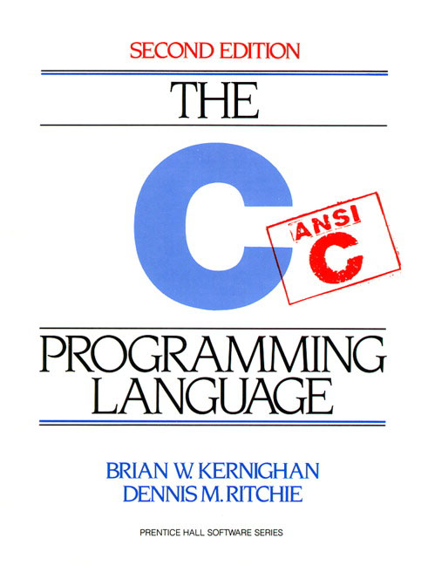
C
Created in 1972 by Dennis Ritchie
Designed for creating system software
Portable across machine architectures
Most recently updated in 1999 (C99) and 2011 (C11)
There’s also C17, which is a bug-fix version of C11.
Characteristics
“Low-level” language that allows us to exploit underlying features of the architecture – but easy to fail spectacularly (!)
Procedural (not object-oriented)
“Weakly-typed” or “type-unsafe”
Small, basic library compared to Java, C++, most others….
Notes:
Dennis Ritchie (1941-2011)
Also part of team that developed UNIX (later rewritten in C)

Slide 18
C Workflow
Editor (emacs, vi) or IDE (VS Code)
EDIT
foo.h
foo.c
bar.c
Source files (.c, .h)
“COMPILE” (compile + assemble)
Statically-linked libraries
foo.o
bar.o
Object files (.o)
libZ.a
LINK
LINK
bar
Shared libraries
libc.so
LINK
LOAD
bar
EXECUTE, DEBUG, …
Notes:
Libraries – .a is for “archive” (static) and .so is for “shared object” (dynamic)

Slide 19
C to Machine Code
void sumstore(int x, int y,
int* dest) {
*dest = x + y;
}
C source file (sumstore.c)
EDIT
C compiler (gcc –S)
C compiler (gcc –c)
sumstore:
addl %edi, %esi
movl %esi, (%rdx)
ret
Assembly file (sumstore.s)
Assembler (gcc -c or as)
400575: 01 fe
89 32
c3
Machine code
(sumstore.o)
Notes:
Most C compilers generate .o files (machine code) directly without actually saving a readable .s assembly file.

Slide 20
Generic C Program Layout
STYLE
TIP
#include <system_files>
#include "local_files"
#define macro_name macro_expr
/* declare functions */
/* declare external variables & structs */
int main(int argc, char* argv[]) {
/* the innards */
}
/* define other functions */

Slide 21
C Syntax: main
To get command-line arguments in main, use:
int main(int argc, char* argv[])
What does this mean?
argc contains the number of strings on the command line (the executable name counts as one, plus one for each argument).
argv is an array containing pointers to the arguments as strings (more on pointers later)
Example: $ foo hello 87
argc = 3
argv[0]="foo", argv[1]="hello", argv[2]="87"
int main(int argc, char* argv[])
Notes:
Why is argc needed? argv array doesn’t know its own length!
What is argv? Conceptually, an array of Strings, but really a pointer to char pointers. (also seen as char** argv)
Advantages? Simple – command-line takes text, so just pass on to program. Flexible – no limit on form or structure of command-line arguments.
Disadvantages? Input checking and data conversion often needed.

Slide 22
When Things Go South…
STYLE
TIP
Errors and Exceptions
C does not have exception handling (no try/catch)
Errors are returned as integer error codes from functions
Standard codes found in stdlib.h: EXIT_SUCCESS (usually 0) and EXIT_FAILURE (non-zero)
Return value from main is a status code
Because of this, error handling is ugly and inelegant
Crashes
If you do something bad, you hope to get a “segmentation fault” (believe it or not, this is the “good” option)
Notes:
There ARE exceptions in the sense of exceptional control flow.

Slide 23
Java vs. C (351 refresher)
Are Java and C mostly similar (S) or significantly different (D) in the following categories?
List any differences you can recall (even if you put ‘S’)
Language Feature | S/D | Differences in C
Control structures
Primitive datatypes
Operators
Casting
Arrays
Memory management
Notes:
Control structures (S): if-else if-else, switch, while, for are all the same.
Primitive datatypes (S): same/similar names.
Primitive datatypes (D): char (ASCII, 1 byte), machine-dependent sizes, no built-in boolean type, not initialized. modifiers.
Operators (S): almost all match. One notable difference is no >>> for logical shift.
Casting (D): Java has type-safe casting, while C does not.
Arrays (D): Not objects; don’t know own length.
Memory management (D): Explicit memory management (malloc/free). No automatic garbage collection.

Slide 24
Primitive Types in C
Integer types
char, int
Floating point
float, double
Modifiers
short [int]
long [int, double]
signed [char, int]
unsigned [char, int]
C Data Type | 32-bit | 64-bit | printf
char | 1 | 1 | %c
short int | 2 | 2 | %hd
unsigned short int | 2 | 2 | %hu
int | 4 | 4 | %d / %i
unsigned int | 4 | 4 | %u
long int | 4 | 8 | %ld
long long int | 8 | 8 | %lld
float | 4 | 4 | %f
double | 8 | 8 | %lf
long double | 12 | 16 | %Lf
pointer | 4 | 8 | %p
Typical sizes – see sizeofs.c
Notes:
This mapping is mostly an arbitrary historical artifact except for address sizes.
Only guarantees: an int is not shorter than a short and not longer than a long. Etc
Lack of guarantees help with portability

Slide 25
C99 Extended Integer Types
STYLE
TIP
Solves the conundrum of “how big is an long int?”
#include <stdint.h>
void foo(void) {
int8_t a; // exactly 8 bits, signed
int16_t b; // exactly 16 bits, signed
int32_t c; // exactly 32 bits, signed
int64_t d; // exactly 64 bits, signed uint8_t w; // exactly 8 bits, unsigned
...
}
void sumstore(int x, int y, int* dest) {
void sumstore(int32_t x, int32_t y, int32_t* dest) {
Notes:
Important for system code. Less important for generic C code.
START USING IN YOUR EXERCISES.

Slide 26
Basic Data Structures
C does not support objects!!!
Arrays are contiguous chunks of memory
Arrays have no methods and do not know their own length
Can easily run off ends of arrays in C – security bugs!!!
Strings are null-terminated char arrays
Strings have no methods, but string.h has helpful utilities
Structs are the most object-like feature, but are just collections of fields – no “methods” or functions
char* x = "hello\n";
x | h | e | l | l | o | \n | \0

Slide 27
Function Definitions
Generic format:
returnType fname(type param1, …, type paramN) {
// statements
}
// sum of integers from 1 to max
int32_t sumTo(int32_t max) {
int32_t i, sum = 0;
for (i = 1; i <= max; i++) {
sum += i;
}
return sum;
}

Slide 28
Function Ordering
You shouldn’t call a function that hasn’t been declared yet
Note: code examples from slides are posted on the course website for you to experiment with!
sum_badorder.c
int main(int argc, char** argv) {
printf("sumTo(5) is: %d\n", sumTo(5));
return EXIT_SUCCESS;
}
// sum of integers from 1 to max
int32_t sumTo(int32_t max) {
int32_t i, sum = 0;
for (i = 1; i <= max; i++) {
sum += i;
}
return sum;
}
Notes:
warning: implicit declaration of function ‘sumTo’ [-Wimplicit-function-declaration]
C compiler goes line-by-line (unlike Java).

Slide 29
Solution 1: Reverse Ordering
Simple solution; however, imposes ordering restriction on writing functions (who-calls-what?)
sum_betterorder.c
// sum of integers from 1 to max
int32_t sumTo(int32_t max) {
int32_t i, sum = 0;
for (i = 1; i <= max; i++) {
sum += i;
}
return sum;
}
int main(int argc, char** argv) {
printf("sumTo(5) is: %d\n", sumTo(5));
return EXIT_SUCCESS;
}
Notes:
Topological sort of functions
What happens with mutually recursive functions?

Slide 30
Solution 2: Function Declaration
STYLE
TIP
Teaches the compiler arguments and return types; function definitions can then be in a logical order
Function comment usually by the prototype
sum_declared.c
// sum of integers from 1 to max
int32_t sumTo(int32_t); // func prototype
int main(int argc, char** argv) {
printf("sumTo(5) is: %d\n", sumTo(5));
return EXIT_SUCCESS;
}
int32_t sumTo(int32_t max) {
int32_t i, sum = 0;
for (i = 1; i <= max; i++) {
sum += i;
}
return sum;
}

Slide 31
Function Declaration vs. Definition
C/C++ make a careful distinction between these two
Definition: the thing itself
e.g. code for function, variable definition that creates storage
Must be exactly one definition of each thing (no duplicates)
Declaration: description of a thing
e.g. function prototype, external variable declaration
Often in header files and incorporated via #include
Should also #include declaration in the file with the actual definition to check for consistency
Needs to appear in all files that use that thing
Should appear before first use

Slide 32
Multi-file C Programs
C source file 1
(sumstore.c)
void sumstore(int x, int y, int* dest) {
*dest = x + y;
}
C source file 2
(sumnum.c)
#include <stdio.h>
void sumstore(int x, int y, int* dest);
int main(int argc, char** argv) {
int z, x = 351, y = 333;
sumstore(x, y, &z);
printf("%d + %d = %d\n", x, y, z);
return 0;
}
Note: not good style. More on multiple files in lecture 5
<- used
Compile together:
$ gcc -o sumnum sumnum.c sumstore.c
Notes:
sumstore() is implemented in sumstore.c, so function prototype is needed.
Function prototype tells compiler about sumstore’s arguments and return type.
So why is #include needed? Where is printf implemented?
https://www.gnu.org/software/m68hc11/examples/stdio_8h-source.html

Slide 33
Compiling Multi-file Programs
The linker combines multiple object files plus statically-linked libraries to produce an executable
Includes many standard libraries (e.g. libc, crt1)
A library is just a pre-assembled collection of .o files
sumstore.c
gcc -c
sumstore.o
ld or
gcc
sumnum
sumnum.c
gcc -c
sumnum.o
libraries
(e.g. libc)
Notes:
glibc includes APIs such as open, read, write, malloc, printf, getaddrinfo, dlopen, pthread_create, crypt, login, exit, and more.
crt0/crt1 – startup routines (before main is called)
Anyone recall what is contained in an object file? symbol & relocation tables

Slide 34
Polling Question
Which of the following statements is FALSE?
Vote at http://PollEv.com/cse333
With the standard main() syntax, It is always safe to use argv[0].
We can’t use uint64_t on a 32-bit machine because there isn’t a C integer primitive of that length.
Using function declarations is beneficial to both single- and multi-file C programs.
When compiling multi-file programs, not all linking is done by the Linker.
We’re lost…

Slide 35
To-do List
Make sure you’re registered on Canvas, Ed Discussion, Gradescope, and Poll Everywhere
All user IDs should be your uw.edu email address
Explore the website thoroughly: http://cs.uw.edu/333
Computer setup: CSE lab, attu, or CSE Linux VM
Exercise 1 is due 11 am on Friday
Find exercise spec on website, submit via Gradescope
Course “CSE 333” under “Spring 2021”, Assignment “Exercise 1”, then drag-n-drop file(s)!
Sample solution will be posted Friday afternoon
Hint: look at documentation for stdlib.h, string.h, and inttypes.h
Pre-Quarter survey up on canvas. Due Friday @ 11:59 pm
Answers are anonymous.

