Slide 1
C++ Templates CSE 333 Winter 2020
Instructor: Justin Hsia
Teaching Assistants:
Andrew Hu Austin Chan Brennan Stein
Cheng Ni Cosmo Wang Diya Joy
Guramrit Singh Mengqi Chen Pat Kosakanchit
Rehaan Bhimani Renshu Gu Travis McGaha
Zachary Keyes

Slide 2
Administrivia
No exercise released today!
Homework 2 due tomorrow (2/6)
Don’t forget to clone your repo to double-/triple-/quadruple-check compilation!
Midterm is next Friday (2/14) @ 5 - 6:10 pm in KNE 210/220 – section split on website
1 double-sided page of hand-written notes; reference info will be provided on exam
Topics: everything from lecture, exercises, project, etc. up through C++ new/delete
Old exams on course website, review in section next week

Slide 3
Lecture Outline
Templates

Slide 4
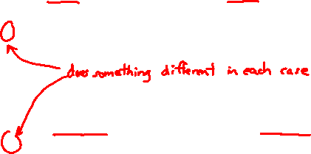
Suppose that…
You want to write a function to compare two ints
You want to write a function to compare two strings
Function overloading!
// returns 0 if equal, 1 if value1 is bigger, -1 otherwise
int compare(const int &value1, const int &value2) {
if (value1 < value2) return -1;
if (value2 < value1) return 1;
return 0;
}
// returns 0 if equal, 1 if value1 is bigger, -1 otherwise
int compare(const int& value1, const int& value2) {
if (value1 < value2) return -1;
if (value2 < value1) return 1;
return 0;
}
// returns 0 if equal, 1 if value1 is bigger, -1 otherwise
int compare(const string& value1, const string& value2) {
if (value1 < value2) return -1;
if (value2 < value1) return 1;
return 0;
}

Slide 5
Hm…
The two implementations of compare are nearly identical!
What if we wanted a version of compare for every comparable type?
We could write (many) more functions, but that’s obviously wasteful and redundant
What we’d prefer to do is write “generic code”
Code that is type-independent
Code that is compile-type polymorphic across types

Slide 6
C++ Parametric Polymorphism
C++ has the notion of templates
A function or class that accepts a type as a parameter
You define the function or class once in a type-agnostic way
When you invoke the function or instantiate the class, you specify (one or more) types or values as arguments to it
At compile-time, the compiler will generate the “specialized” code from your template using the types you provided
Your template definition is NOT runnable code
Code is only generated if you use your template

Slide 7
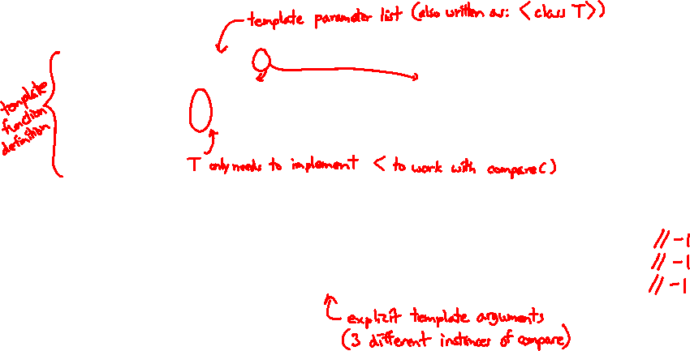
Function Templates
Template to compare two “things”:
#include <iostream>
#include <string>
// returns 0 if equal, 1 if value1 is bigger, -1 otherwise
template <typename T> // <...> can also be written <class T>
int compare(const T &value1, const T &value2) {
if (value1 < value2) return -1;
if (value2 < value1) return 1;
return 0;
}
int main(int argc, char **argv) {
std::string h("hello"), w("world");
std::cout << compare<int>(10, 20) << std::endl;
std::cout << compare<std::string>(h, w) << std::endl;
std::cout << compare<double>(50.5, 50.6) << std::endl;
return EXIT_SUCCESS;
}
functiontemplate.cc
Notes:
in template, "class" is traditional, but may see "typename" instead

Slide 8
Compiler Inference
Same thing, but letting the compiler infer the types:
#include <iostream>
#include <string>
// returns 0 if equal, 1 if value1 is bigger, -1 otherwise
template <typename T>
int compare(const T &value1, const T &value2) {
if (value1 < value2) return -1;
if (value2 < value1) return 1;
return 0;
}
int main(int argc, char **argv) {
std::string h("hello"), w("world");
std::cout << compare(10, 20) << std::endl; // ok
std::cout << compare(h, w) << std::endl; // ok
std::cout << compare("Hello", "World") << std::endl; // hm…
return EXIT_SUCCESS;
}
functiontemplate_infer.cc
Notes:
in template, "class" is traditional, but may see "typename" instead

Slide 9
Template Non-types
You can use non-types (constant values) in a template:
#include <iostream>
#include <string>
// return pointer to new N-element heap array filled with val
// (not entirely realistic, but shows what’s possible)
template <typename T, int N>
T* valarray(const T &val) {
T* a = new T[N];
for (int i = 0; i < N; ++i)
a[i] = val;
return a;
}
int main(int argc, char **argv) {
int *ip = valarray<int, 10>(17);
string *sp = valarray<string, 17>("hello");
...
}
valtemplate.cc
Notes:
More realistic example would be a class where a buffer or queue size is a template parameter, but at least this makes a little more sense than the old “print n copies’ example

Slide 10
What’s Going On?
The compiler doesn’t generate any code when it sees the template function
It doesn’t know what code to generate yet, since it doesn’t know what types are involved
When the compiler sees the function being used, then it understands what types are involved
It generates the instantiation of the template and compiles it (kind of like macro expansion)
The compiler generates template instantiations for each type used as a template parameter

Slide 11
This Creates a Problem
#ifndef COMPARE_H_
#define COMPARE_H_
template <typename T>
int comp(const T& a, const T& b);
#endif // COMPARE_H_
#include <iostream>
#include "compare.h"
using namespace std;
int main(int argc, char **argv) {
cout << comp<int>(10, 20);
cout << endl;
return EXIT_SUCCESS;
}
compare.h
main.cc
#include "compare.h"
template <typename T>
int comp(const T& a, const T& b) {
if (a < b) return -1;
if (b < a) return 1;
return 0;
}
compare.cc
Notes:
Ask them to write out the usual compile commands to create the executable.
Ask them to analyze where in this compilation process something goes wrong.
g++ -c compare.cc → empty compare.o
g++ -c main.cc → main.o without definition of comp<int>
g++ main.o compare.o → linker error (no comp<int>)

Slide 12
Solution #1 (Google Style Guide prefers)
#ifndef COMPARE_H_
#define COMPARE_H_
template <typename T>
int comp(const T& a, const T& b) {
if (a < b) return -1;
if (b < a) return 1;
return 0;
}
#endif // COMPARE_H_
#include <iostream>
#include "compare.h"
using namespace std;
int main(int argc, char **argv) {
cout << comp<int>(10, 20);
cout << endl;
return EXIT_SUCCESS;
}
main.cc
compare.h

Slide 13
Solution #2 (you’ll see this sometimes)
#ifndef COMPARE_H_
#define COMPARE_H_
template <typename T>
int comp(const T& a, const T& b);
#include "compare.cc"
#endif // COMPARE_H_
#include <iostream>
#include "compare.h"
using namespace std;
int main(int argc, char **argv) {
cout << comp<int>(10, 20);
cout << endl;
return EXIT_SUCCESS;
}
compare.h
main.cc
template <typename T>
int comp(const T& a, const T& b) {
if (a < b) return -1;
if (b < a) return 1;
return 0;
}
compare.cc

Slide 14
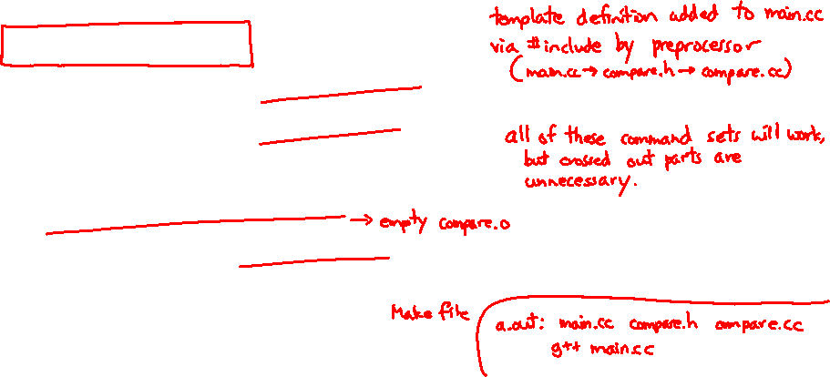
Polling Question
Assume we are using Solution #2 (.h includes .cc)
Which is the simplest way to compile our program (a.out)?
Vote at http://PollEv.com/justinh
A. g++ main.cc
B. g++ main.cc compare.cc
C. g++ main.cc compare.h
D. g++ -c main.cc g++ -c compare.cc g++ main.o compare.o
E. We’re lost…

Slide 15
Class Templates
Templates are useful for classes as well
(In fact, that was one of the main motivations for templates!)
Imagine we want a class that holds a pair of things that we can:
Set the value of the first thing
Set the value of the second thing
Get the value of the first thing
Get the value of the second thing
Swap the values of the things
Print the pair of things

Slide 16
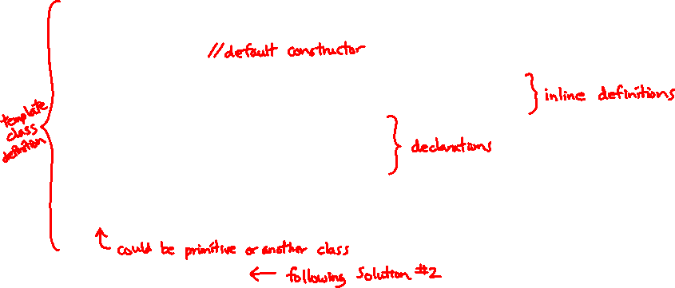
Pair Class Definition
Pair.h
#ifndef PAIR_H_
#define PAIR_H_
template <typename Thing> class Pair {
public:
Pair() { };
Thing get_first() const { return first_; }
Thing get_second() const { return second_; }
void set_first(Thing &copyme);
void set_second(Thing &copyme);
void Swap();
private:
Thing first_, second_;
};
#include "Pair.cc"
#endif // PAIR_H_
Notes:
in template, "class" is traditional, but may see "typename" instead

Slide 17
Pair Function Definitions
Pair.cc
template <typename Thing>
void Pair<Thing>::set_first(Thing &copyme) {
first_ = copyme;
}
template <typename Thing>
void Pair<Thing>::set_second(Thing &copyme) {
second_ = copyme;
}
template <typename Thing>
void Pair<Thing>::Swap() {
Thing tmp = first_;
first_ = second_;
second_ = tmp;
}
template <typename T>
std::ostream &operator<<(std::ostream &out, const Pair<T>& p) {
return out << "Pair(" << p.get_first() << ", " << p.get_second() << ")";
}
Notes:
in template, "class" is traditional, but may see "typename" instead

Slide 18
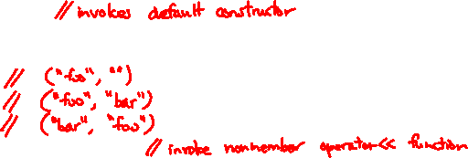
Using Pair
usepair.cc
#include <iostream>
#include <string>
#include "Pair.h"
int main(int argc, char** argv) {
Pair<std::string> ps;
std::string x("foo"), y("bar");
ps.set_first(x);
ps.set_second(y);
ps.Swap();
std::cout << ps << std::endl;
return EXIT_SUCCESS;
}
Notes:
in template, "class" is traditional, but may see "typename" instead

Slide 19
Class Template Notes (look in Primer for more)
Thing is replaced with template argument when class is instantiated
The class template parameter name is in scope of the template class definition and can be freely used there
Class template member functions are template functions with template parameters that match those of the class template
These member functions must be defined as template function outside of the class template definition (if not written inline)
The template parameter name does not need to match that used in the template class definition, but really should
Only template methods that are actually called in your program are instantiated (but this is an implementation detail)

Slide 20
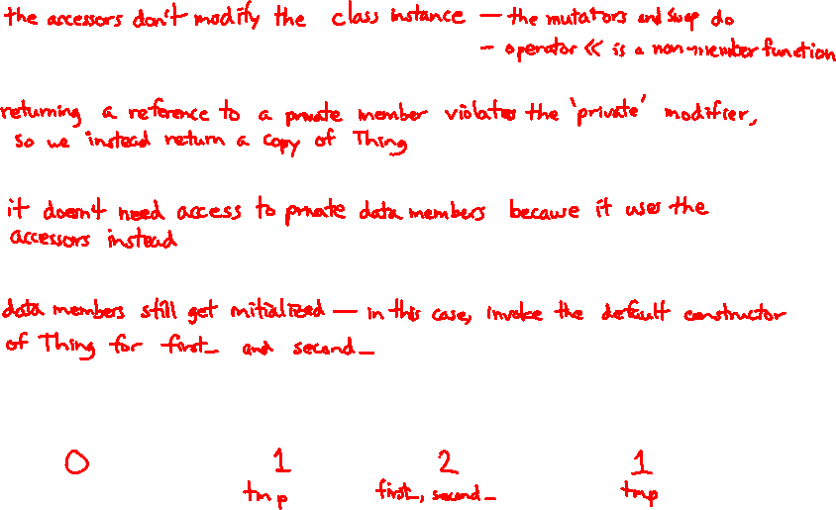
Review Questions (Classes and Templates)
Why are only get_first() and get_second() const?
Why do the accessor methods return Thing and not references?
Why is operator<< not a friend function?
What happens in the default constructor when Thing is a class?
In the execution of Swap(), how many times are each of the following invoked (assuming Thing is a class)?
ctor ____ cctor ____ op= ____ dtor ____

