Slide 1
C++ Class Details, Heap CSE 333 Winter 2020
Instructor: Justin Hsia
Teaching Assistants:
Andrew Hu Austin Chan Brennan Stein
Cheng Ni Cosmo Wang Diya Joy
Guramrit Singh Mengqi Chen Pat Kosakanchit
Rehaan Bhimani Renshu Gu Travis McGaha
Zachary Keyes

Slide 2
Administrivia
Exercise 11 released today, due Wednesday
Modify your Vector class to use the heap & non-member functions
Refer to Complex.h/Complex.cc and Str.h/Str.cc
Homework 2 due Thursday (2/6)
File system crawler, indexer, and search engine
Don’t forget to clone your repo to double-/triple-/quadruple-check compilation!
Midterm: next Friday (2/14) from 5 - 6:10 pm in KNE 210/220
Alt exams have also been scheduled

Slide 3
Lecture Outline
Class Details
Filling in some gaps from last time
Using the Heap
new / delete / delete[]

Slide 4
Rule of Three
If you define any of:
Destructor
Copy Constructor
Assignment (operator=)
Then you should normally define all three
Can explicitly ask for default synthesized versions (C++11):
class Point {
public:
Point() = default; // the default ctor
~Point() = default; // the default dtor
Point(const Point& copyme) = default; // the default cctor
Point& operator=(const Point& rhs) = default; // the default "="
...

Slide 5
Dealing with the Insanity (C++11)
C++ style guide tip:
Disabling the copy constructor and assignment operator can avoid confusion from implicit invocation and excessive copying
Point_2011.h
class Point {
public:
Point(const int x, const int y) : x_(x), y_(y) { } // ctor
...
Point(const Point& copyme) = delete; // declare cctor and "=" as
Point& operator=(const Point& rhs) = delete; // as deleted (C++11)
private:
...
}; // class Point
Point w; // compiler error (no default constructor)
Point x(1, 2); // OK!
Point y = w; // compiler error (no copy constructor)
y = x; // compiler error (no assignment operator)

Slide 6
Clone
C++11 style guide tip:
If you disable them, then you instead may want an explicit “Clone” function that can be used when occasionally needed
Point_2011.h
class Point {
public:
Point(const int x, const int y) : x_(x), y_(y) { } // ctor
void Clone(const Point& copy_from_me);
...
Point(Point& copyme) = delete; // disable cctor
Point& operator=(Point& rhs) = delete; // disable "="
private:
...
}; // class Point
sanepoint.cc
Point x(1, 2); // OK
Point y(3, 4); // OK
x.Clone(y); // OK
Notes:
Allows for explicit copying without inadvertent execution of the copy constructor (especially during function calls and returns).

Slide 7
Access Control
Access modifiers for members:
public: accessible to all parts of the program
private: accessible to the member functions of the class
Private to class, not object instances
protected: accessible to member functions of the class and any derived classes (subclasses – more to come, later)
Reminders:
Access modifiers apply to all members that follow until another access modifier is reached
If no access modifier is specified, struct members default to public and class members default to private

Slide 8
Nonmember Functions
“Nonmember functions” are just normal functions that happen to use some class
Called like a regular function instead of as a member of a class object instance
This gets a little weird when we talk about operators…
These do not have access to the class’ private members
Useful nonmember functions often included as part of interface to a class
Declaration goes in header file, but outside of class definition

Slide 9
friend Nonmember Functions
A class can give a nonmember function (or class) access to its non-public members by declaring it as a friend within its definition
Not a class member, but has access privileges as if it were
friend functions are usually unnecessary if your class includes appropriate “getter” public functions
Complex.h
class Complex {
...
friend std::istream& operator>>(std::istream& in, Complex& a);
...
}; // class Complex
std::istream& operator>>(std::istream& in, Complex& a) {
...
}
Complex.cc

Slide 10
Namespaces
Each namespace is a separate scope
Useful for avoiding symbol collisions!
Namespace definition:
namespace name { // declarations go here }
Doesn’t end with a semi-colon and doesn’t add to the indentation of its contents
Creates a new namespace name if it did not exist, otherwise adds to the existing namespace (!)
This means that components (e.g. classes, functions) of a namespace can be defined in multiple source files
namespace name { // declarations go here } // namespace name

Slide 11
Classes vs. Namespaces
They seems somewhat similar, but classes are not namespaces:
There are no instances/objects of a namespace; a namespace is just a group of logically-related things (classes, functions, etc.)
To access a member of a namespace, you must use the fully qualified name (i.e. nsp_name::member)
Unless you are using that namespace
You only used the fully qualified name of a class member when you are defining it outside of the scope of the class definition

Slide 12
Complex Example Walkthrough
See:
Complex.h
Complex.cc
testcomplex.cc

Slide 13
Lecture Outline
Class Details
Filling in some gaps from last time
Using the Heap
new / delete / delete[]

Slide 14
C++11 nullptr
C and C++ have long used NULL as a pointer value that references nothing
C++11 introduced a new literal for this: nullptr
New reserved word
Interchangeable with NULL for all practical purposes, but it has type T* for any/every T, and is not an integer value
Avoids funny edge cases (see C++ references for details)
Still can convert to/from integer 0 for tests, assignment, etc.
Advice: prefer nullptr in C++11 code
Though NULL will also be around for a long, long time

Slide 15
new/delete
To allocate on the heap using C++, you use the new keyword instead of malloc() from stdlib.h
You can use new to allocate an object (e.g. new Point)
You can use new to allocate a primitive type (e.g. new int)
To deallocate a heap-allocated object or primitive, use the delete keyword instead of free() from stdlib.h
Don’t mix and match!
Never free() something allocated with new
Never delete something allocated with malloc()
Careful if you’re using a legacy C code library or module in C++

Slide 16
new/delete Example
int* AllocateInt(int x) {
int* heapy_int = new int;
*heapy_int = x;
return heapy_int;
}
Point* AllocatePoint(int x, int y) {
Point* heapy_pt = new Point(x,y);
return heapy_pt;
}
heappoint.cc
#include "Point.h"
... // definitions of AllocateInt() and AllocatePoint()
int main() {
Point* x = AllocatePoint(1, 2);
int* y = AllocateInt(3);
cout << "x's x_ coord: " << x->get_x() << endl;
cout << "y: " << y << ", *y: " << *y << endl;
delete x;
delete y;
return EXIT_SUCCESS;
}

Slide 17
Dynamically Allocated Arrays
To dynamically allocate an array:
Default initialize:
To dynamically deallocate an array:
Use delete[] name;
It is an incorrect to use “delete name;” on an array
The compiler probably won’t catch this, though (!) because it can’t always tell if name* was allocated with new type[size]; or new type;
Especially inside a function where a pointer parameter could point to a single item or an array and there’s no way to tell which!
Result of wrong delete is undefined behavior
type* name = new type[size];
delete[] name;

Slide 18
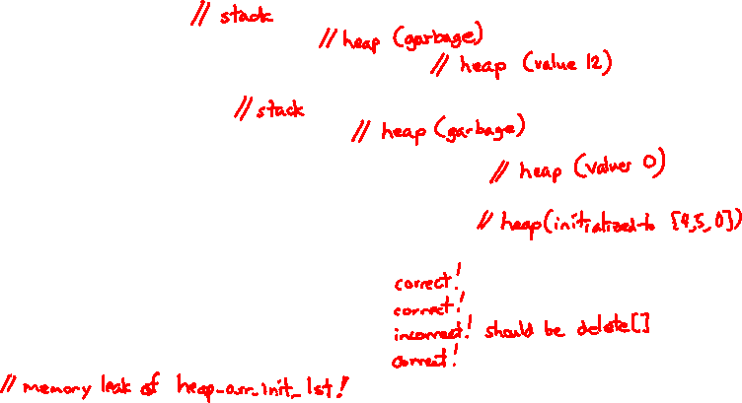
Arrays Example (primitive)
arrays.cc
#include "Point.h"
int main() {
int stack_int;
int* heap_int = new int;
int* heap_int_init = new int(12);
int stack_arr[3];
int* heap_arr = new int[3];
int* heap_arr_init_val = new int[3]();
int* heap_arr_init_lst = new int[3]{4, 5}; // C++11
...
delete heap_int; //
delete heap_int_init; //
delete heap_arr; //
delete[] heap_arr_init_val; //
return EXIT_SUCCESS;
}
Notes:
delete heap_arr; // should be delete[] heap_arr;
Memory leak of heap_arr_init_lst
DEMO: run $ valgrind --leak-check=full ./arrays
- highlight “Mismatched free() / delete / delete []”

Slide 19
Arrays Example (class objects)
arrays.cc
#include "Point.h"
int main() {
...
Point stack_pt(1, 2);
Point* heap_pt = new Point(1, 2);
Point* heap_pt_arr_err = new Point[2];
Point* heap_pt_arr_init_lst = new Point[2]{{1, 2}, {3, 4}}; // C++11
...
delete heap_pt;
delete[] heap_pt_arr_init_lst;
return EXIT_SUCCESS;
}
Notes:
Point* heap_pt_arr_err = new Point[2]; // no default constructor

Slide 20
malloc vs. new
 | malloc() | new
What is it? | a function | an operator or keyword
How often used (in C)? | often | never
How often used (in C++)? | rarely | often
Allocated memory for | anything | arrays, structs, objects, primitives
Returns | a void* (should be cast) | appropriate pointer type (doesn’t need a cast)
When out of memory | returns NULL | throws an exception
Deallocating | free() | delete or delete[]
Notes:
What else is there besides arrays, structs, objects, and primitives?

Slide 21
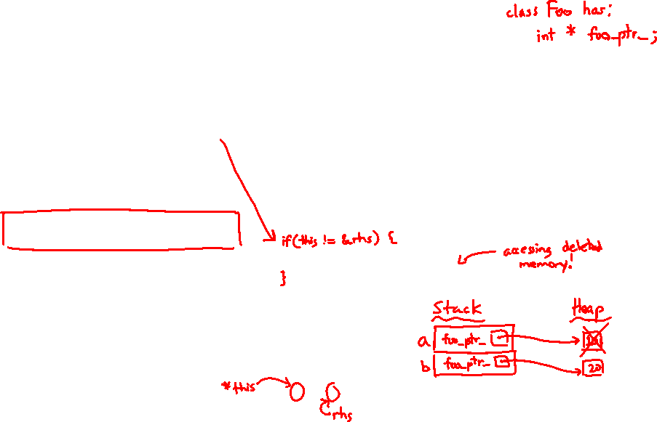
Dynamically Allocated Class Members
What will happen when we invoke bar()?
Vote at http://PollEv.com/justinh
If there is an error, how would you fix it?
A. Bad dereference
B. Bad delete
C. Memory leak
D. “Works” fine
E. We’re lost…
Foo::Foo(int val) { Init(val); }
Foo::~Foo() { delete foo_ptr_; }
void Foo::Init(int val) {
foo_ptr_ = new int;
*foo_ptr_ = val;
}
Foo& Foo::operator=(const Foo& rhs) {
delete foo_ptr_;
Init(*(rhs.foo_ptr_));
return *this;
}
void bar() {
Foo a(10);
Foo b(20);
a = a;
}
Notes:
Foo is a class with a private data member int* foo_ptr_

Slide 22
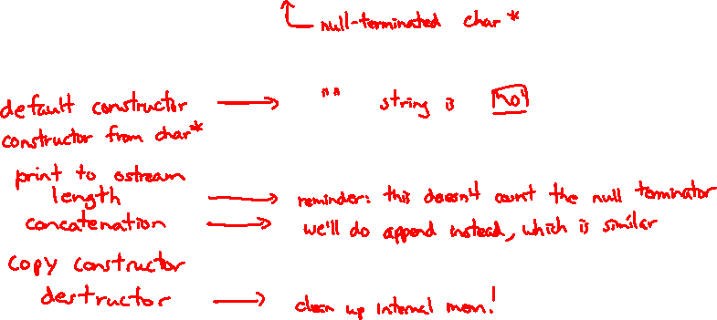
Heap Member Example
Let’s build a class to simulate some of the functionality of the C++ string
Internal representation: c-string to hold characters
What might we want to implement in the class?
Notes:
Constructors, copy constructor, destructor, assignment
Length, concatenate (append), stream output, “getter” (must return a copy!)

Slide 23
Str Class Walkthrough
Str.h
#include <iostream>
using namespace std;
class Str {
public:
Str(); // default ctor
Str(const char* s); // c-string ctor
Str(const Str& s); // copy ctor
~Str(); // dtor
int length() const; // return length of string
char* c_str() const; // return a copy of st_
void append(const Str& s);
Str& operator=(const Str& s); // string assignment
friend std::ostream& operator<<(std::ostream& out, const Str& s);
private:
char* st_; // c-string on heap (terminated by '\0')
}; // class Str

Slide 24
Str::append
Complete the append() member function:
char* strncpy(char* dst, char* src, size_t num);
char* strncat(char* dst, char* src, size_t num);
#include <cstring>
#include "Str.h"
// append contents of s to the end of this string
void Str::append(const Str& s) {
}

Slide 25
Extra Exercise #1
Write a C++ function that:
Uses new to dynamically allocate an array of strings and uses delete[] to free it
Uses new to dynamically allocate an array of pointers to strings
Assign each entry of the array to a string allocated using new
Cleans up before exiting
Use delete to delete each allocated string
Uses delete[] to delete the string pointer array
(whew!)

